Slide 1


Sustainability Superheroes Adopt-A-Road
Problem
Which road should our class adopt?
Alternatives
What are the different roads?
Criteria
What might impact which road to adopt?
Decision
Which road did your class adopt? How did you make that decision?

Slide 2
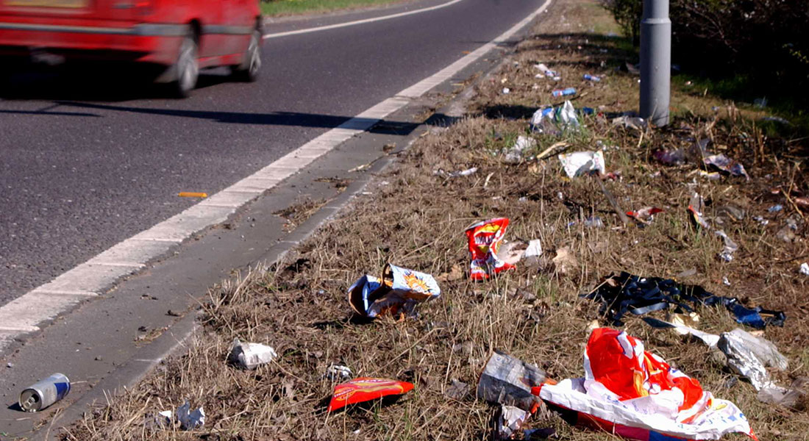
Image Analysis
What do I see? | What do I think? | What do I wonder?

Slide 3
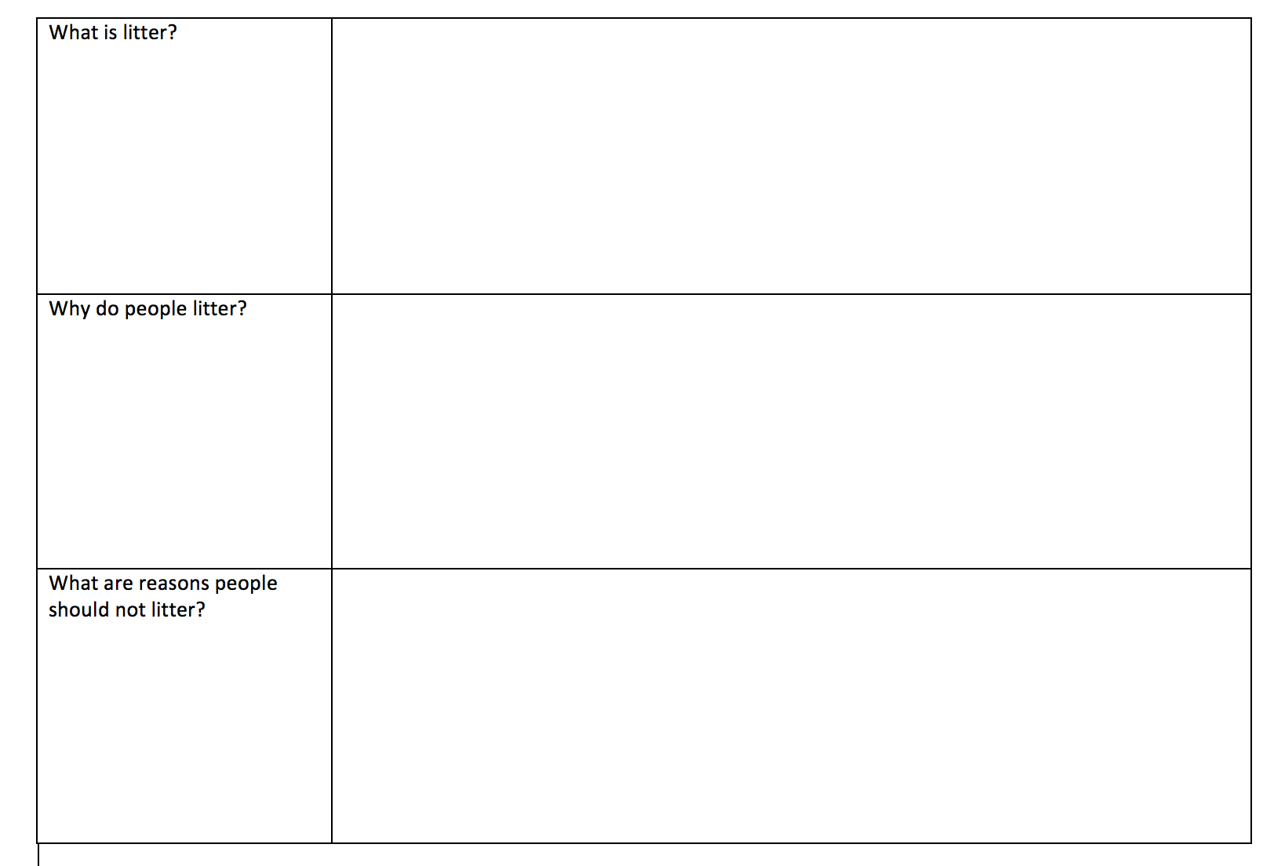
Read the informational text.
What is litter?
What problems are caused by litter?
What are natural resources?
What impact does litter have on our natural resources?
What choices can you make to help solve the problems caused by litter?

Slide 4

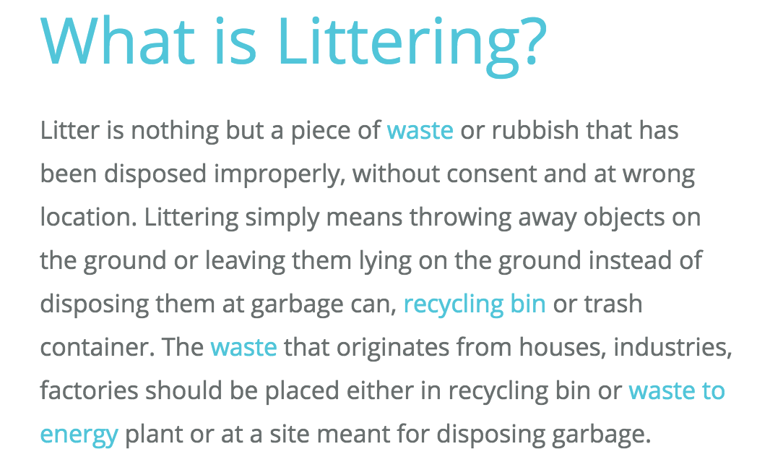
Read the informational text.
https://www.conserve-energy-future.com/various-littering-facts.php

Slide 5
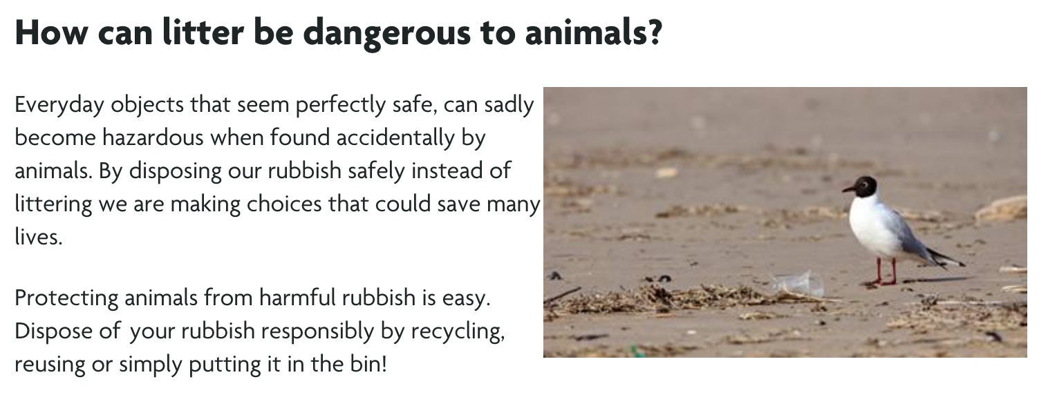
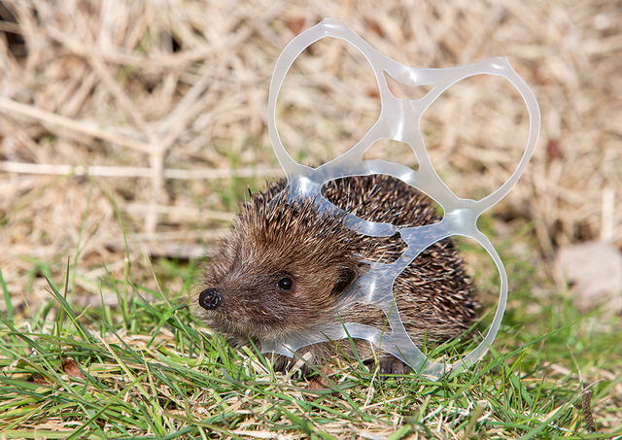
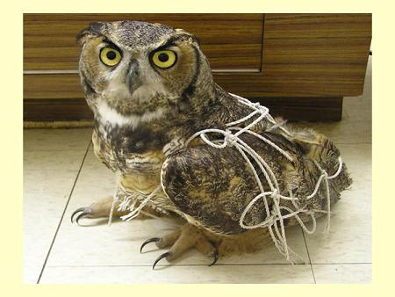
Read the informational text.
  https://www.rspca.org.uk/adviceandwelfare/litter

Slide 6
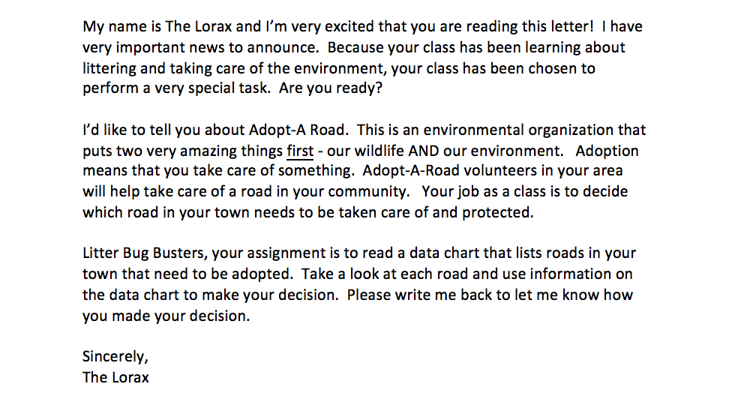
What would The Lorax like for us to do?
Why might this be something good for our community?

Slide 7
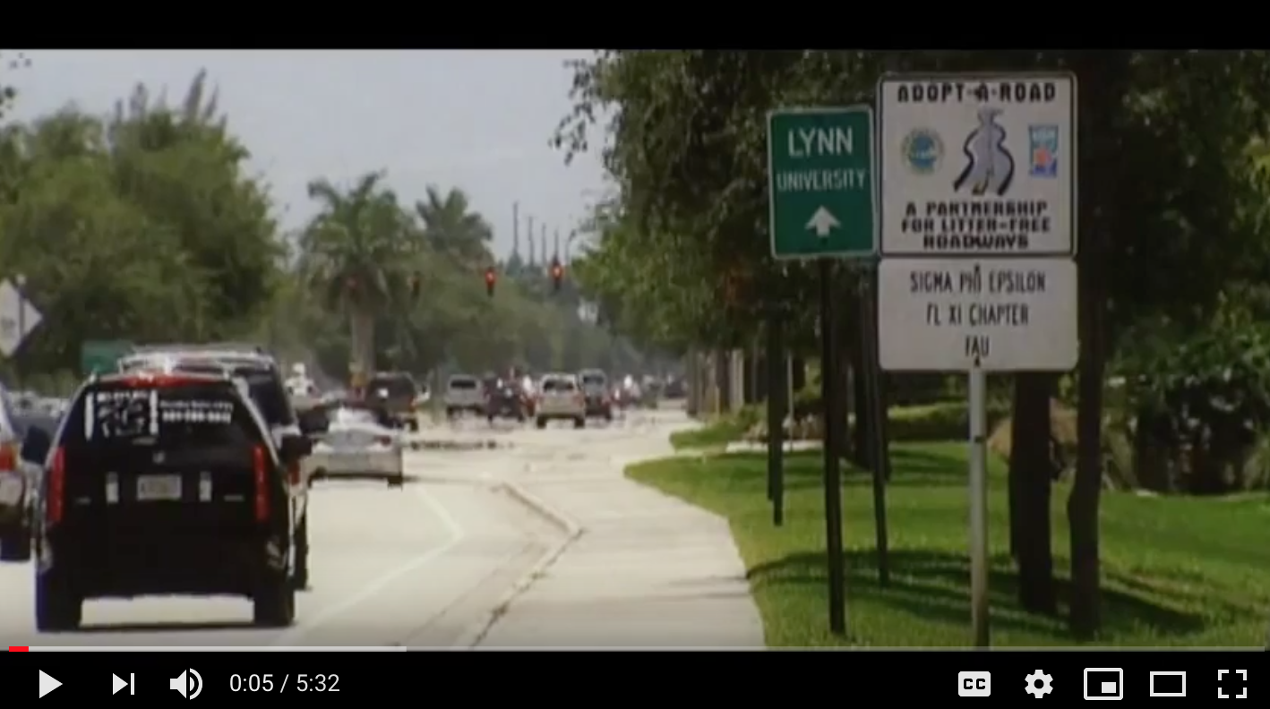
Learn about Adopt-A-Road
https://www.youtube.com/watch?v=htzcWeAsyp0

Slide 8
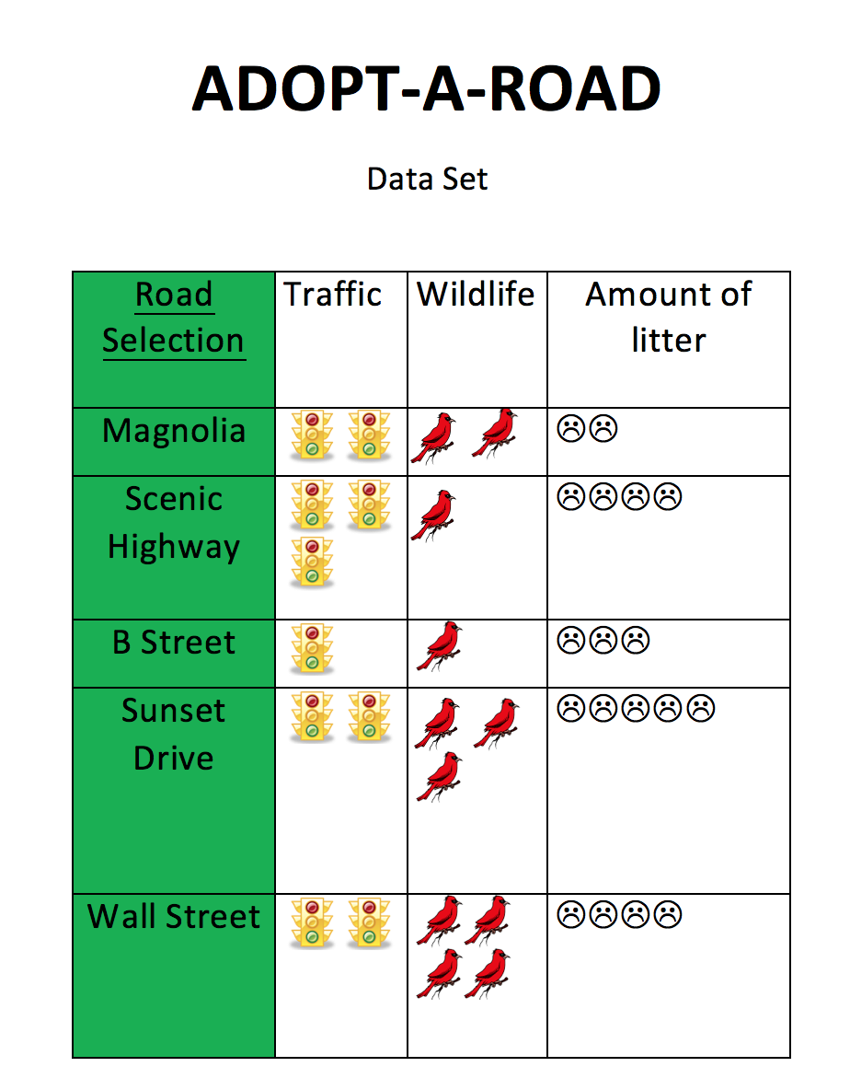
Data set
What criteria should we consider in choosing which street to adopt?

Slide 9
Rank the alternatives.
Guiding/reflective Questions
Which road would be the best road to adopt?
Why do you think that would be the best road?
What category on the data set is the most important to you?
Which road would be your next choice? And after that?
Do you agree with your group's ideas? Why or why not?

Slide 10
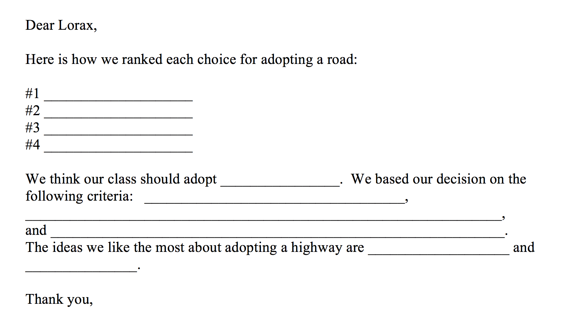
Write back to
The Lorax

Slide 11
Extend the learning.
Have student groups present their decisions to the class and discuss how they decided which road to adopt. Create a poster that highlights the importance of adopting this particular road.
Research which roads in the community are a part of the Adopt-A-Highway program. Involve parents to take pictures of these signs to share in class.
Put it to work! Plan a clean up time for a safe, near-by area that allows students to contribute to the community as responsible citizens.
Substitute symbols for criteria (e.g. cars instead of traffic lights; trash cans instead of frowny faces)

Slide 12
Questions?
Thank you so much for attending!
Send us your ideas for future Decisionomics lessons linked to Reading Wonders ☺
Sherry Moser smoser@usf.edu

