Slide 1
SEE (Social, Environmental, Economic) a Sustainable Future: From the First to the Fourth Industrial Revolutions
Deborah Kozdras dkozdras@usf.edu
SustainabilitySuperheroes.org
@usfstavros
#CokeGivesBack

Slide 2
Historical Literacy
SS.912.A.1.2 Utilize a variety of primary and secondary sources to identify author, historical significance, audience, and authenticity to understand a historical period.
SS.912.A.1.3 Utilize timelines to identify the time sequence of historical data.
SS.912.A.1.4 Analyze how images, symbols, objects, cartoons, graphs, charts, maps, and artwork may be used to interpret the significance of time periods and events from the past.
SS.912.A.1.5 Evaluate the validity, reliability, bias, and authenticity of current events and Internet resources.
SS.912.A.1.6 Use case studies to explore social, political, legal, and economic relationships in history.
SS.912.A.1.7 Describe various socio-cultural aspects of American life including arts, artifacts, literature, education, and publications.

Slide 3
Standards
SS.912.A.3.4: Determine how the development of steel, oil, transportation, communication, and business practices affected the United States economy.
SS.912.W.6.2: Summarize the social and economic effects of the Industrial Revolution. Examples are urbanization, increased productivity and wealth, rise of the middle class, conditions faced by workers, rise of labor unions, expansion of colonialism.
SS.912.A.7.14: Review the role of the United States as a participant in the global economy (trade agreements, international competition, impact on American labor, environmental concerns). Examples may include, but are not limited to, NAFTA, World Trade Organization.
SS.912.W.9.6:Analyze the rise of regional trade blocs such as the European Union and NAFTA, and predict the impact of increased globalization in the 20th and 21st centuries.

Slide 4
Designing Better Futures: From the Problems of the Past and Present to Sustainable Solutions
Problems
What was
Problems
What is
Solutions
What if . . .

Slide 5
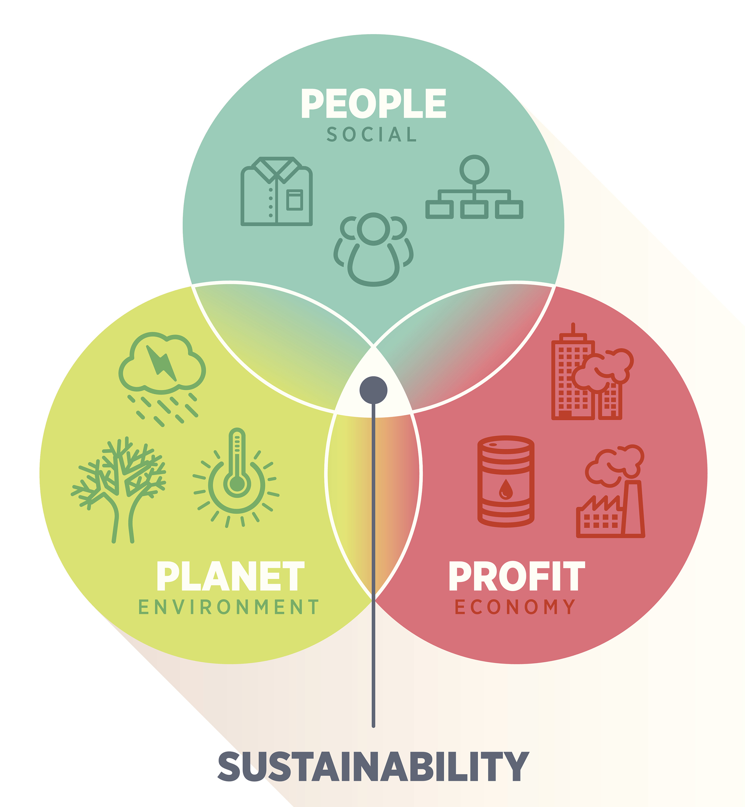
SEE the Future: Social, Environmental, and Economic Impacts of the Triple Bottom Line

Slide 6
Can You Manage the Triple Bottom Line?

Slide 7
Economists vs Economic Historians

Slide 8
Economic vs Economic Historic Thinking
Economics
Economic Historians
Economists practice something few historians do look to the future and predict
Economists isolate independent variables to find regularities that predict
Historians don’t try to predict the future.
Historians feel that isolating variables is unattainable because all variables are interdependent. They consider as many variables as possible.

Slide 9
Economic Social Scientists Investigate: People, Places, and Things
Things
What was produced?
How was it produced?
How did what was produced get distributed?
People and Places
What were the social and economic impacts on people?
What were the environmental and economic impacts on places?
https://hti.osu.edu/history-lesson-plans/european-history/industrial-revolution

Slide 10
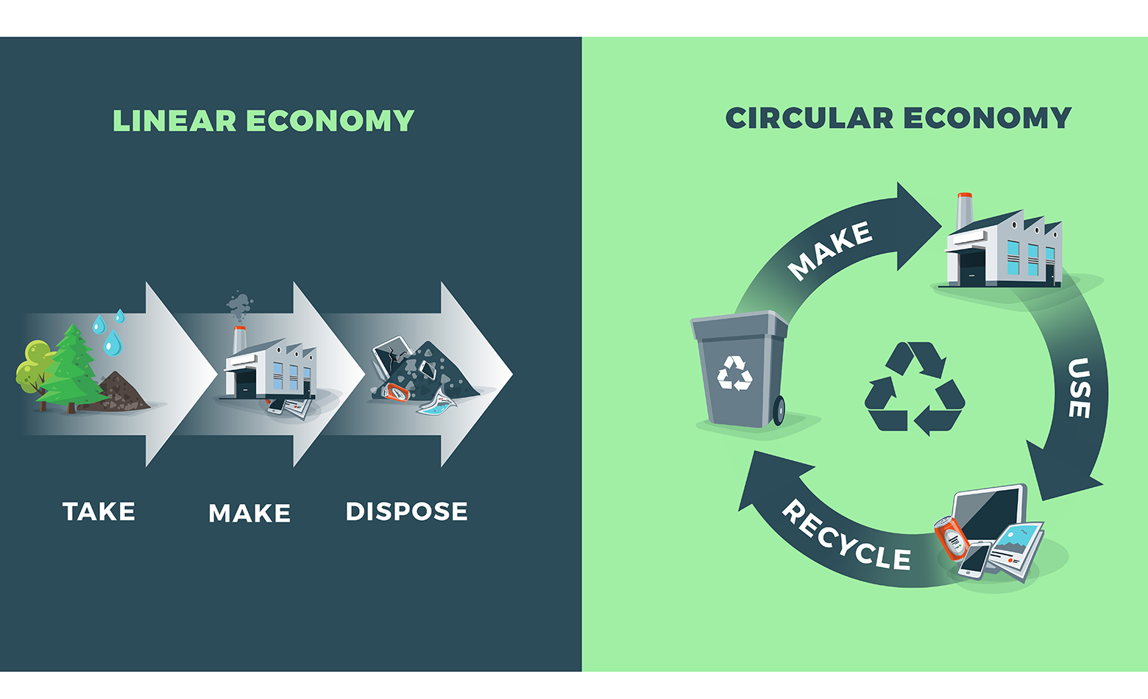
From Development to Sustainable Development

Slide 11
British Industrial Revolution: What Questions Do You Have? https://hti.osu.edu/history-lesson-plans/european-history/industrial-revolution

Slide 12
SEE the future with Social, Environmental, and Economic thinking
Things
What was produced?
How was it produced?
How did what was produced get distributed?
People and Places
What were the social and economic impacts on people?
What were the environmental and economic impacts on places?

Slide 13
Historical Thinking
Close Reading
What claims does the author make?
What evidence does the author use to support those claims?
How is this document supposed to make me feel?
What words or phrases does the author use to convince me that he/she is right?
What information does the author leave out?
Corroboration (Cross Checking)
What do other pieces of evidence say?
Am I finding the same information everywhere?
Am I finding different versions of the story? (If yes, why might that be?)
Where else could I look to find out about this?
What pieces of evidence are most believable?
Sourcing
Who wrote this?
What is the author's point of view?
Why was it written?
When was it written? (A long time or a short time after the event?)
Contextualizing What else was going on at the time this was written?
What things were different back then? What things were the same?
What would it look like to see this event through the eyes of someone who lived back then? (Not yours….)

Slide 14
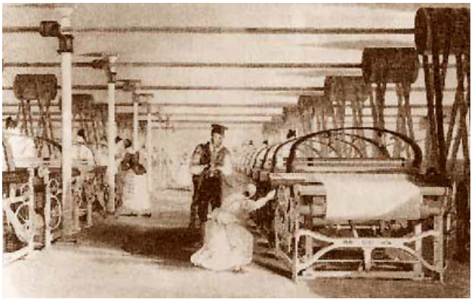
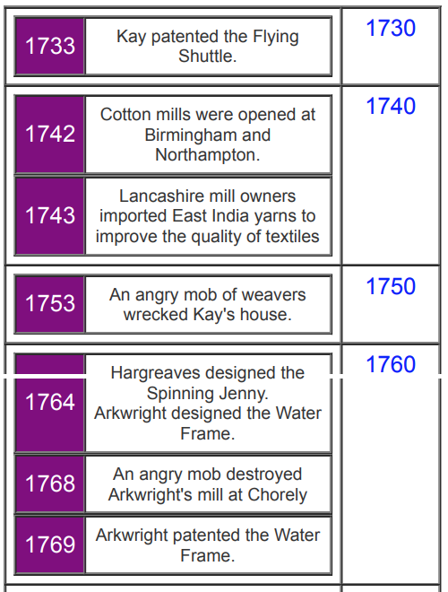
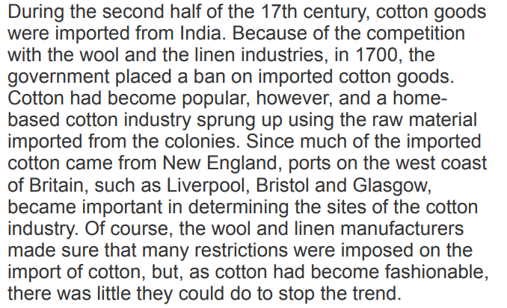
Integrating text with timelines and images
https://hti.osu.edu/sites/hti.osu.edu/files/A-Brief-History-of-the-Cotton-Industry-Saburchill-web-site.pdf

Slide 15
Historical Paintings
Genre emerged in 1700s to describe paintings with subject matter from classical history and mythology, and the Bible
During the first half of 19th century history painting was one of the few ways that the British public could experience its overseas Empire. In this context, history painting became a form of documentation.
http://www.tate.org.uk/learn/online-resources/glossary/h/history-painting
http://www.metmuseum.org/metmedia/interactives/art-trek/george-washington-crossing-the-delaware

Slide 16
Historical Thinking About Art
Study
Findings
historical thinking as: the ability to place a piece of artwork in a larger historical context, and to make an argument about the artwork’s place in a particular time period, just as historians do (Barton, 2001; Desai, Hamlin, & Mattson, 2010).
students do not automatically comprehend the meanings and significances of primary and secondary sources within a larger historical context
sources alone do not teach students nor do they equip students to think historically
http://www.socstrpr.org/wp-content/uploads/2013/09/MS_06372_Spring2013.pdf

Slide 17
Historical Literacy Through the Lens of an Artist/Art Historian
Sourcing
Who painted/created this?
What is the artist’s point of view?
Why was it created?
When was it created? (A long time or a short time after the event?)
Contextualizing
What else was going on at the time this was created?
What things were different back then? What things were the same?
What would it look like to see this event through the eyes of someone who lived back then? (Not yours….)
Close Reading
What details does the artist emphasize?
What techniques does the artist use to support these details?
How is this piece of art supposed to make me feel?
What images does the artist use to create this feeling?
What details does the artist leave out?
Corroboration(Cross Checking)
What do other pieces of evidence say?
Am I finding the same information everywhere?
Am I finding different versions of the story? (If yes, why might that be?)
Where else could I look to find out about this?
What pieces of evidence are most believable?

Slide 18
SEE the future with Social, Environmental, and Economic thinking
Things
What was produced?
How was it produced?
How did what was produced get distributed?
People and Places
What were the social and economic impacts on people?
What were the environmental and economic impacts on places?
https://hti.osu.edu/history-lesson-plans/european-history/industrial-revolution

Slide 19
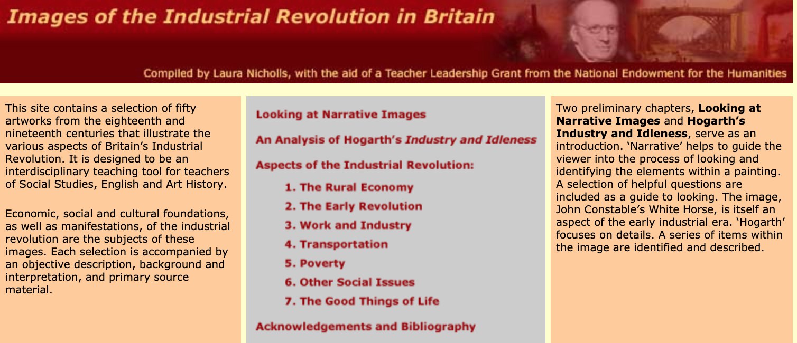
http://www.netnicholls.com/neh2001/index.html#

Slide 20
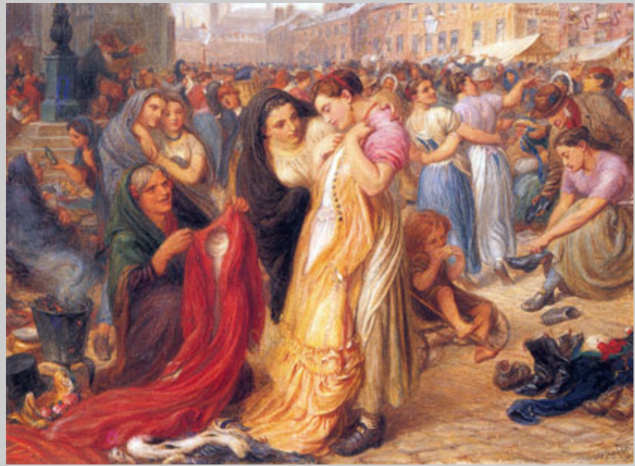
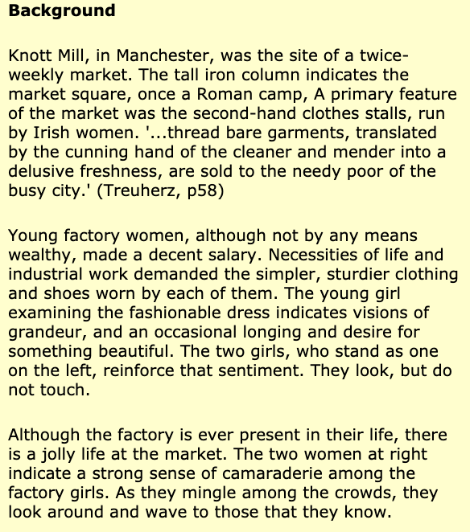

Slide 21
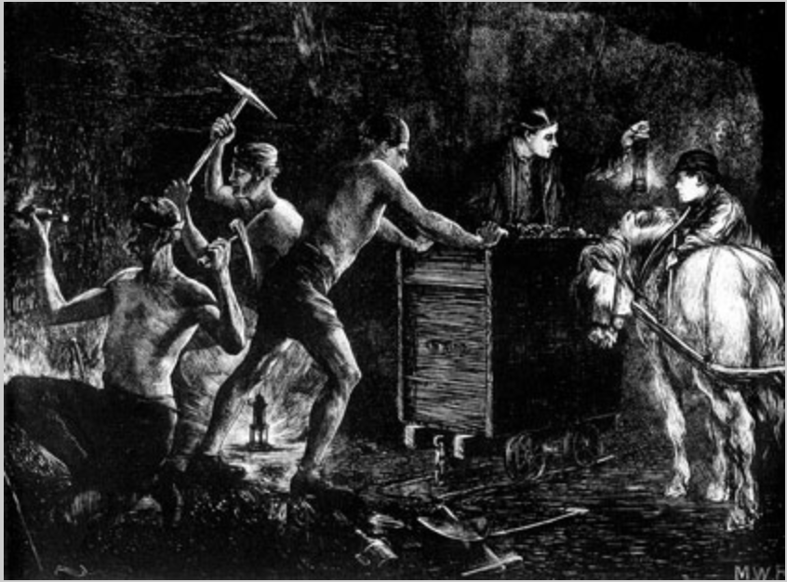
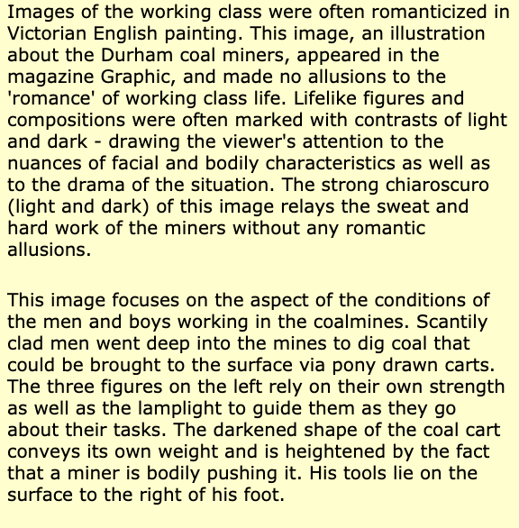

Slide 22
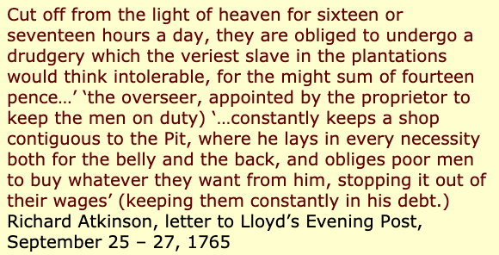
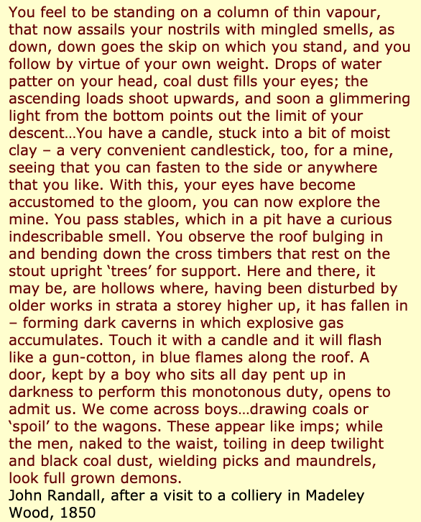
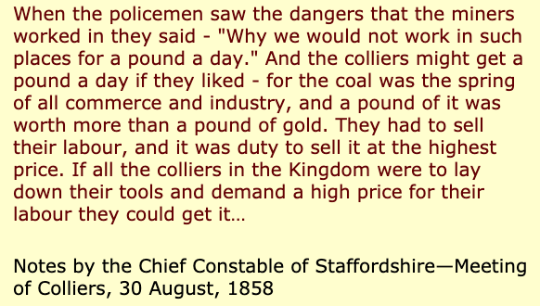

Slide 23
From England to America . . .
http://www.loc.gov/pictures/item/ri0102/
Notes:
An early landmark moment came near the end of the 18th century when Samuel Slater brought new manufacturing technologies from Britain to the US and founded the first US cottom mill in Beverly Mass. Did not last long because of economic difficulties and pro

Slide 24
Slater Mill

Slide 25
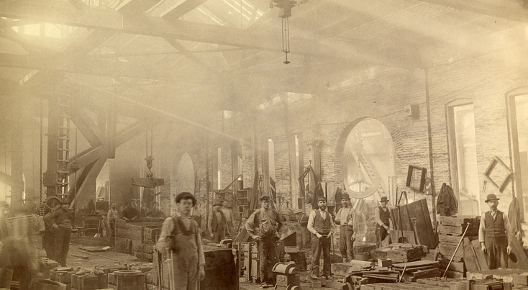
Corporate Era: 1860s to 1930s
http://americanhistory.si.edu/american-enterprise-exhibition/corporate-era

Slide 32
https://www.youtube.com/watch?v=Xac4Px49Tfo
How will you be great? How can you solve problems of the corporate era?

Slide 33
Debating Enterprise Activity: Private Gain vs Public Good

Slide 34
Debating Enterprise: Private Gain vs Public Good

Slide 35
Debating Enterprise: Private Gain vs Public Good

Slide 36
Explore Find Evidence: Through the different topics
Andrew Carnegie: Competition strengthens the country | Louis Brandeis: The wealthy few will overwhelm the rights of the many | Theodore Roosevelt: Government needed to regulate big business

Slide 37
Building an Argument
Main Idea
Here is what I think . . .
Counter
Arguments
Evidence to back up my reasons
Here are my reasons!
___________________________________________________
___________________________________________________
___________________________________________________
You could argue that…
_________________________________________________________________________________________________________
. . .but here is the weakness . . .
_______________________________________________________________
Strong Finish!
__________________________________________________________________________________________________________________________________________
CON
When you weigh all the evidence
you conclude that . . .
PRO

Slide 38
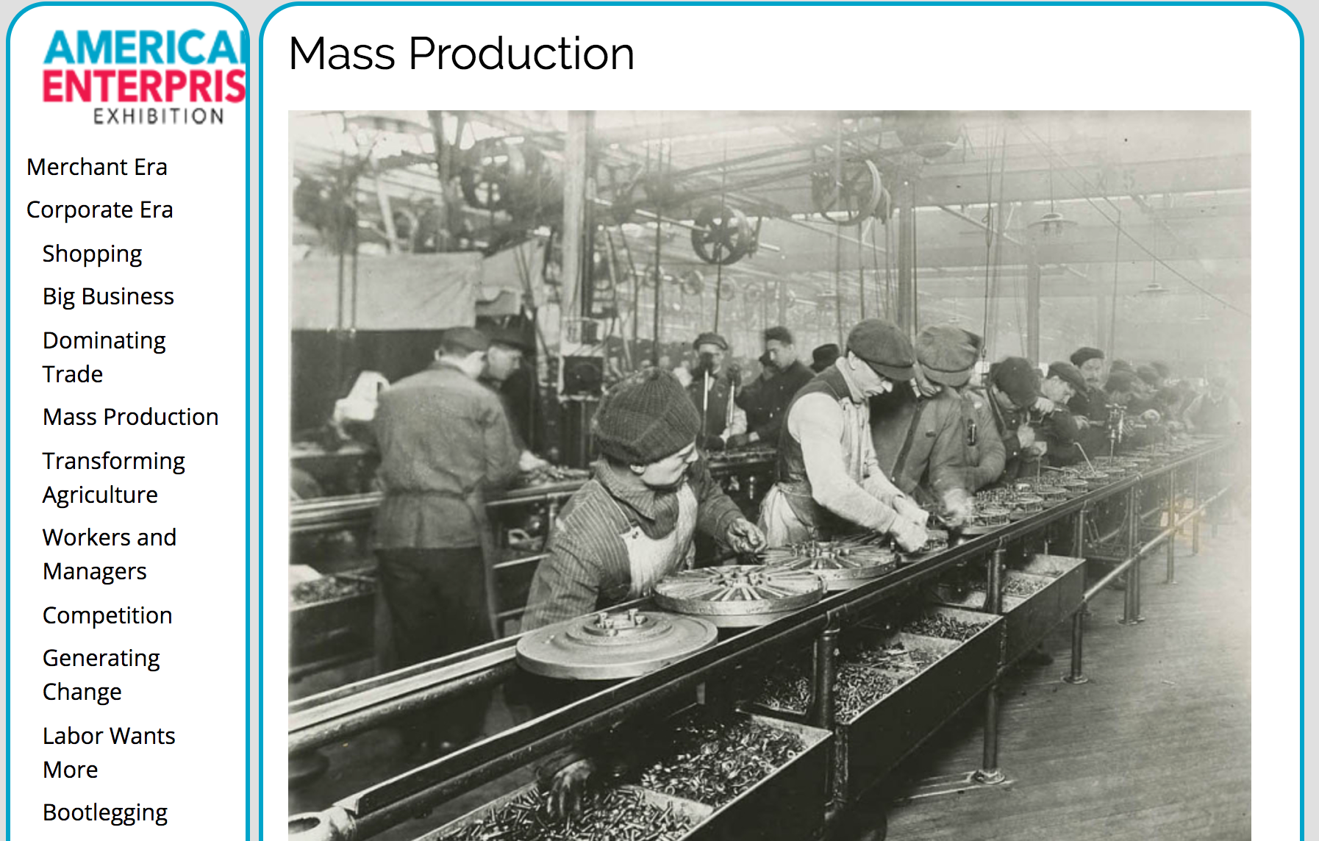
What was the impact of mass production?

Slide 39
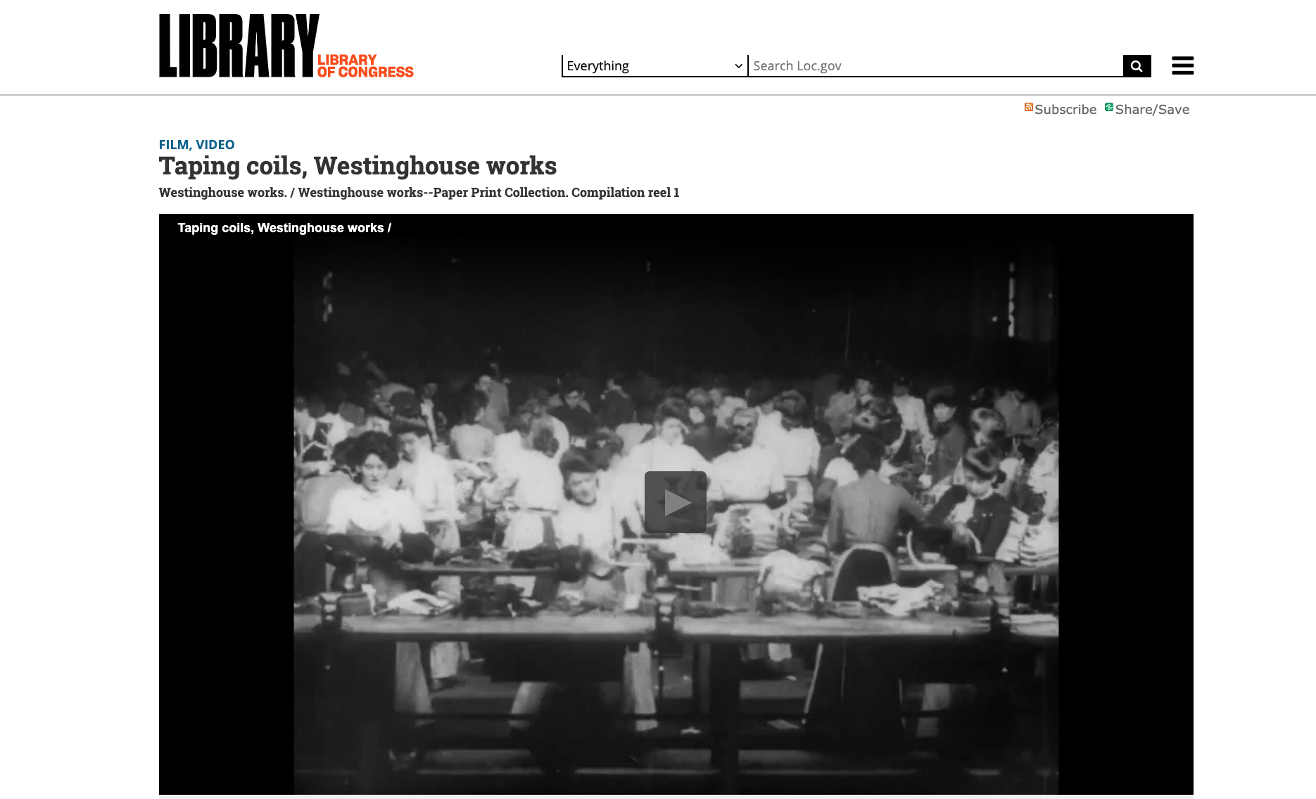
Library of Congress

Slide 40
SEE the future with Social, Environmental, and Economic thinking
Things
What was produced?
How was it produced?
How did what was produced get distributed?
People and Places
What were the social and economic impacts on people?
What were the environmental and economic impacts on places?
https://hti.osu.edu/history-lesson-plans/european-history/industrial-revolution

Slide 41
What were the relationships between workers and managers?

Slide 42
SEE the future with Social, Environmental, and Economic thinking
Things
What was produced?
How was it produced?
How did what was produced get distributed?
People and Places
What were the social and economic impacts on people?
What were the environmental and economic impacts on places?

Slide 43
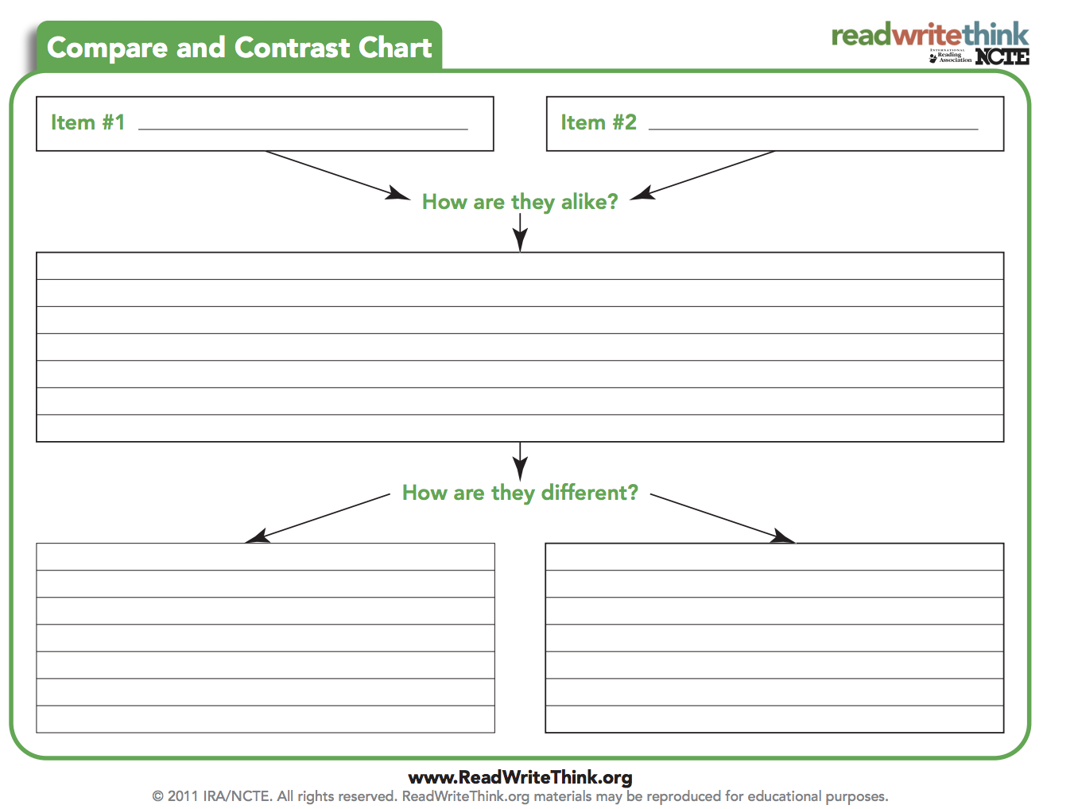
How did agriculture change from 1800’s to 1920?
Oliver plow, 1877
Fordson tractor, 1918

Slide 44
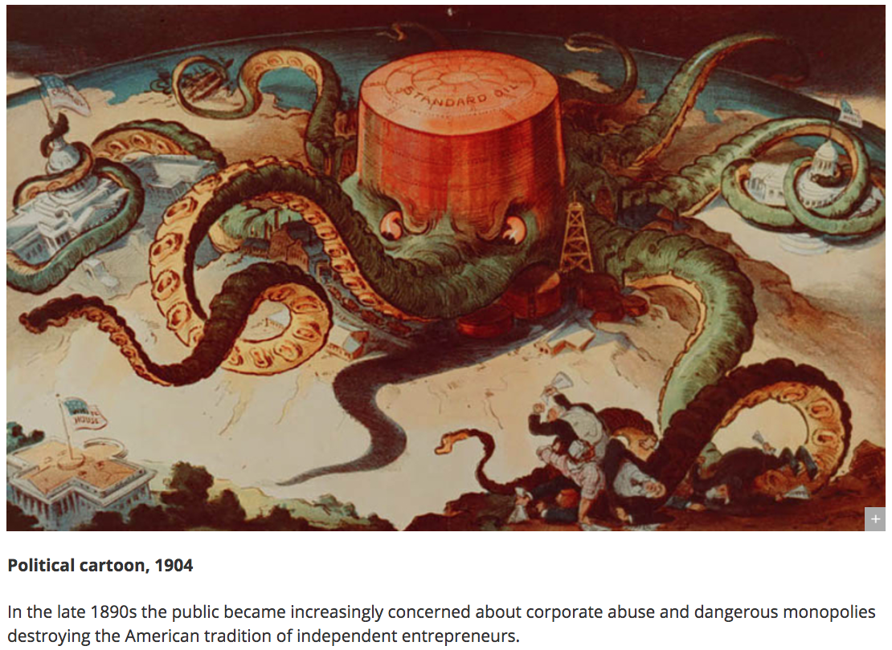
What were some problems during the corporate era?

Slide 45
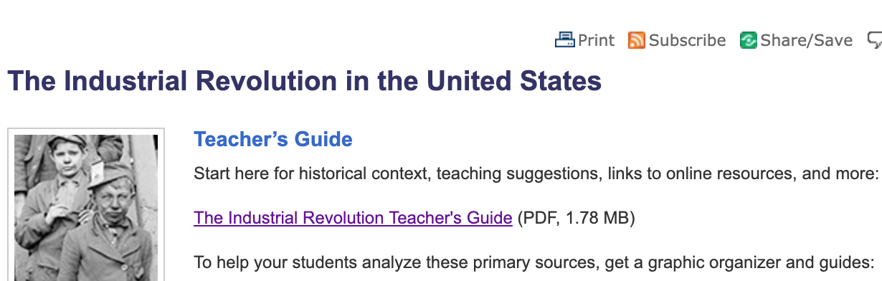
Library of Congress
http://www.loc.gov/teachers/classroommaterials/primarysourcesets/industrial-revolution/

Slide 46
http://www.loc.gov/teachers/usingprimarysources/resources/Analyzing_Political_Cartoons.pdf

Slide 47
Shopping

Slide 48
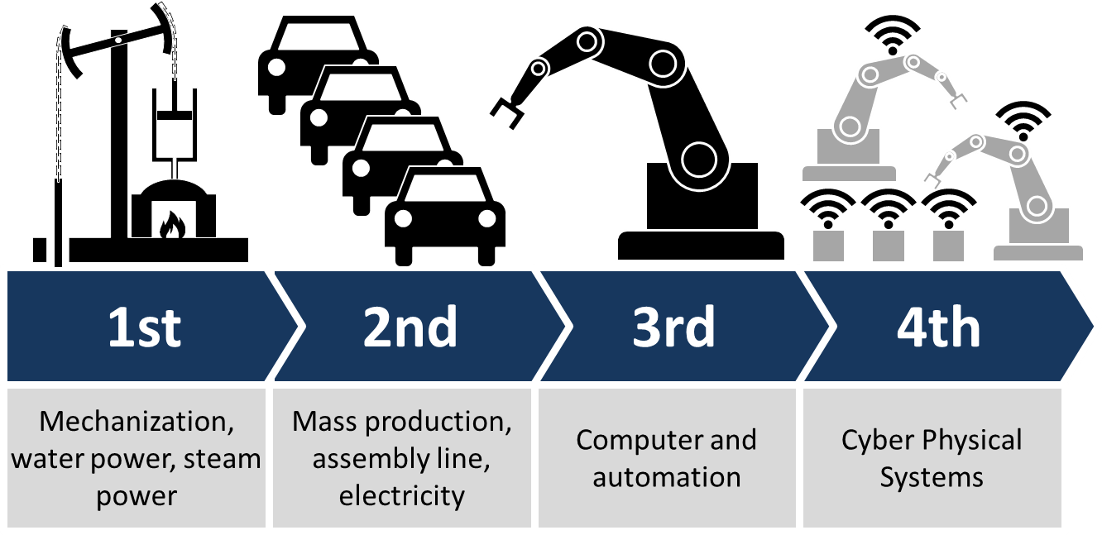

Slide 49
Rethinking Progress

Slide 50
Sustainable Development Goals United Nations and WTO
https://www.wto.org/english/thewto_e/coher_e/sdgs_e/sdgs_e.htm

