Slide 1
Sustainable Development Goals 101
Christine Angel Danger and Lisa Lawson
USF Stavros Center
#CokeGivesBack

Slide 2
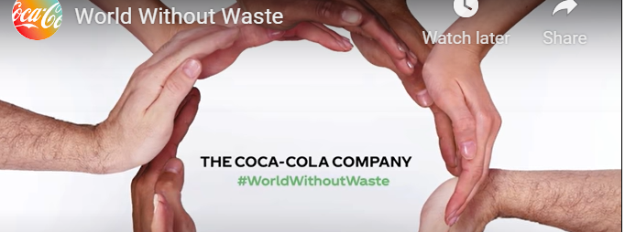

Slide 3
SustainabilitySuperheroes.org
Click on the RESOURCES tab

Slide 4
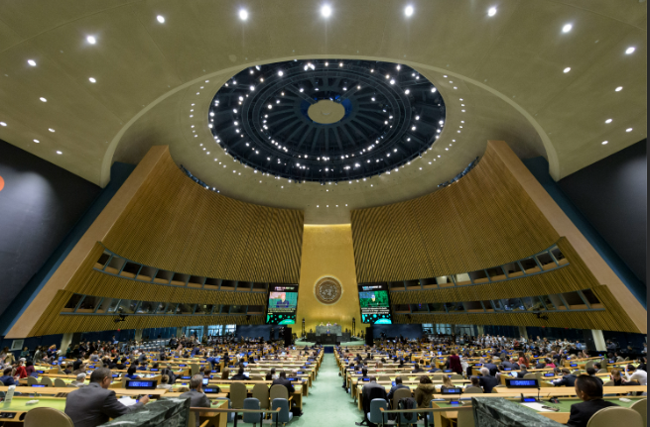
In September 2015 the United Nations General Assembly formally adopted the 2030 Agenda for Sustainable Development at a UN summit meeting held in New York, New York. The agenda included 17 Sustainable Development Goals (SDGs) to be met over the next 15 years. The goals aimed at eliminating all forms of poverty and reducing inequalities around the world. They also focused on mobilizing efforts to combat climate change and to promote environmental protection. In opening the summit, UN Secretary-General Ban Ki-Moon described the 17 global policy goals as “a to-do list for people and planet.” He urged all UN member states to “look beyond national boundaries and short-term interests” and to work together to implement the 2030 Agenda. The SDGs officially entered into force on January 1, 2016.
Notes:
5 45

Slide 5
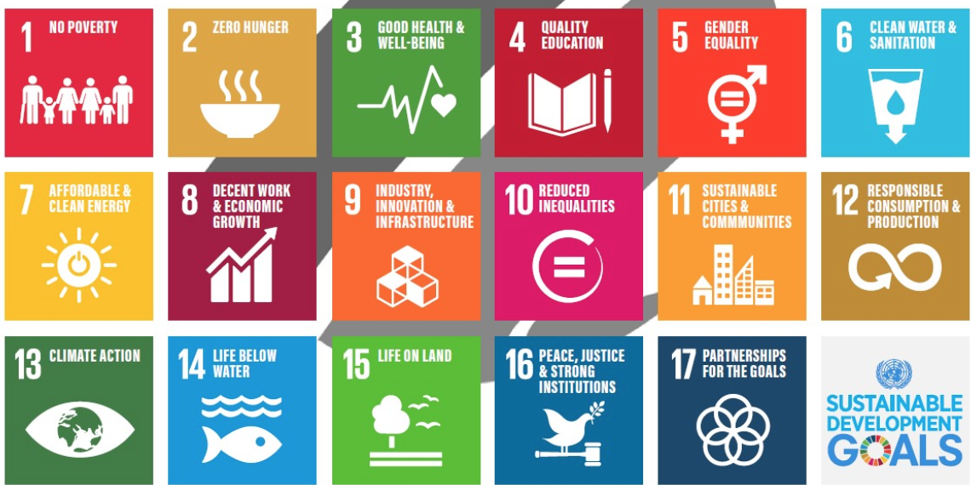
Sustainable Development Goals (SDGs)
"Meeting the needs of the present without compromising the ability of future generations to meet their own needs. . ."

Slide 6
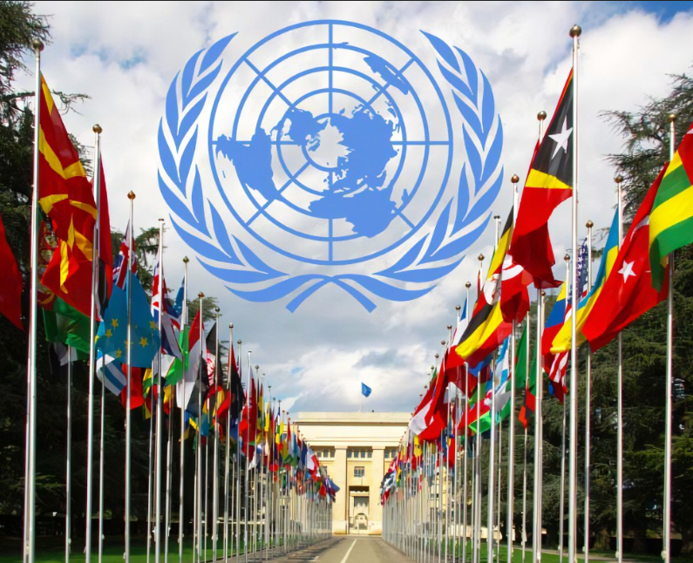
The United Nations is an international organization of countries set up in 1945, in succession to the League of Nations, to promote international peace, security, and cooperation.

Slide 7
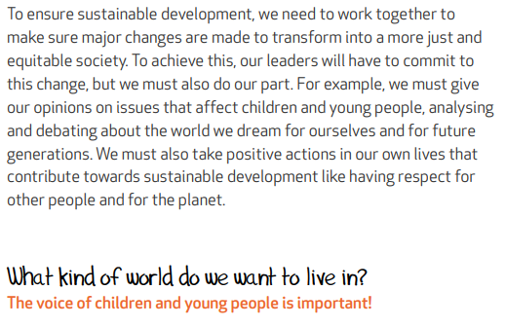
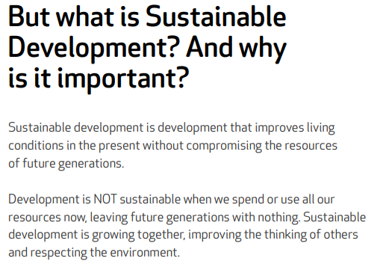
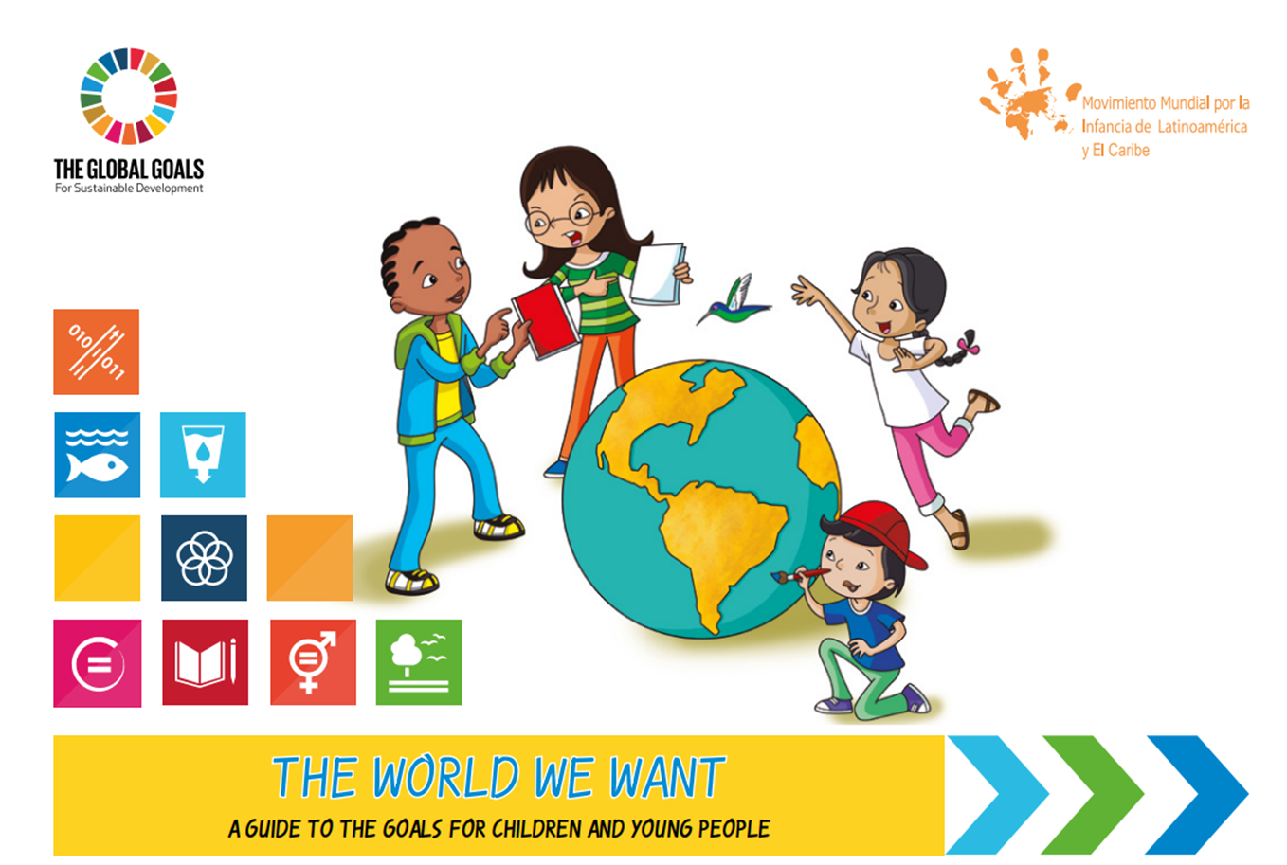
f96108_93c60d09bd8a4513aad86d7612ae3ad5.pdf (kidsforsdgs.org)

Slide 8
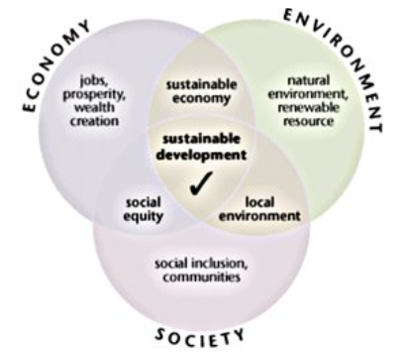
What is sustainable development?
"Meeting the needs of the present without compromising the ability of future generations to meet their own needs. . ."

Slide 9
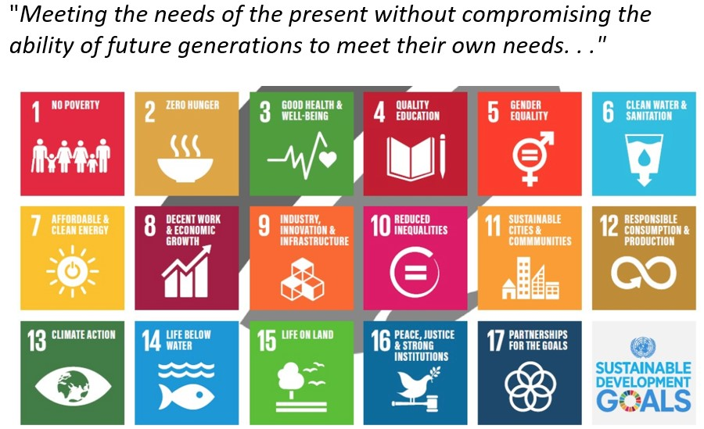
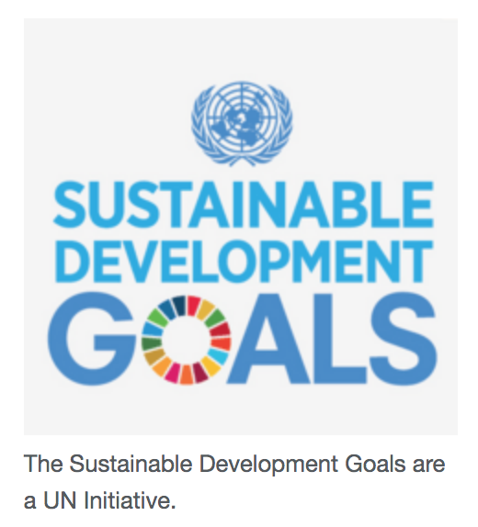
The Sustainable Development Goals (SDGs) are a set of targets relating to future international development. They are created by the United Nations and promoted as the Goals for Global Sustainable Development.
https://kids.kiddle.co/Sustainable_Development_Goals

Slide 10
The SDGs were formulated over a period of three years through a participatory process among UN member states. The process began following the UN Conference on Sustainable Development in June 2012. The 17 goals built on an earlier UN policy agenda, the Millennium Development Goals, which focused on tackling the problem of extreme poverty worldwide between 2000 and 2015. A global body known as the UN High-level Political Forum was established to monitor progress toward achieving the SDGs and fulfilling the 2030 Agenda’s central pledge of “ensuring that no one is left behind.” An annual Sustainable Development Goals Report was also produced by the office of the UN Secretary-General.

Slide 13
1. Read about a Sustainable Development Goal. 2. Write a Tweet (about 14 words) 3. to tell the world about the goal. Write your Tweet on a sticky note.

Slide 14
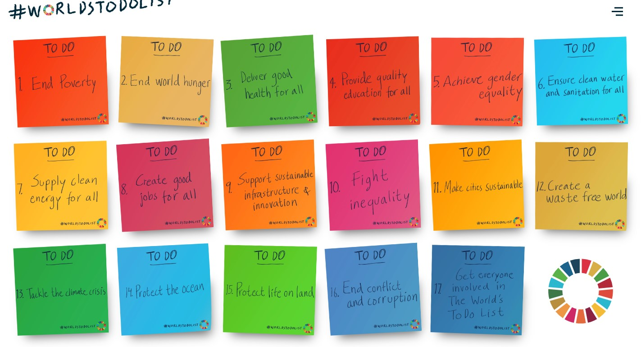
Each person or pair will get a description of one SDG and an infographic. Using the information you are given, create a to do list for the world on a sticky note.
Make your list specific actions such as “buy locally grown foods”.
Notes:
At 45 min
Tweets

Slide 15
Which group does your goal belong in?
Economy | Society | Environment
Decide which group your goal and
To Do List belongs in .
Put your sticky notes on the poster
you think it most belongs on.
Notes:
Need 3 posters

Slide 16
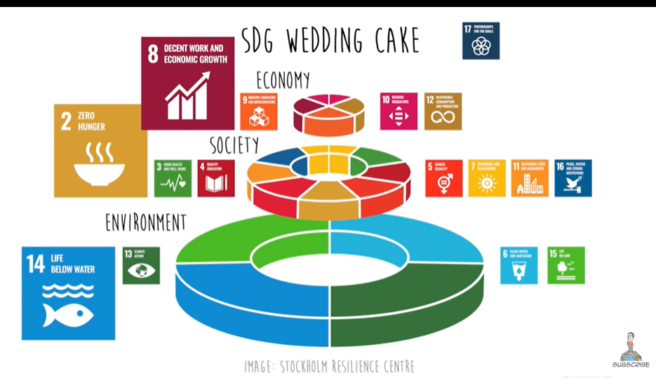
Notes:
The SDGs are interconnected. The Stockholm resilience center recommended organizing the SDGs into 3 layers: the environment, society, and the economy. We also call this people, planet, and profit. Environment is the base that supports society which supports the economy. This is known as the triple bottom line or the three pillars of sustainability. Sustainability is about meeting our present needs without harming future generations. There are 4 goals about the environment, 7 goals about society, and 4 goals about the economy. We cannot achieve decent economic growth or even food security without first taking care of our oceans, fresh water supply, land, and greenhouse gas emissions.

Slide 17
The Good Life Goals: sustainable development gets personal - SEI
Notes:
Can you add more to your to do list?

Slide 18
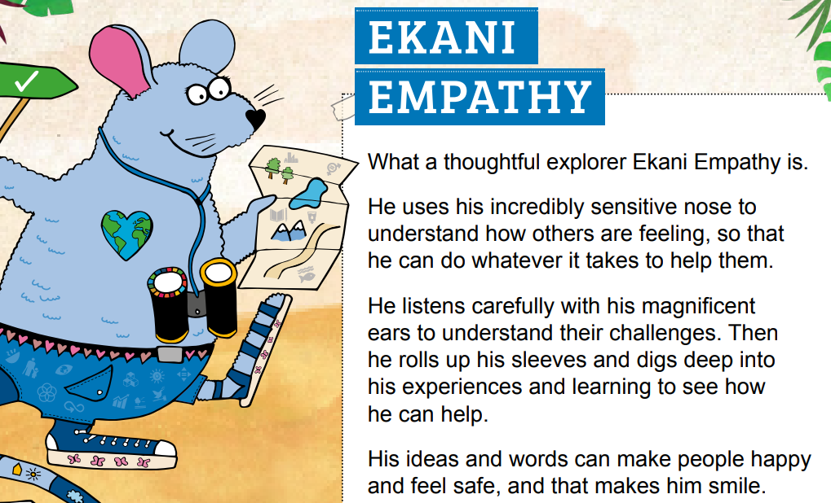

Slide 19
The decisions your students make dictate the path that their lives take. Posing phenomena as situations in which students analyze information and data then make decisions, teaches them to judge the risks and rewards of their decisions.
Notes:
6:30

Slide 20
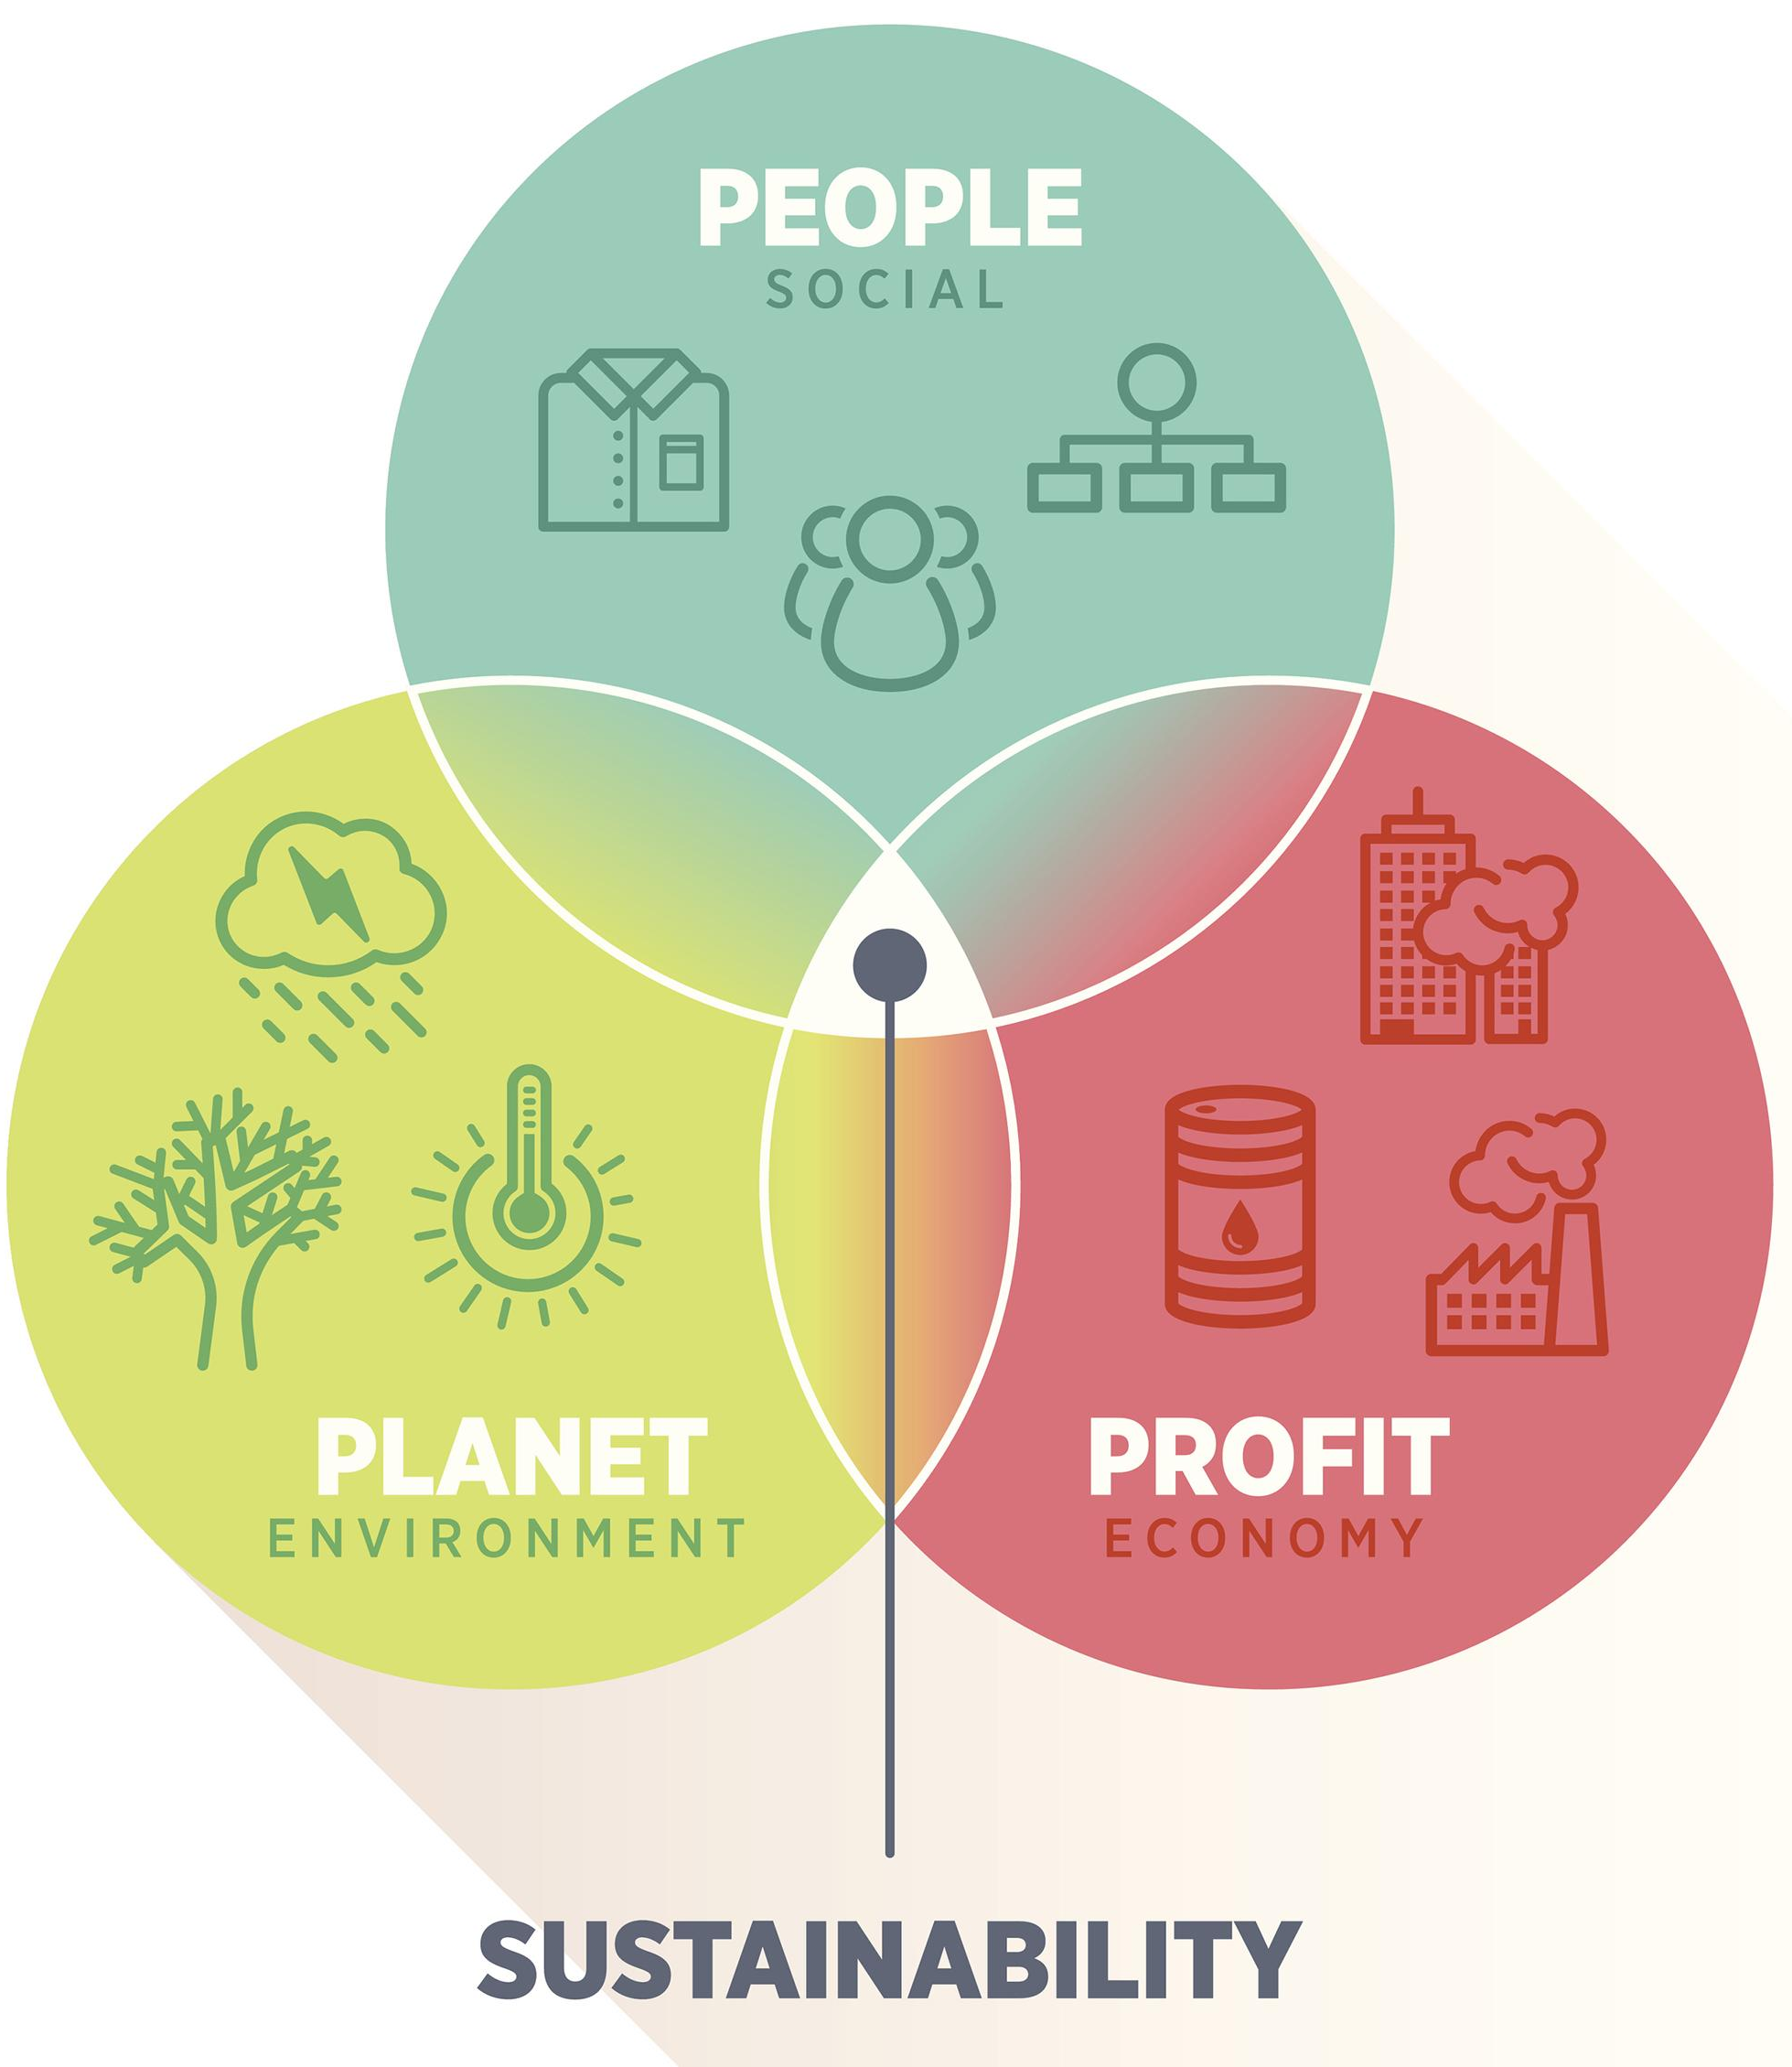
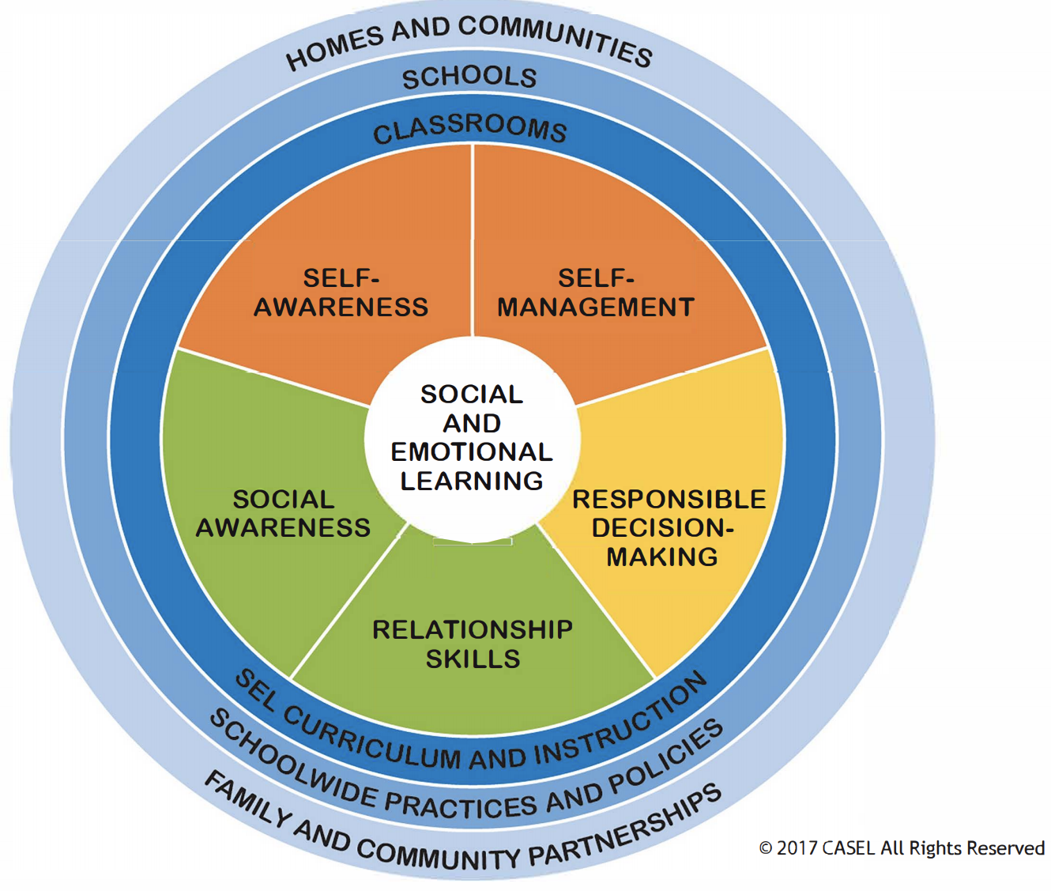
Decision-making and Social Emotional Learning
CASEL.org

Slide 21
Decision Making
Define problem
List choices
Evaluate choices (good/bad better/best)
Make a decision
I decided ______________________________.
The reasons I made this decision are _______________________________________________________
I think this is a good decision because _______________________________________________________

Slide 22
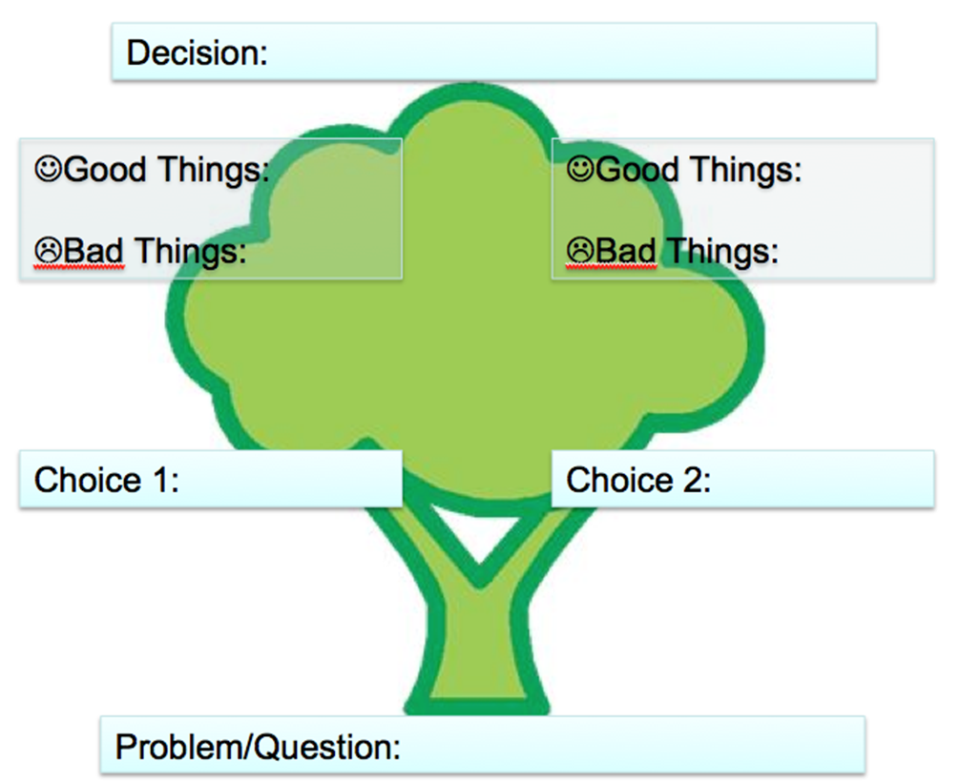

Slide 23
Slides below as headers for MEAs

Slide 24
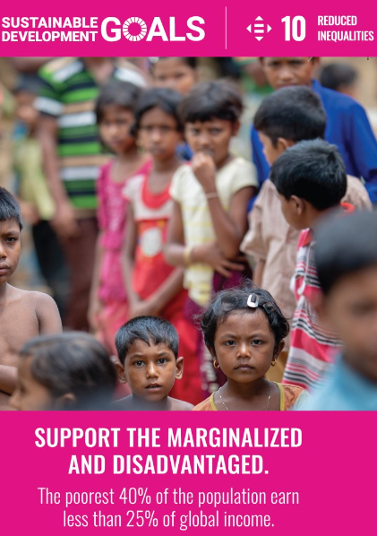
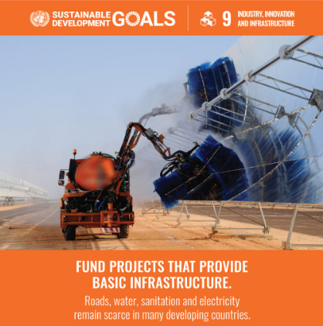
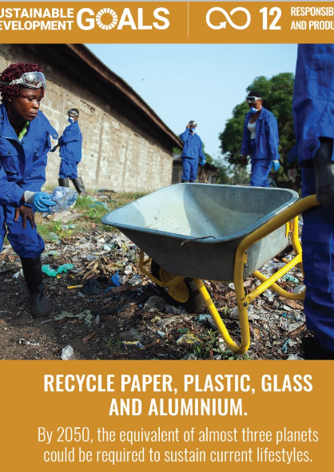
Economy

Slide 25
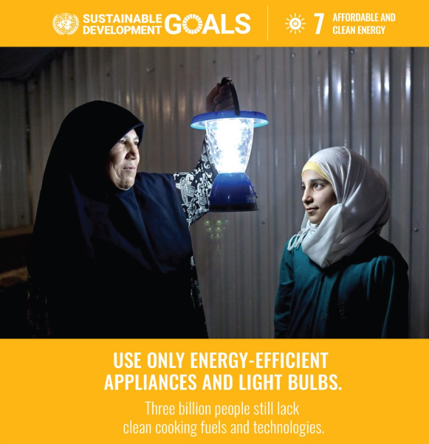
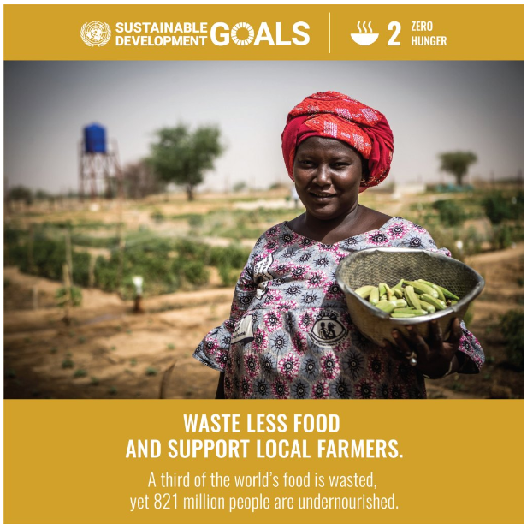
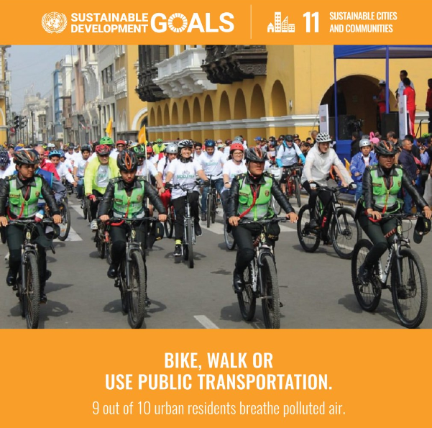
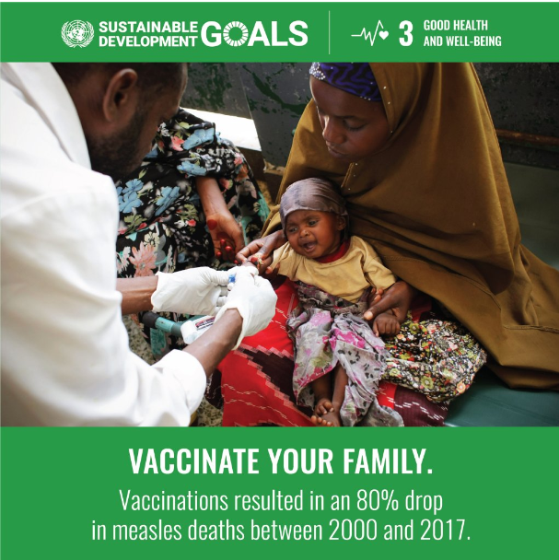
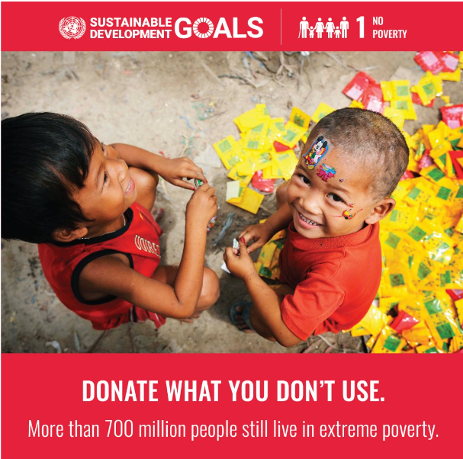
Society

Slide 26
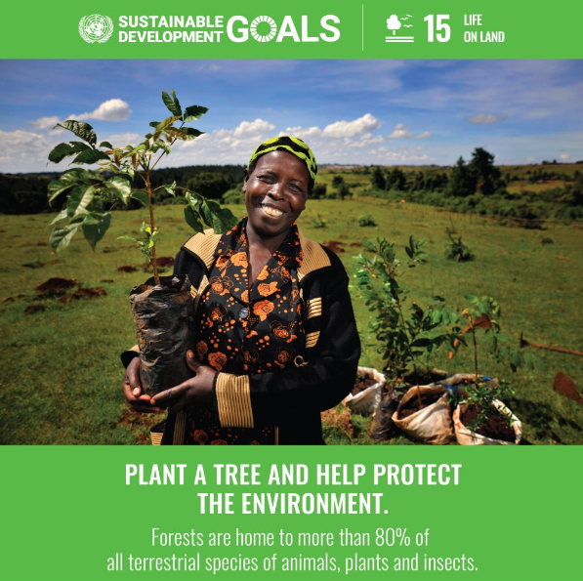
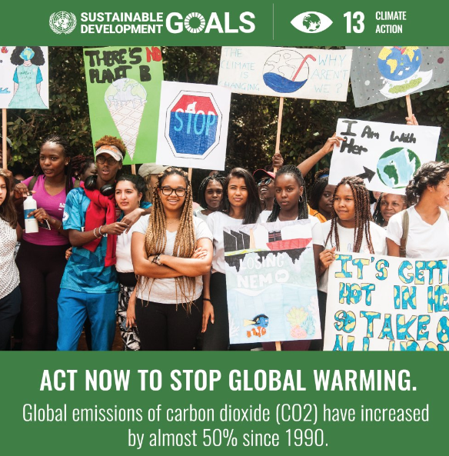
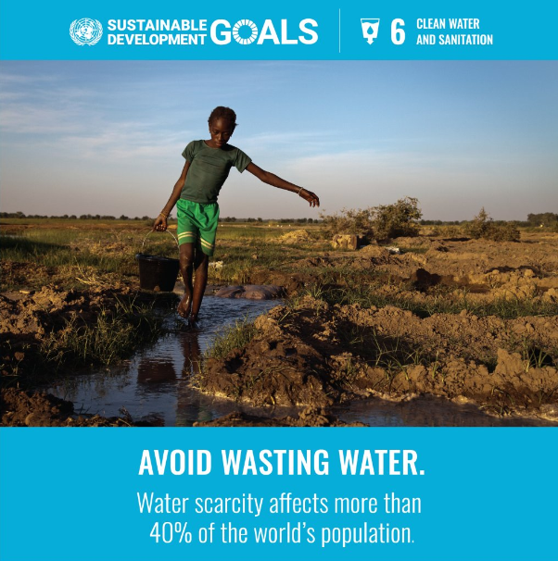
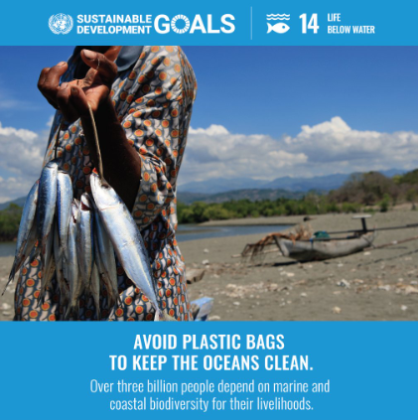
Environment

Slide 27
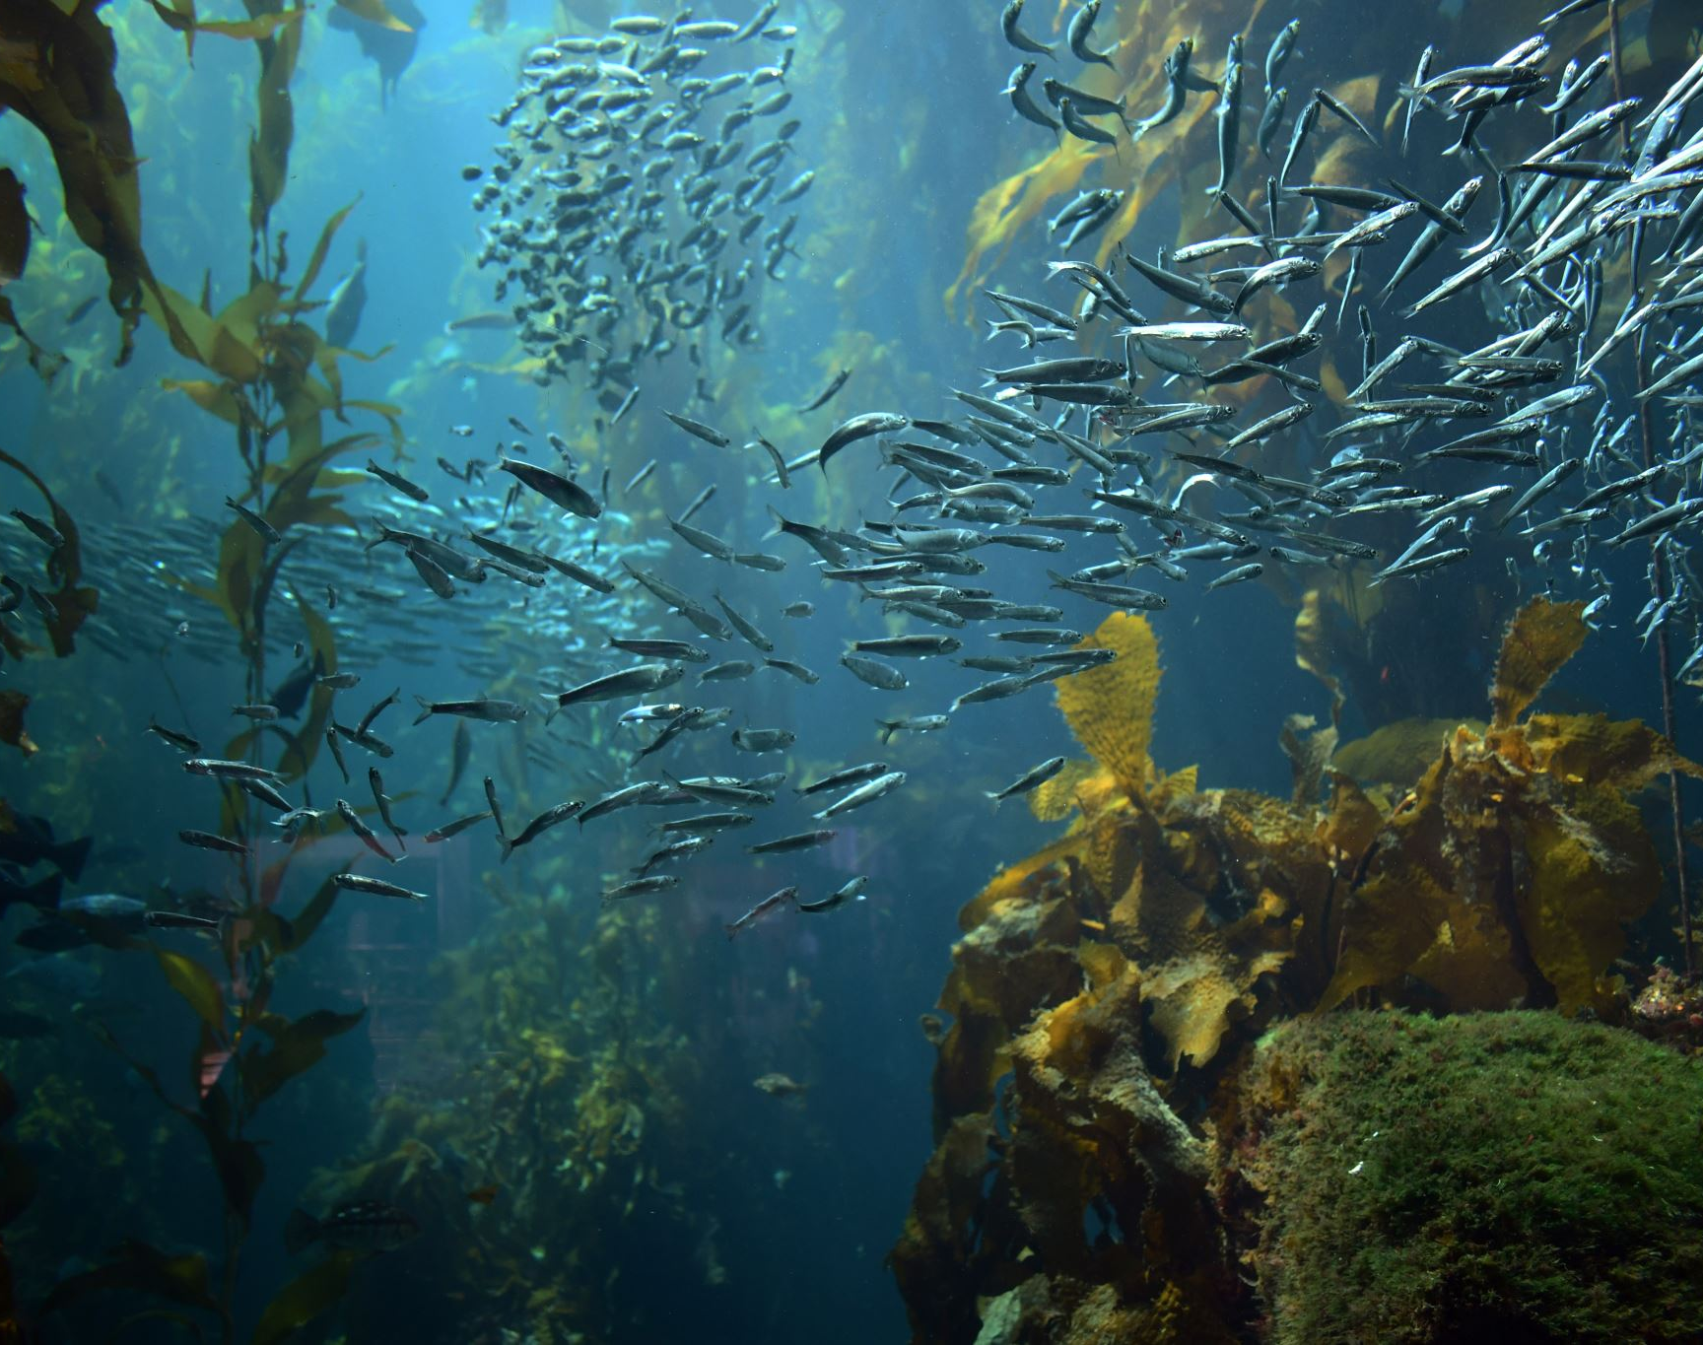
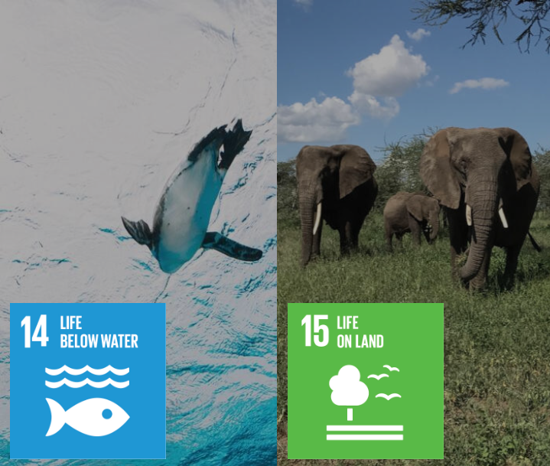

Slide 28
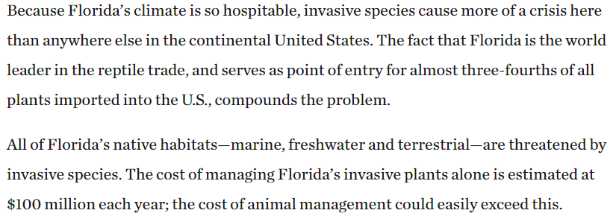
SC.4.L.17.4 – Recognize ways plants and animals, including humans, can impact the environment. SC.5.L.17.1 – Compare and contrast adaptations displayed by animals and plants that enable them to survive in different environments such as life cycles variations, animal behaviors and physical characteristics.

Slide 29
Florida’s Most (un)Wanted!
UN
Which animals and plants are on this list?
The state of Florida has funding to hire a company to work on ridding the state of one of these invasives.
Which one should they focus on? Why?
Notes:
Link to Nature conservancy

Slide 30
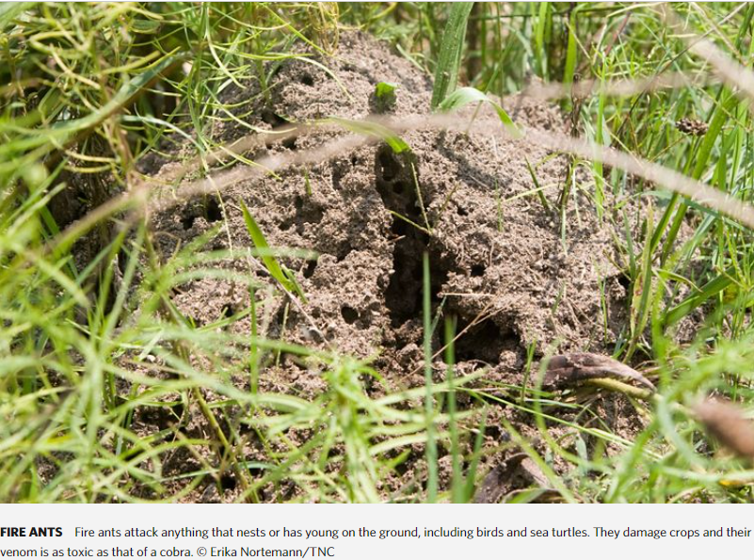

Slide 31
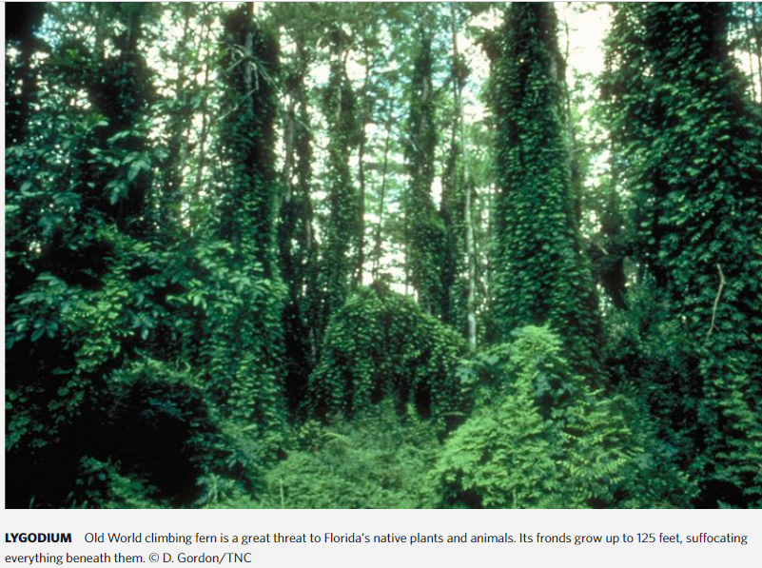

Slide 32
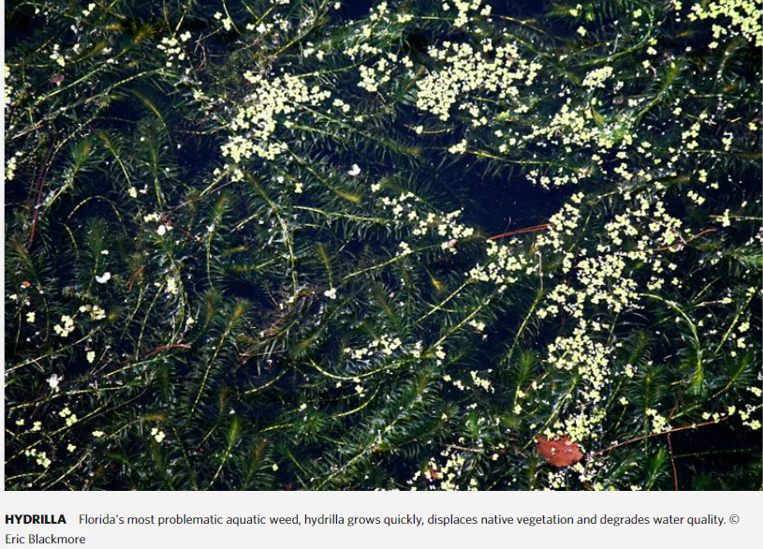

Slide 33
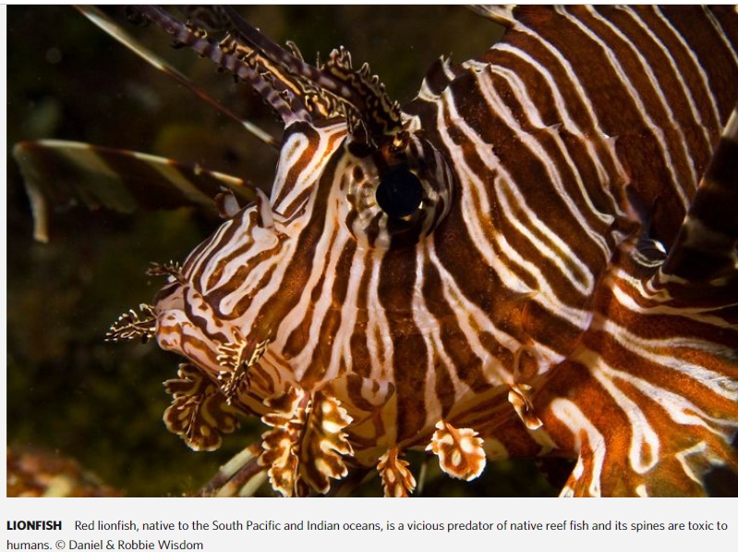

Slide 34
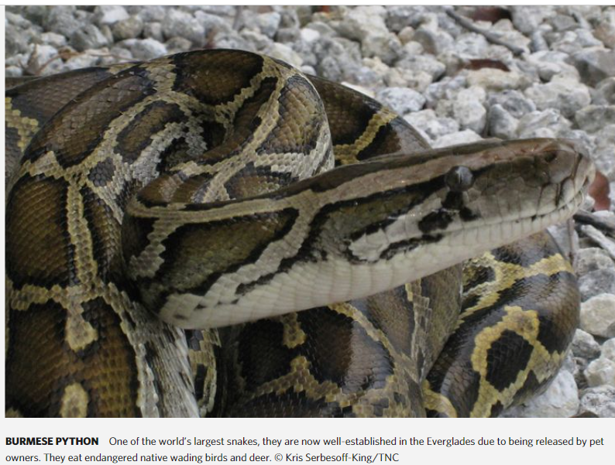

Slide 35
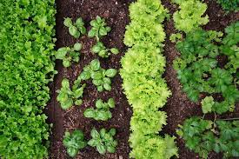
SC.3.L.17.1 - Describe how animals and plants respond to changing seasons.

Slide 36
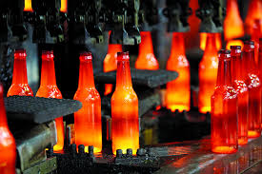
SC.4.E.6.3 – Recognize that humans need resources found on Earth and that these are either renewable or nonrenewable. SC.5.P.9.1 – Investigate and describe that many physical and chemical changes are affected by temperature.

Slide 37
Dear Students,
Sunshine school district wants to start a recycling program.
We have enough money to buy one dumpster for each school. The school will put one kind of recyclable material in the dumpsters. The dumpsters will be emptied once a week. We need a way to decide which material we should recycle first.
After the recycling program has raised enough money to buy more dumpsters and recycling bins we will be able to buy more dumpsters. When we have more dumpsters we will be able to recycle more materials.
We need you to come up with a system to decide which material they should recycle first. As we earn money from recycling they will add more materials. We need to know the order in which to add materials to be recycled. We hope that someday we will be able to recycle all of the materials on the list. Other materials may be added to the list later. Please create a system to rate the order in which we should choose which material to recycle. Make sure your system will still work if the list of materials to recycle changes.
Thank you for your help,

Slide 38
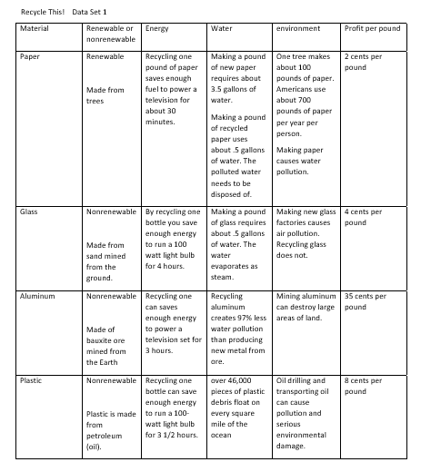

Slide 40
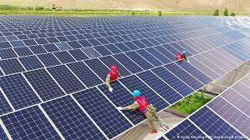
SC.3.E.5.2 Identify the Sun as a star that emits energy; some of it in the form of light. SC.3.P.10.1 Identify some basic forms of energy such as light, heat, sound, electrical, and mechanical.

Slide 41
Dear Students,
My name is Mike Wazowski and I am the new Sustainability Manager of Monster Inc., a manufacturing company in Florida. We are building a new factory in Florida and need to decide which type of energy to use to power it. The kids in the local community want us to use a form of energy that will protect Florida’s environment so that they will have a clean and safe place to live when they grow up.
We need to know what type of energy you would suggest that our developers use in our new factory. We have given you an energy chart to help you make your decision.
Please write us back to let us know your decision, including how you arrived at your decision.
Thank you for your assistance with this project!
Regards,
Mike

Slide 42
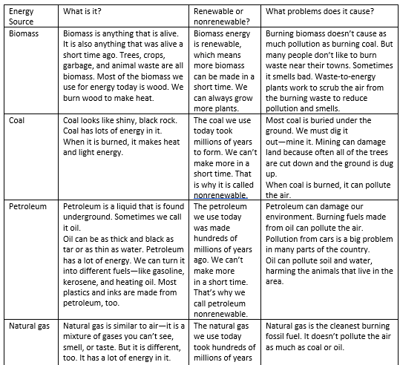

Slide 43
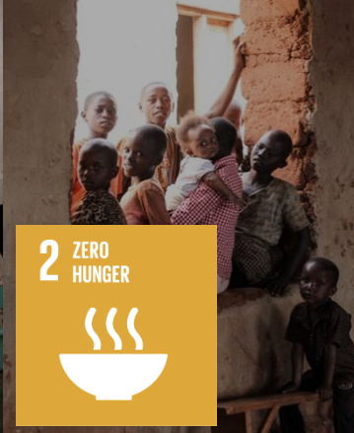

Slide 44
Dear Students,
We have a school garden and we want to plant two different crops this year. That means we need one crop to finish growing and be harvested before we can plant the second crop. We can only plant one type of plant at a time.
Plants only grow during certain seasons because of the different amounts of sunlight and heat available during different seasons.
There are so many things to consider when planting a garden. We are stuck and cannot make up our minds!
Seedlings need to be started indoors a month before we plant them.
If plants can be planted closer together we can have more plants, but that means they will cost us more money.
Kids like some of these foods better than others.
We need your help! We are sending you a data table along with this letter. The data table shows the types of seeds we have available to plant this year. The types of seeds available each year changes, so we need instructions from you on how to use different sets of data to choose which crops to plant each year.
Please keep in mind that we start school during the last week of August and school closes for summer from May until late August.

Slide 45
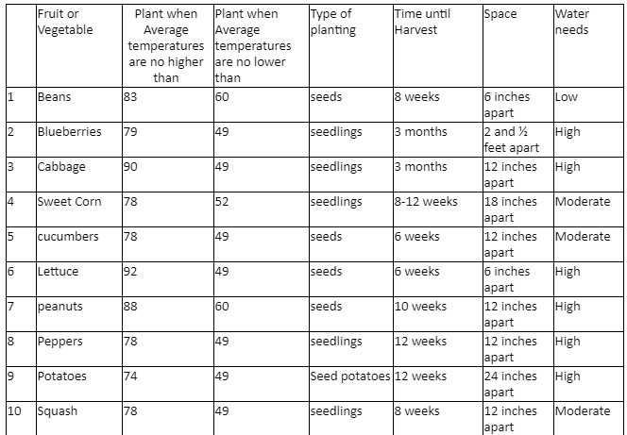

Slide 46
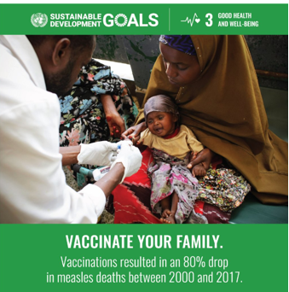

Slide 47
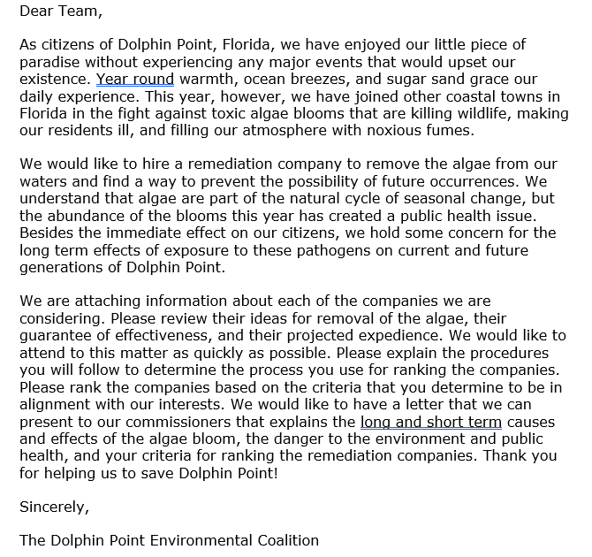

Slide 49
Activities
Economy | Society | Environment
Notes:
Need 3 posters

Slide 50
Resources
Economy | Society | Environment
Notes:
Need 3 posters

Slide 51
Books
Economy | Society | Environment
Notes:
Need 3 posters

Slide 52
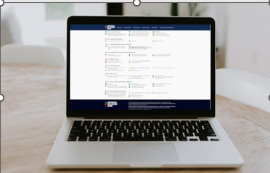
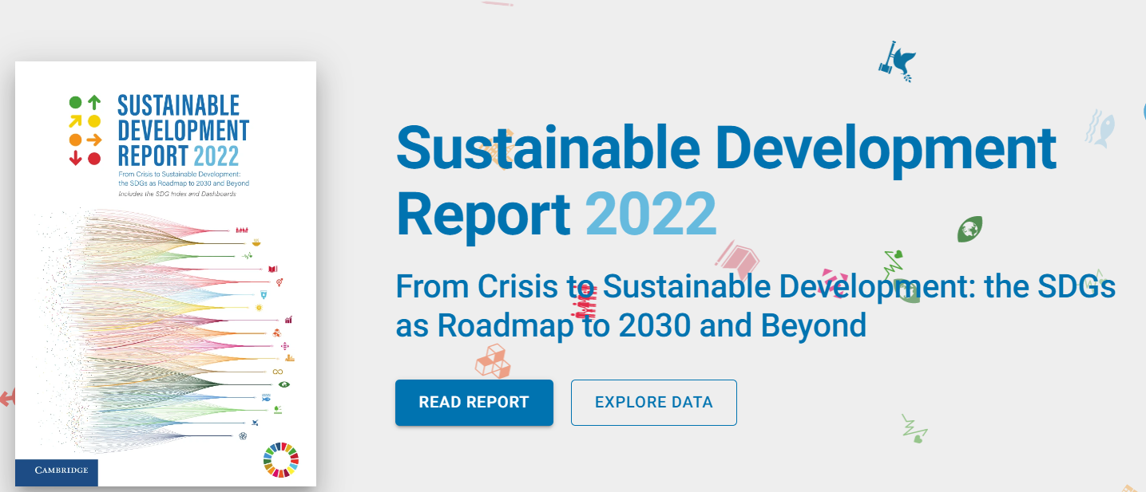
How are we doing?
Check our report card.
https://dashboards.sdgindex.org/

