Slide 1
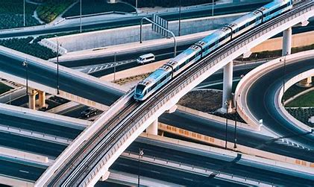
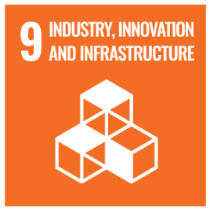
GLOBAL LITERACY: INDUSTRIES, INNOVATION, AND INFRASTRUCTURE
Christine Angel Danger
Kara Windish

Slide 2
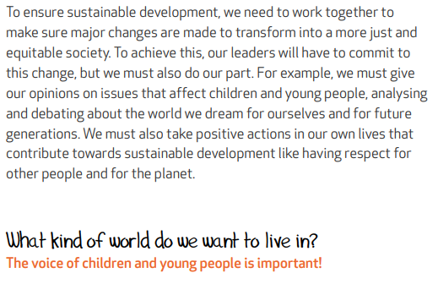
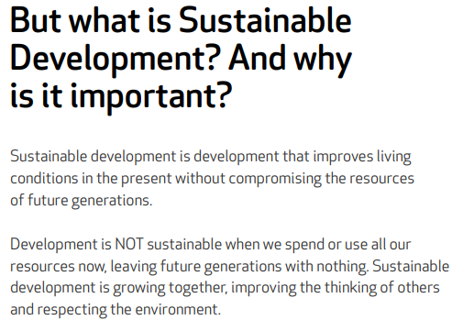
f96108_93c60d09bd8a4513aad86d7612ae3ad5.pdf (kidsforsdgs.org)

Slide 3
Build resilient infrastructure, promote inclusive and sustainable industrialization and foster innovation

Slide 4
Test your knowledge on SDG 9
Use your camera to scan the QR code

Slide 5
What is Infrastructure?

Slide 7
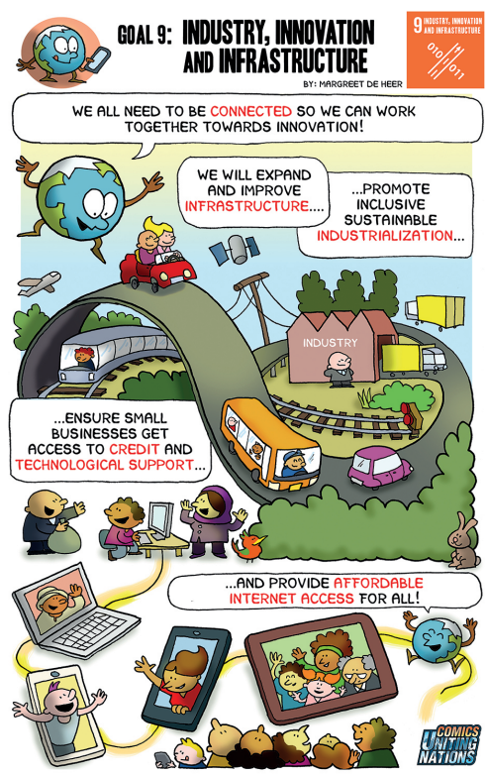
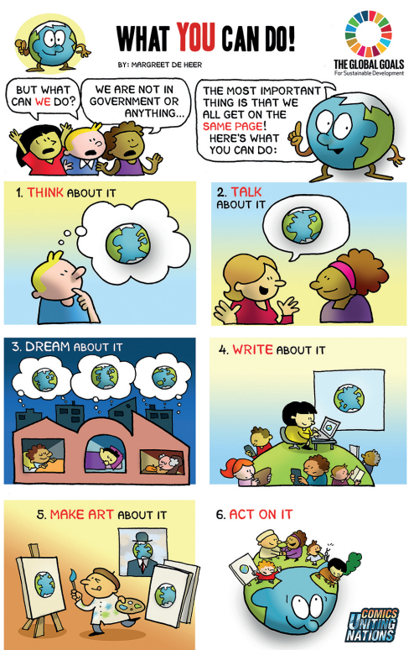
Global Goals Comic - Rob Clarke.pdf - Google Drive

Slide 8
https://www.youngvoicesfortheplanet.com/youth-climate-videos/save-tomorrow/

Slide 10
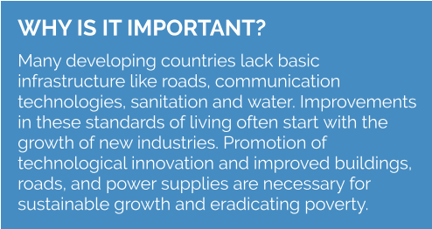

Slide 11
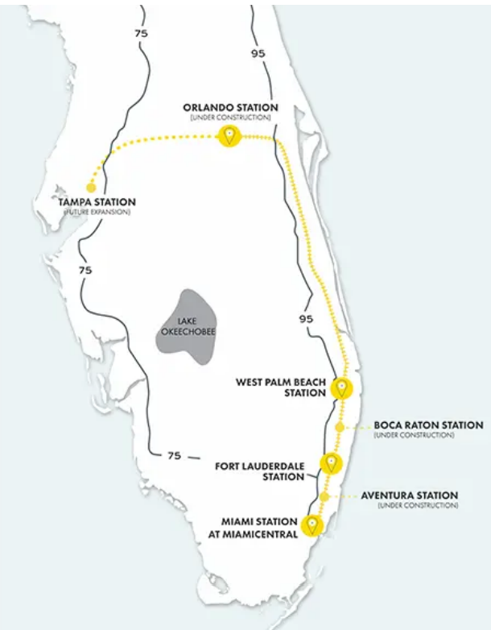
Brightline is actively constructing a new rail line to connect our stops in Miami, Fort Lauderdale and West Palm Beach to Orlando. Our team is hard at work to continue our exciting expansion plans. Service connecting South Florida to Central Florida is expected to open in 2023.
Phase 1: Miami - West Palm Beach 65-mile shared use line with freight 79 mph Operations began 2018 2019 ridership 885,000
Phase 2: West Palm Beach - Orlando International Airport West Palm Beach - Cocoa 120-mile upgraded shared use line 110 mph Under construction now, operational 2022 Cocoa – Orlando International Airport 35-mile new dedicated high-speed line 125 mph Under construction now, operational 2022 Expected annual ridership 3+ million
Phase 3: Orlando International Airport - Tampa 85-mile proposed dedicated line in the medians of I-4 and SR 417 125 mph Still in planning phases

Slide 12
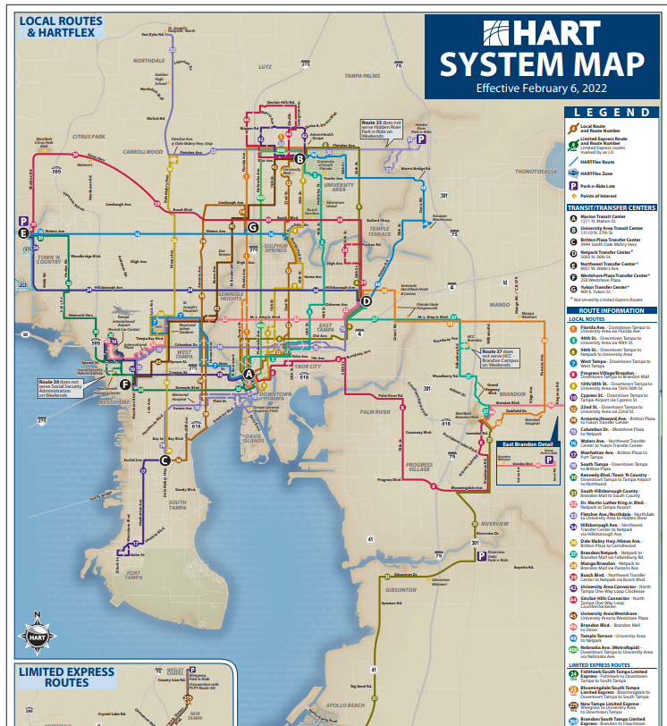
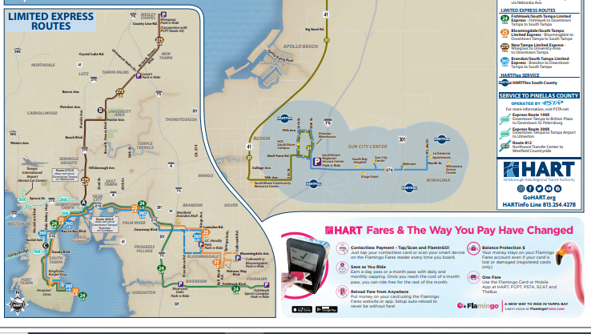

Slide 15
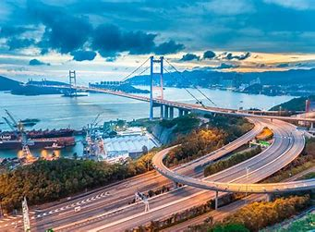
National Bridge Inventory Rating Scale
DOTs typically use a numbered and color-coded rating system of 0 to 9 to rate bridge integrity. A 9 rating would imply that the bridge is in excellent condition, whereas a 0 rating would imply that the bridge has failed.
The government classifies a bridge as “structurally deficient” if any one of the following bridge components is rated less than or equal to 4 (in poor or worse condition):
Deck condition
Superstructure condition
Substructure condition
Culvert condition

Slide 16
President Biden's Bipartisan Infrastructure Law | The White House

Slide 18
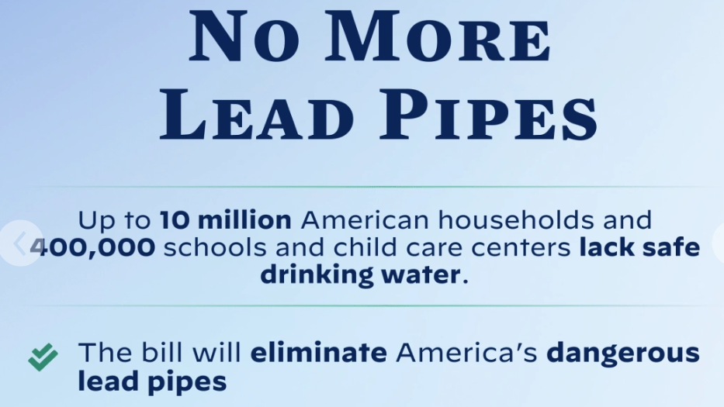

Slide 19
According to the most recent data from the National Center for Education Statistics (NCES), 14% of American children ages 3-18 don't have internet access at home. More than 9 million schoolchildren will face difficultly completing assignments online.
More than 9 million children lack internet access at home for online learning (usafacts.org)

Slide 20
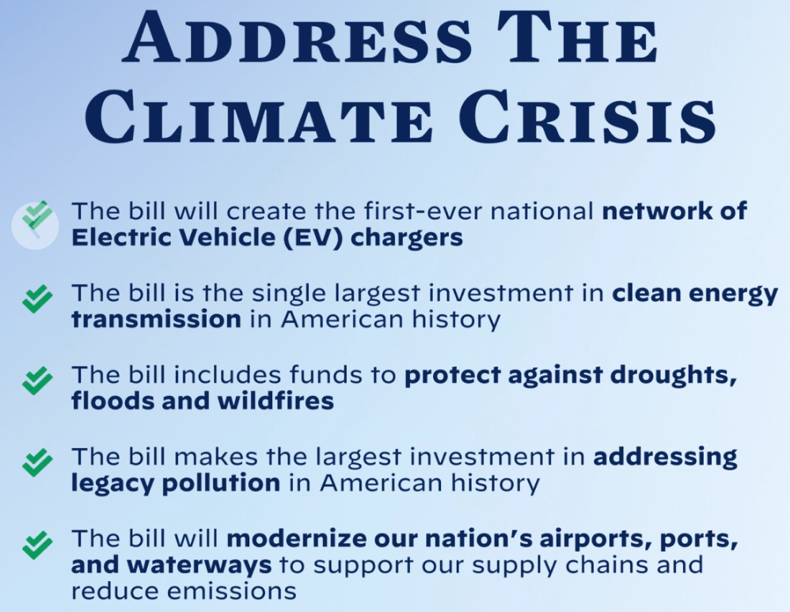
Modern, resilient, and sustainable port, airport, and freight infrastructure will strengthen our supply chains and support U.S. competitiveness by removing bottlenecks and expediting commerce and reduce the environmental impact on neighboring communities.

Slide 21
The Bipartisan Infrastructure Law makes the single largest investment in repairing and reconstructing our nation’s bridges since the construction of the interstate highway system. It will rebuild the most economically significant bridges in the country as well as thousands of smaller bridges.

Slide 22
Goal 9: Industries, Innovation, and Infrastructure - United Nations Sustainable Development
Wild Buildings and Bridges
Award-winning author Etta Kaner combines science and art in this unique look at nature’s influence on architecture and design. The emphasis on problem-solving and critical thinking make it an excellent choice for science and technology lessons on structures, mechanisms and engineering.
Authors: Etta Kaner | Illustrator: Carl Wiens | ISBN: 978-1771387811 | Publisher: Kids Can Press

Slide 23
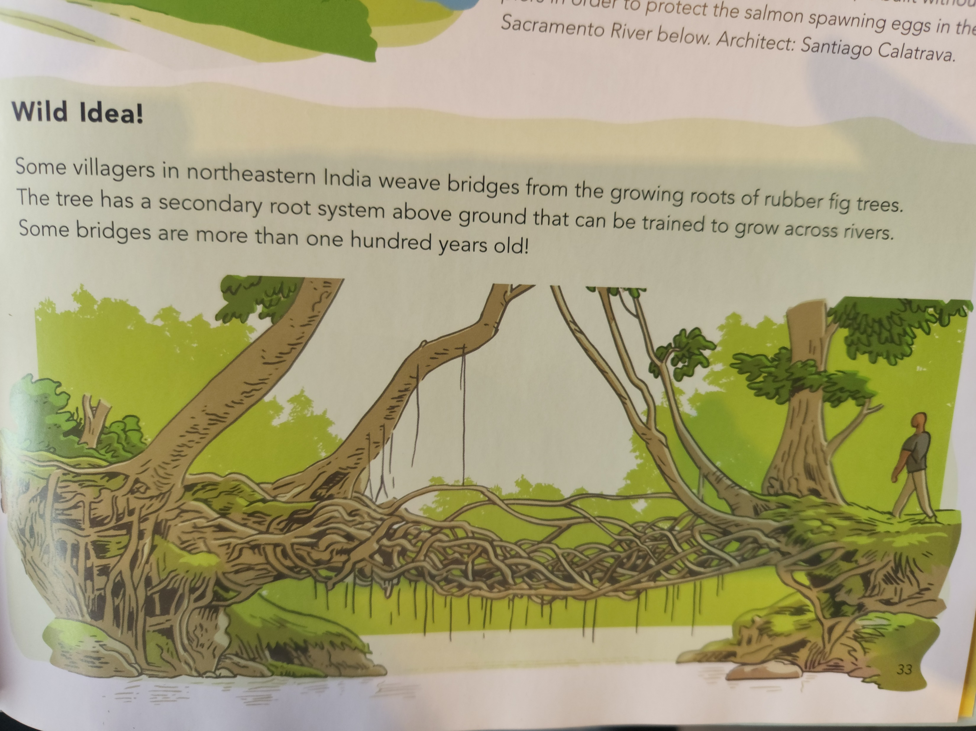
33

Slide 24
25

Slide 25
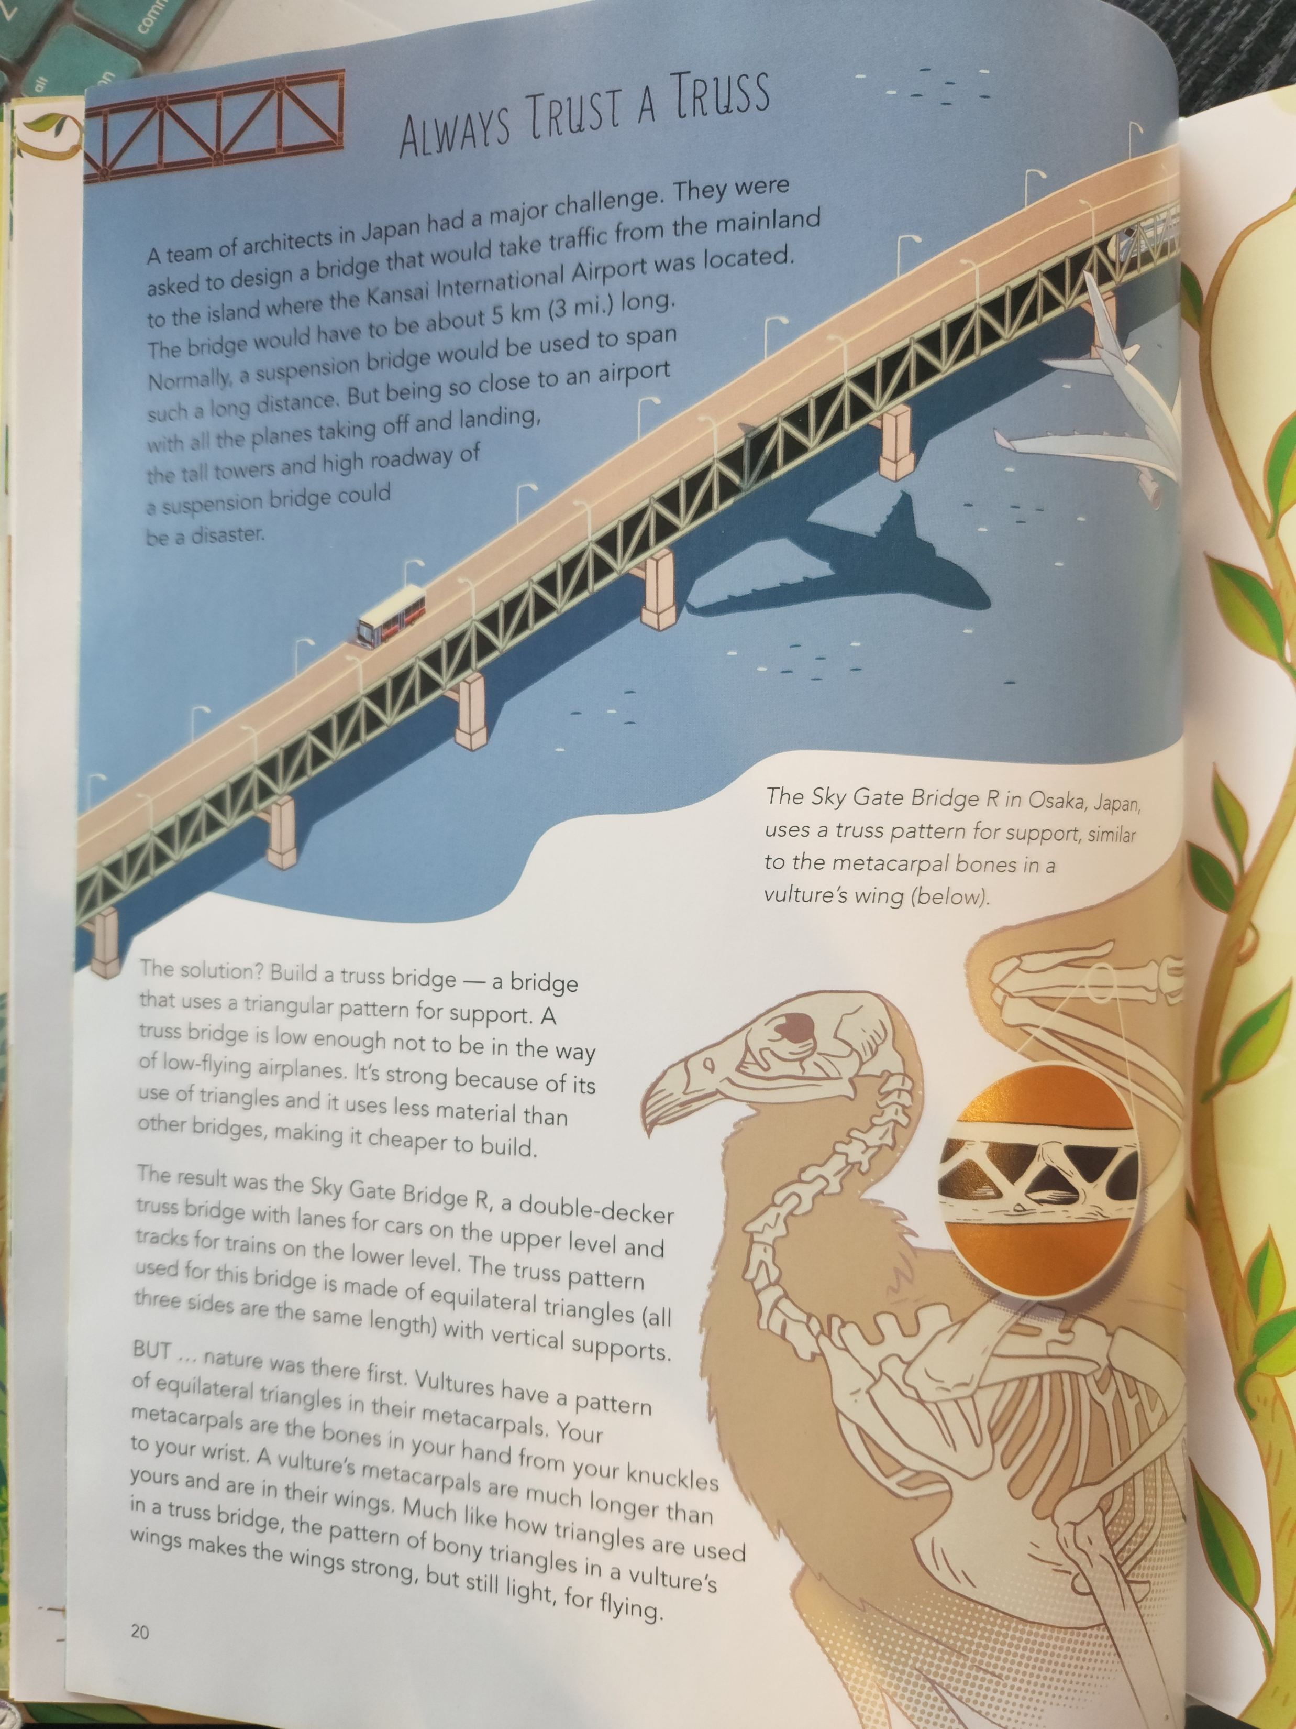
Biomimicry, also called biomimetics, comes from the Greek roots bios, meaning “life,” and mimesis, “to imitate.”
It is observing “what works” in nature and mimicking it to solve problems, create, and innovate.
20

Slide 26
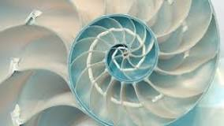
Biomimicry for the Classroom
https://www.youtube.com/watch?v=OdQIaaD77uA

Slide 27
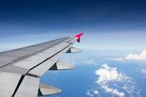
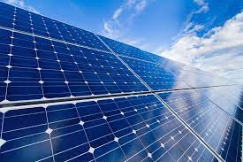
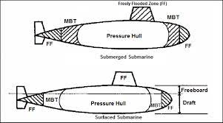
To Be Or Not To Be?
Is it Biomimicry?
Airplane wing
ipod
Sonar Navigation
Computer printer
Soft cushion for a chair
Solar cell
Hulls of submarines
Hard coatings for car windshields

Slide 28
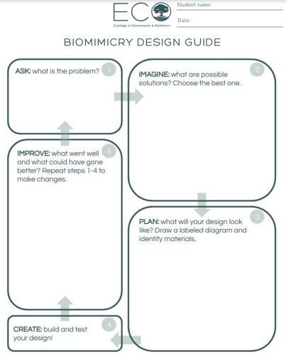
Create your own design
www.teacheco.org

Slide 29
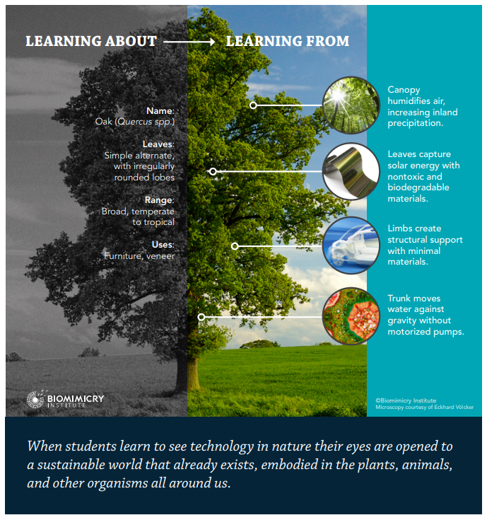

Slide 30
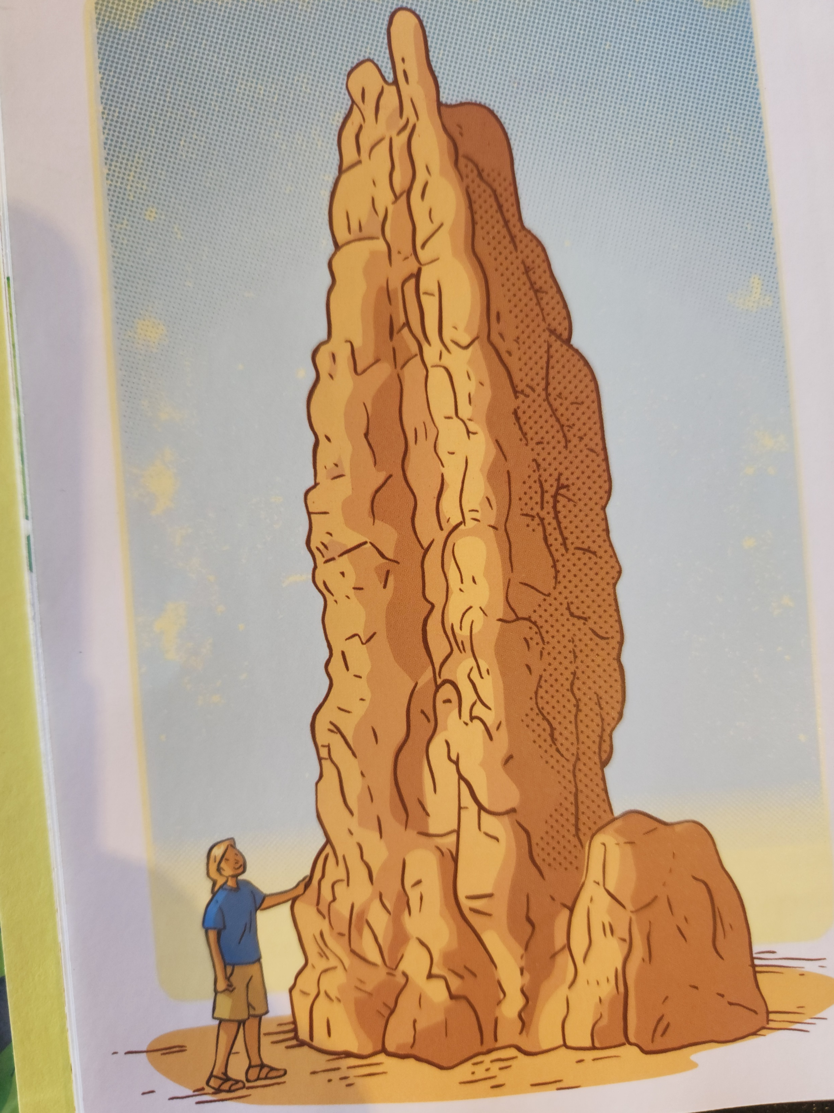
What can termites teach us about keeping our buildings cool more efficiently and sustainably?
14

Slide 31
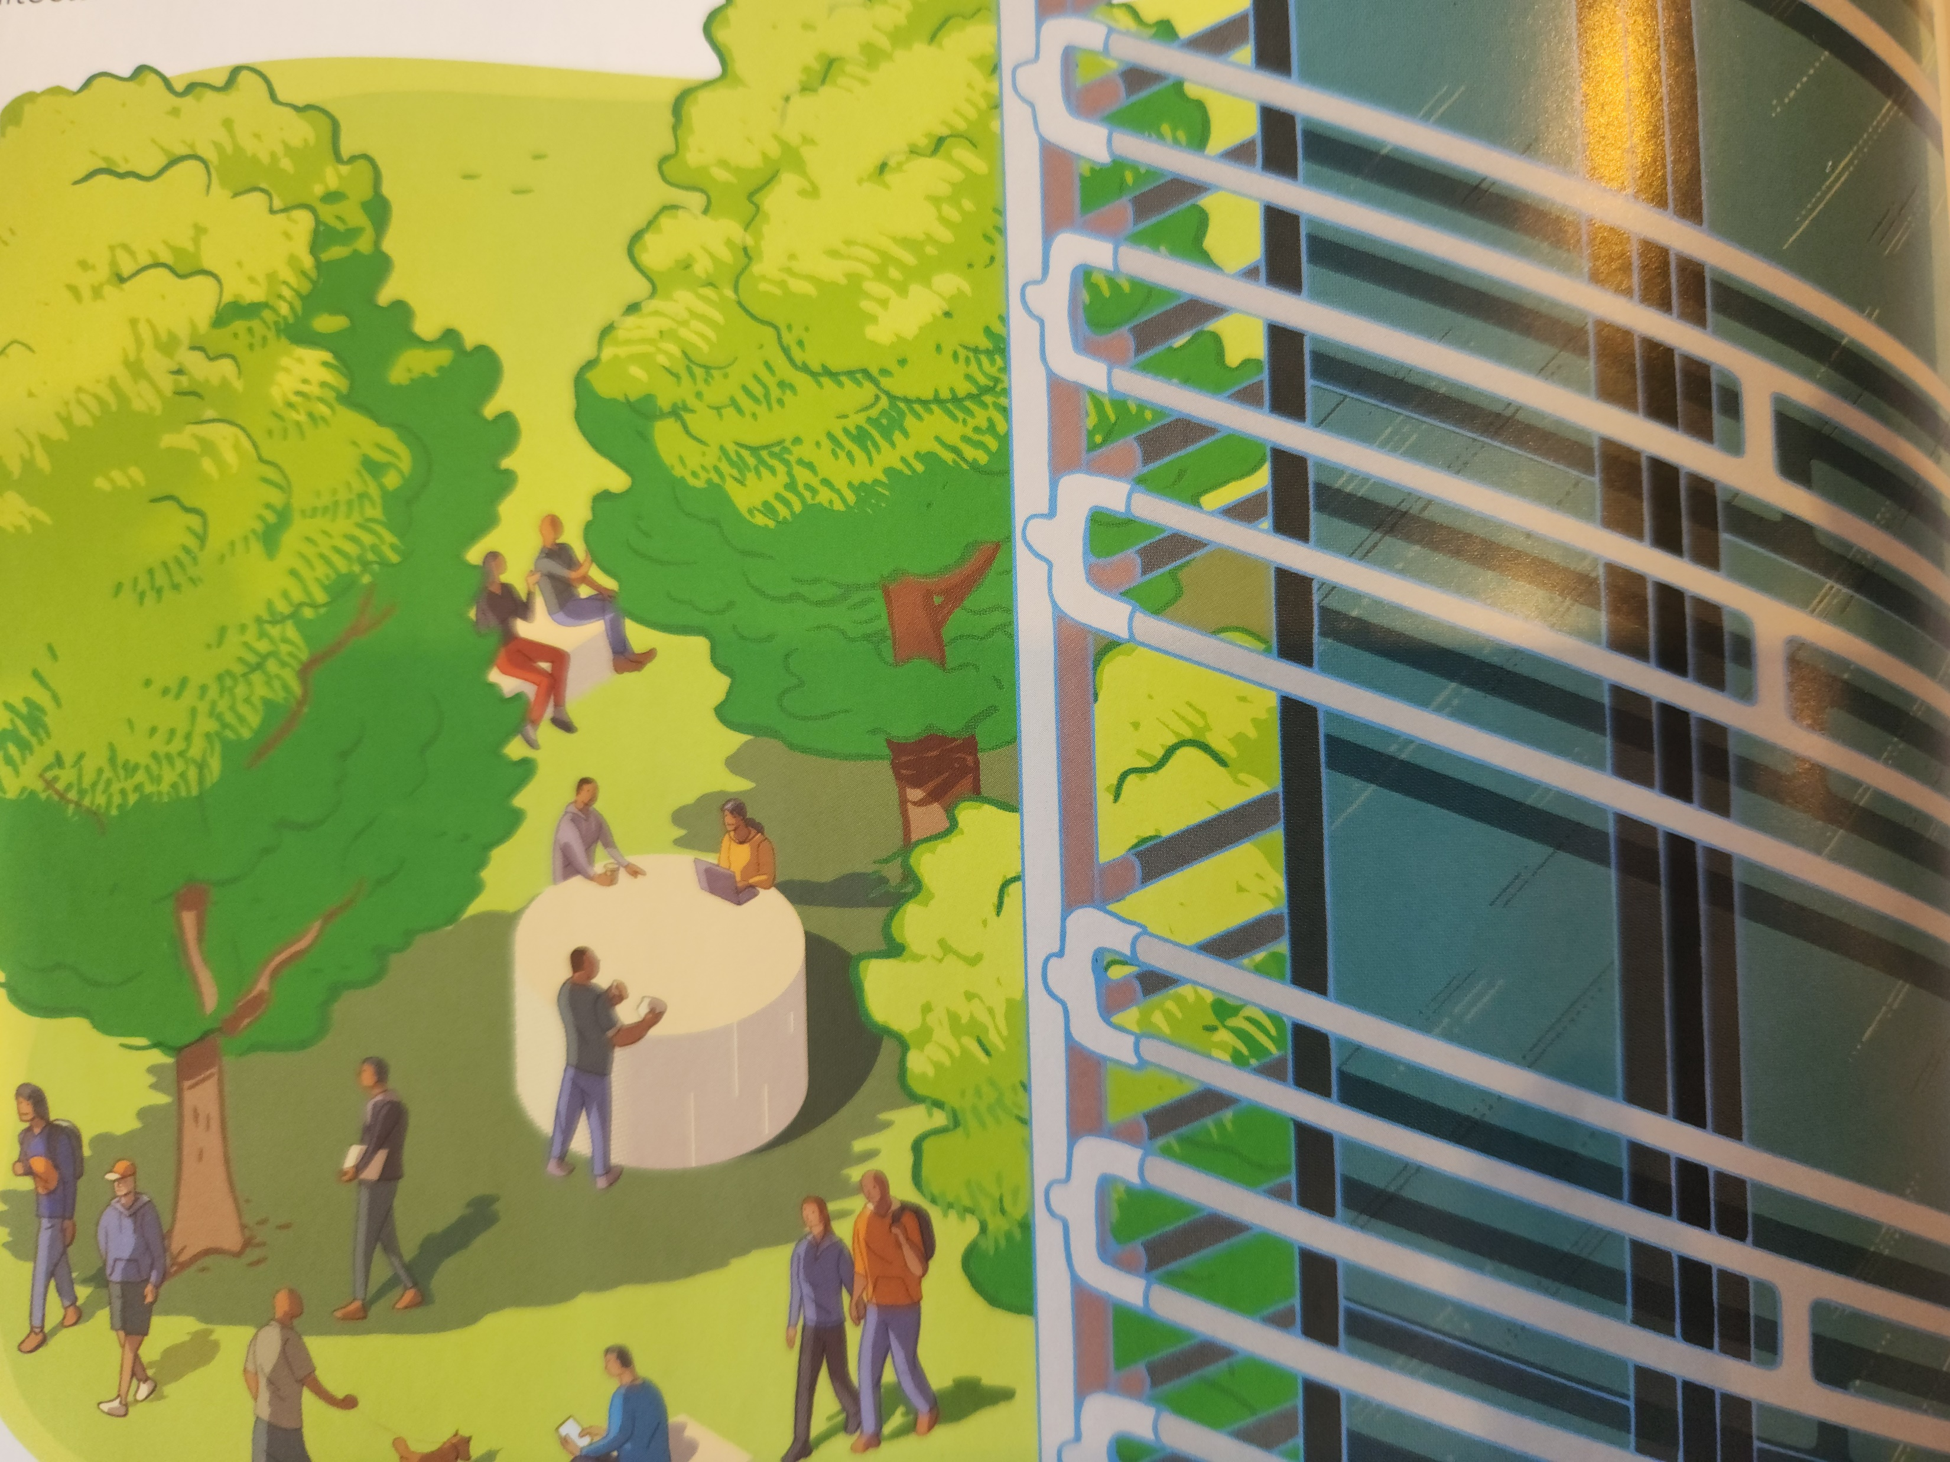
What ideas did science and nature provide for keeping this building cool?
10

Slide 32
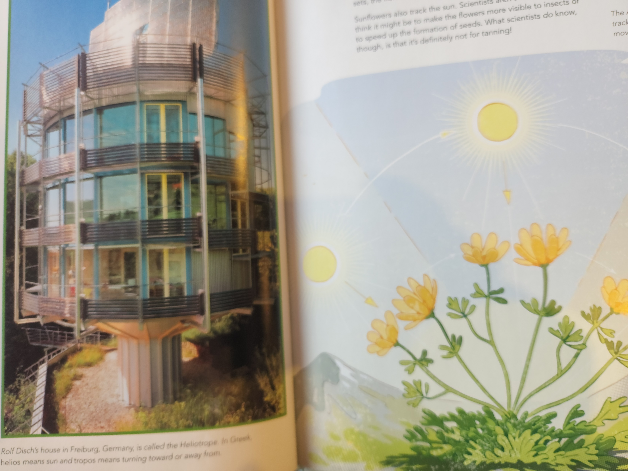
How is this building like a flower?
18

Slide 33
A Rare Look Inside Tesla’s “Gigafactory”
https://www.npr.org/sections/alltechconsidered/2016/04/18/474346868/a-rare-look-inside-the-gigafactory-tesla-hopes-will-revolutionize-energy-use

Slide 34
Business Ethics Through Film
Monster’s Inc.

Slide 35
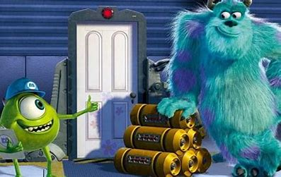
Scare City Power Company
Sustainability Superheroes Use Energy Wisely! Lesson plans and resources for teaching sustainable energy: Energy (sustainabilitysuperheroes.org)

Slide 36
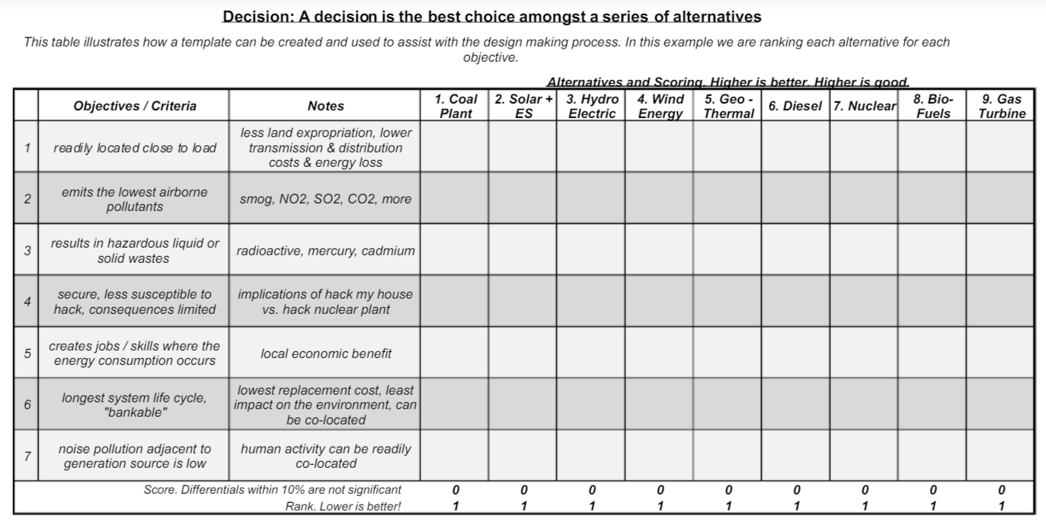

Slide 37
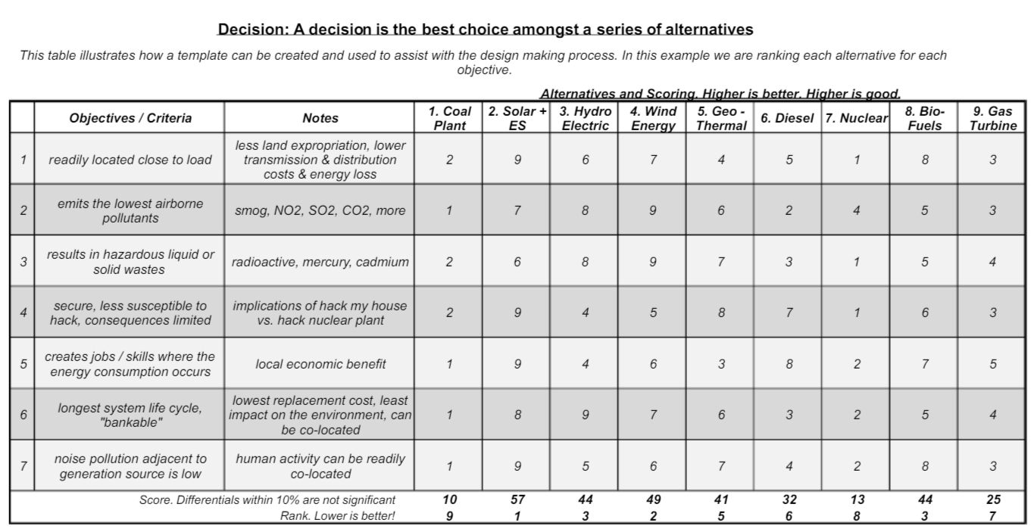

Slide 42
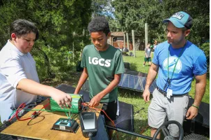
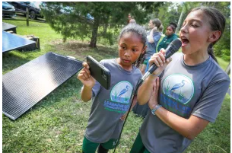
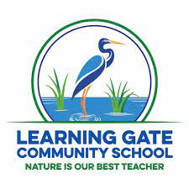
LEARNING GATE COMMUNITY SCHOOL GETS TO WORK
https://lakerlutznews.com/lln/2022/10/108060/

Slide 43
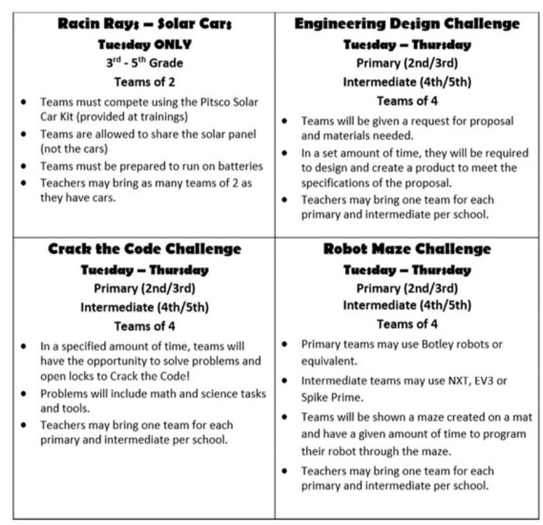
Racin Rays... Join us for Training
December 1, 2022
Bing Elementary 3:30-6:30
Course Number 111605
Cars will be provided
STEMPalooza
January 31, 2023- February 2, 2023
MOSI
Updates on SMATHSMARTS.com
Contact:
Margaret.Berridge@hcps.net

Slide 44
Link to HCPS 22-23 Elementary STEM Fair Information:
2022-2023 HRSF K-5 Timeline.pdf

Slide 47
Internet Infrastructure in the US
United States has the second highest broadband costs. The Bipartisan Infrastructure Law will deliver $65 billion to help ensure that every American has access to reliable high-speed internet through investment in broadband infrastructure deployment. The legislation will also help lower prices for internet service and help close the digital divide, so that more Americans can afford internet access.

Slide 48
Target 9.C: Universal access to information and communications technology
Population using the internet
Mobile Phone subscriptions
https://sdg-tracker.org/infrastructure-industrialization#targets

Slide 49
Improve Infrastructure
Which type of infrastructure would you like to improve?
What are some problems with that type of infrastructure that you would like to solve?
What is already being done to
solve this problem?
What will you call your business?
E3: Economy - Energy - Environment | US EPA

Slide 50
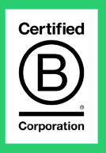
What is a Certified B Corporation?
Businesses that nonprofit B Lab grade each year to ensure they're meeting the highest standards of social and environmental performance, public transparency, and legal accountability to balance profit and purpose.
They strive to reduce inequality; lower poverty levels; and create a healthier environment, stronger communities, and purposeful jobs.
Find a B Corp (bcorporation.net)

Slide 52
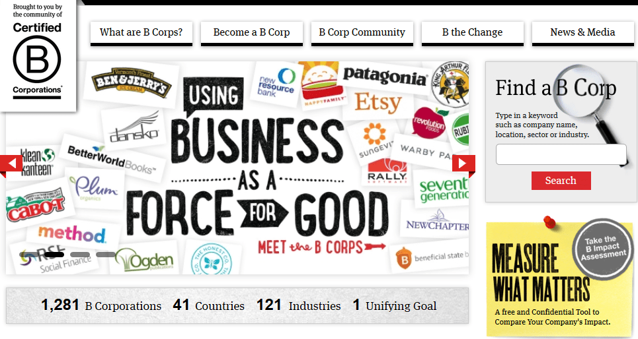
19 Ethical B Corps Making Great Products: Allbirds, Prose & More (insider.com)

Slide 53
To pass their impact assessment and become a B Corp, businesses have to show that they treat employees, the environment, and the local community well. Here are some examples of things that B Corps might do…
– Pay their employees a Living Wage at minimum, to ensure they have enough money to cover all the everyday needs of themselves and their families.
– Offer their employees extra training opportunities, to help them learn and develop.
B Corporations:
– Care about the environment as much as they care about profit, and run the company openly and honestly, so that everyone can see where money is being spent.
– Record their carbon footprint, so they can start trying to reduce it.
– Act sustainably by reducing their waste, reusing whatever they can.
– Work with partners and suppliers who treat their employees ethically
- Terms and who also consider the environment in their business plans.
– Listen to feedback from their customers and act on this accordingly.
– Create products that help save water, reduce emissions, or work towards social problems by providing access to education or reducing food poverty.
– Give back to their local community by giving employees volunteer days or by donating money to charity.
As you can see, there are lots of things to consider! B Corps have to think hard about the impact of their business, and their influence on everything and everyone around them.

Slide 54
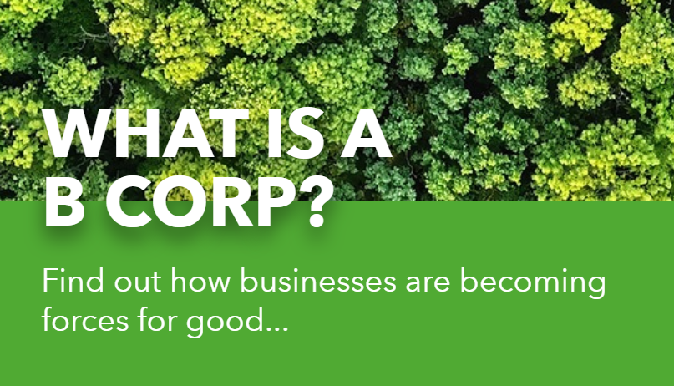
Improve Infrastructure and create a B Corporation to carry out your plan.
Design a way to improve infrastructure of an urban, suburban, or rural area.
Explain how it will improve people’s lives and the environment.
Create a plan to make your company into a B Corporation.
What is a B Corp? - National Geographic Kids (natgeokids.com)

Slide 55
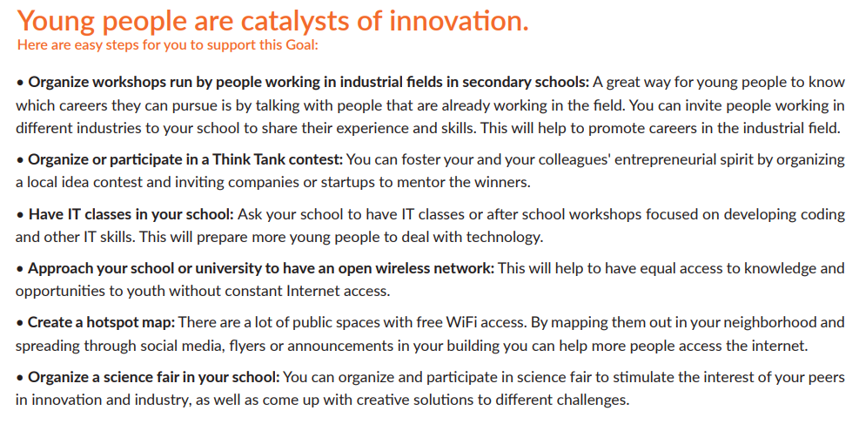

Slide 56
Thank you!
Christine Angel Danger
Kara Windish

