Slide 1
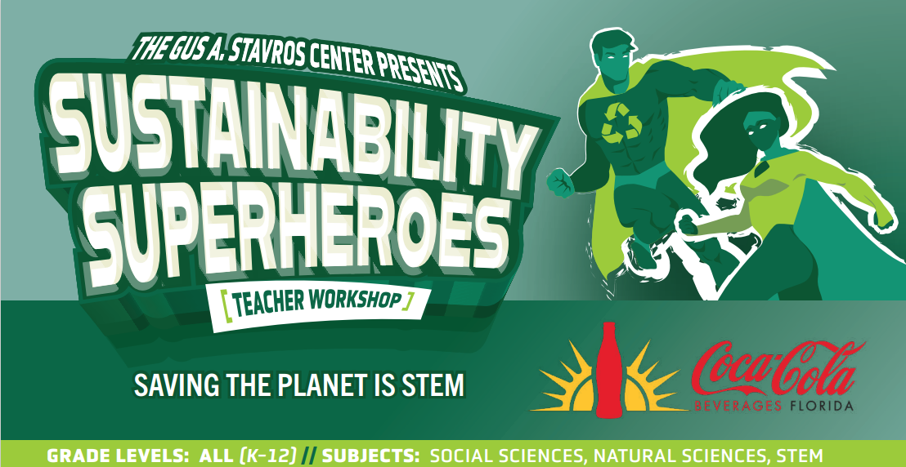

Slide 2
Saving the World is S.T.E.M.
Christine Angel Danger M. Ed.
Master Teacher Mentor
University of South Florida
Stavros Center

Slide 4
Saving the World is S.T.E.M.
Notes:
Housekeeping – points, stipends, bathrooms, snacks…

Slide 5
Why should we make sure our students are getting STEM Educations?
Write ideas on sticky notes.
One idea to a sticky.
Put sticky ideas on the chart.
Notes:
Revisit and add to this

Slide 6
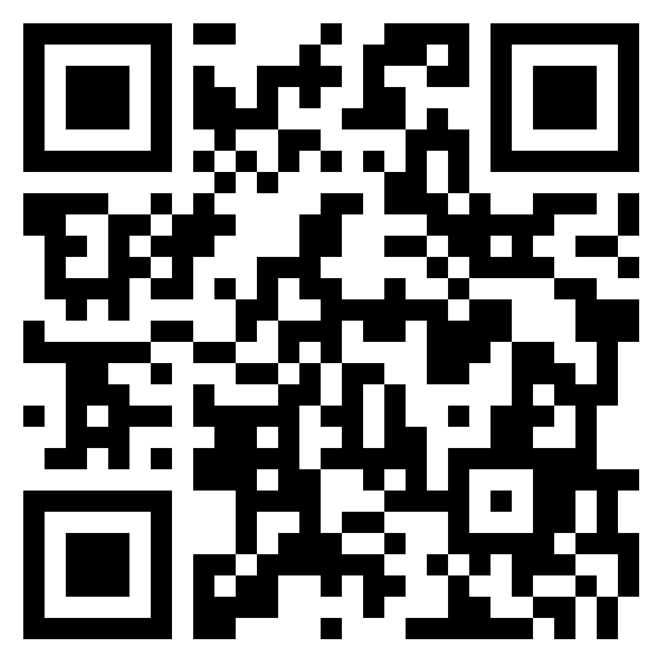
Padlet Scan with your phone and join the conversation.
Why should we make sure our students are getting STEM Educations?
Why should we make sure our students are getting STEM Educations? (padlet.com)

Slide 7
Welcome Superhero Trainers!
You are gathered here today to prepare the future superheroes for the most important mission ever:
Saving the World!
The world is facing many problems. Your superhero trainees will need the special superpowers you give them in order to solve these problems and save the world.
Let’s Get Started!!

Slide 8
The future of our planet is in the hands of the STEM workforce. For saving lives and saving ecosystems. For feeding the world and addressing climate change. And yet, the shortage of STEM talent needed to address these issues is profound. How will the next generation rise to face the world’s challenges if not through STEM?
We will explore the future through the lens of STEM. The global challenges in need of attention, opportunities for innovation and the STEM pathways to making the world a better place. As the teachers of future superheroes, our mission is to expose, engage and inspire the next generation of STEM talent to consider the pathways and opportunities that will truly make a difference in the world; because pathways to STEM education and careers are available to all people, and saving the planet is the responsibility of the human race.

Slide 9
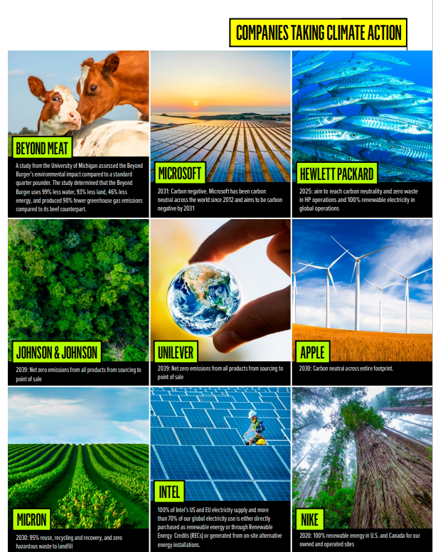
75% of Millennials are willing to pay more for an environmentally sustainable product, compared to 63% of Gen Z, 64% of Gen X, and 57% of Boomers.
77% of Americans are concerned about the environmental impact of products they buy.
More than half (56%) of Americans would use a credit card that could calculate and offset the environmental footprint of products purchased.
76% of Americans would switch their preferred packaged goods brand if they were offsetting carbon emissions. 74% would switch gasoline brands in the same situation.
-GreenPrint’s Business of Sustainability Index

Slide 10
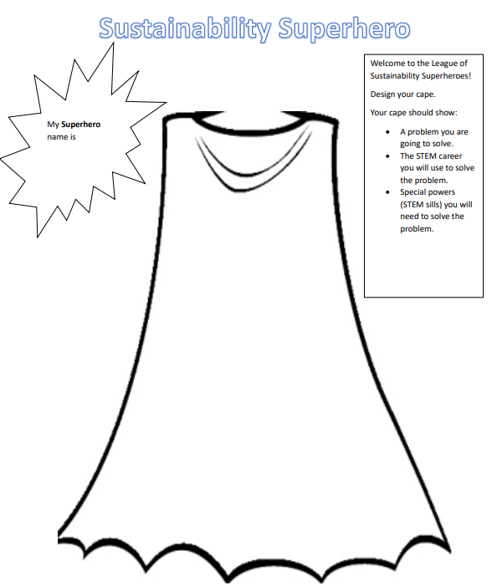
Design Your Cape
Prepare to design your SUPERHERO cape.
We will explore ways that you can save the world. After you choose what type of superhero you will become you will design your cape.
You are going to play the role of a Superhero in Training.
We will explore the world’s problems
As a Superhero Trainee you will first need to choose a problem that you want to solve.

Slide 11
Notes:
Intro video while we eat

Slide 12
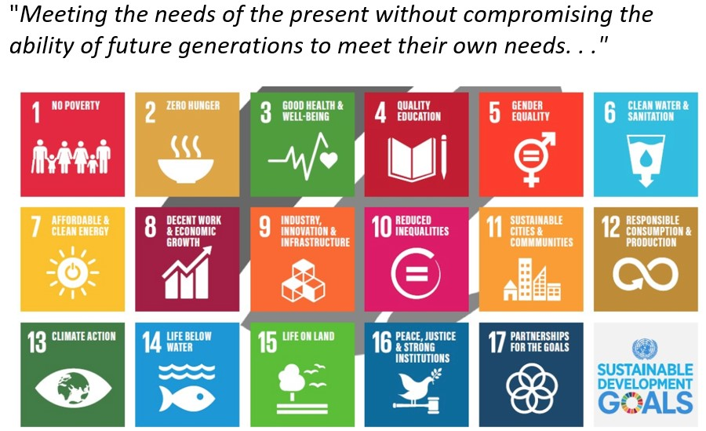
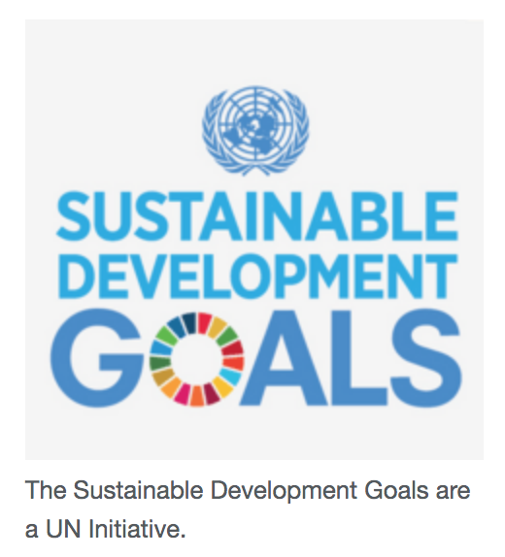
The Sustainable Development Goals (SDGs) are a set of targets relating to future international development. They are created by the United Nations and promoted as the Goals for Global Sustainable Development.
https://kids.kiddle.co/Sustainable_Development_Goals

Slide 13
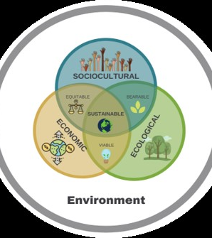
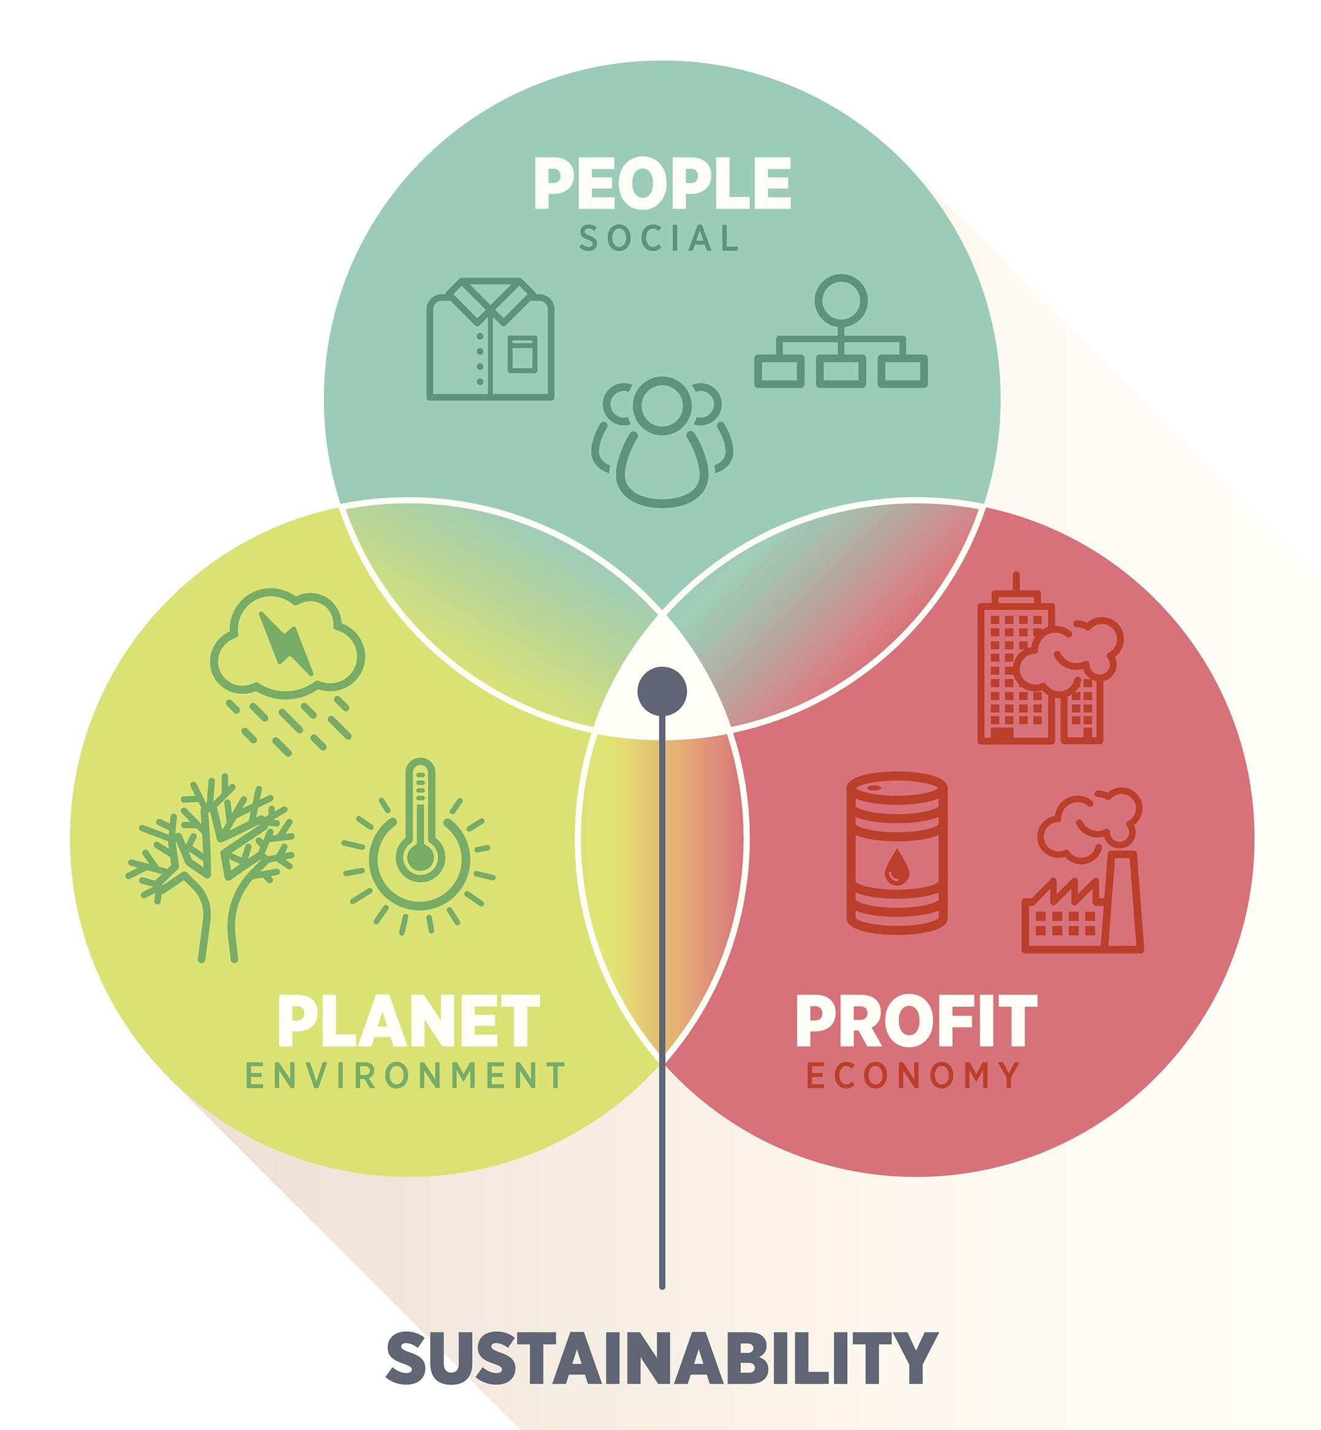

Slide 14
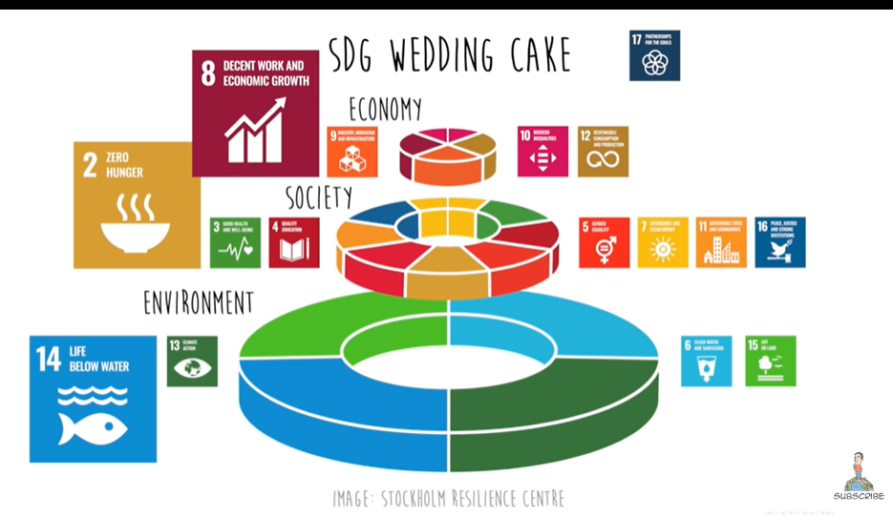
Notes:
The SDGs are interconnected. The Stockholm resilience center recommended organizing the SDGs into 3 layers: the environment, society, and the economy. We also call this people, planet, and profit. Environment is the base that supports society which supports the economy. This is known as the triple bottom line or the three pillars of sustainability. Sustainability is about meeting our present needs without harming future generations. There are 4 goals about the environment, 7 goals about society, and 4 goals about the economy. We cannot achieve decent economic growth or even food security without first taking care of our oceans, fresh water supply, land, and greenhouse gas emissions.

Slide 15
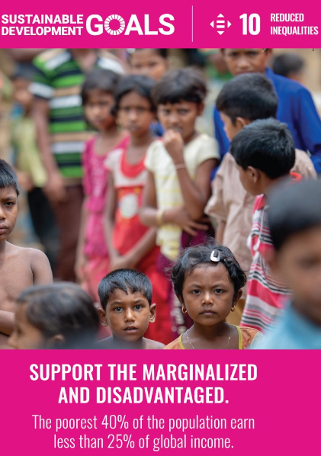
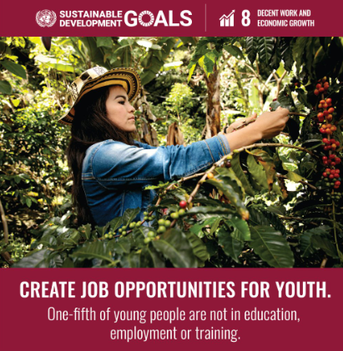
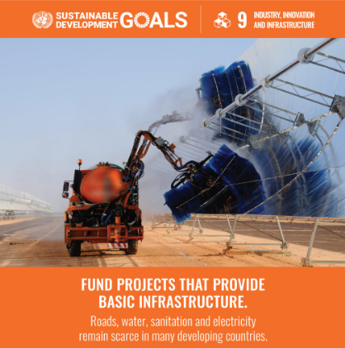
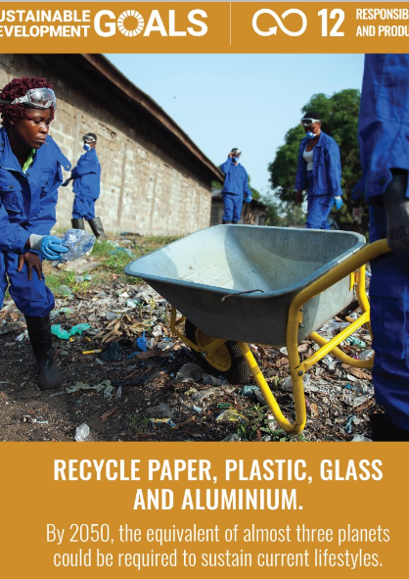
Economy

Slide 16
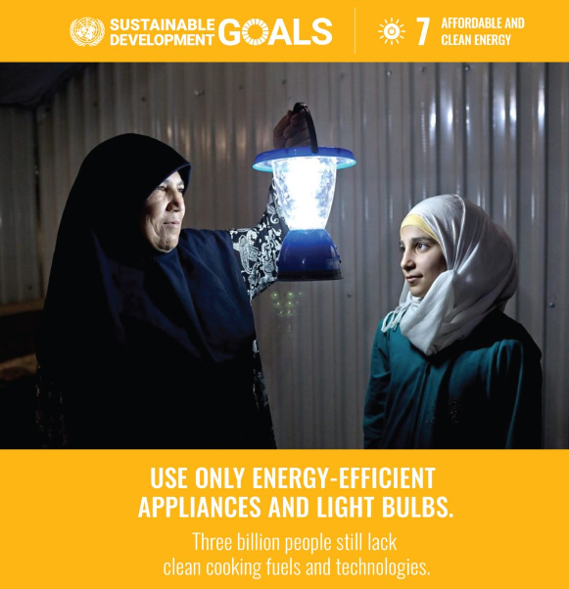
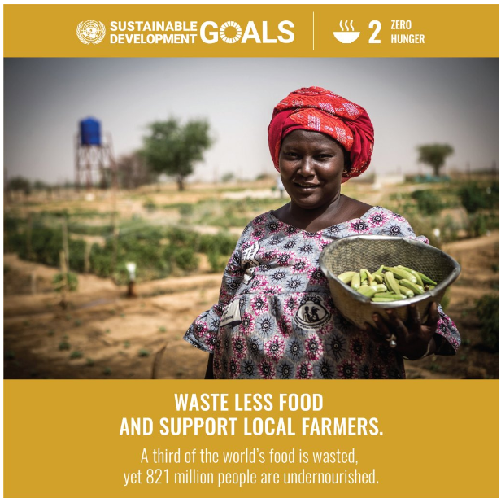
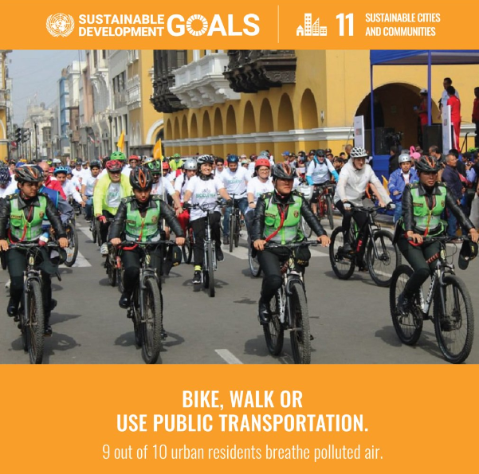
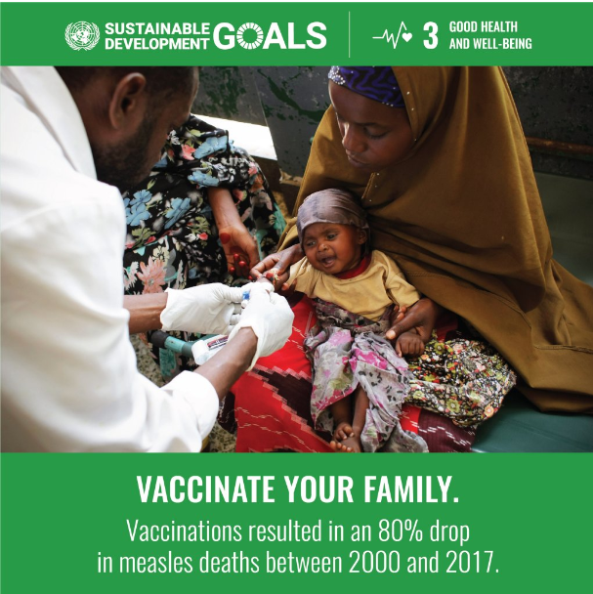
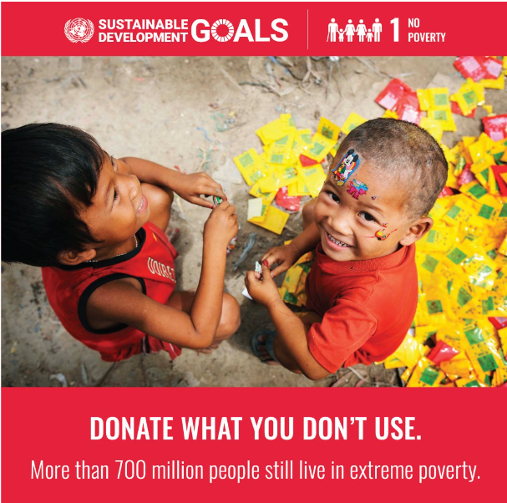
Society

Slide 17
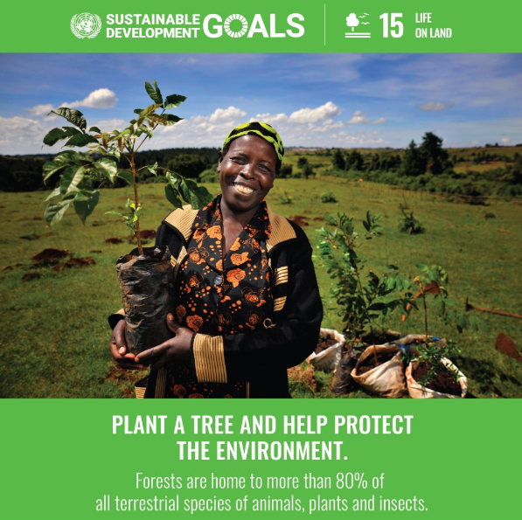
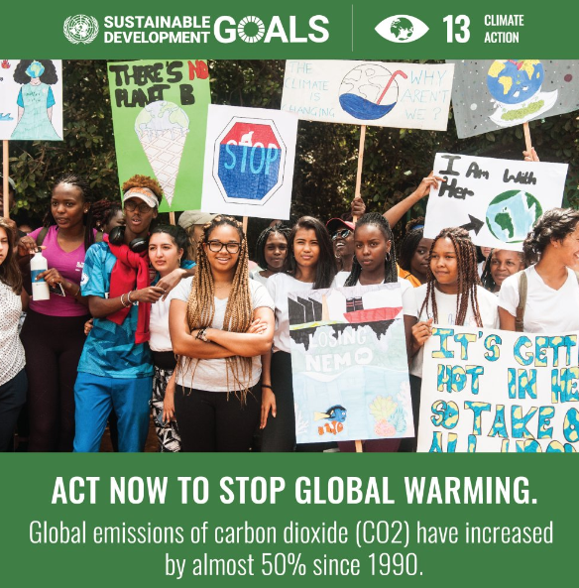
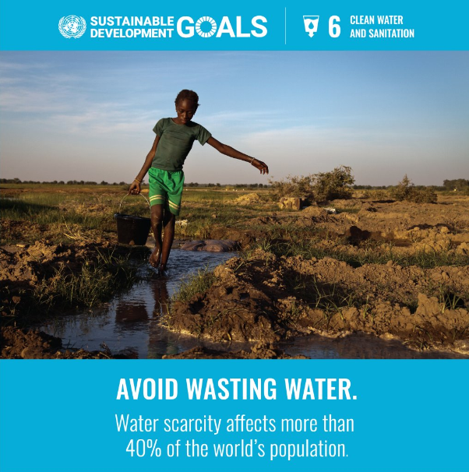
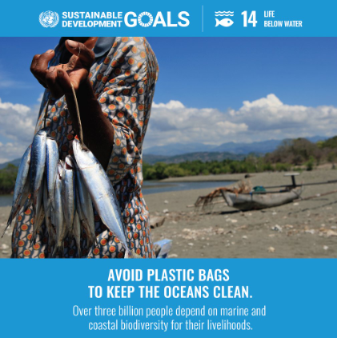
Environment

Slide 18
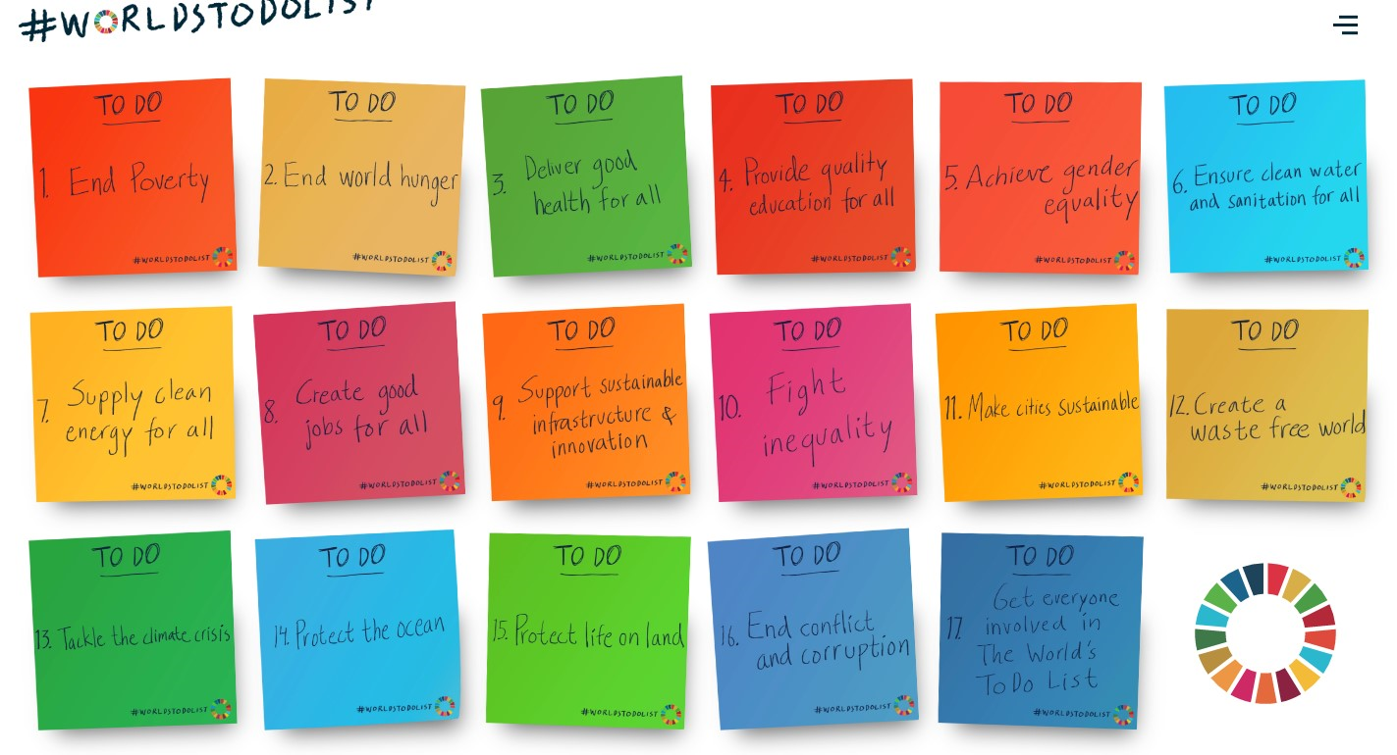
Notes:
Which problem do you want to solve?

Slide 20
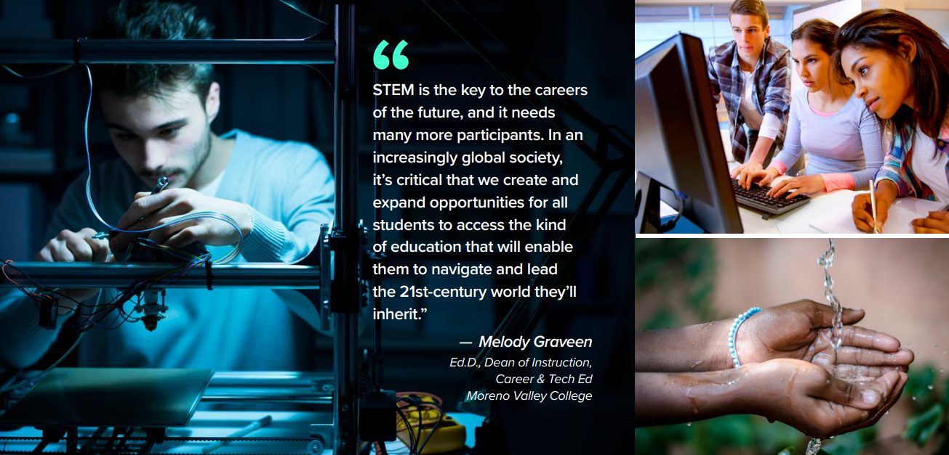

Slide 21
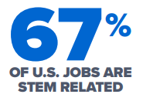
THE FUTURE IS STEM
Statistics tell us that there are more than a million STEM job vacancies in the STEM industry while at the same time only about 16% of college students graduate in the STEM fields or subjects. Demand for STEM jobs increased dramatically over the past 20 years. STEM is the key to the careers of the future, and it needs many more participants.

Slide 22
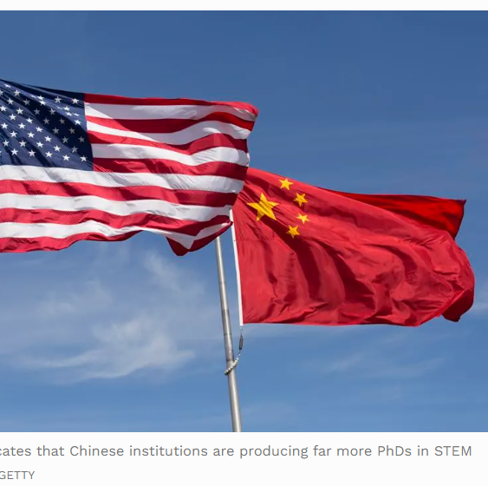
U.S. Universities Fall Further Behind China In Production Of STEM PhDs (forbes.com)
Based on current enrollment patterns, the report projects that by 2025 China’s yearly STEM PhD graduates (77,179) will nearly double those in the United States (39,959).
40% of students working toward STEM degrees in US universities are foreign students, most of whom will return to their home countries.

Slide 23
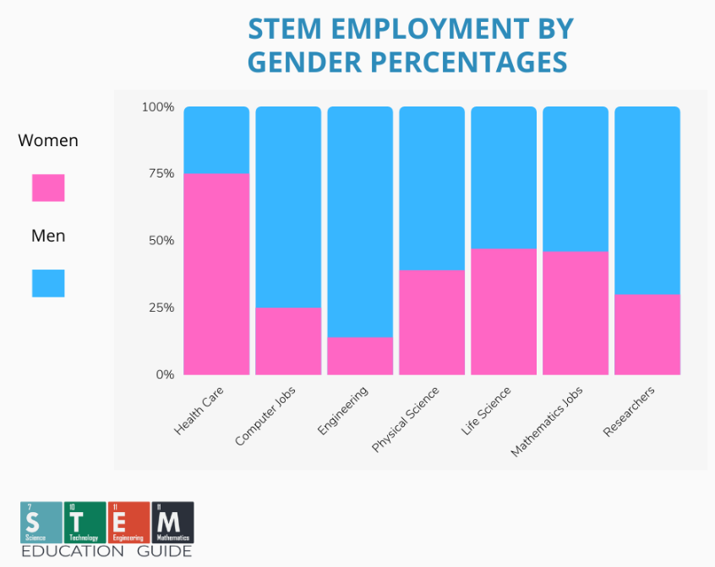
STEM Education Statistics in 2024 - STEM Education Guide

Slide 24
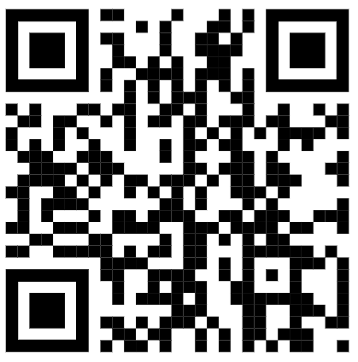
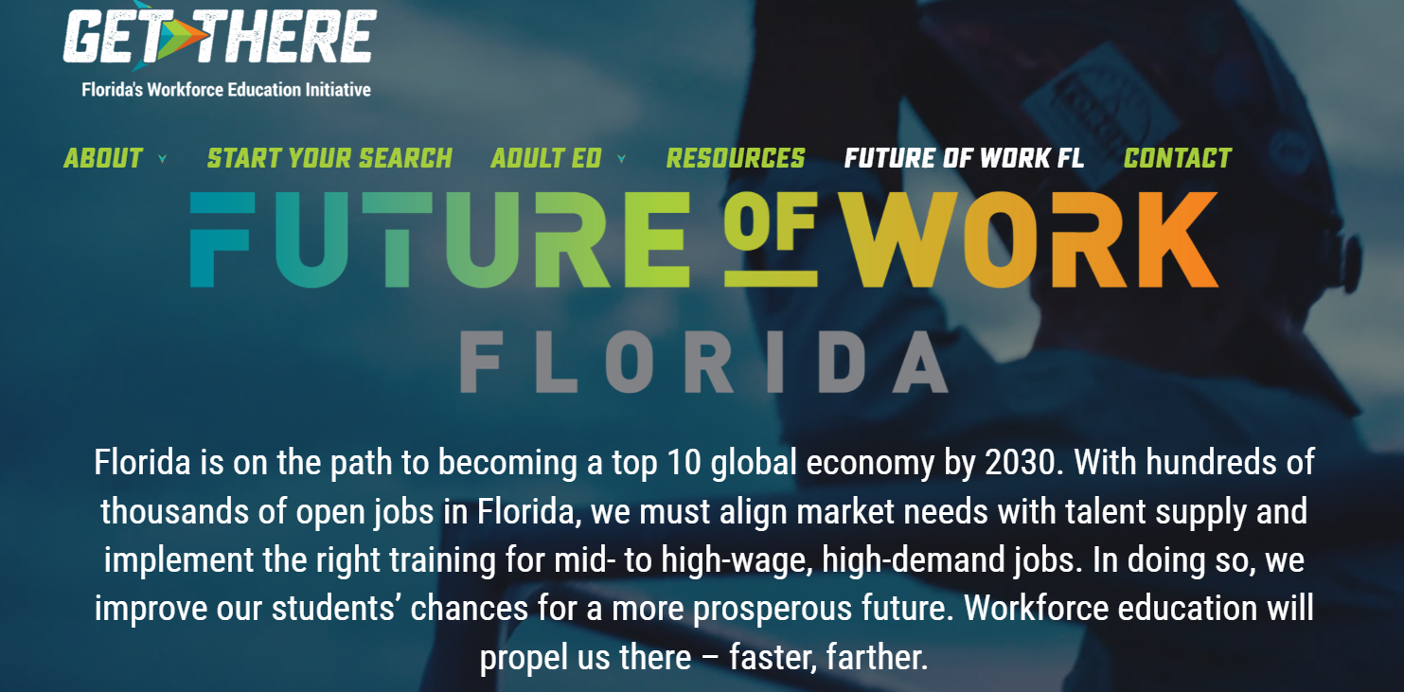
Future of Work | Get There FL

Slide 25
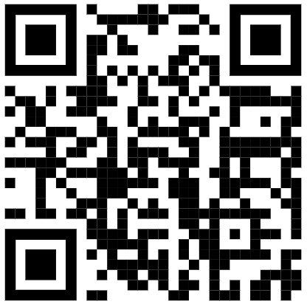
Quiz
Australia's top FREE student STEM careers guides - Careers With STEM

Slide 26
A green transition, including a shift to renewable energy, the manufacturing of electric vehicles and construction of energy-efficient buildings, will create 24 million jobs by 2030, far more than the 6 million that could be lost.
By 2030, among 163 economic sectors, only 14 are predicted to have employment losses of more than 10,000 jobs worldwide, and only two, refining and extracting petroleum, show losses of 1 million or more jobs.
If cities in 21 emerging markets prioritize climate-smart growth in their recovery plans, they stand to gain as much as $7 trillion in investments and could create 144 million new jobs by 2030.
Jobs created by the renewable energy industry could total 42 million worldwide by 2050 – more than enough to offset jobs lost in fossil fuel industries, with more people able to find employment in manufacturing, installing, operating and maintaining renewable energy systems.
Jobs in renewable energy reached 11.5 million globally in 2019.
A circular economy, based on the principles of reduce, reuse and recycle, could create around 6 million new jobs in recycling and waste management.
Solar photovoltaic industries created some 3.8 million jobs in 2019. Other large generators of new jobs in renewable energy were biofuels at 2.5 million jobs, hydropower at close to 2 million jobs and wind at 1.2 million jobs.
Jobs in renewables are more gender balanced than in the broader energy field, with women holding 32 per cent of the total in 2019. In fossil fuels, they have only 21 per cent.
Key Findings | United Nations

Slide 27
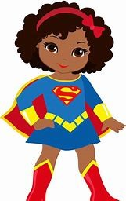
Padlet Scan with your phone and add to the conversation.
Why should we make sure our students are getting STEM Educations?
Why should we make sure our students are getting STEM Educations? (padlet.com)

Slide 28
Problem:
Manufacturing of many products is polluting our air and water.
Solution:
Become a chemical engineer
average salary $91,581 per year
As of 9/23
What does a chemical engineer do?
Chemical engineers use math and science to address problems involving chemicals, food, fuel and other products. They develop manufacturing equipment, materials and processes and oversee production methods. Chemical engineers commonly perform the following tasks:
Collaborating with engineering team
Researching existing manufacturing processes: Chemical engineers meet with teams or clients to determine manufacturing needs and goals. They research existing processes and consider methods for improving manufacturing productivity, lowering costs or meeting other objectives.
Designing new equipment and processes: After conducting research, chemical engineers use chemical reactions to develop new ways to separate the basic components of elements like liquids and gases. They also design and use equipment to perform these processes. Testing and troubleshooting manufacturing designs: Once they complete the research and development phases, chemical engineers build prototypes and test their designs. They resolve problems with the processes or equipment and develop modified designs.
What Does a Chemical Engineer Do? (With Average Salary) | Indeed.com

Slide 29
40 Careers in STEM (Plus Average Salary And Job Duties)
The science, technology, engineering and mathematics (STEM) field has numerous career options, including lucrative opportunities in medicine, research, robotics, biochemistry, aeronautics and other in-demand disciplines. Reviewing the details of some potential STEM careers can help you determine which best aligns with your skill set and interests.
In this article, we explore 40 different careers in STEM, including their national average salaries and their primary job duties.
40 Careers in STEM (Plus Average Salary And Job Duties) | Indeed.com

Slide 30
What kind of superhero will you be? Explore STEM careers Which STEM career will solve the problem you chose to solve?
Exploration Options:
Watch the video about outdoor careers.
Use the QR code.
Take a walk and read the posters.
Read the text on your table.
Record Information:
What career will turn you into the superhero that can solve the problem you chose?
What skills (superpowers) will you need?
40 Careers in STEM (Plus Average Salary And Job Duties) | Indeed.com

Slide 31
Design Your Cape
You are going to play the role of a Superhero in Training.
We will explore the world’s problems
As a Superhero Trainee you will first need to choose a problem that you want to solve.

Slide 32
Search for a S.T.E.M. Career that will solve the problem you identified.
Try These 5 Adventurous Outdoor Jobs if You Just Can't Bear a Desk Job (careerswithstem.com.au)

Slide 33
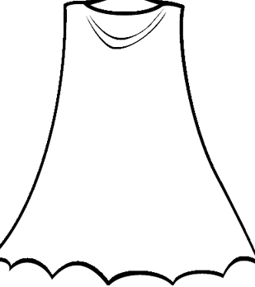
Share Your Cape
Make sure your cape includes:
A problem you are going to solve.
The STEM career you will use to solve the problem.
Special powers (STEM sills) you will need to solve the problem.

Slide 34
Text Resources
Careers with Science by Refraction Media – Issuu
What's that STEM job? Download free Careers with STEM Job Kits
Saving the Planet is STEM - STEMconnector

Slide 35
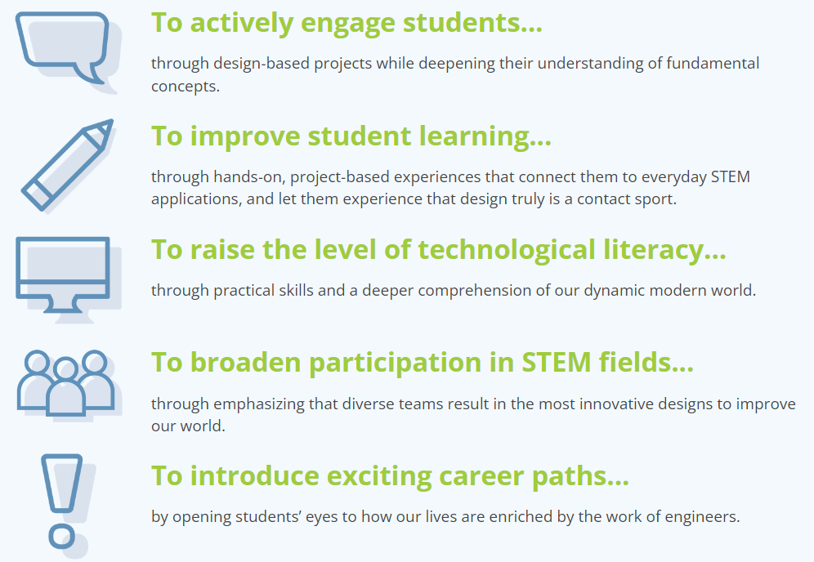
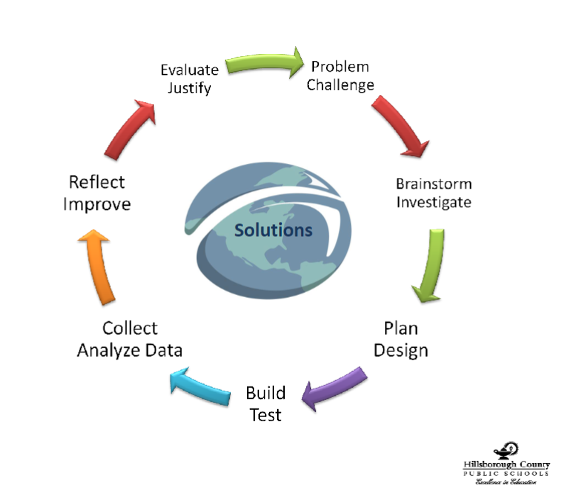
Why Teach Engineering in K-12?
Why Teach Engineering in K-12? - TeachEngineering

Slide 38
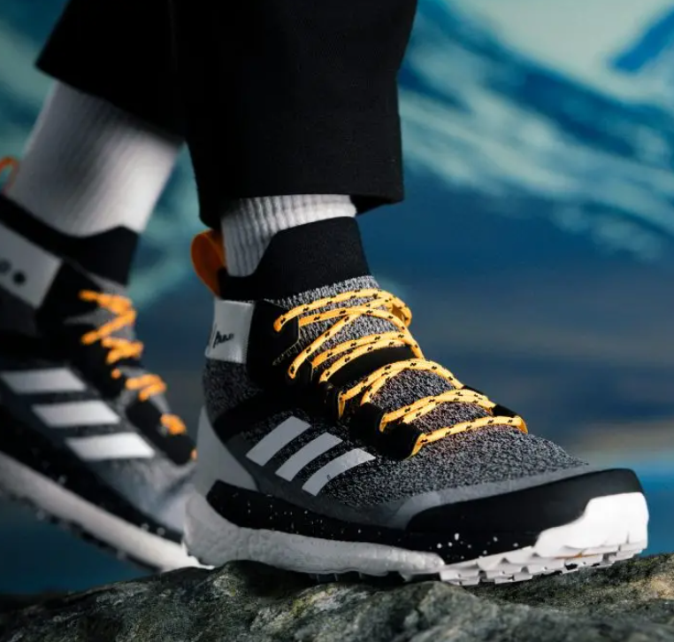
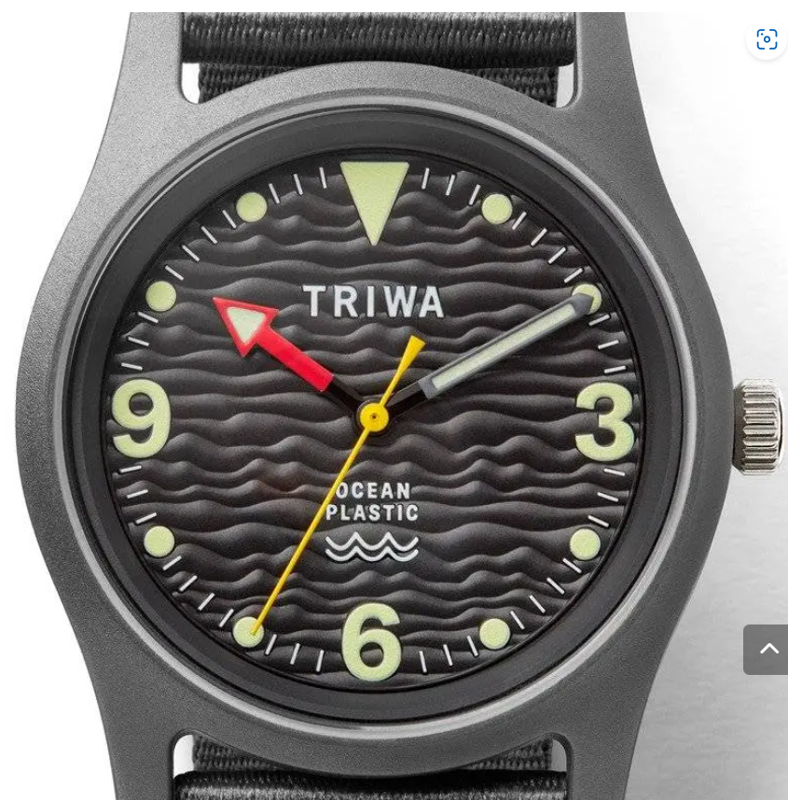
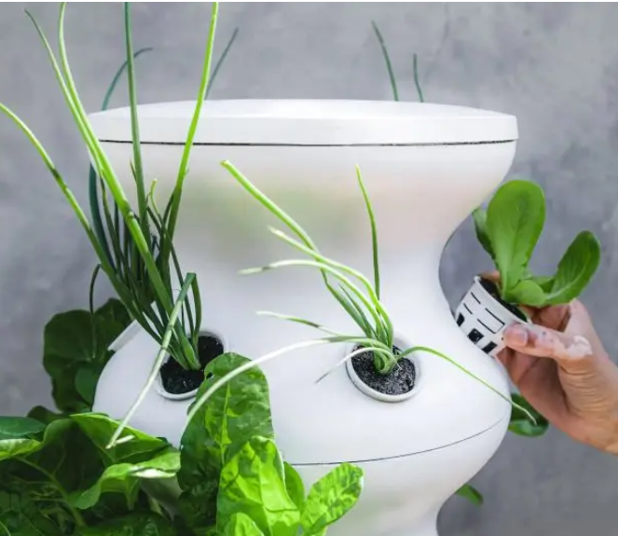
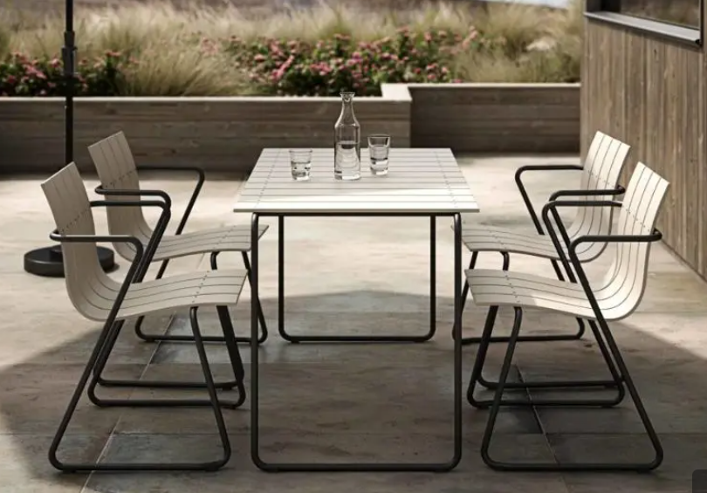
13 Stunning Recycled Ocean Plastic Products (lazyenvironmentalist.com)
Notes:
Efforts underway to make recycled ocean plastic products are vital. According to National Geographic, over 5 Trillion pieces of plastic debris are in our oceans. That’s because humanity is both addicted to plastic and lousy at recycling it. As the chart indicates below, globally only 20% of plastic is recycled.
A study released this past spring portrays a situation that will get worse unless we concertedly work to make it better. That’s because by 2040 more than 1.4 Billion tons of plastic will flow into our oceans. Currently, we’re at a rate of about 8 million tons per year. For some context, that’s like a New York City garbage truck full of plastic garbage backing up to New York Harbor and dumping its contents into the ocean-bound waters every minute of every day for the entire year.
Plastic is harmful to marine life and potentially to human life. Plastic is also a climate issue because it’s made directly from fossil fuels (ie. coal, oil, and natural gas) through an energy-intensive manufacturing process that happens to also burn massive amounts of fossil fuels. The resulting climate emissions are strikingly enormous and growing (see what’s happening in Texas).
We can’t kick our fossil fuels habit without kicking our plastic habit too.
Plastic is cheap and durable, which is why we depend on it. The silver lining is that its durability is what enables companies to recycle it into the raw material for new high-quality goods.
The stories behind these brands are deeply inspiring. Their products embody humanity’s vast capacity for environmental problem-solving.
Here are 12 sustainable products made from recycled ocean plastic.

Slide 39
Engineering Design
Plastic Upcycling Challenge
Objective: In this engineering design challenge, your goal is to repurpose discarded plastic materials to create something useful or artistic. By doing this, you'll learn about recycling and the importance of reducing plastic waste.
This engineering design challenge not only encourages creativity and problem-solving but also instills a sense of environmental responsibility by demonstrating how discarded plastics can be transformed into something useful or beautiful instead of ending up in landfills or polluting the environment.
Environmental Science and Sustainability: As concerns about climate change and sustainability grow, expertise in environmental science, renewable energy, and green technologies will be in demand.
Soft Skills: In addition to technical skills, soft skills like problem-solving, critical thinking, communication, and adaptability will continue to be highly valued as they are essential for collaboration and creativity.

Slide 40
What would you make out of ocean plastics?
Write an advertisement or create a video explaining why people should buy your product.
Notes:
Identify the Problem or Need
Research and Gather Information
Generate Ideas and Brainstorm
Develop Concepts and Designs
Create Prototypes
Test and Evaluate
Iterate and Refine
Finalize the Design
Prepare for Production or Implementation
Implement and Build
Test in Real-World Conditions
Evaluate and Gather Feedback
Make Adjustments
Document the Design
Communicate Results and Solutions
Reflect and Learn

Slide 41
Problem: Natural disasters like floods and fires cause people to have to leave their homes for safer locations. Many people will not leave because they have nowhere to take their pets.
What solution did they create?

Slide 42
Animal Sanctuary Engineering Design Challenge
This Engineering Design Challenge is a hands-on investigation in both math and science. Students will be able to use prior knowledge and problem-solving skills to solve non-routine problems and real-world situations, using mathematical and scientific models. It is a great way to introduce your students to real-world problem solving. Students will be engaged in hands-on learning by designing and creating an enclosure for animals. Both math and science standards have been incorporated for an integrated lesson.

Slide 43
Future engineers, today you will be designing an animal enclosure for a local animal sanctuary. Animal Crackers will represent the animals in your task. You will have the following materials to choose from when planning and constructing your animal enclosure: large and small marshmallows, toothpicks, rulers, engineering consultations (where you can ask an engineer up to 3 questions). There are also criteria ("must haves") and constraints ("can't dos") for this challenge. Your criteria and constraints will be written on your paper, but I will also read them now.
Criteria:
Your enclosure must have a door that opens and closes.
Your enclosure must be a 3-D shape that you can name and justify.
Your enclosure must hold more than one animal with enough space for both animals.
Your enclosure must be at least 6 inches tall.
Your enclosure must be able to stand on its own.
Spend as little money as you can to achieve your goal.
Constraints:
The enclosure cannot be created with materials that are not found on the price list.
You cannot split the marshmallows (marshmallows must be used as whole items).
You cannot re-visit the store after your purchase is made; there are no returns.
Materials
Large marshmallows
Small marshmallows
Toothpicks
Rulers (with both inches and centimeters)
Animal crackers

Slide 44
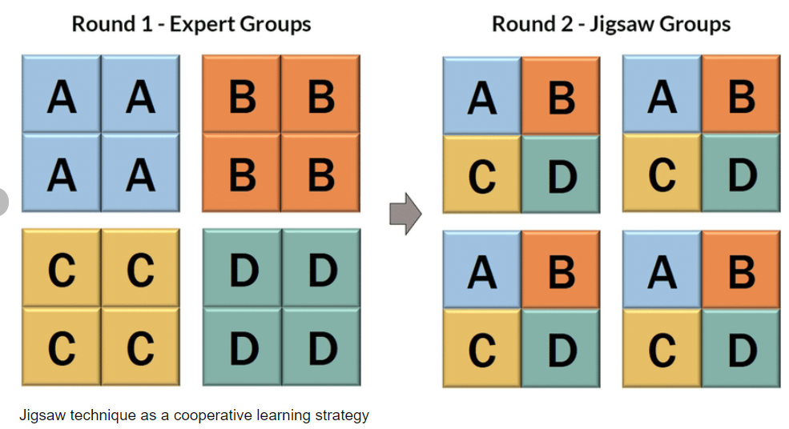

Slide 45
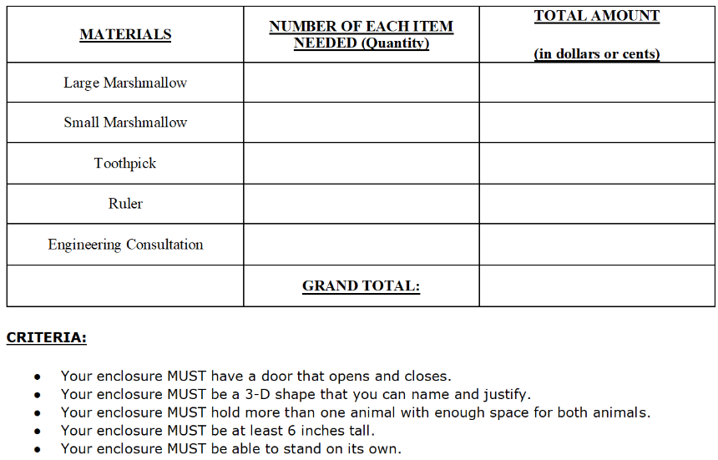
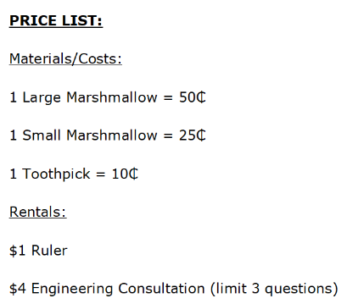

Slide 46
Guiding Questions: What are the guiding questions for this lesson?
Guiding questions can be used for teams or the entire class and are meant as an educative type of assessment for students to think about their solutions or progress during or following the Engineering Design Challenge. Guiding questions are stated clearly and elicit high level thinking by students.
What are the strengths and weaknesses of each type of design?
If the situation were slightly different, would your design type need to change?
Who has a different strategy or procedure?
How is your strategy similar or different from other teams?
Do you agree or disagree with your classmates' ideas? Why or why not?
Are there other constraints we are not considering?
What is another reason that a business may want an animal enclosure?
How do you think your team is going to "think like engineers" for this task?

Slide 47
Learning Objectives: What will students know and be able to do as a result of this lesson?
The student will be able to use prior knowledge and problem solving skills to solve non-routine problems and real-world situations, using mathematical and scientific models.
The student will be able to solve word problems involving dollar bills, quarters, dimes, nickels, and pennies, using dollar and cent symbols appropriately.
Students will be able to recognize and draw shapes having specified attributes.

Slide 48
Honey Bee Human--an Engineering Design Challenge
This Engineering Design Challenge is intended to help students apply the concepts of pollination from SC.4.L.16.1 as they design an apparatus that will pollinate a field. It is not intended as an initial introduction to this benchmark.
In this Engineering Design Challenge, students will make a 2-dimensional model (a graphic illustration) rather than build a prototype.

Slide 49
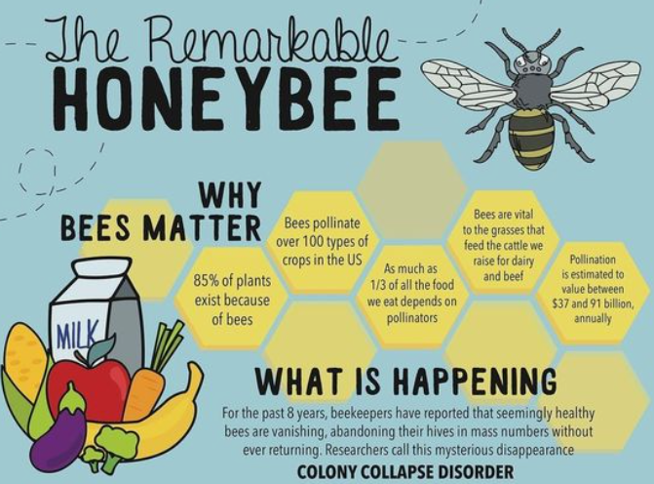

Slide 50
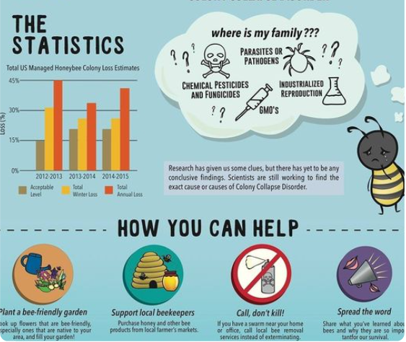
Honeybee Mystery--a Comprehension Instructional Sequence Lesson Plan
In this lesson tied to academic standards for English/Language Arts, students receive support as they read a complex informational text about honeybees. The teacher facilitates a close reading and writing a response-to-text.
Honeybee Mystery--a Comprehension Instructional Sequence Lesson Plan In this lesson tied to academic ... (cpalms.org)

Slide 51
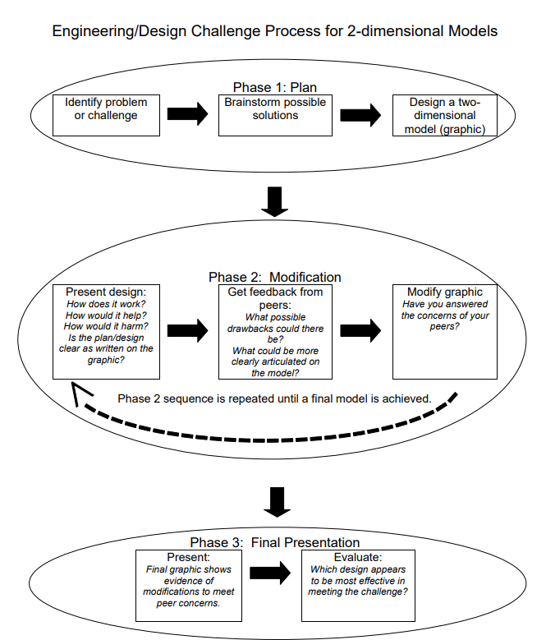

Slide 52
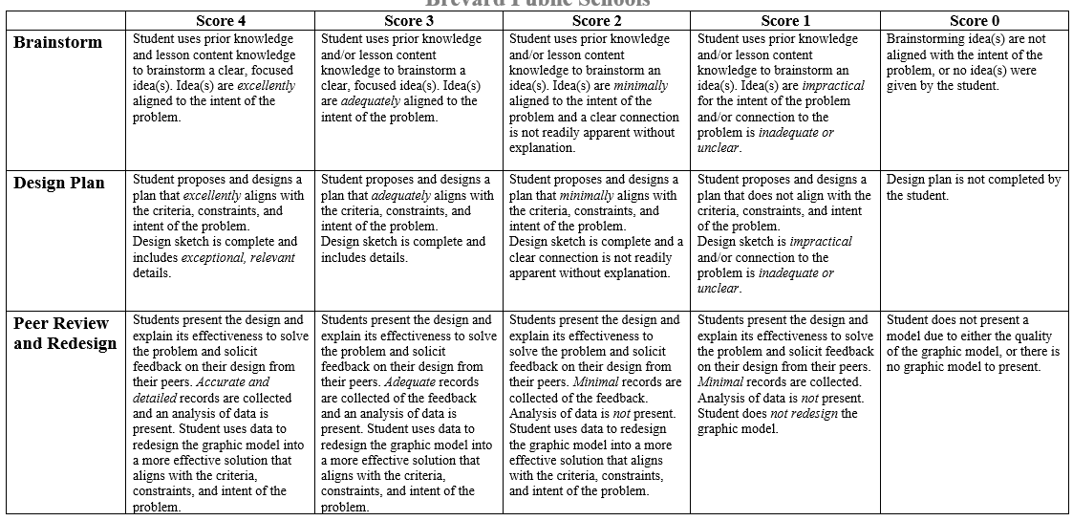

Slide 54
Natural Builders STEM Engineering Design Challenge
In this lesson, students will investigate and explain balanced and unbalanced forces as they design a building for Miami Beach that is inspired by Florida's natural environment.
In this challenge/lesson, students must design a building model that is at least thirty centimeters tall, features two elements that move in the wind, and can also withstand the wind.
Natural Builders - STEM Engineering Design Challenge In this lesson, students will investigate and e ... (cpalms.org)

Slide 55
6-8 Wind Farm Design Challenge
This lesson is a problem-based learning activity aligned to Florida's math and science standards. In this middle-school engineering design challenge, students are asked to create the most efficient wind turbine while balancing cost constraints. Students will apply their knowledge of surface area and graphing while testing 3D-printed wind farm blades. In the end, students are challenged to design and test their own wind farm blades, using Tinkercad to model a 3D-printable blade.
Wind Farm Design Challenge This lesson is a problem-based learning activity aligned to Florida's mat ... (cpalms.org)

Slide 56
9-12 Bottled Up Energy
This experimental design project deals with real life understanding of being assigned a group task, creating a budget, and providing evidence about the completion of the assigned task. The task in this case is that students are being asked to create a model of a car out of supplied materials and to test these designs. After each trial the students will analyze the data collected and make any improvements that are necessary. The teams will test all modifications and after analyzing the results of their trials, they will create a presentation to the class on how their design performed.

Slide 57
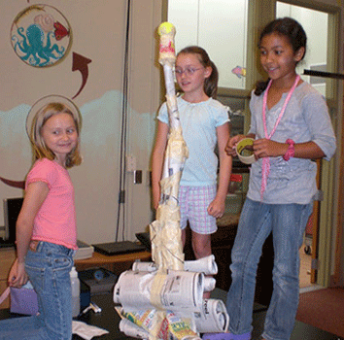
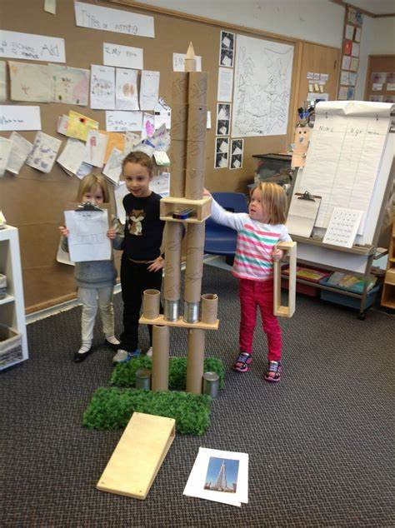
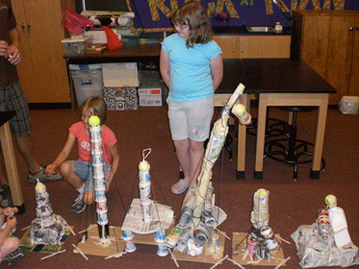
Building a Tall Tower - an Engineering Design Challenge
KGD
This Engineering Design Challenge is intended to help students apply the concept of gravity in an engineering design challenge.
Building a Tall Tower - an Engineering Design Challenge This Engineering Design Challenge is intende ... (cpalms.org)

Slide 58
Choose a STEM Lesson
Discuss and jot notes
In your group determine what types of careers might be involved in solving this type of problem. Those are the superheroes we will need!
What skills (Superpowers) will your superheroes need?

Slide 61
Thank you!
Please complete the survey.

Slide 63
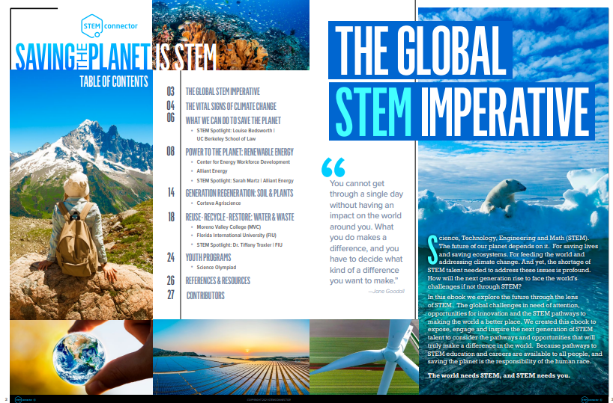

Slide 64
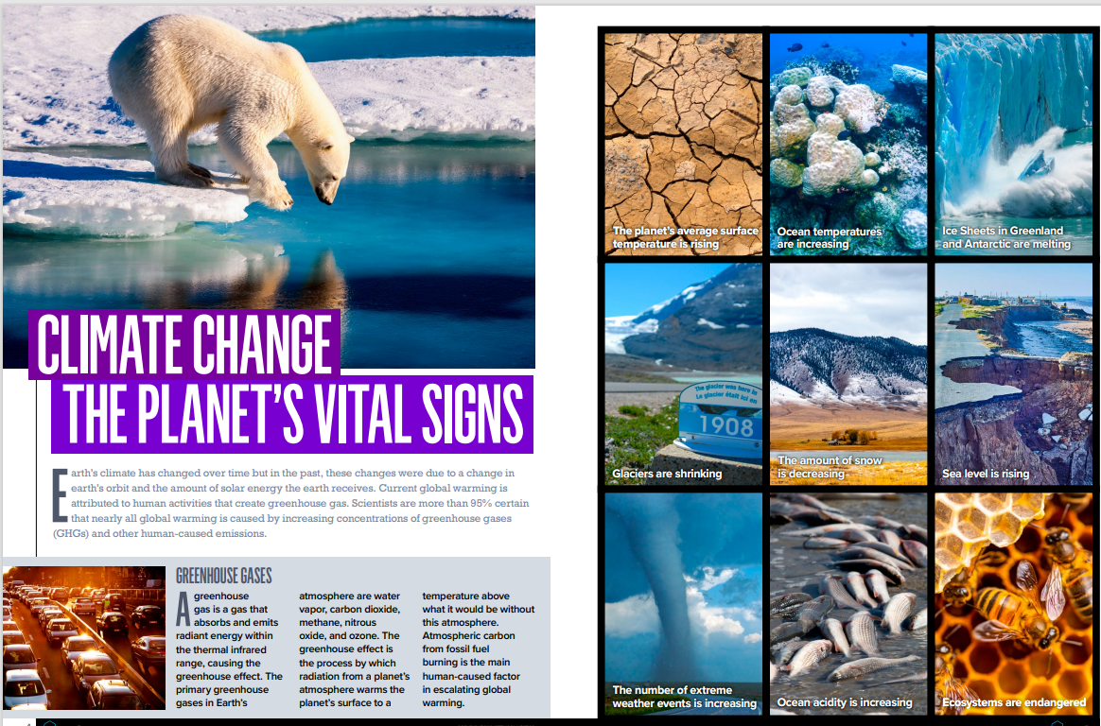

Slide 73
critical thinking and problem-solving skills
Bridging the gender gap
Need for STEM educated workers
STEM activities create a collaborative environment
STEM fuels creative, innovative thinking
Careers of the future
Building future entrepreneurs
Boosts curiosity and thinking skills
Saving the world
STEM encourages knowledge application
interact with their team members, communicate their thoughts, and explore new ideas
helps kids to develop soft skills from early and middle childhood because it requires children to think through problems and find solutions
Media and technology literacy
Money! Higher median salary
Students learn key project management and leadership skills

