Slide 1
Make Your Job Easier:
Teach Students to Ask Better Questions
(short version)
https://rightquestion.org/
Christine Angel Danger M. Ed. , NBCT
Christine.Danger@SDHC.K12.FL.US
Dr. Deborah Kozdras
Dkozdras@USF.EDU
@usfstavros

Slide 2
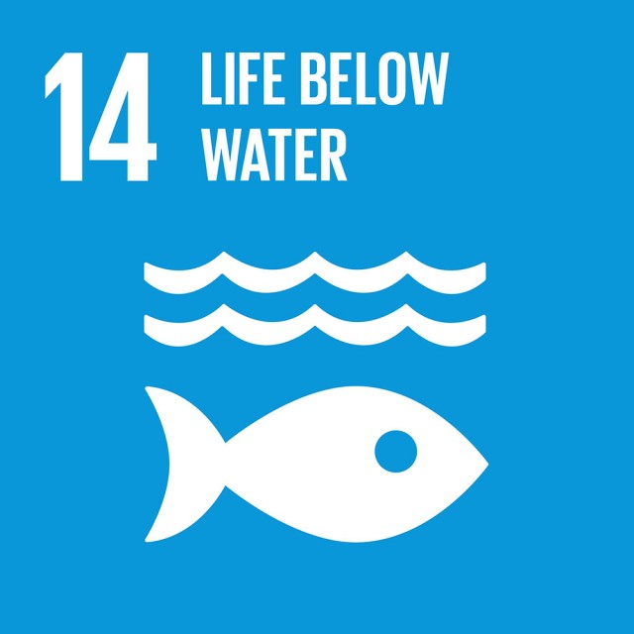
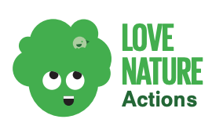
https://docs.wbcsd.org/2018/09/Good_Life_Goals/Pack_of_Actions.pdf

Slide 3
Participant Outcomes
Use question formulation technique to increase student questioning.
Understand why asking questions increases student understanding and engagement.
Explain why it is important to encourage students to ask questions.
Connect question formulation technique to standards effectively.

Slide 5
#1 Reason parents do not ask questions at teacher parent conferences: “I don’t know what to ask”.
https://rightquestion.org/
Notes:
About RQI Our History
The Right Question Institute (RQI) began its work with a dropout prevention program in Lawrence, Massachusetts, funded by the Annie E. Casey Foundation, when parents told us they were not participating in their children’s education because they “don’t even know what to ask.” It only took hearing that statement one or two… thousand times, and we finally got it. Parents had identified an obstacle that prevents many people from learning, from thinking for themselves, from doing their own problem solving, and from becoming more self-sufficient.
Eventually, we figured out that we had to find a way for people to learn how to formulate their own questions and to effectively participate in the decision-making process. RQI has spent over 25 years designing strategies, such as the Question Formulation Technique (QFT) and the Framework for Accountable Decision-Making (FADM), and resources so practitioners can teach these skills as simply and effectively as possible. In field after field, in community after community, our simple yet powerful strategies have been effective for engaging all individuals, no matter their r

Slide 6
College Presidents on What Students Should Learn in College
“The primary skills should be analytical skills of interpretation and inquiry. In other words, know how to frame a question.”
- Leon Botstein, President of Bard College
“…the best we can do for students is have them ask the right questions.”
- Nancy Cantor, Chancellor of University of Illinois
The New York Times, August 4, 2002

Slide 7
Yet…only 27%of students believe college taught them to ask their own questions
Alison Head, Project Information Literacy at University of Washington, 2016

Slide 8
But, the problem begins long before college…

Slide 9
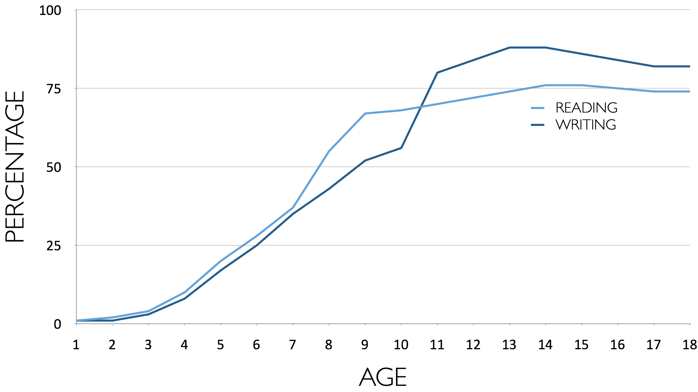
Percentage of Basic Skill Attainment
Sources
http://nces.ed.gov/nationsreportcard/pdf/main2009/2011455.pdf
http://nces.ed.gov/nationsreportcard/pubs/main2007/2008468.asp#section1
Data on question-asking based on parent and teacher feedback

Slide 10
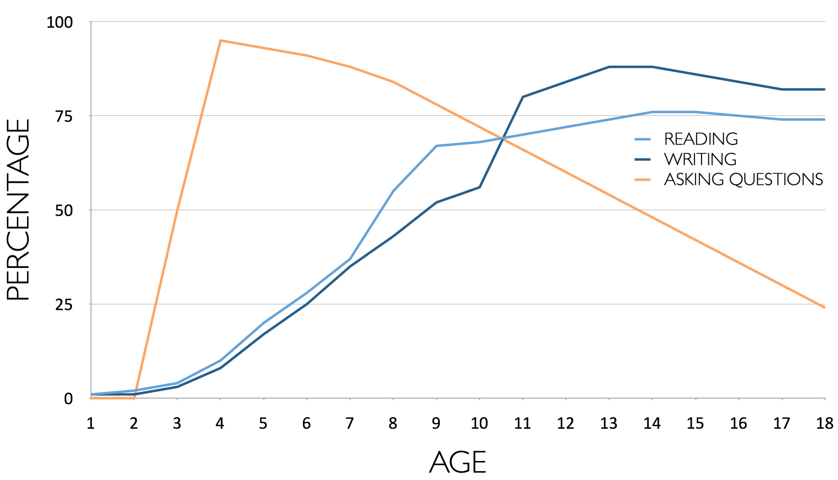
Percentage of Basic Skill Attainment
Sources
http://nces.ed.gov/nationsreportcard/pdf/main2009/2011455.pdf
http://nces.ed.gov/nationsreportcard/pubs/main2007/2008468.asp#section1
Data on question-asking based on parent and teacher feedback

Slide 11
We can work together on changing the direction of that slope.
Ken Robinson Video
https://www.ted.com/talks/ken_robinson_changing_education_paradigms
Notes:
Added a period

Slide 12
Research Confirms the Importance of Student Questioning
Self-questioning (metacognitive strategy):
Student formulation of their own questions is one of the most effective metacognitive strategies
Engaging in pre-lesson self-questioning improved students rate of learning by nearly 50% (Hattie, p.193)
John Hattie
Visible Learning: A Synthesis of Over 800
meta-Analyses Relating to Achievement, 2008

Slide 13
What happens when students do learn to ask their own questions?

Slide 14
The Question Formulation Technique (QFT)
Students learn to:
Produce their own questions
Improve their questions
Strategize on how to use their questions
Reflect on what they have learned and how they learned it
#QFT
Notes:
Before we start, give 1 minute to introduce selves, where you work, what age group, and pick one person as the recorder.
Warning: you may feel frustrated by the time constraints, it will be frustrating sometimes to stop just as you’ve started; we’ve made this choice because we think it is best to experience the whole process, at least a taste, this is an intro not a deep dive (you may hate the timer by the end of it)

Slide 15
Classroom Example: 4th Grade
Teacher: Deirdre Brotherson
Topic: Math unit on variables
Purpose: To engage students at the start of a unit on variables

Slide 16
Question Focus
24 = ☺ + ☺ + ☺
Notes:
Refer to Troubleshooting you Q Focus questions.
Troubleshoot your QFocus by answering Yes, No, or Unsure
Is the QFocus a question?
Is there too much information?
Will the QFocus limit students to only one line of thinking?
Is there a word that might distract students?
Will the students perceive the QFocus as just another way of presenting the teacher’s message or ideas?
If you answer “yes” to any questions what are some ways you might you change your Q Focus to sharpen it?

Slide 17
Student Questions
Why is the 24 first?
What do the smiley faces mean?
Why are there 3 smiley faces?
How am I suppose to figure this out?
Is the answer 12?
Can I put any number for a smiley face?
Do three faces mean something?
Do the numbers have to be the same because the smiley faces are the same?
What numbers will work here?
Does it mean 24 is a really happy number?
Can we replace each smiley face with an 8?
Do any other numbers work?
Can we do this for any number?
Does it always have to be smiley faces?
Do we always have to use three things?
Notes:
How can you use student’s questions to guide instruction?

Slide 18
Next Steps with Student Questions
Questions posted on classroom walls.
Students cross off the questions they answer during subsequent lessons.
Teacher returns to student questions at the end of the unit to discuss with students what they learned and what they still want to know.

Slide 19
Rules for Producing Questions
1. Ask as many questions as you can
2. Do not stop to answer, judge, or discuss
3. Write down every question exactly as stated
4. Change any statements into questions
Notes:
Circulate and listen. Remind participants to follow the rules.

Slide 20
Notes:
Ask participants to use QFT to come up with questions about this image.
Have them discuss the standards this connects to.

Slide 21
Notes:
Ask participants to use QFT to come up with questions about this image.
Have them discuss the standards this connects to.

Slide 22
We are going to learn about recycling.
What questions can you ask?
Notes:
Ask participants to use QFT to come up with questions about this image.
Have them discuss the standards this connects to.

Slide 23
We are learning about the water cycle.
What questions can you ask?
Notes:
Erosion, Water cycle
Ask participants to use QFT to come up with questions about this image.
Have them discuss the standards this connects to.

Slide 24
We are learning about the biological problems of litter. What questions do you have?
Notes:
Erosion, Water cycle
Ask participants to use QFT to come up with questions about this image.
Have them discuss the standards this connects to.

Slide 25
Produce Questions
Ask Questions
Follow the Rules
Ask as many questions as you can.
Do not stop to answer, judge, or discuss.
Write down every question exactly as it was stated.
Change any statements into questions.
Number the Questions

Slide 26
Categorize Questions: Closed/ Open
Definitions:
Closed-ended questions can be answered with a “yes” or “no” or with a one-word answer.
Open-ended questions require
more explanation.
Directions: Identify your questions as closed-ended or open-ended by marking them with a “C” or an “O.”

Slide 27
Discussion
Closed-ended Questions
Advantages
Disadvantages
Notes:
Closed-ended questions can serve as a good “warm-up” for expressing bigger ideas or a good way to scaffold a child’s thinking around a complex question. Teachers may use a couple closed-ended questions to get a child to do some thinking about the topic before he is ready to consider the more open-ended question.
Closed questions work well for simple recall, to determine whether students understand a concept or for review.

Slide 28
Discussion
Open-ended Questions
Advantages
Disadvantages
Notes:
Asking an open-ended question (sometimes called a divergent question) is a way to elicit discussion, brainstorm solutions to a problem, or create opportunities for thinking outside the box. The highest-order open-ended questions engage students in dynamic thinking and learning, where they must synthesize information, analyze ideas and draw their own conclusions.

Slide 29
Improve Questions
Take one closed-ended question and change it into an open-ended question.
Take one open-ended question and change it into a closed-ended question.
Closed
Open
Open
Closed
Notes:
Both types of questions have their place in questioning.

Slide 30
Prioritize Questions
Review your list of questions
Choose the three questions you are most curious to explore further.
While prioritizing, think about your Question Focus: Some students are not asking questions.
After prioritizing consider…
Why did you choose those three questions?
Where are your priority questions in the sequence of your entire list of questions?

Slide 31
Strategize on How to Use Questions
From priority questions to action plan
In order to answer your priority questions:
What do you need to know? Information
What do you need to do? Tasks

Slide 32
Share
Questions you changed from open/closed
Your three priority questions and their numbers in your original sequence
Rationale for choosing priority questions
Next steps

Slide 33
Reflection
What did you learn?
How did you learn it?
What do you understand differently now about some students not asking questions?

Slide 34
A Look Inside the Process

Slide 35
Curiosity and Rigor
Three thinking abilities
with one process

Slide 36
Thinking in many different directions
DIVERGENT THINKING
Divergent thinking: The ability to generate a wide range of ideas and think broadly and creatively

Slide 37
Narrowing Down, Focusing
Convergent thinking: The ability to analyze and synthesize information and ideas while moving toward an answer or conclusion.
CONVERGENT
THINKING

Slide 38
Thinking about Thinking
METACOGNITIVE
THINKING
Metacognition: The ability to think about one’s own thinking and learning.
Notes:
The term “metacognition” was coined by John Flavell in the 1970s, the concept has become an important part of the ongoing dialogue about student learning. Metacognition – i.e., an individual’s awareness of his or her thought processes – requires an ability to stand back and observe oneself.

Slide 39
"There is no learning without having to pose a question."
-Richard Feynman, Nobel-Prize- winning physicist

Slide 40
Dr. Deborah Kozdras Christine Angel Danger M. Ed. , NBCT Dkozdras@USF.EDU Christine.Danger@SDHC.K12.FL.US
Make Your Job Easier:
Teach Students to Ask Better Questions
https://rightquestion.org/

