Slide 1
Inquiring Minds Want to Know: The Question Formulation Technique

Slide 2
Grounding Activity
What is a question your students asked this week in class?
Notes:
J
Stickies (chart for later) + share out a few

Slide 3
Agenda:
How do we get our students to ask good questions?
Once they ask the question what should
happen next?
3. How can students make their thinking
public?
Notes:
J

Slide 4
Outcomes
Investigate the Science and Engineering Practice of asking questions (SEP 1).
How does SEP 1 link to the Science and Engineering Practice of planning and carrying out investigations (SEP 3)?
Notes:
J

Slide 5
Who’s Asking the Questions?
One of the shifts in the NGSS is from teachers asking all the questions, to students asking the questions.
“Some teachers…corner the market on talking without looking for input. Teachers ask around 250 questions per day, per week. On the other hand, students ask questions at a rate of 2 per class, per week,” (Hattie, 2015).
Notes:
J

Slide 6
Notes:
S

Slide 7
“Students are only going to school to watch a teacher work.”
Notes:
J
Source of quote: Hidden Lives of Learners (Nuthall)

Slide 8
Number of questions asked. . .
Studies show that the average pre-school aged student asks about 300 questions per day.
By the end of elementary school, that number is cut in half, and by the end of middle school it is almost 0.
Notes:
J

Slide 9
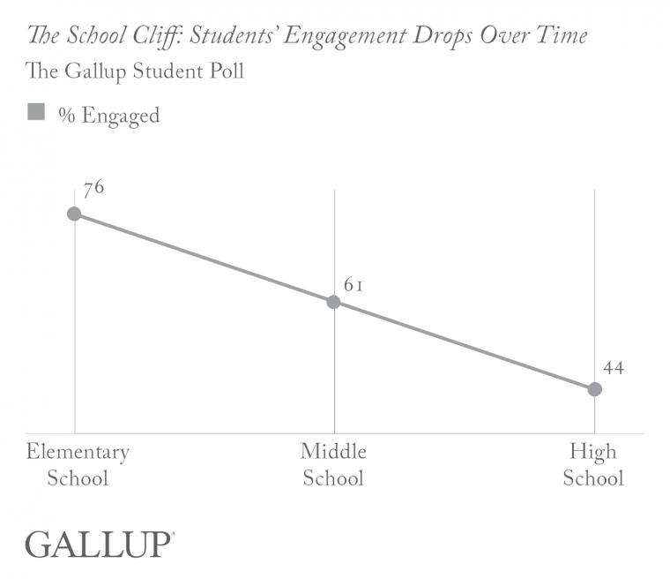
Notes:
J

Slide 10
Discussion
What are some challenges you’ve had eliciting relevant or rigorous student questions?
Notes:
S

Slide 11
Introducing the Question Formulation Technique (QFT) Into Your Classroom
A Step-by-step Guide

Slide 12
What is the Question Formulation Technique?
The Question Formulation Technique (QFT) is a simple, but rigorous, step-by-step process designed to help students produce, improve, and strategize on how to use their questions.
The QFT allows students to practice three thinking abilities in one process: divergent, convergent and metacognitive thinking.

Slide 13
Using Student Questions
Students can use their questions for many purposes, including the following:
Conduct Research
Reports
Conduct Experiments
Independent Projects
Write Papers/ Essays
Group and Individual Projects
Socratic Seminars/ Debates
Prepare for Presentations/Interviews

Slide 14
Components of the Question Formulation Technique
1. The Question Focus (QFocus)
2. The Rules for Producing Questions
3. Producing Questions
4. Categorizing Questions
5. Prioritizing Questions
6. Next Steps
7. Reflection

Slide 15
1
The Question Focus (QFocus)

Slide 16
The Question Focus (QFocus)
The QFocus should:
be brief
provoke or stimulate new lines of thinking
The QFocus should not:
be a question

Slide 17
The Question Focus (QFocus)
The QFocus should be designed to accomplish one or more of the following:
Generate Interest
Stimulate New Thinking
Introduce a Topic
Set a Learning Agenda
Deepen Comprehension
Formative Assessment

Slide 18
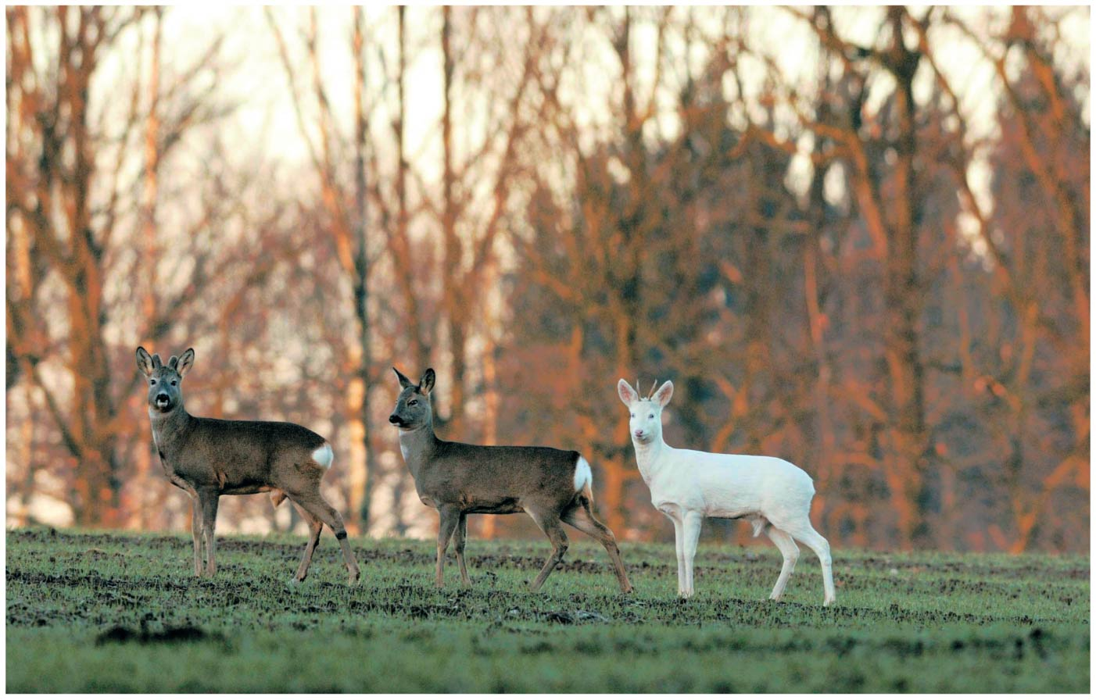
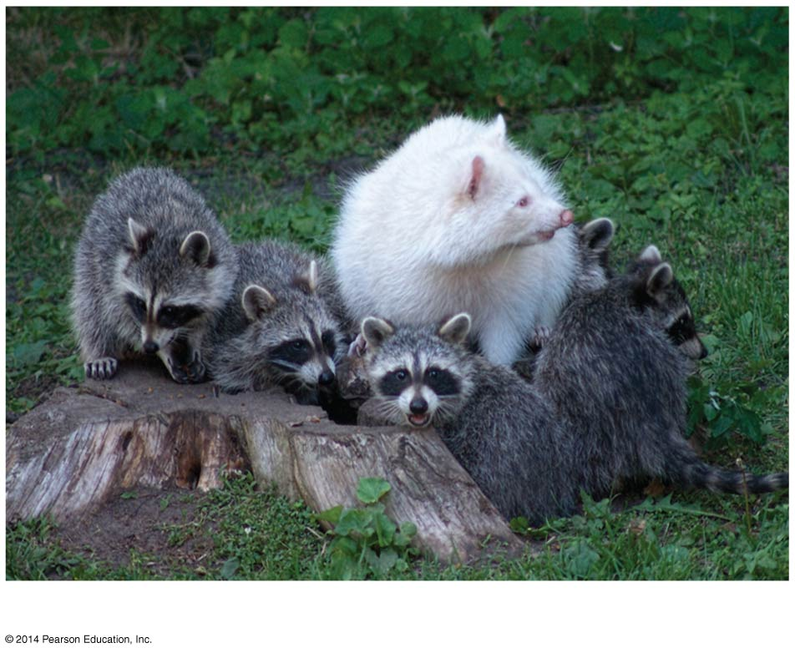
Discrepant Event
Notes:
S

Slide 19
Video
Notes:
S
Watch more than once.

Slide 20
Question Focus: A picture…
School: Frederick County Public Schools, Walkersville, MD Teacher: Jennifer Shaffer
Notes:
J
She showed her students the QFocus – a picture of an alligator with baby alligators on its head. The room “erupted” with their questions and she recorded their questions and allowed them to whisper their final question to their partner. The class then used their questions as they were reading a non-fiction text about alligators. Jay Corrigan, one of the observers noted

Slide 21
Question Focus: A word…
The Q Focus: Trapezium » Trapezoid » Parallelogram
5th Grade Common Core Geometry Standards
related to classifying two-dimensional figures in a hierarchy based on properties (5.G.B.4) and understanding that attributes belonging to a category of figures also belongs to all
subcategories of that category (5.G.B.3).
Jay Corrigan.
Notes:
J
1. The arrows show a progression from a Trapezium (a quadrilateral with zero pairs of parallel sides), to a Trapezoid (a quadrilateral with one pair of parallel sides), to a parallelogram (a quadrilateral with two pairs of parallel sides). I thought by isolating this attribute in this way, I could help kids start to see a shape like a parallelogram as a figure with a set of attributes, rather than a shape that looks long and slanted.
2. I was pretty sure that there would be fifth graders who would know what a trapezoid was, and it was also a safe bet that parallelogram wouldn’t be a foreign term for some of them either. However, I was equally confident that no one would have a clue what a Trapezium was so between that and the arrows, there should be something unknown for everyone to ask questions about.

Slide 22
Question Focus: A quote or statement…
“It is not the strongest of the species that survive, nor the most intelligent, but the one most responsive to change,”
Charles Darwin
Matter is everywhere and can change over time.
Notes:
J

Slide 23
2
Rules For Producing Questions

Slide 24
Rules For Producing Questions
Let students know that you will soon be giving them a focus for asking questions
But, before doing that, you will have them review and discuss the Rules for Producing Questions

Slide 25
Rules For Producing Questions
Introduce the Rules for Producing Questions:
Ask as many questions as you can
Do not stop to answer, judge or to discuss the questions
Write down every question exactly as it is stated
Change any statement into a question
TIP: Distribute or post the Rules for Producing Questions

Slide 26
Rules For Producing Questions
Ask students to review the rules
Ask students to reflect about one of these questions:
What do you think would be difficult about following these rules?
Which one of these rules might be difficult to follow?
Why?
TIP: Do not skip over the discussion of the rules the first time you introduce students to the QFT.
Review the Rules for Producing Questions every time you use the QFT.

Slide 27
Producing Questions
Once students have discussed the Rules for Producing
Questions:
Divide students into small groups of 3-5
Ask groups to identify a note-taker
Distribute newsprint or worksheets to each small group

Slide 28
Producing Questions
Introduce the QFocus and ask students to:
Produce as many questions as they can in allotted time
Follow the Rules for Producing Questions
Number the questions
TIP: The note-taker should also contribute questions

Slide 29
4
Categorizing Questions
CLOSED-ENDED
OPEN-ENDED

Slide 30
Categorizing Questions
Define closed and open-ended questions:
Closed-ended Questions can be answered with a “yes’ or “no” or with a one-word answer
Open-ended Questions require more explanation

Slide 31
Categorizing Questions
Step 1
Ask students to look over the list and:
mark the questions that are closed-ended with a “C”
mark the questions that are open-ended with an “O”

Slide 32
Categorizing Questions
Step 2
Ask students to name:
advantages of closed-ended questions
And
disadvantages of closed-ended questions

Slide 33
Categorizing Questions
Step 3
Ask students to practice changing questions from one type to another
“Choose one closed-ended question from your list and change it into an open-ended one.”
“Choose one open-ended question from your list and change it into an closed-ended one.”
TIP: If students have questions from only one type, for example they only have open-ended questions, ask them to change two of those questions to closed-ended.

Slide 34
5
Prioritizing Questions

Slide 35
Prioritizing Questions
Criteria for prioritizing is usually set by the teacher. Criteria will depend on what you have planned as next steps with the questions. Instructions for prioritization will vary. Here are some examples:
Choose three questions that…
most interest you.
you consider to be the most important.
will best help you design your research project
will best help you design your experiment
will best help you solve a problem
you want/need to answer first.

Slide 36
Prioritizing Questions
Ask students to review their list of questions and choose three questions (most important; to develop a project, etc.). Mark them with an “X”
Remind students to keep the QFocus in mind while prioritizing.

Slide 37
Prioritizing Questions
Ask students to think about and share their rationale for choosing their priority questions.
For example: “Why did you choose these three as the
most important?”
Ask students to identify where are their priority questions in the sequence of the whole list of questions.
For example: “What numbers are the priority questions?”

Slide 38
6
SHARE

Slide 39
Reports
Ask students to share aloud:
The questions they changed from closed to open-ended
and then from open-ended to closed-ended:
Read the original question
Read the new question
2. Their three priority questions.
3. Their reasons for choosing the priority questions.
4. The numbers of the priority questions in the sequence of the entire list.
TIP: One group member can report and others can join in.

Slide 40
Reports
When students share the numbers of the priority questions they will notice where in the sequence of questions the priority questions were produced.
Often, students notice that the priority questions came from different places (beginning, middle or end) and that helps them see value of generating a lot of questions before choosing priority questions.
TIP: Ask students to pay attention to the numbers of the priority questions.

Slide 41
7
Next Steps

Slide 42
Next Steps
You can ask students to use their questions for:
You could also ask students to decide how they will use their questions.
Papers and Essays | Research
Independent Projects | Group Projects
Experiments Presentations/Interviews | Debates Socratic Seminars

Slide 43
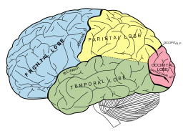
8
Reflection

Slide 44
Reflection
Ask students to think about the work they have done, what they have learned and its value. For example, you can use questions like:
What did you learn?
What is the value of learning to ask your own questions?
How can you use what you learned?
TIP: Use one or more reflection questions.
Ask one question at a time.

