Slide 1

The Pursuit of
Renewable Energy
George Philippidis, Ph.D.
Associate Dean and Associate Professor
Patel College of Global Sustainability
University of South Florida (USF)
Contact information: gphilippidis@usf.edu - (813) 974-9333

Slide 2
Forms of Renewable Energy
POWER
Hydroelectric
Wind
Solar
Bioenergy
Geothermal
Ocean
FUELS
Biofuels
  Ethanol (cars)
  Biodiesel (buses, trucks)
  Jet biofuel (planes)
Electricity
Hydrogen
Source: Philippidis, G. “Powering America with sustainable energy in the 21st century”, J. Renewable Sustainable Energy, 4, 062801 (2012)

Slide 3
US Renewable Power (2018)
Wind soon the largest renewable; solar growing the fastest
Source: Energy Information Agency

Slide 4
US Power Generation (2018)
Still heavy dependence on fossils (63%),
but renewables are growing fast
Source: Energy Information Agency

Slide 5
Florida Power Generation (2017)
Risky dependence on single source (natural gas)
Source: Energy Information Agency

Slide 6
Drivers of Renewable Power
Endless, clean, sustainable
  One or more forms of renewable energy available everywhere
Energy security
  Diversification
  No dependence on imports
  Benefits to domestic economy
No or low emissions
  Combat climate change
  Protect air quality

Slide 7
Climate Change
Increasing atmospheric carbon dioxide, methane, nitrous oxide, and chlorofluorocarbons alter earth’s climate
  CO₂: from power generation, transportation, industry
  CH₄ and N₂O: from agriculture
  CFC: from industrial applications
Climate change leads to:
  Global warming
  Extreme weather phenomena (life and property loss)
  Sea-level rise
  Ocean acidification
  Damages to agriculture
  Damages to fishing
Sea level rise threatens coastal large cities: adapt or relocate at huge costs
Take steps to reduce GHG emissions as an insurance policy regardless of political beliefs

Slide 8
Atmospheric CO₂ Level
Source: National Oceanic and Atmospheric Administration (accessed 2019)

Slide 9
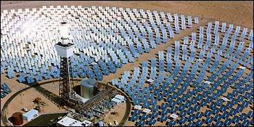
Solar Power
  Water heating
    Solar energy heats up water
    Widely practiced around the world in small scale
  Photovoltaics
    Solar energy converted to electricity
    Residential, commercial, institutional, utility
  Thermal (concentrated)
    Solar energy converted to heat and then to electricity
    Large power generation

Slide 10
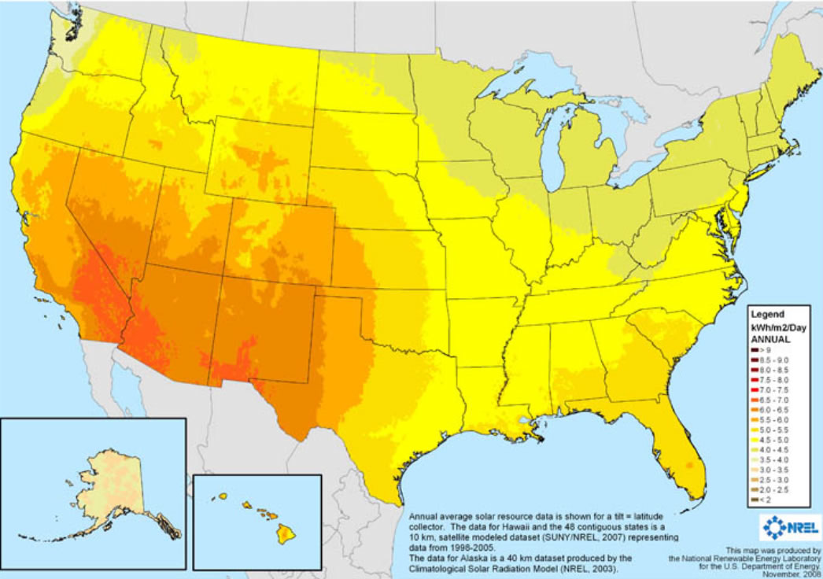
US Solar Insolation
(average daily)
Source: National Renewable Energy Laboratory (accessed, 2014))

Slide 11

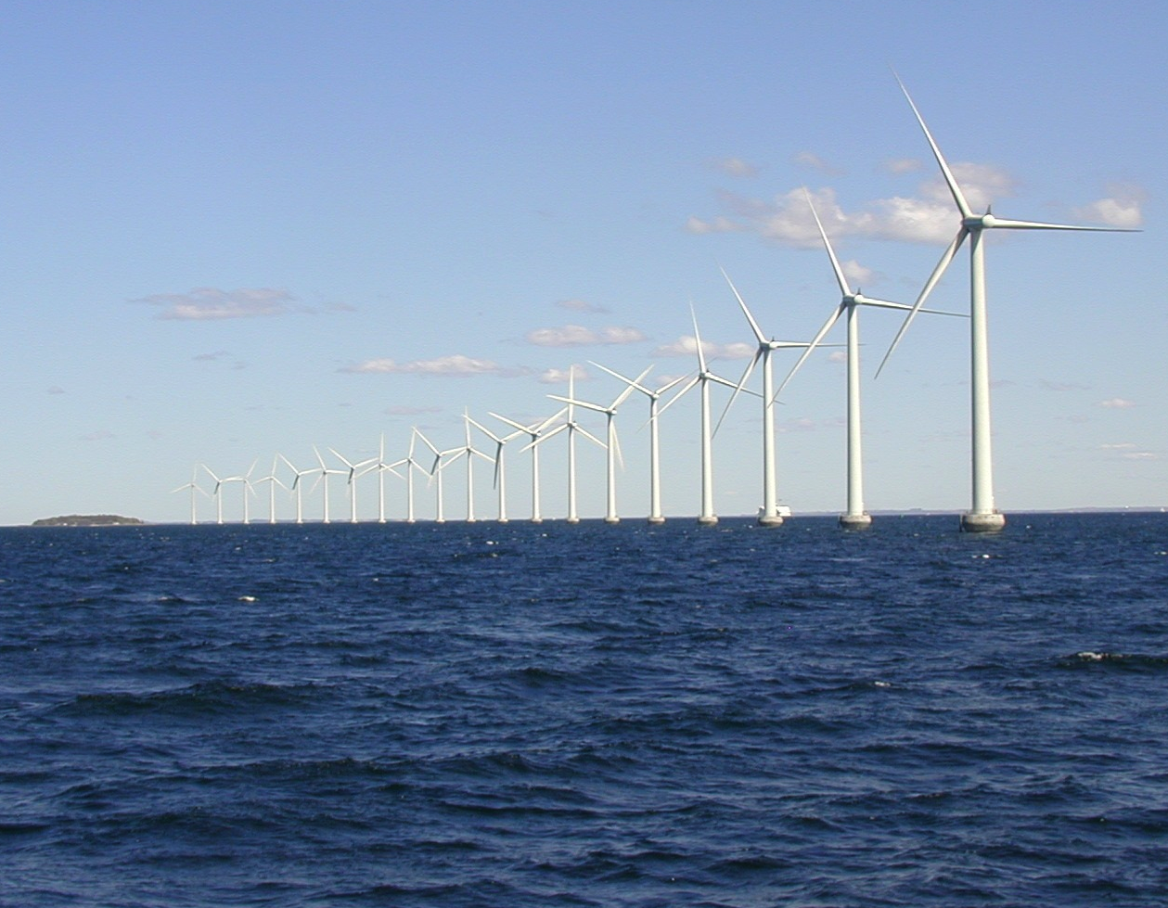
Wind Power
  Expanding quickly (on-shore, off-shore)
  Already cost-effective at large scale (< $0.05/kWh)
  Florida’s FPL leading wind power producer in USA

Slide 12
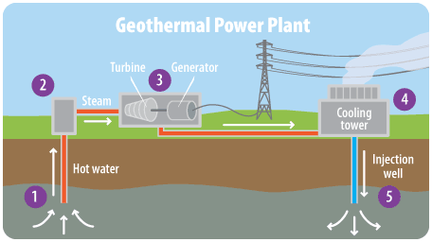
Geothermal Power
  Thermal energy from the earth
  Steam for electricity generation
  Hot water for space heating

Slide 13
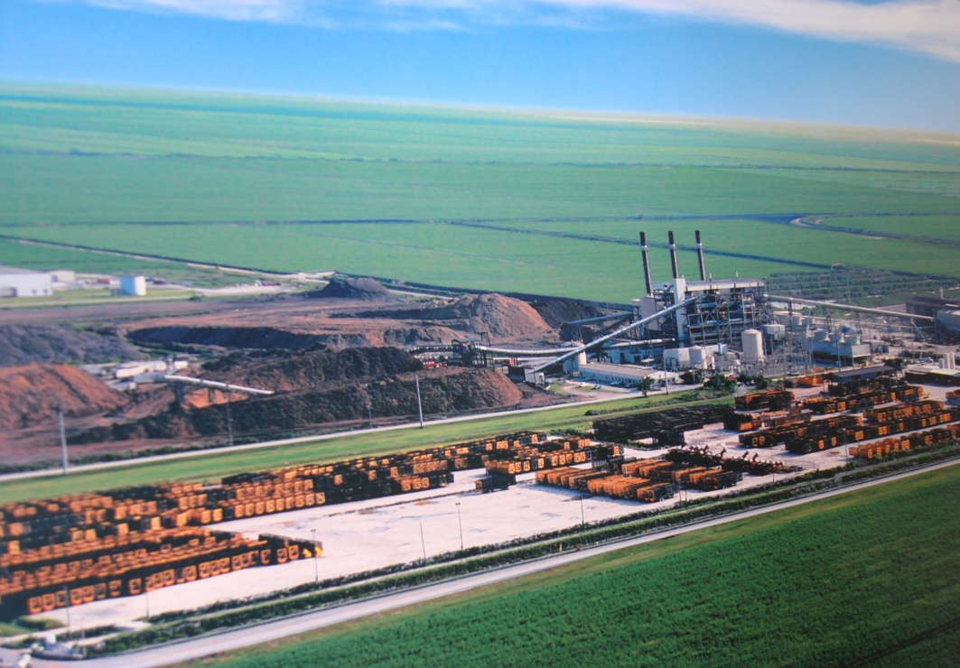
Bioenergy
  Power from agricultural residues, forest residues, and yard waste (biomass)
  Biogas from anaerobic digestion (industry, farms)
  Landfill gas
  In abundance in all states and countries

Slide 14
Ocean Power
  Tides, waves, thermal, currents
  Emerging technologies
  Continuous source of power
  Florida: Gulf Stream looks promising

Slide 15



Renewable Fuels
Biofuels
  Ethanol from corn, sugarcane, biomass
    High octane fuel (113)
  Biodiesel from vegetable oils, waste oils, grease
    Cleaner than diesel (lower emissions)
  Jet Fuel from vegetable oils
    Inedible oils (sustainable agriculture)

Slide 16




Biofuels = Agricultural Fuels
Source: North Florida Research and Education Center (2016)

Slide 17
Jet Fuel from Carinata
Brassica carinata
  Mustard family crop, related to canola
  Non-edible crop
  Produces seeds rich in oil
Winter cover crop in southeastern US
  Complements summer crops (soy, cotton, peanuts, corn)
  Additional income for farmers
  Crop rotation improves soil quality
  Cover crop reduces erosion

Slide 18
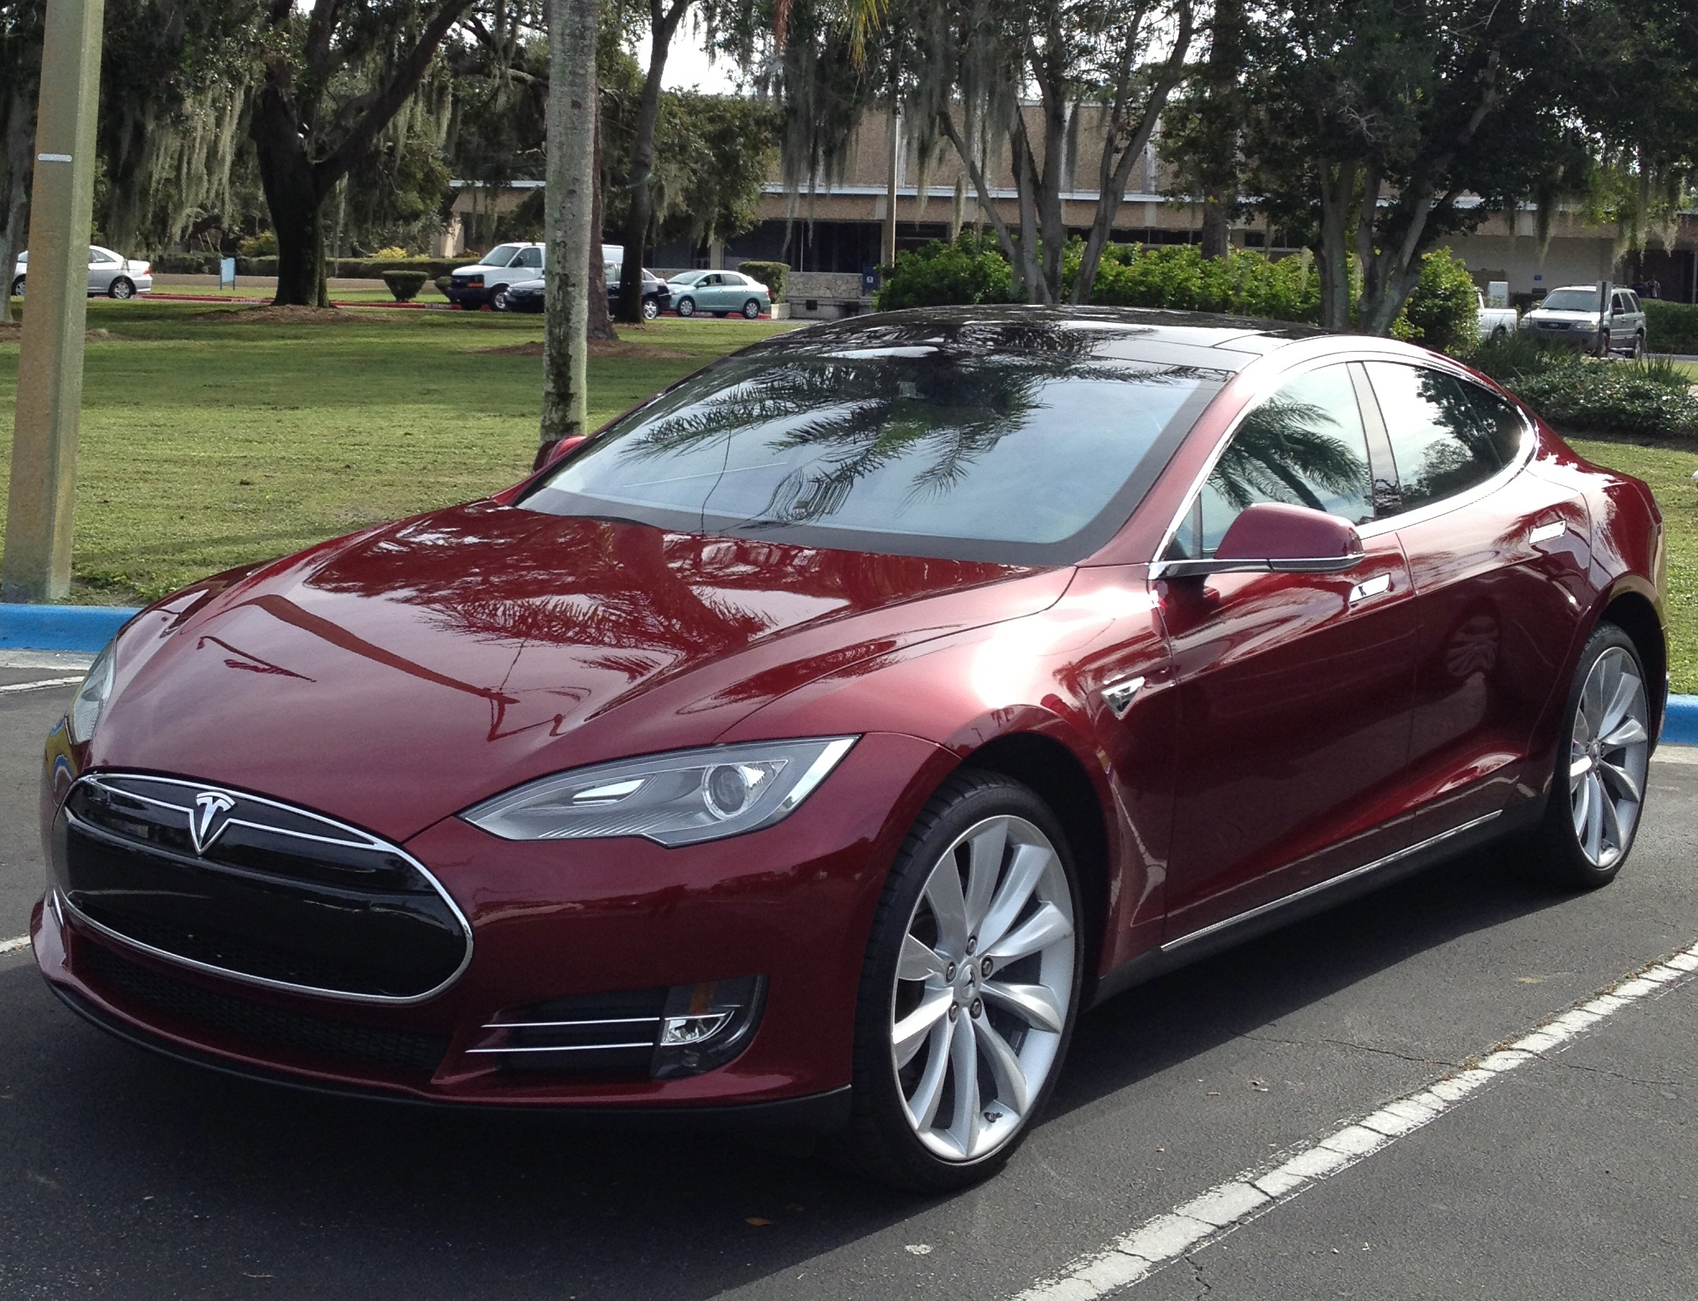
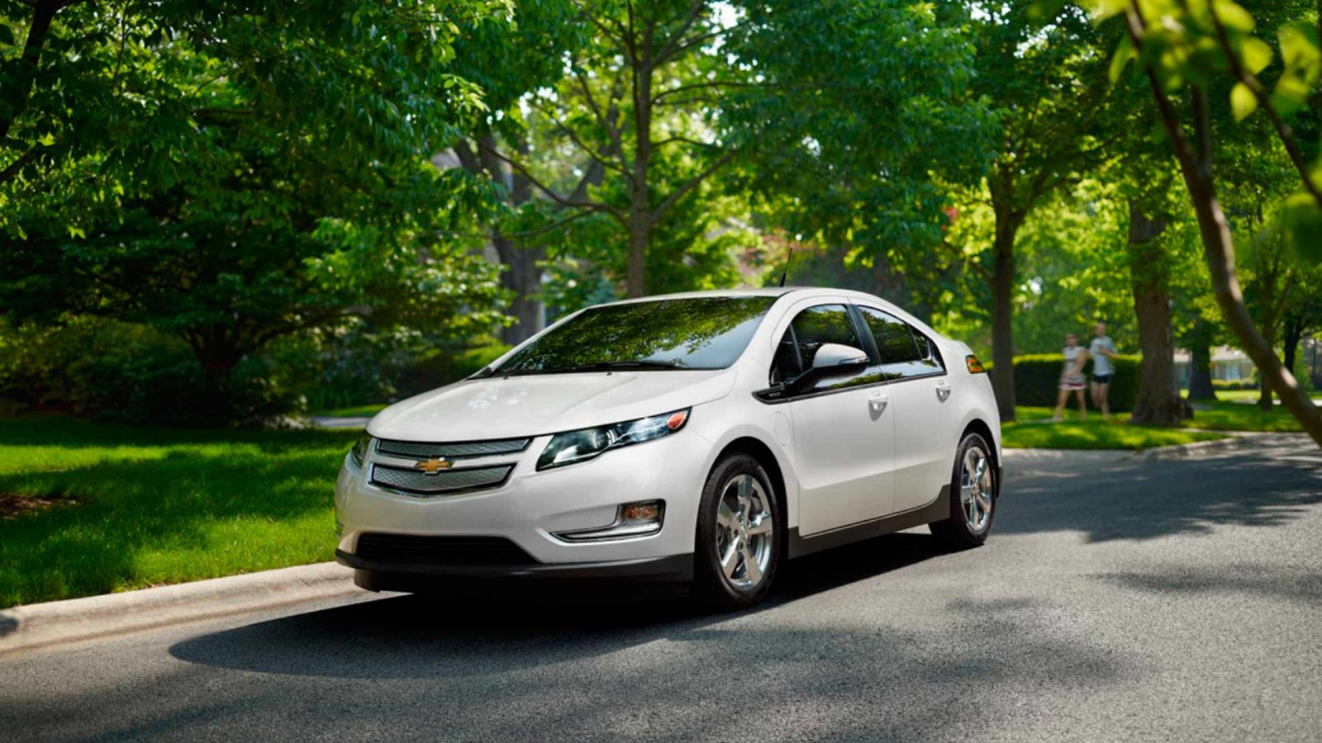
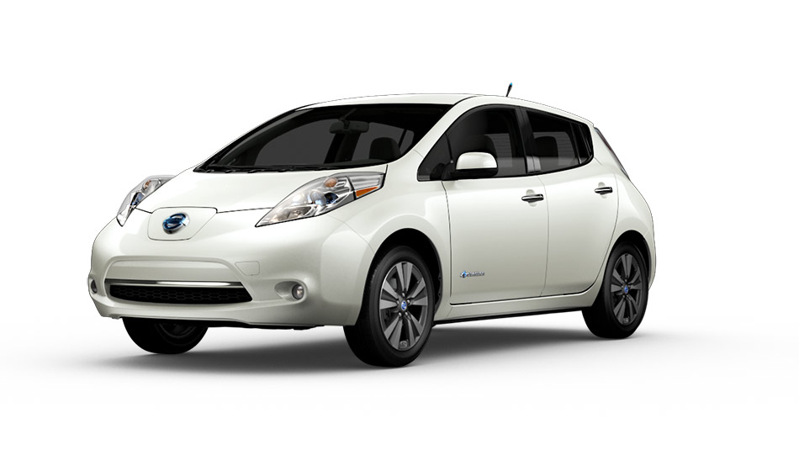
Electric Vehicles
  Sustainable, but only if the power is renewable
  Electric and hybrid vehicles
  Battery technology:
    Extend driving range
    Shorten recharge time
Tesla Model S
Chevrolet Volt
Nissan Leaf

Slide 19
Sensible Strategy
No single energy source is a “silver bullet”
For a sustainable economy:
  Promote energy conservation and efficiency
  Boost deployment of renewable energy

Slide 20
What about Florida?
Our best resources:
  Solar
    Utility, commercial, institutional, residential
  Biomass
    Utility
  Ocean (gulf stream)
    Utility

