Slide 1
BYOEC
Build Your Own Equitable City

Slide 2
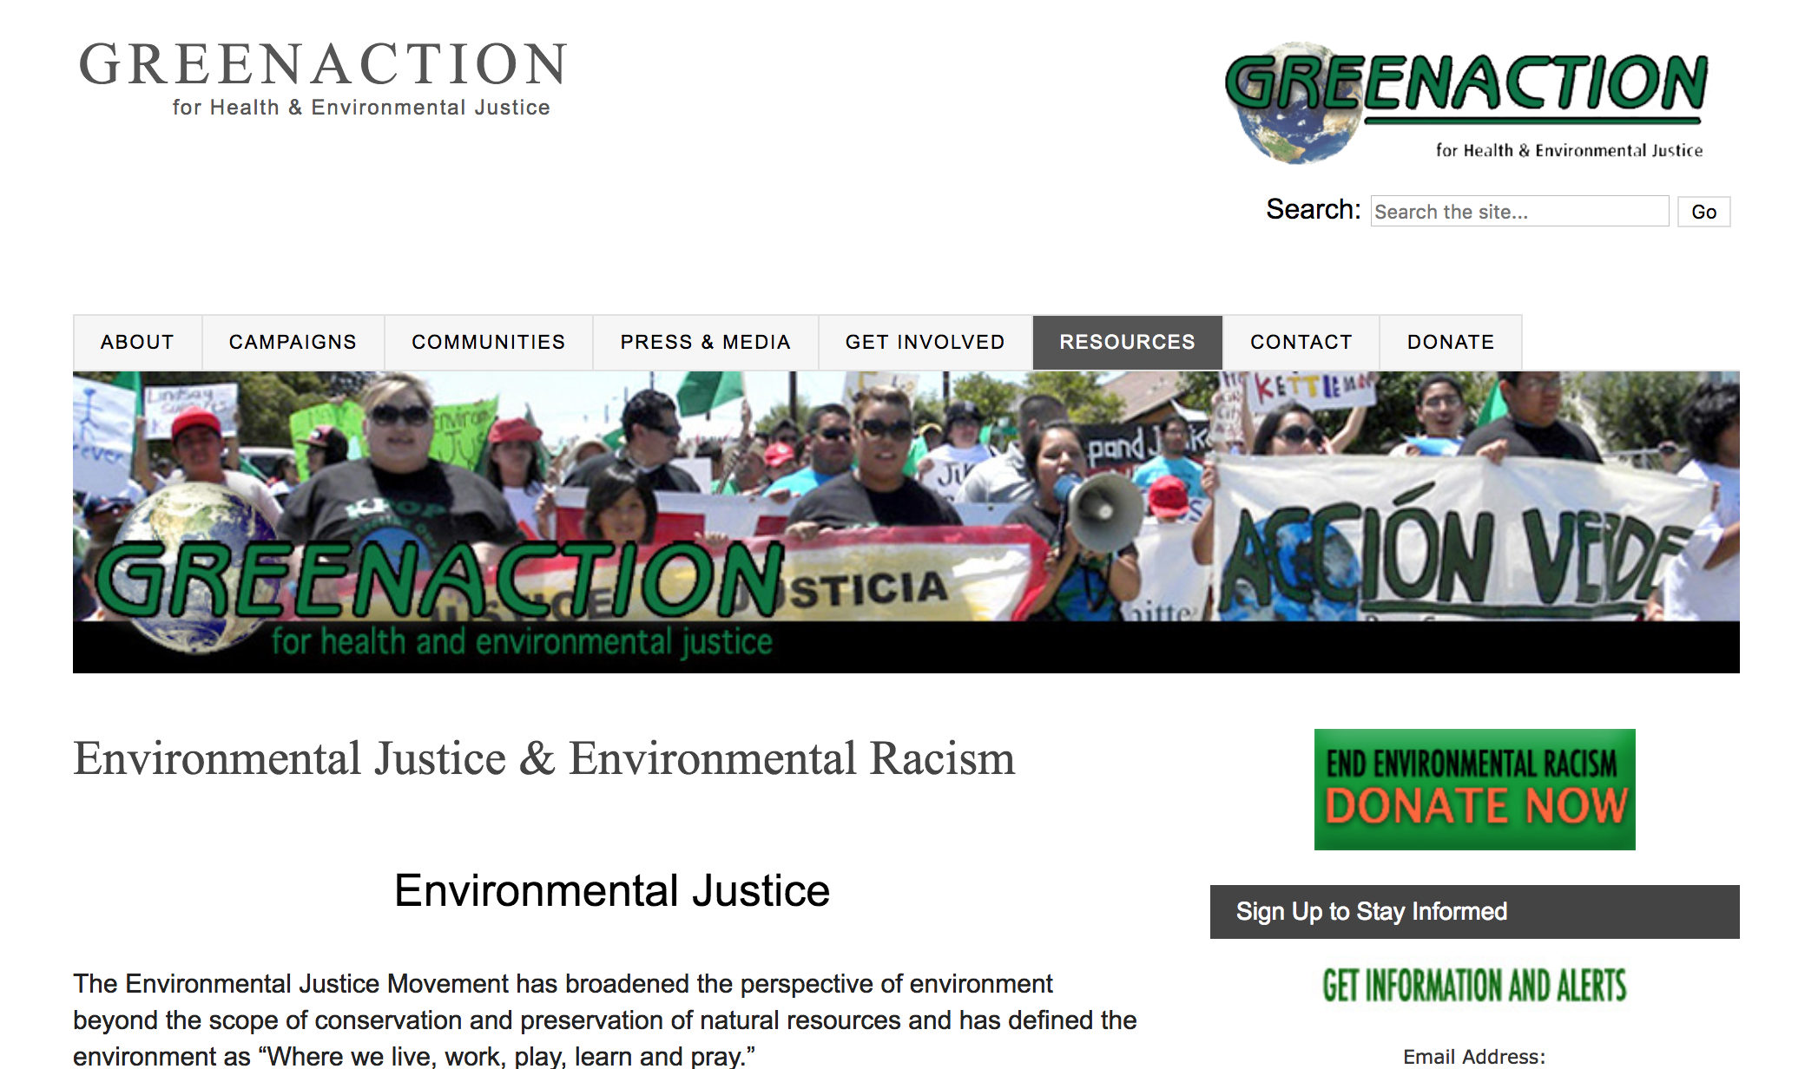
Environmental Racism
Notes:
GreenAction: Environmental Justice and Environmental Racism
Environmental Racism: disproportionate impact of environmental hazards on people of color

Slide 3
BYOEC
“Equitable”

Slide 4
BYOEC
Draw a main road for people to visit your town. Be sure to include: a reservoir, 5 houses, a grocery store, post office, and garbage dump.
Notes:
Building An Equitable City: Teacher’s Script

Slide 5
BYOEC
Now your village is getting larger, so you’d want to add a few more buildings and businesses to sustain your growing population. What else would you add? Discuss with your group and draw what you discussed into your original infrastructure.
Be sure to add: more houses, an elementary school, a park and a town hall.
Notes:
Building An Equitable City: Teacher’s Script

Slide 6
BYOEC
Your population is still increasing because people want to move to the suburbs from the city.
Be sure to add: a car manufacturing plant, a sewage plant, high school, and a road that connects the car manufacturing building to your original main road.
Notes:
Building An Equitable City: Teacher’s Script

Slide 7
BYOEC
Your population is still increasing because people want to move to the suburbs from the city.
Be sure to add: a car manufacturing plant, a sewage plant, high school, and a road that connects the car manufacturing building to your original main road.
Notes:
Building An Equitable City: Teacher’s Script

Slide 8
BYOEC
Your population is also going to increase with the jobs created by the new factory opening up, so you need to add a few more houses and 2 new apartment buildings.
Where can you put them?
Notes:
Building An Equitable City: Teacher’s Script

Slide 9
BYOEC
There are so many people that your two roads are always heavily trafficked, making people late to work and thus reducing the amount of revenue your city can generate. Build a train and/or bus line that connects one part of the city to another.
Be sure not to exceed your city’s limits (i.e. your piece of paper)!
Notes:
Building An Equitable City: Teacher’s Script

Slide 10
Environmental Racism
Did your “equitable” city marginalize a portion of citizens in terms of their environmental quality? If so, how? What could you do to alleviate that environmental quality?
Do you believe you were able to create an “equitable” city based on your definition of “equitable”? Why or why not?
Notes:
GreenAction: Environmental Justice and Environmental Racism

Slide 11
Final Thoughts
How can urban developers and policy-makers better plan an “equitable” city?

