Slide 1
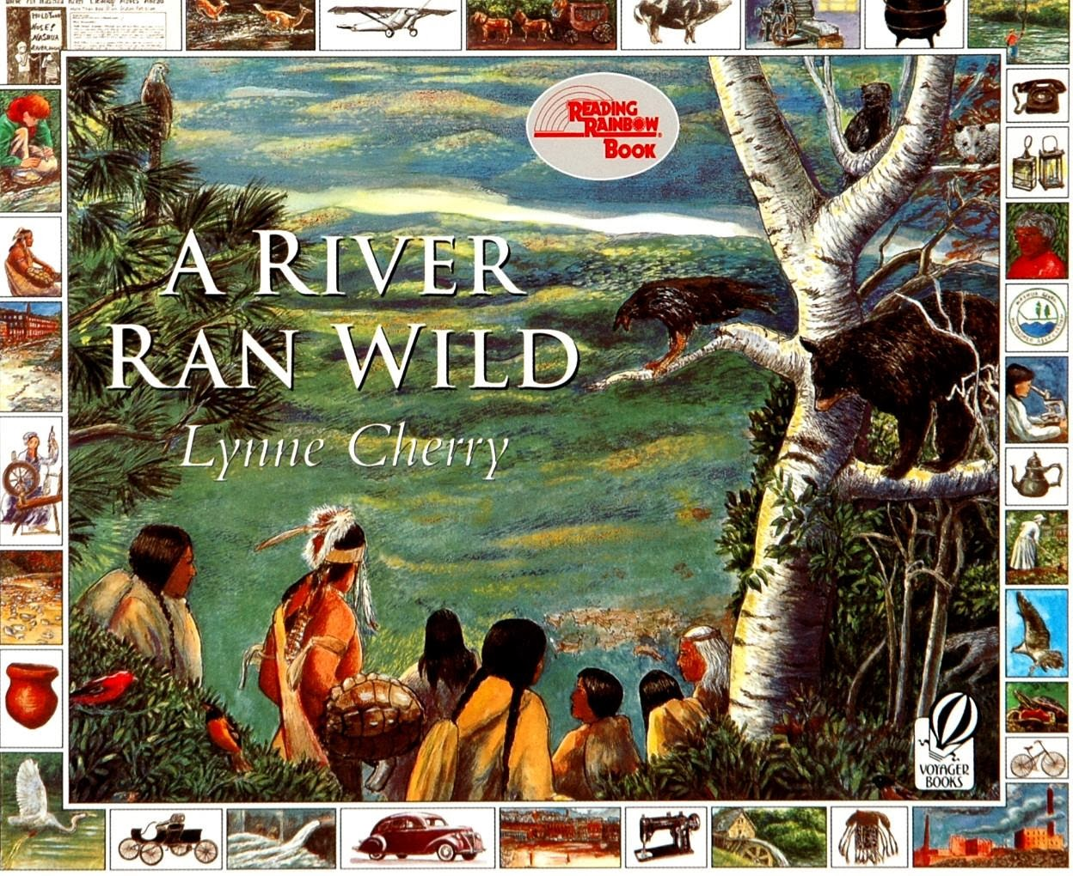

Slide 2
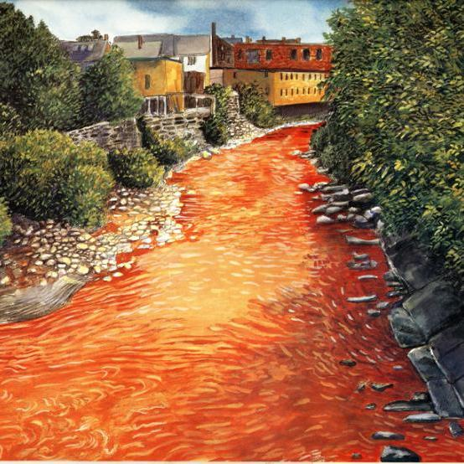
From CSI to ESI: Who killed the river?
What do you see? | What do you think? | What questions do you have?

Slide 3
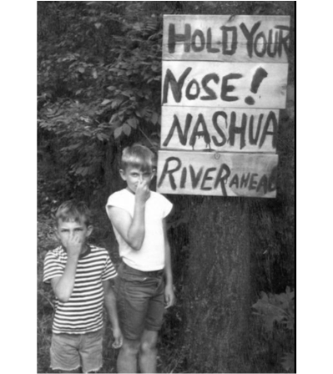
Step 1
Becoming a Detective
•As a detective, your job will be to explore the following documents to determine who or what killed the Nashua River.
•The Nashua River is located in northern Massachusetts.
In the 1960's, the Nashua River's pollution could be smelled long before reaching the river's banks.
(NRWA Archives)

Slide 4
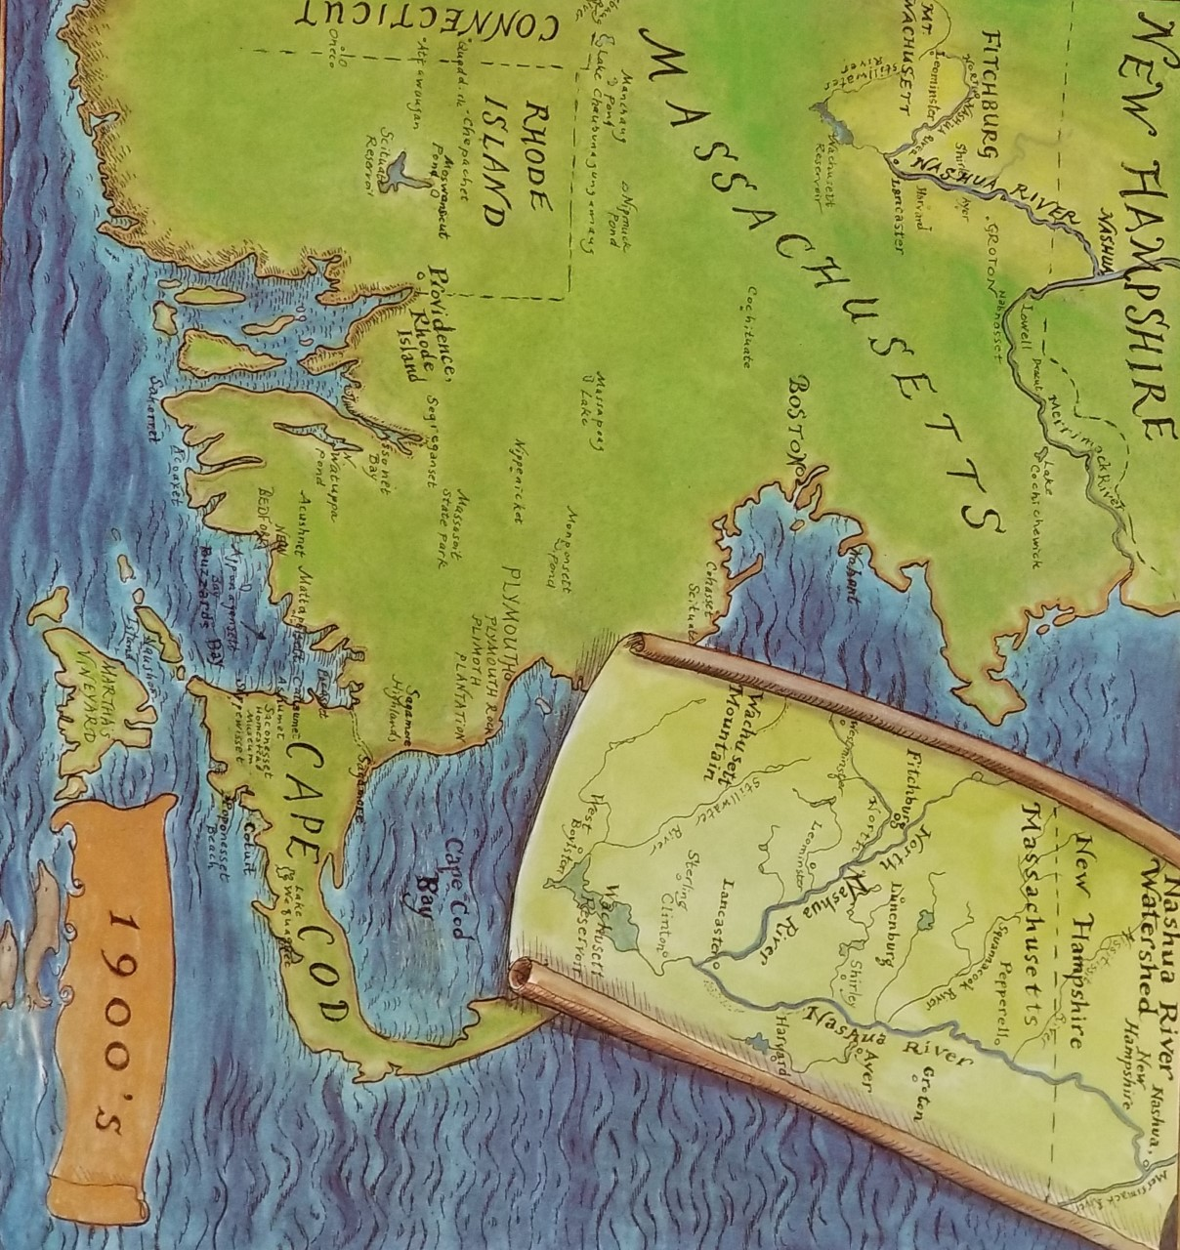
Nashua River
https://earth.google.com/web/@42.71564655,-71.51303715,65.69118264a,34181.23914254d,35y,0h,0t,0r/data=ChMaEQoJL20vMDQ1cjNyGAIgASgC
Notes:
Introduce the book, show the map. Use link to Google Earth to show location. Point out the timeline on the map pages.

Slide 5
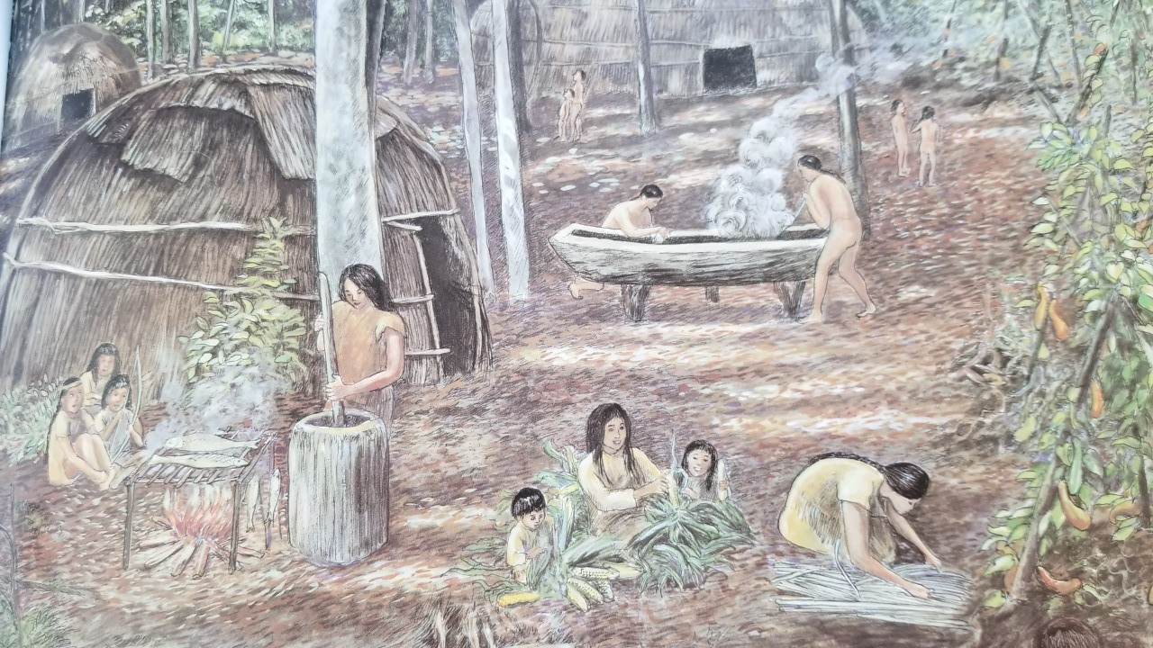
Step 2: Investigating the Evidence:
The Nashaway were a tribe of Algonquian Indians inhabiting the upstream portions of the Nashua River valley in what is now the northern half of Worcester County, Massachusetts near Mount Wachusett.

Slide 6
Investigate Native American Tribes
https://www.history.com/topics/native-american-history/native-american-cultures

Slide 7
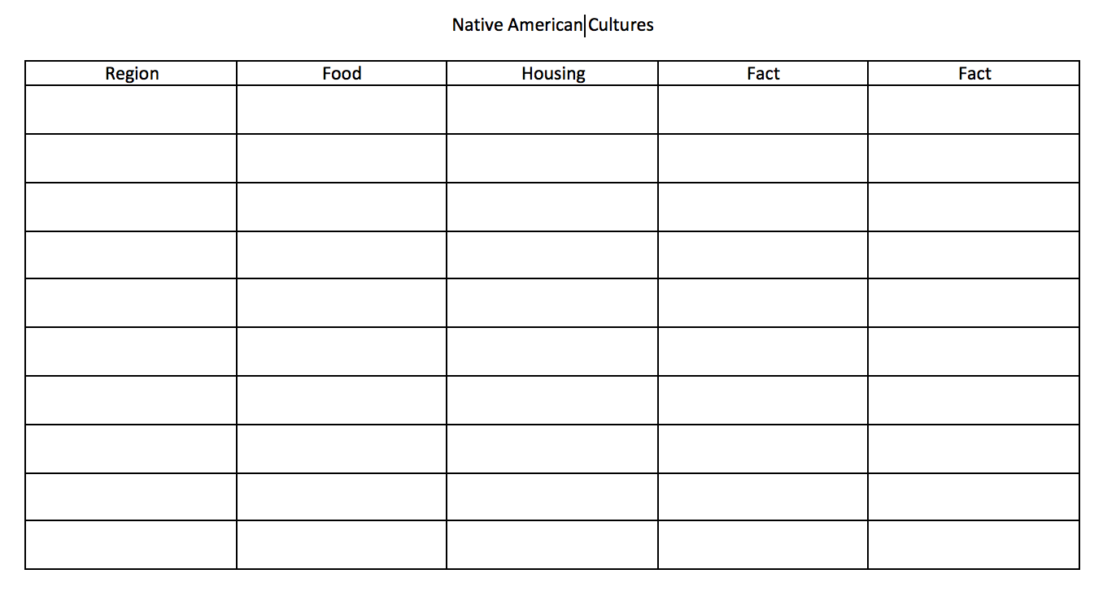
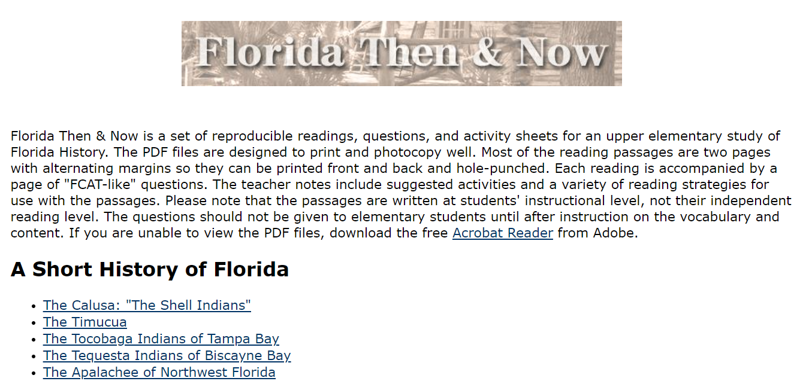
Investigate Native American Tribes
Florida Then & Now (usf.edu)

Slide 8
From CSI to ESI: Who killed the river?
Have any of your questions been answered?
What questions do you have now?

Slide 9
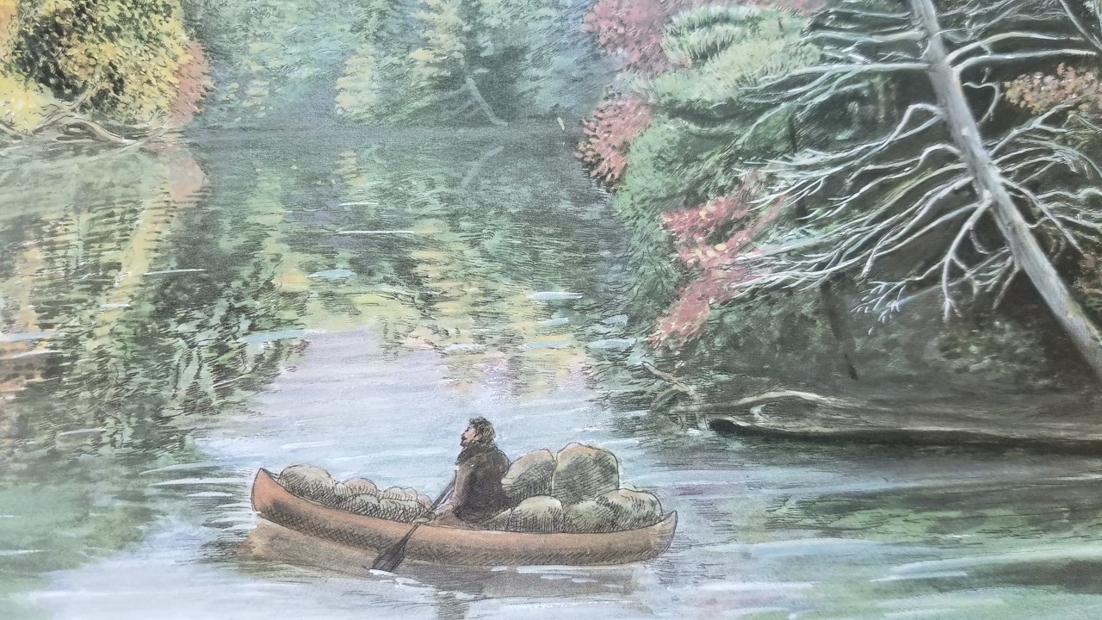
The fur trade in North America began during the 1500s when Europeans explored the eastern coast. Native Americans traded furs, deer hides, and meat for iron tools, wool blankets, colorful cloth, and guns.

Slide 10
Investigate Early Trade
https://sunnymoney.weebly.com/5.html

Slide 11
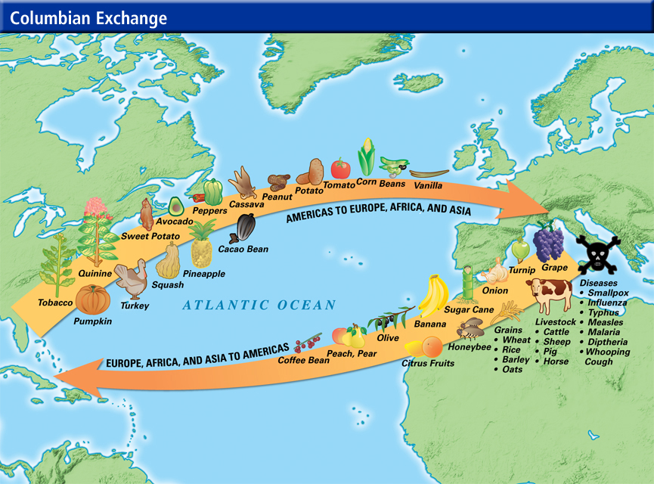
Investigate Early Colonial Trade
https://www.southamptonschools.org/site/handlers/filedownload.ashx?moduleinstanceid=1227&dataid=23681&FileName=Columbian%20Exchange.pdf

Slide 12
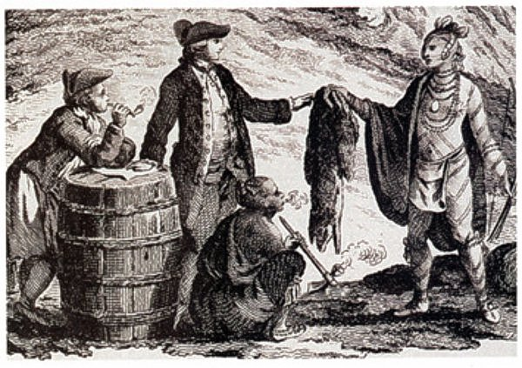
Investigate Early Colonial Trade
https://www.khanacademy.org/humanities/us-history/precontact-and-early-colonial-era/old-and-new-worlds-collide/a/environmental-and-health-effects-of-contact

Slide 13
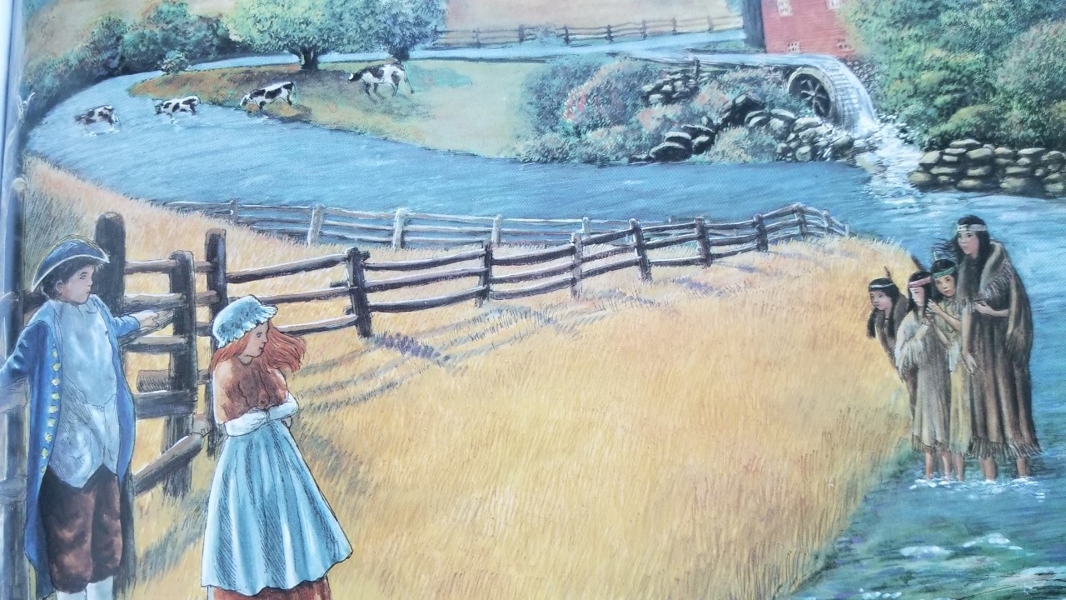
The growth of settlements along the Nashua led to fights between settlers and Indians. Settlers fenced land and cut down forests. They hunted and killed more animals than needed for survival in order to sell pelts to be sent to England.

Slide 14
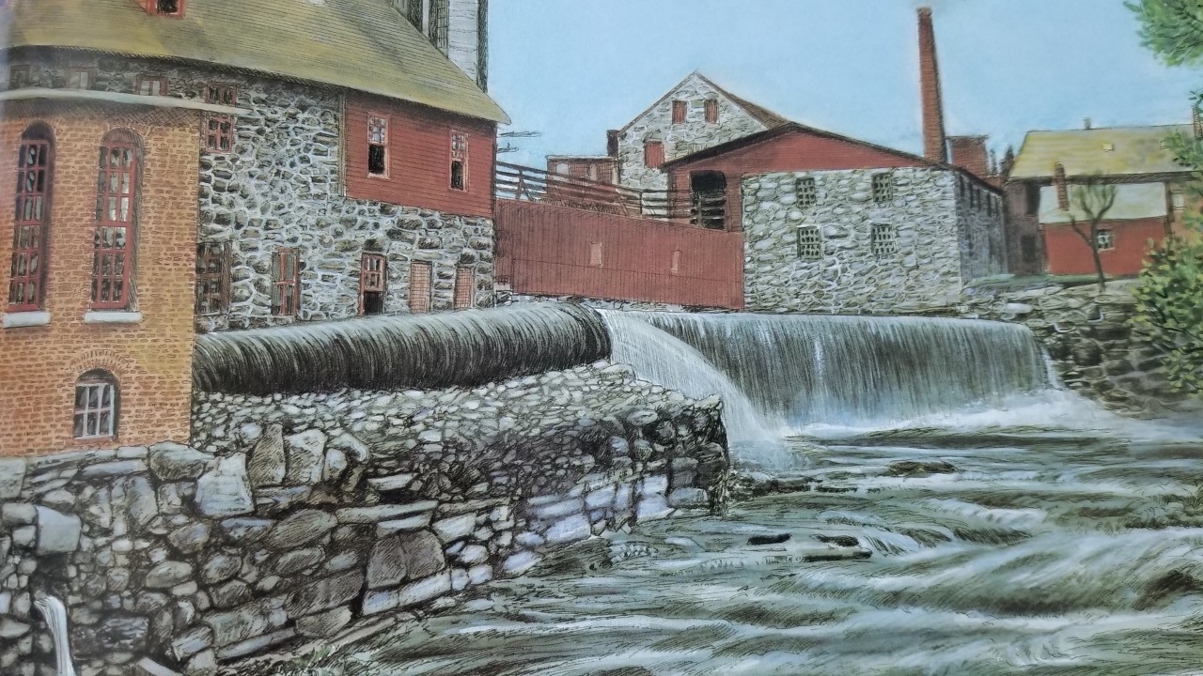
The Industrial Revolution impacted settlements in North American into the 19th century. America’s economy grew as new industries formed. New machines for making cloth and paper dumped their waste into the Nashua River.

Slide 15
From CSI to ESI: Who killed the river?
Have any of your questions been answered?
What questions do you have now?

Slide 16
Extra Activity: Technology and Development of the Market Economy
https://sunnymoney.weebly.com/5.html

Slide 17
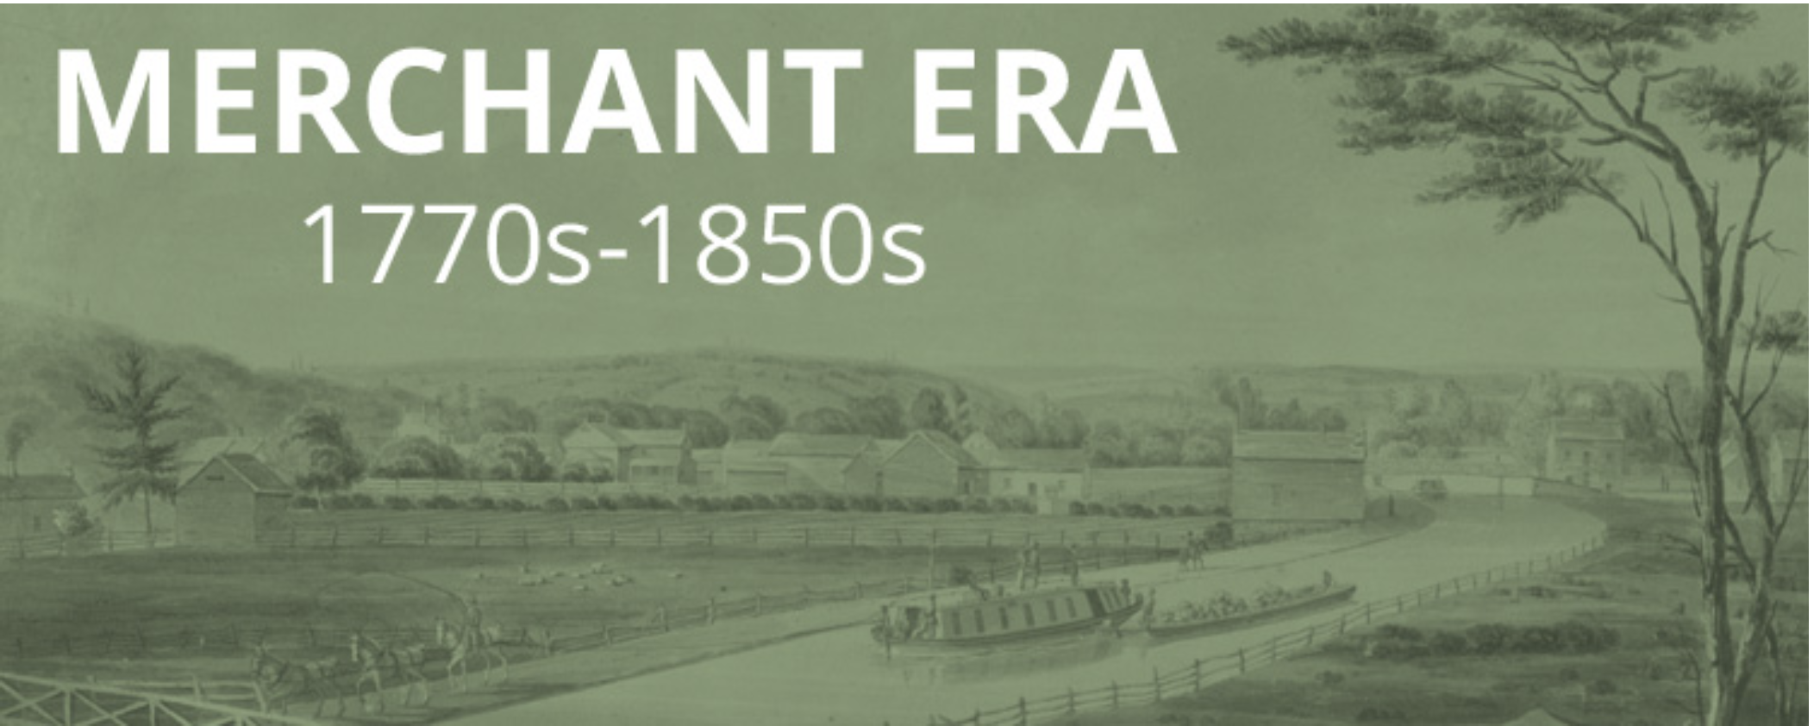
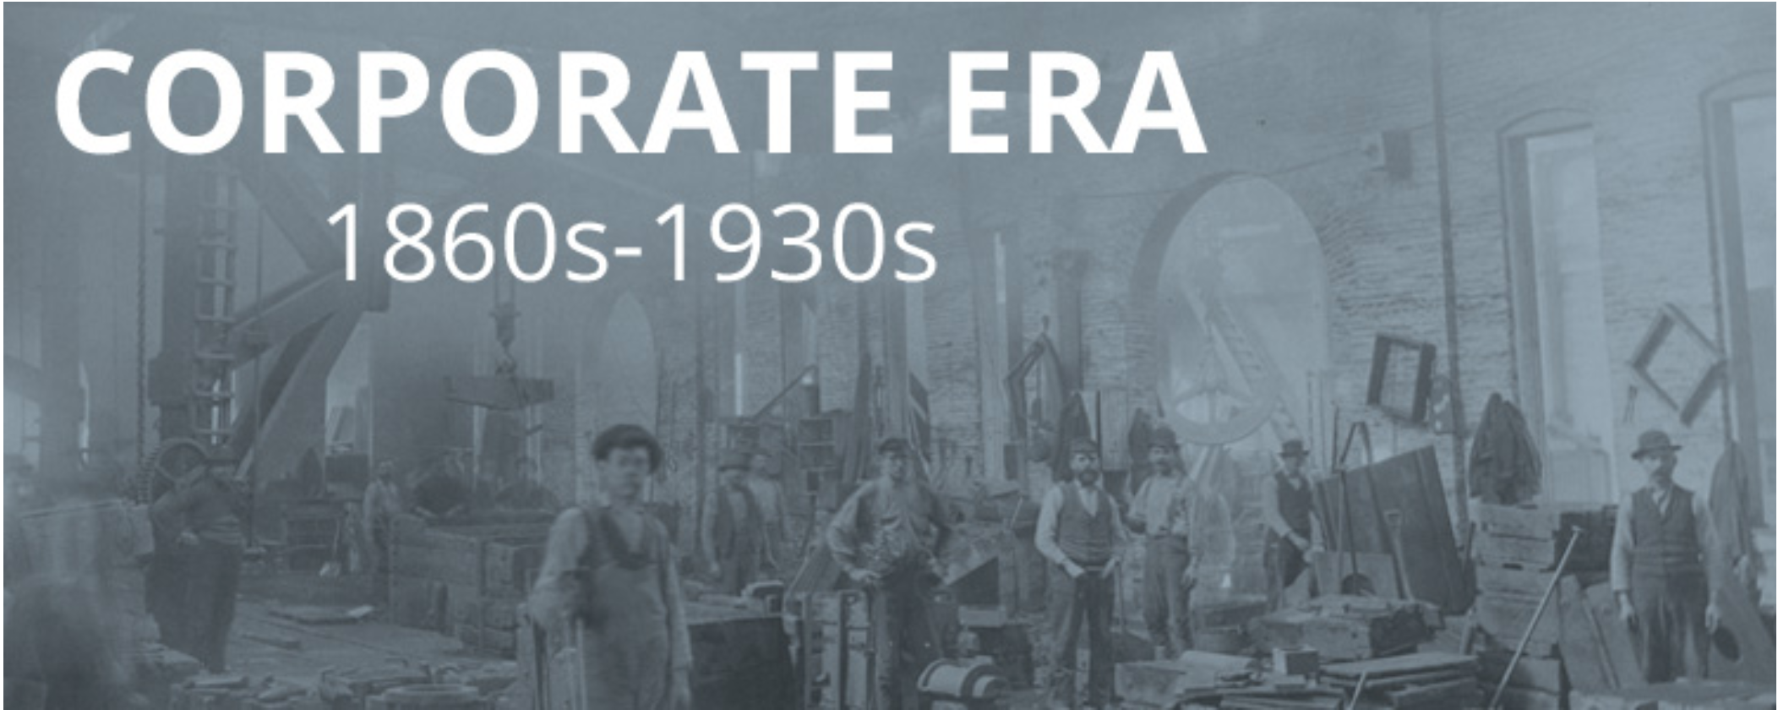
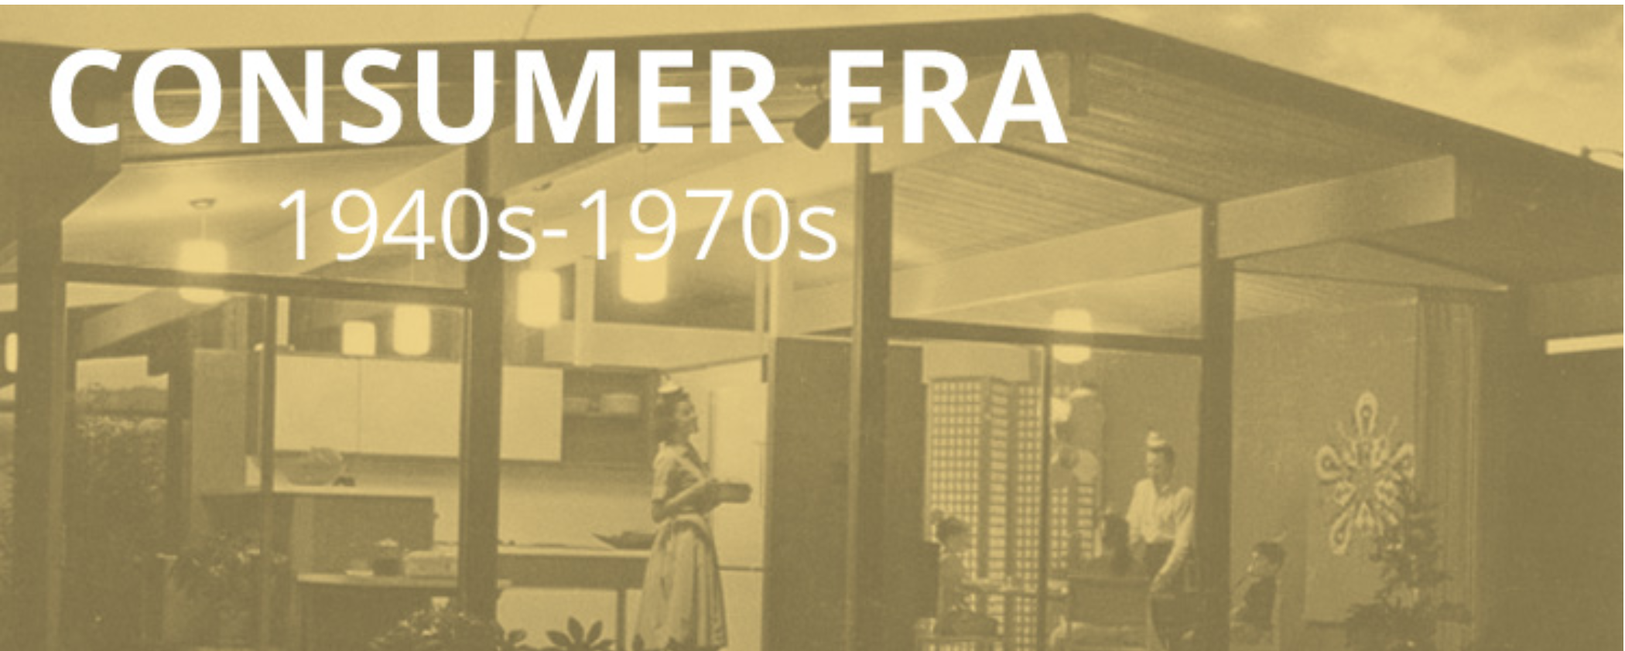
Extra Activity: Technology and Development of the Market Economy
https://americanhistory.si.edu/american-enterprise-exhibition

Slide 18
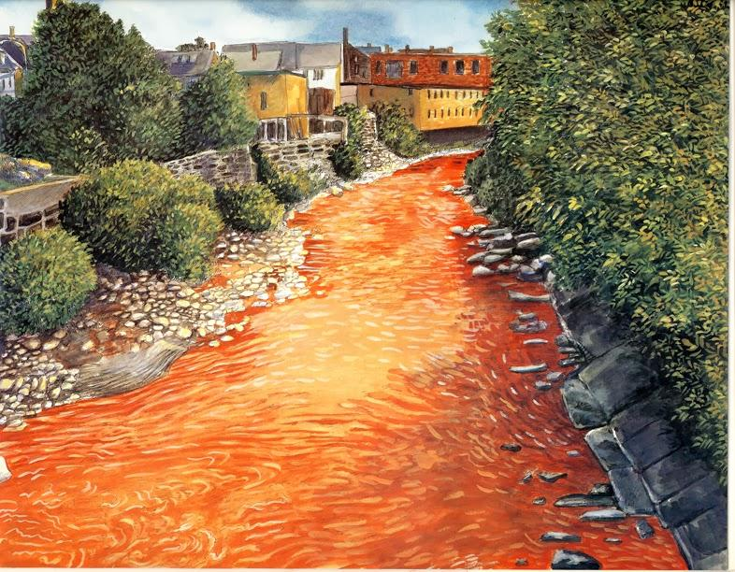
The polluting of the Nashua River caused it to run more slowly. Over time, pulp clogged the river, fish died and the dark and dirty river smelled bad. Birds no longer came to the river.

Slide 19
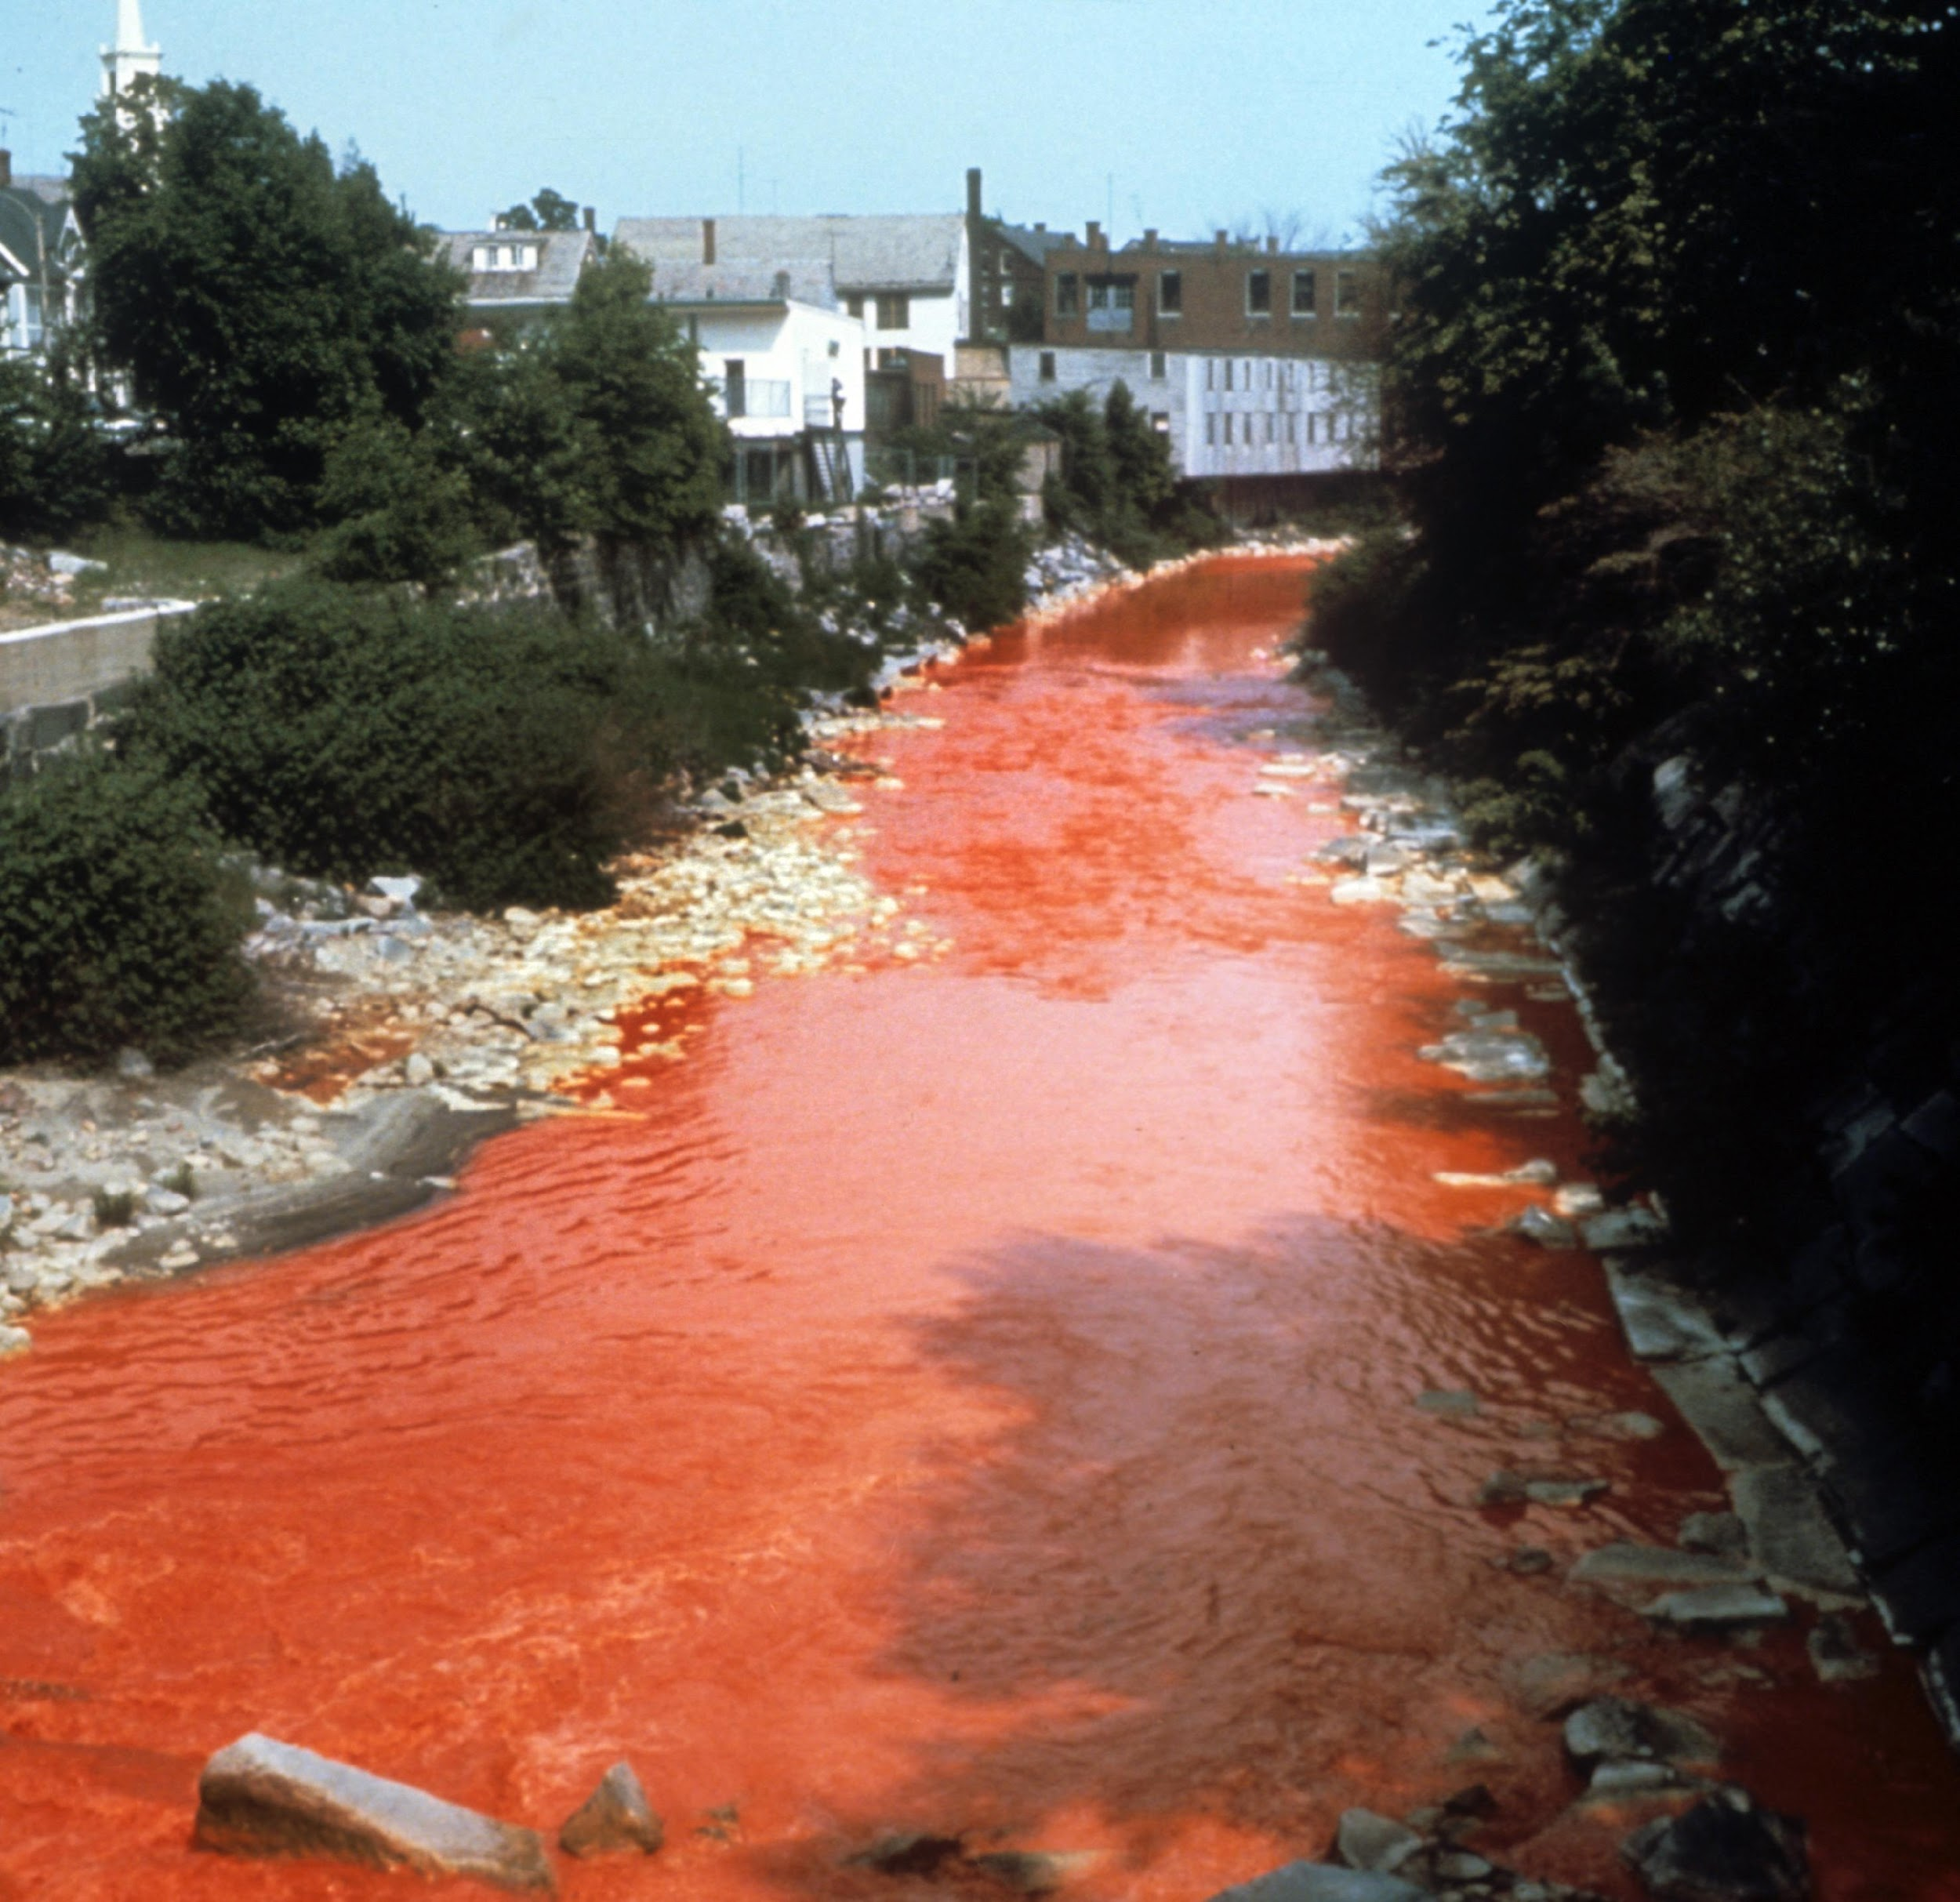
Investigate evidence in the next slides
Descriptive Questions:
Who, What, When, Where
Analytical Questions:
How, Why

Slide 20
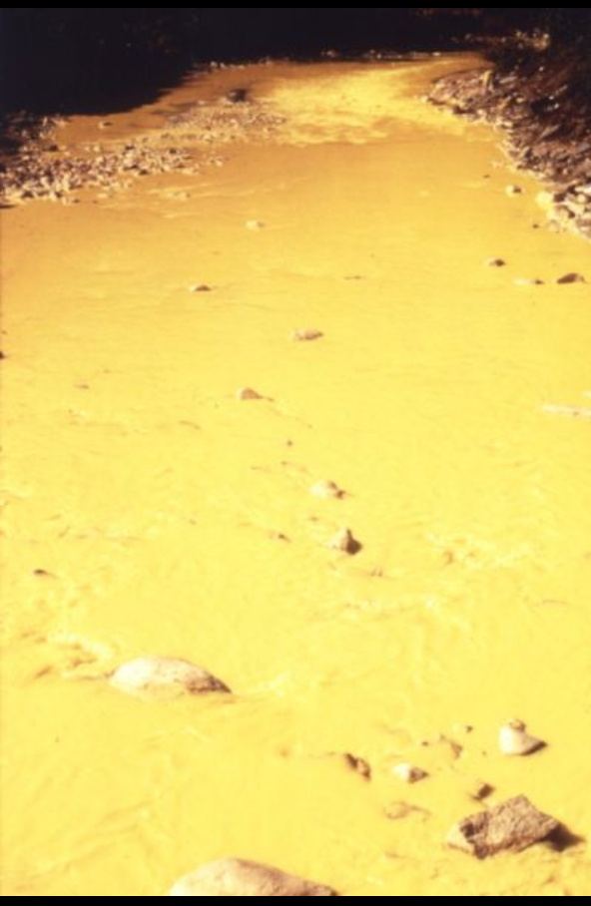
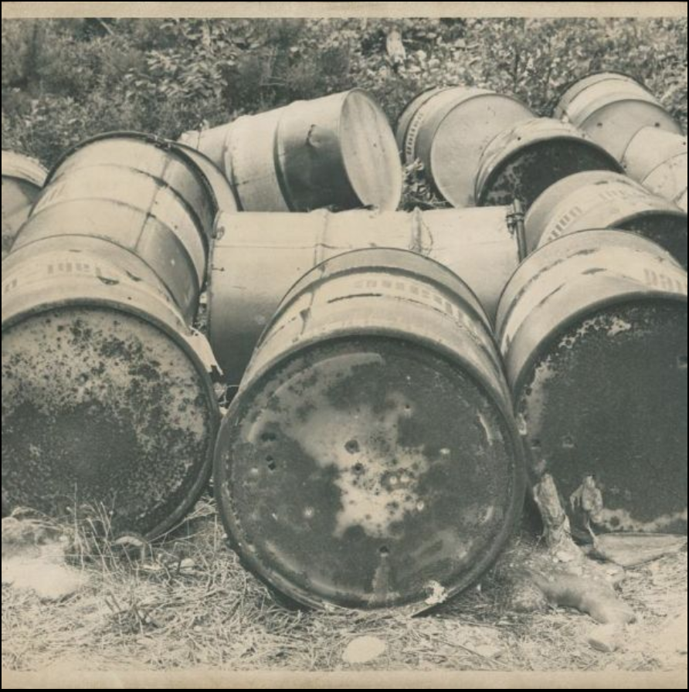
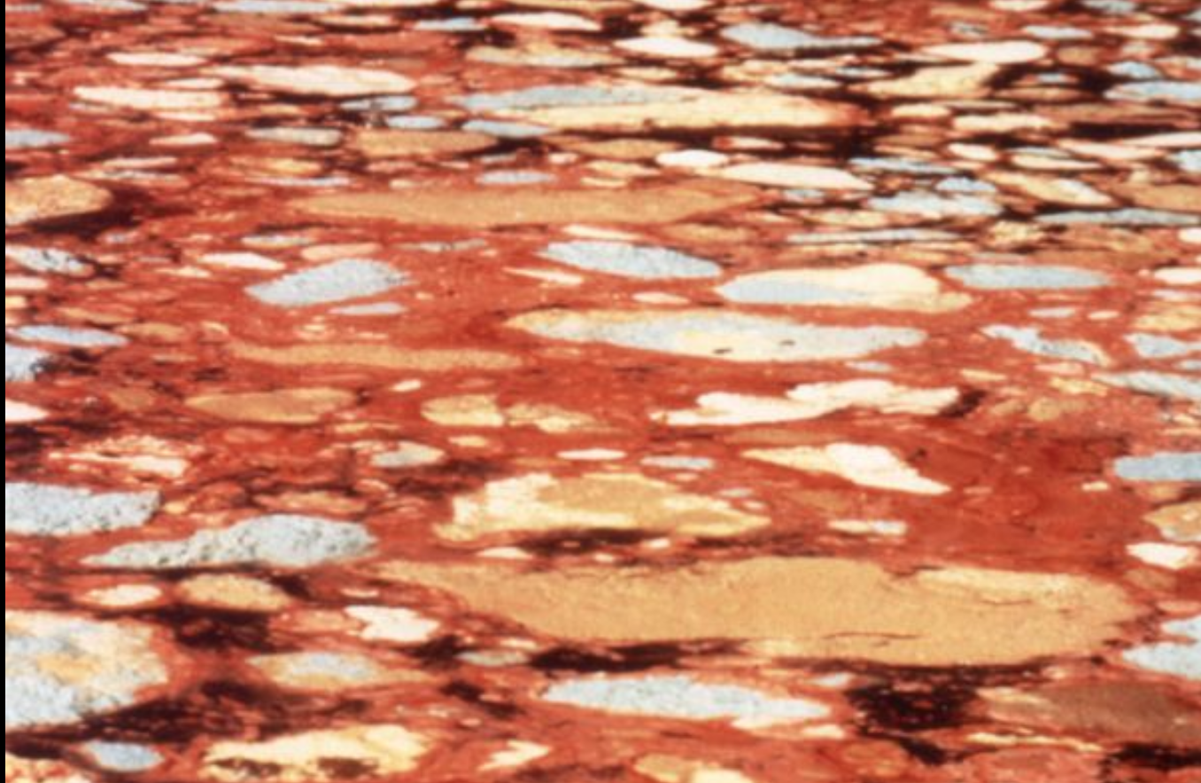
Observe, Infer, Ask Questions
Exhibit 1: A mat of paper sludge from local mills
floating on the Nashua River in the 1960's
(NRWA Archives)
Exhibit 3: Barrels that contained chemicals for making paper dumped at the river's edge.
Exhibit 2: Yellow dye pollutes the Nashua River in the 1960's
(NRWA Archives)

Slide 21
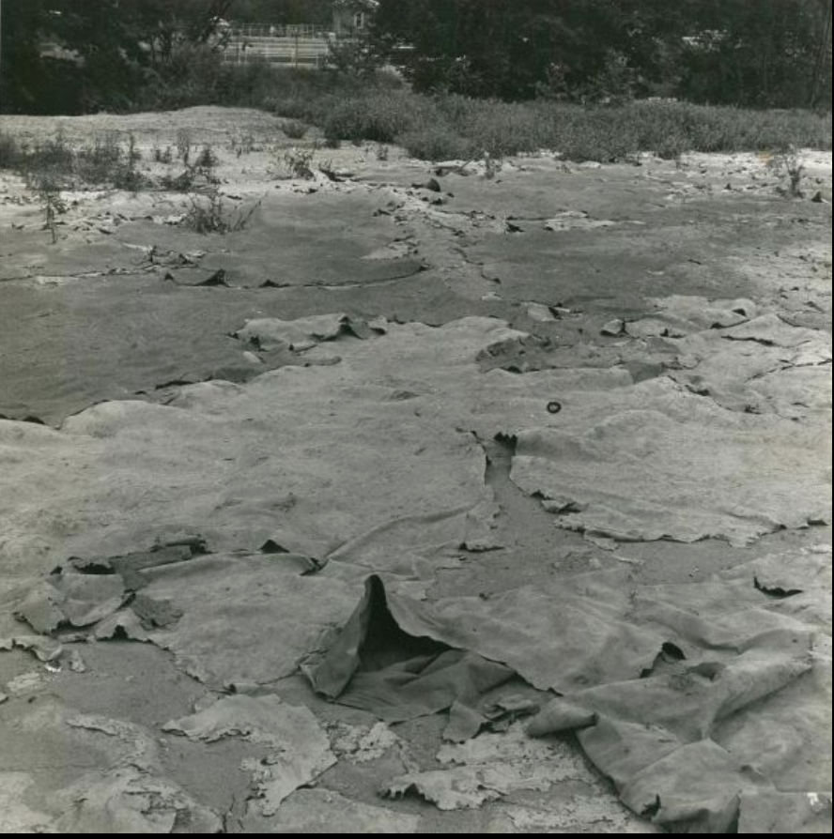
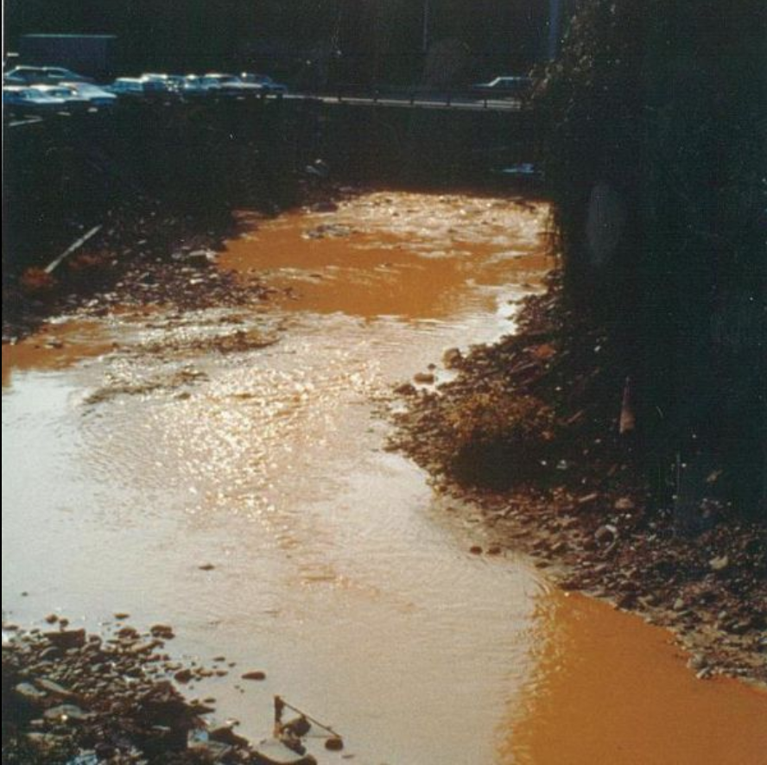
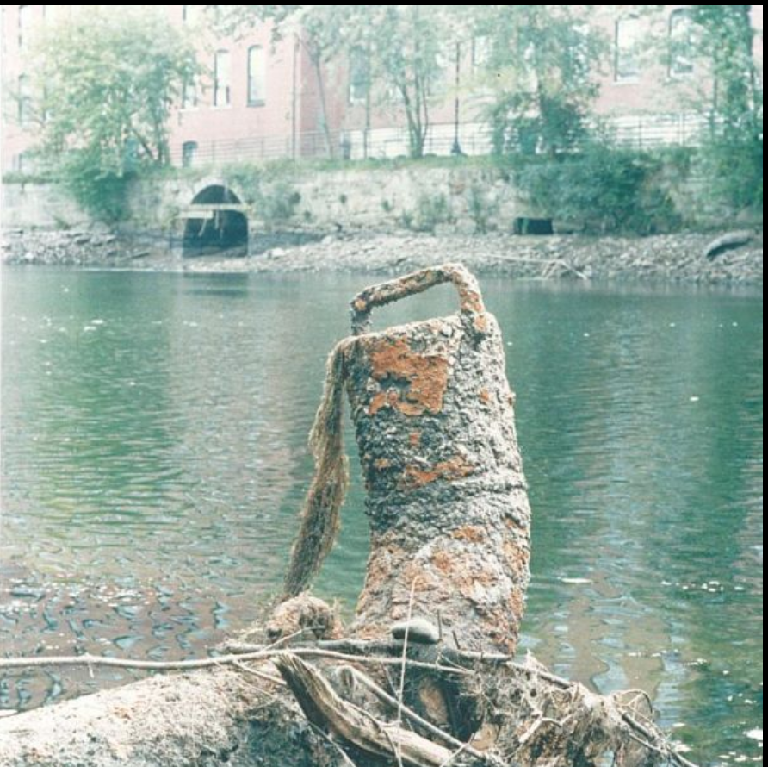
Observe, Infer, Ask Questions
Exhibit 4: Paper mill refuse, Nashua River flood plain, Leominster, MA
(Photo by Jack Swedberg)
Exhibit 6: Downstream from a factory.
Exhibit 7: Exposed pipe from factory into river

Slide 22
From CSI to ESI: Who killed the river?
Have any of your questions been answered?
What questions do you have now?

Slide 23
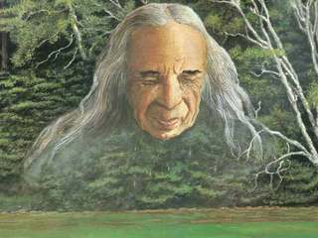
Who will save the river?

Slide 24
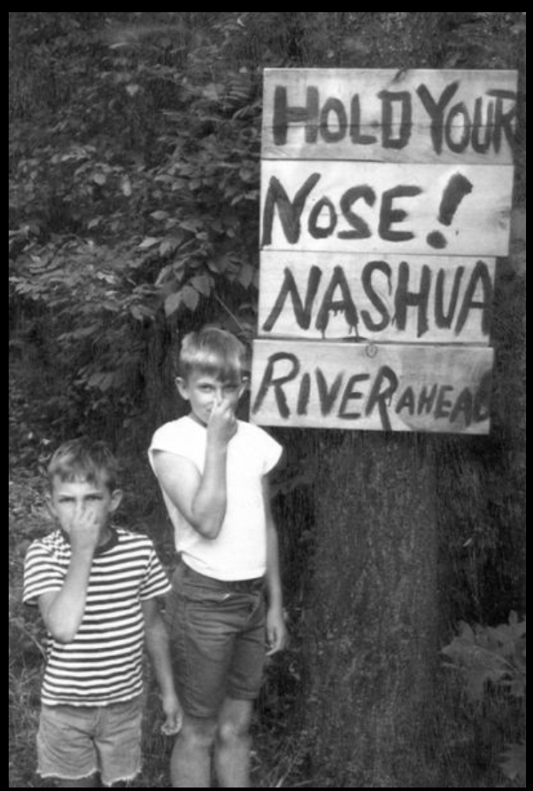
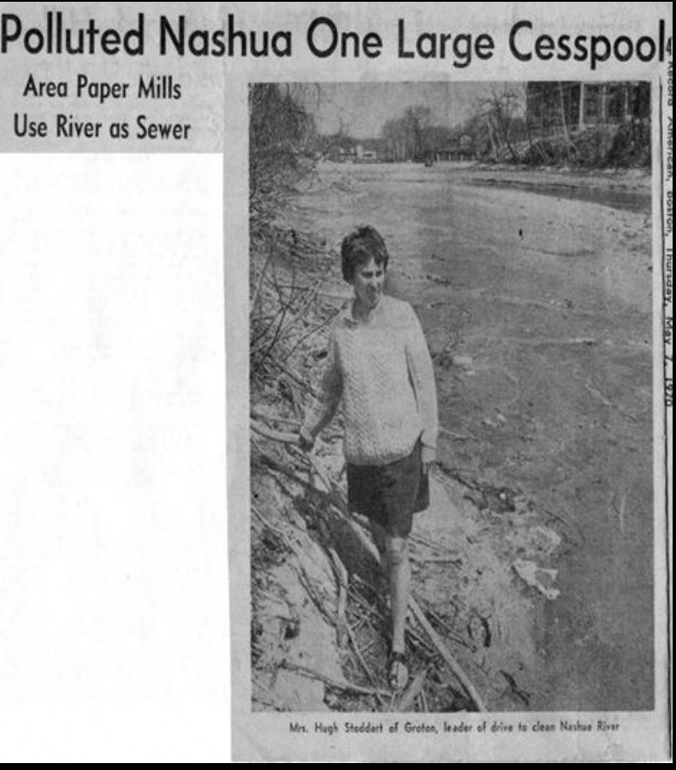
NRWA Historical Highlights
The restoration of the Nashua River launched the Nashua River Watershed Association into an international spotlight, a prime example of collaboration to accomplish a goal for the betterment of all society. The Association’s leadership and approach to protecting natural resources through a watershed approach, protecting both land and water throughout the region, continues to be recognized by federal, state, and local governmental leaders, as well as by leaders in the fields of environmental protection and environmental education.
What questions do you have now?
In the 1960's, the Nashua River's pollution could be smelled long before reaching the river's banks.
(NRWA Archives)
Marion Stoddart led the movement to restore the highly polluted Nashua River.
(NRWA Archives)

Slide 25
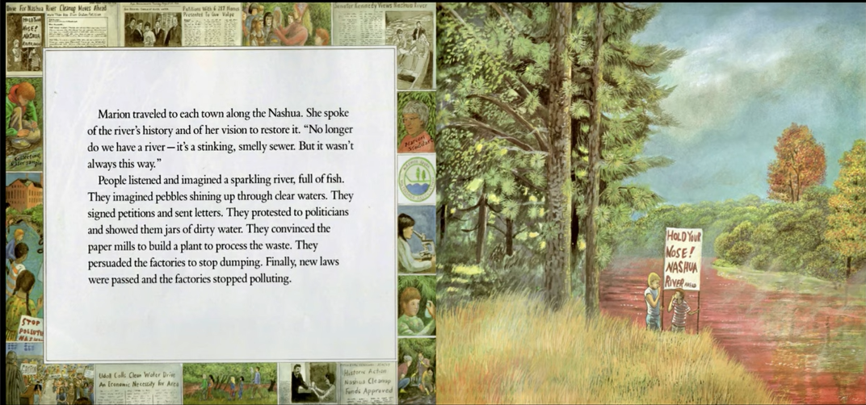
What questions do you have now?

Slide 26
Who Saved the River?
In 1965, the U. S. Congress passed the first Clean Water Act. The next year, Marion Stoddart coordinated a successful citizen campaign that led to the passage of the Massachusetts Clean Water Act of 1966.
https://www.youtube.com/watch?v=OQ3j4_HQJ4o
Stop video at 2:30

Slide 27
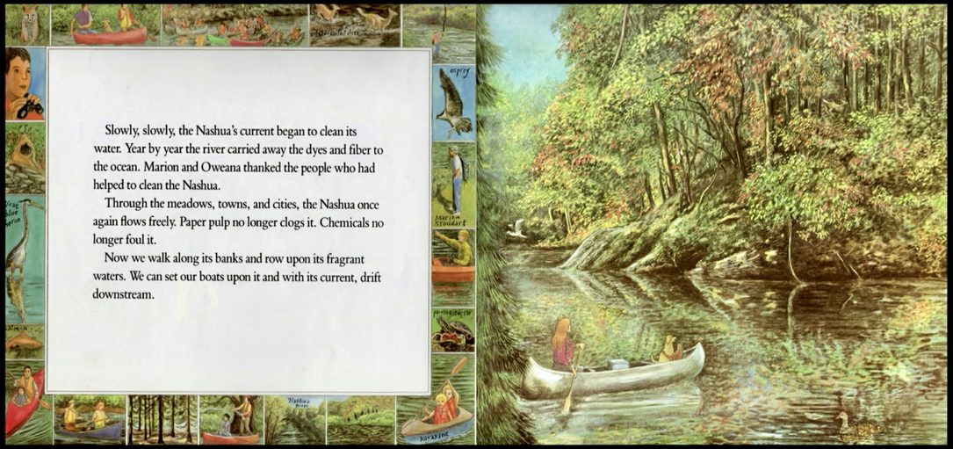

Slide 28
Saving the Nashua River
In the early 1960s there were no laws regulating the way waste from industry was disposed of on either the state or federal level in the United States. By the mid-1960s there was some preliminary legislation to regulate the pollution of waterways, but as yet no laws on the state level. In the 1960s, when Stoddart began to organize to save the Nashua River, it was one of the ten most polluted rivers in the US.^{[3]}
In 1962 the Stoddarts moved from Nevada to the small community of Groton Massachusetts with their three children.^{[4]} Their home in Groton was only three quarters of a mile from the Nashua River, which by then was already known to be highly polluted, and even dangerous. To address the problem, Stoddart enlisted the help of thousands of ordinary citizens to form a Nashua River Clean Up Committee. She also met with Massachusetts Governor John Volpe, Fitchburg Mayor William Flynn, and executives of the paper mills that were polluting the river. Through her tireless efforts Stoddart was able to get the first anti-water pollution bill enacted by any state in the US: the 1965 Massachusetts Clean Water Act.^{[3]}
Stoddart’s work did not stop with the passage of the 1965 legislation. She also founded the Nashua River Watershed Association. This organization helped to further protect 174 miles of the river and its major tributaries.^{[3]}
Marion Stoddart - Wikipedia

Slide 29
Summary of the Clean Water Act
https://www.epa.gov/laws-regulations/summary-clean-water-act
https://ejatlas.org/print/nashua-river-pollution-usa
Nashua River, 1962

