Slide 1
5th Grade What Energy Should You Use?
Problem
What form of energy should the More than Once-ler use?
Alternatives
What forms of renewable and non-renewable energy are you examining?
Criteria
What are important considerations related to each alternative?
Decision
What form of energy would you use if you were trying to be the person who cares about people, planet, and profit?

Slide 2
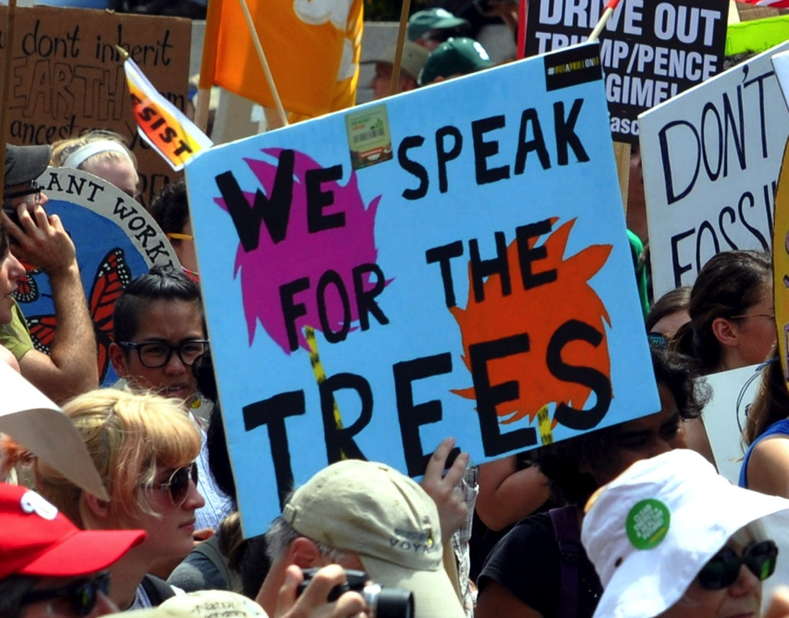
Image Analysis
What do I see? | What do I think? | What do I wonder?
What do you see in the picture? What do you see in the caption? | What was happening? Who were the people? Why were they carrying a sign? What is their message?
Edward Kimmel from Takoma Park, MD Climate March 0777 Lorax
Placard "We speak for the trees" at the Climate March. Reference to Dr. Seuss's The Lorax.
Notes:
After analysis, explain to students that this image is of a lake’s ecosystem. Ecosystems are areas where living and nonliving things live together in balance.

Slide 3
Watch the video: What is renewable energy?
https://www.youtube.com/watch?v=1kUE0BZtTRc

Slide 4
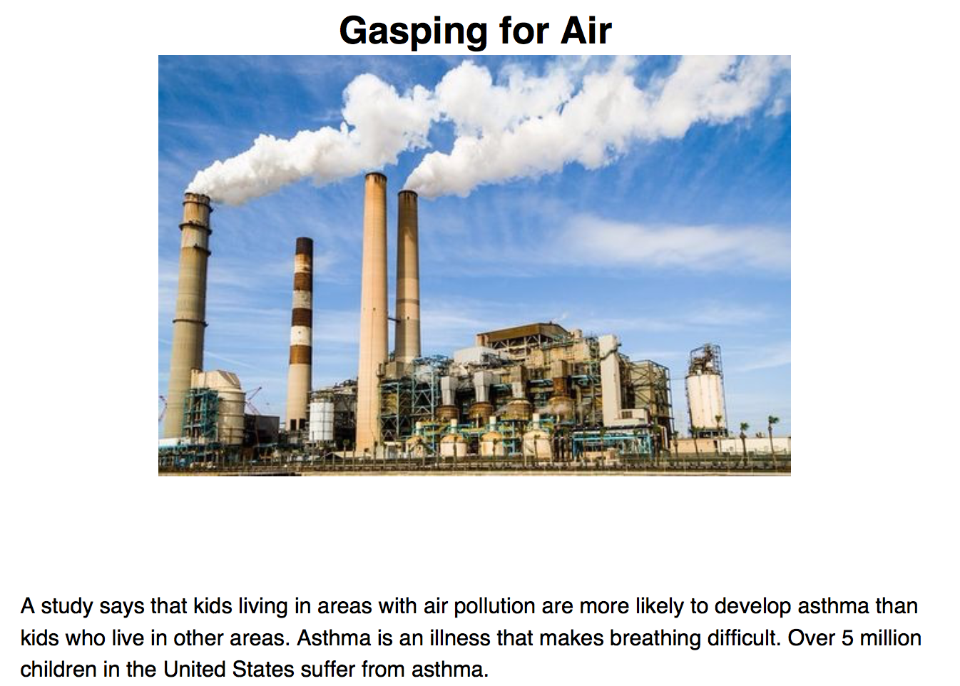
Read the informational texts (Readworks)

Slide 5
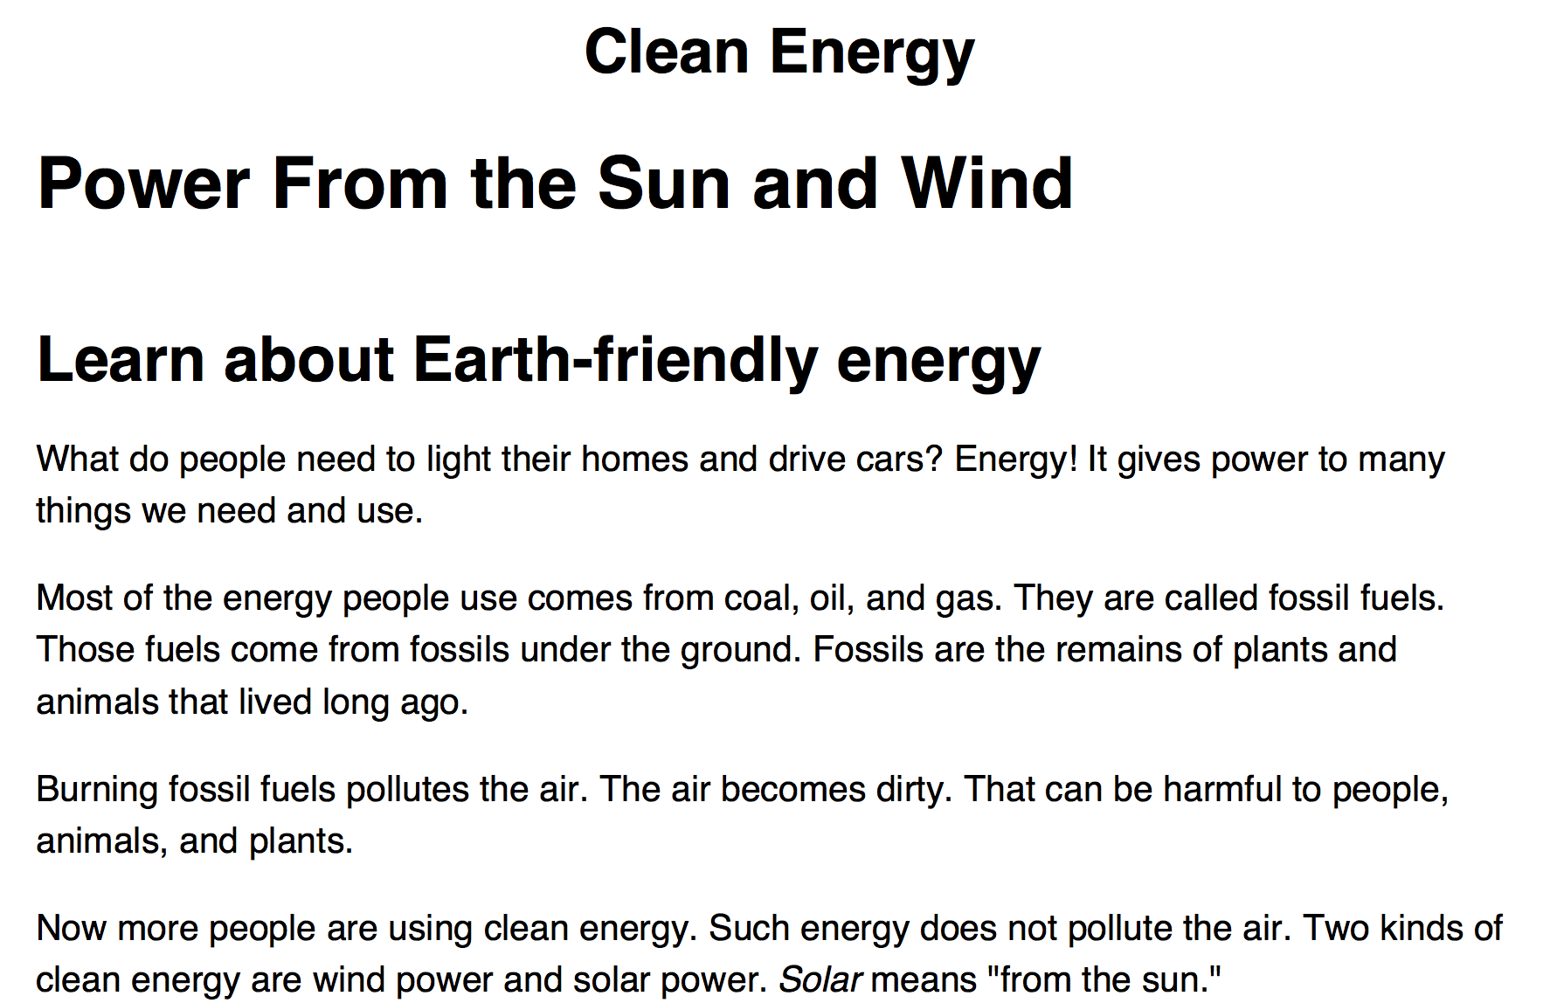
Read the informational texts (ReadWorks)

Slide 6
Read the Informational Text (NEED)

Slide 7
Sustainable Thneeds Inc.
2015 Solution Way
Cleanville, FL 36498
Dear Students,
My name is The More Than Once-ler and I am the new Sustainability Manager of Sustainable Thneeds Inc., a manufacturing company in Florida. We are building a new factory in Florida and need to decide which type of energy to use to power it. The kids in the local community want us to use a form of energy that will protect Florida’s environment so that they will have a clean and safe place to live when they grow up.
We need to know what type of energy you would suggest that our developers use in our new factory. We have given you an energy chart to help you make your decision.
Please write us back on the attached template, including how you arrived at your decision. Thank you for your assistance with this project!
Regards,
The More Than Once-ler
Sustainable Thneeds Inc.
Introduce the problem.
What is the problem?
What is the More Than Once-ler asking you to do?

Slide 8
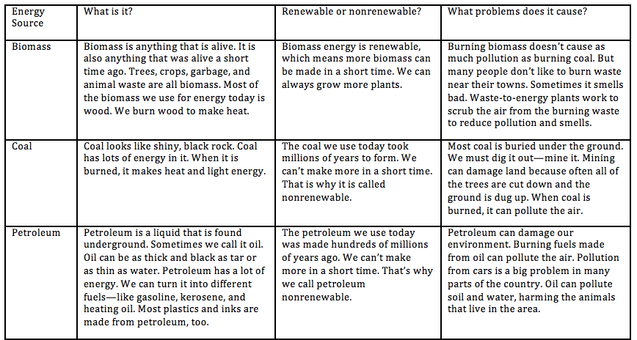
Research the alternatives.

Slide 9
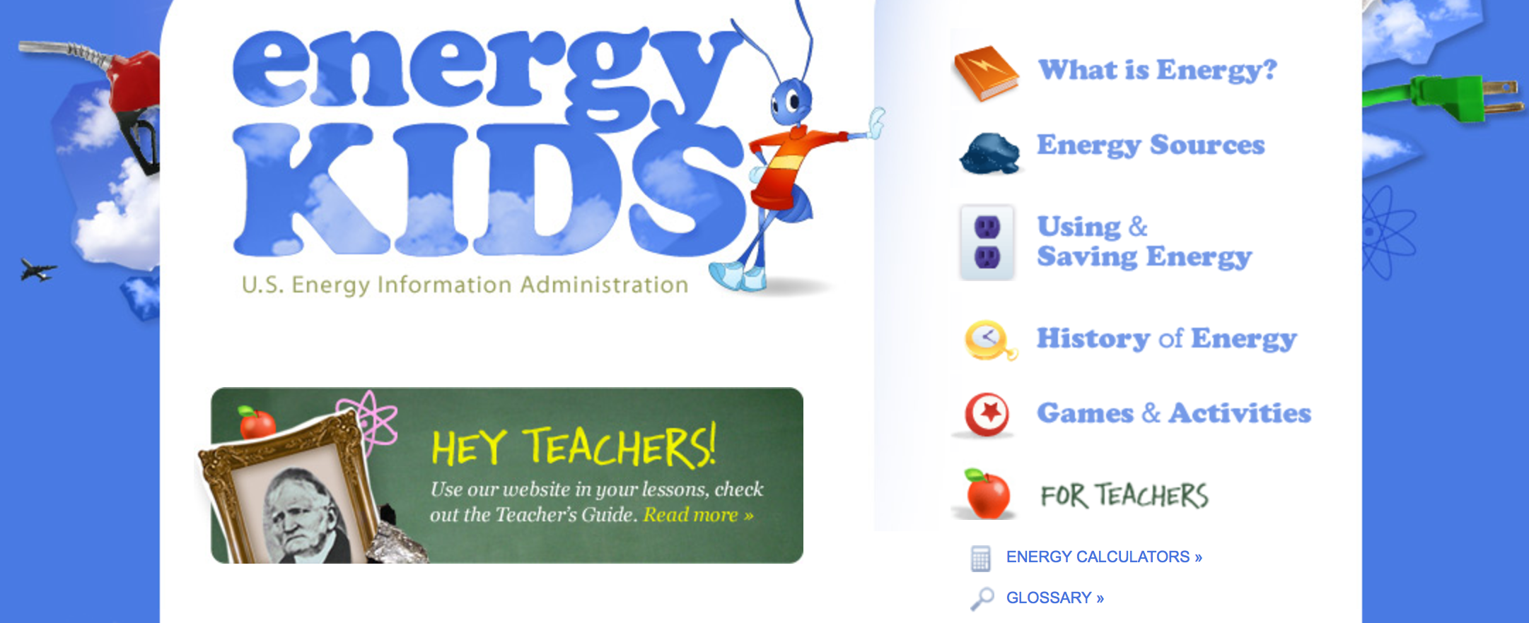
Research Using the EIA.gov
https://www.eia.gov/kids/

Slide 10
Research Using the NASA Climate Kids
https://climatekids.nasa.gov/menu/energy/

Slide 11
Rank the alternatives.
Guiding/reflective Questions
Which resources are scarce? Scarce resources are non-renewable. Which energy sources are scarce?
What are the costs of the different energy choices?
What are the benefits of the choices?
Which decision would you make based on the criteria mentioned by the More than Once-ler?
Based on your research, are there any other things you would recommend to More than Once-ler?

Slide 12
Write proposal to More than Once-ler
Dear The More Than Once-ler,
Our team has reviewed all of the data that you provided and are suggesting the following types of energy for Sustainable Thneeds Inc. We have ranked the types of energy in order beginning with our top choice.
Top Choice of Energy:
Alternate Choice #1: Alternate Choice #2:
Alternate Choice #3: Alternate Choice #4:
The evidence we used to make our choice was:

