Slide 1
4th Grade– Hurricane Relief
Problem
Which location needs the greatest support following Hurricane Irma?
Alternatives
Key West, The Everglades, Miami
Criteria
Impact on ecosystems, impact on families, impact on tourism, impact on the local economy
Decision
How were locations ranked? How was that decision reached?

Slide 2
Social Studies Benchmarks:
SS.4.E.1.2 Explain Florida's role in the national and international economy and conditions that attract businesses to the state.
SS.4.C.2.2 Identify ways citizens work together to influence government and help solve community and state problems.
Financial Literacy Benchmark:
SS.4.FL.1.1 People have many different types of jobs from which to choose. Identify different jobs requiring people to have different skills.

Slide 3
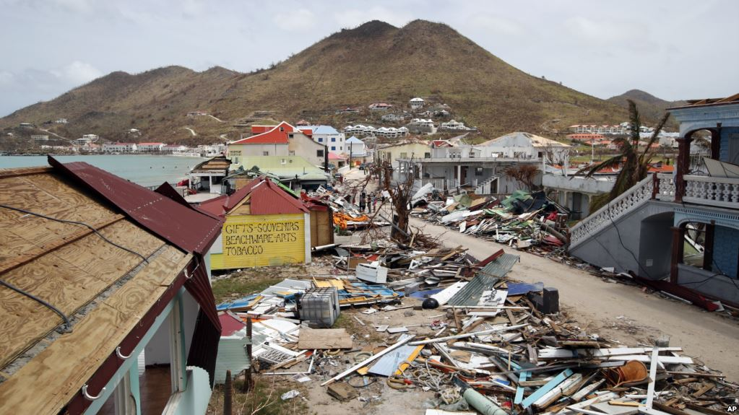
Image Analysis
What do I see? | What do I think? | What do I wonder?
What do you see in the picture? | What happened? | How might people and animals be affected?
Notes:
After analysis, explain to students that this image is of a lake’s ecosystem. Ecosystems are areas where living and nonliving things live together in balance.

Slide 4
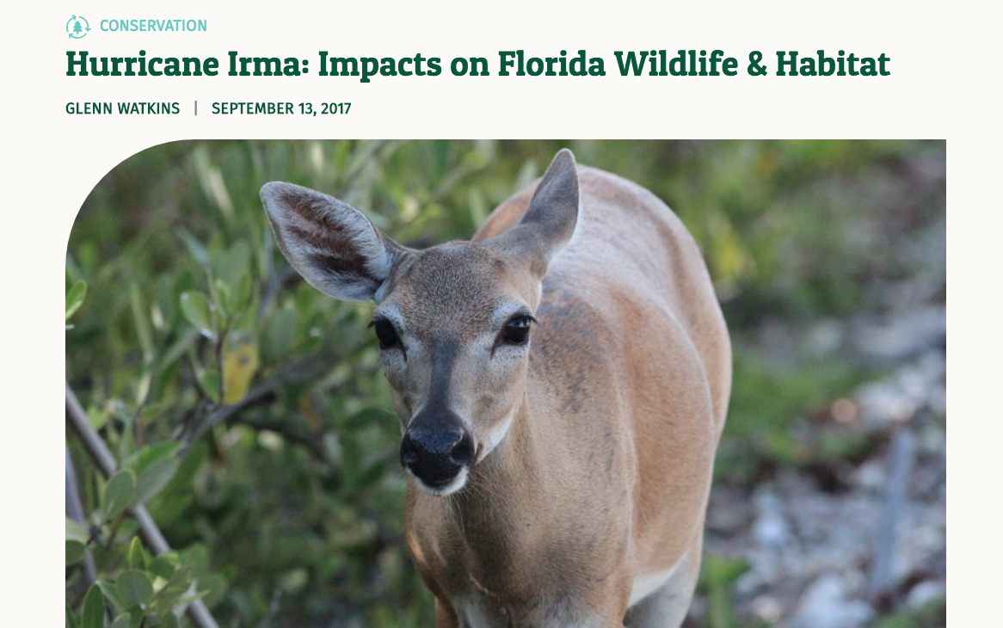
Read the Informational Text
https://blog.nwf.org/2017/09/hurricane-irma-impacts-on-florida-wildlife-habitat/
Model using the note-taking tool to record information on how the ecosystems in Miami, Key West, and the Everglades were impacted by Hurricane Irma. Note: Teachers will need to connect the coral reefs off of Miami Beach by showing students where The Florida Reef Tract is located.

Slide 5
Introduce the problem.
What is the problem?
What are the Hurricane Support Society and The Lorax asking you to do?

Slide 6
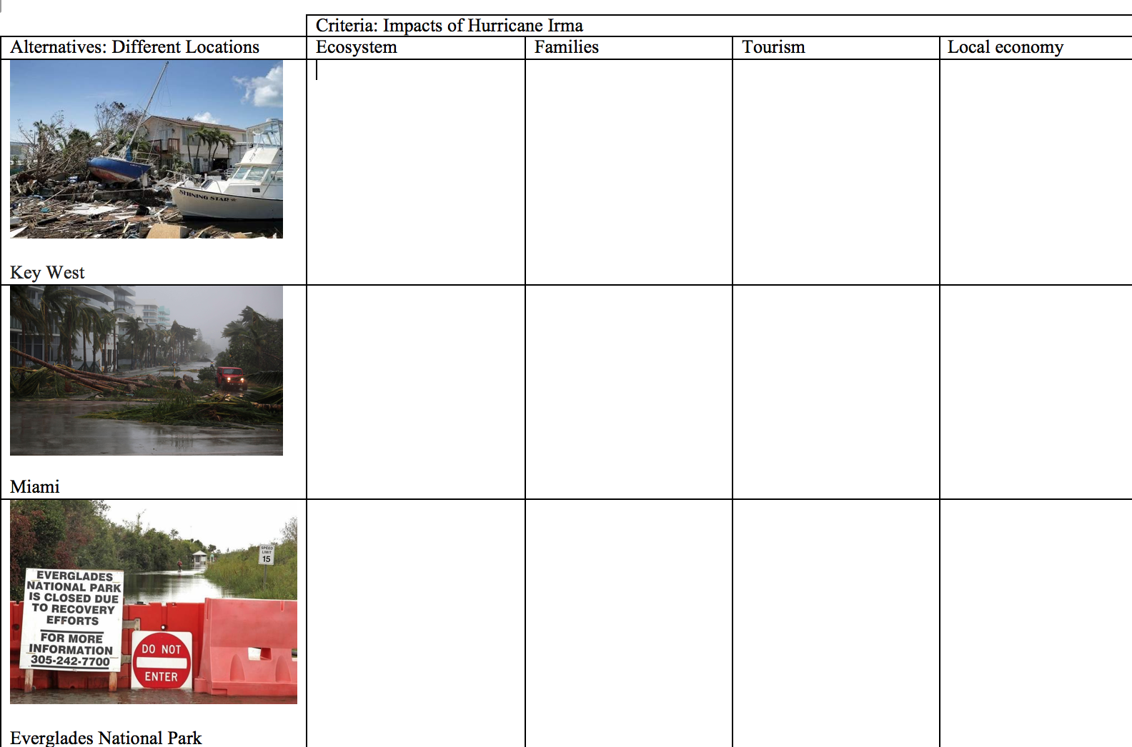
Research the alternatives.

Slide 7
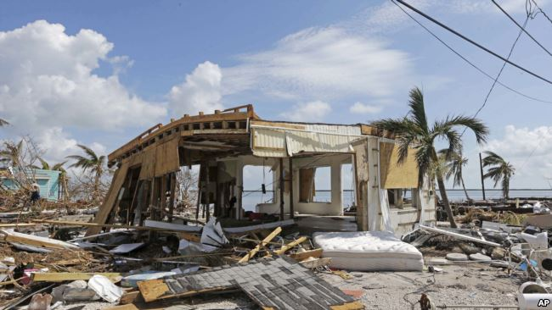
Research Impacts of Hurricane Irma on Tourism
Use the following links to research the impact of Hurricane Irma on tourism (scroll down to find specifics regarding Florida).
https://learningenglish.voanews.com/a/tourism-in-caribbean-and-florida-suffers-from-hurricane-irma/4027329.html
https://www.cnbc.com/2017/09/11/hurricane-irma-threatens-floridas-bustling-tourism-industry.html
http://www.miamiherald.com/news/weather/hurricane/article177383186.html

Slide 8
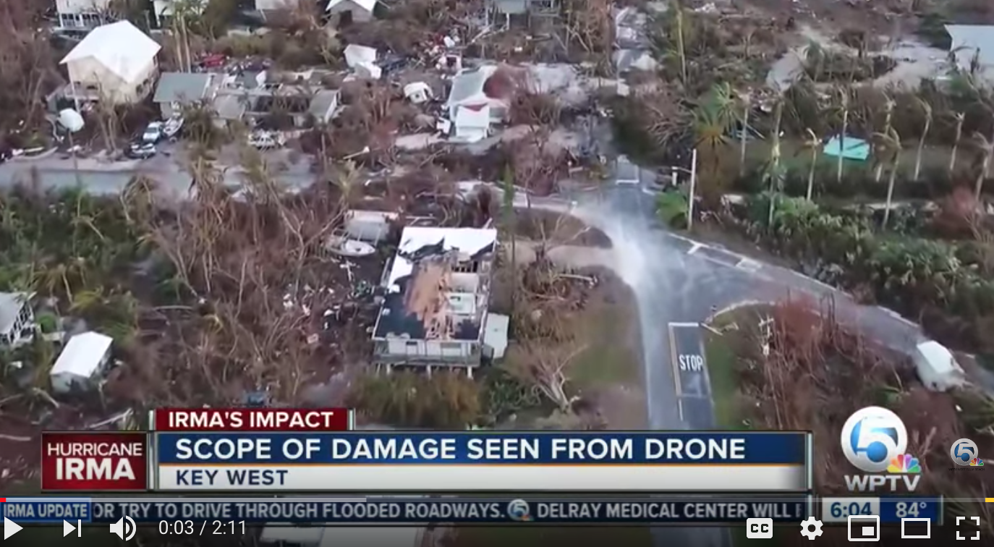
Watch the videos
Using the following links, students can research each location:
Key West
https://www.youtube.com/watch?v=bLwkmUeouh4 (newscast)
The Everglades
https://www.youtube.com/watch?v=p_pqaW7RgPo (newscast)
Miami
https://www.youtube.com/watch?v=FqCKKZBK_DM (live footage, Use first 2 minutes, then go to 8 minutes)

Slide 9
Rank the alternatives.
Guiding/reflective Questions
Which turtle would be the best choice for support?
Why do you think that?
What of the criteria is the most important to you?
Which animal would be your next choice? And after that?
Do you agree with your group's ideas? Why or why not?

Slide 10
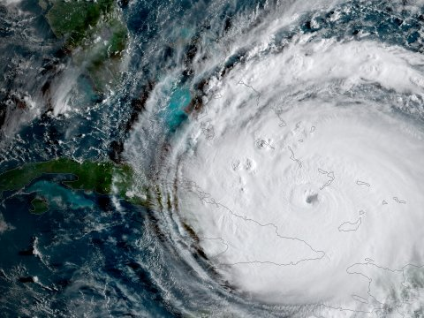
Write back to The Lorax and the Hurricane Support Society

Slide 11
Extend the learning.
Have each group create a presentation explaining how they made their choices.
Research the impact of Hurricane Irma on the Caribbean Islands and other parts of the United States.
Read more about hurricanes in articles from ReadWorks:
Storm Chasers https://www.readworks.org/article/Storm-Chasers/27890ad7-5d9f-4b52-a9f5-54c1fd632406#!articleTab:content/
Children of the Storm https://www.readworks.org/article/Children-of-the-Storm/2ba88535-da29-4142-ab75-7684b55aa8b9#!articleTab:content/
Helping Hands https://www.readworks.org/article/Helping-Hands/f43c7c31-f14a-4441-8945-cbca9c0bf154#!articleTab:content/
Provide a return letter from Hurricane Support Society asking students to reconsider their choices based on different alternatives/criteria

