Slide 1
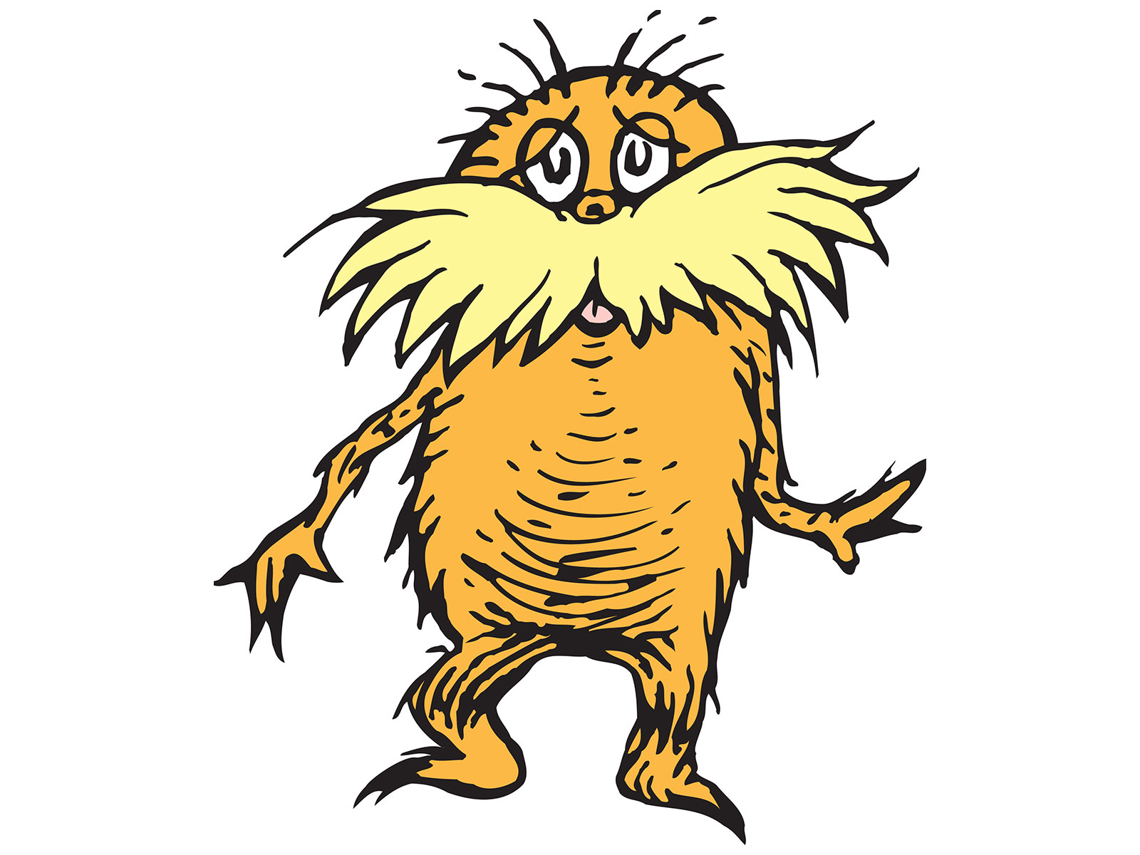
Second Grade– Endangered Species
Problem
Which animal should be protected?
Alternatives
Grey bat, West Indian manatee, Florida alligator, Florida panther
Criteria
Where does it live, what is the main cause of endangerment, and is it helpful to the environment?
Decision
Which animal should The Lorax choose?

Slide 2
Social Studies Benchmarks:
SS.1.E.1.3 Distinguish between examples of goods and services.
SS.1.E.1.4 Distinguish people as buyers, sellers, and producers of goods and services.
SS.1.C.2.3 Identify ways students can participate in the betterment of their school and community.
Financial Literacy Benchmark:
SS.4.FL.1.1 People have many different types of jobs from which to choose. Identify different jobs requiring people to have different skills.

Slide 3
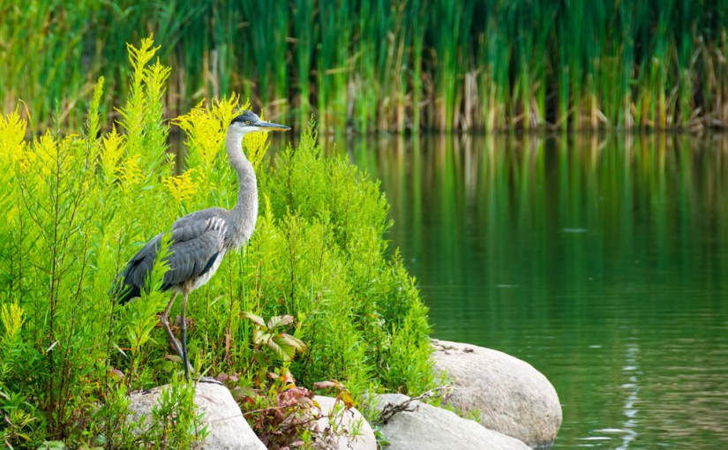
Image Analysis
What do I see? | What do I think? | What do I wonder?
What do you see in the picture? | Which things in the picture are living things? Which are nonliving things? | What other living or nonliving things might be behind the plants? Under the water?
Notes:
After analysis, explain to students that this image is of a lake’s ecosystem. Ecosystems are areas where living and nonliving things live together in balance.

Slide 4
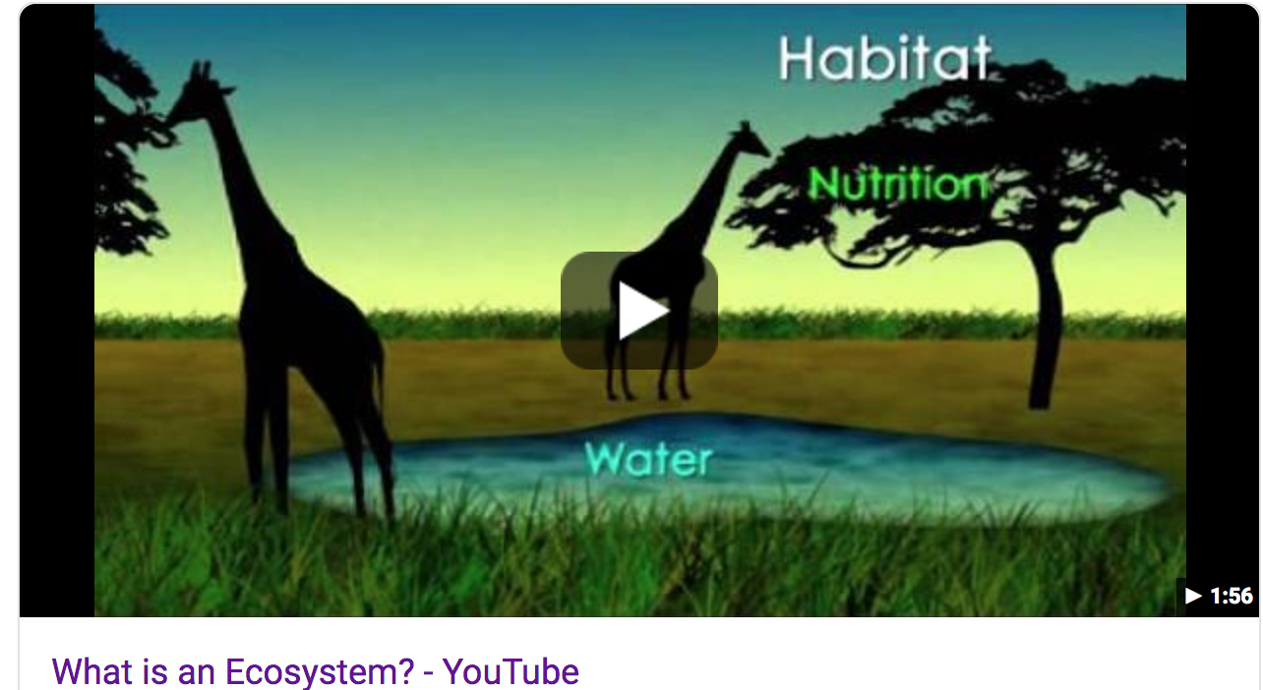
Watch the video: What is an ecosystem:.
What is an ecosystem?
What is an environment?
What are examples of living and nonliving things in an ecosystem?
What are different types of ecosystems?
What are producers?
What are consumers?
How does energy move through an ecosystem?
https://www.youtube.com/watch?v=JPHqUxxyLsY

Slide 5
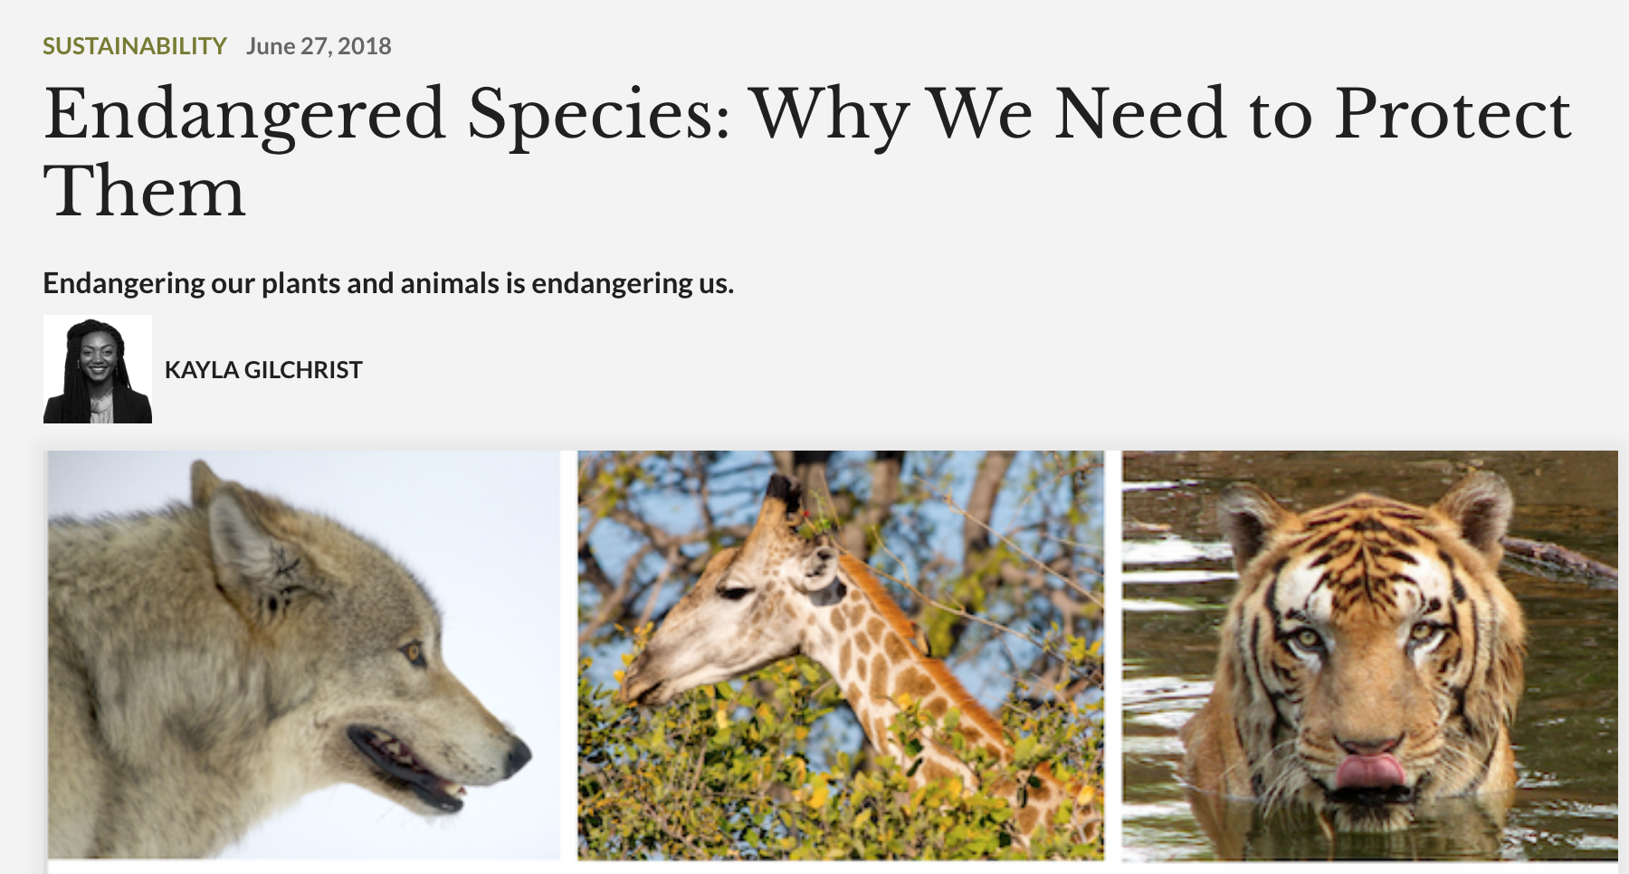
Read the informational text.
What are endangered species?
What are four reasons that it is important to protect endangered species?
What are two important facts about each reason?
https://www.entitymag.com/endangered-species-are-our-responsibility/
Notes:
There is an adapted version of the text for use with students.

Slide 6
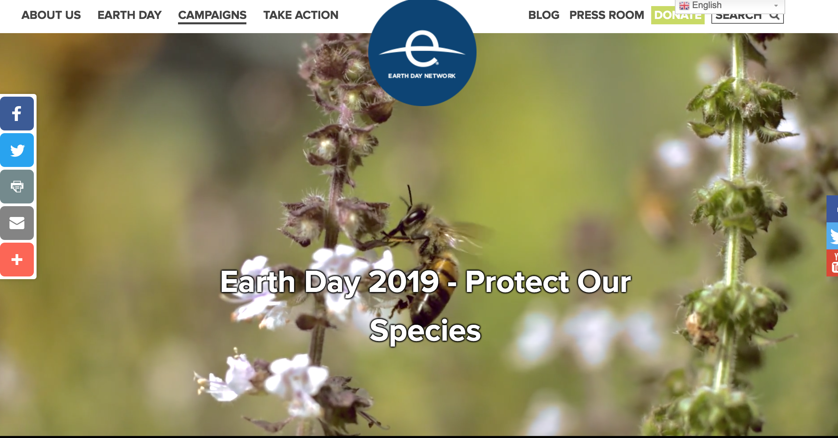
Read the informational text.
https://www.earthday.org/campaigns/endangered-species/earthday2019/

Slide 7
Read the Informational Text
Florida’s Endangered & Threatened Species
Use this document to show how many animals in Florida are in danger or at-risk.
https://myfwc.com/media/1945/threatened-endangered-species.pdf

Slide 8
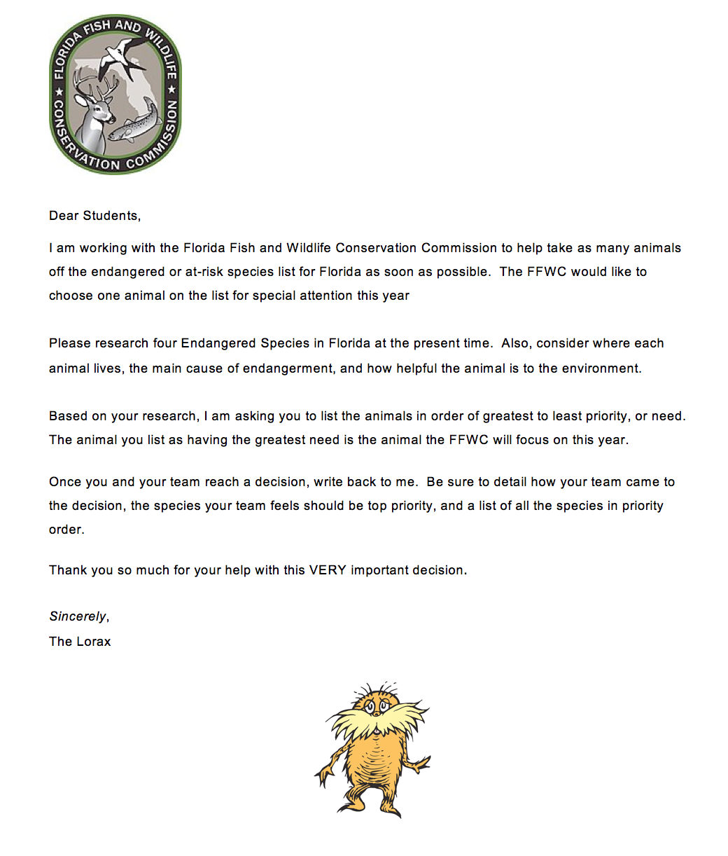
Introduce the problem.
What is the Lorax’s problem?
What is he asking you to do?

Slide 9
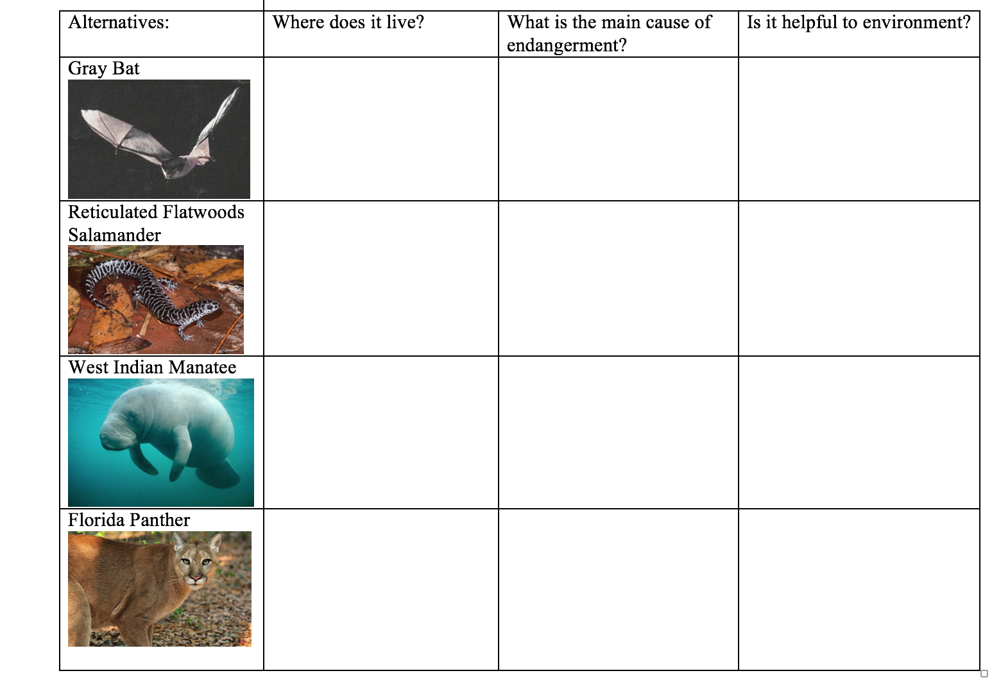
Research the alternatives.

Slide 10
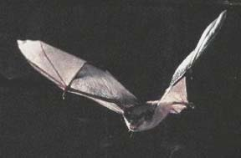
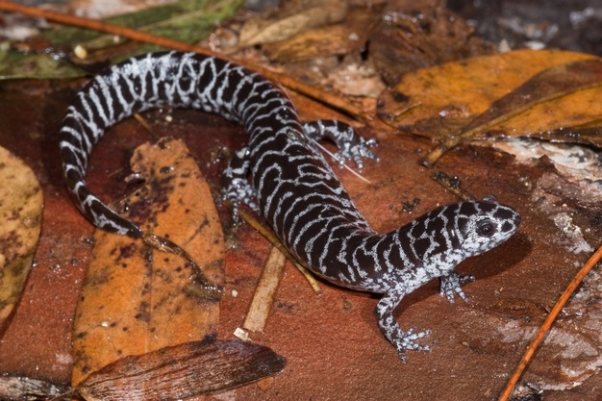
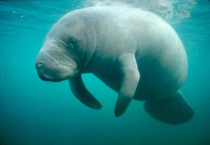
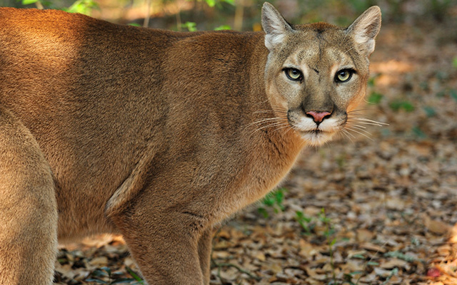
Review videos and informational texts about each animal.
  https://myfwc.com/conservation/you-conserve/wildlife/bats/field-guide/gray-bat/ https://www.youtube.com/watch?v=waeLSbceclY
  https://myfwc.com/wildlifehabitats/profiles/amphibians/reticulated-flatwoods-salamander/
  https://www.facebook.com/HurlburtFieldOfficial/videos/endangered-reticulated-flatwoods-salamander/1836046046416960
  http://myfwc.com/wildlifehabitats/profiles/mammals/aquatic/florida-manatee/
  https://www.youtube.com/watch?v=vEh4laZokEE
  https://myfwc.com/wildlifehabitats/profiles/mammals/land/florida-panther/ https://www.youtube.com/watch?v=t-TiDWndD-4

Slide 11
Rank the alternatives.
Guiding/reflective Questions
Which endangered animal would be the best choice for support?
Why do you think that?
What of the criteria is the most important to you?
Which animal would be your next choice? And after that?
Do you agree with your group's ideas? Why or why not?

Slide 12
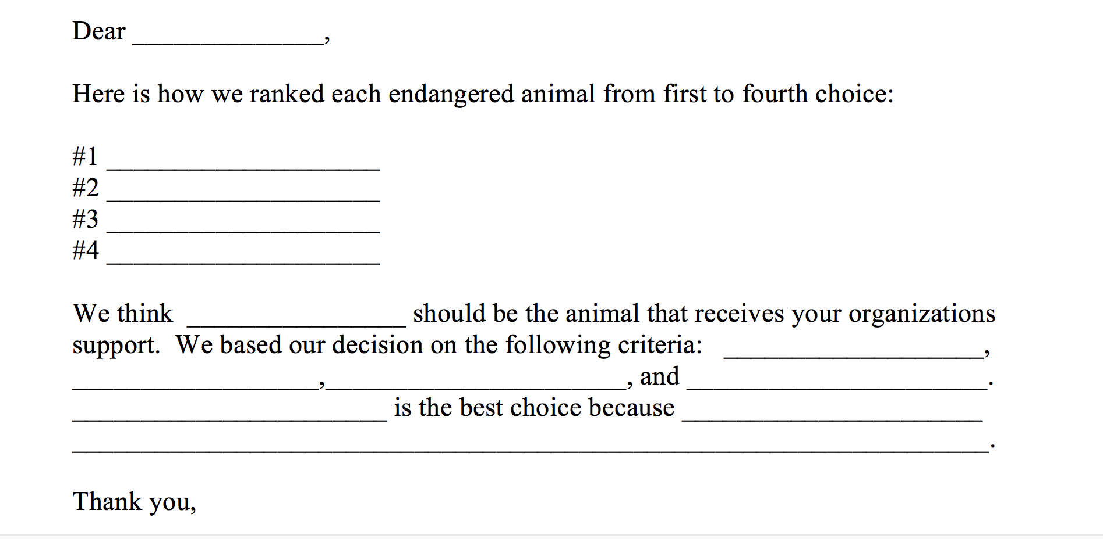
Write back to The Lorax

Slide 13
Extend the learning.
Read more about endangered animals in ReadWorks (2nd and 3rd grade):
  The American Crocodile
  The Bald Eagle is Back
  Back from the Brink
  Trouble in the Ocean
  Saving Big Cats
Create posters presentations of the groups’ work. Display in classroom, library, office, etc.
Have teams debate differing conclusions regarding the ranking of animals. Use evidence from research to support arguments.

