Slide 1
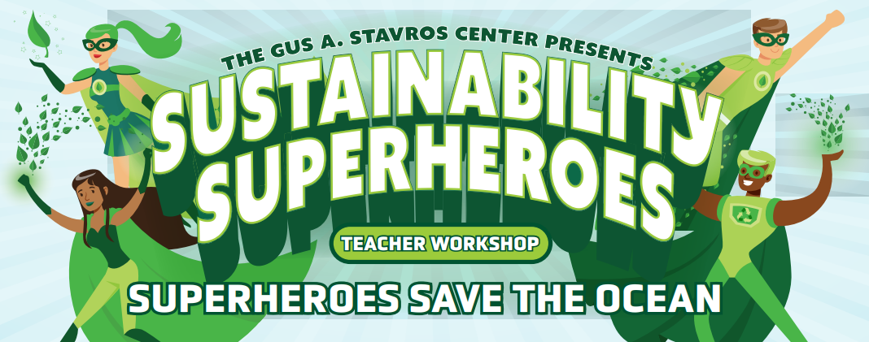
Save the Water

Slide 2
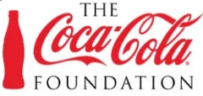
Presented by:
Christine Angel Danger M.Ed..

Slide 4
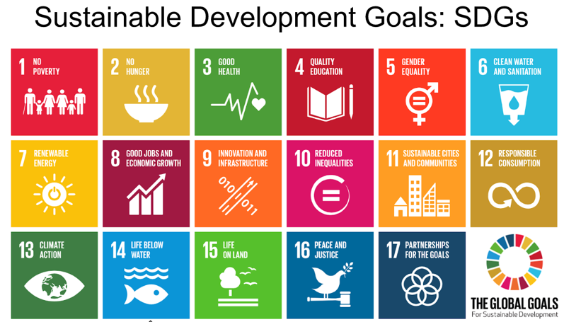
Goal for Today

Slide 5
Predictions about water:
Water will be to the 21st Century what oil was to the 20th.
Water scarcity will lead to food shortages, ecological decline, food shortages, maybe even wars.
The World Economic Forum declared water crises to be THE top global threat to society over the next decade.
How Much Water Do You Use Each Day?
One kilo of beef = 16,000 liters of water
One cup of coffee = 140 liters of water
One liter of wine = 870 liters of water
One kilo of potatoes = 287 liters of water
One kilo of tobacco = 2,925 liters of water
Car = 52,000–83,000 liters of water
Leather Shoes = 8,000 liters of water
Smartphone (mobile) = 12,760 liters of water
Paper (1 piece; A4) = 5.1 liters of water
TABLE: Data compiled, converted and produced by Water Footprint Calculator. Sources: Berger et al; Water Footprint Network, “Water footprints of nations”; Friends of the Earth/Trucost; WFN, “The water footprint of cotton consumption” ; WFN, “The water footprint of wood for lumber, pulp, paper, fuel and firewood”
What's Your Water Footprint: Water Footprint Calculator Home Page (watercalculator.org)

Slide 6
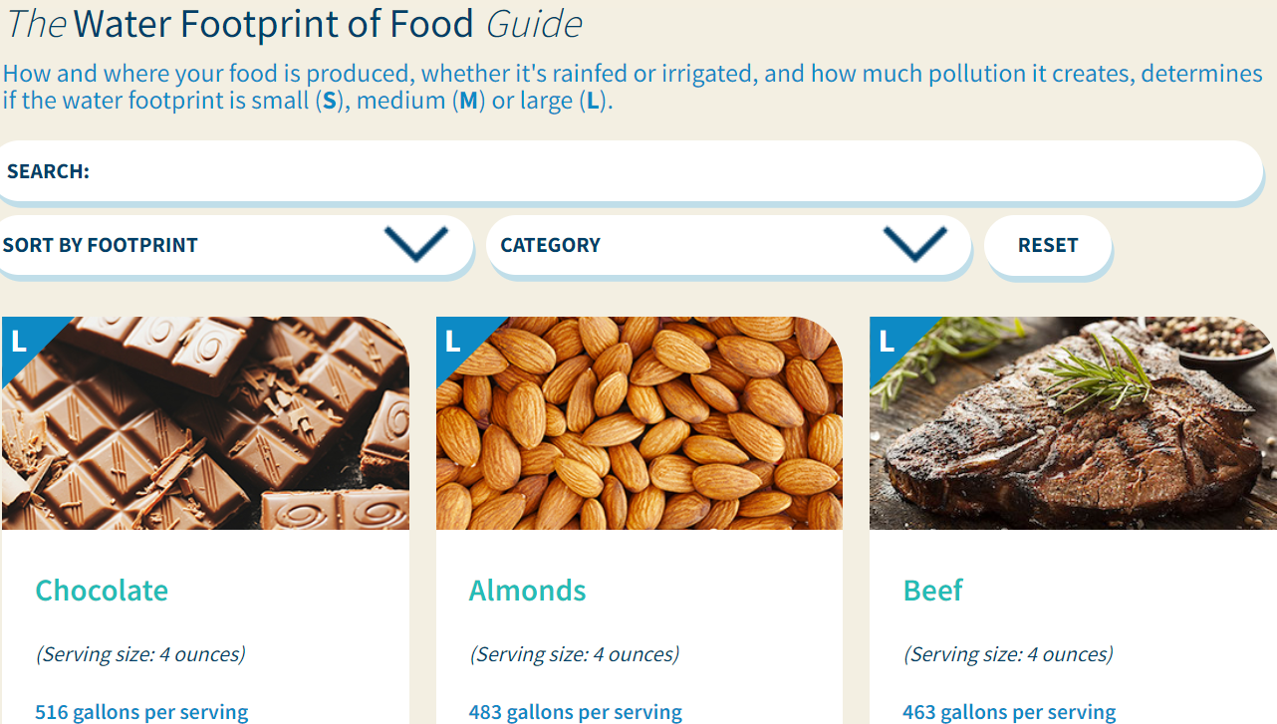
Water Footprint of Food Guide - Water Footprint Calculator (watercalculator.org)

Slide 7
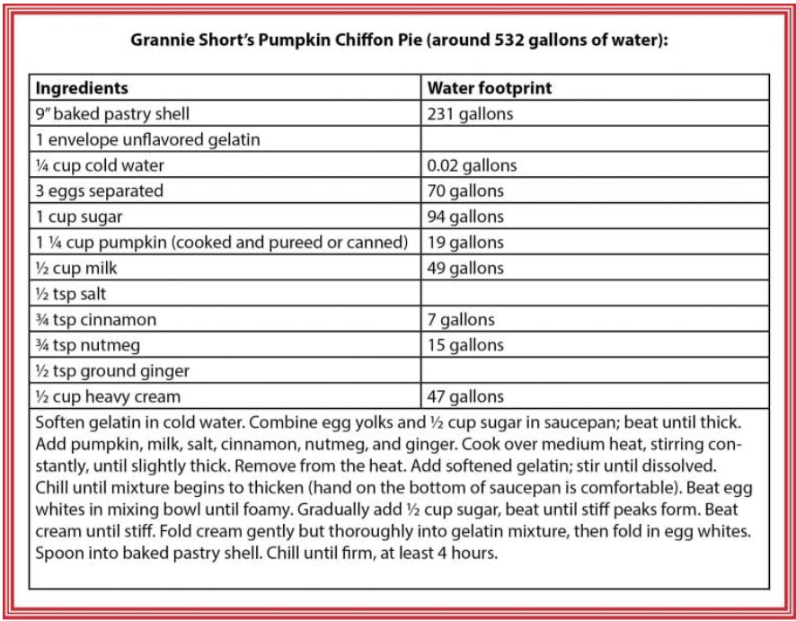
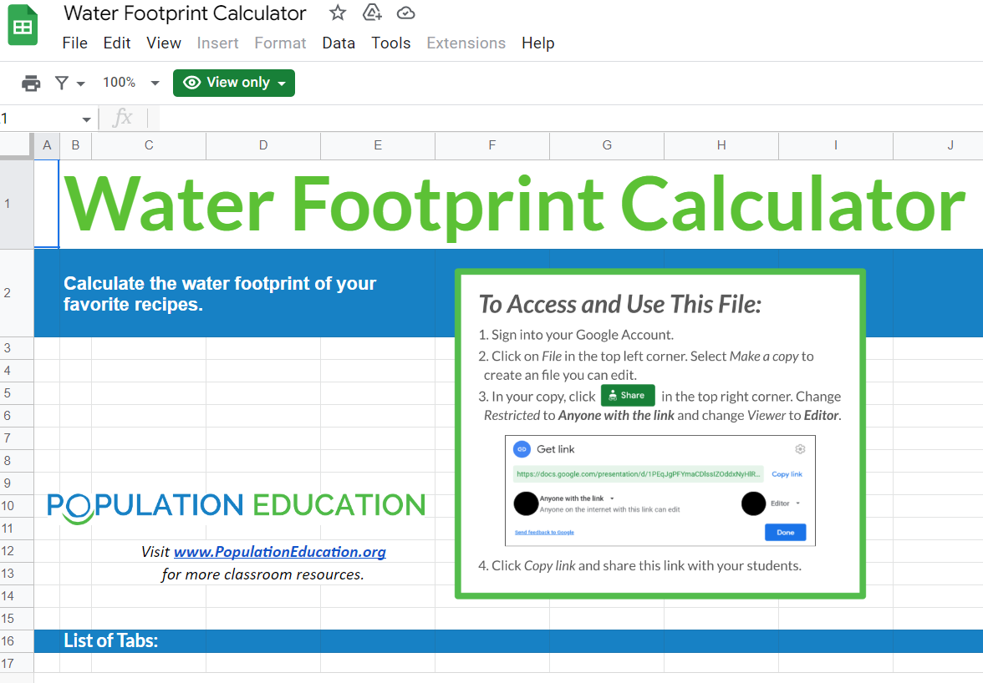
Water Footprint Calculator - Google Sheets

Slide 8
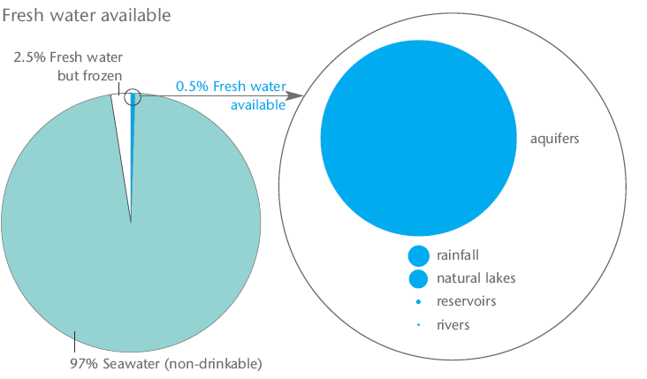
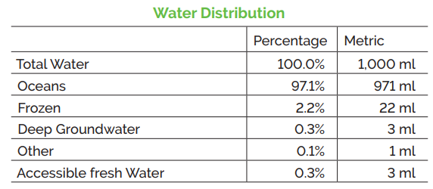
Global Water Sources
Global Water Sources - How much is accessible?
How much of Earth’s water is freshwater?
How much is accessible?
Do we have enough water for now and the future?
“All the water that will ever be is, right now.” – National Geographic, October 1993
Water, Water Everywhere (populationeducation.org)

Slide 9
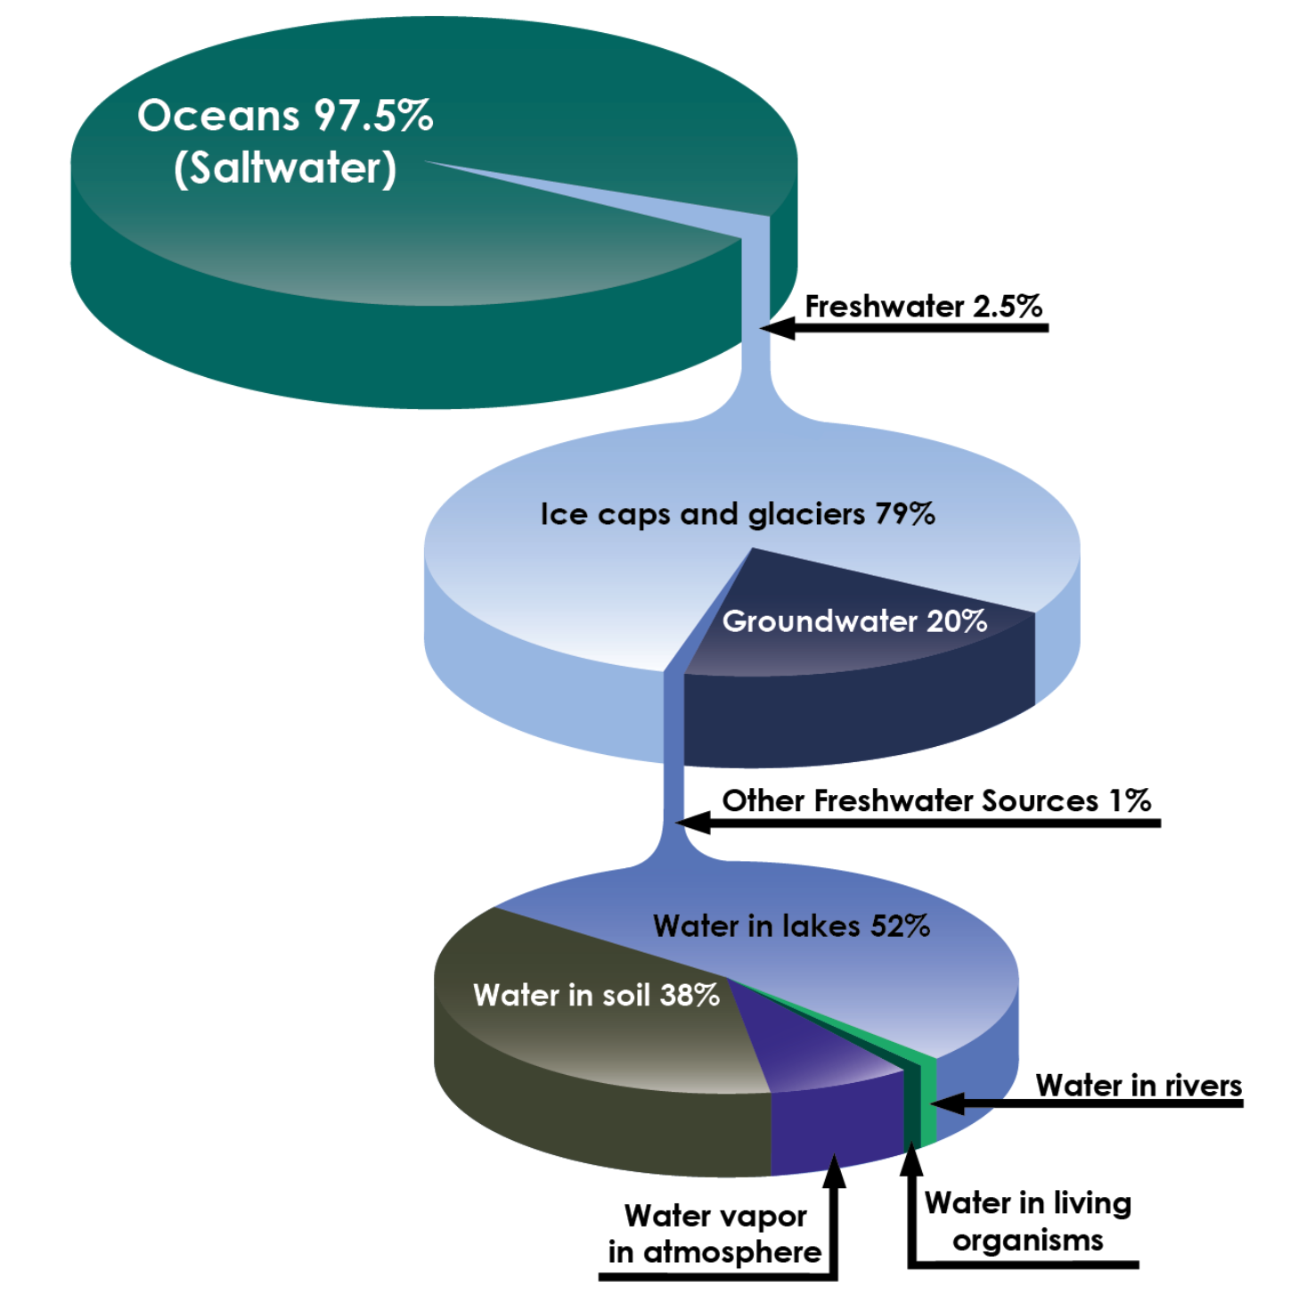
Let's discuss...
Why is water so important on Earth?
What roles does water in the water cycle?
Notes:
Read aloud the text on the slide and host a brief VERY brief class discussion.

Slide 10
If water is a renewable resource and is never destroyed, why conserve it?

Slide 11
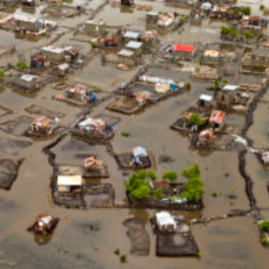
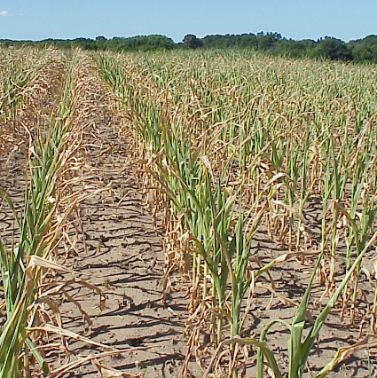
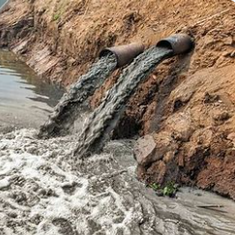
Water Woes
Over 90% of disasters are water-related,
due either to a shortage or excess.
Too Much Too Little Too Polluted
Notes:
The challenges of water scarcity amid rampant climate change (activesustainability.com)

Slide 12
Goal 6: Clean Water and Sanitation
Clean Water and Sanitation - Ensure availability and sustainable management of water and sanitation for all
The first three out of eight targets include:
"By 2030, achieve universal and equitable access to safe and affordable drinking water for all."
"By 2030, achieve access to adequate and equitable sanitation and hygiene for all and end open defecation, paying special attention to the needs of women and girls and those in vulnerable situations."
"By 2030, improve water quality by reducing pollution, eliminating dumping and minimizing release of hazardous chemicals and materials, halving the proportion of untreated wastewater and substantially increasing recycling and safe reuse globally."

Slide 13
Sustainable Development Goal #6 Clean Water and Sanitationhttps://youtu.be/LCKsU4bPFOQ

Slide 14
https://youtu.be/HszSrdjQ0Oo

Slide 15
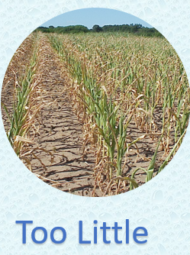

Slide 16
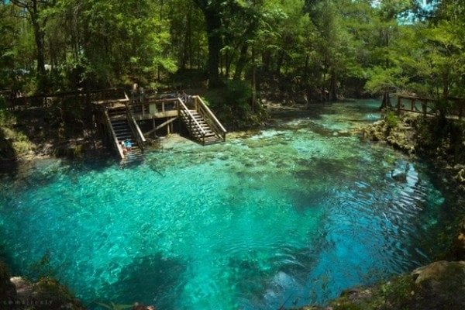
Top 10 Resources We Are Running Out Of
(And The Economic Implications If We Do)
1:The fresh water shortage will likely be the cause of the next great global disaster. Today, nearly 1 billion people in the developing world don’t have access to it. Despite this, many people waste water. Drinkable water is so often taken for granted by millions worldwide. Only 3% of the water on Earth is drinkable, and every living thing depends on it for survival. This fact becomes even more frightening when you realize that a majority of that 3% of drinkable water is trapped in underground reservoirs which are not easily accessible. From crop production to simply requiring water itself for survival, fresh water is so vitally important to everything we do.
Fresh, drinkable water is disappearing at an alarming rate; from being consumed, being wasted to simply disappearing as the Earth heats up. Billions of people worldwide are already feeling the effects of water scarcity, as they do not have access to drinkable water. There have even been international disputes over water, such as the conflict between Egypt and Ethiopia over the latter’s plans to dam the Nile.
Experts say that, as water scarcity becomes more and more widespread, the conflicts over water will just continue to escalate. When water scarcity reaches a critical point, it will likely act as the catalyst for the next global conflict as countries scramble to seize and hoard stores of fresh water for their own use and consumption.
Markets Affected: All; directly and indirectly

Slide 17
The UK's Green Poet and composer Martin Kiszko is hoping to inspire budding writers through the launch of a water-themed poetry competition with WaterAid. This film illustrates his poem: 'Water Walk,' which he has written to help get children started. The film has been voiced by a child who attends Torridon Junior School in London and the footage features 11-year-old Lala from Soavinarivo village, Bongolava region, Madagascar. Lala is the eldest of seven siblings and has been collecting water since the age of 4 at least twice a day. To find out more please visit: https://www.wateraid.org/uk/schools/

Slide 18
Cape Town drought limits people to 13 gallons of water a day

Slide 19
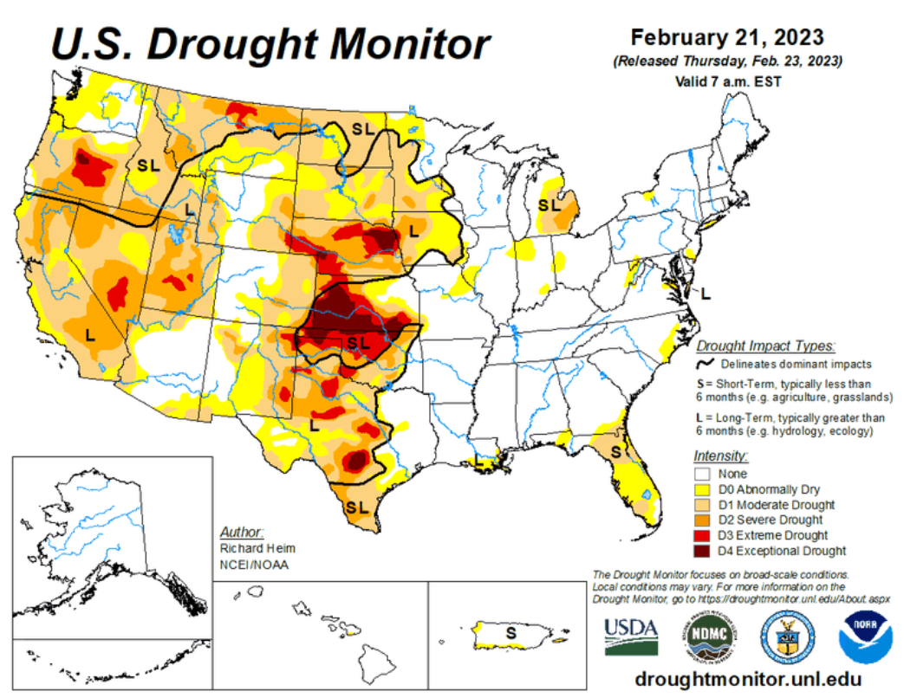
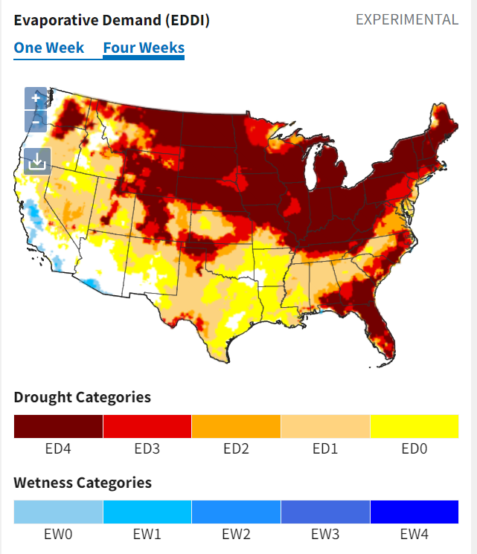
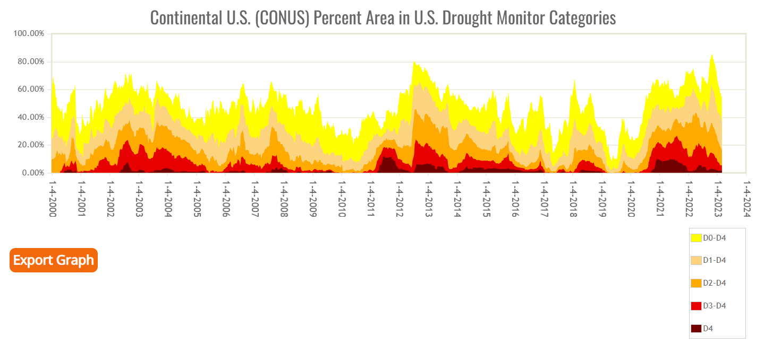
As of March 7, 2023, 37.65% of the lower 48 states are in drought, according to the U.S. Drought Monitor.
National Drought Status | Drought.gov
Time Series | U.S. Drought Monitor (unl.edu)

Slide 20
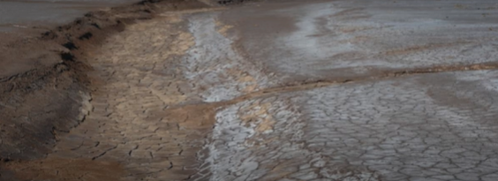
Climate change is increasing evaporation and reducing rainfall. The warmer the air becomes, the more of our fresh water is locked in the air as vapor.
A drought is a period of time when an area or region experiences below-normal precipitation. The lack of adequate precipitation, either rain or snow, can cause reduced soil moisture or groundwater, diminished stream flow, crop damage, and a general water shortage.
www.nationalgeographic.org/encyclopedia/drought/

Slide 21
People in developed nations with access to toilets and clean water are changing their diets. They prefer meat to vegetables.
That means 15,000 liters of water instead of 2,00 liters of water per kilogram of food.
vegetables

Slide 22
Ecologists are concerned about jeans because it takes about 7,600 gallons of water to make cotton in a pair of jeans and 700 gallons of water to make a shirt.

Slide 23
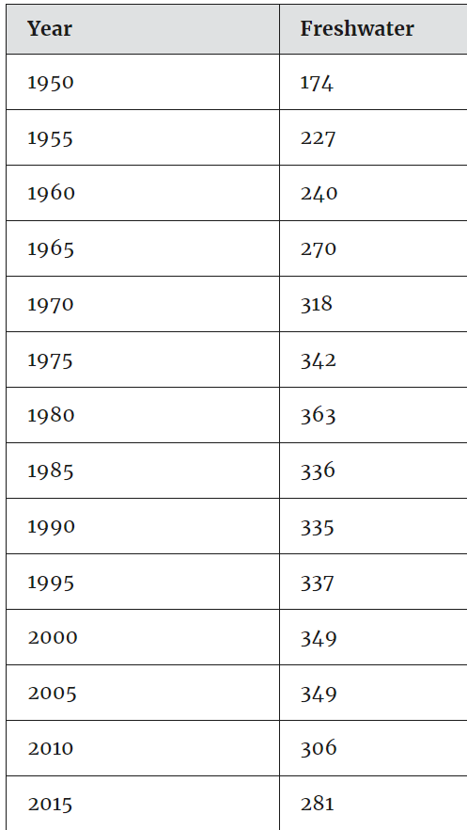
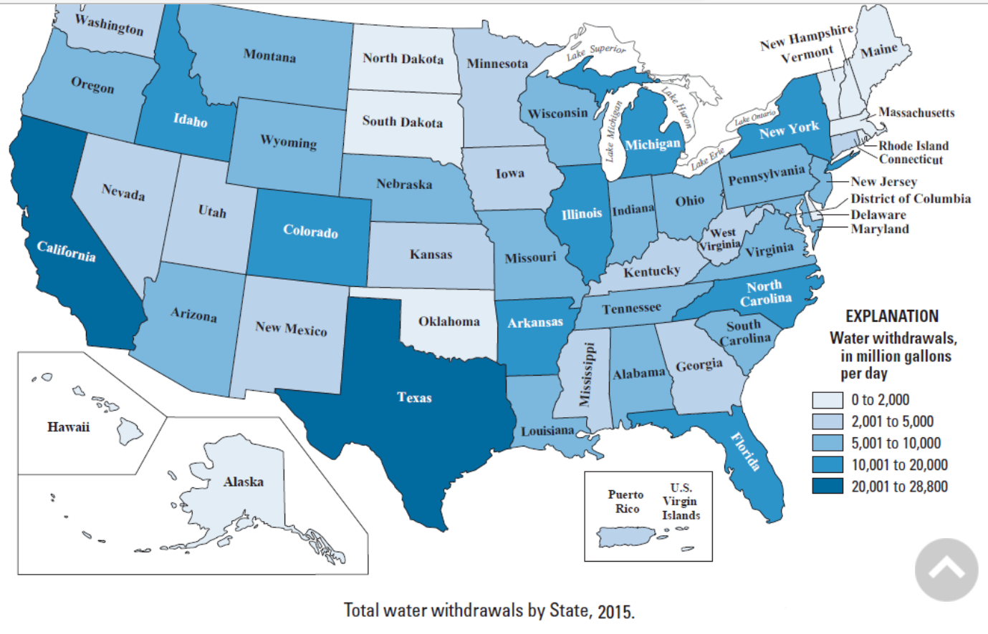
Trends in the Nation's water withdrawals
Total water withdrawals for the United States, 1950-2015. (Data are in billion gallons per day (Bgal/d))

Slide 24
Renewable and Non-Renewable Water Resources
Renewable - long-term average annual flow of rivers (surface water) and recharged aquifers generated from precipitation
Non-renewable - often deep aquifers that have a negligible rate of recharge in the human time-scale
Notes:
According to scientists at Utrecht University and the research institute Deltares, up to 25 percent of ANNUAL global sea rise could be due to WATER MINING. After water is extracted from the ground (much of it non-renewable) the water evaporates, enters the hydrosphere as rain, and ends up in the ocean rather than returning as ground water.
Groundwater depletion can have further ecological consequences, sometimes causing ecological disaster, by causing rivers and WETLANDS to run dry, and possibly sparking a future famine.

Slide 25
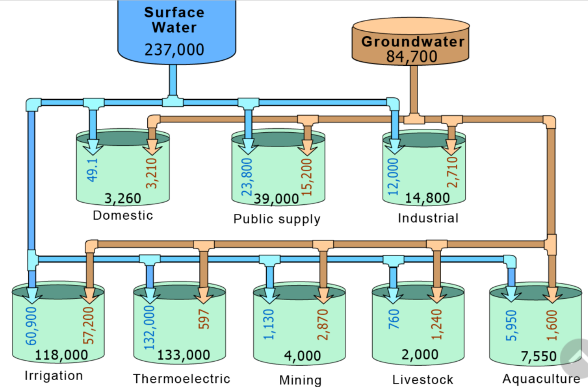
Vulnerable to pollution and evaporation
NOT Renewable

Slide 26
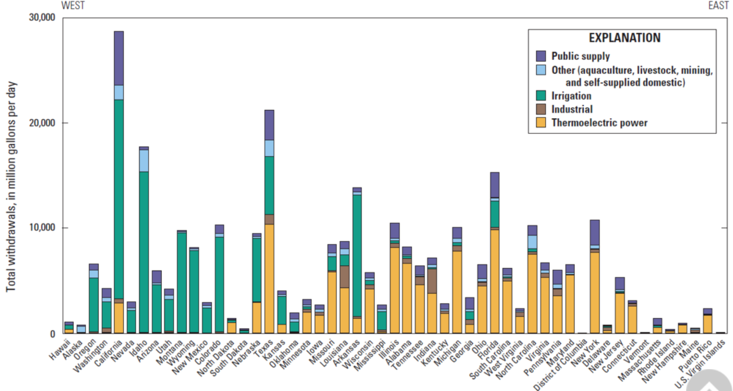
What do you see? (Observe)
What does it mean? (infer)

Slide 27
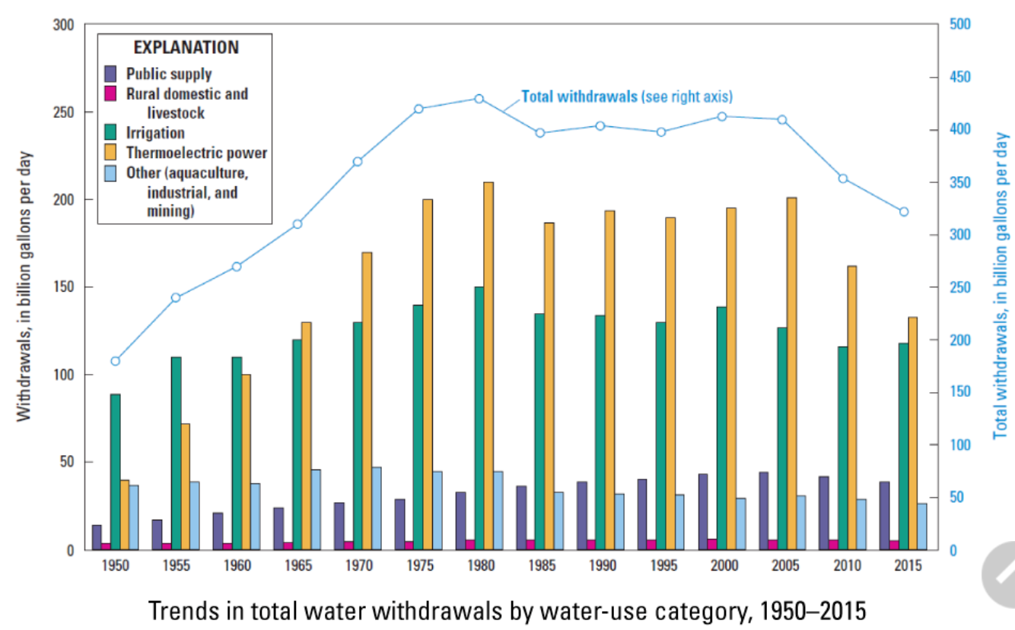

Slide 28
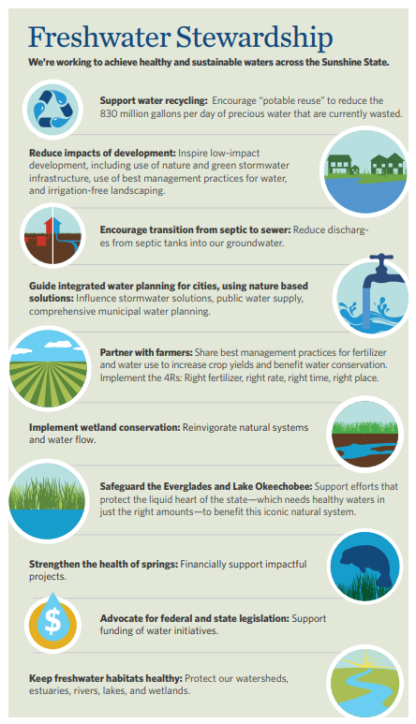

Slide 29
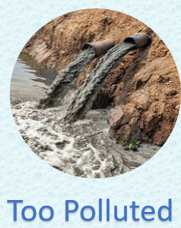

Slide 30
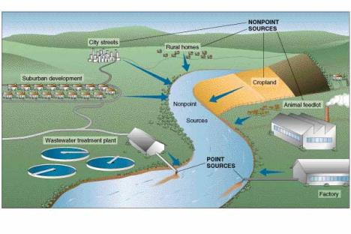
What makes water unsafe?
The most important things that make water dirty and unsafe include:
Solids from soil
Micro-organisms from wastewater, garbage, soil
Chemicals from houses, streets, industries and farms

Slide 31
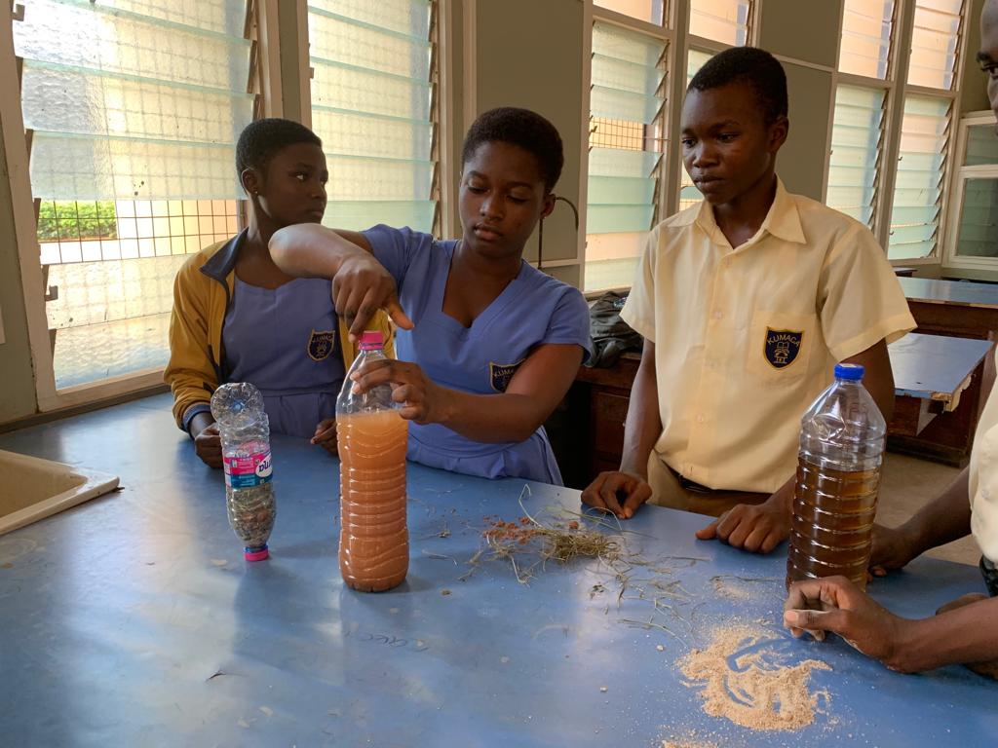
How do you tell if water is not clean?
By using our senses
color
smell
taste
But not all contaminants can be detected using our senses
Therefore, we need to do water quality tests

Slide 32
Common contaminants in water
Physical: sediment or organic material suspended in the water
Chemical: nitrogen, salts, pesticides, metals, and human or animal drugs
Biological (microbiological): bacteria, viruses, protozoan, and parasites
Radiological: plutonium, uranium, radon

Slide 33
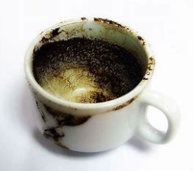
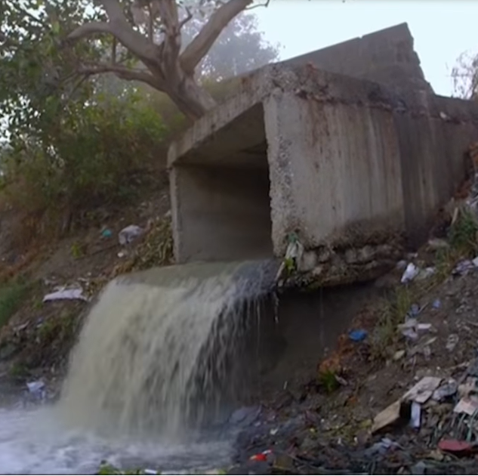
If you put clean water
in a dirty container,
the water is dirty.
Pollution
#1 cause of fresh water pollution worldwide is lack of sanitation.
15% of the worlds population lacks access to clean water
Billions of gallons of wastewater are being dumped into freshwater sources every day.

Slide 34
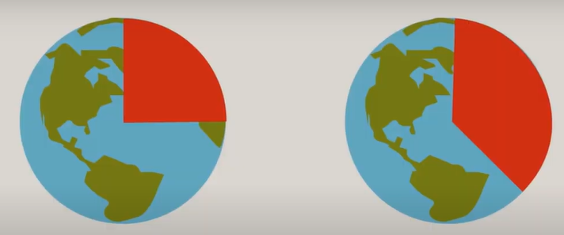
25% without
clean water
33% no toilet

Slide 35
494 million people around the world still defecate in the open, which includes about 15 percent of India’s population. In 55 countries of the world, more than 5 percent of the population still defecates in the open.
The Joint Monitoring Program Progress report on ‘Household Drinking Water, Sanitation and Hygiene 2000-2020’ presents the estimates regarding the access of households to drinking water, sanitation, and hygiene services and assesses progress in achieving the six Sustainable Development Goals (SDGs). With a view to “ensuring the availability and sustainable management of water and sanitation for all before 2030 ”.

Slide 36
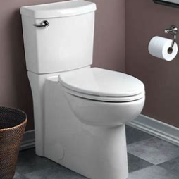
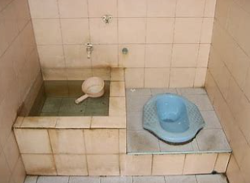
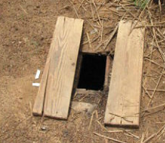
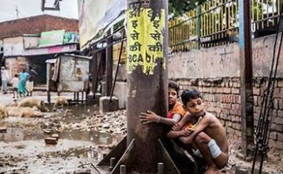
What is a toilet?

Slide 37
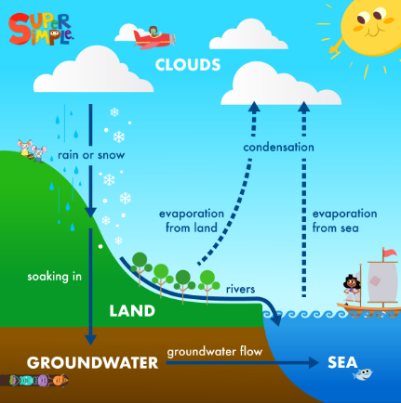
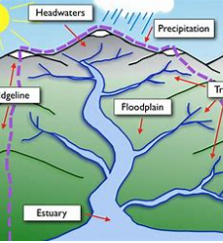

Slide 38
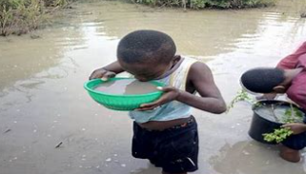
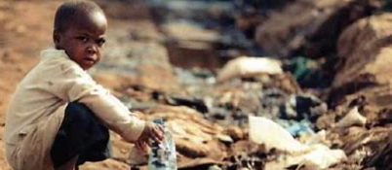
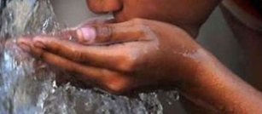
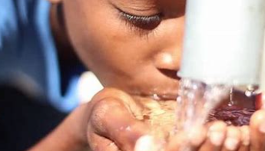

Slide 39
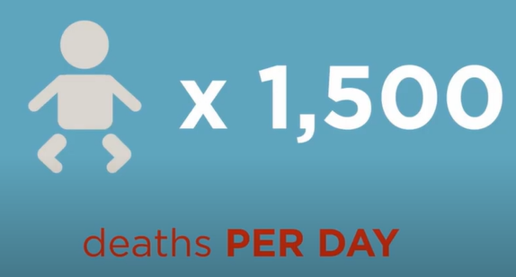
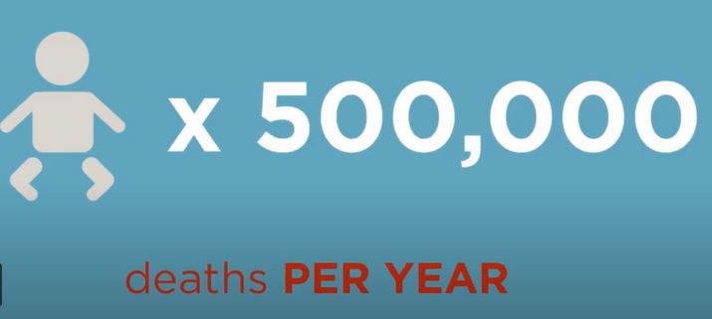
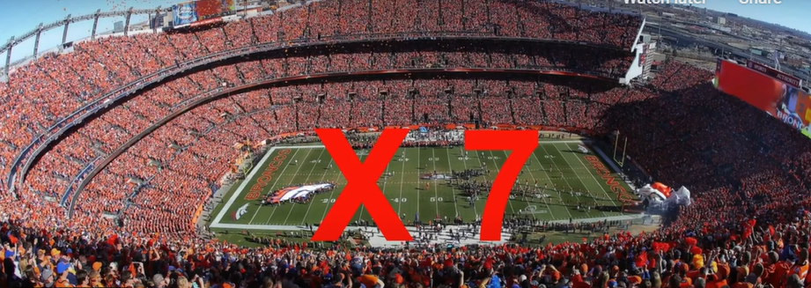
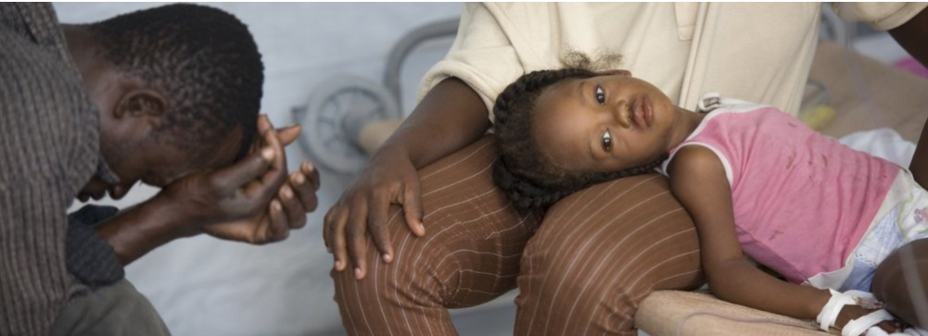
Water polluted with untreated waste is the
#2 killer of children worldwide.
Cholera, diarrhea, and parasites are contracted through contaminated water.
#1 is respiratory infections (WHO)

Slide 40
From CSI to ESI
Environmental Scene Investigators
Which well was the source of a London epidemic?
Who Killed the River?
The Waterville Mystery

Slide 41
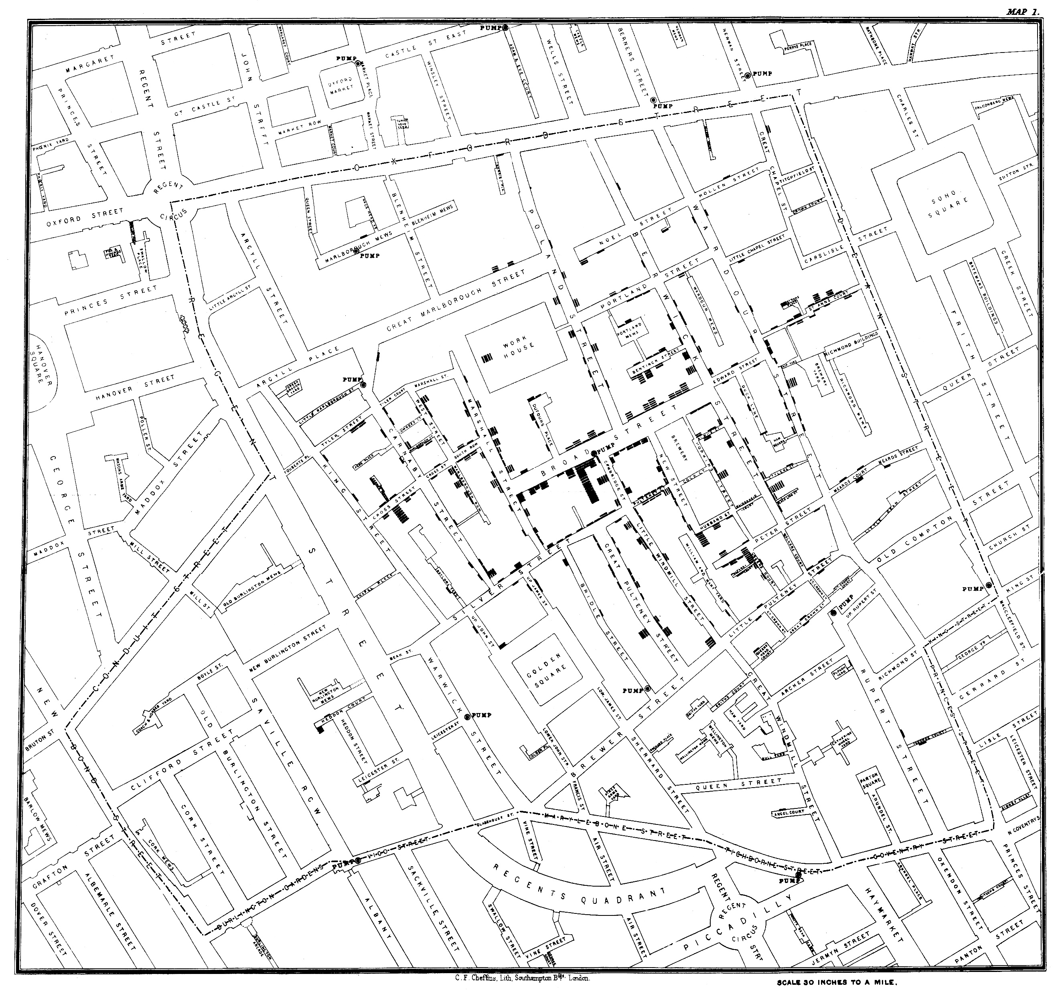
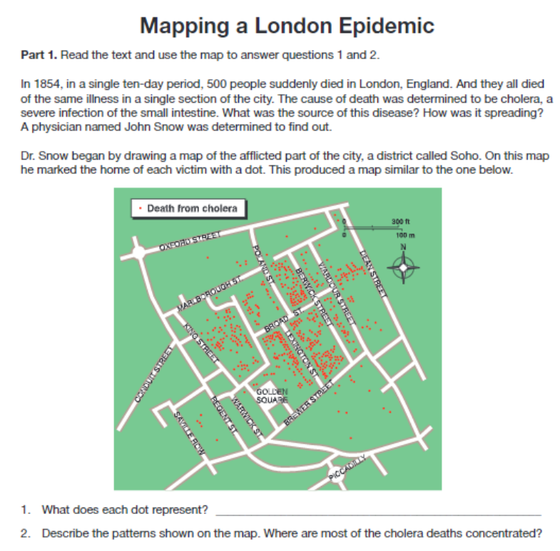
Mapping A London Epidemic | National Geographic Society
John Snow’s Interactive Cholera Map - Victor A. Mateevitsi, PhD (vmateevitsi.com)

Slide 42
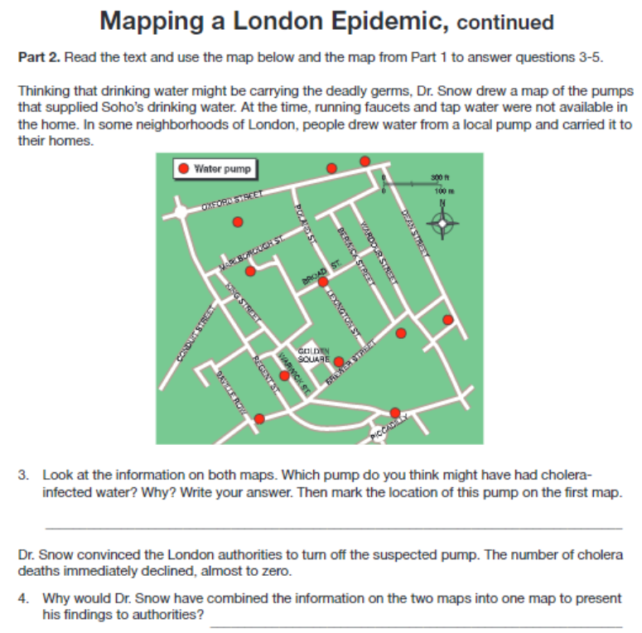
Which pump handle would remove?
Why?

Slide 43
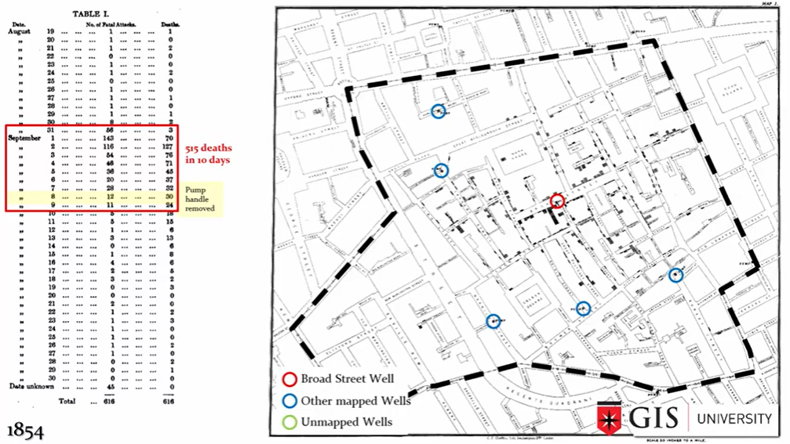

Slide 44
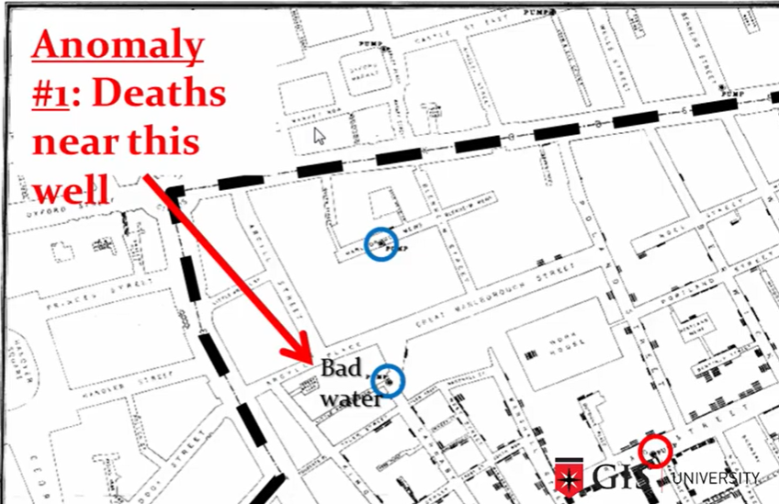
John Snow’s interviews with residents revealed that the water from that well had a bad taste so people near it were going to the Broad street pump to get their drinking water.

Slide 45
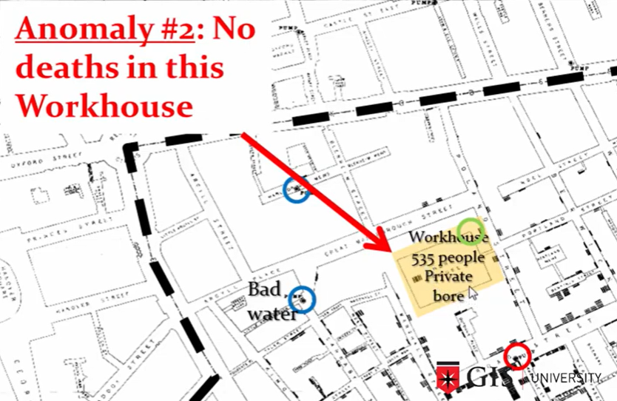
The workhouse had its own well and pump.

Slide 46
Beer was much safer to drink than water.
Brewery also had its own private well.

Slide 48
People in this area evacuated at the start of the outbreak. John Snow would not have known this without an “on the ground” investigation.

Slide 50
From CSI to ESI: Who killed the river?
What do you see? | What do you think? | What questions do you have?

Slide 51
Step 1
Becoming a Detective
•As a detective, your job will be to explore the following documents to determine who or what killed the Nashua River.
•The Nashua River is located in northern Massachusetts.
In the 1960's, the Nashua River's pollution could be smelled long before reaching the river's banks.
(NRWA Archives)

Slide 52
Nashua River
https://earth.google.com/web/@42.71564655,-71.51303715,65.69118264a,34181.23914254d,35y,0h,0t,0r/data=ChMaEQoJL20vMDQ1cjNyGAIgASgC
Notes:
Introduce the book, show the map. Use link to Google Earth to show location. Point out the timeline on the map pages.

Slide 53
Step 2: Investigating the Evidence:
The Nashaway were a tribe of Algonquian Indians inhabiting the upstream portions of the Nashua River valley in what is now the northern half of Worcester County, Massachusetts near Mount Wachusett.

Slide 54
Extra Activity: Investigate Native American Tribes
https://www.history.com/topics/native-american-history/native-american-cultures

Slide 55
Extra Activity: Investigate Native American Tribes

Slide 56
From CSI to ESI: Who killed the river?
Have any of your questions been answered?
What questions do you have now?

Slide 57
The fur trade in North America began during the 1500s when Europeans explored the eastern coast. Native Americans traded furs, deer hides, and meat for iron tools, wool blankets, colorful cloth, and guns.

Slide 58
Extra Activity: Investigate Early Colonial Trade
https://www.southamptonschools.org/site/handlers/filedownload.ashx?moduleinstanceid=1227&dataid=23681&FileName=Columbian%20Exchange.pdf

Slide 59
Extra Activity: Investigate Early Colonial Trade
https://www.khanacademy.org/humanities/us-history/precontact-and-early-colonial-era/old-and-new-worlds-collide/a/environmental-and-health-effects-of-contact

Slide 60
Extra Activity: Investigate Early Trade
https://sunnymoney.weebly.com/5.html

Slide 61
The growth of settlements along the Nashua led to fights between settlers and Indians. Settlers fenced land and cut down forests. They hunted and killed more animals than needed for survival in order to sell pelts to be sent to England.

Slide 62
The Industrial Revolution impacted settlements in North American into the 19th century. America’s economy grew as new industries formed. New machines for making cloth and paper dumped their waste into the Nashua River.

Slide 63
From CSI to ESI: Who killed the river?
Have any of your questions been answered?
What questions do you have now?

Slide 64
Extra Activity: Technology and Development of the Market Economy
https://sunnymoney.weebly.com/5.html

Slide 65
Extra Activity: Technology and Development of the Market Economy
https://americanhistory.si.edu/american-enterprise-exhibition

Slide 66
The polluting of the Nashua River caused it to run more slowly. Over time, pulp clogged the river, fish died and the dark and dirty river smelled bad. Birds no longer came to the river.

Slide 67
Investigate evidence in the next slides
Descriptive Questions:
Who, What, When, Where
Analytical Questions:
How, Why

Slide 68
Observe, Infer, Ask Questions
Exhibit 1: A mat of paper sludge from local mills
floating on the Nashua River in the 1960's
(NRWA Archives)
Exhibit 3: Barrels that contained chemicals for making paper dumped at the river's edge.
Exhibit 2: Yellow dye pollutes the Nashua River in the 1960's
(NRWA Archives)

Slide 69
Observe, Infer, Ask Questions
Exhibit 4: Paper mill refuse, Nashua River flood plain, Leominster, MA
(Photo by Jack Swedberg)
Exhibit 6: Downstream from a factory.
Exhibit 7: Exposed pipe from factory into river

Slide 70
From CSI to ESI: Who killed the river?
Have any of your questions been answered?
What questions do you have now?

Slide 71
Who will save the river?

Slide 72
NRWA Historical Highlights
The restoration of the Nashua River launched the Nashua River Watershed Association into an international spotlight, a prime example of collaboration to accomplish a goal for the betterment of all society. The Association’s leadership and approach to protecting natural resources through a watershed approach, protecting both land and water throughout the region, continues to be recognized by federal, state, and local governmental leaders, as well as by leaders in the fields of environmental protection and environmental education.
What questions do you have now?
In the 1960's, the Nashua River's pollution could be smelled long before reaching the river's banks.
(NRWA Archives)
Marion Stoddart led the movement to restore the highly polluted Nashua River.
(NRWA Archives)

Slide 73
Who Saved the River?
In 1965, the U. S. Congress passed the first Clean Water Act. The next year, Marion Stoddart coordinated a successful citizen campaign that led to the passage of the Massachusetts Clean Water Act of 1966.
https://www.youtube.com/watch?v=OQ3j4_HQJ4o
Stop video at 2:30

Slide 74
What questions do you have now?

Slide 76
Saving the Nashua River
In the early 1960s there were no laws regulating the way waste from industry was disposed of on either the state or federal level in the United States. By the mid-1960s there was some preliminary legislation to regulate the pollution of waterways, but as yet no laws on the state level. In the 1960s, when Stoddart began to organize to save the Nashua River, it was one of the ten most polluted rivers in the US.^{[3]}
In 1962 the Stoddarts moved from Nevada to the small community of Groton Massachusetts with their three children.^{[4]} Their home in Groton was only three quarters of a mile from the Nashua River, which by then was already known to be highly polluted, and even dangerous. To address the problem, Stoddart enlisted the help of thousands of ordinary citizens to form a Nashua River Clean Up Committee. She also met with Massachusetts Governor John Volpe, Fitchburg Mayor William Flynn, and executives of the paper mills that were polluting the river. Through her tireless efforts Stoddart was able to get the first anti-water pollution bill enacted by any state in the US: the 1965 Massachusetts Clean Water Act.^{[3]}
Stoddart’s work did not stop with the passage of the 1965 legislation. She also founded the Nashua River Watershed Association. This organization helped to further protect 174 miles of the river and its major tributaries.^{[3]}
Marion Stoddart - Wikipedia

Slide 77
Summary of the Clean Water Act
https://www.epa.gov/laws-regulations/summary-clean-water-act
https://ejatlas.org/print/nashua-river-pollution-usa
Nashua River, 1962

Slide 78
Cracking The Case
Poetry Template
What___________________________________________
When___________________________________________
Where__________________________________________
Who____________________________________________
How____________________________________________
Why____________________________________________
What if . . ._______________
________________________
Who Killed the River?
Based on your analysis of the documents and citing evidence to support your answer, please write a paragraph or a poem answering: Who/What killed the river?

Slide 79
Poetry Frame
Nashua River Poem by Lexi
A dirty stinky river
In the 1960s
Flowed through Massachusetts
Nashua
like nasty dirty mud
Because of pollution
What if no cared?
A clean river
Today
Flows through Massachusetts
Nashua
Like a beautiful sparkling joy
Because Marion Stoddard did something about it
What if everyone cares about the environment?
What__________________________
When_________________________
Where________________________
Who__________________________
How__________________________
Why__________________________

Slide 80
Using Rivers to Explore Poetry
The Brook by Alfred Lord Tennyson (poetry.com)
I chatter, chatter, as I flow To join the brimming river, For men may come and men may go, But I go on for ever.
Alliteration
Simile
Metaphor
Anthropomorphism
Vocabulary…
https://interestingliterature.com/2018/01/31/10-of-the-best-poems-about-rivers-and-streams/
https://www.poemhunter.com/poems/river/

Slide 81
Waterville Mystery

Slide 82
The citizens in Waterville have been complaining that their drinking water tastes bad! The town is very small so most people have their own private wells. This includes businesses and schools too!
Good work, Detective. Now we know how the fuel might have leaked into the water supply. Let’s assess the damage. What questions can you ask?
STUDENT QUESTION: How many contaminated wells are there?
STUDENT QUESTION: How did the fuel leak?
Teacher questions: What fraction of all the wells are contaminated? What percentage of wells in the town are contaminated?

Slide 83
The map that they mayor gave you is a called a topographic map with contour lines.
What do you see (observe)?
What questions do you have?
STUDENT QUESTION: What does “topographic” mean?
STUDENT QUESTION: What do ‘contour lines” represent?
STUDENT QUESTION: In which direction does ground water flow on the map?
Teacher direction: With your pencil, try and draw ONE loop around all the contaminated wells.
STUDENT QUESTION: What do you think the area inside the loop represents?

Slide 84
We have spoken to all three fuel companies.... And all three fuel companies say they have checked their underground storage tanks and are not responsible for any leaks. WE NEED YOU TO HELP US FIND WHO REALLY DID IT!
As detectives, create a list of questions that you can use to solve this mystery.

Slide 85
QUESTON: Which company is the source of pollution?
Teacher : The contamination plume (or the loop you have drawn), will continue to spread slowly through the ground…
QUESTION: Where on the map will the pollution will move to?
QUESTION: Is there a natural area that may be negatively impacted? What is this ecosystem called?
QUESTION: What types of animals may be found close to the contamination ?
(Hint: look at the picture below for a clue!)
Are these animals are in danger?

Slide 86
Thomas & Friends on Clean Water & Sanitation - Goal #6 – YouTube
All Aboard for Global Goals | Sustainability Classroom Resources at Resources for Rethinking (resources4rethinking.ca)

Slide 87
U.S. Has pollution problems due to household cleaning products
Ten of the Most Toxic Cleaning Supplies
1. Chlorine Discs for Toilet Bowls
2. Air-Freshening Room Sprays
3. Scrubbing Bubbles
4. Drain Cleaners
5. Toilet Bowl Cleaners
6. Comet
7. Oven Cleaners
8. Dishwasher Detergents
9. Bleach
10. Ammonia
10 of the Most Toxic Cleaning Supplies - The Restful Home
Why Plumbers Adviser Against Drano (jiffyondemand.com)

Slide 88
Water pollution occurs when harmful substances—often chemicals or microorganisms—contaminate a stream, river, lake, ocean, aquifer, or other body of water, degrading water quality and rendering it toxic to humans or the environment.
The EWG estimates tap water supplies for 110 million Americans are contaminated with PFAS chemicals, according it its own analysis…
Associations between PFAS exposure and several ailments in humans:
* Pregnancy-induced hypertension/pre-eclampsia
* Liver damage
* Increases in total and LDL cholesterol
* Increased risk of thyroid disease
* Decreased antibody response to vaccines
* Increased risk of asthma diagnosis
* Increased risk of decreased fertility
* Small decreases in birth weight
Approximately 27 billion gallons of sewage and runoff make it into New York City waterways every year.
When It Rains, It Pours Raw Sewage into New York City’s Waterways | NRDC
Toxic invasion in one of America’s most beautiful beach destinations (nbcnews.com)

Slide 89
EWG Tap Water Database | City of Fort Lauderdale

Slide 90
Toxic invasion in one of America’s most beautiful beach destinations (nbcnews.com)
Sea Rise Is Making Fort Lauderdale's Sewage Leaks Worse | WUSF Public Media

Slide 91
EWG's Guide to Healthy Cleaning | Top Green Cleaning Products

Slide 92
Water.org

Slide 93
Easy Ways to Prevent Water Pollution
Ensure minimal use of bleach or detergents.
Reduce the use of herbicides, pesticides, and fertilizers.
Dispose trash properly.
Avoid direct dumping into water systems.
Insist on using environmentally safe products.
Plant trees and plants, not grass.
Support green-oriented companies.
Dispose motor oil, batteries or antifreeze at specially assigned collection points.
Practice organic farming.
Buy less new stuff.
25 Amazing Ways to Prevent Water Pollution | Earth Eclipse

Slide 94
Green infrastructure filters and absorbs stormwater where it falls.
What is Green Infrastructure? | US EPA

Slide 95
About Us | Who Gives A Crap USA
Buy the change you want to see.

Slide 97
https://www.msn.com/en-us/weather/topstories/snow-and-rain-set-to-hit-california-as-state-braces-for-possible-flooding/vi-AA18phfS
Atmospheric rivers, explained | CNN

Slide 98
Sea level rise and coastal flood risk maps -- a global screening tool by Climate Central
Climate change: More accurate future global sea level rise projections | Nature Communications | Nature Portfolio (natureasia.com)

Slide 99
Fiction and Non-Fiction
Pairing
Flood (nationalgeographic.org)

Slide 100
Using Poetry as a Summative Assessment
I used to think _________________,
but now I know _____________.

Slide 102
We don’t need a handful of people conserving and protecting water perfectly. We need millions of people doing it imperfectly.

