Slide 1
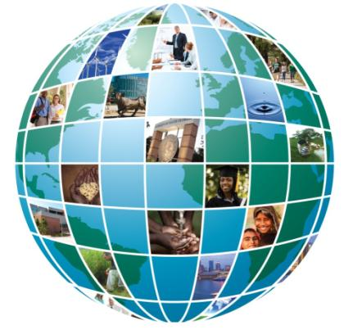
Sustainable Water Resources Management
Kebreab Ghebremichael
Patel College of Global Sustainability
kebreab@usf.edu
813 974 9061
CGS 238

Slide 2
Topics included
Hydrologic cycle and water budget
Water availability and scarcity
Water quality and pollution
Challenges and impacts of global change pressures on water resources
STEM project on water purification in middle and high schools in Tampa

Slide 3
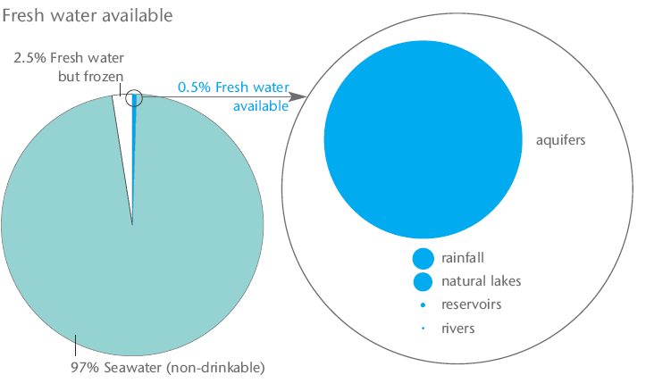
Global Water Sources
Global Water Sources - How much is accessible?
How much of Earth’s water is freshwater?
How much is accessible?
Do we have enough water for now and the future?
“All the water that will ever be is, right now.” – National Geographic, October 1993

Slide 4
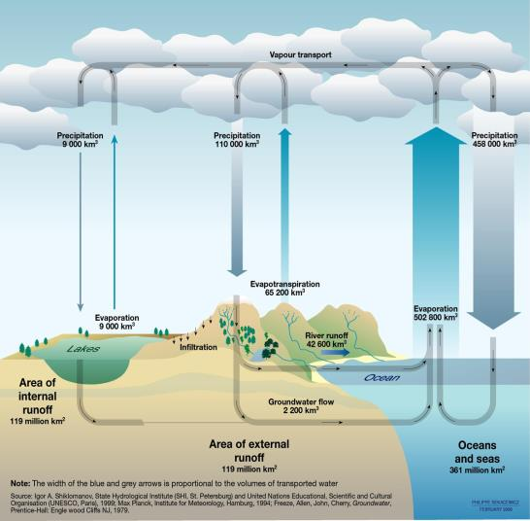
The Hydrologic Cycle
Earth’s water is in continuous motion under the hydrologic cycle
Mostly occurs through precipitation and evaporation

Slide 5
Renewable and Non-Renewable Water Resources
Renewable - long-term average annual flow of rivers (surface water) and recharged aquifers generated from precipitation
Non-renewable - often deep aquifers that have a negligible rate of recharge in the human time-scale
Notes:
According to scientists at Utrecht University and the research institute Deltares, up to 25 percent of ANNUAL global sea rise could be due to WATER MINING. After water is extracted from the ground (much of it non-renewable) the water evaporates, enters the hydrosphere as rain, and ends up in the ocean rather than returning as ground water.
Groundwater depletion can have further ecological consequences, sometimes causing ecological disaster, by causing rivers and WETLANDS to run dry, and possibly sparking a future famine.

Slide 6
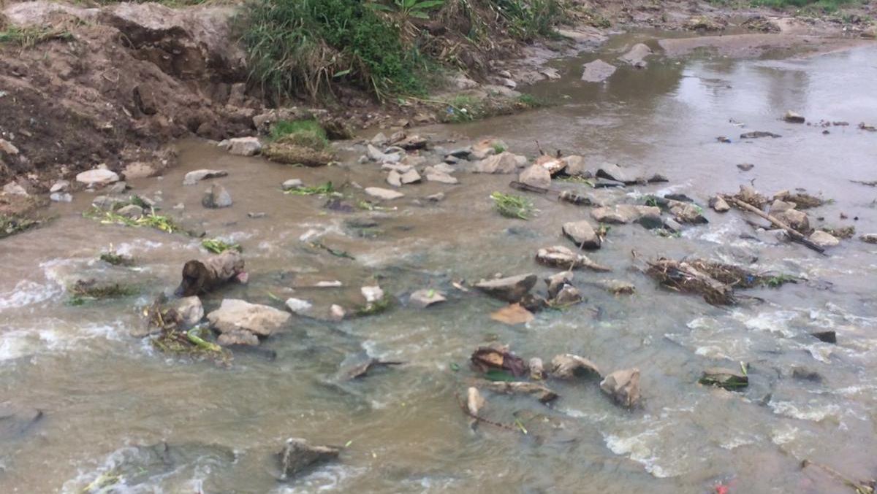
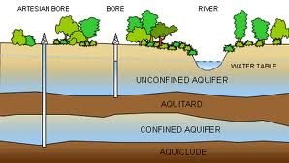
Sources of Water
Surface water
  Rivers
  Lakes
Ground water
  Unconfined aquifer
  Confined aquifer
Alternative sources
  Rainwater harvesting
  Reclaimed wastewater (gray or black water)
  Desalinated seawater and brackish water
Notes:
Major Freshwater sources are surface water and groundwater

Slide 7
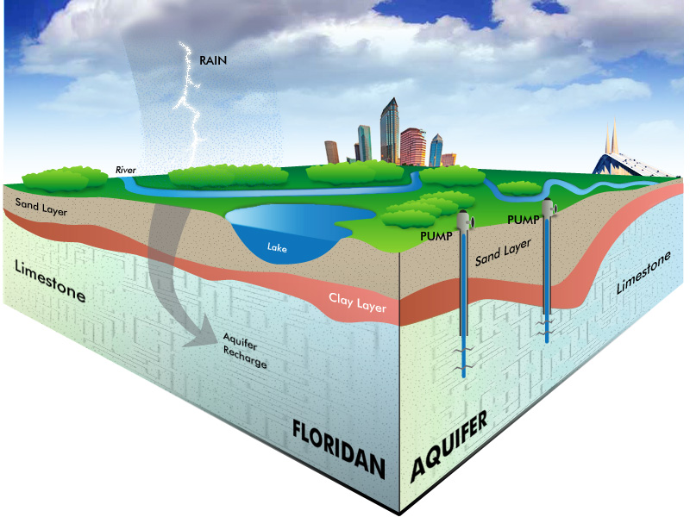
Water sources for Tampa Bay area
Surface water
  Hillsborough River
  Alafia River
Ground water
  Morris bridge wells
Reservoir
  Bill Young Reservoir
Alternative sources
  Desalinated seawater and brackish water
https://www.tampabaywater.org/water-supply-source-groundwater

Slide 8
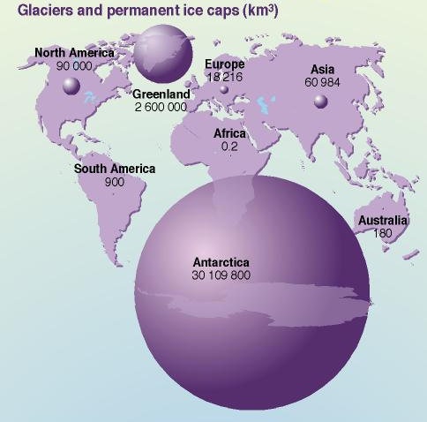
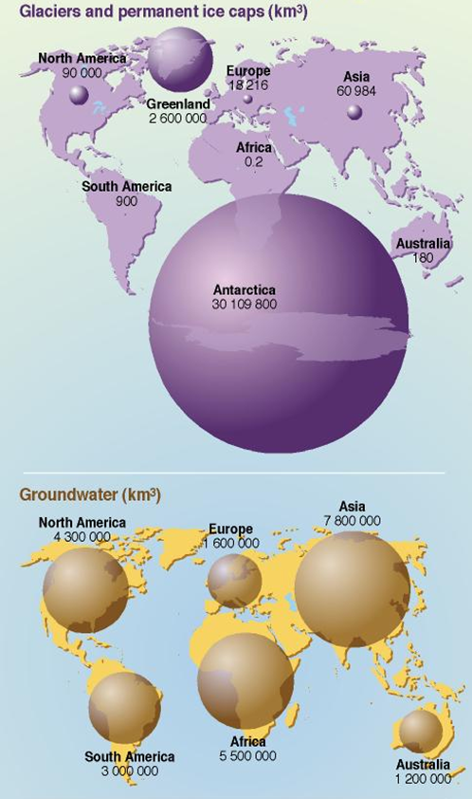
Freshwater resources are unevenly distributed
Global Freshwater Resources – quantity and distribution, Km³
About 10 countries possess 60% of world freshwater
How much renewable water (in percentage) are we consuming?
USA
Canada
Middle East
: 20%
: <1%
: >100% how?
Notes:
Water is not distributed evenly over the globe. Fewer than 10 countries possess 60% of the world’s available fresh water supply: Brazil, Russia, China, Canada, Indonesia, USA, India, Columbia, and the Democratic Republic of Congo (UN Water, 2006

Slide 9
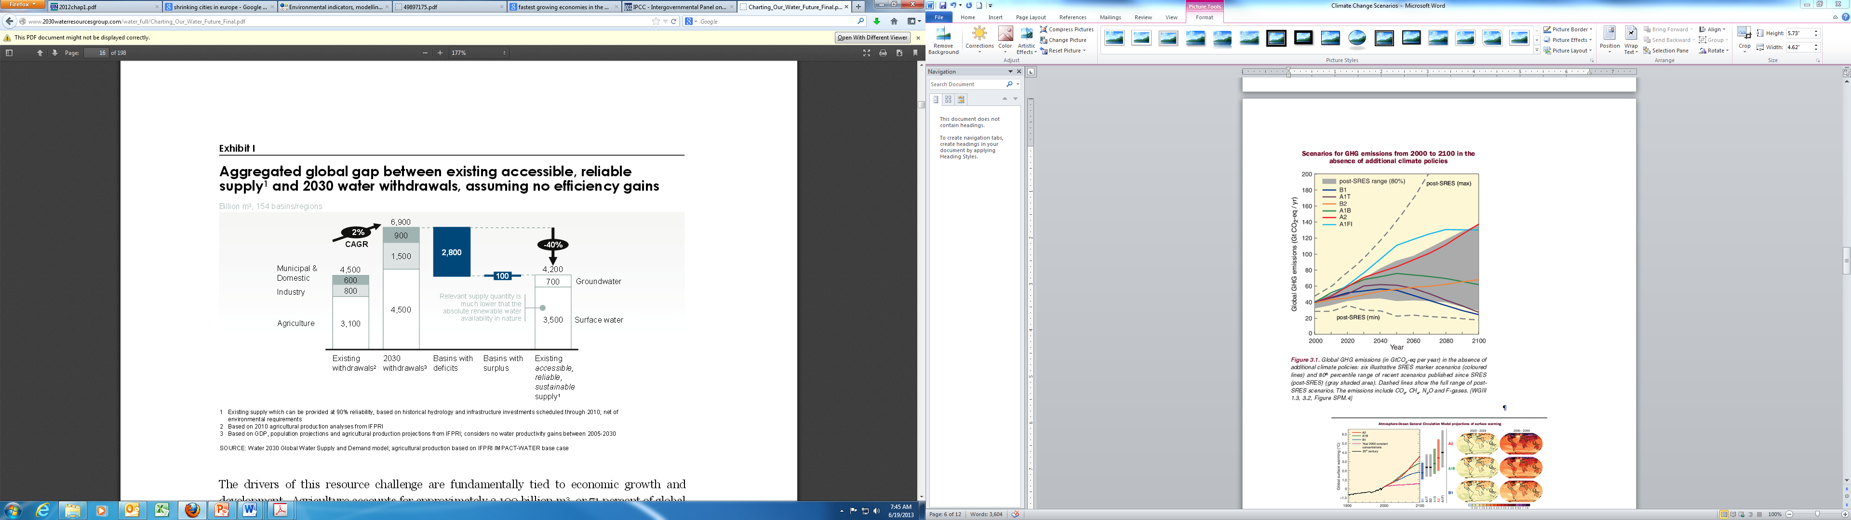
Over 40% of global population will live under severe water stress
The 2030 Water Resources Group (2009)
Note: These are global average values and significant variations exist among regions

Slide 10
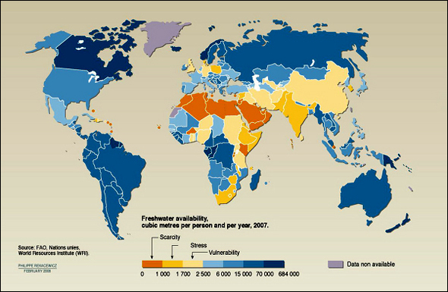
Many countries have limited freshwater sources

Slide 11
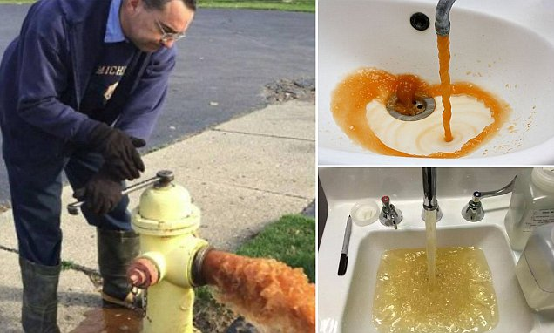
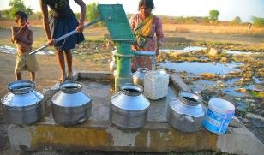
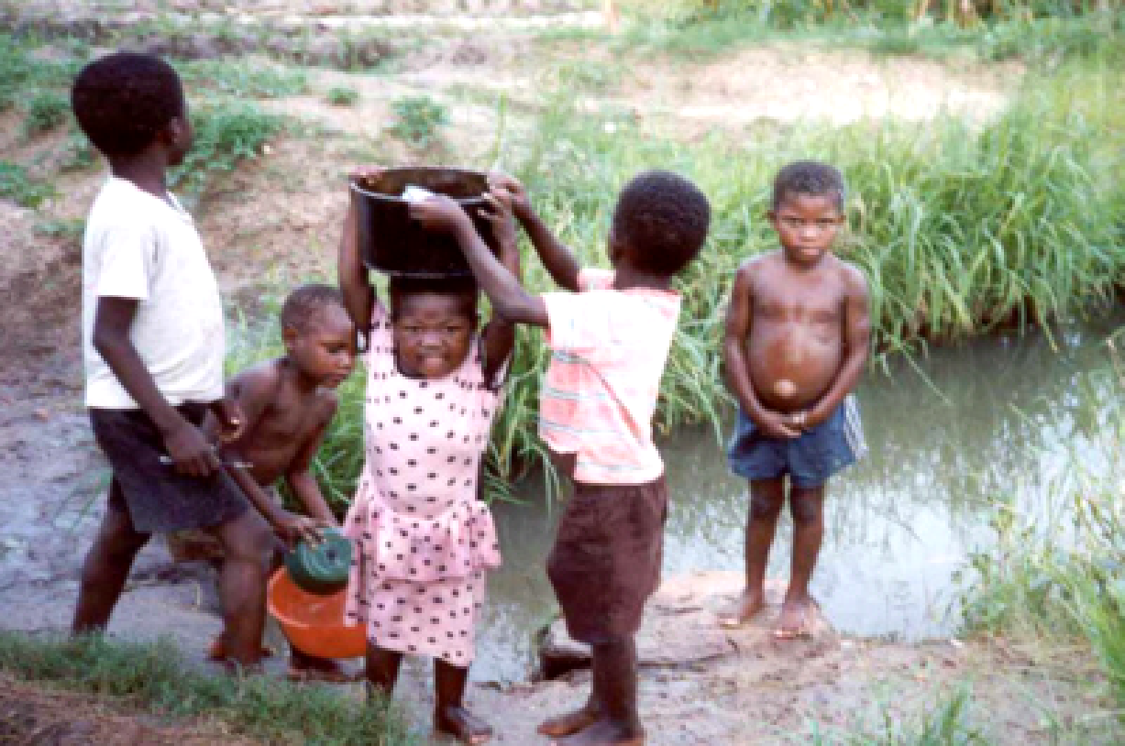
  Do you know that ….
  Almost 800 Million people lack access to safe drinking water – more than 2 times the population of USA

Slide 12

Global Water Supply Problems
https://www.youtube.com/watch?v=4V-KoJGGJ4s
Notes:
https://www.youtube.com/watch?v=yPxMOzN0Uq4

Slide 13
How does climate change impact water resources?
Increased temperature – impact on water quality
Changes in runoff - pollutant transport to reservoirs and lakes
New pattern of precipitation and evaporation – drought and flooding
Sea level rise - increase salt water intrusion

Slide 14
Challenges of water scarcity on children and women
Surviving on cave water https://www.bbc.com/news/av/49436917/the-village-surviving-a-drought-on-cave-water
Water Walk https://www.youtube.com/watch?v=4V-KoJGGJ4s
SDS Goal 6 https://www.youtube.com/watch?v=LCKsU4bPFOQ

Slide 15
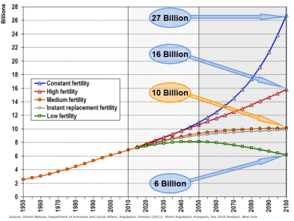
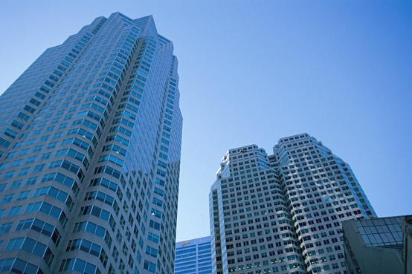
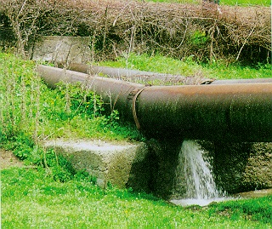
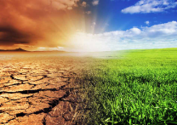
Global changes will further complicate water resources management
Global change pressures
Population growth
Urbanization
Economic growth
Aging infrastructure
Climate change
These are associated with huge uncertainty

Slide 16
Discussion
How does climate change (CC) impact water resources:
Impact on water quantity
Impact on water quality

Slide 17
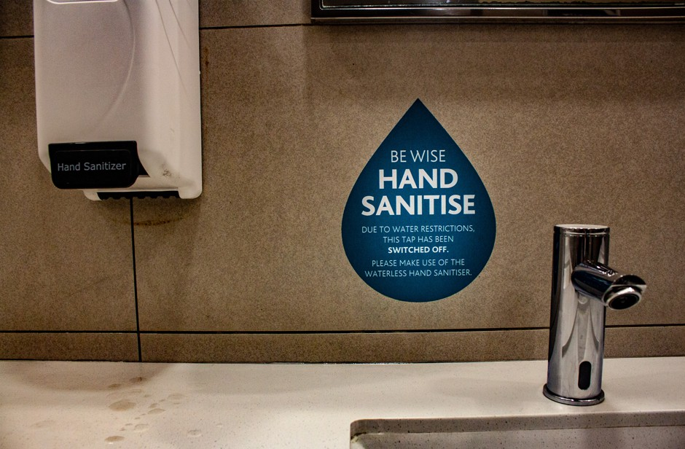
“Day Zero” in Cape Town, South Africa
https://www.youtube.com/watch?v=pJ6pZeTK9cM

Slide 18
Water Quality

Slide 19
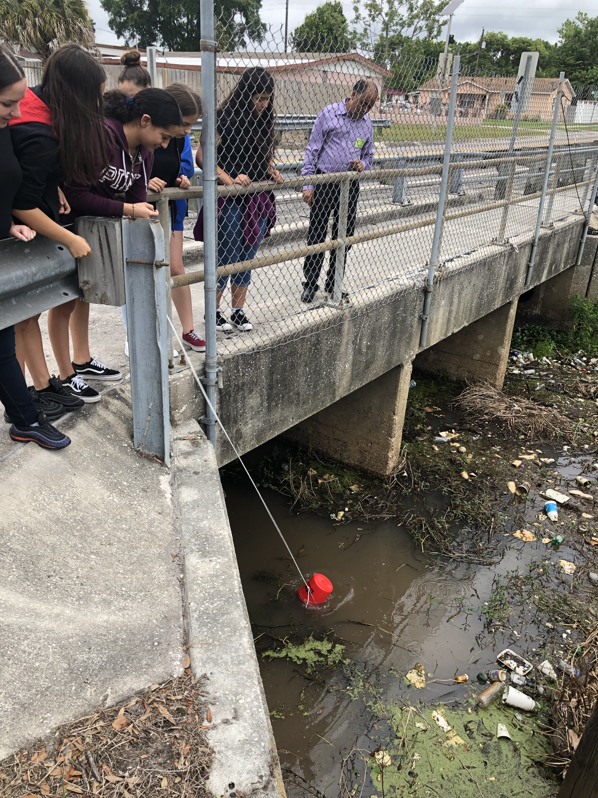
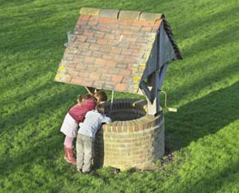
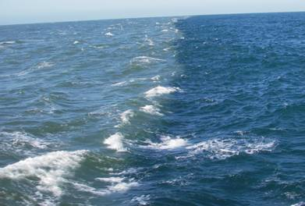
Would you drink water directly from a well, river or sea?

Slide 20
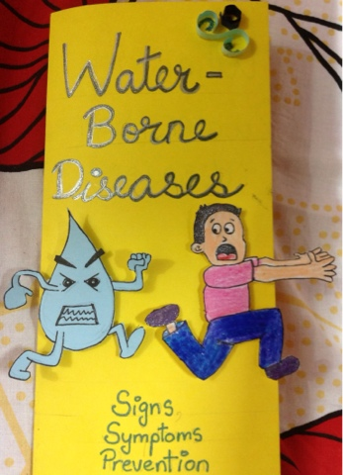
Do you know that ….
  Do you know that….
  Every day more than 6,000 people die due to water borne diseases- most of these are children below the age of 5.

Slide 21
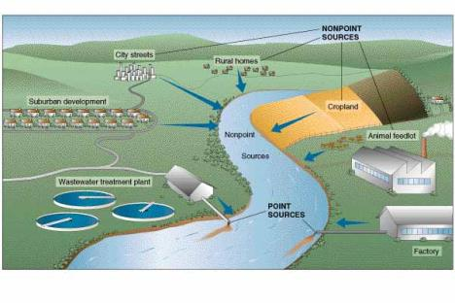
What makes water unsafe?
The most important things that make water dirty and unsafe include:
  Solids from soil
  Micro-organisms from wastewater, garbage, soil
  Chemicals from houses, streets, industries and farms

Slide 22
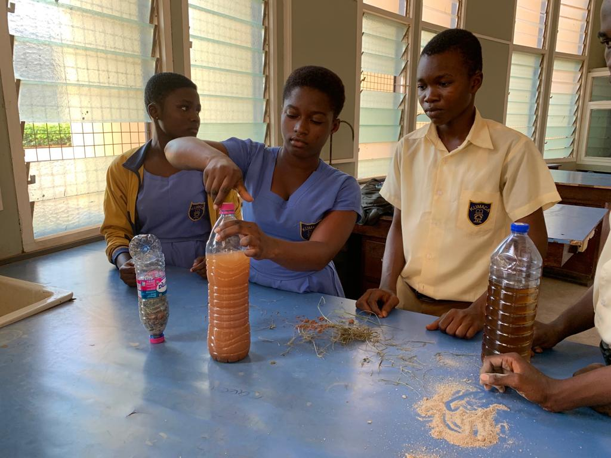
How do you tell if water is not clean?
By using our senses
  color
  smell
  taste
But not all contaminants can be detected using our senses
Therefore, we need to do water quality tests

Slide 23
Common contaminants in water
Physical: sediment or organic material suspended in the water
Chemical: nitrogen, salts, pesticides, metals, and human or animal drugs
Biological (microbiological): bacteria, viruses, protozoan, and parasites
Radiological: plutonium, uranium, radon

Slide 24
Emerging contaminants are complicating water management
Emerging water quality parameters
Micro and nano-pollutants
Trace organics – pesticides, pharmaceuticals, endocrine disrupting chemicals
Resistant microorganisms (Antibiotic resistant bacteria (ARB) and Antibiotic resistant genes (ARG)
By 2050, the number of deaths from ARB related infectious diseases will rise to 10 million people per year, outnumbering all current causes of death (O’Neill, 2016).

Slide 25
Water treatment at city level

Slide 26
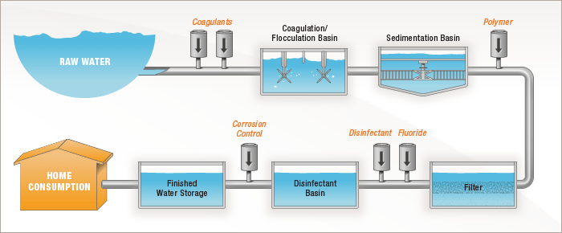
Conventional water treatment

Slide 27
Water treatment at home

Slide 28
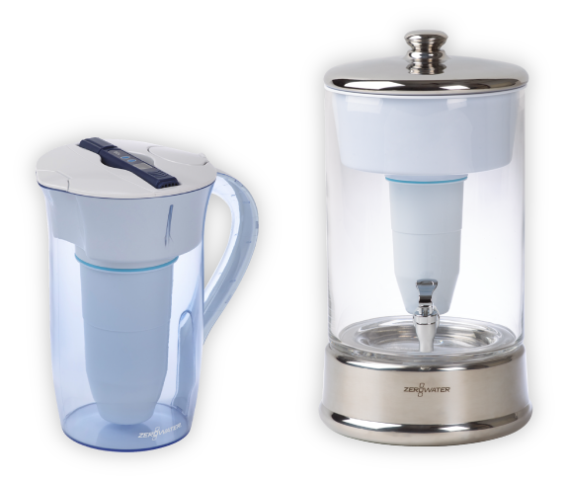
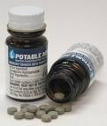
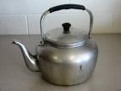
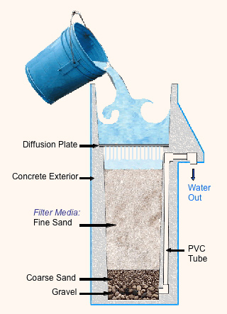

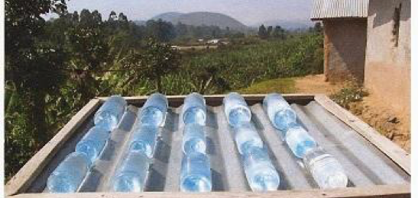
Water Treatment at home
Chlorine tablets
Pitcher Filters
Boiling
Ceramic filters
Solar disinfection
Biosand filters

Slide 29
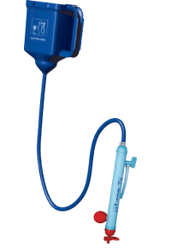
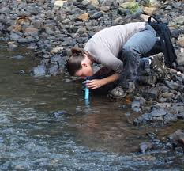
LifeStraw – membrane filter
Individual use lifestraw
Family use lifestraw

Slide 30
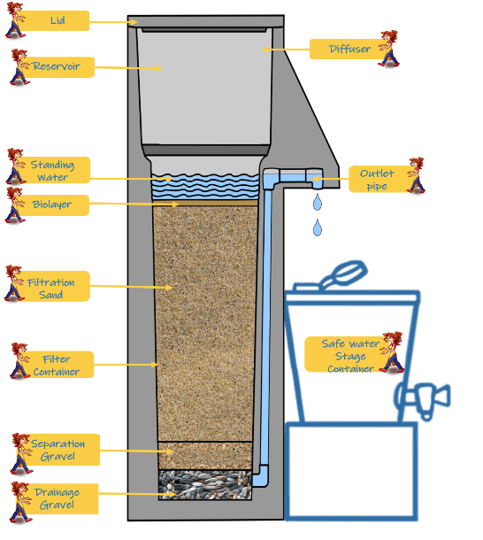

Biosand Filter

Slide 31
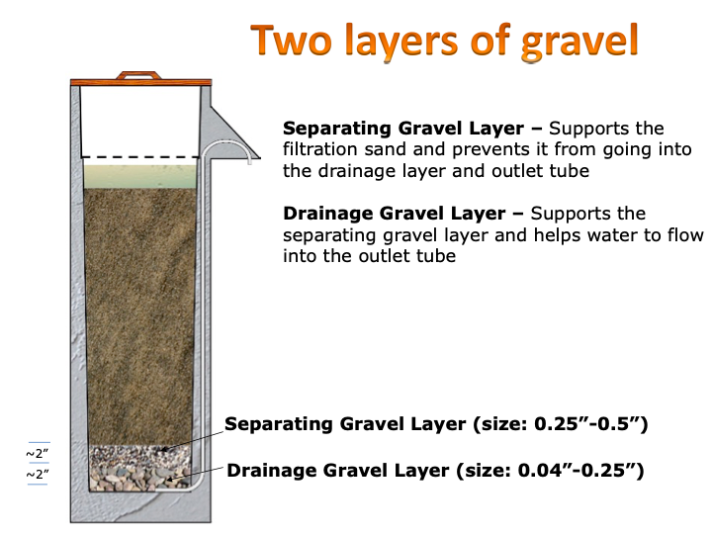
Sand and Gravel layers in BSF
Sand layer- 21.4 “
Sand layer – This is where the purification happens. Biological layer develops at the top of the sand which removes most of the contaminants

Slide 32
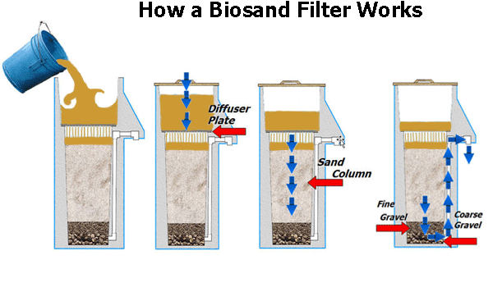
BSF – How it works

Slide 33
What can a BSF remove?
Suspended solids
Organic matter
Microorganisms

Slide 34
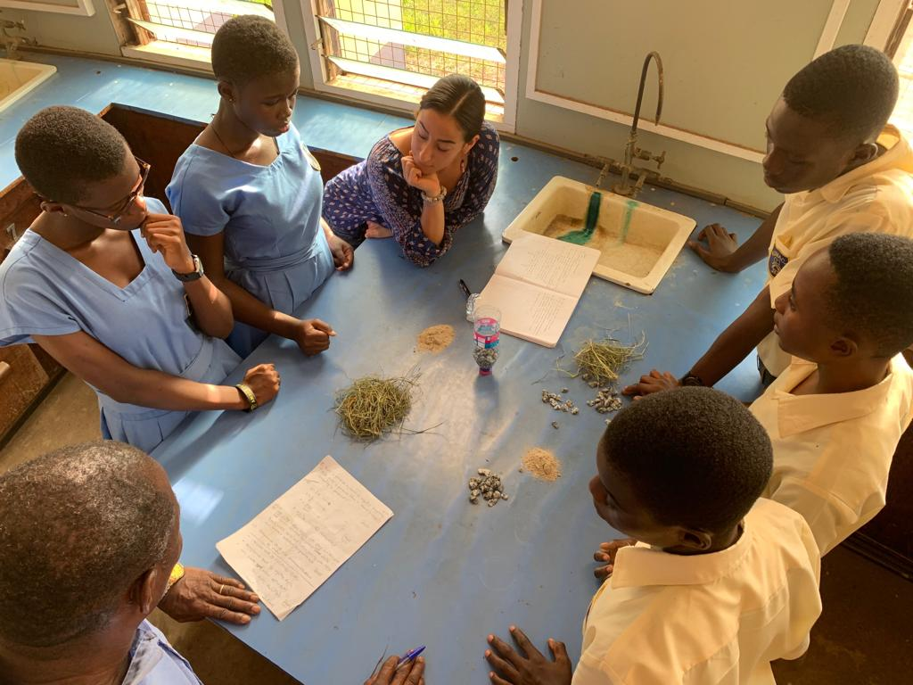
How does a BSF remove particles?
Mechanical trapping
Adsorption
Predation
Natural die-off

Slide 35
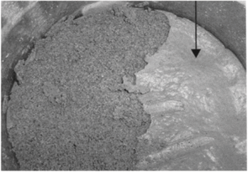
The Biolayer
Biolayer develops at the top of the sand
It develops over time – its ripening period
When the biolayer grows too much, the flow through the filter slows down
  Then the BSF needs to be cleaned.

Slide 36
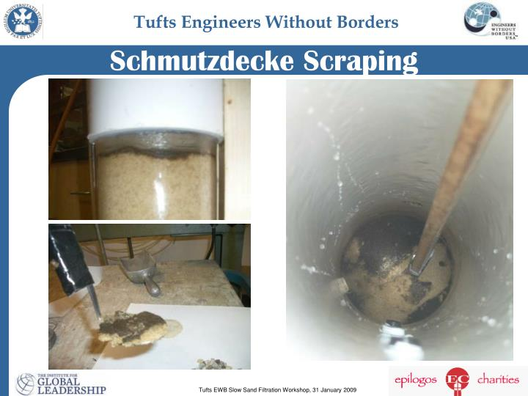
How do you clean a BSF?
Mix the top sand layer by hand or with a stick
Scoop out the dirty water
You may need to do this more than one time

Slide 37
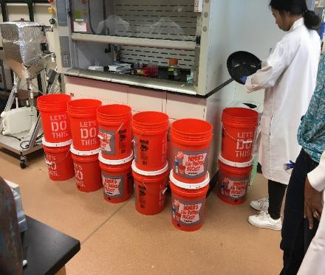
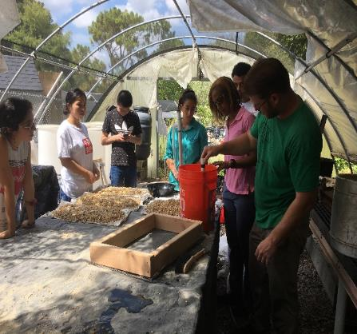
What can an advanced BSF remove?
Nitrate
Fluoride
Lead
Arsenic

Slide 38






What did Middle and high school students do in the BSF project
?
Learned how to do measurements
Came up with research questions
Designed experiment
Collected and analyzed data
Reported findings to USF and possibly others

Slide 39
Leto High School

Slide 40
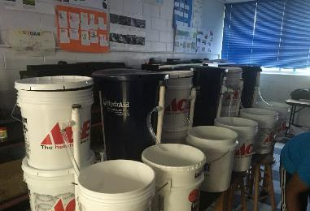
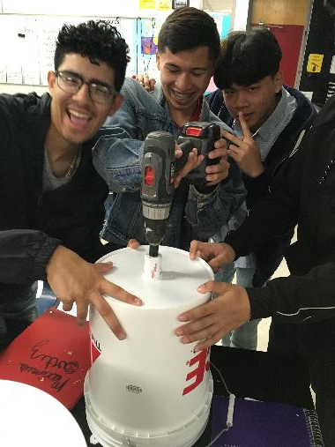
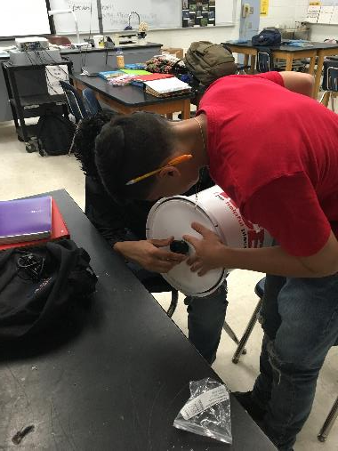
Design and building of BSF at Leto

Slide 41
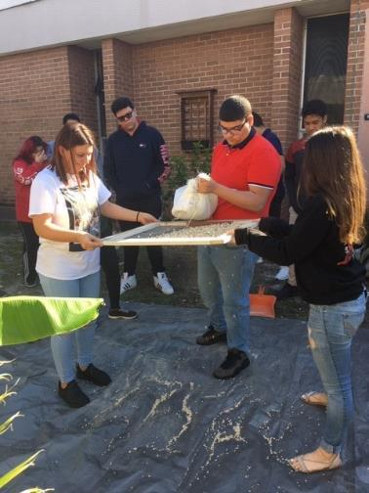
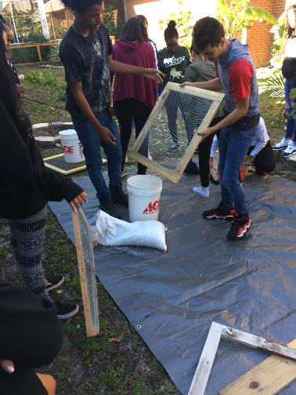
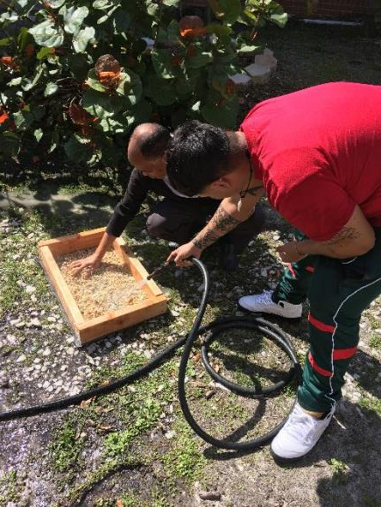
Sieving and washing sand and gravel at Leto

Slide 42
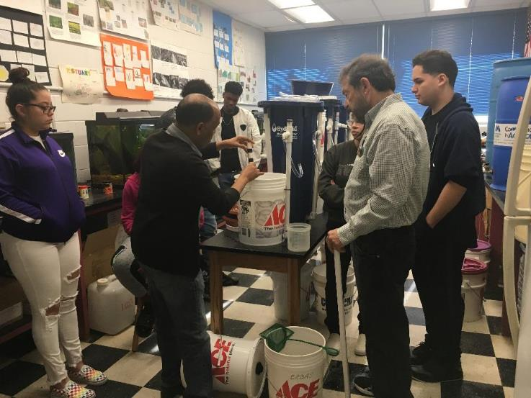
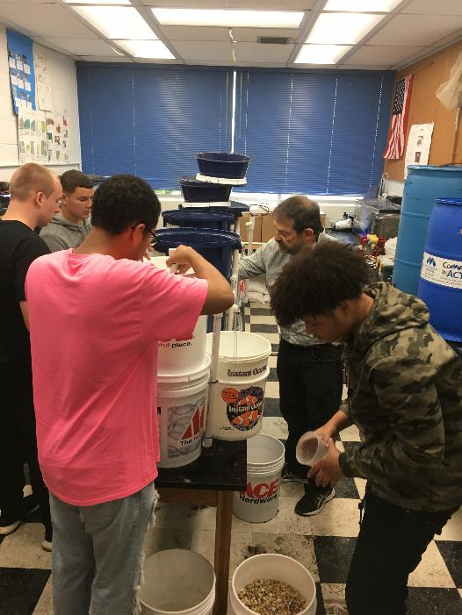
Filling washed gravel and sand in BSF, at Leto

Slide 43
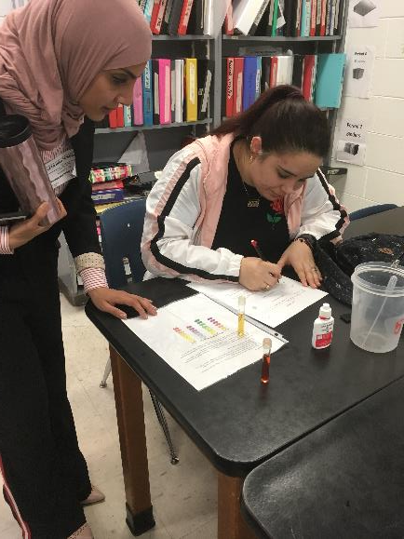
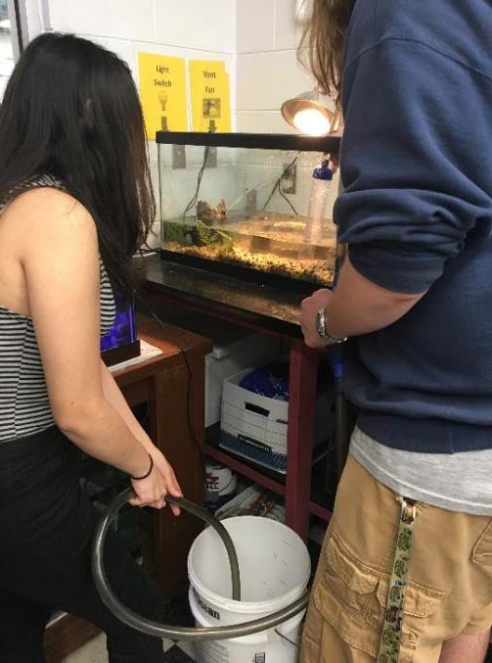
Developing research questions and collecting water for charging BSFs at Leto

Slide 44



Measuring water quality and presenting results at Leto

Slide 45
Pierce Middle School

Slide 46


Design and build of BSF at Pierce

Slide 47


Testing the column BSF for leaks at Pierce

Slide 48


Washing of gravel and sand at Pierce

Slide 49


Raw water source (canal) at Pierce

