Slide 1



SustainabilitySuperheroes.org in the Shark Tank
Presented by: Deborah Kozdras, Ph.D.
There is nothing more powerful than an idea whose time has come –Victor Hugo

Slide 2
U.N. Definition of Sustainable Development
In 1987, the UN Brundtland Commission defined sustainable development as: "meeting the needs of the present without compromising the ability of future generations to meet their own needs."
(Report of the World Commission on Environment and Development.)

Slide 3
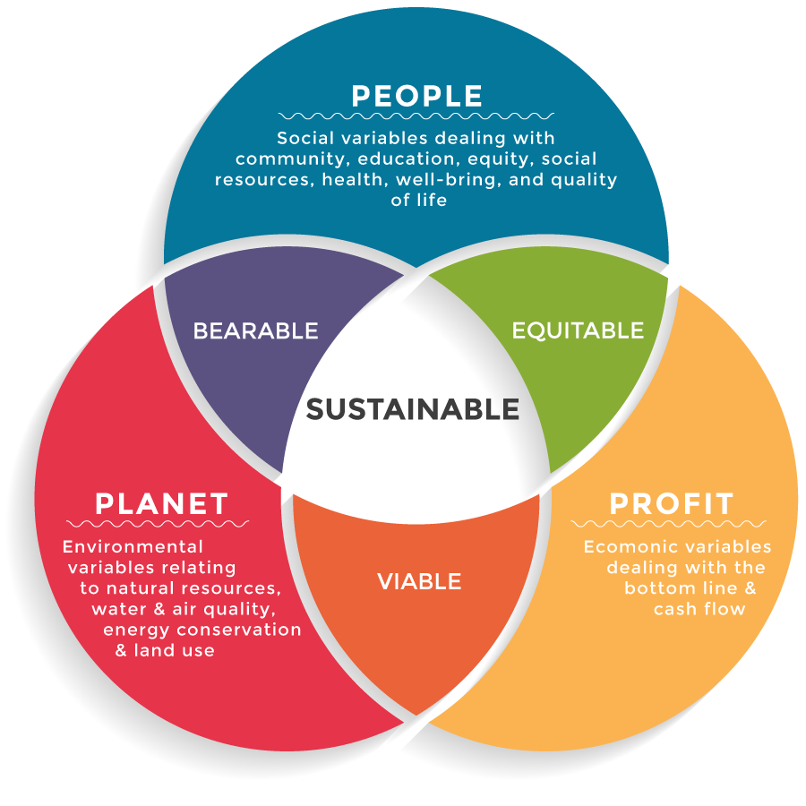
Sustainability: Triple Bottom Line

Slide 4
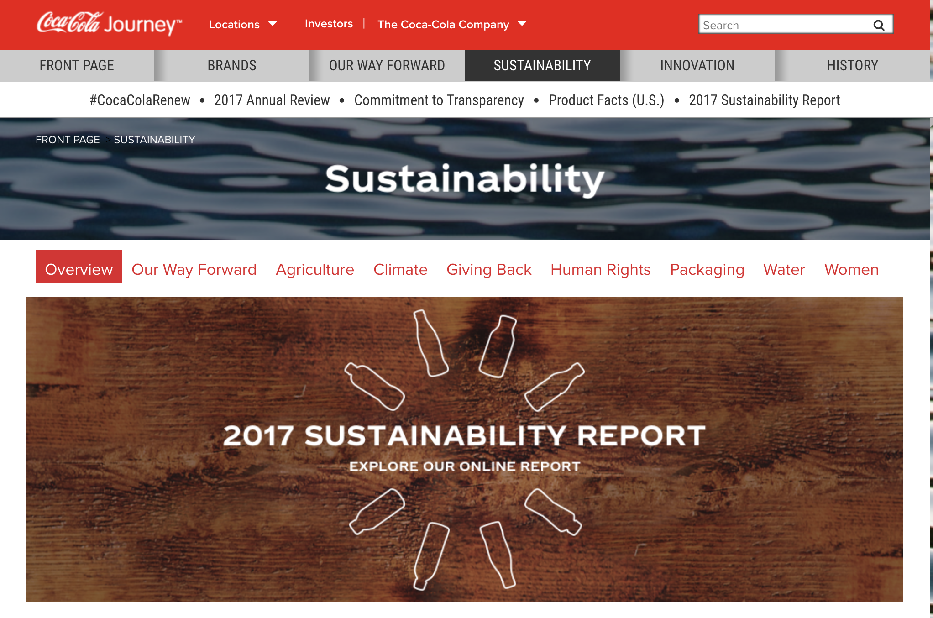
#cokegivesback

Slide 5

Sustainability Superheroes

Slide 6
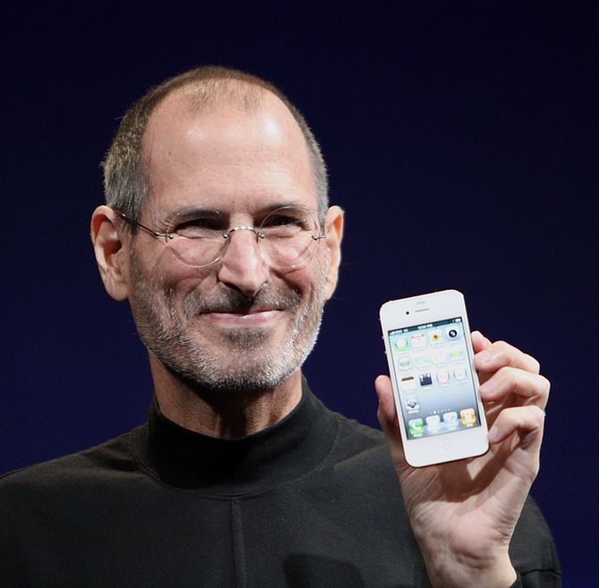
Entrepreneurship
Life can be much broader once you discover one simple fact:
Everything around you that you call life was made up by people that were no smarter than you and you can change it, you can influence it, you can build your own things that other people can use.
–Steve Jobs
Notes:
Home is a comfortable place, but it can make you complacent and overly reliant on what’s readily available to you. Traveling as a child (and later as a young adult), you come to realize that the world can function in totally different ways. There is not necessarily a “right” or “normal” way to do anything. That is, cars don’t always have to drive on the right side of the road, gas doesn’t always need to be calculated in gallons, food can be made of things you never imagined eating and could be prepared in many ways, and cars don’t all have to look the same. The business world, just like a foreign country you’ve never traveled to, requires that you are comfortable while navigating alone without a map.
The earlier you realize there is more than one way to do things, the sooner you’ll break the psychological barriers that keep you from taking on new challenges. If there were a single formula to success, everyone would be successful.

Slide 7
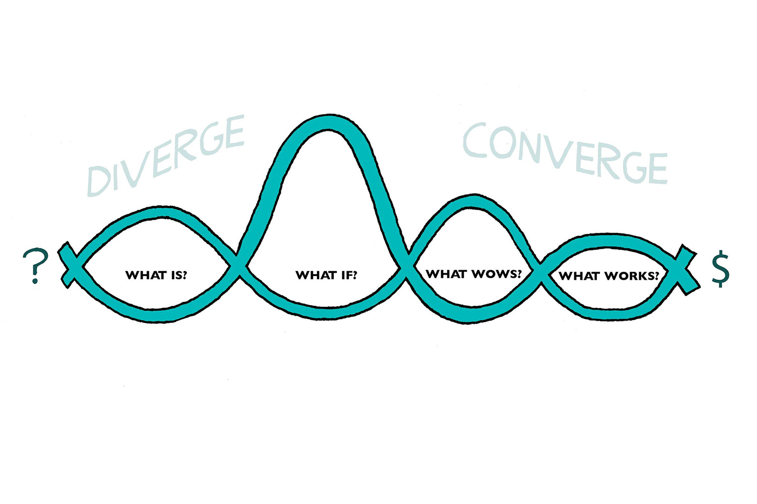
Entrepreneurship with Design Thinking

Slide 8
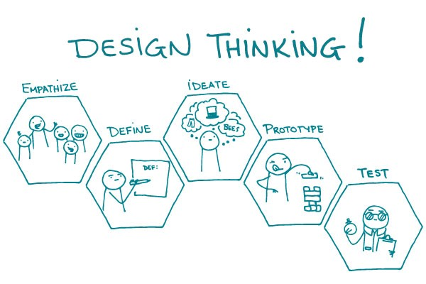

Slide 9
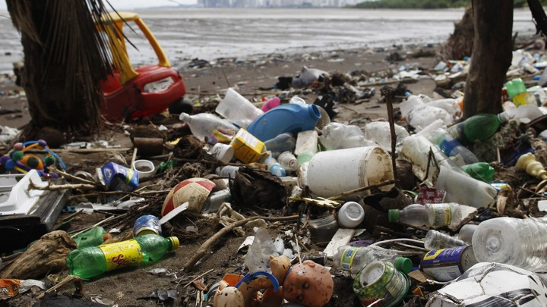
What is . . .
https://www.theatlantic.com/science/archive/2016/04/ocean-garbage-marine-debris/476481/

Slide 10
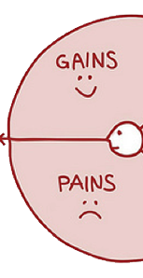
What is?
What is the situation?
What problems do people have?
What pains do they have?
What gains could they use?

Slide 11

What if . . .

Slide 12
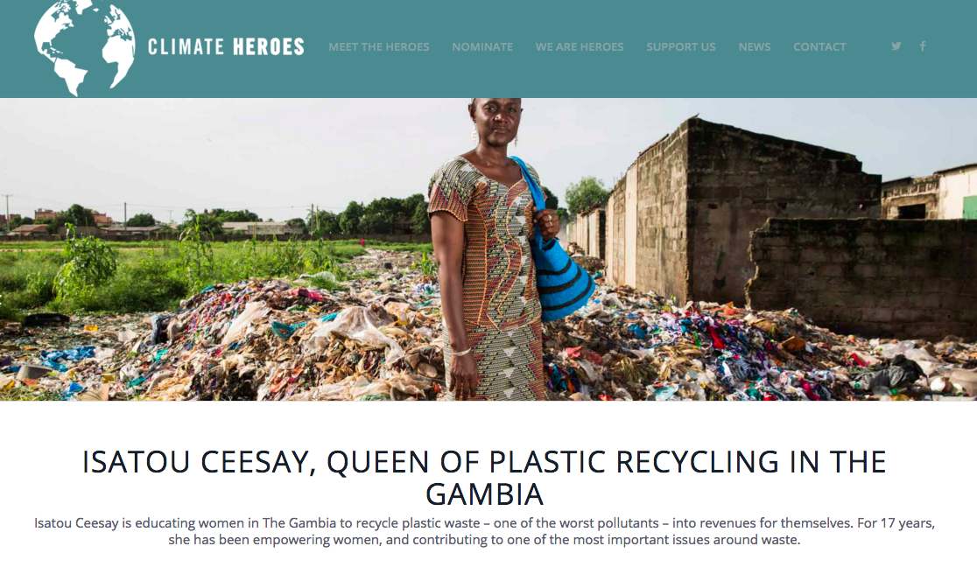
What if . . .

Slide 13
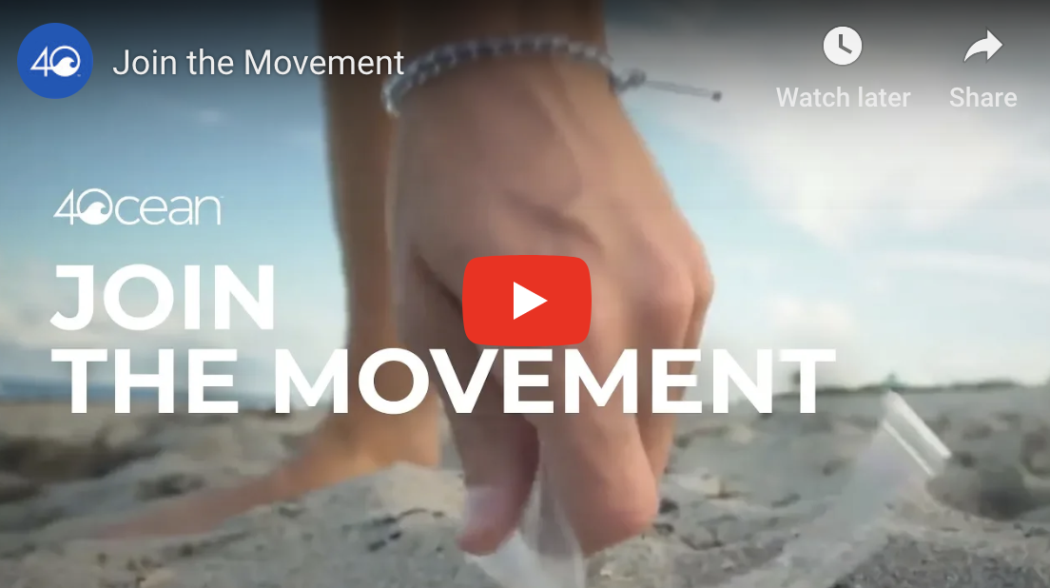
What if . . .
https://4ocean.com/

Slide 14
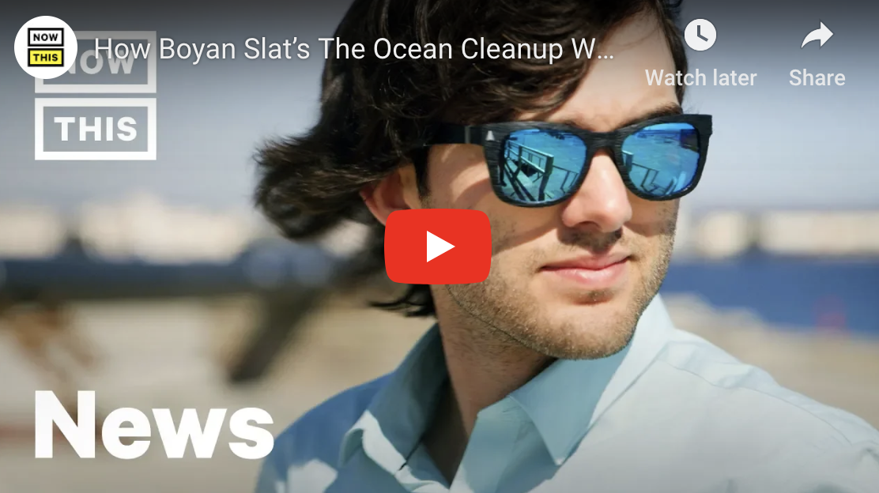
What if . . .
https://www.theoceancleanup.com/

Slide 15
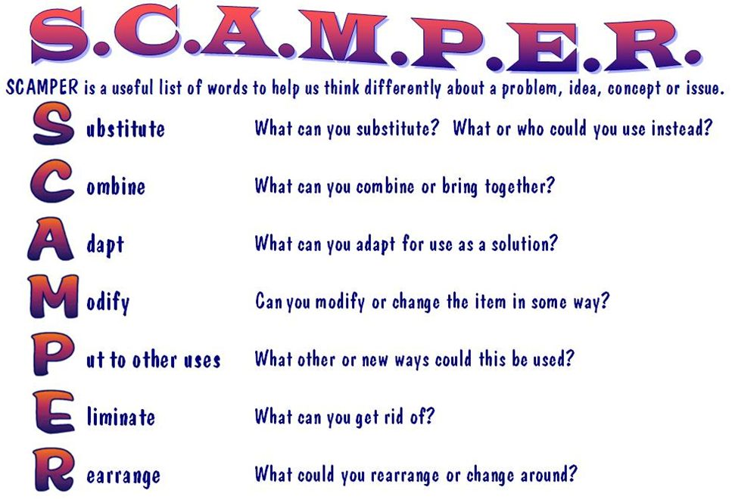
What If? With SCAMPER

Slide 16


Slide 17
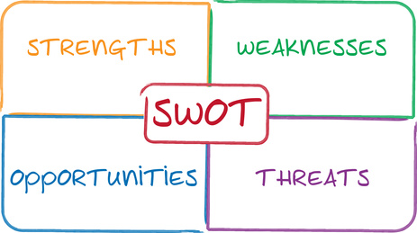
What Wows? What Works?

Slide 18
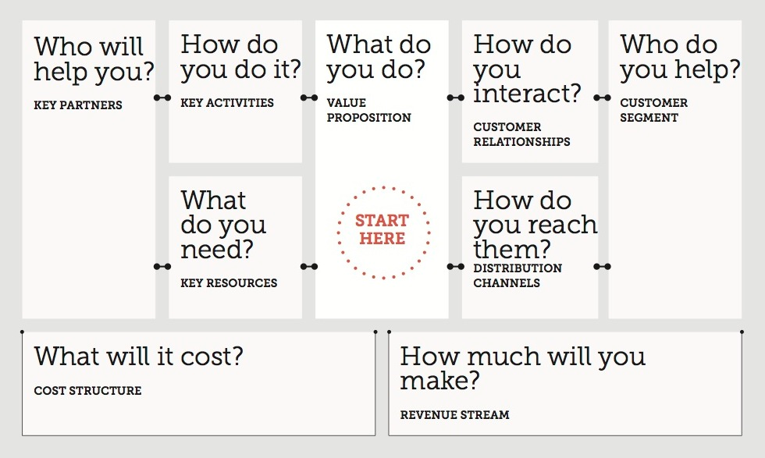
Business Model Canvas

