Slide 1
Food Sustainability: Growing Garden Movements
BROOKE HANSEN, Ph.D.
Director, Sustainable Tourism
Patel College of Global Sustainability
Co-Chair, Urban Food Sovereignty Group
University of South Florida, Tampa

Slide 2
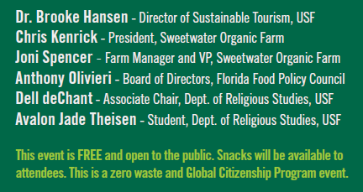

Slide 3
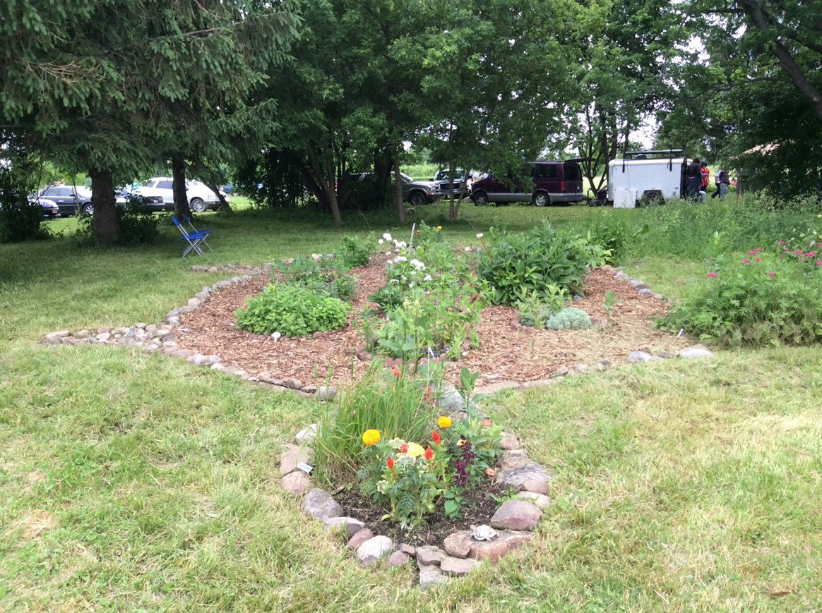
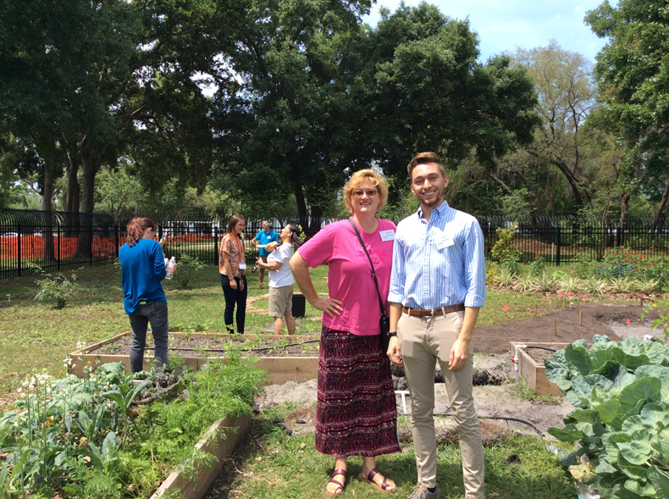
About me
Anthropologist
Ithaca College - 18 years - Anthropology of Food
Native American collaborative farm project in Central New York – Cayuga SHARE Farm
Hawai`i: Univ. of Hawai`i College of Agriculture
Florida: Farm Bureau, Tampa Bay Network to End Hunger, School Gardens

Slide 4
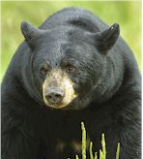
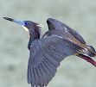
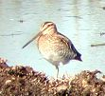
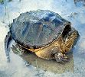
CAYUGA - "Guyohkohnyoh" People of the Great Swamp Cayuga SHARE Farm
Community based collaborative educational farm

Slide 5
The Three Sisters

Slide 6
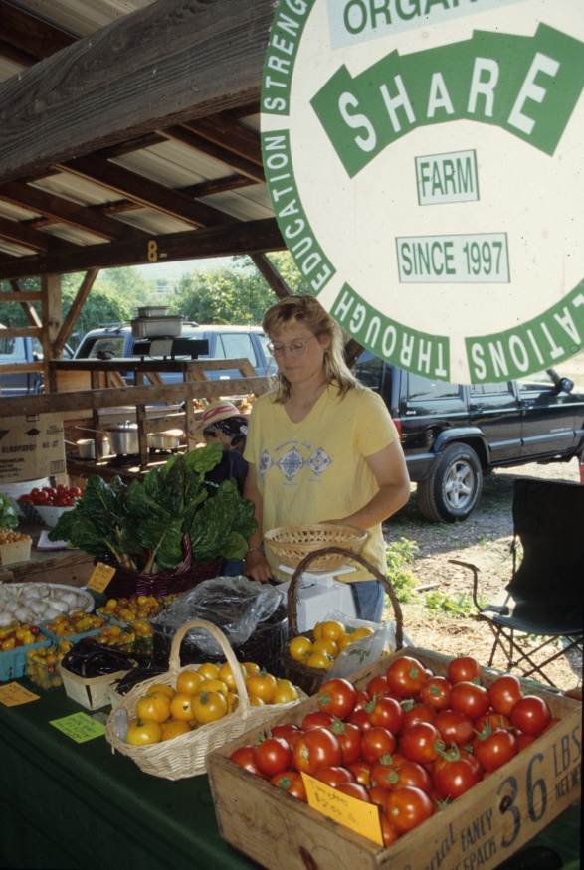

Slide 7
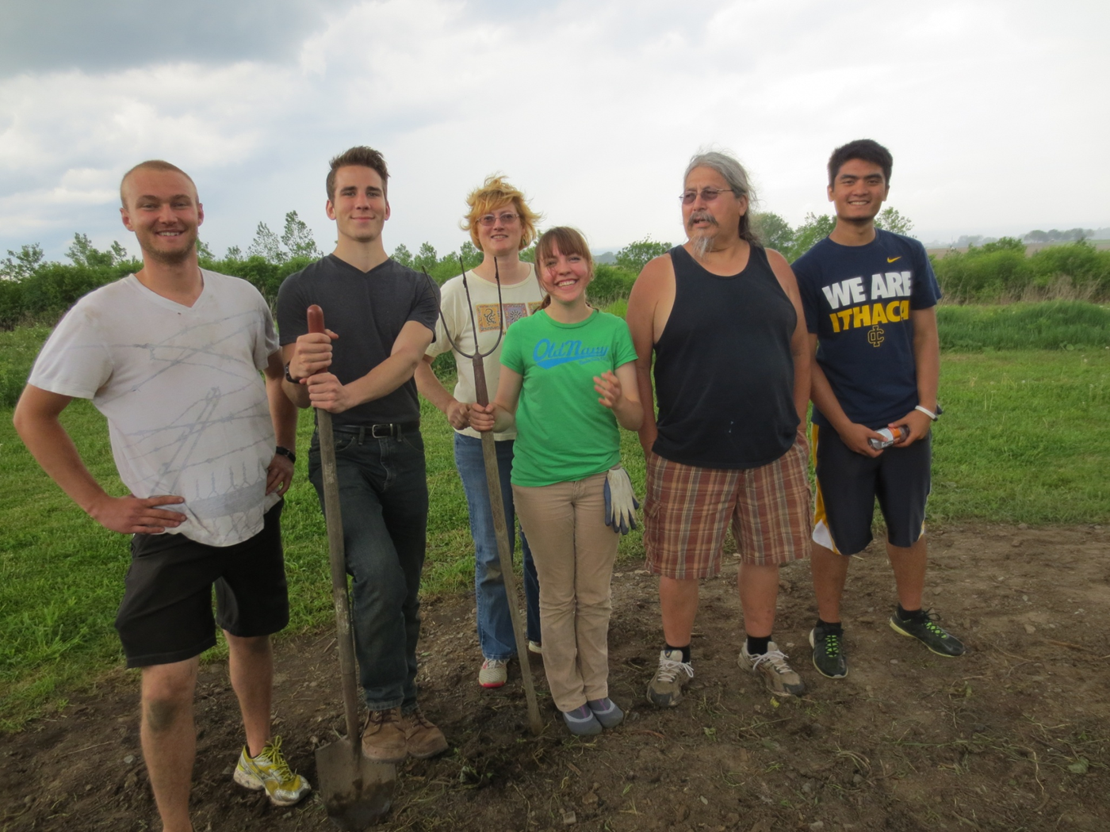
Experiential & service learning – assessment based

Slide 8
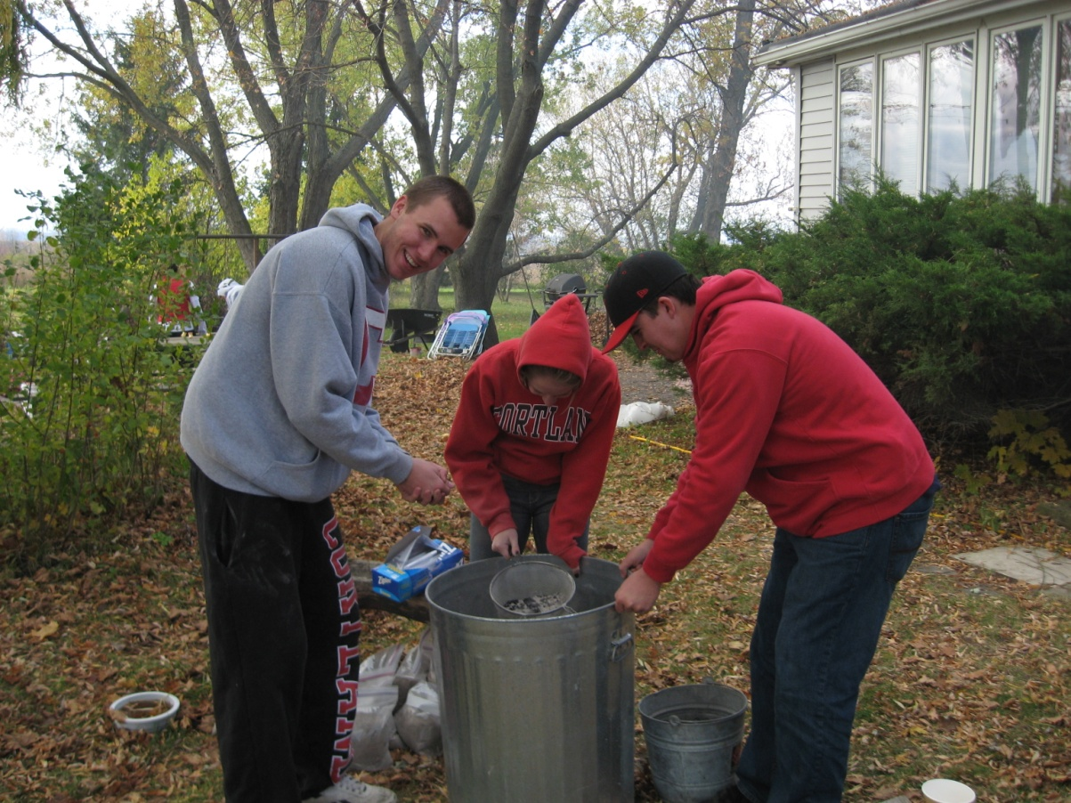
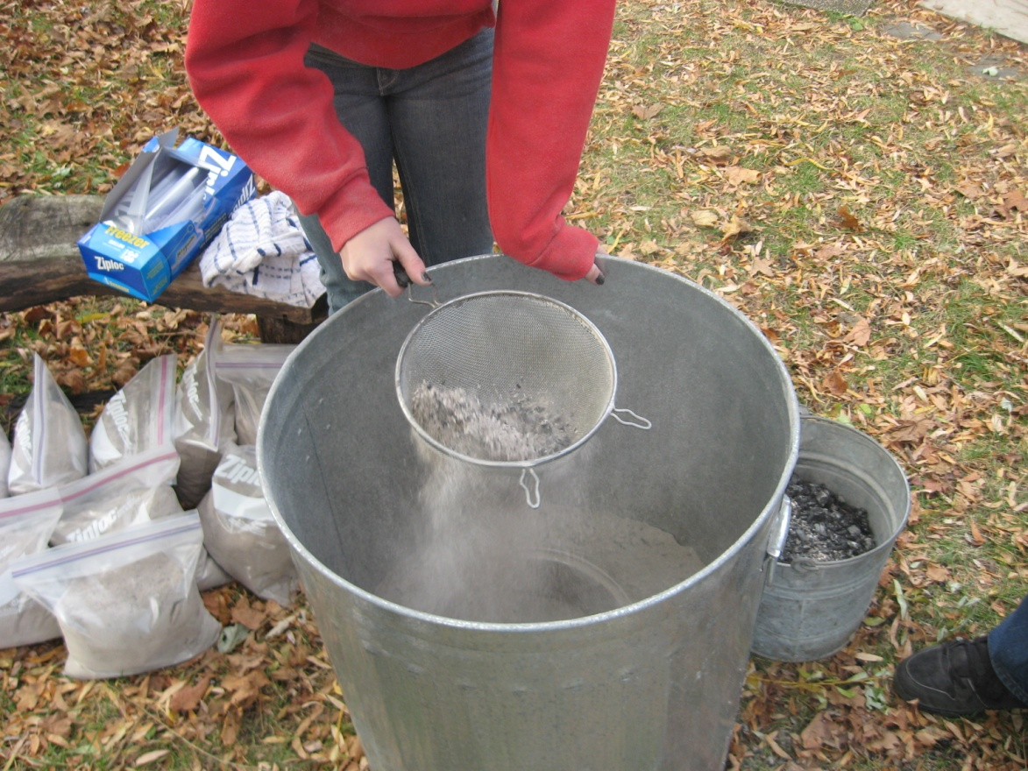
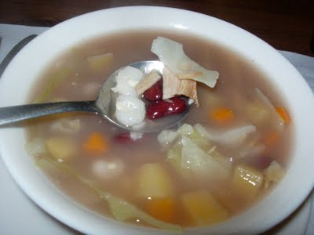
Sifting ash for traditional corn soup,
Cayuga SHARE Farm

Slide 9
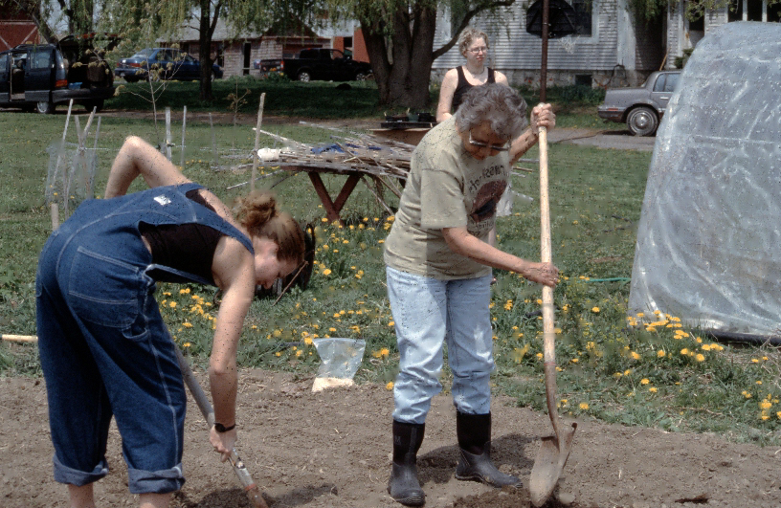
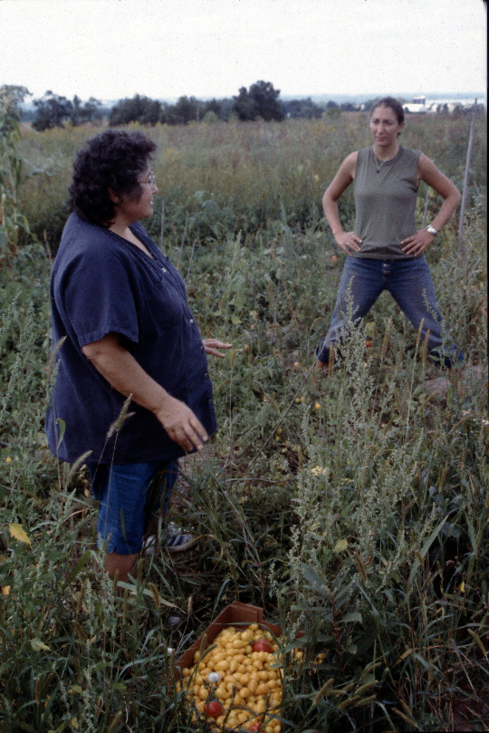
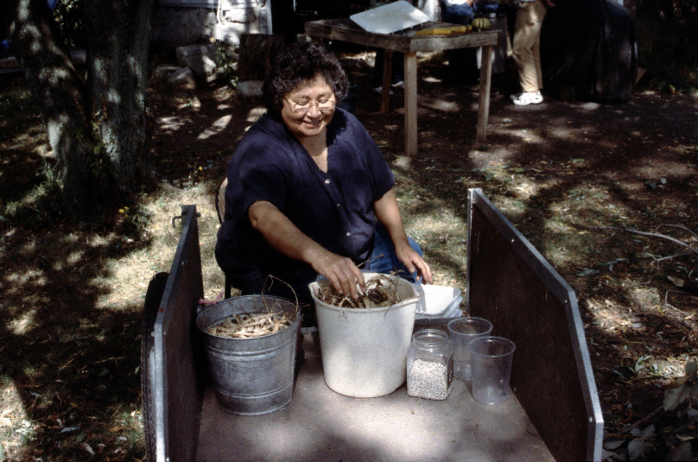

Slide 10
Time for a Change! Hawai`i!

Slide 11
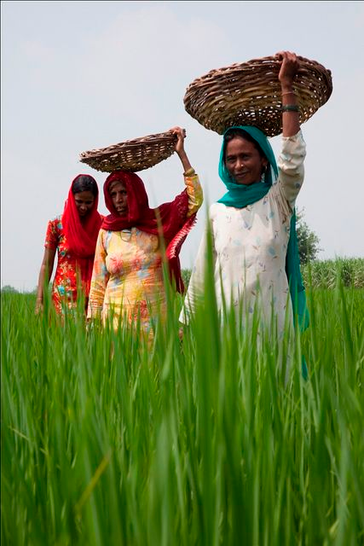
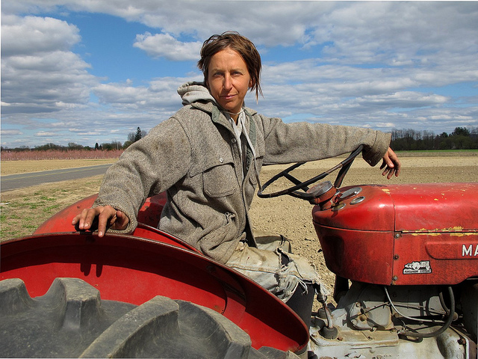
AG 397 Gendered Fields: Women, Agriculture and Food Resiliency
We examine the recent rise in women farmers, organizations, Facebook groups (e.g., Women Who Farm), and theoretical frameworks (e.g., FAST – feminist agrifood systems theory).
Cross-listed with WS 397 MWF 10-10:50
New FALL 2017 Course
on the role women have played in farming, agriculture, food production and food resiliency throughout human history to today.
Brooke Hansen, kbhansen@hawaii.edu
cell/text 607-280-1147

Slide 13
Hawai`i Island School Garden Movement
https://kohalacenter.org/hisgn/curriculum-map

Slide 14
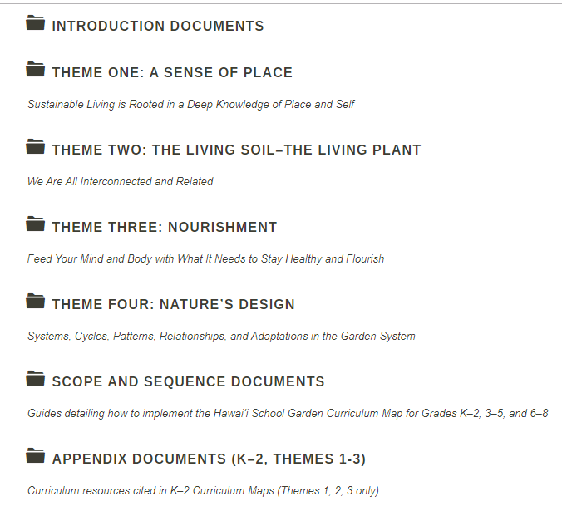
Hawai`i
School Garden
Curriculum Maps
https://kohalacenter.org/hisgn/curriculum-map

Slide 16
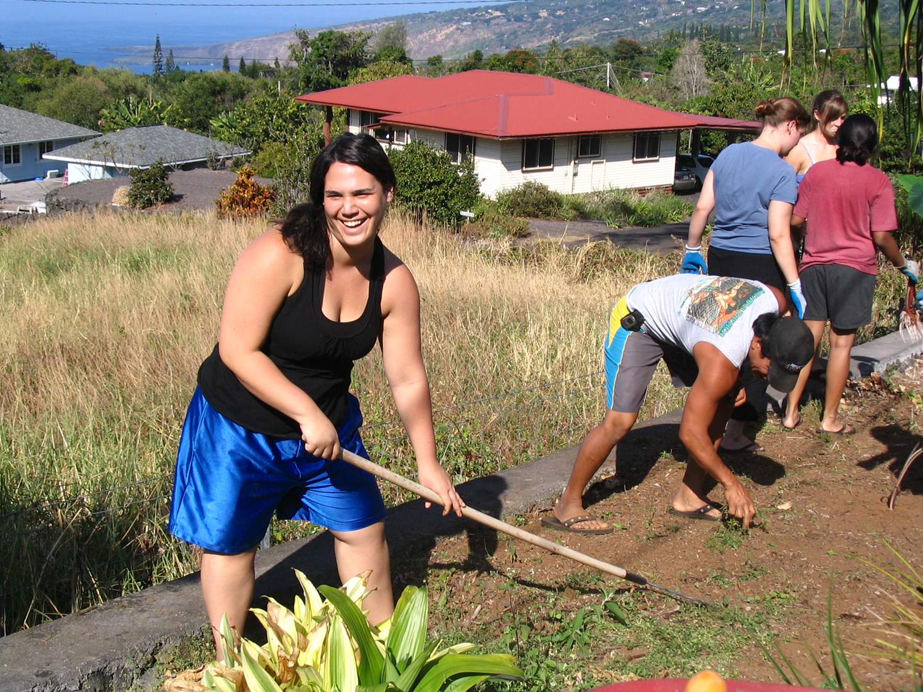
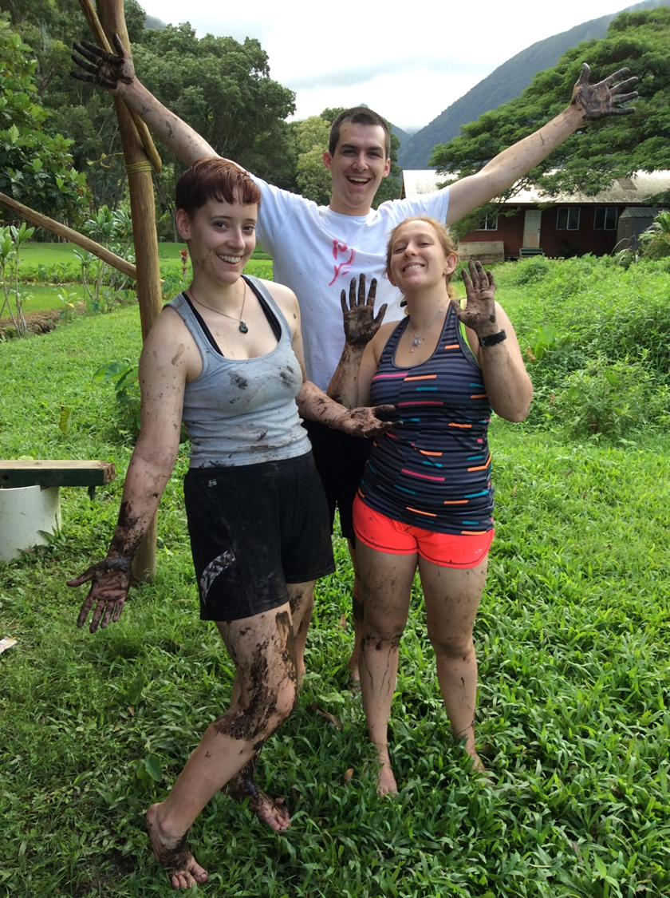
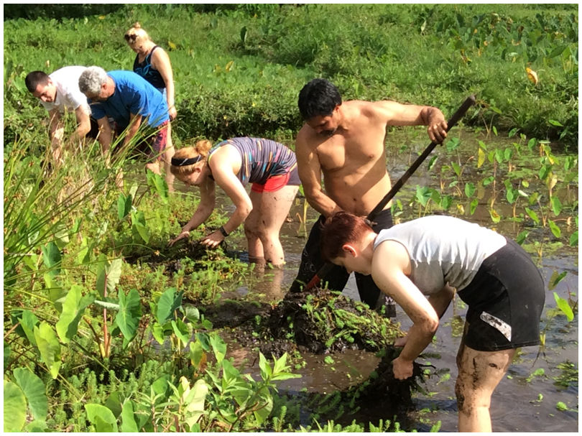
From Hawai`i to Florida
Thinking like an island…

Slide 18
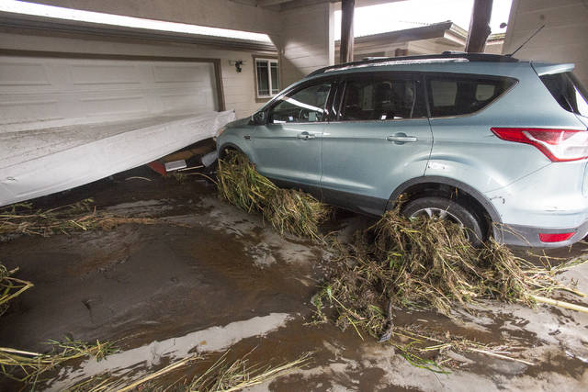

Slide 19
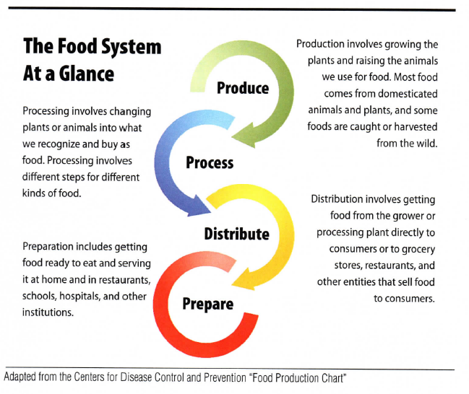
Food System Sustainability Triple Bottom Line (PPP)
Complex and multifaceted – economics, production, distribution, politics, …
Focus on local food production as one way to support sustainability
How do we achieve it? School gardens are an excellent place to start!

Slide 20
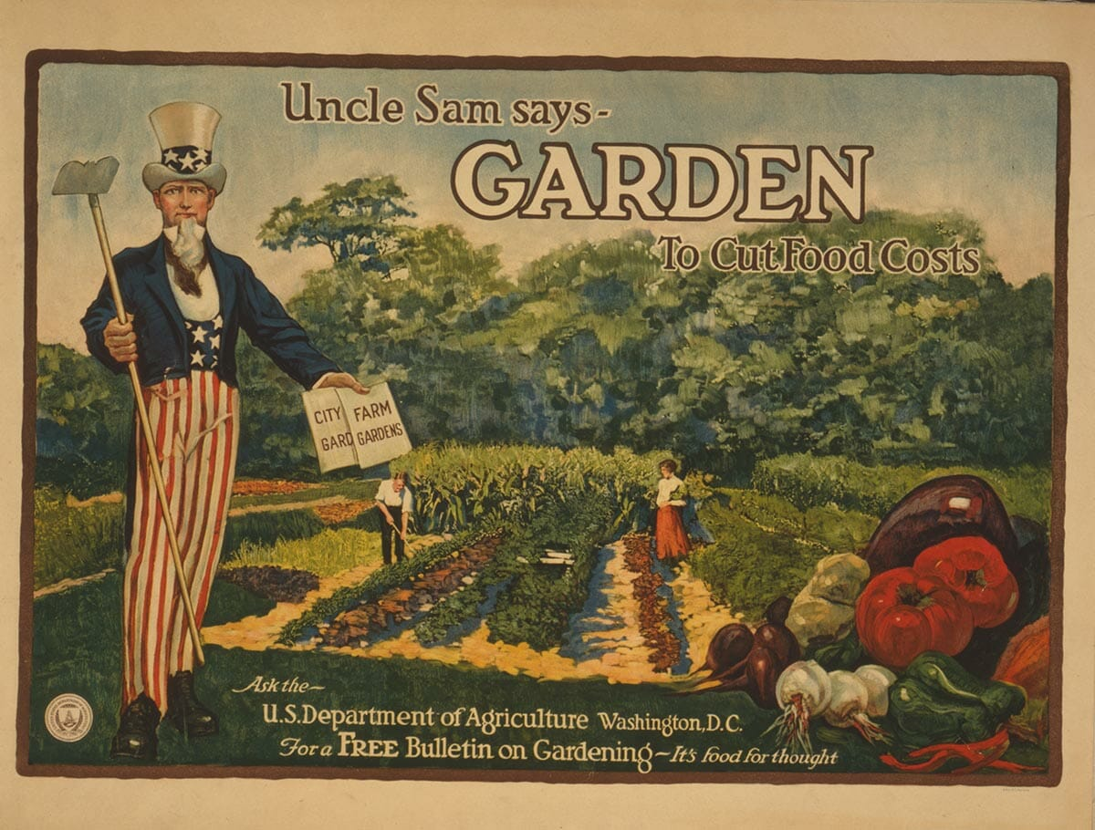
What happened to local food production?

Slide 21
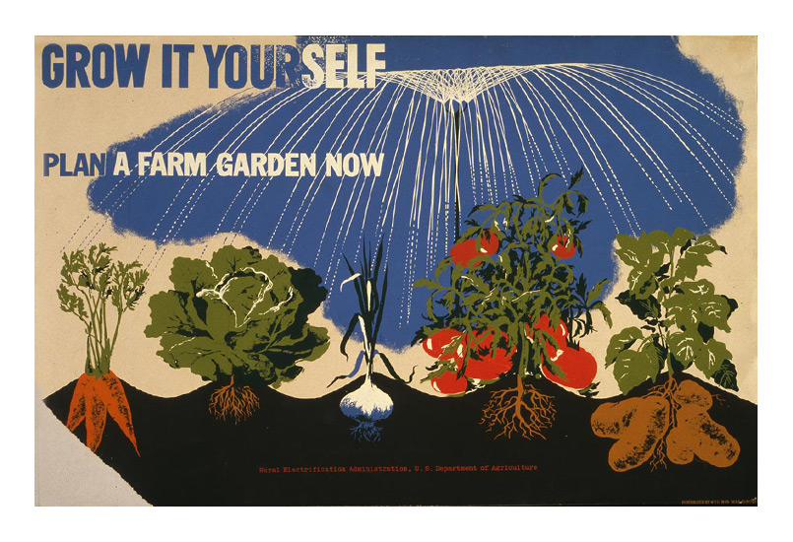
What happened!?

Slide 22
http://www.todayifoundout.com/wp-content/uploads/2013/08/tv-dinner.jpg

Slide 23
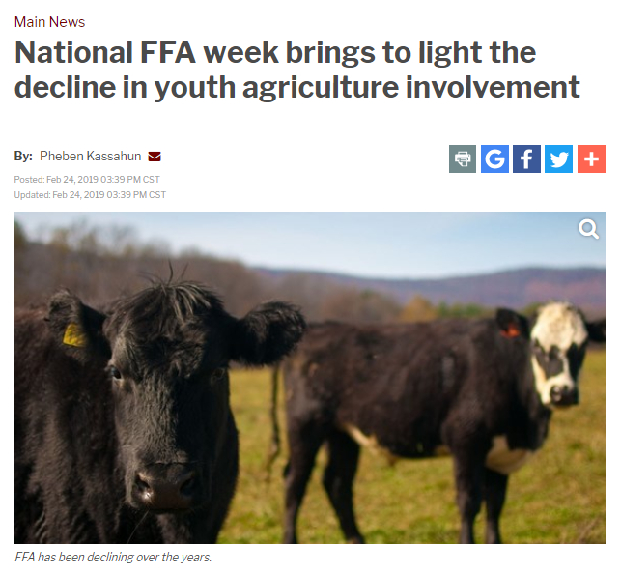
https://www.bigcountryhomepage.com/news/main-news/national-ffa-week-brings-to-light-the-decline-in-youth-agriculture-involvement/1806424921

Slide 24
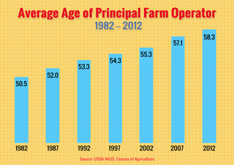

Slide 25
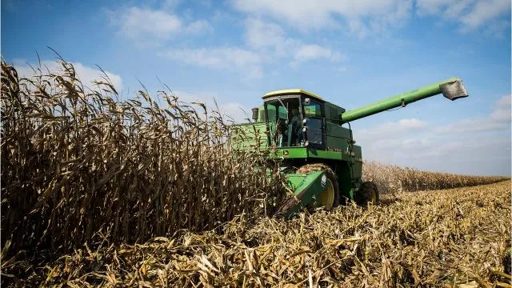
https://www.usatoday.com/story/money/business/2018/0
5/17/farm-income-could-lowest-12-years-prices-fall/618204002/

Slide 26
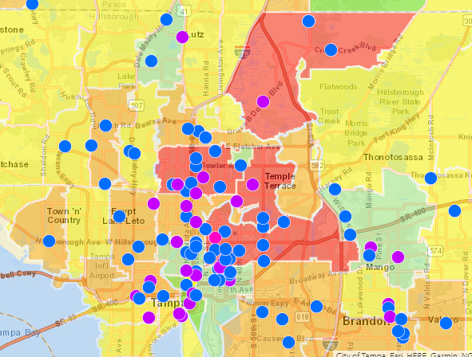
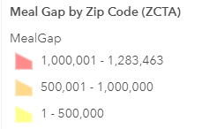
http://www.arcgis.com/home/webmap/viewer.html?webmap=5d00cc308cb940ae826074c66a5b5561

Slide 27
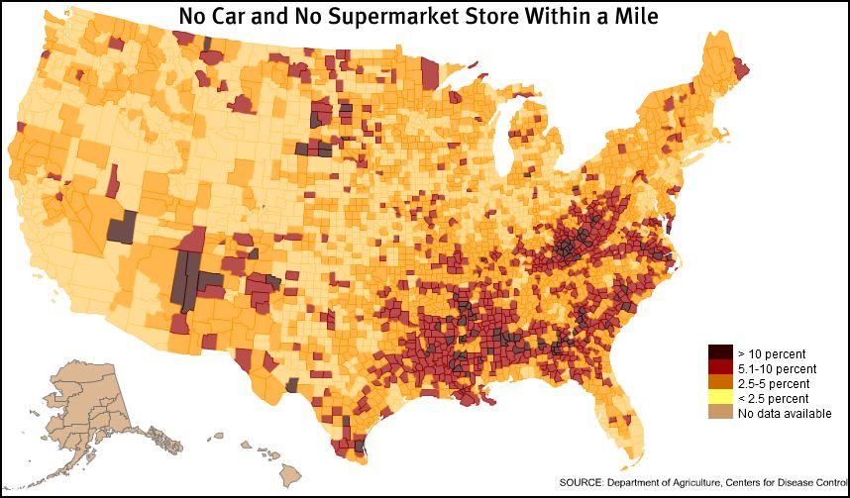

Slide 28
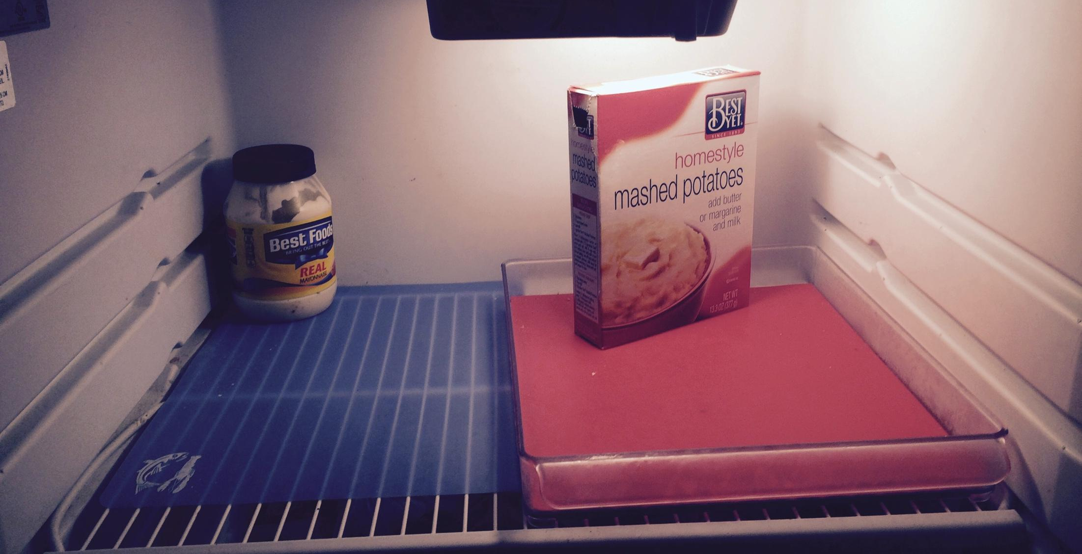
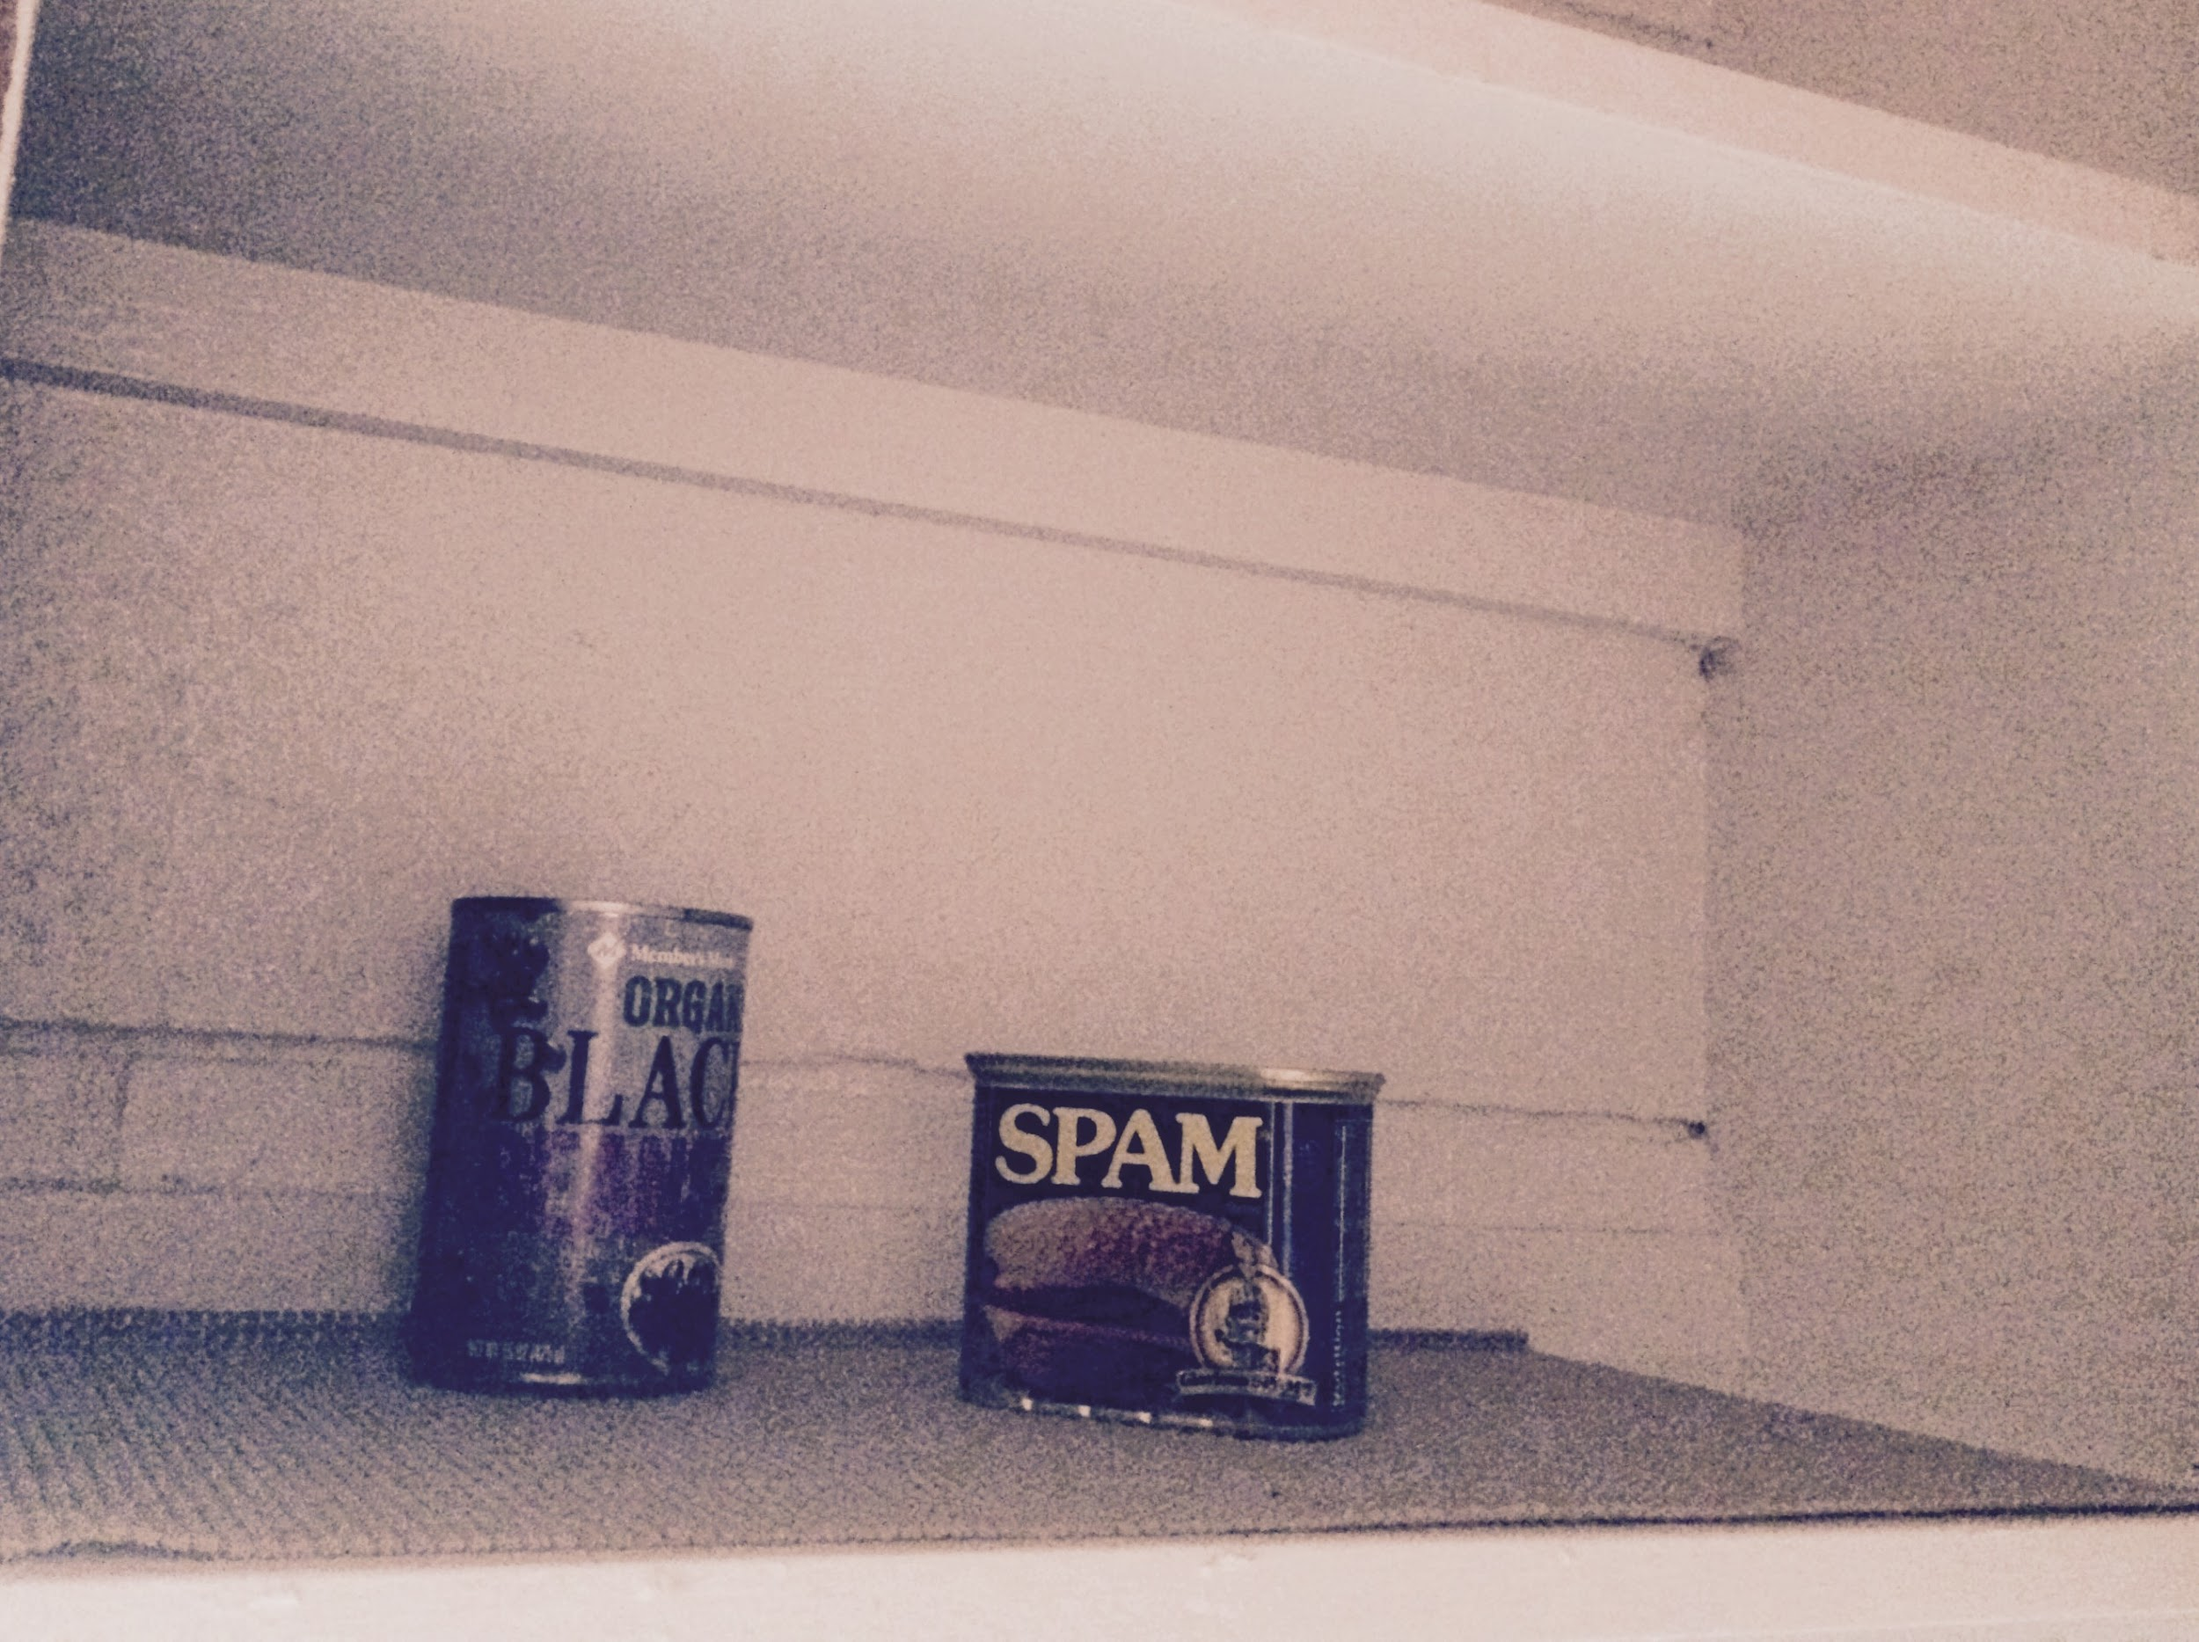
What is Food Security?
The USDA defines food security as having “consistent, dependable access to enough food for active, healthy living” (Coleman-Jensen, et al., 2015).
Food insecurity is hunger caused by lack of “access to adequate food… limited by a lack of money and other resources” (Coleman-Jensen, et al., 2015).

Slide 29
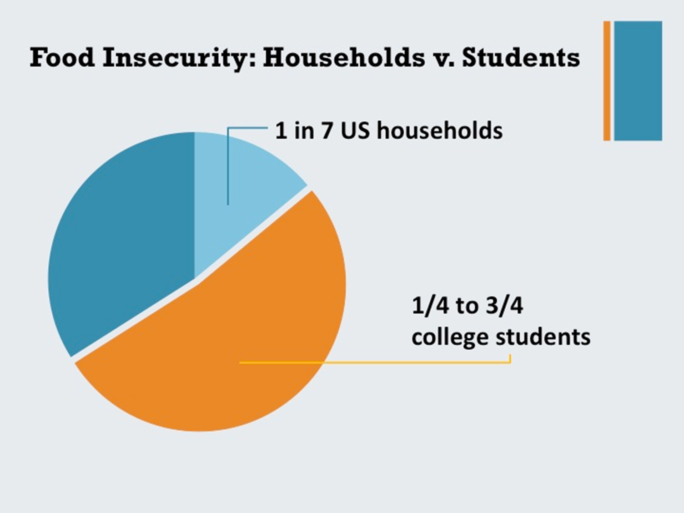
How significant is the problem?
USDA 2015 Food Insecurity Study

Slide 30
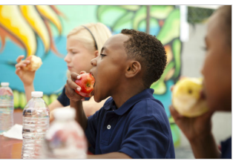
How significant is the problem?
Prevalence of food insecurity reported on some campuses across the nation:
University of California (Martinez, 2016): 42%
City University of New York (Freudenberg, 2011): 39%
University of Arkansas (Lisnic, 2016): 37% to 47%
Bowling Green University, Ohio (Koller, 2014): 19%
http://exclusive.multibriefs.com/content/too-many-k-12-students-face-food-insecurity/education

Slide 31
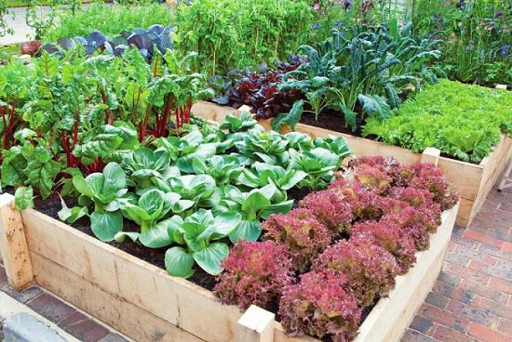
We need to bring back
local food production. Everyone! Everywhere!

Slide 32
Local Food Production & Sustainability
LFP & Sustainability – depends on growing techniques, impacts to the ecosystem, carbon footprint, equity issues for labor, access, etc. >> the TBL
Local Food Production has the potential to:
Increase resilience (against climate events &
disruptions in food distribution)
Address food insecurity – 1/3 of food farmers produce goes uneaten -- $161.6 billion. That’s enough food waste to fill 44 Sears Towers every year.” Need to GLEAN.
Boost the local economy
Provide a context for education for locals and visitors
https://www.usda.gov/media/blog/2016/02/02/usda-innovations-reduce-food-waste-help-farmers-bounty-go-farther

Slide 33
Challenges to Local Food Production & Gardening
General Challenges
Complacency of a centralized food system
Knowledge & time
Access to land & materials
Challenges of School Gardens
Institutional commitment – school, district
Resources: time, funding, partners, curriculum
Teacher turnover
Summer!
The rewards are worth it!

Slide 34
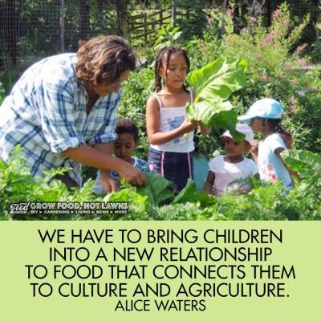

Slide 35
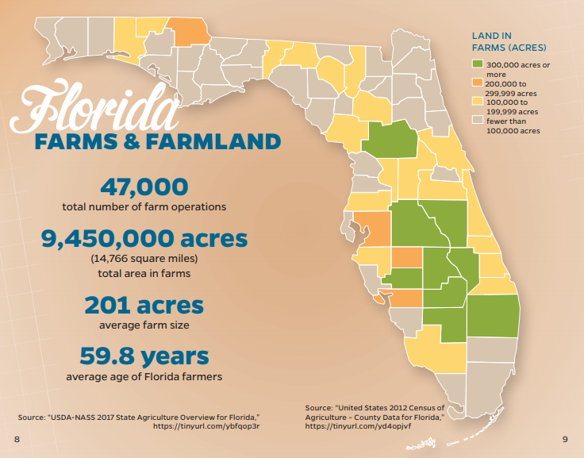

Slide 36
Florida Food Sustainability
https://migrationfiles.ucdavis.edu/uploads/farm-labor/2017/11/28/zahniser-us-produce-imports-from-mexico.pdf

Slide 38
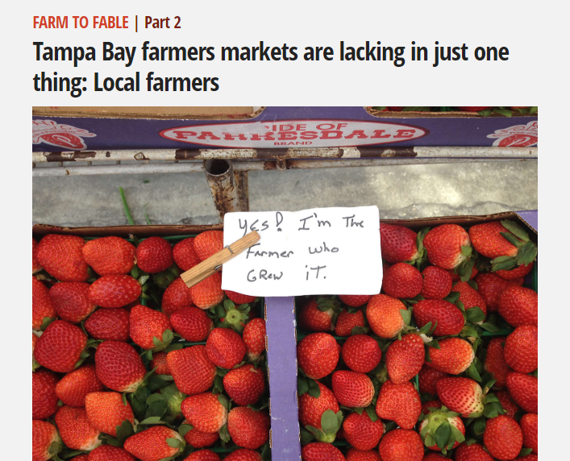
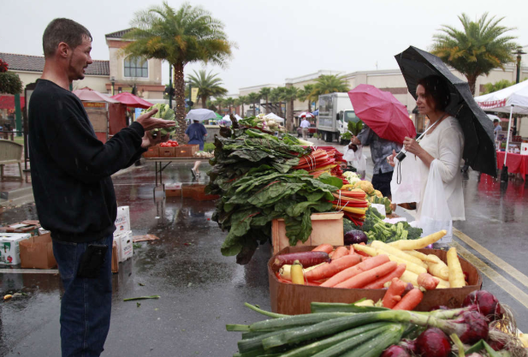
Farmer’s Markets Florida
http://www.tampabay.com/projects/2016/food/farm-to-fable/farmers-markets/
“At a dozen different markets, I counted 346 discrete vendors, many of whom sell at multiple markets. Of that number, only 16 sold their own produce, honey, eggs, meat or dairy. Plenty of wind chimes and hot sauces, but less than 5 percent represented Florida farmers growing their own food.”
-- Laura Reiley

Slide 39
Solutions to Local Food Production & Gardening
Solutions
Community based-programs & educational partnerships
Tampa Bay Farm 2 School & Kids’ Kitchen
Sweetwater Organic Farm Education Program
4H and FFA
IFAS – extension – Master Gardeners
University and community college interns
Harness other sectors to support local food production (farm to table, agritourism)
Close the loop – think like an island

Slide 40
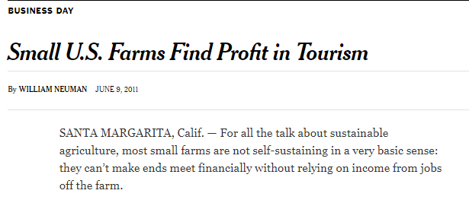
https://www.nytimes.com/2011/06/10/business/10tourism.html
https://visitfloridafarms.com/

Slide 41
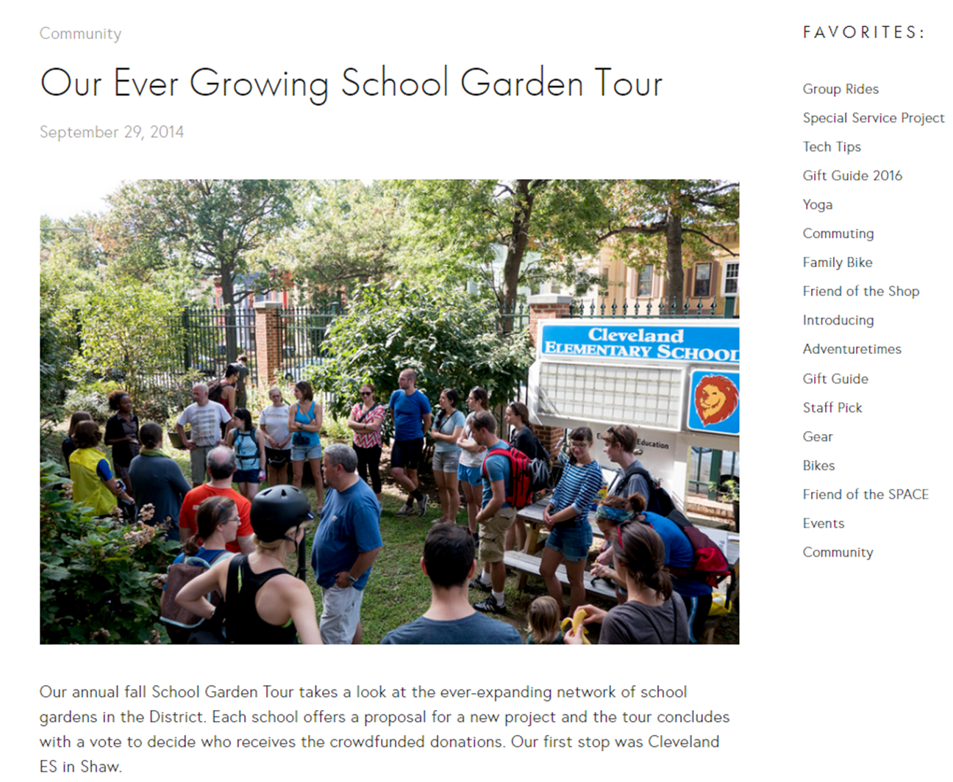
Agritourism Trends Promoting Education & Local Food Production
Washington, DC

Slide 43
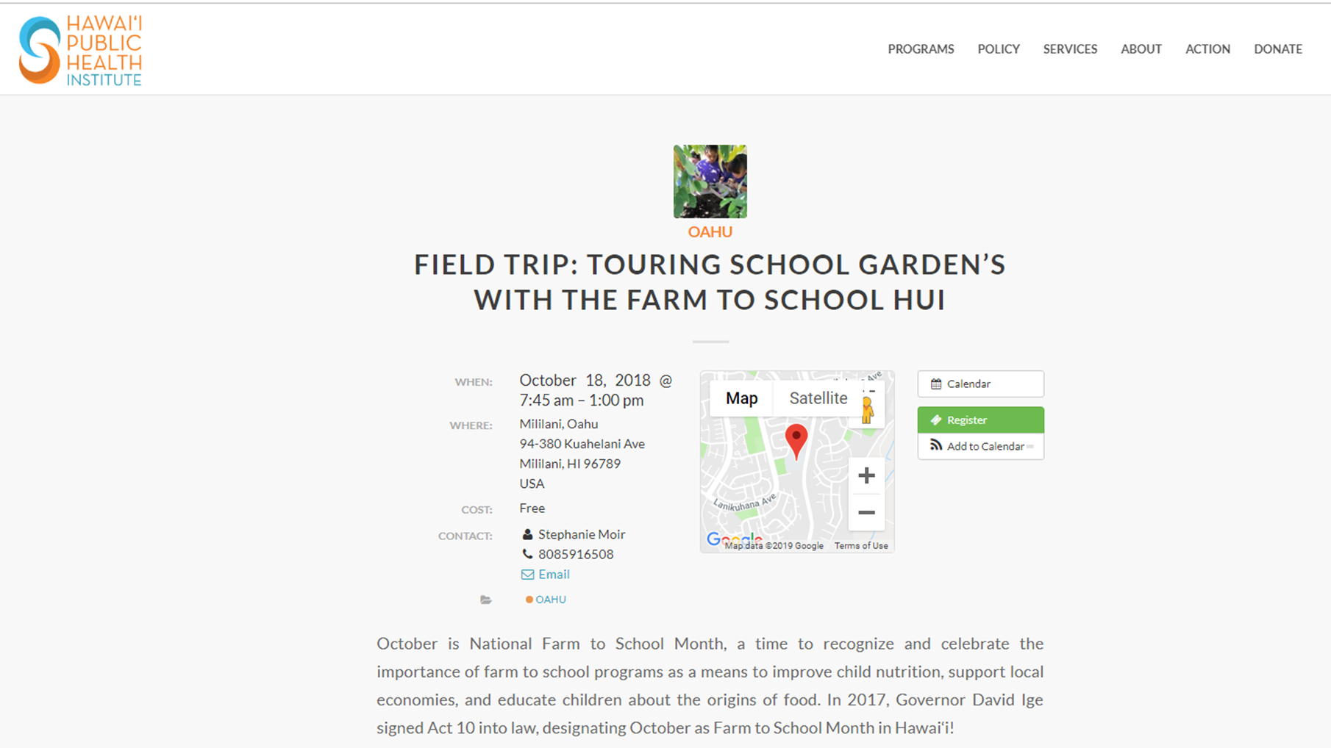

Slide 44
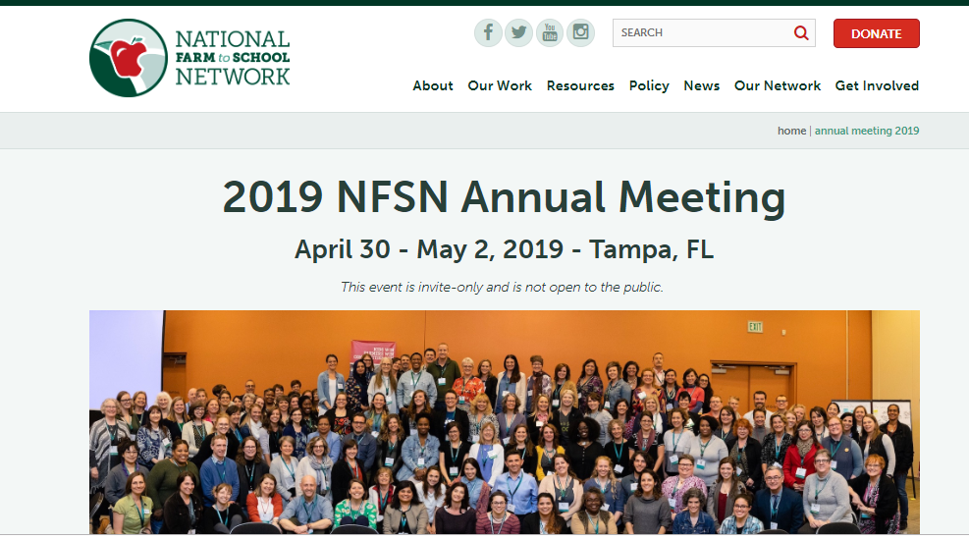

Slide 45
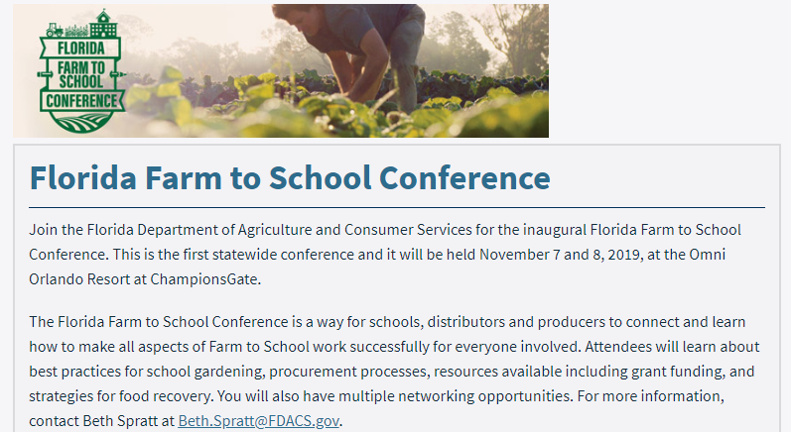
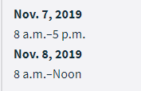

Slide 46
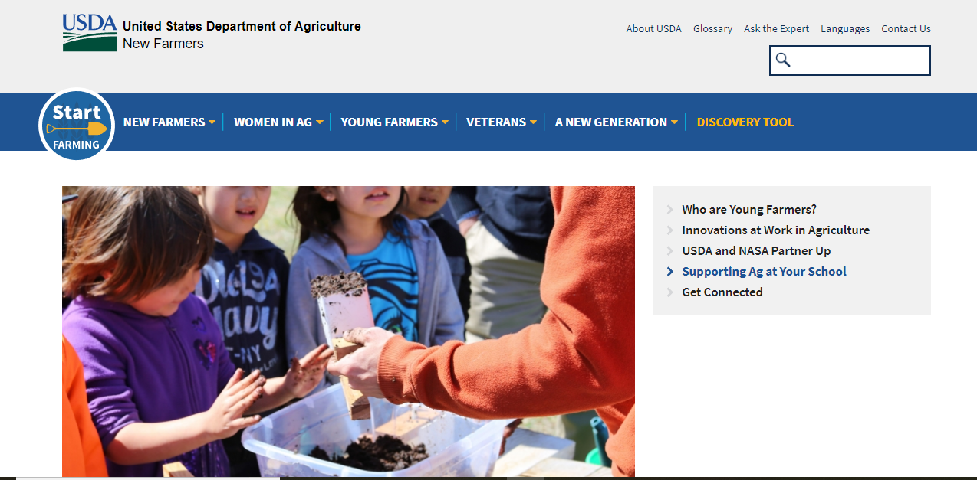

Slide 47
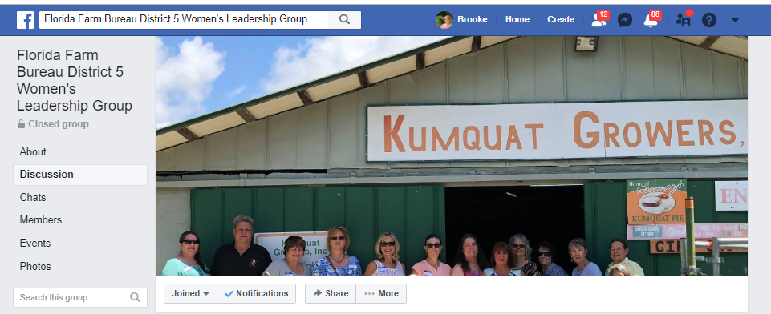
What are the concerns and aspirations of Florida farmers?
How can we encourage more local food production?
How can women & young people be empowered to be part of these movements?

Slide 48
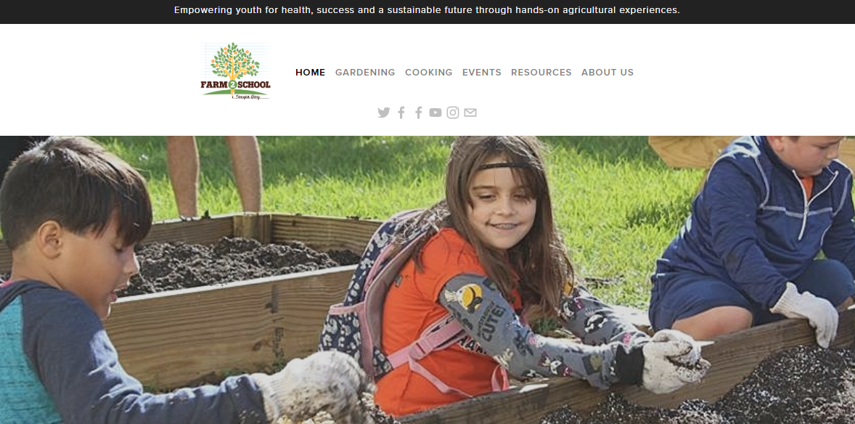

Slide 49
Tampa Bay Farm 2 School Kids’ Kitchen
Reinforce cooking skills everywhere we can
Close the loop on food
Sprouts grant
Evaluations
Assessment
Curriculum
STEM -- STEAM

Slide 50
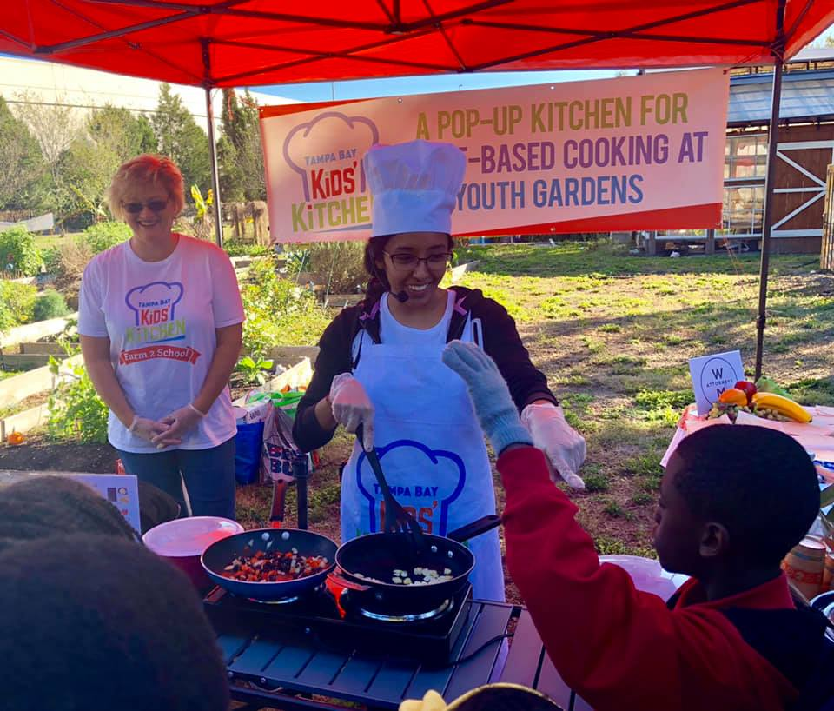

Slide 54
Garden Movement Growing
http://www.sweetwater-organic.org/community-programs/

Slide 55
Key Resources – FDACS Website
https://www.fdacs.gov/Food-Nutrition/Nutrition-Programs/Farm-to-School/School-Gardens

Slide 58
The New Farm to School Coordinator

Slide 59
It starts with us!

