Slide 1
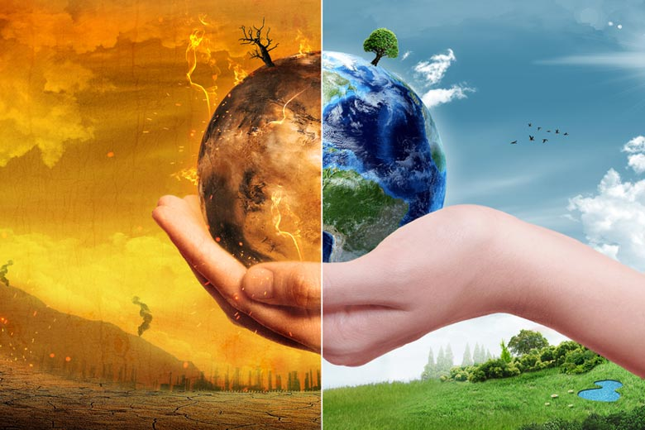
Human Geography & Sustainability Infusing the Curriculum
Dr. Brooke Hansen

Slide 2
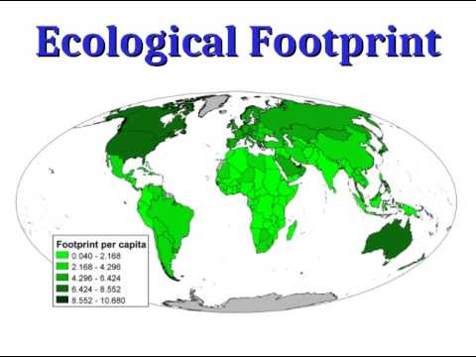
Where can you implement sustainability into the curriculum? Everywhere!
Human Geography
Earth Science
Marine Science
Biology
Physics
Social Studies
Family/Consumer Sciences …
Check out this video on Geography & Sustainable Development
https://www.youtube.com/watch?v=XQs8fItoxoc

Slide 3
All disciplines are embracing and catching up with SUSTAINABILITY EDUCATION!
https://www.tandfonline.com/doi/full/10.1080/03098265.2010.548086

Slide 4
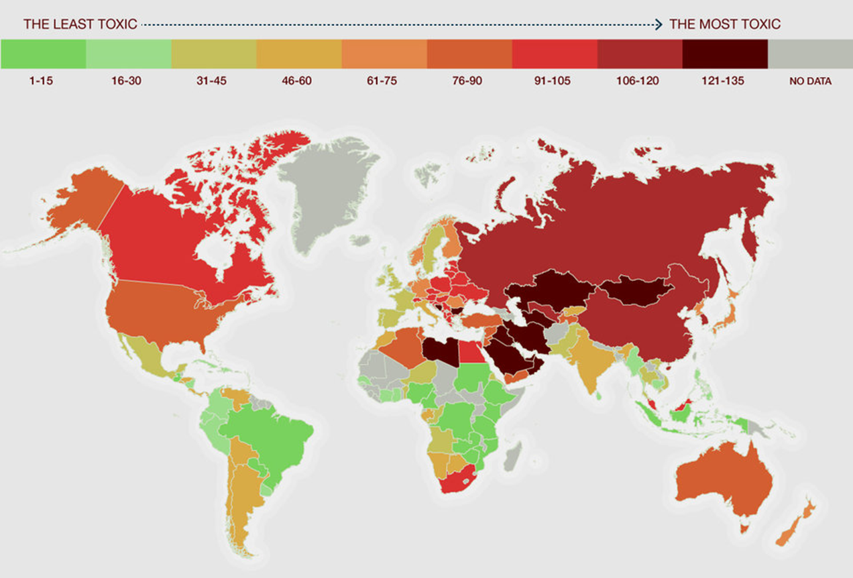
https://www.theecoexperts.co.uk/

Slide 5
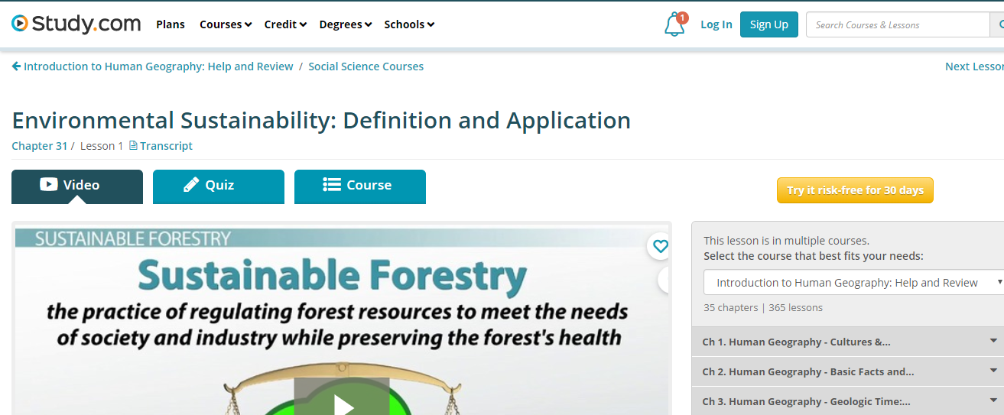
Resources – Do You Use These??
https://study.com/academy/lesson/environmental-sustainability-definition-and-application.html

Slide 6
https://worldgeochat.wordpress.com/2017/09/08/sustainable-development-goals/
https://docs.google.com/document/d/1FnbtvXio7g_c8jNnWApKtt5C0kAzwo5GafW-7xC2GbM/edit

Slide 7
Using the UN Sustainable Development Goals

Slide 8
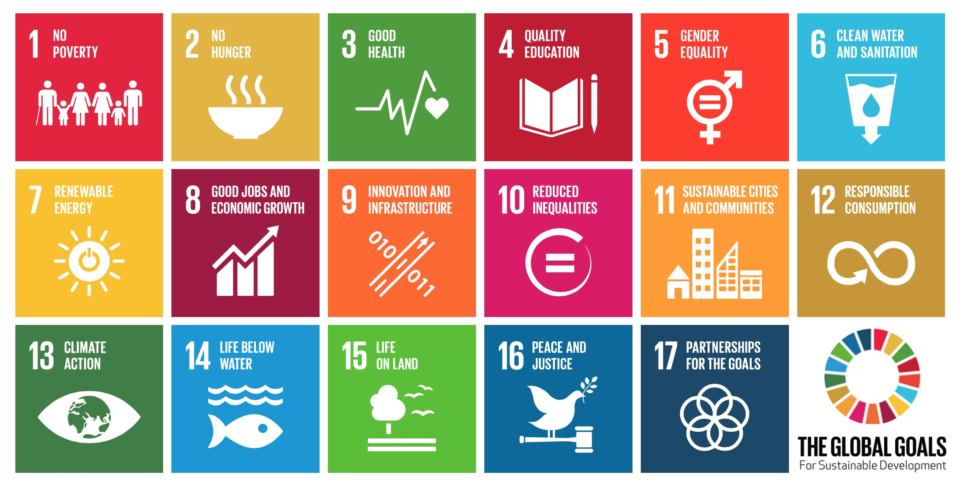

Slide 9
http://www.ungeorgia.ge/eng/news_center/media_releases?info_id=493#.XORdYchKjIU

Slide 10
Why use the UN SDGs?
…to prepare our students and communities for
well being, adaptation & resiliency

Slide 11
Why use the UN SDGs?
…to prepare our students and communities for
well being, adaptation & resiliency

Slide 12
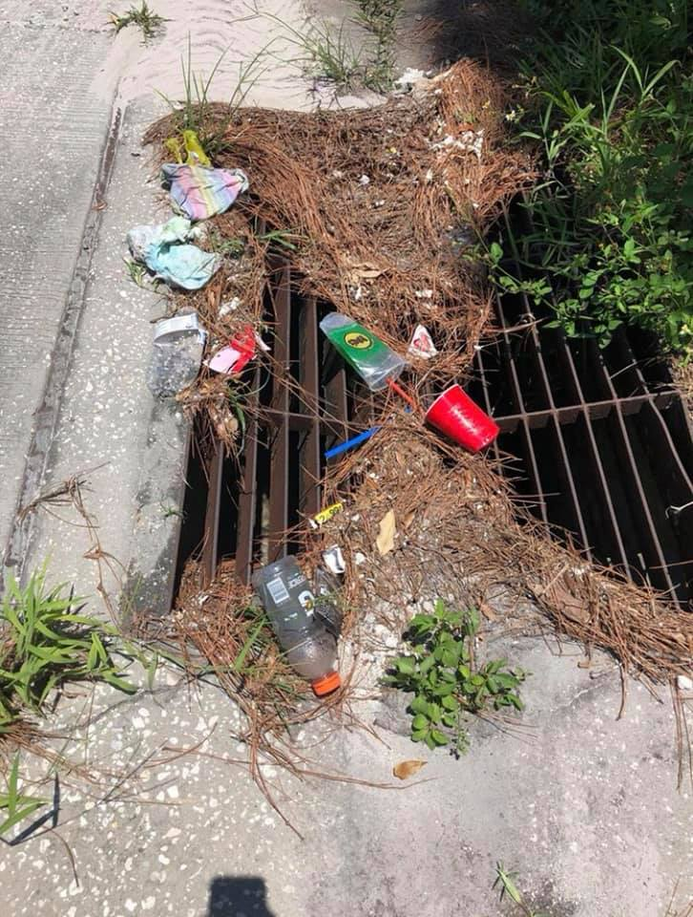
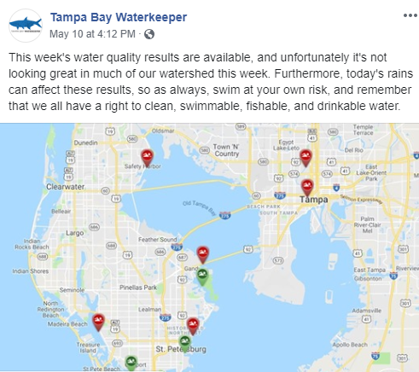
Why use the UN SDGs?

Slide 13
Why use the UN SDGs?
https://www.participatelearning.com/blog/4-reasons-to-teach-the-sustainable-development-goals/

Slide 14
To collaborate and learn from other teachers around the world
Why use the UN SDGs?
http://www.teachsdgs.org/TeachSDGsAmbassadorsBios.html

Slide 15
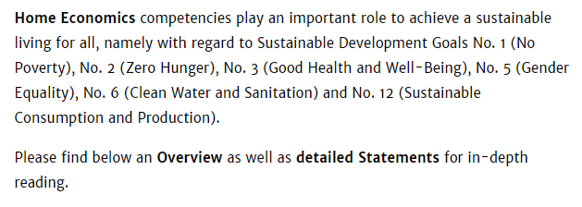
To collaborate and learn from global-regional teacher organizations & foster interdisciplinarity
Why use the UN SDGs?
https://www.ifhe.org/publications/ifhe-special-publications/ifhe-position-statements-on-un-sdgs/

Slide 16
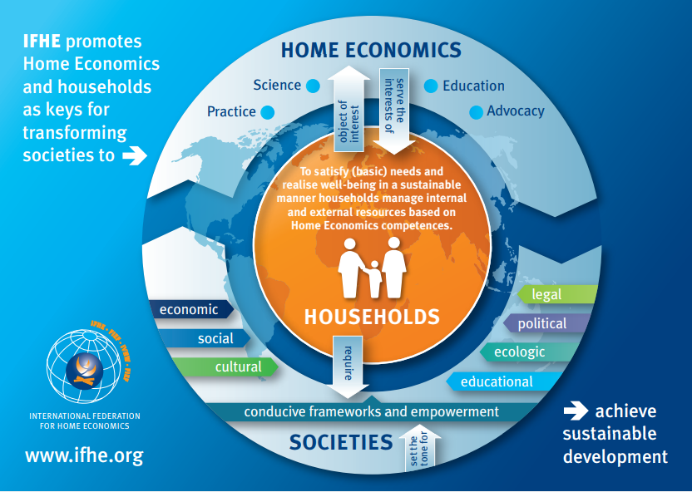

Slide 17
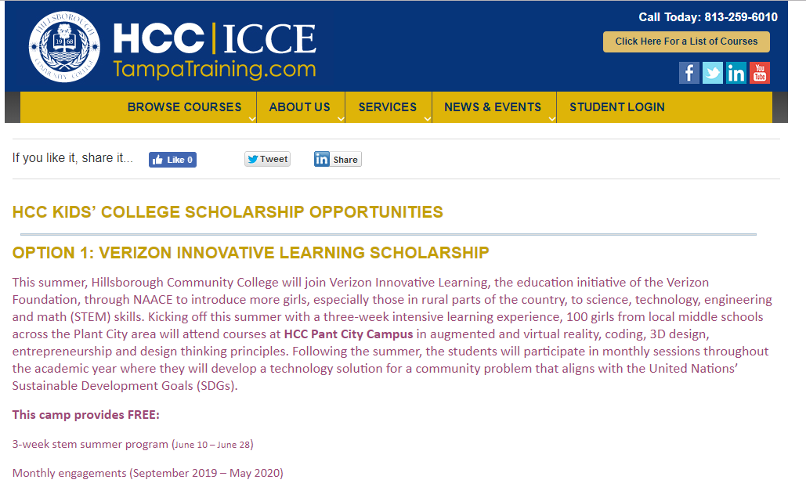
To collaborate and learn from teachers around our area
Middle school girls living in the South County area, entering 6th, 7th or 8th grade and are on a free or reduced lunch program.

Slide 18
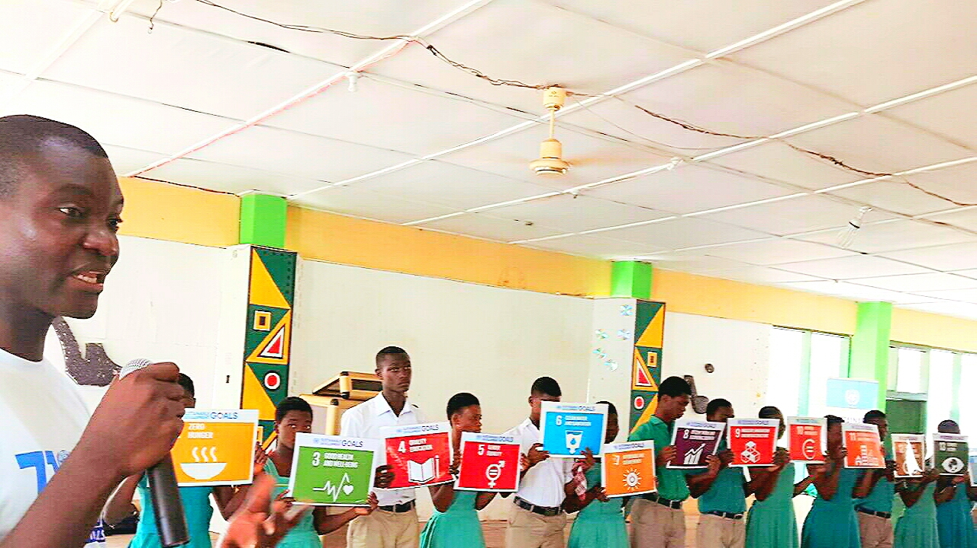
Who is using the SDGs?
http://www.gh.undp.org/content/ghana/en/home/presscenter/articles/2016/11/08/undp-joins-effort-to-reach-out-to-schools-on-the-sdgs.html
Everyone!!

Slide 19
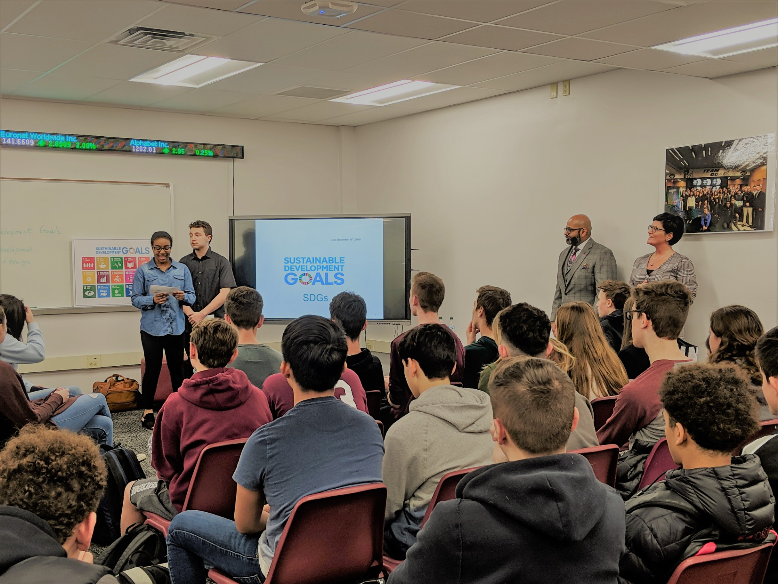
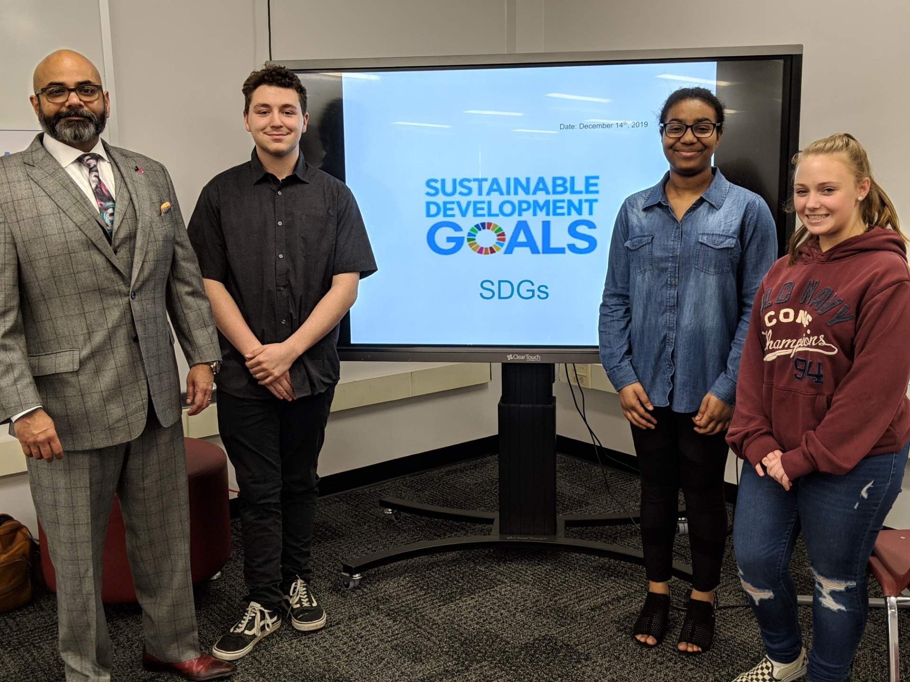
http://www.trschools.com/community/un-sustainability-expert-talks-tech-business-at-high-school-south
Toms River, NJ
Systems engineering specialist Hemant Ramachandra (standing, second from right) and High School South teacher Amber Hull (standing, right) look on proudly as students present their work on sustainability in education.

Slide 20
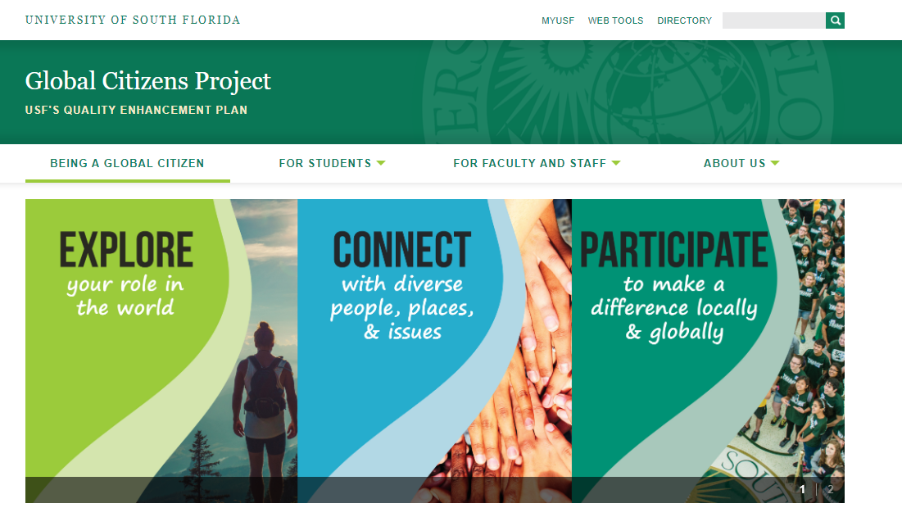

Slide 21
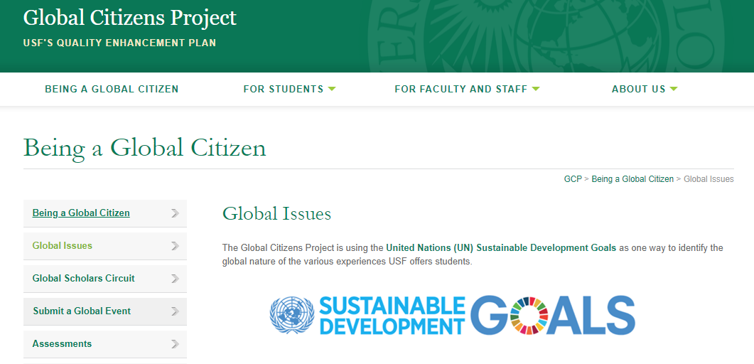

Slide 22
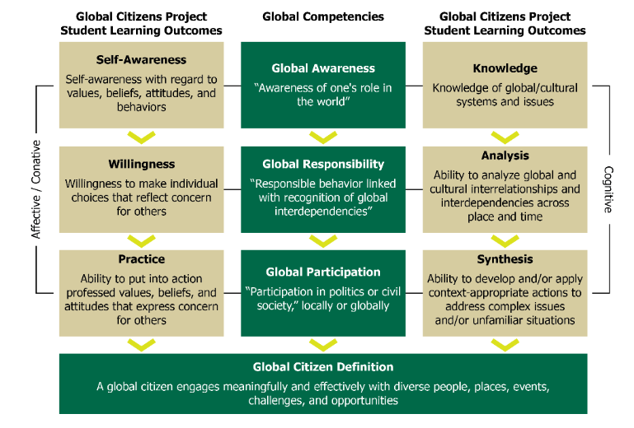

Slide 23
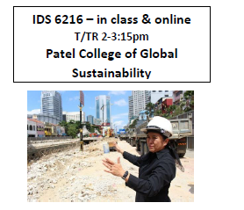
OPEN TO ALL
GRADUATE STUDENTS
Dr. Brooke Hansen
kbhansen@usf.edu
Dr. Heather Rothrock
hrothrock@usf.edu

Slide 24
Who is using the SDGs?

Slide 25
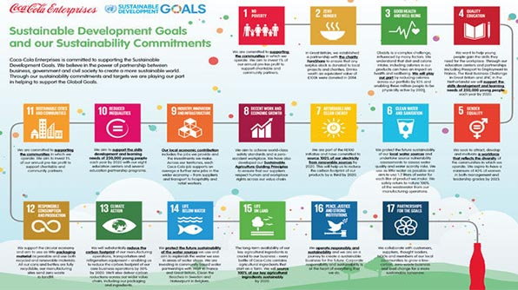
Ambitious – Coca Cola is trying to implement all 17!!

Slide 26
Using the SDGs for Sustainable Development
Resource depletion
Mass consumption
Climate change
Pollution
Apply sustainable development lens to Florida
What are the two largest industries in the state?

Slide 27
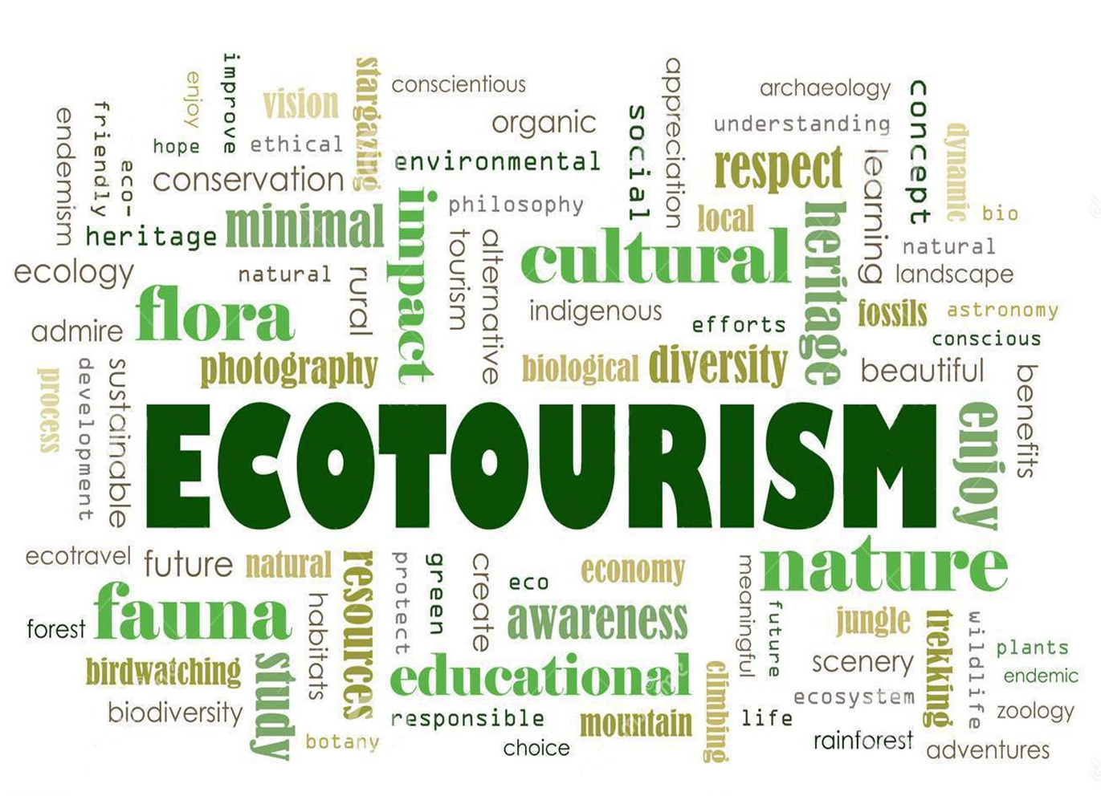
Ecotourism Development in Florida
Compared to other countries and regions – far behind!

Slide 28
TIES, 1990: “Responsible travel to natural areas that conserves the environment and improves the well-being of local people.”
Martha Honey, 2008:
“Ecotourism is travel to fragile, pristine, and usually protected areas that strives to be low impact and (often) small scale. It helps educate the traveler, provides funds for conservation, directly benefits the economic development and political empowerment of local communities, and fosters respect for different cultures and for human rights”

Slide 29
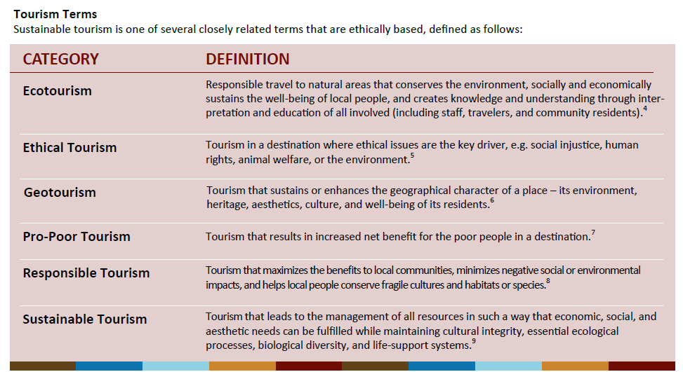
How to identify Ecotourism – there is overlap..
From CREST

Slide 30
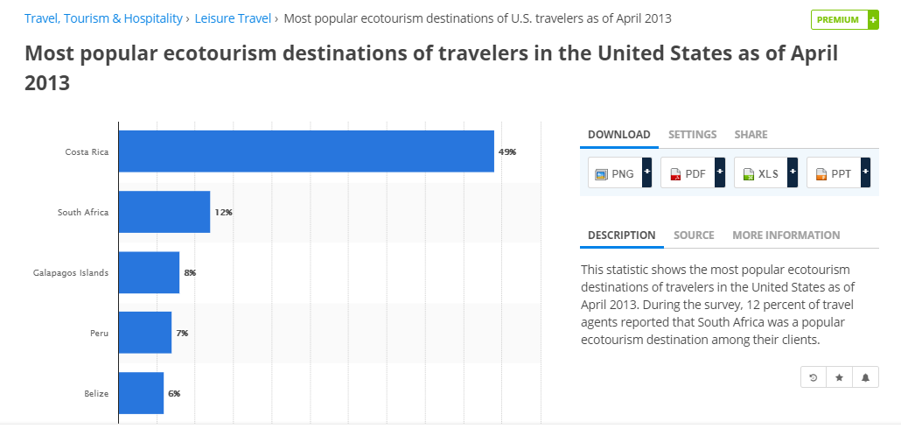
How Big is Ecotourism?
6% of World GDP
One of the fastest growing sectors of tourism
Realization that tourism is not a “smokestack-less” industry

Slide 31
Key Timeline Events
Earth Summit – Rio – 1992 – Agenda 21
UN International Year of Ecotourism 2002
World Ecotourism Summit – 2002 – Quebec – produced the Quebec Declaration on Ecotourism -- https://www.gdrc.org/uem/eco-tour/quebec-declaration.pdf
TIES: first conference on ecotourism in the US – 2005
UN International Year of Sustainable Tourism Development 2017 http://www.tourism4development2017.org/

Slide 32
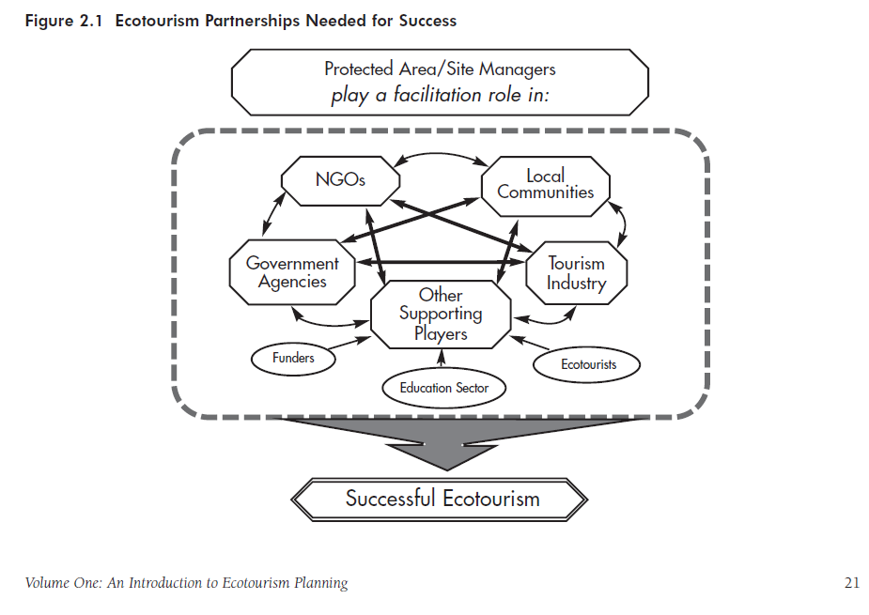

Slide 33
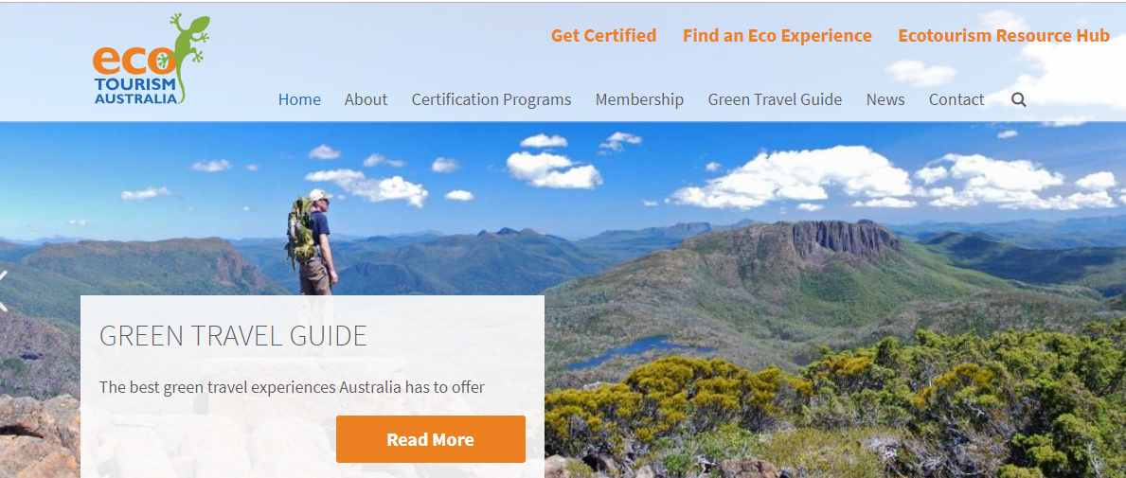
Global Examples – Costa Rica as the benchmark
Australia – spent $10 million to develop national ecotourism strategy (we can’t even get one in Tampa Bay or Florida!)
Malawi – food crisis – jumpstart the economy with ecotourism and agritourism (we are trying to model this here)

Slide 34
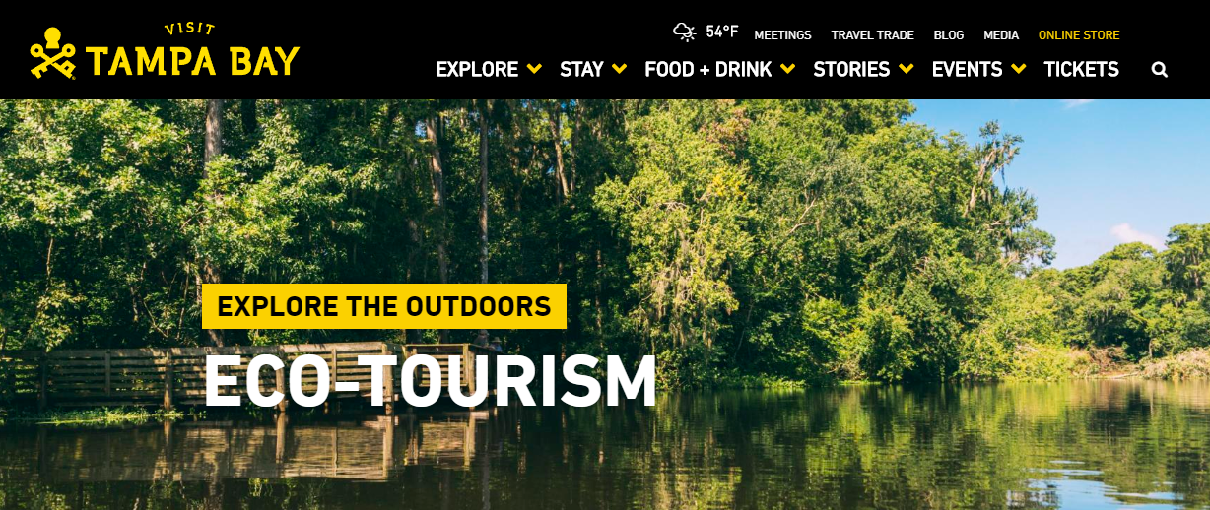
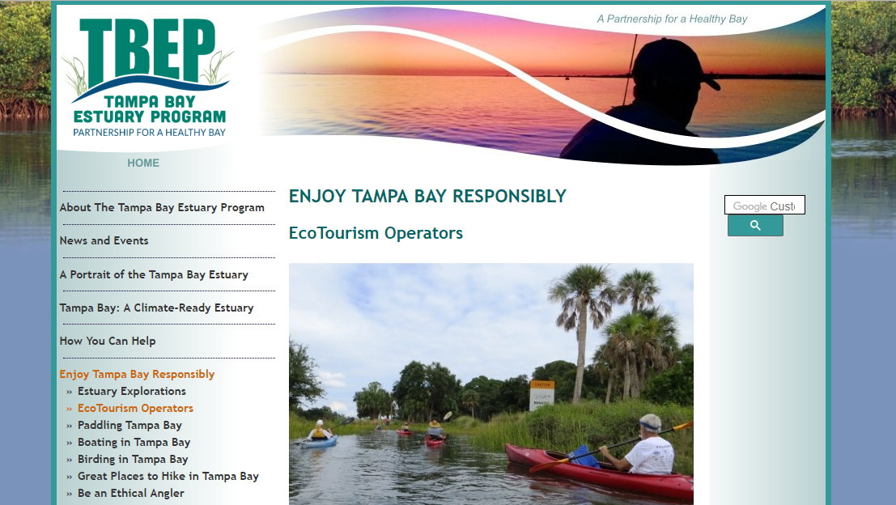
Ecotourism in Tampa Bay … beware of greenwashing!
https://www.visittampabay.com/things-to-do/tampa-outdoors-nature/eco-tourism/
http://www.tbep.org/enjoy_tampa_bay_responsibly-ecotourism_operators.html

Slide 35
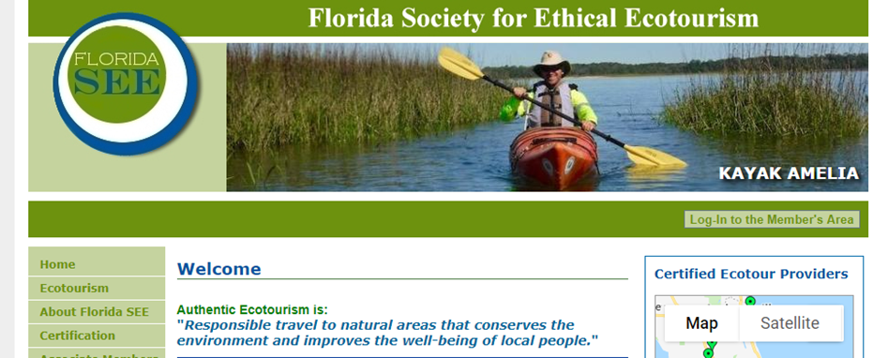
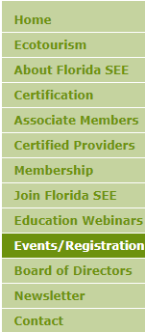
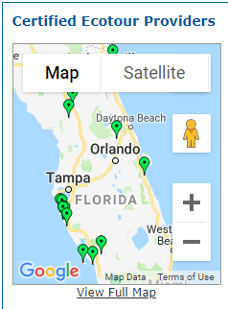
https://www.floridasee.org/

Slide 36
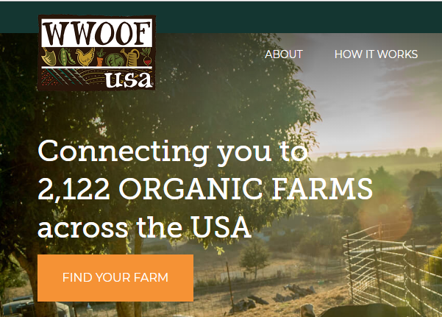
Sweetwater Organic Farm - Tampa: Sustainable Tourism Development
Agritourism of a working organic farm
A WWOOFing site – World Wide Opportunities on Organic Farms
Airbnb Experiences site
Ecotourism site

Slide 37
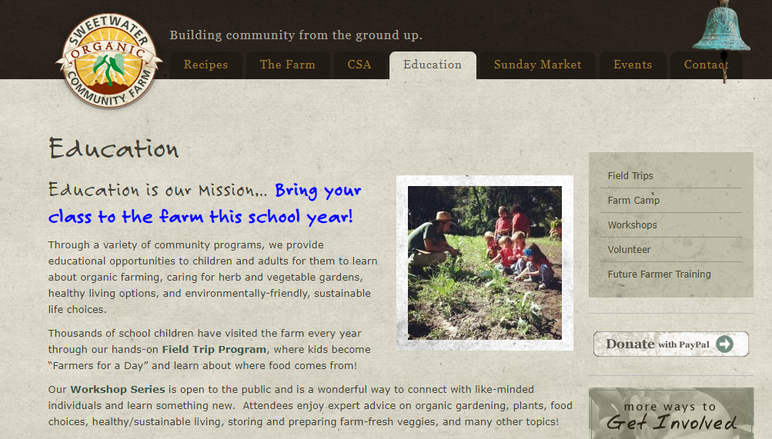
http://www.sweetwater-organic.org/community-programs/

Slide 38
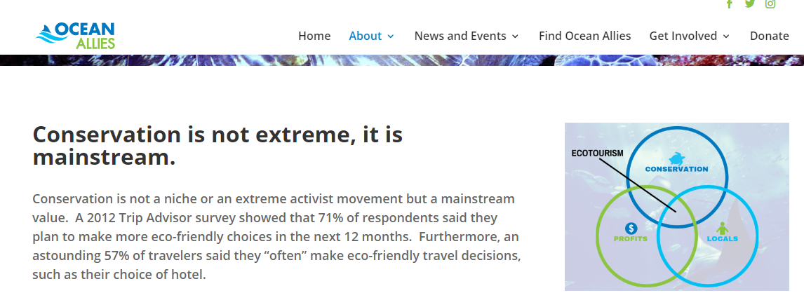
Local organization providing Ocean Friendly Certifications here in the Tampa Bay area for tourism and beyond
The are certifying schools too! Great class/ind. project
http://oceanallies.org/lead-an-ocean-friendly-life/

Slide 39
Tie to personal actions – sustainable travel pledges, Ocean Friendly Certification of their homes! What else….
https://sdghub.com/goodlifegoals/

Slide 40
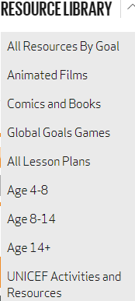
More Resources
http://www.teachsdgs.org/
http://worldslargestlesson.globalgoals.org/teachers-guide/

Slide 41
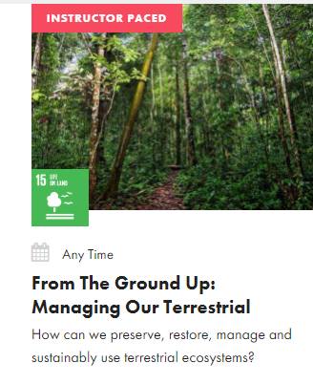
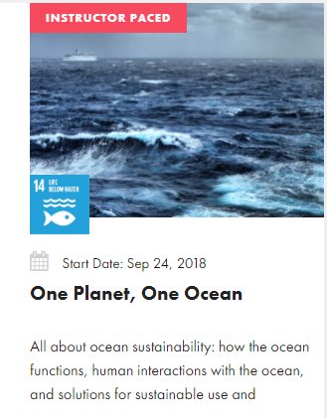
https://sdgacademy.org/courses/

Slide 42
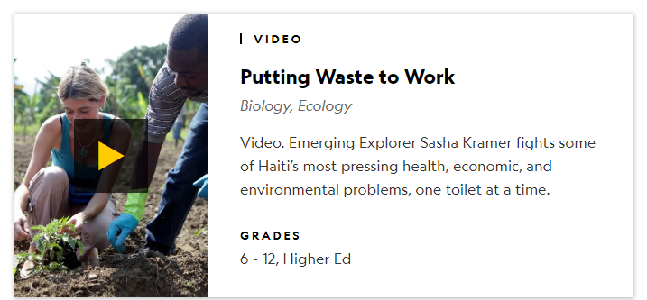
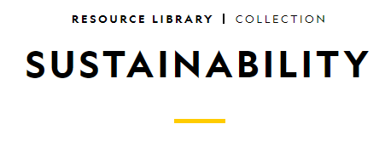
Other Resources

Slide 43
THANK YOU
Insert Image

