Slide 1
Christine Angel Danger M.ED. NBCT
Ben Donatelli – Hillsborough County Public Schools

Slide 3
Write your questions about energy on a sticky note.
I wonder...
What questions do you have?
Add it to the wonder wall.
Notes:
Give about 3-5 minutes for questions to be posted.

Slide 4
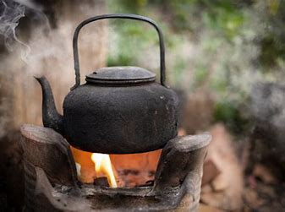
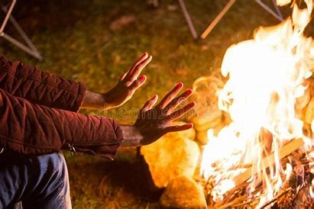
Energy for Survival
Cooling
Making water safe to drink
Heating
Cooking
Notes:
Coke

Slide 5
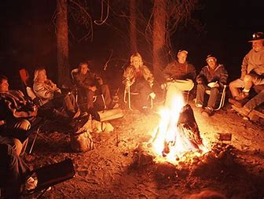
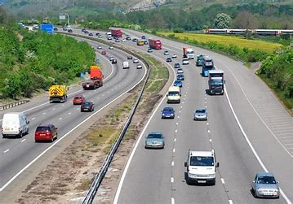
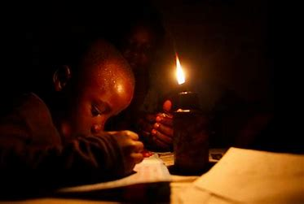
Energy allows us to extend our days.
Energy transfers work away from people.

Slide 6
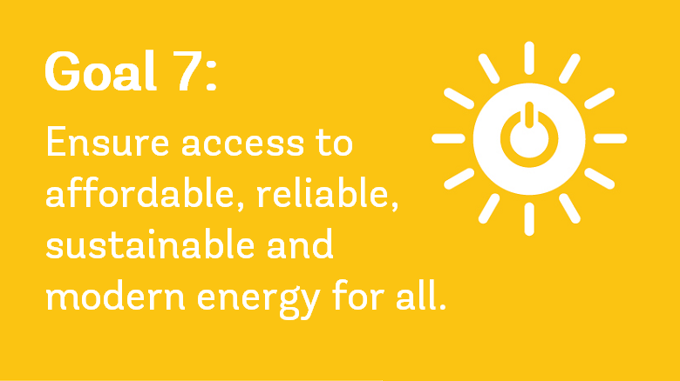
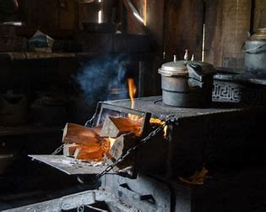

Slide 7
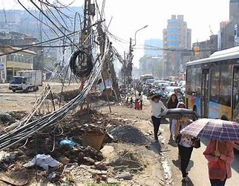
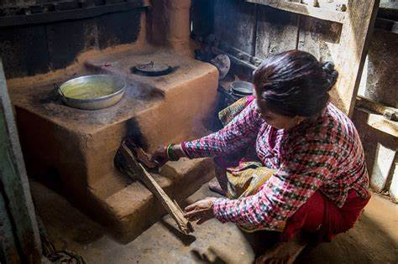
This means access to enough electricity to provide basic lighting and charge a cell phone or
radio for about 4 hours per day, and access to clean cooking methods such as gas, biomass,
or electricity which are cleaner than burning wood, coal, animal dung, tree leaves, and crop
residue.
Approximately 4 million people died prematurely last year from illness attributed to particulates breathed in from inefficient cooking practices.
-World Health Organization

Slide 8
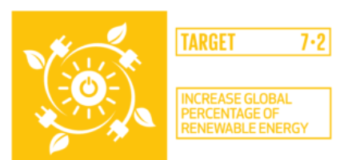
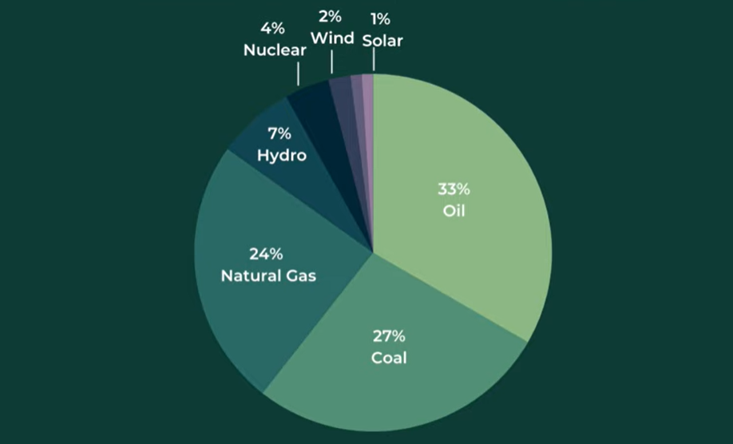
Target 7.2 By 2030, increase substantially the share of renewable energy in the global energy mix
Indicator 7.2.1: Renewable energy share in the total final energy consumption
Renewable energy sources – mostly hydro – accounted for 11% of the world’s energy produced in 2019. Fossil fuels account for 80% of the world’s energy consumption. When we look at electricity only, about 25% of thye world’s electricity is from renewable sources. We are on course to supply about 30% of the world’s electricity using renewable sources – mainly wind and solar – by 2030. Less than 3% of vehicles in use are electric.

Slide 9
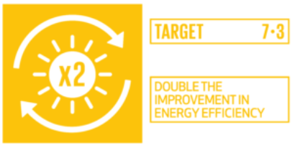
Target 7.3 By 2030, double the global rate of improvement in energy efficiency
Indicator 7.3.1: Energy intensity measured in terms of primary energy and GDP
Energy Efficiency. Simply put, energy efficiency means using less energy to get the same job done – and in the process, cutting energy bills and reducing pollution. Many products, homes, and buildings use more energy than they actually need, through inefficiencies and energy waste
According to the US Department of Energy, energy efficiency is “one of the easiest and most cost effective ways to combat climate change, clean the air we breathe, improve the competitiveness of our businesses and reduce energy costs for consumers.”
The International Energy Agency’s “Energy Efficiency 2018” report found that efficiency gains would reduce energy bills for consumers by more than $500 billion dollars per year, lower energy imports and reduce air pollution. Air pollution includes the release of harmful particulates or substances into the atmosphere.

Slide 10
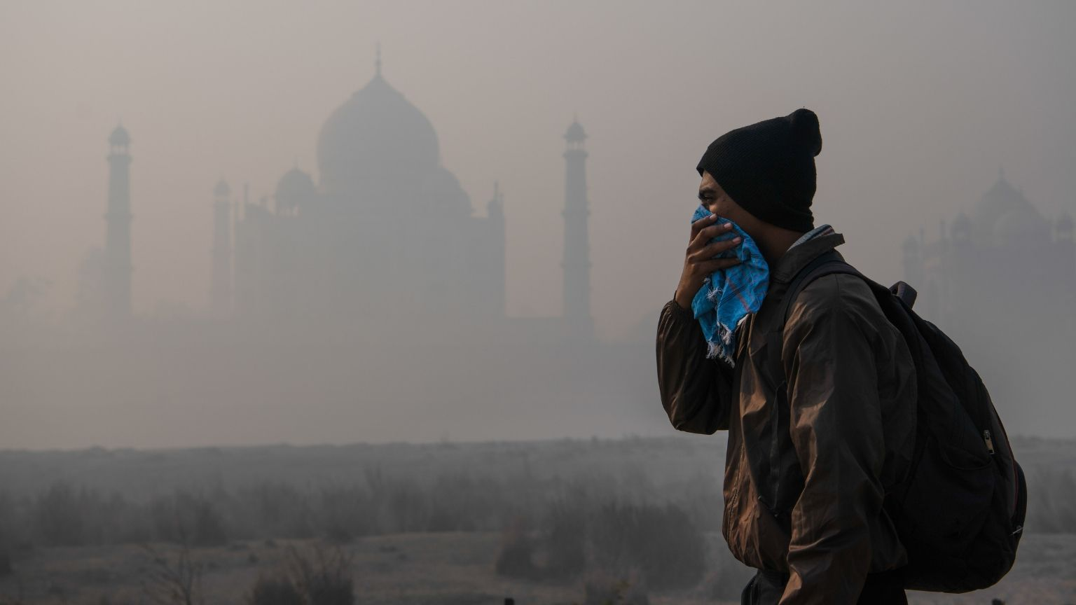
Target 7.B By 2030, expand infrastructure and upgrade technology for supplying modern and sustainable energy services for all in developing countries, in particular least developed countries, small island developing States, and land-locked developing countries, in accordance with their respective programmes of support
Indicator 7.B.1: Investments in energy efficiency as a proportion of GDP and the amount of foreign direct investment in financial transfer for infrastructure and technology to sustainable development services

Slide 12
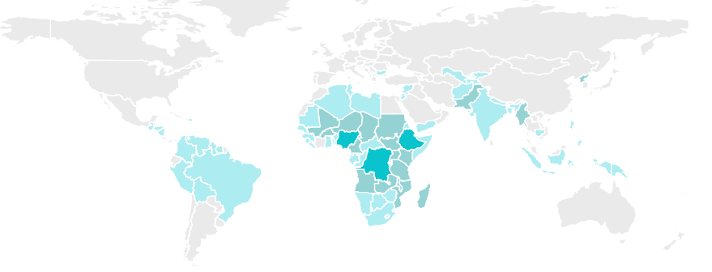

Slide 13
SDG7
In 2015, the UN General Assembly adopted the 2030 Agenda for Sustainable Development, which include a dedicated and stand-alone goal on energy, SDG 7, calling to "ensure access to affordable, reliable, sustainable and modern energy for all". Energy lies at the heart of both the 2030 Agenda for Sustainable Development and the Paris Agreement on Climate Change. Achieving SDG7 will open a new world of opportunities for millions of people through new economic opportunities and jobs, empowered women, children and youth, better education and health, more sustainable, equitable and inclusive communities, and greater protections from, and resilience to, climate change. The Global Roadmap for Accelerated SDG 7 Action resulting from the High-level Dialogue on Energy 2021 provides a guide for collective action on energy across sectors.

Slide 14
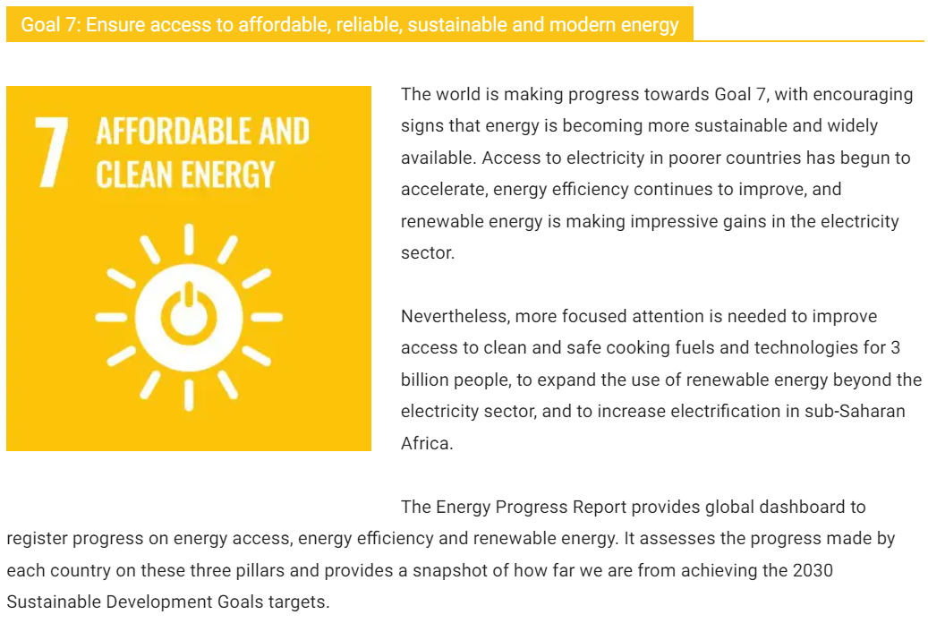

Slide 15
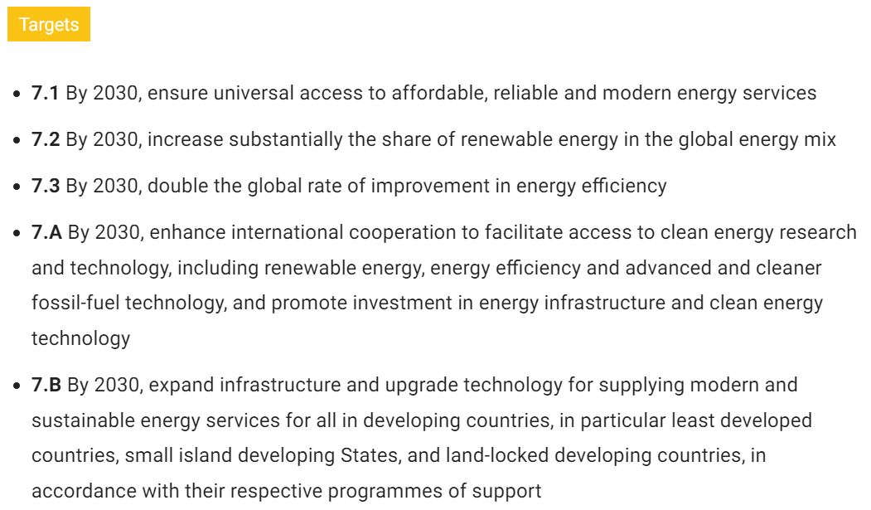

Slide 19
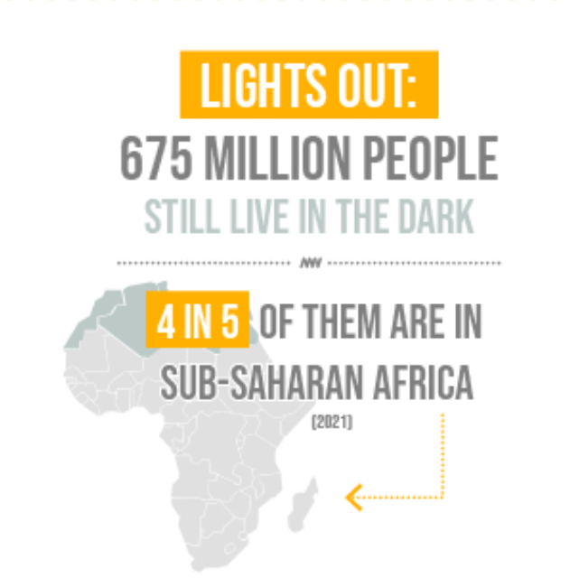
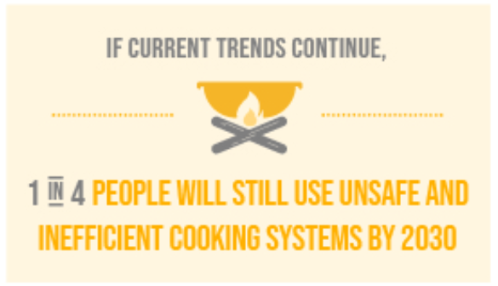

Slide 20
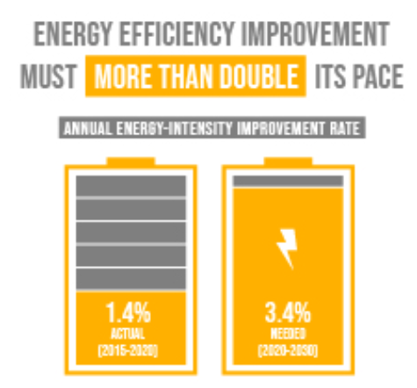
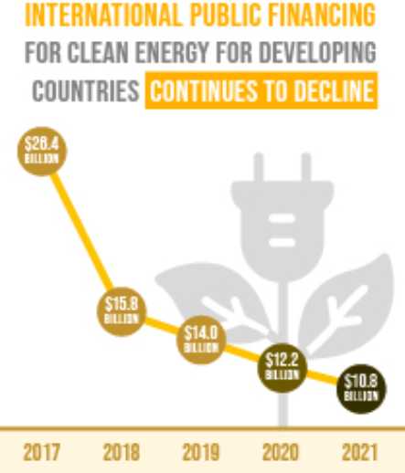

Slide 21
Goal 7 infographic, source: https://unstats.un.org/sdgs/report/2023/

Slide 22
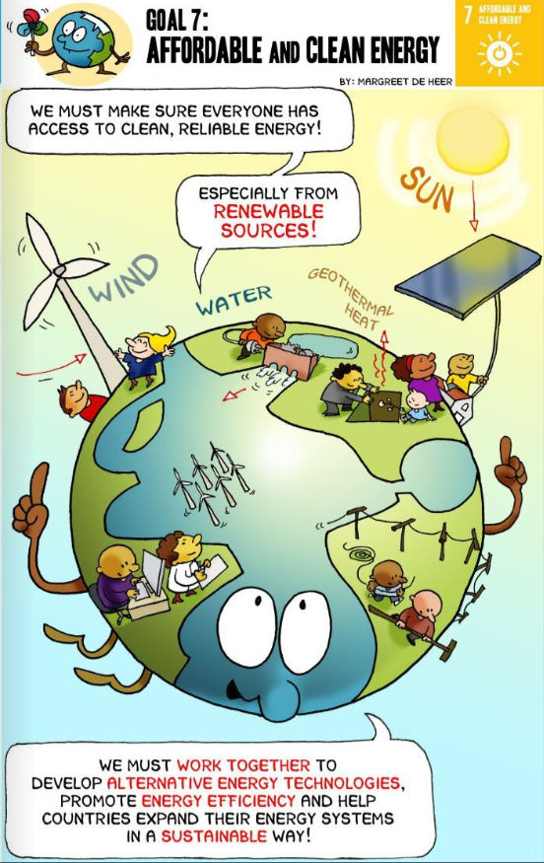
The answer is to end our reliance on carbon-based fuels...If we succeed, we create booming new industries, wealth, clean secure energy and maybe we prevent the greatest disaster so far in human history, saving millions of lives while improving billions more. If we fail, basically it's business as usual while things slowly get worse all around us.
http://worldslargestlesson.globalgoals.org/global-goals/modern-energy/
Global Goals Posters | The World's Largest Lesson

Slide 23
A factivist is an activist who can argue with data.
What types of energy does the US produce and consume?
How much energy do Americans use?
2023 Current State of the Union: US Energy (usafacts.org)

Slide 24
The United States uses a mix of energy sources, with 68% of energy consumption coming from petroleum or natural gas. The remaining 20% comes from renewable and nuclear sources. There are five energy-use sectors, and the amounts of their primary energy consumption in 2019 were:
Electric power: 37.1 quads
Transportation: 28.2 quads
Industrial: 23.1 quads
Residential: 7.0 quads
Commercial: 4.8 quads
Renewable power consumption overtook coal for the first time in 130 years in 2019.
The quad is a unit of energy defined as 1 quadrillion (10¹⁵) BTU. Quads are used in similar settings as the exajoule (10¹⁸ joules) when speaking of world or national energy supply/demand.

Slide 25
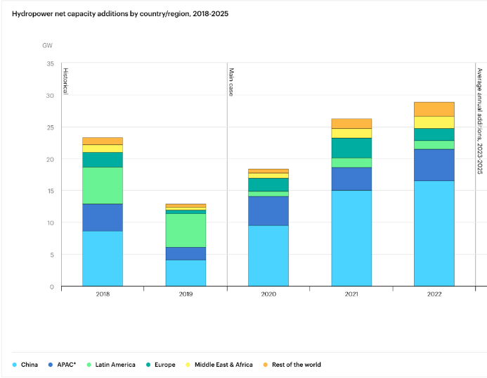
These 4 energy storage technologies are key to climate efforts | World Economic Forum (weforum.org)

Slide 26
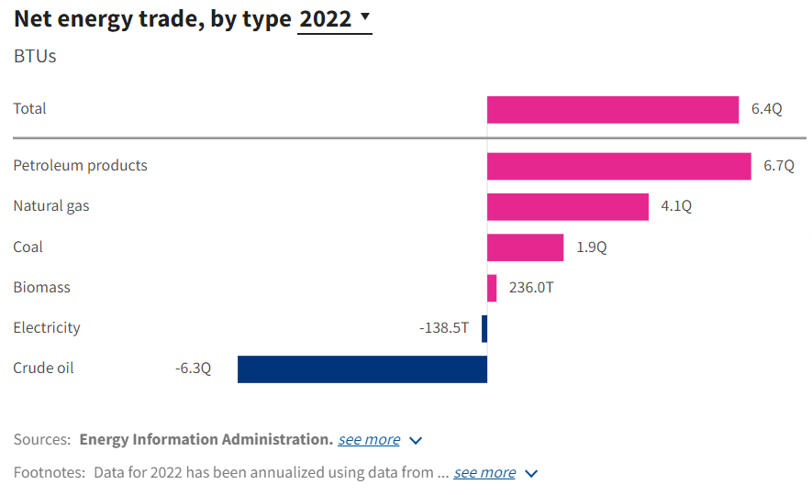
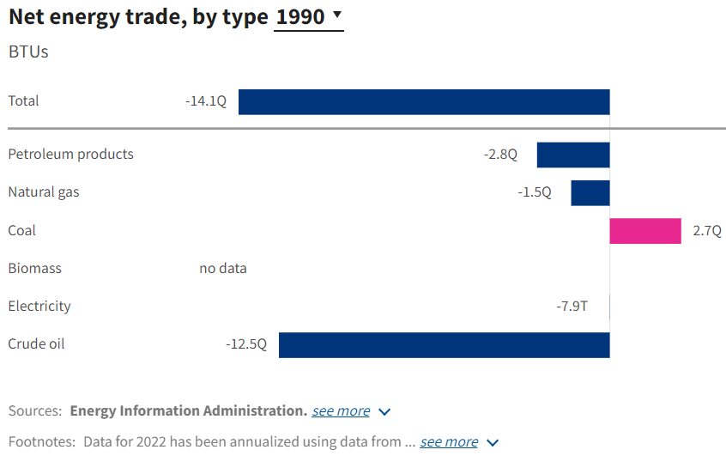
The US exported about 30% more energy than it imported in 2022.

Slide 27
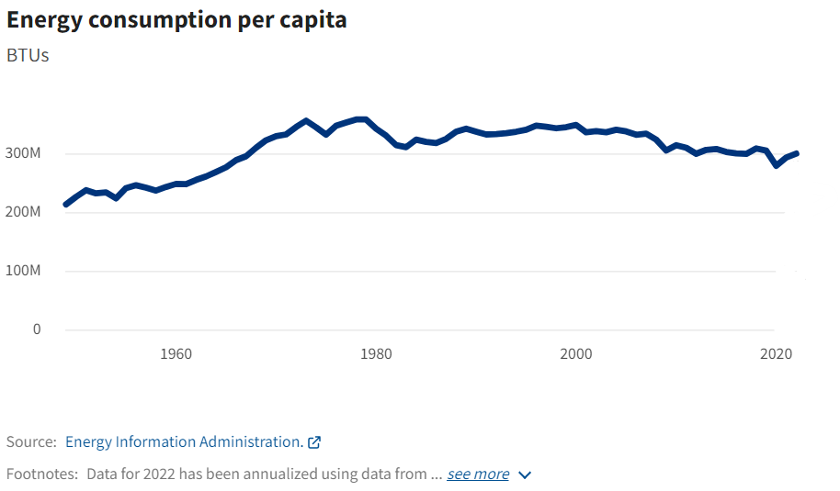
Energy consumption per person increased for the second year after dipping in 2020.
However, per-person energy consumption in 2022 was still 1% lower than the 2010s average.

Slide 28
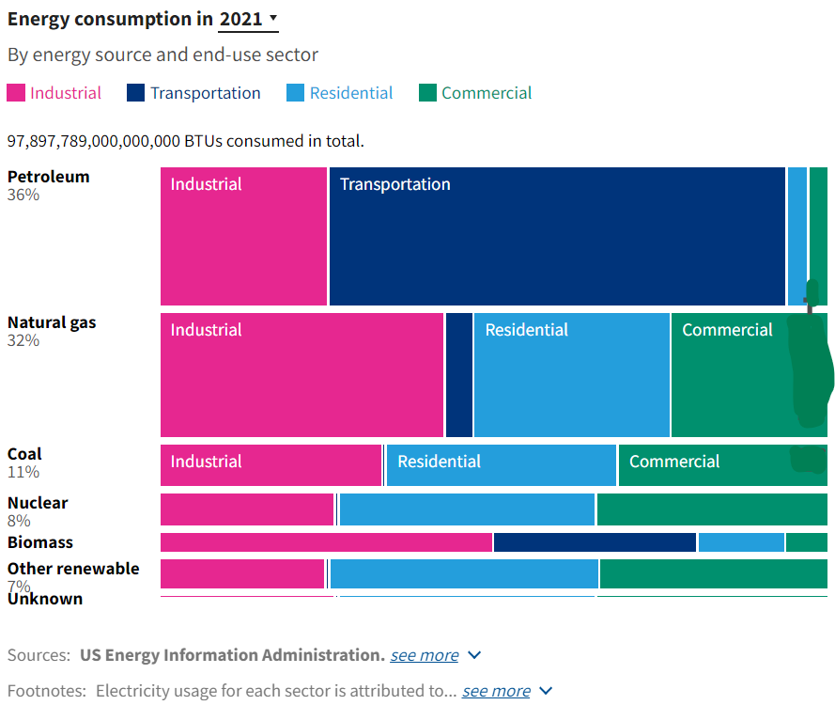
About 68% of energy consumption is from petroleum or natural gas, while renewable and nuclear sources account for 20%.
Coal is 11% of energy consumption. Two-thirds of fossil fuel energy consumption comes from the industrial and transportation sectors.

Slide 29
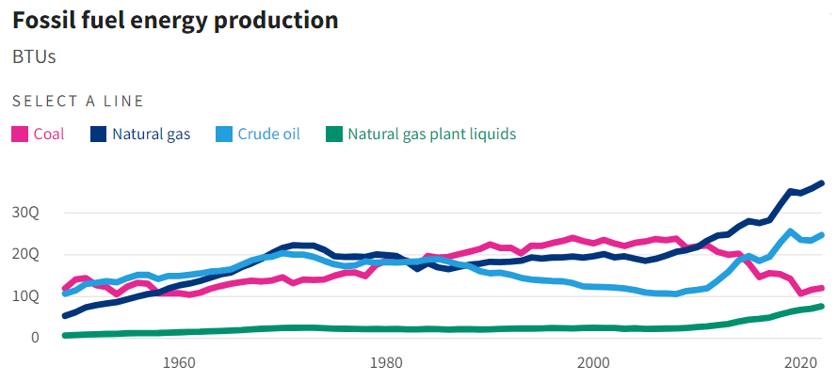
Coal production has declined since 2010. Natural gas and crude oil production are growing.
US fossil fuel production increased from 2021 to 2022.

Slide 30
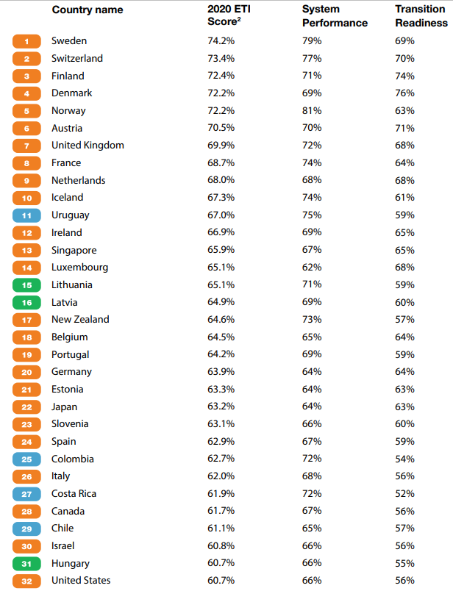
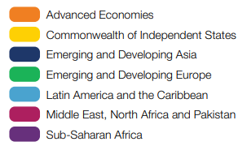

Slide 31
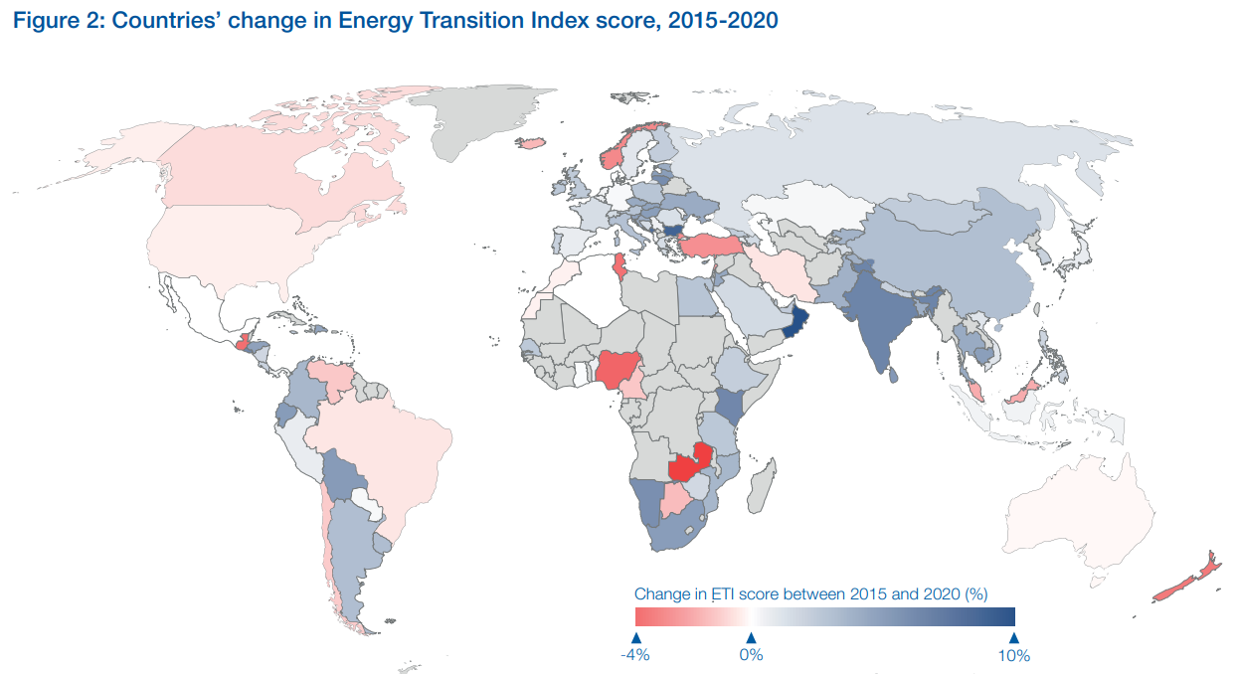

Slide 32
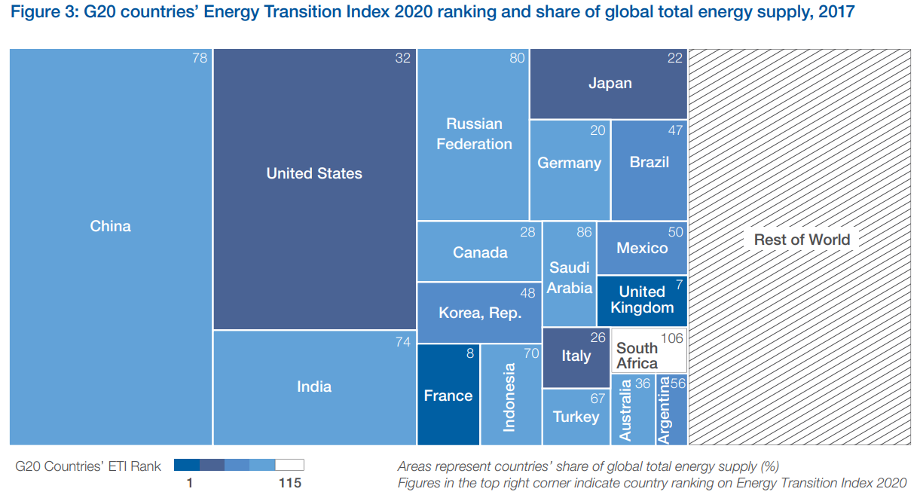

Slide 33
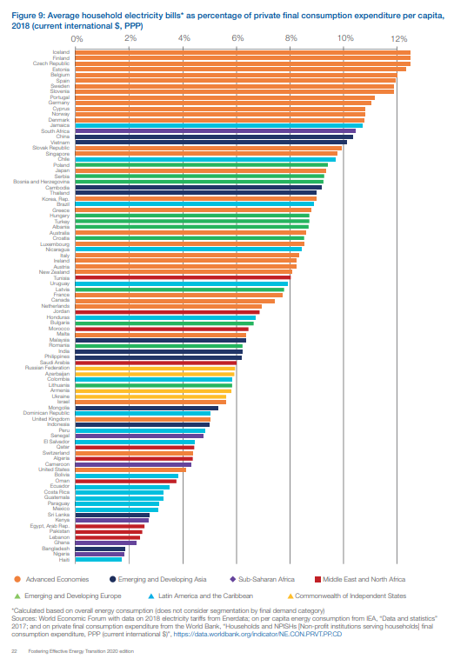
Price of Electricity by Country

Slide 34
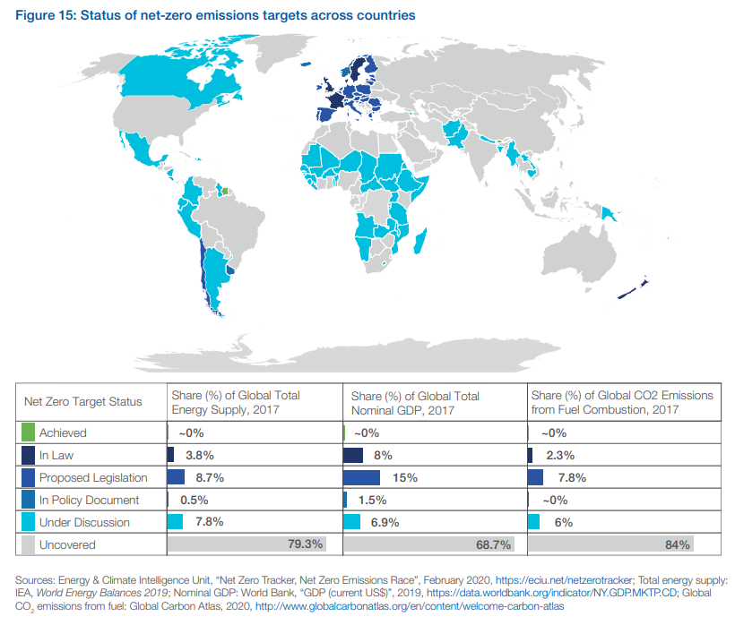

Slide 35
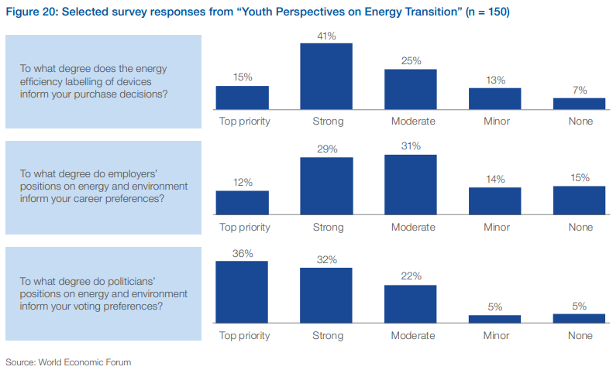

Slide 36
The United States’ clean energy industry is hiring, faster than the overall national economy, and it’s paying above-average wages.
In 2021, energy jobs grew 4.0% from 2020, outpacing overall U.S. employment, which climbed 2.8% in the same time. The energy sector added more than 300,000 jobs, increasing the total number of energy jobs from 7.5 million in 2020 to more than 7.8 million in 2021.
AtlasJobs Energy Careers (stemconnector.com)

Slide 37
Careers
in
Energy
Center for Energy Workforce Development (CEWD)Student Pathways
There are a lot of educational paths you can take to pursue an energy career. Generally, Science, Technology, Engineering, and Math (STEM) classes will serve you well. Check out schools that offer energy-related programs and learn how to start energy career right after high school.
Student Pathways - Get Into Energy

Slide 39
At a time when most countries are producing ever-increasing amounts of greenhouse gasses, the rather ordinary citizens of Samsø have accomplished something extraordinary―in just ten years they have reduced their carbon emissions by 140% and become almost completely energy independent. A narrative tale and a science book in one, this inspiring true story proves that with a little hard work and a big idea, anyone can make a huge step toward energy conservation. The inspiring first book in the author’s acclaimed series about real-world communities going green.

Slide 41
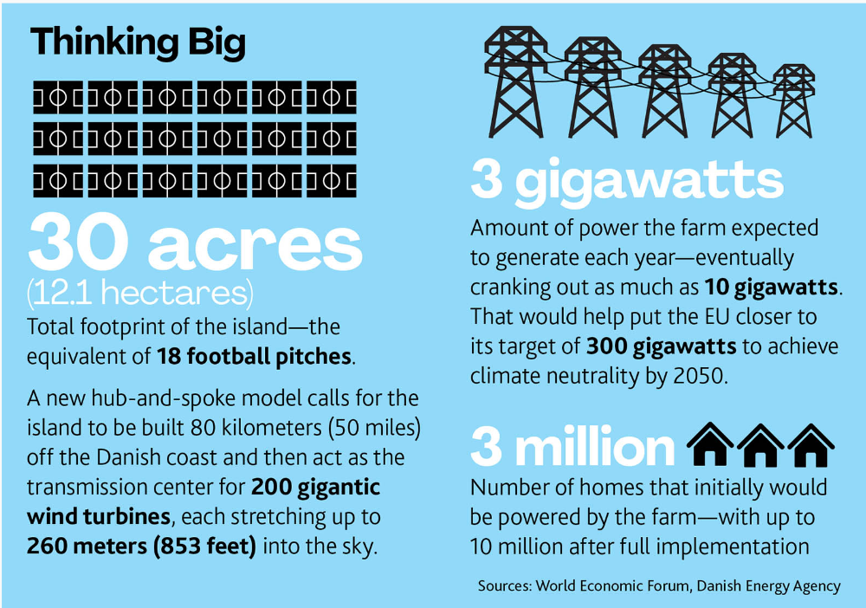

Slide 42
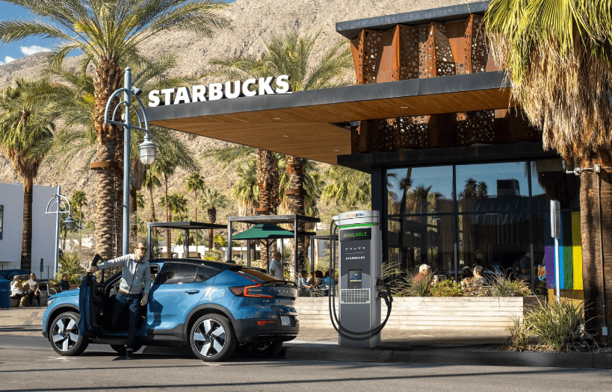
250+ miles (400+ kilometers):
The median distance a 2020 EV can travel on a full charge
40 minutes:
About how long it takes for a Volvo EV to power up from 20 percent to 90 percent on a ChargePoint DC fast charger
60:
The number of planned charging stations located at up to 15 Starbucks locations
53,011:
The number of U.S. public EV charging stations as of August 2022
More than 2 million:
The number of EVs currently on the road in the United States, but some projections have that number zooming up to 26 million by 2030
A driving force in new electric vehicle infrastructure
The U.S. government is thinking big: It wants half of all new cars sold in the country to be electric by 2030. To achieve this goal, US$7.5 billion was allotted to build out a much-needed network of 500,000 electric vehicle (EV) charging stations throughout the country.
But the private sector is making some power moves, too, with coffeemaker Starbucks﻿ and Swedish automaker Volvo﻿ joining forces to pilot a public network of high-speed EV chargers at Starbucks locations between Denver and Seattle.
The route was chosen for maximum impact: It’s an area Starbucks’ chief sustainability officer Michael Kobori has called a “charging desert.” The 60 ChargePoint﻿ machines—strategically placed every 100 miles (161 kilometers) or so—will allow drivers to road trip the 1,350 miles (2,173 kilometers) between the two cities without range anxiety.
Notes:
Top 10 Projects in Energy | #MIP2022 (pmi.org)

Slide 43
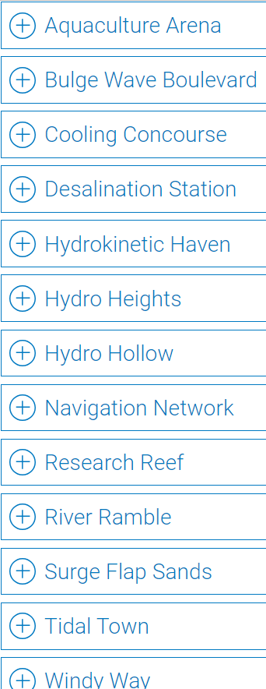

Slide 44
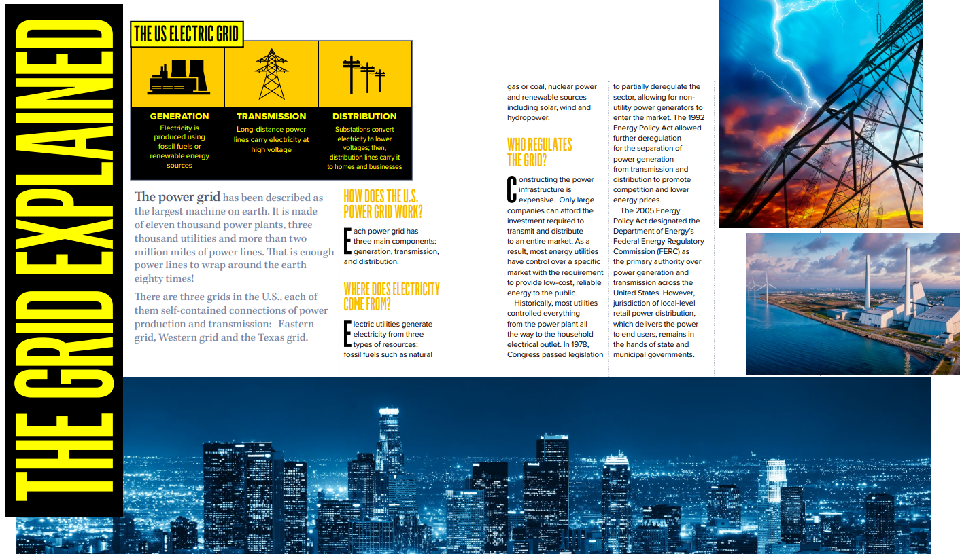

Slide 45
If you had a question and now have an answer please go put a checkmark on your sticky note.
I wonder...
What questions have been answered?
If you have a new question please add it to the wonder wall.
Notes:
Give about 3-5 minutes for questions to be posted.

Slide 47
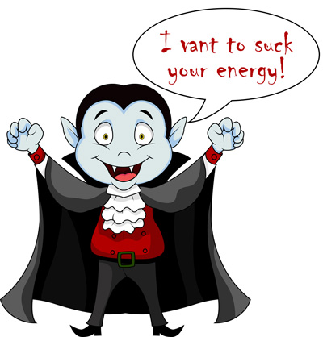
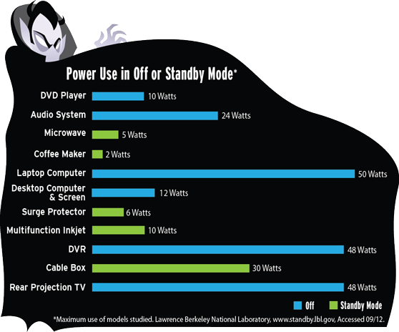
Energy Vampires/Phantom Power

Slide 48
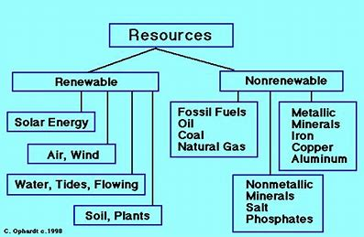

Slide 49
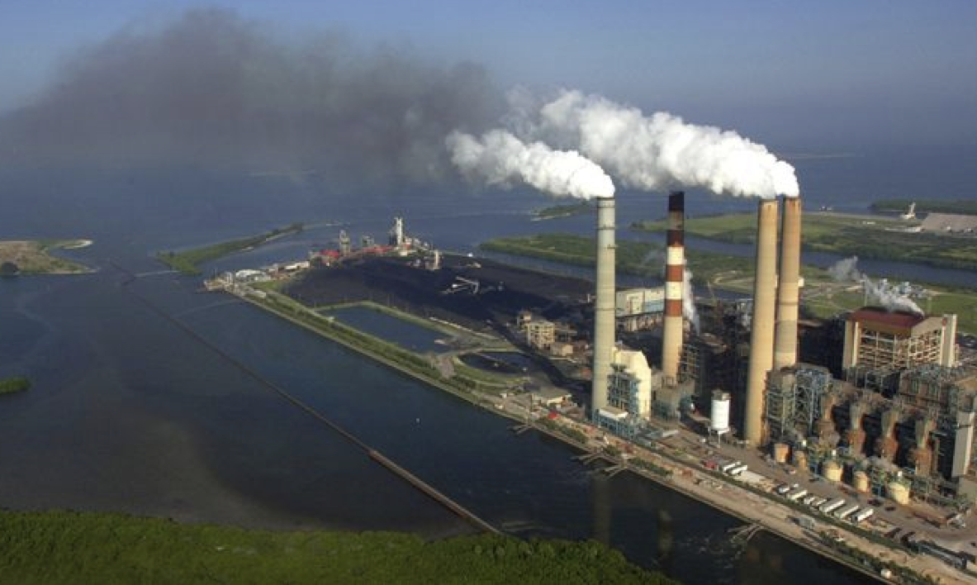
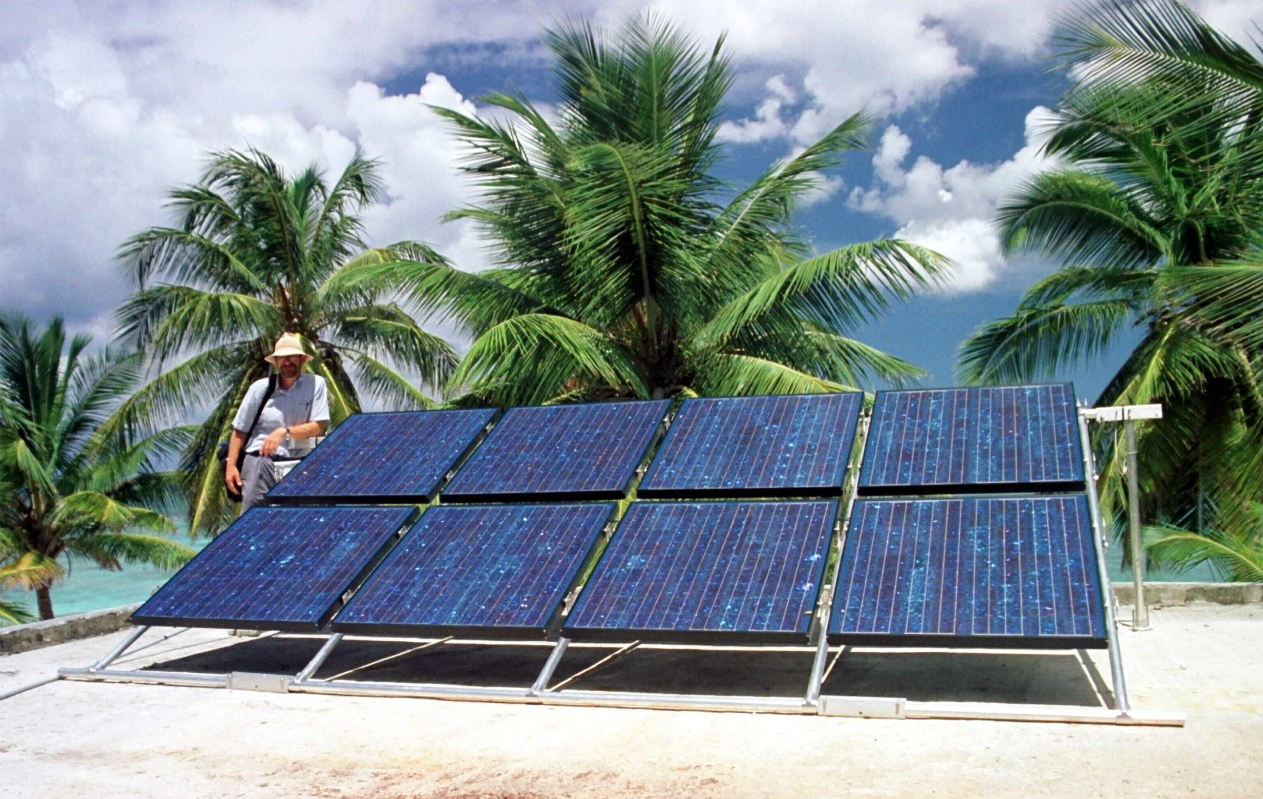
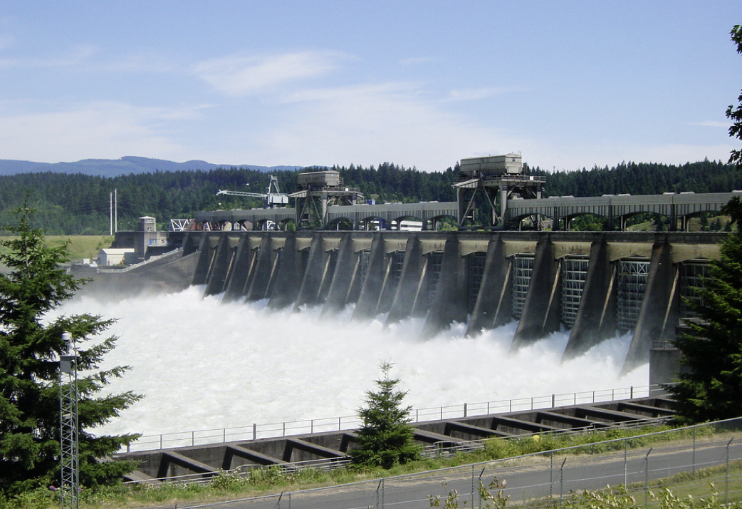
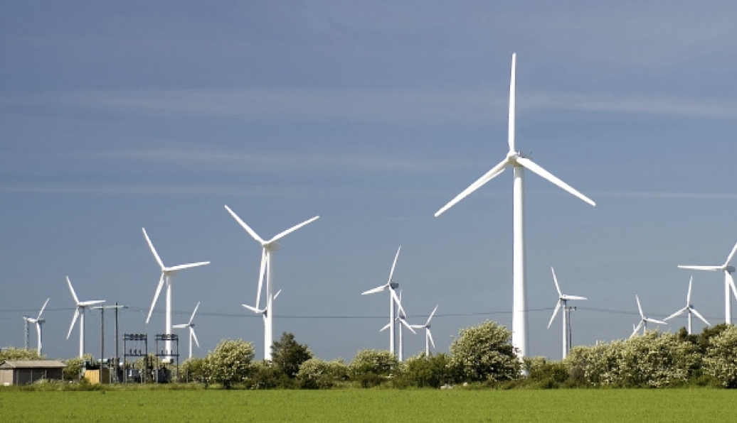
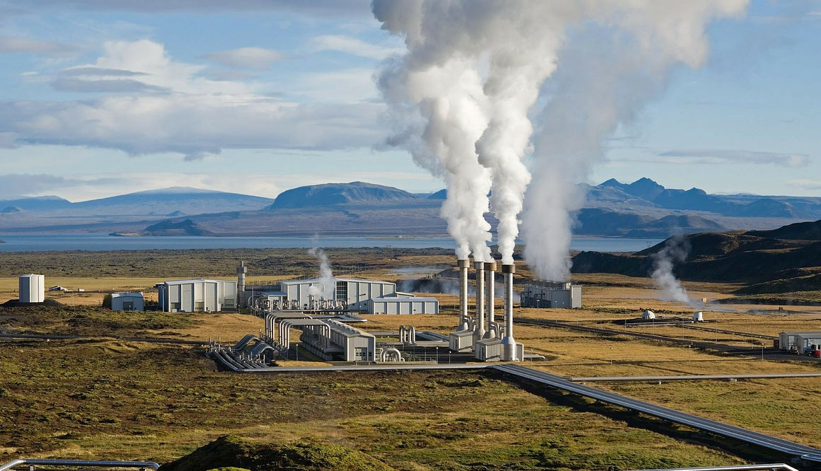
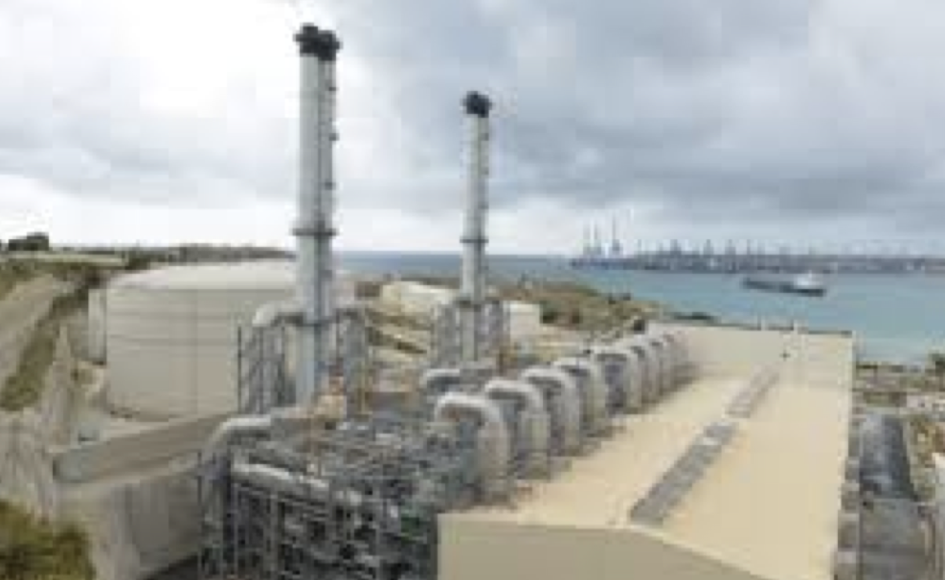
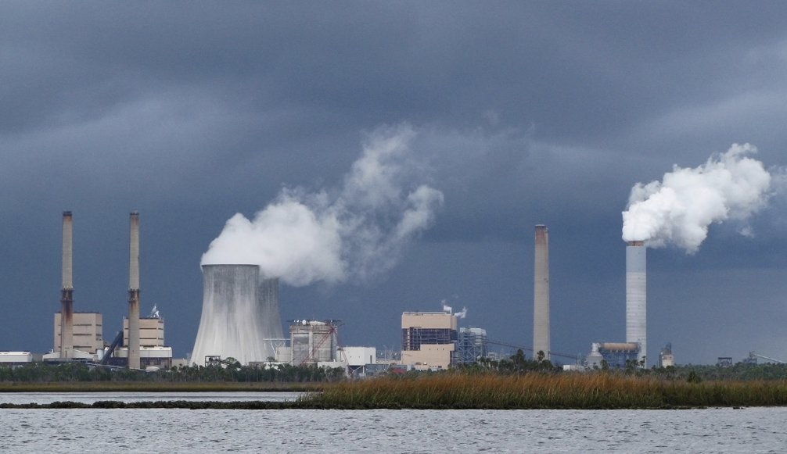
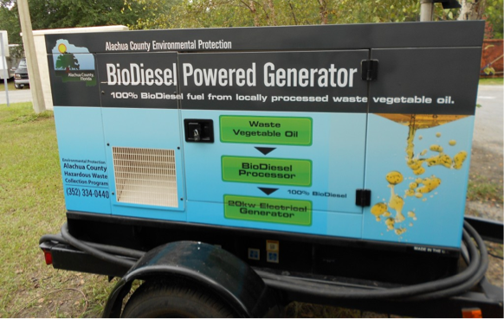
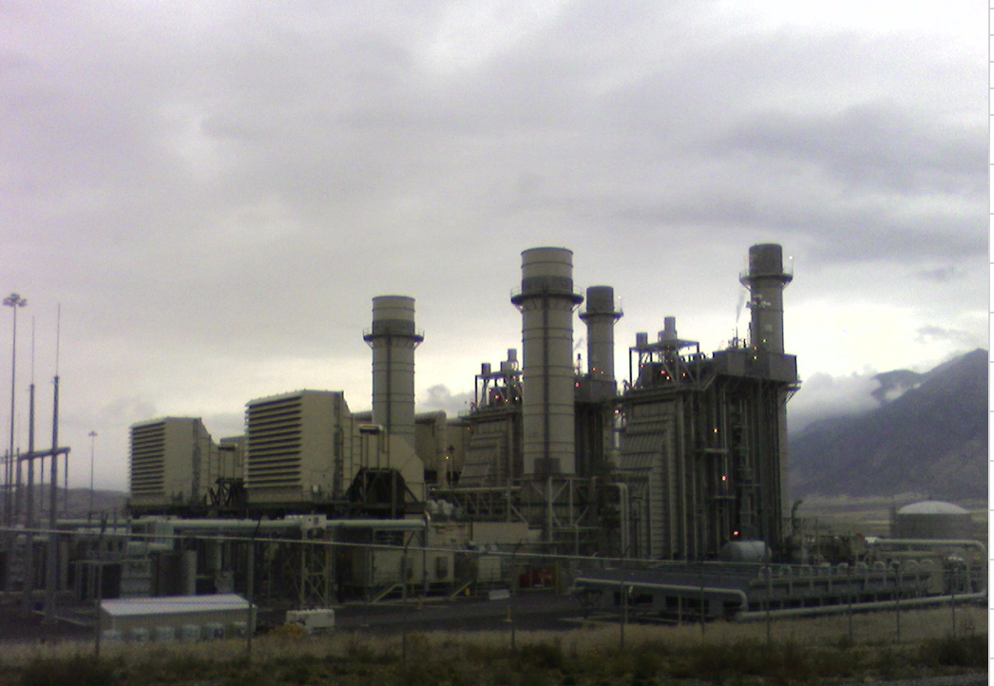
1 Coal-fired plant
2 Solar
3 Hydroelectric power plant
4 Wind energy
5 Geothermal
6 Diesel generation plant
7 Nuclear plant
8 Biofuels
9 Natural gas turbine plant

Slide 53
Wind power challenge
Can you find out about renewable energy in Peru, then design and make a model wind turbine?

Slide 54
Peru
Peru is a country in South America.
What do you already know about Peru?
1
Notes:
Ask pupils to show you where Peru is on a map.
Some facts about Peru are below. Ask pupils first what they already know then see if they covered alpacas, Macho Picchu and quinoa.
The Amazon rainforest covers 60% of Peru and this part of the forest is home to the highest number of bird species in the world.
Peru grows over 110 thousand tons of quinoa. It is the largest quinoa producer in the world.
Peru is famous for having an ancient civilisation called the Incas, whose empire ruled for over 100 years. They lived in the Andes Mountains where, today, the ancient Inca ruins of Machu Picchu attract half a million visitors a year.
Just under 30 million people live in Peru
Alpacas are important animals in Peru. Their fleece is used to make clothes and it is softer, stronger and warmer than sheep's wool. They are also used by families living in the mountains to move goods to markets.
The capital city of Peru is Lima which is home to more than a quarter of Peru's population.
Most people in Peru speak Spanish.

Slide 55
Living in Peru
Abigail and Marco (the two children on the right) live with their friends and family high in the mountains of Peru.
They live in a remote rural village and they don’t have any electricity in their houses or their school. This limits how much they can study and the type of businesses their parents can run and earn money from.
2
Notes:
An introduction to Abigail and Marco who live in Peru. There is a printed case study to show later.

Slide 56
Many people around the world face the same or similar problems to Abigail and Marco, trapping them in poverty. In 2015 the United Nations (UN) called a meeting with leaders from over 30 countries to work out how best to work together to solve some of the world's biggest problems. They identified 17 Global Goals to end poverty in the world by 2030. They called them the
Sustainable Development Goals
Or the
Global Goals
Notes:
Introduce the Global Goals. Do this by explaining that in 2015 the United Nations identified a number of problems faced by people and communities around the world. They came up with 17 Global Goals which they agreed to work towards to help solve world poverty by 2030. These goals are also called the Sustainable Development Goals or SDGs.

Slide 57
The Sustainable Development Goals (SDGs)
Notes:
These are the 17 goals.
Ask pupils which goals might be linked to some of the problems Marco and Abigail and their families face in Peru.

Slide 58
Making a
NATIONAL GRID

Slide 59
Making a National Grid
Imagine you are an electricity pylon and the string you have been given is an electric cable.
Use the string to connect as many people as possible to the power stations so they can get electricity.
Question: Often towns and villages are connected to more than one power station. Why do you think that is important?
6
Notes:
Now pupils have identified how important energy is this activity helps them understand that whilst in most parts of the world a national grid provides electricity, sometimes people living in rural areas do not get electricity. This raises the issues of fairness and equality of access to energy.

Slide 60
Renewable energy
In areas in any country where the National Grid does not reach there are alternative ways of producing energy.
Making a
National grid
Question: Can you name the different energy sources in these pictures?
7
Notes:
This is a good time to discover what pupils know about renewable energy. You may like to show our renewable energy poster at this point. You can request a free poster from schools@practicalaction.org.uk.

Slide 61
What is a
WATT?
Notes:
Hand out weights and carry out the starter activity as described in the Teacher’s guide.

Slide 62
Did you Know?
A large offshore wind turbine (one in the sea) can produce upto to 8 MW (or 0.008 GW) of electricity.
A large onshore wind turbine (one on land) can produce up to 2 MW (or 0.002 GW) of electricity.
A coal-fired power station can produce 2 GW of electricity.
So you need a lot of wind turbines to
get the same amount of electricity as a
coal-fired power station.
To see how much power we are using right now go to:
mygridgb.co.uk/dashboard
9
Notes:
For older students (13-16 years)
Ask them to calculate e.g. how many offshore wind turbines we would need to generate 50 GW of electricity.
Pupils should understand the equation in the Teacher’s guide.
They also need to understand that power in watts is the rate of use of energy in Joules i.e. 1 Watt is 1 Joule per second.

Slide 63
Your
WIND POWER
CHALLENGE

Slide 64
.
A few ground rules
Imagine you are engineers working together to find a way to bring electricity to Marco and Abigail and their community.
You must fix your wind turbine to the desk.
When operating your model you must not touch it.
Design, make and test a model of a system that can transport tomatoes in a way that won't squash them!
Other than that, anything goes. Do your research to help you make the best design.
Good luck!
Can you design, make and test a wind turbine that will pick a cup of pennies off the floor?
11
Notes:
When completing the wind power challenge, students can actually calculate the power of their wind turbine (this will be very very small) using the equation
$$power= \frac{mgh}{t}$$
Where m is the mass raised (I recommend using 5 g masses i.e. 0.005 kg), g is always 10 N kg⁻¹ and h is the height lifted in meters (not cm!). They should measure the time in seconds using a stopwatch.
Pupils aged 13-16 should also understand that the wind turbine converts kinetic energy into electrical energy and kinetic energy.

Slide 65
At the end of your challenge you will have 3 minutes to present or ‘pitch’ your work on the Wind power challenge. Remember to leave time to work out how you are going to do this.

Slide 66
Feedback
Teamwork How well did you work together?
Research What did you find out? Developing ideas What ideas did you try out and how did you change your design as a result? Final design How successful was it? How would you improve it if you had more time?
13
Notes:
We suggest that pupils present their model to the rest of the class reflecting on how well they worked together, problems they solved, etc. (this will be necessary if you are planning for your pupils to gain a CREST Discovery Award).
Hand out the Team feedback sheet at this point
Allow time for pupils to work on their presentations as well as building their model.

Slide 67
You will be pleased to know that Abigail and Marco’s lives have been much improved as a result of Practical Action working with their community to build lots of wind turbines. They now have electricity in their school. Their teacher said: ‘Our school now has electricity, hot water even tiled bathrooms! The children’s lives have improved, now they have facilities as good as or even better than in the city!’
This is just one way Practical Action is working with other organisations towards achieving the Sustainable Development Goals.
15
Notes:
Hand out the ‘Harvesting the wind’ case study and go back to the story of Abigail and Marco. Discuss how their lives have changed for the better since their village build a wind turbine.

Slide 68
Celebrating
SUCCESS

Slide 69
We hope you enjoyed the Wind power
challenge
For more information and resources go to:
practicalaction.org/schools

Slide 70
Dear Engineer,
The world needs more natural resources. Our carbon footprint is destroying the world for future generations. The United Nations is looking at creating Windmills to help increase the number of natural resources in the World. They need your help to design and test some new windmills. The windmills are going to be made from recycled materials that each area has on hand. The United Nations needs you to create a working model of a windmill to be tested in your classroom. You must create a windmill that is able to spin with our man-made wind. We will then be able to replicate your design in areas around the world. Thank you for your help and making our planet a greener society.
Materials
Cardboard
Pipe cleaners
Brads
Paperclips
Rubber bands
Straws
Tongue depressors
Scissors
Glue

Slide 73
A Monster’s Dilemma:
What can replace the screams?
Notes:
Watch video

Slide 74
A New Movie . . .
Create a trailer for a new movie on renewable energy.
How do the renewables save the world?

Slide 75
Where Does Our Electricity Come From?
https://issuu.com/theneedproject/docs/primaryinfobook
https://issuu.com/theneedproject/docs/elementaryenergyinfobook_490b65b2dbf1e4
Print one copy of the book and divide it into forms of energy. Give a section to each group. Each group creates a poster to present to the class.
As presentations are given individuals take notes in a graphic organizer.
Notes:
Show download of primary NEED book. This same activity can be done in K-2 with primary book.

Slide 76
Dear Students,
I have exciting news! Florida Power Company is building a new electricity plant in Tampa Florida. We have eight possible energy sources we could use to make electricity, but we must choose only one.
This power plant will be in your community and effect your future, therefore we want to let help us decide which type of energy source we should use.
Please study the eight energy sources: Geothermal, hydropower (water), solar, wind, coal, petroleum, and propane. Find out which ones are renewable (we can always get more of it), which are nonrenewable (we will eventually run out of it), which are fossil fuels, and what is good and bad about each one.
Once you have found this information please use it to choose the best choice for our new power plant and let us know what you chose. Please explain why you chose it.
I look forward to hearing back from you!
Thank you for your help,
Electra Conservation

