Slide 1
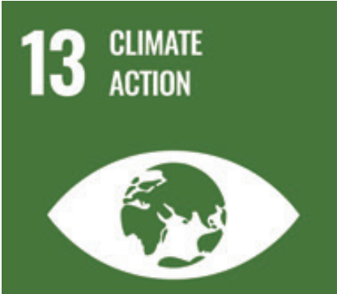
Christine Angel Danger M.Ed. NBCT
Master Teacher Mentor USF Stavros Center
Transformation Network Academic Coach HCPS

Slide 2
SustainabilitySuperheroes.org
Click on the RESOURCES tab

Slide 3
The Coca-Cola Company's 2021 Business & Environmental, Social and Governance Report

Slide 4
What Is Climate Change? • Weather is the temperature, humidity, precipitation, cloudiness, and wind that we experience in the atmosphere at a given time in a specific location. Weather forecasts are generally accurate over days to weeks. Climate is the average weather over a long time period (30–50 years) in a region. • Climate variability refers to natural variation in climate that occurs over months to decades. El Niño, which changes temperature, rain, and wind patterns in many regions over about 2–7 years, is an example of natural climate variability. Climate change is a systematic change in the long-term state of the climate over multiple decades or longer.2 Climate scientists use statistical tests to ascertain that observed changes in climate are not within the range of natural variability

Slide 5
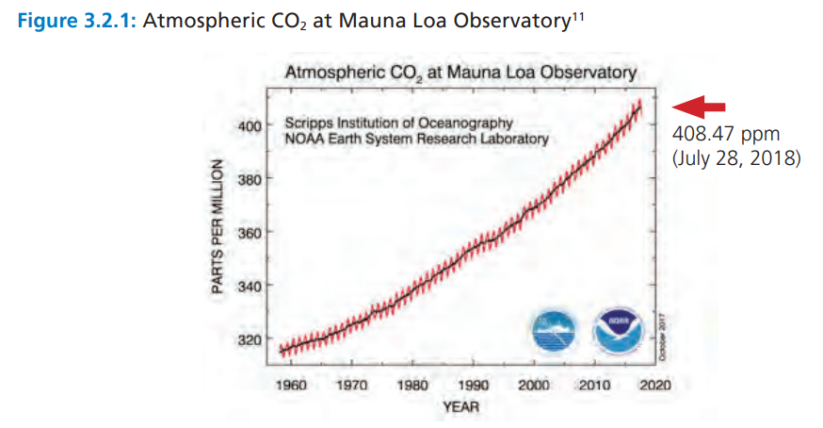

Slide 6
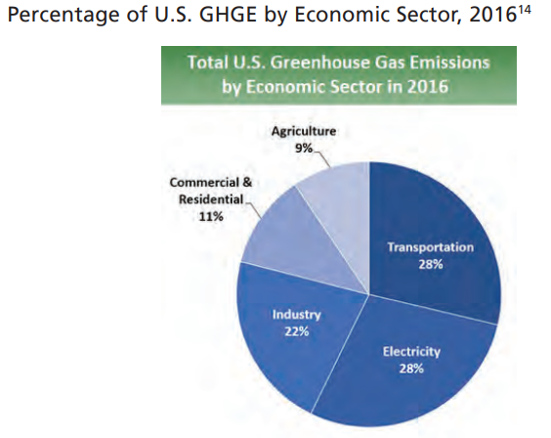

Slide 7
Overview of Florida's Climate Change Preparations - Georgetown Climate Center

Slide 8
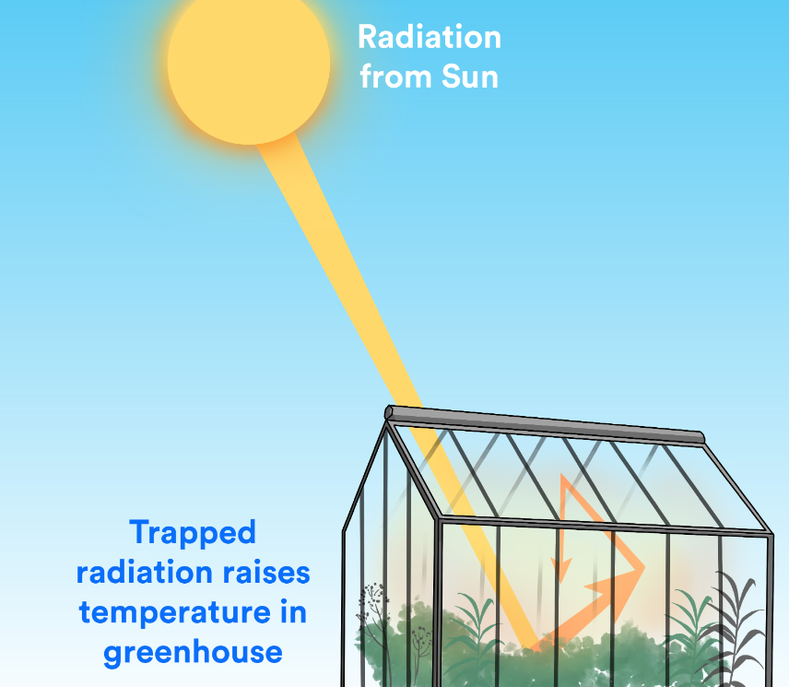
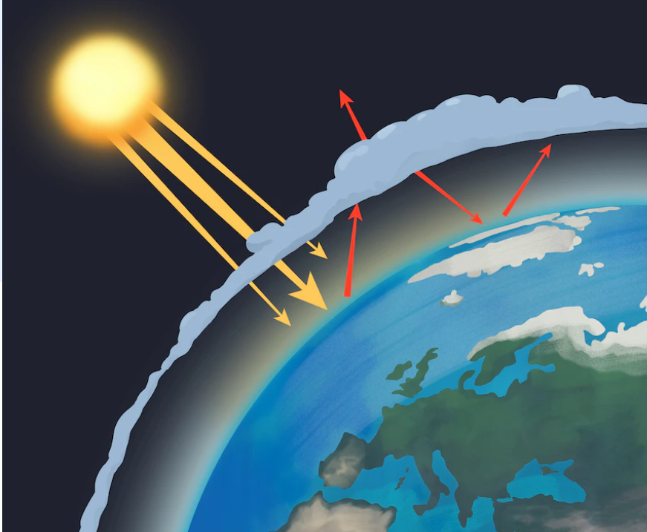

Slide 9
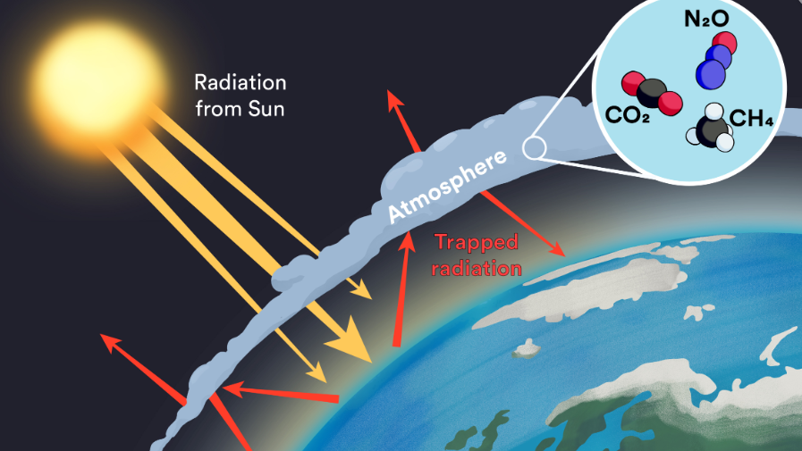

Slide 13
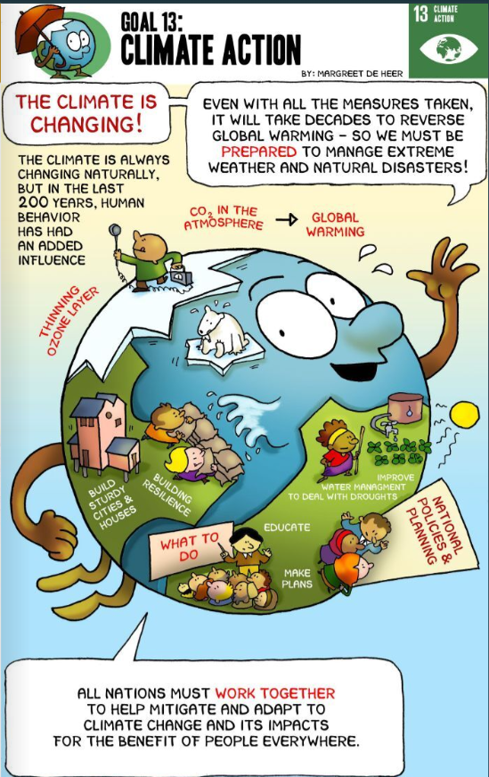

Slide 15
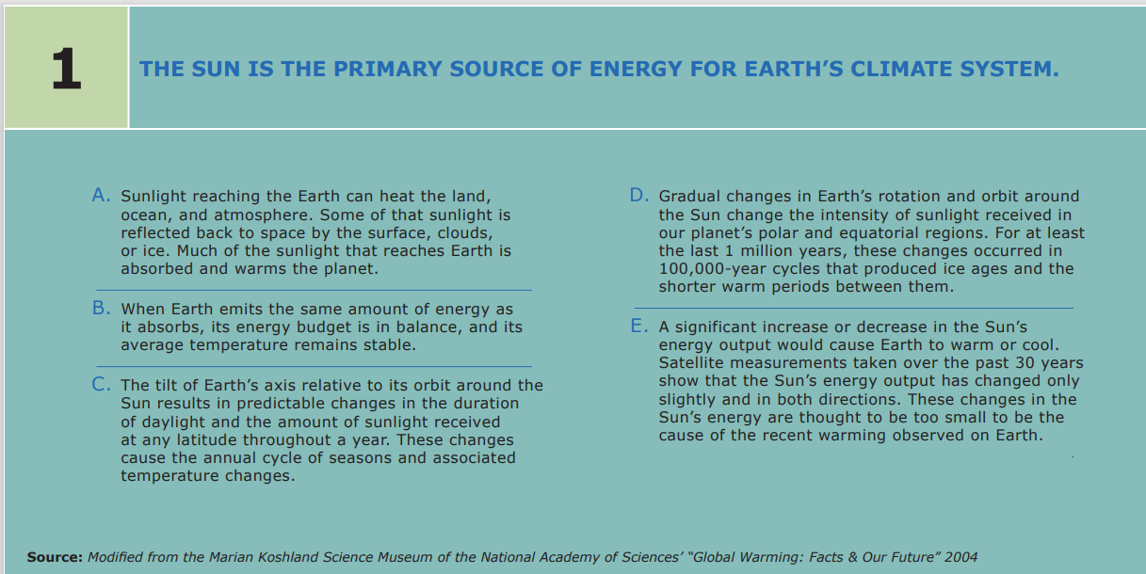

Slide 16
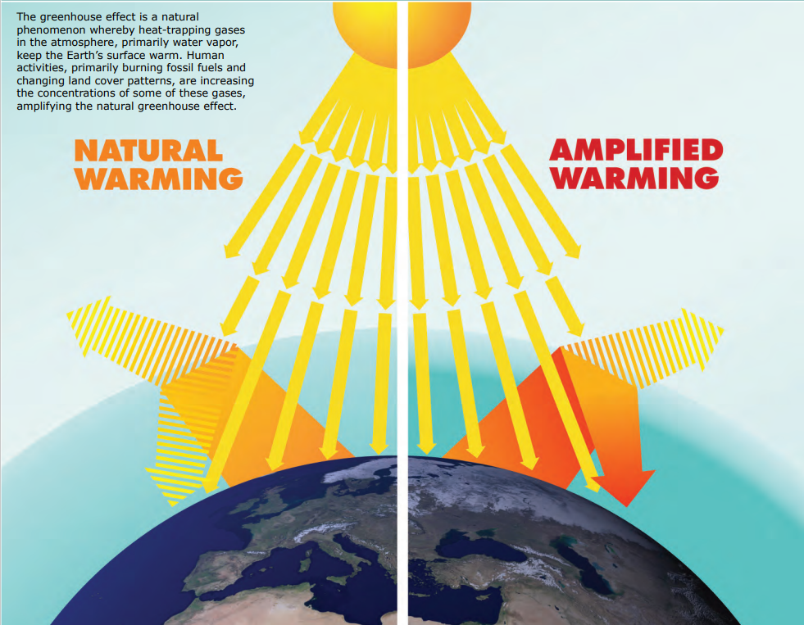

Slide 17
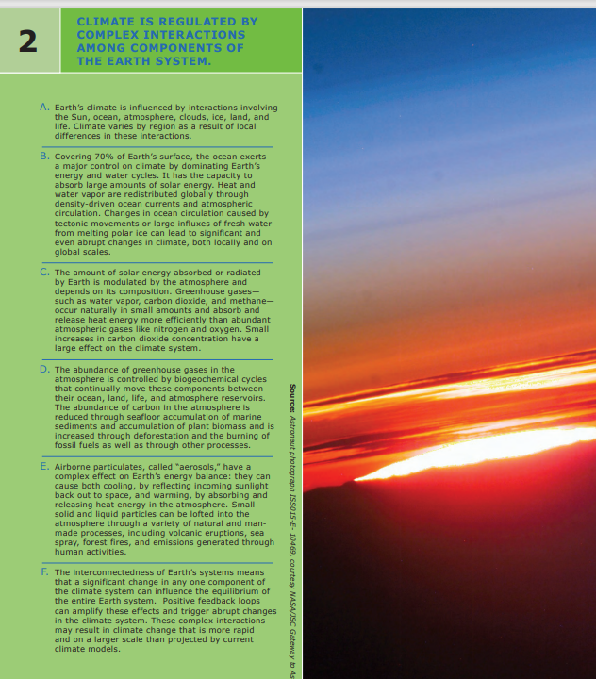
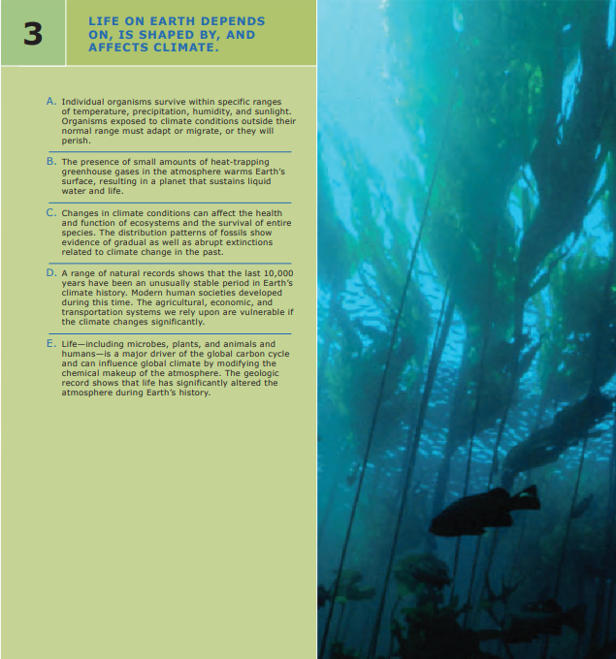

Slide 18
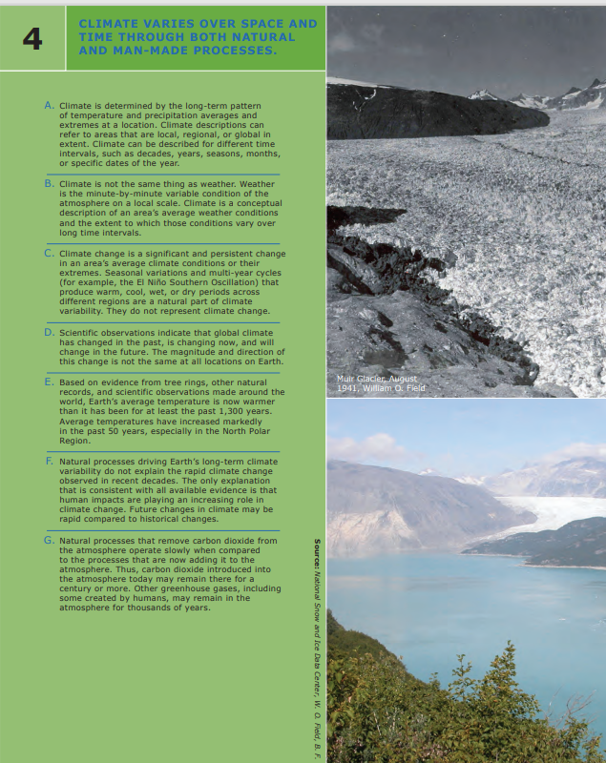
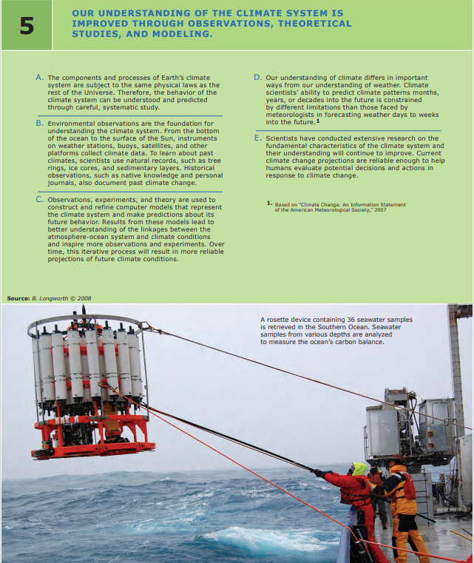

Slide 19
