Slide 1
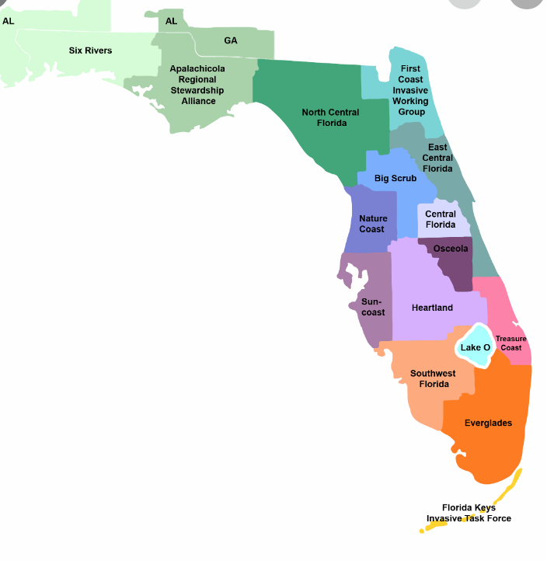
What’s in Your Backyard, Florida?
Nonnative Florida Animals

Slide 2
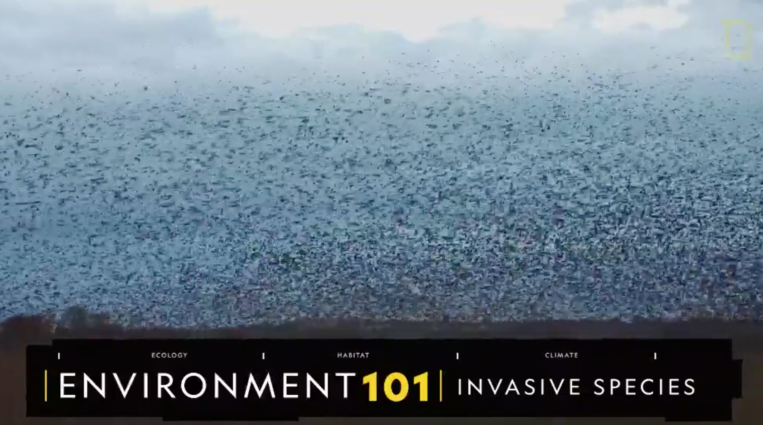
What are nonnative, invasive species?
What are invasive species?
Why are they problematic?
How do invasive species come to an ecosystem?
What are different types of invasive species?
What are some negative economic impacts from invasive species?
How can people help prevent the spread of invasive organisms.
https://video.nationalgeographic.com/video/environment/101-videos/0000016b-248c-d426-af6f-edced2fd0000

Slide 3
Why are nonnative animals a problem in Florida?
What’s the problem?
How do they get here?
Are they a danger to humans?
https://www.sun-sentinel.com/features/fl-fea-most-invasive-dangerous-species-in-florida-20180924-story.html
Notes:
Read the information on invasive species to Florida. Complete the chart. There is a picture gallery of many types of nonnative species found in Florida.

Slide 4
Decisionomics
Which nonnative species is the most problematic in Florida?
Alternatives
  Rhesus Macaque, Burmese Python, Lionfish, or Cane Toad
Criteria
  dangerous to humans, pets, and other native Florida wildlife
  increasing in number or expanding in location in Florida
  cause damage to Florida’s ecosystems

Slide 5
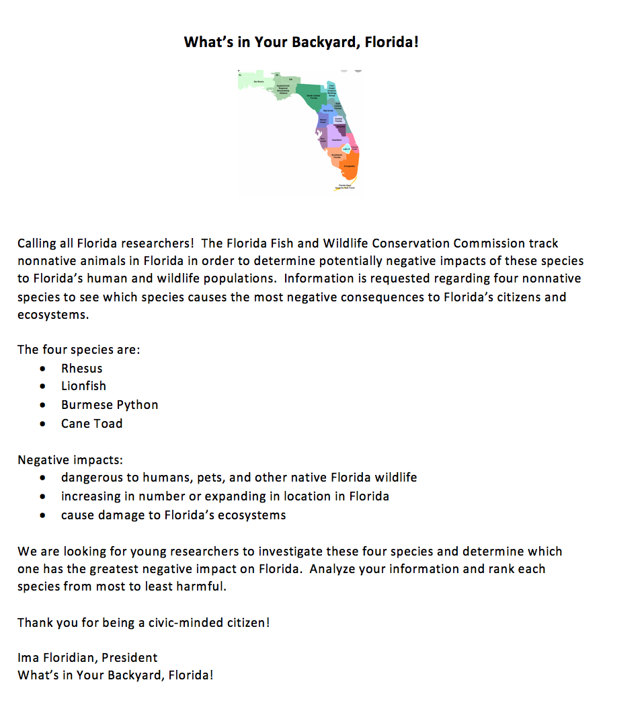
Notes:
Read the letter with the students. Define the task, the alternatives (choices) and criteria (determining factors in choosing).

Slide 6
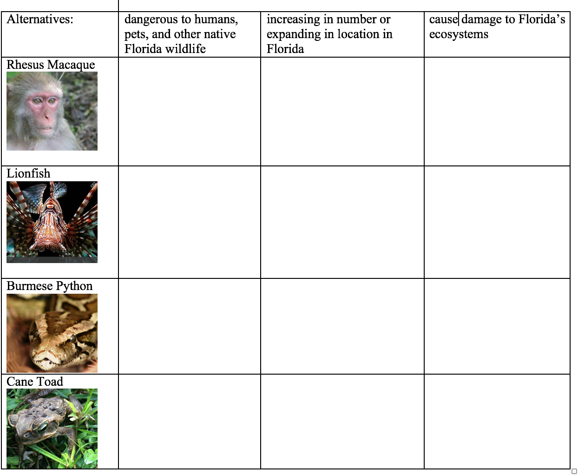
Notes:
Use the matrix to take notes during research.

Slide 7
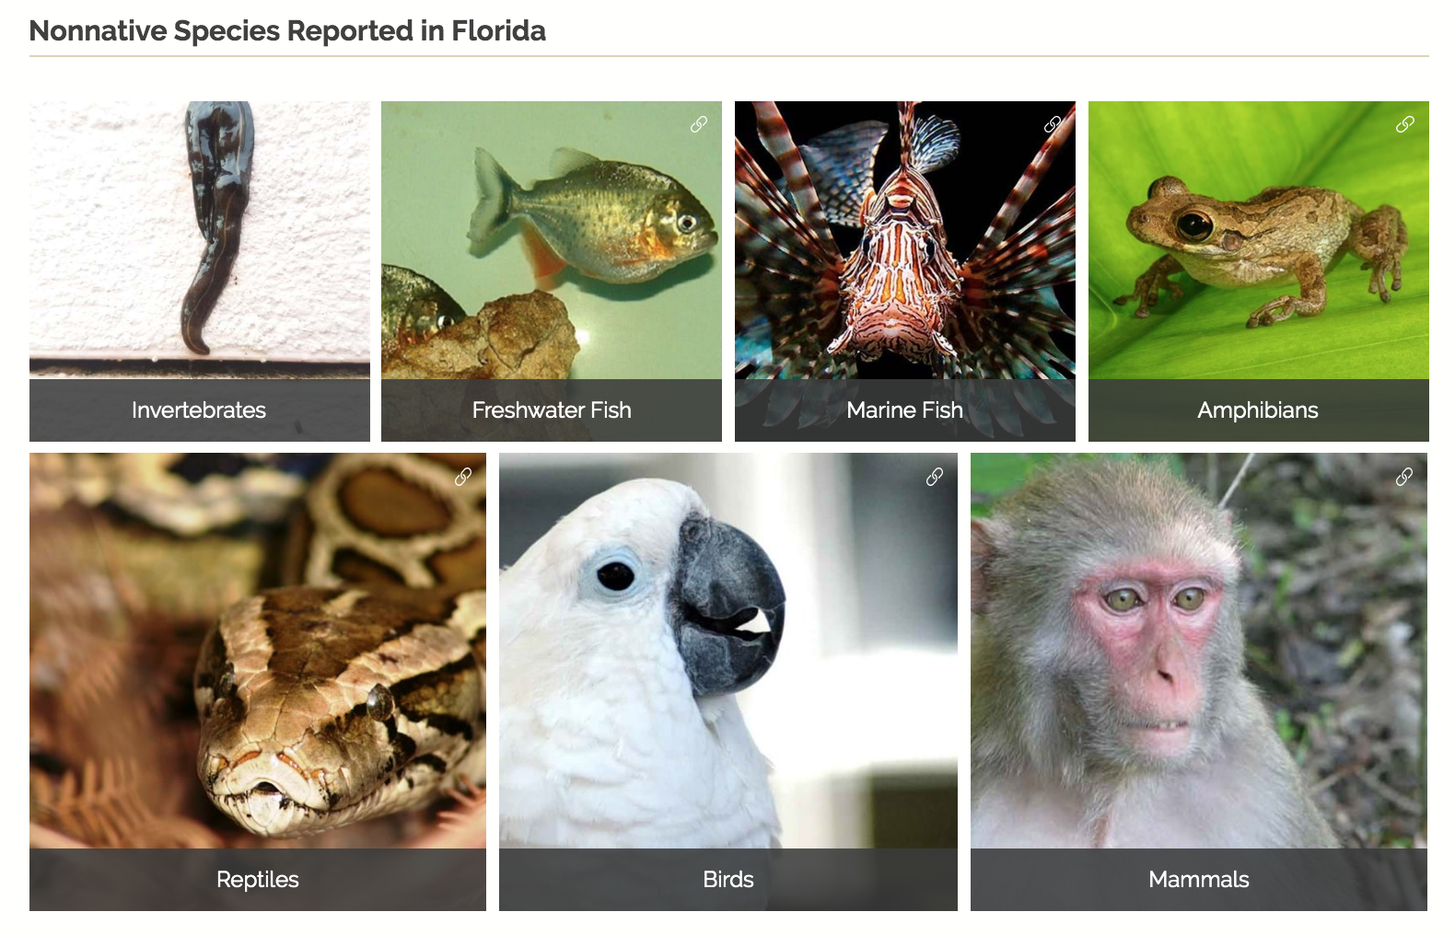
Florida’s Nonnative Fish and Wildlife
https://myfwc.com/wildlifehabitats/nonnatives/
Notes:
Click on the link to go to Florida Fish and Game’s website to learn about nonnative fish and wildlife in Florida. Scroll to the bottom of the page and discuss the 7 different species found in Florida. A KWL chart could be used to determine background. Clarify the meanings of the different categories. Click on Mammals.

Slide 8
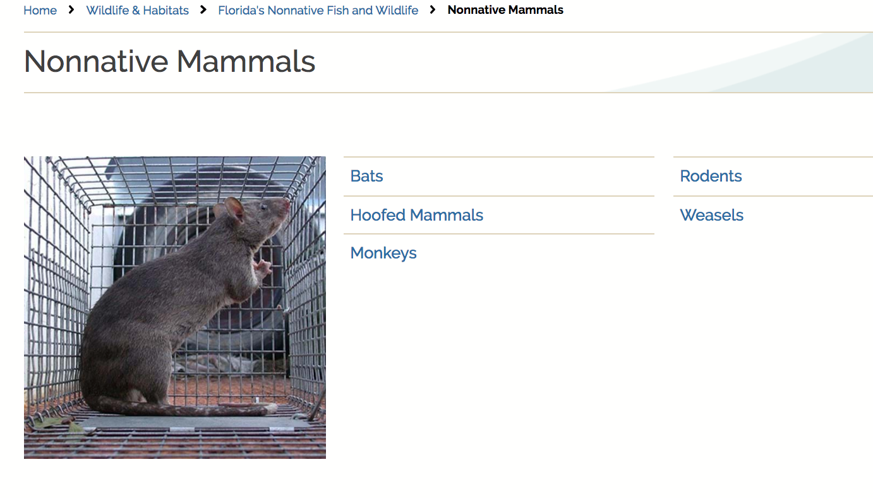
Nonnative Mammals in Florida
https://myfwc.com/wildlifehabitats/nonnatives/mammals/
Notes:
Review each category of nonnative mammals. Click on each link (save Monkeys for last) and discuss the information provided on each chart. Discuss how these mammals came to Florida.

Slide 9
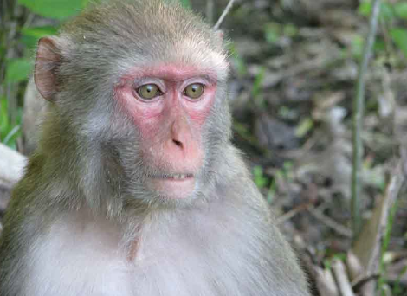
Rhesus Macaque
https://myfwc.com/wildlifehabitats/nonnatives/mammals/monkeys/
Notes:
Click on Monkeys. View the table listing non-native monkeys in Florida. Discuss how each species came to the state. Click on the link to the Rhesus Macaque.

Slide 10
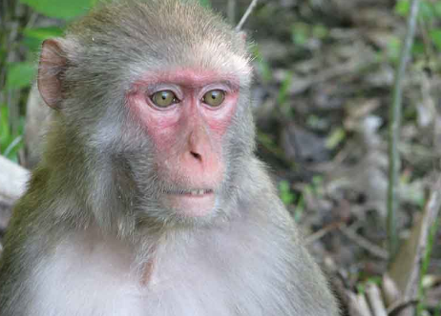
Rhesus Macaque
https://myfwc.com/wildlifehabitats/nonnatives/mammals/monkeys/rhesus-macaque/
Notes:
Review the information about the Rhesus Macaque on it’s homepage. Click on the interactive map to see recent sightings in Florida.

Slide 11
Rhesus Macaque
https://myfwc.com/wildlifehabitats/nonnatives/mammals/monkeys/rhesus-macaque/
Notes:
Review the 2 PDFs on wild monkeys – links at the bottom of the page. PDFs have been downloaded and sent with the power point.

Slide 12
Florida’s Nonnative Fish and Wildlife
https://myfwc.com/wildlifehabitats/nonnatives/
Notes:
Go back to Florida Fish and Game’s website to learn about nonnative fish and wildlife in Florida. Click on Reptiles.

Slide 13
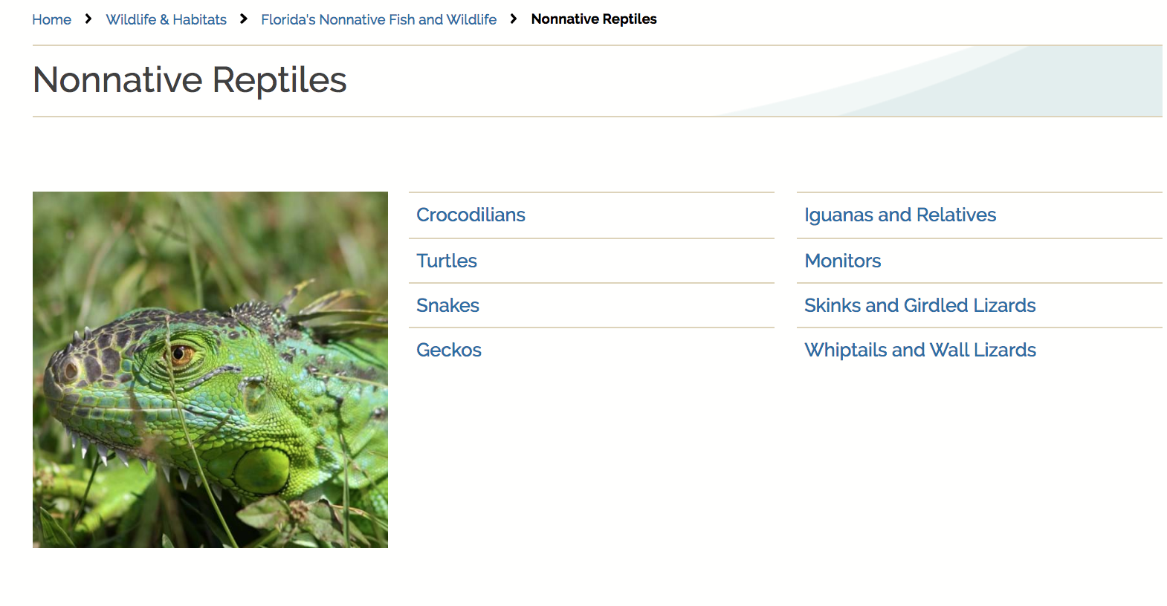
Nonnative Reptiles in Florida
https://myfwc.com/wildlifehabitats/nonnatives/reptiles/
Notes:
Review each category of nonnative reptiles. Click on each link (save Snakes for last) and discuss the information provided on each chart. Discuss how these reptiles came to Florida.

Slide 14
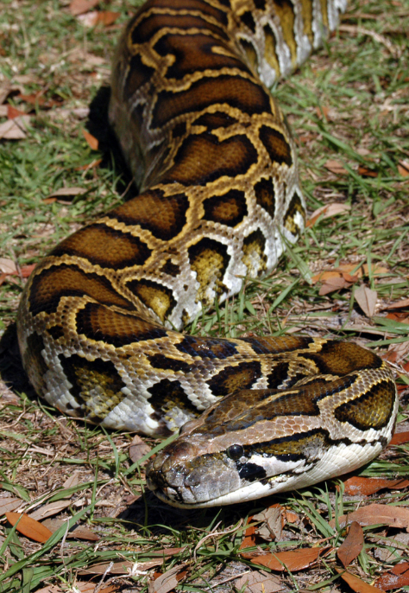
Burmese Python
https://myfwc.com/wildlifehabitats/nonnatives/reptiles/snakes/
Notes:
Click on Snakes. View the table listing non-native monkeys in Florida. Discuss how each species came to the state. Click on the link to the Burmese Python.

Slide 15
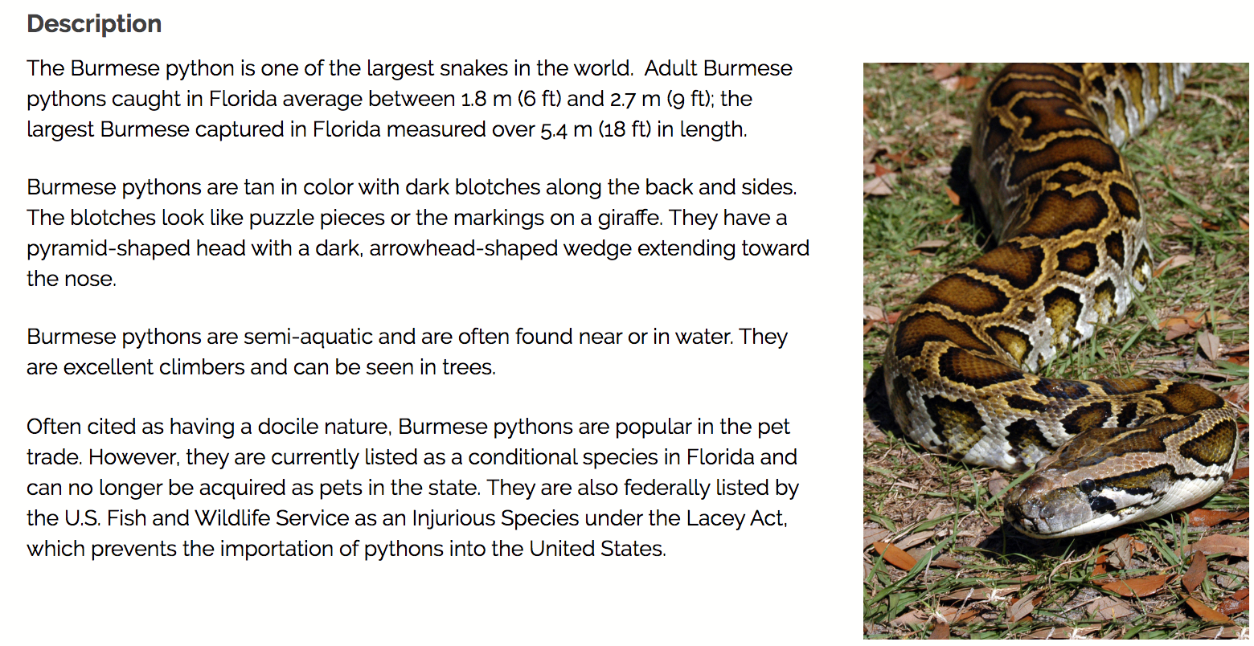
Burmese Python
https://myfwc.com/wildlifehabitats/profiles/reptiles/snakes/burmese-python/
Notes:
Review the information about the Burmese Python on it’s homepage. Click on Python Removal Opportunities link at the bottom of the page. Click on the links about Python removal and how to identify Pythons. Explore other types of snakes similar to Pythons.

Slide 16
Burmese Python
https://myfwc.com/wildlifehabitats/profiles/reptiles/snakes/burmese-python/
Notes:
Explore the Burmese Python brochure and poster (links are at the bottom of the page). PDFs have been downloaded and sent with the power point.

Slide 17
Florida’s Nonnative Fish and Wildlife
https://myfwc.com/wildlifehabitats/nonnatives/
Notes:
Click on the link to go back to Florida Fish and Game’s website to learn about nonnative fish and wildlife in Florida. Click on Marine Fish.

Slide 18
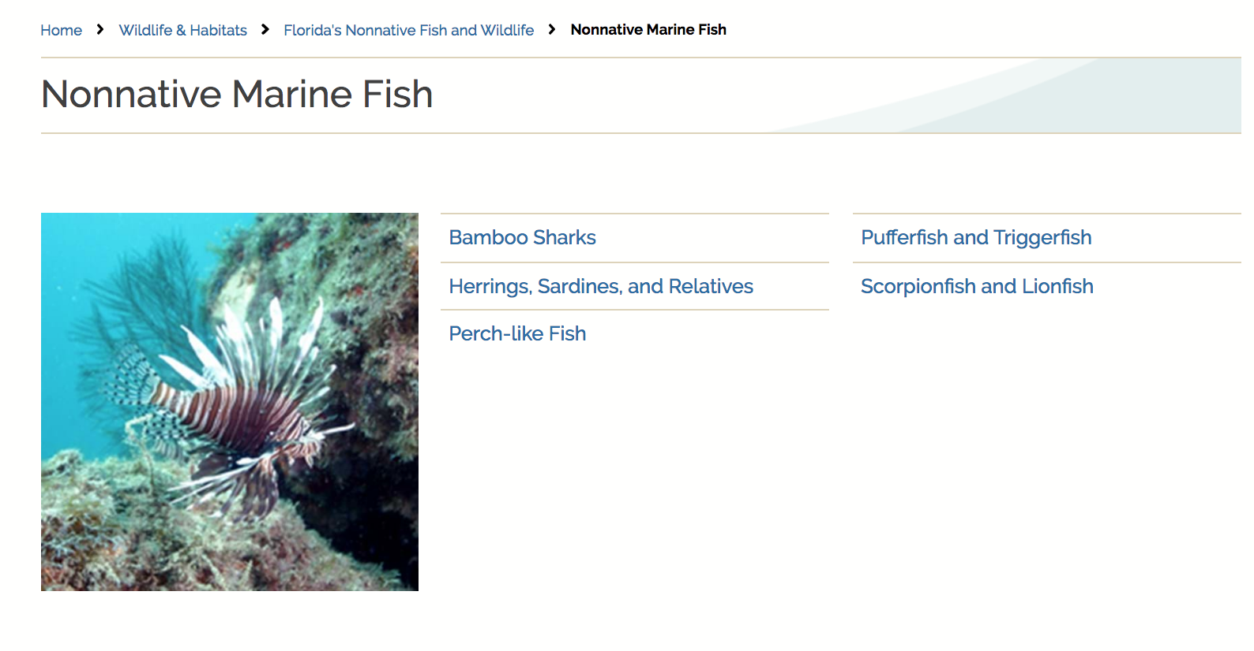
Nonnative Marine Fish in Florida
https://myfwc.com/wildlifehabitats/nonnatives/marine-fish/
Notes:
Review each category of nonnative marine fish. Click on each link (save Scorpionfish and Lionfish for last) and discuss the information provided on each chart. Discuss how these fish came to Florida.

Slide 19
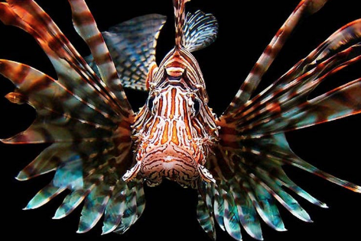
Lionfish
https://myfwc.com/wildlifehabitats/nonnatives/marine-fish/scorpionfish-and-lionfish/
Notes:
Click on Scorpionfish and Lionfish. View the table listing the Lionfish in Florida. Discuss how it came to the state. Click on the link to the Lionfish.

Slide 20
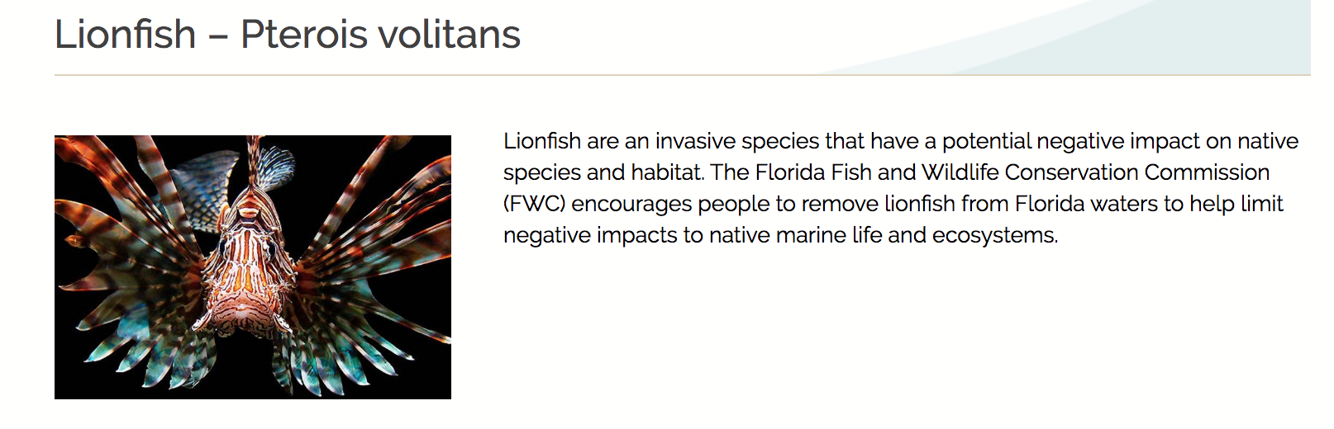
Lionfish
https://myfwc.com/wildlifehabitats/nonnatives/marine-fish/scorpionfish-and-lionfish/lionfish/
Notes:
Review the information about the Lionfish on it’s homepage. Review the maps to see where Lionfish come from and how they have multiplied in Florida in Florida. Click on the Lionfish Derby and Events at the bottom of the page, then click Learn More to read about Lionfish Removal and Awareness.

Slide 21
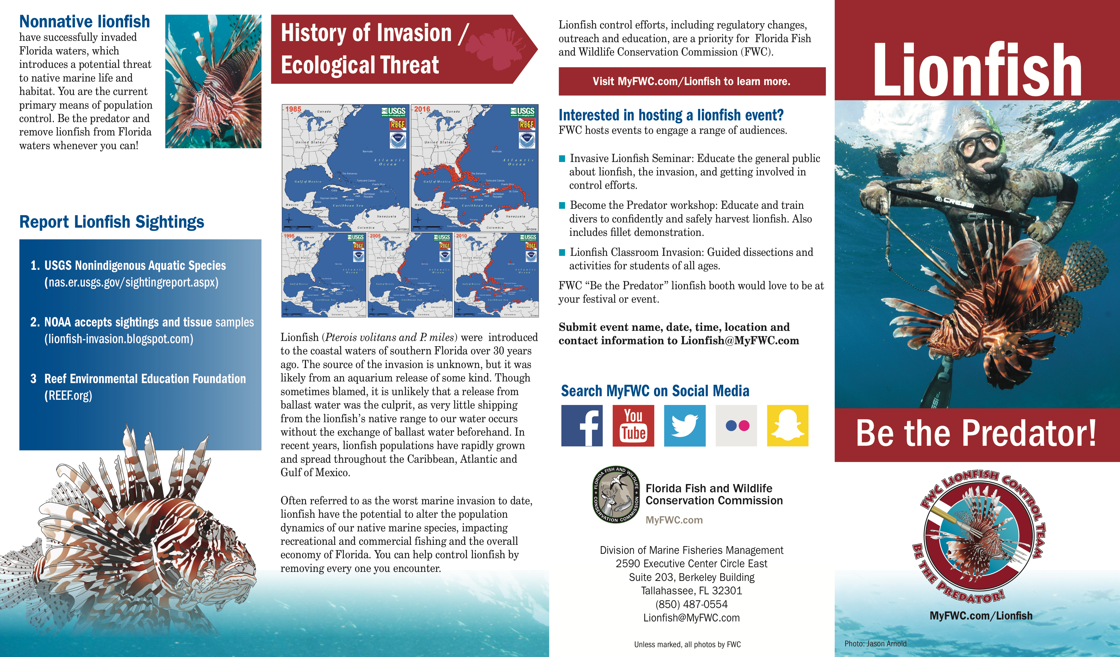
Lionfish
https://myfwc.com/media/1332/lionfishbrochure.pdf
Notes:
Review the PDF on Lionfish – link at the bottom of the page. PDF have been downloaded and sent with the power point.

Slide 22
Florida’s Nonnative Fish and Wildlife
https://myfwc.com/wildlifehabitats/nonnatives/
Notes:
Go back to Florida Fish and Game’s website to learn about nonnative fish and wildlife in Florida. Click on Amphibians.

Slide 23
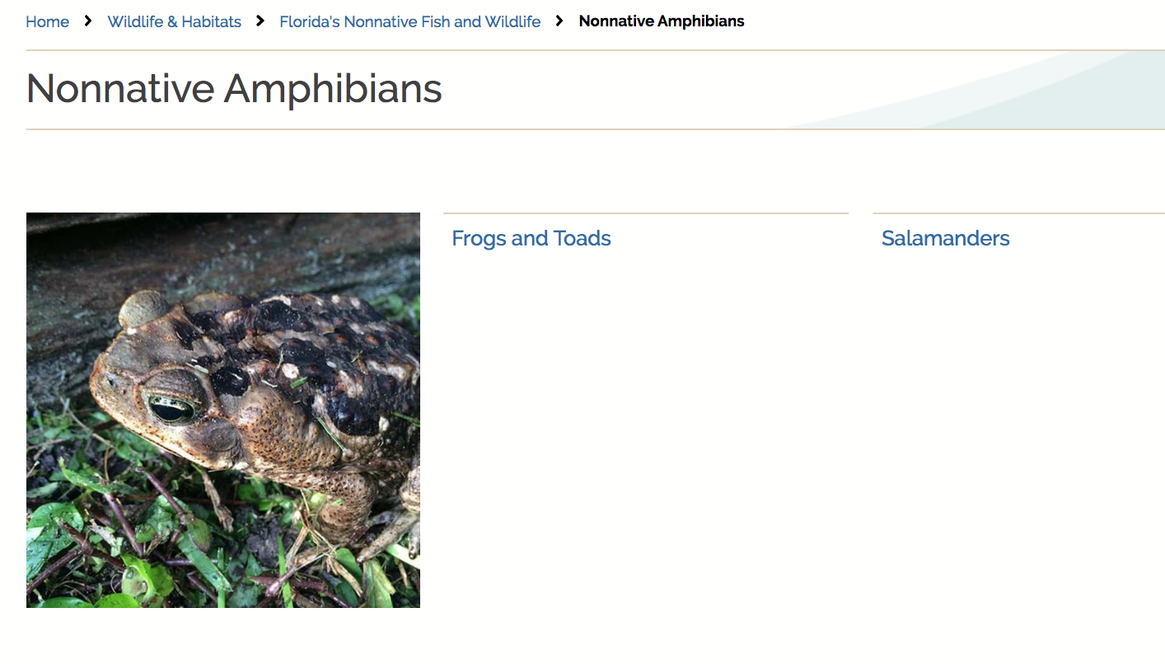
Nonnative Amphibians in Florida
https://myfwc.com/wildlifehabitats/nonnatives/amphibians/
Notes:
Review each category of nonnative amphibians. Click on Salamanders (save Frogs and Toads for last) and discuss the information provided on the chart. Discuss how these amphibians came to Florida.

Slide 24
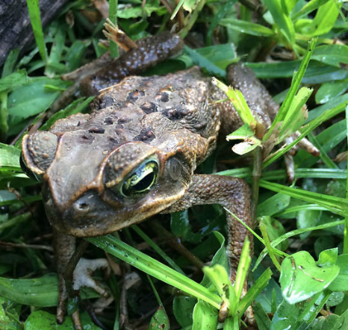
Cane Toad
https://myfwc.com/wildlifehabitats/nonnatives/amphibians/frogs-and-toads/
Notes:
Click on Frogs and Toads. View the table listing non-native frogs and toads in Florida. Discuss how each species came to the state. Click on the link to the Cane Toad.

Slide 25
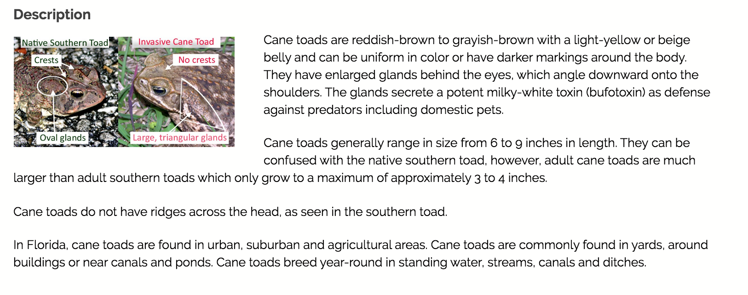
Cane Toad
https://myfwc.com/wildlifehabitats/profiles/amphibians/cane-toad/
Notes:
Review the information about the Cane Toad on it’s homepage. Watch the How to Identify Invasive Cane Toads through 5:53 Discuss 1) What are the characteristics of toads? 2) What do you do if you find any toad under and inch long? (let it live), 3) In what parts of Florida are Cane Toads found? Are they large or small? 4) Where are Cane Toads usually found? and 5) What are features that can help you identify a Cane Toad? Click on the interactive map to see where Cane Toads have been sighted in Florida.

Slide 26
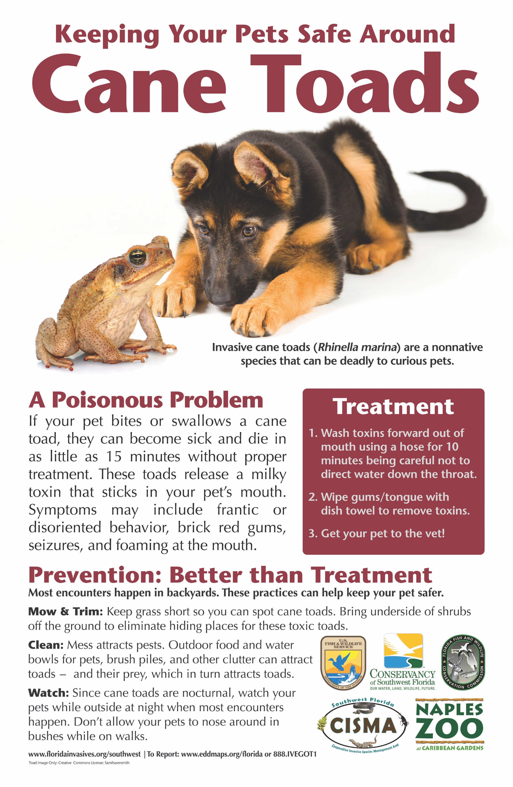
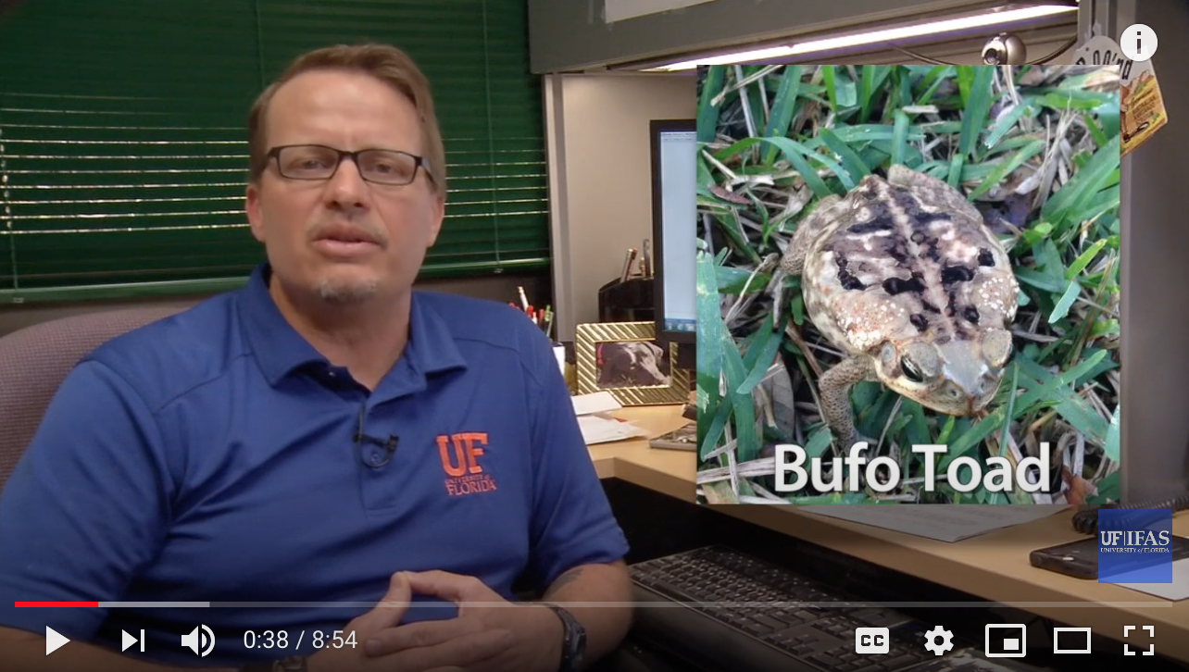
Cane Toad
https://myfwc.com/wildlifehabitats/profiles/amphibians/cane-toad/
Notes:
Explore the Cane Toad brochure (link is at the bottom of the page). PDF has been downloaded and sent with the power point. There are also additional videos about Cane Toads and the dangers they bring to your pets.

Slide 27
What Decision Did You Make?
Which nonnative species did you determine is the most problematic in Florida?
How did you rank all four?
How will you notify Ima Floridian of your decision?

Slide 28
Writing about Florida’s invasive plant species
Write an informative essay on the issues with nonnative animal species in Florida.
Write an opinion essay about which nonnative animal is the most problematic for Florida.
Write and record a Public Service Announcement on nonnative animal species in Florida https://www.govtech.com/education/news/How-to-Create-the-Perfect-Public-Service-Announcement.html
Write an editorial calling for the public’s action in identifying and reporting nonnative animal species in their backyards.

