Slide 1
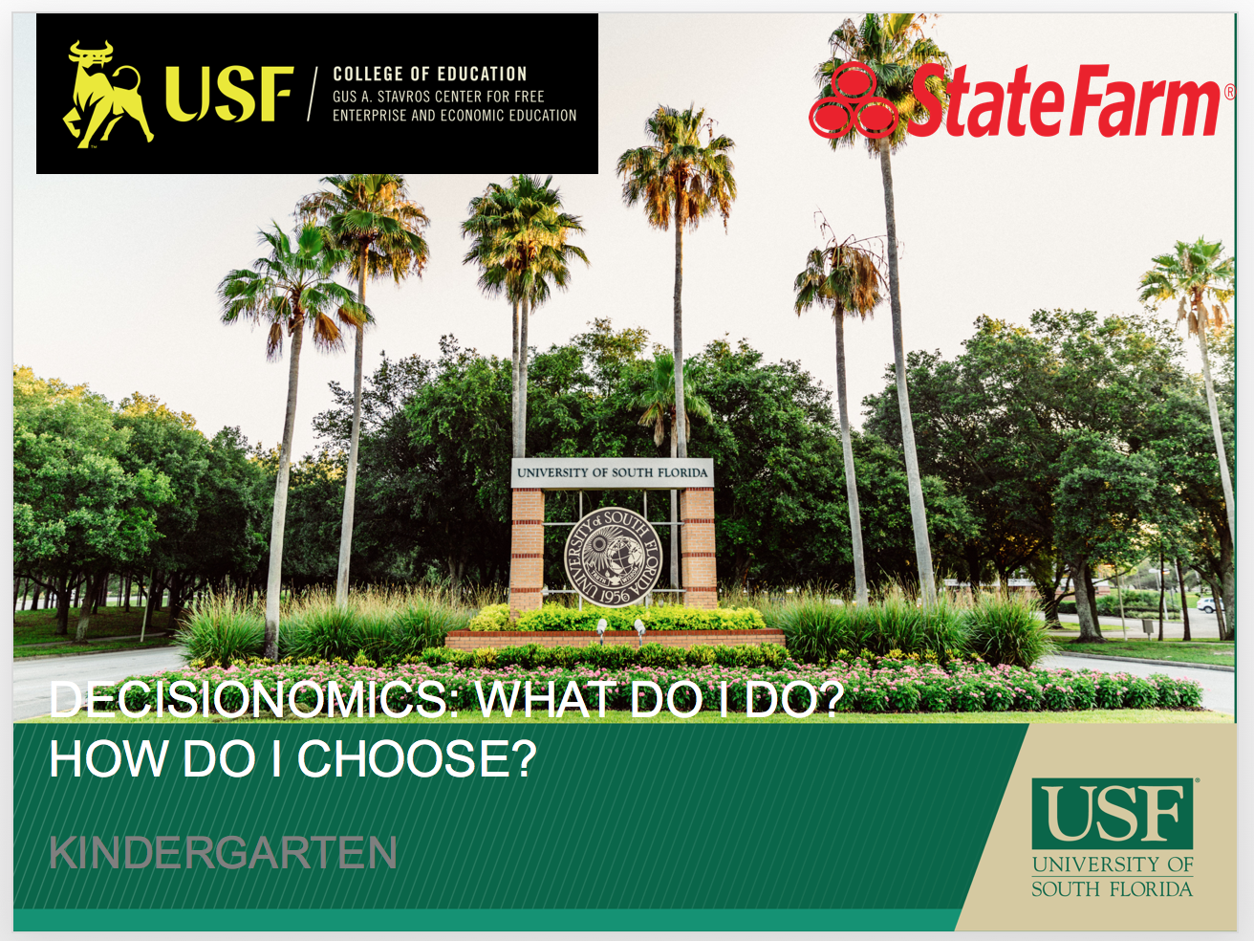
What do I do? How do I choose?

Slide 2
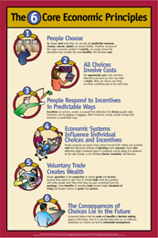
What is decision-making?
People choose. People choose the alternative which seems best to them because it involves the least cost and greatest benefit.
People's choices involve costs. Cost is the second best choice people give up when they make their best choice.
People respond to incentives in predictable ways. Incentives are actions or rewards that encourage people to act. When incentives change, people's behavior changes in predictable ways.
People create economic systems that influence individual choices and incentives. How people cooperate is governed by written and unwritten rules. As rules change, incentives change and behavior changes.
People gain when they trade voluntarily. People can produce more in less time by concentrating on what they do best. The surplus goods or services they produce can be traded to obtain other valuable goods or services.
People's choices have consequences that lie in the future. The important costs and benefits in economic decision making are those which will appear in the future. Economics stresses making decisions about the future because it is only the future that we can influence. We cannot influence things that have happened in the past.
Notes:
The focus of these lessons is on 1, 2, and 6. Discuss each.

Slide 3

Why take the time to teach decision-making lessons?
Decision-making lessons require students to
Analyze a variety of complex texts
Ask and answer questions
Evaluate alternatives and criteria
Make judgments based on alternatives and criteria
Notes:
These skills are standards-based and require students to use higher-order thinking skills.

Slide 4
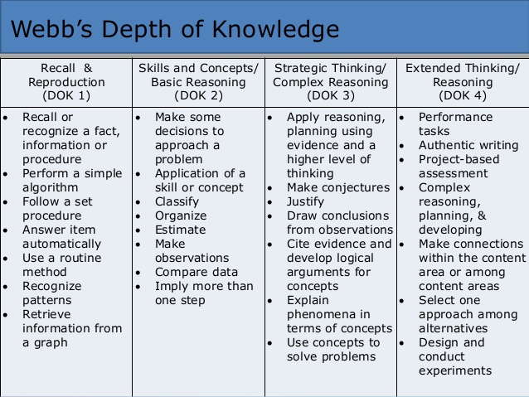
Notes:
Decision-making also falls into the higher categories of Webb’s Depth of Knowledge. We will take a closer look at this later.

Slide 5

What is Decisionomics?
Students are asked to solve a problem.
Students use a variety of resources to research the alternatives and criteria related to the problem.
Students apply criteria to each alternative.
Students rank alternatives from highest to lowest/best to worst.
Students write to explain how they made their decisions.
Notes:
All of the lessons follow this format. Once students have participated in 1-2 lessons, they understand the format and tasks.

Slide 6
Language Arts Standards
R.1.1 Read closely to determine what the text says explicitly and to make logical inferences from it; cite specific textual evidence when writing or speaking to support conclusions drawn from the text.
R.3.7 Integrate and evaluate content presented in diverse media and formats, including visually and quantitatively, as well as in words.
W.3.8 Gather relevant information from multiple print and digital sources, assess the credibility and accuracy of each source, and integrate the information while avoiding plagiarism.
SL.1.1 Prepare for and participate effectively in a range of conversations and collaborations with diverse partners, building on others’ ideas and expressing their own clearly and persuasively.
Notes:
These are the College and Career Standards that appear in the Language Arts Florida Standards K-12. The grade-level standards are on the lesson plans. These standards fall into cognitive complexity level 2 and 4.

Slide 7


Kindergarten – Adopt-A-Road
Problem
Which road should our class adopt?
Alternatives
What are the different roads?
Criteria
What might impact which road to adopt?
Decision
Which road did your class adopt? How did you make that decision?

Slide 8
Social Studies Benchmarks:
SS.K.E.1.4 Identify the difference between basic needs and wants.
SS.K.C.2.1 Demonstrate the characteristics of being a good citizen.
SS.K.G.2.1 Locate and describe places in the school and community.
Financial Literacy Benchmark:
SS.4.FL.1.1 People have many different types of jobs from which to choose. Identify different jobs requiring people to have different skills.

Slide 9
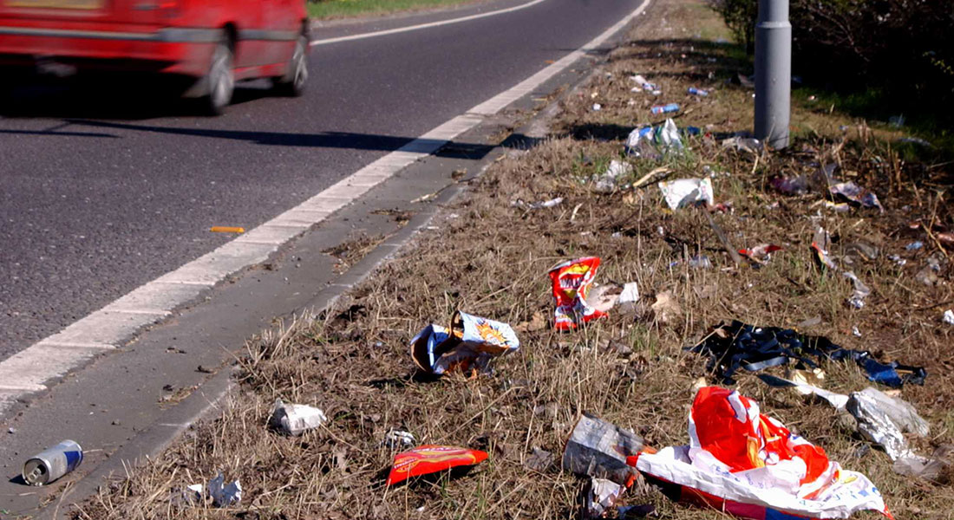
Image Analysis
What do I see? | What do I think? | What do I wonder?

Slide 10
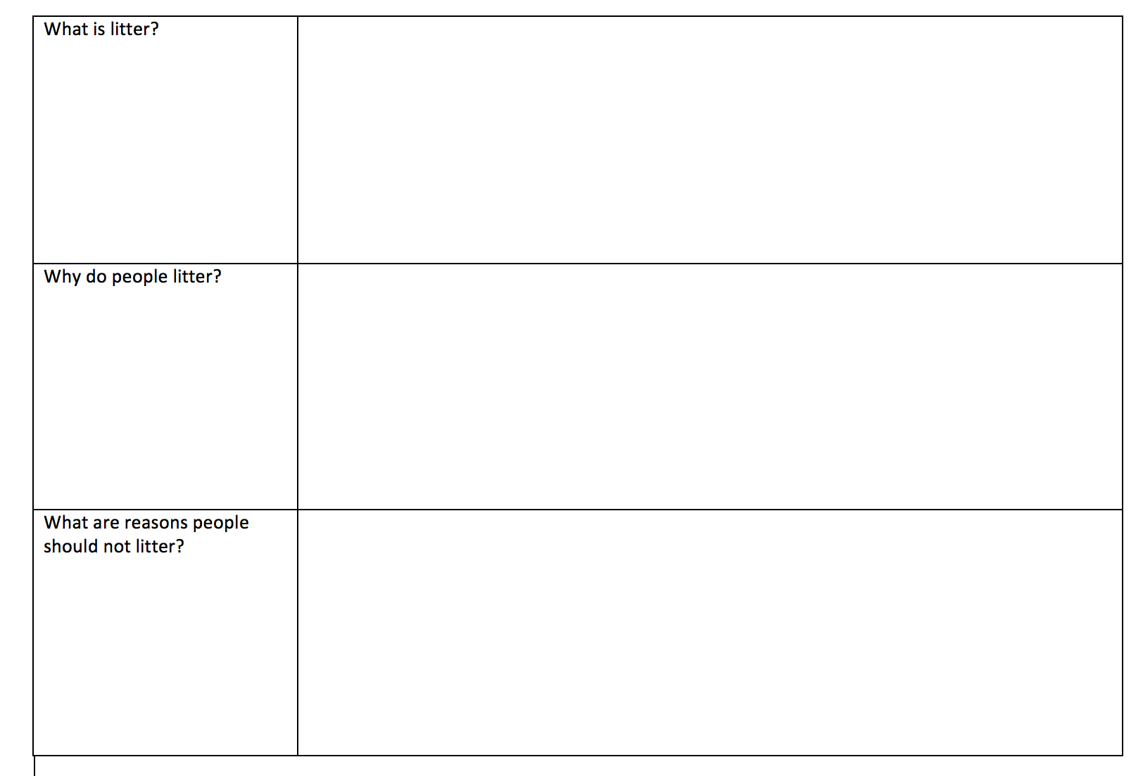
Read the informational text.
What is litter?
What problems are caused by litter?
What are natural resources?
What impact does litter have on our natural resources?
What choices can you make to help solve the problems caused by litter?

Slide 11

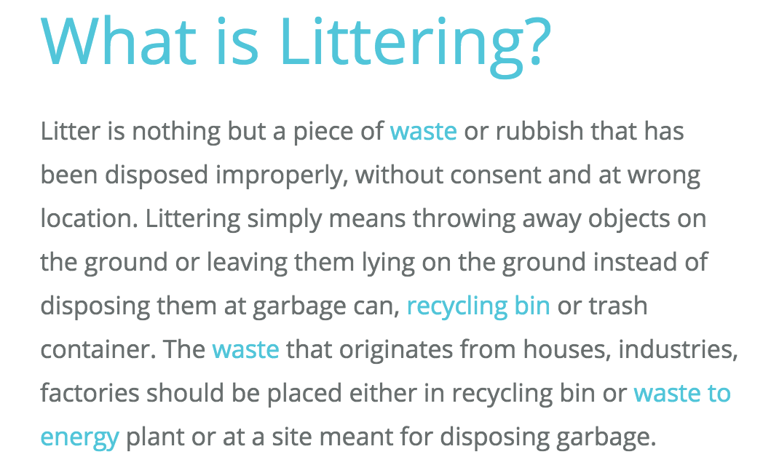
Read the informational text.
https://www.conserve-energy-future.com/various-littering-facts.php

Slide 12
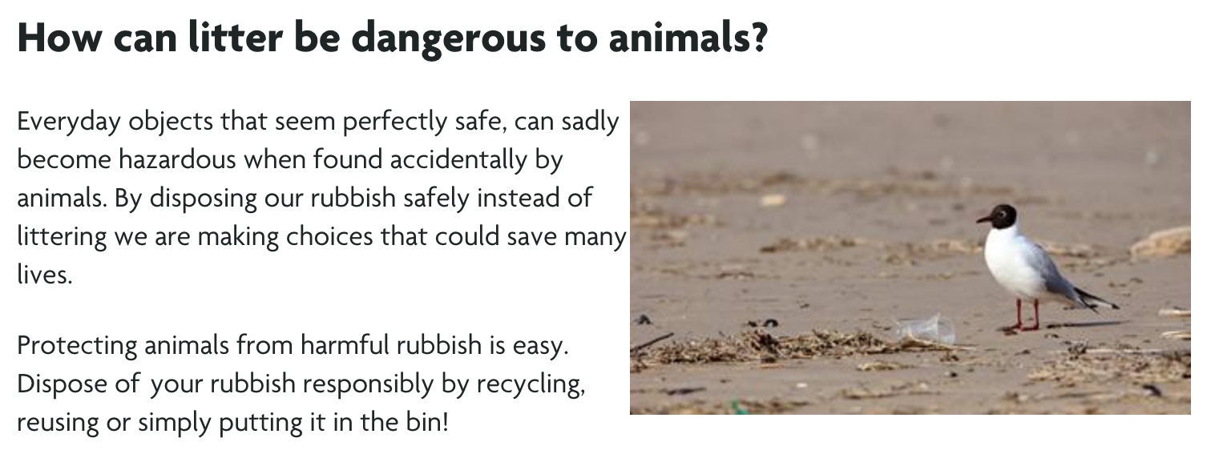
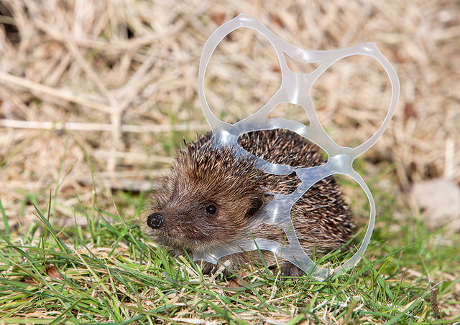
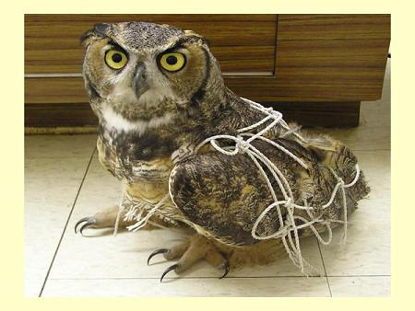
Read the informational text.
  https://www.rspca.org.uk/adviceandwelfare/litter

Slide 13
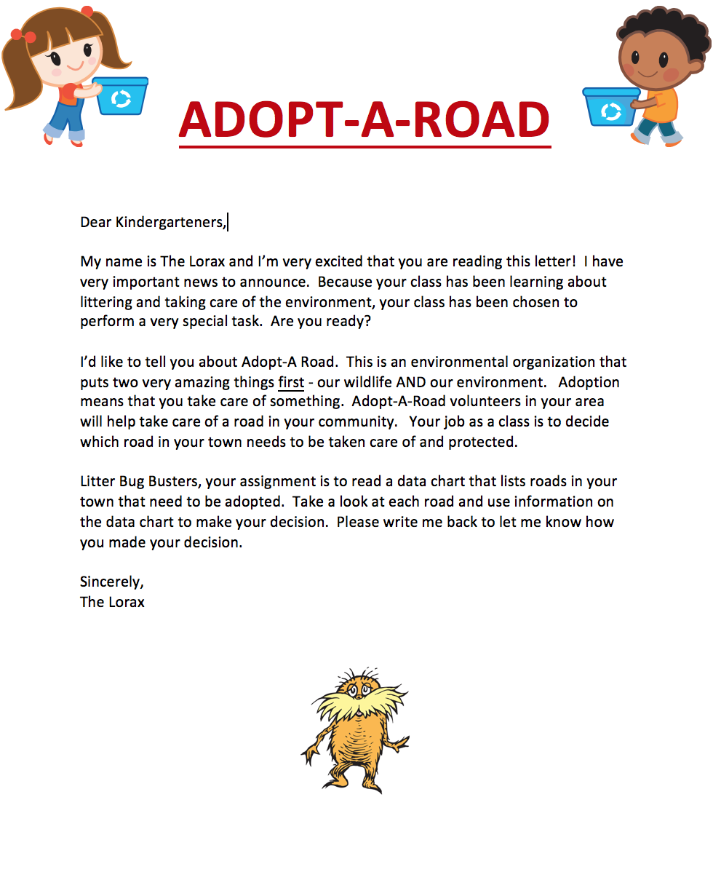
Introduce the problem.
What would The Lorax like for us to do?
Why might this be something good for our community?

Slide 14
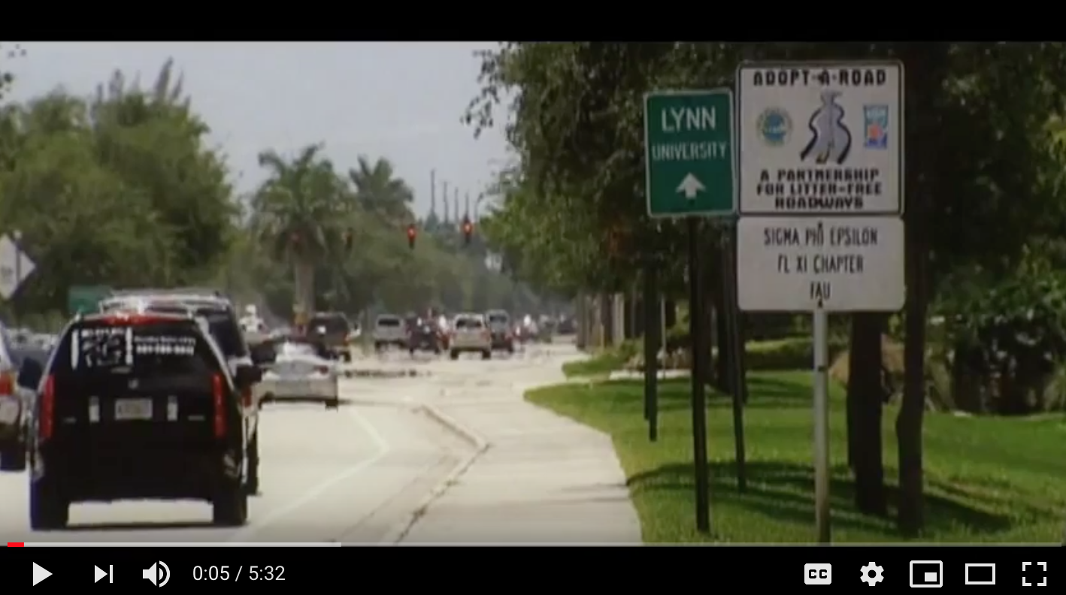
Learn about Adopt-A-Road
https://www.youtube.com/watch?v=htzcWeAsyp0

Slide 15
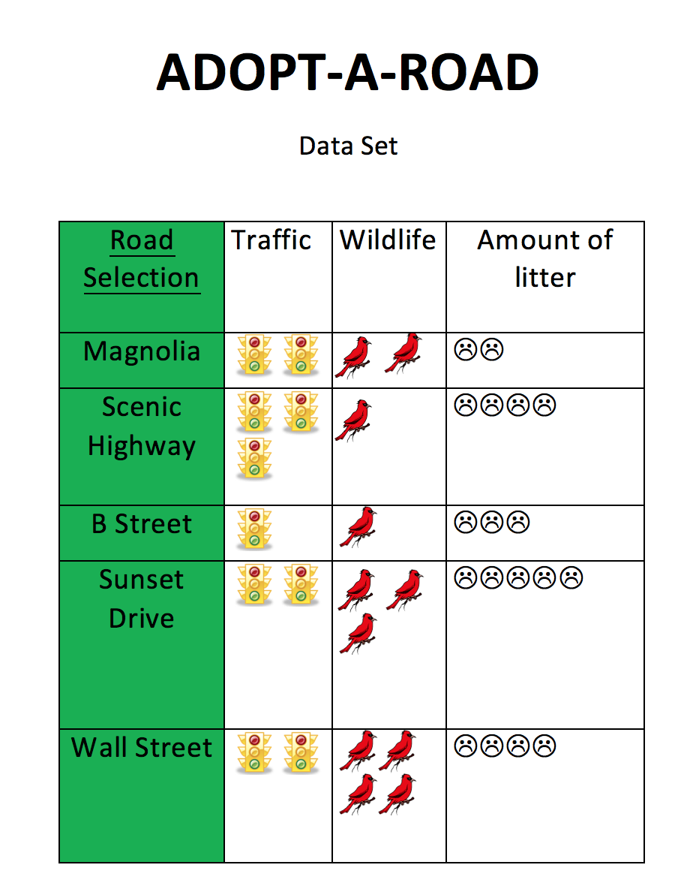
Data set
What criteria should we consider in choosing which street to adopt?

Slide 16
Rank the alternatives.
Guiding/reflective Questions
Which road would be the best road to adopt?
Why do you think that would be the best road?
What category on the data set is the most important to you?
Which road would be your next choice? And after that?
Do you agree with your group's ideas? Why or why not?

Slide 17
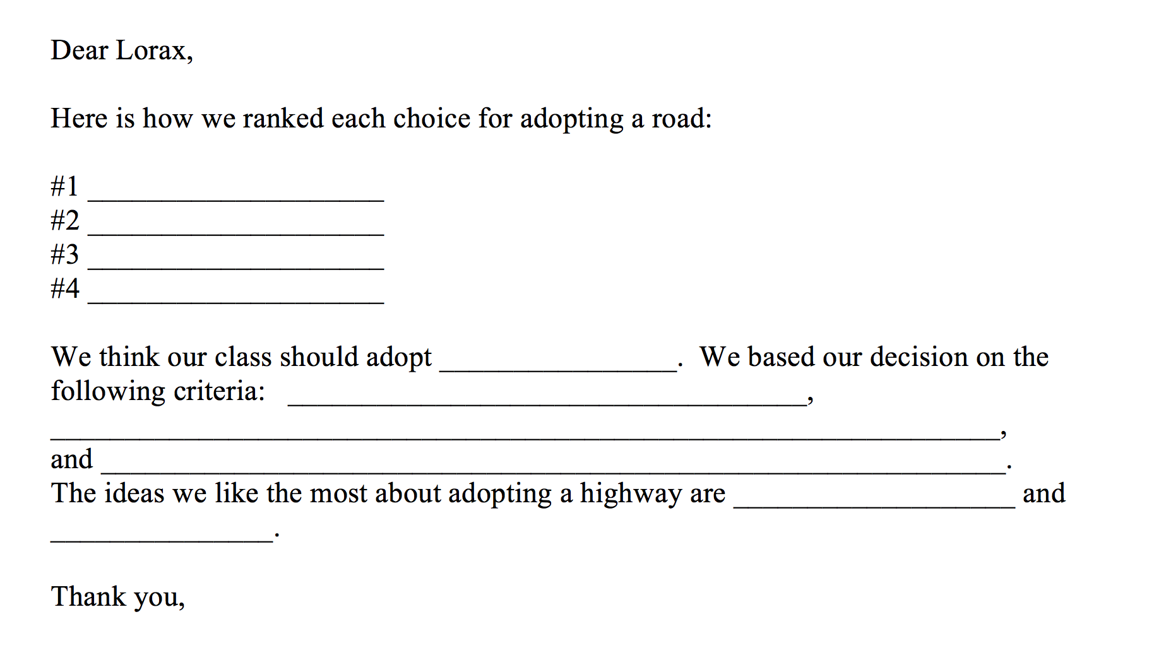
Write back to
The Lorax

Slide 18
Extend the learning.
Have student groups present their decisions to the class and discuss how they decided which road to adopt. Create a poster that highlights the importance of adopting this particular road.
Research which roads in the community are a part of the Adopt-A-Highway program. Involve parents to take pictures of these signs to share in class.
Put it to work! Plan a clean up time for a safe, near-by area that allows students to contribute to the community as responsible citizens.
Substitute symbols for criteria (e.g. cars instead of traffic lights; trash cans instead of frowny faces)

Slide 19
Questions?
Thank you so much for attending!
Send us your ideas for future Decisionomics lessons linked to Reading Wonders ☺
Sherry Moser smoser@usf.edu

