Slide 1
Entrepreneurship for the Environment: In the Rethink Tank
#CokeGivesBack

Slide 2
Maya Penn – Kid Entrepreneur for the Environment
Read the excerpt from the introduction.
What did you learn about Maya’s background?
How is she different from most 13 year old girls or boys?
Why do you think she is so nervous?
How is she an entrepreneur?
What did she do for the environment?

Slide 3
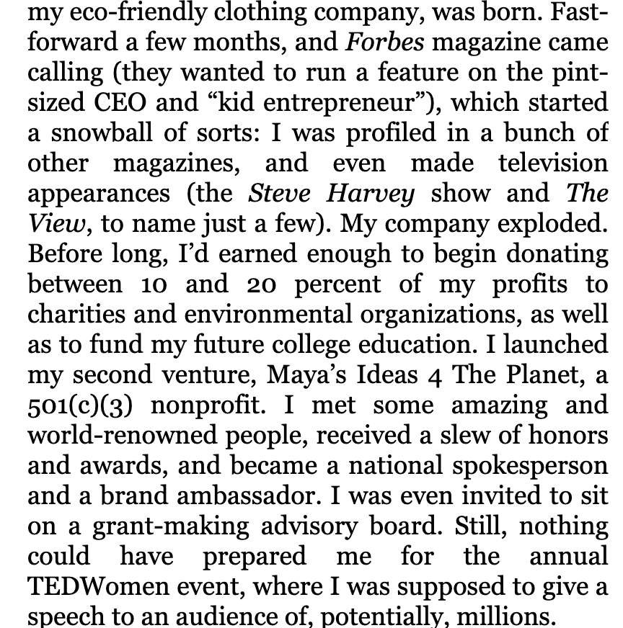
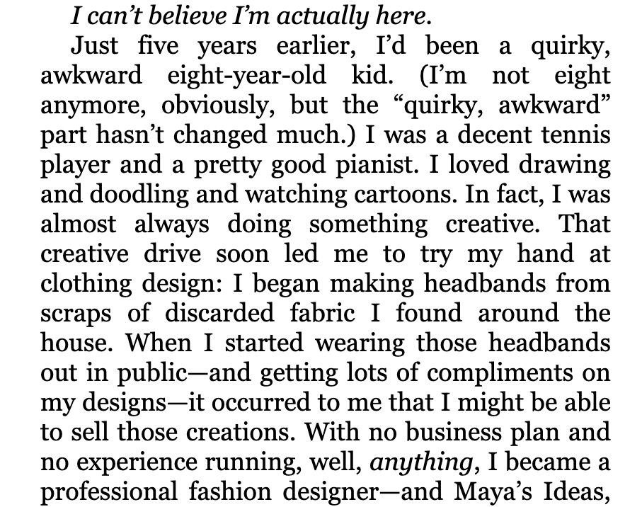

Slide 4
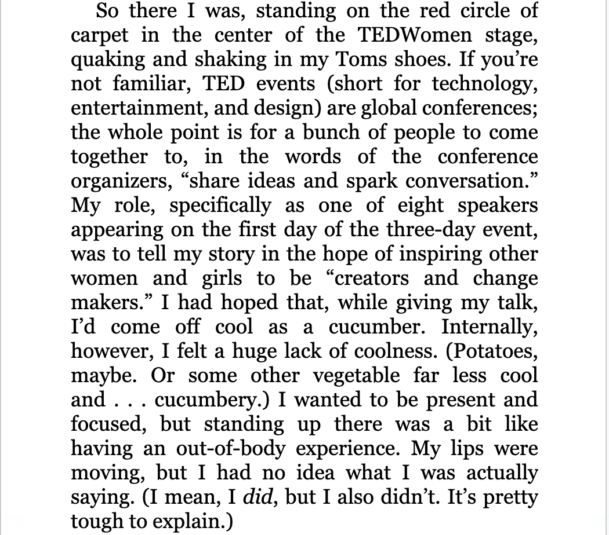
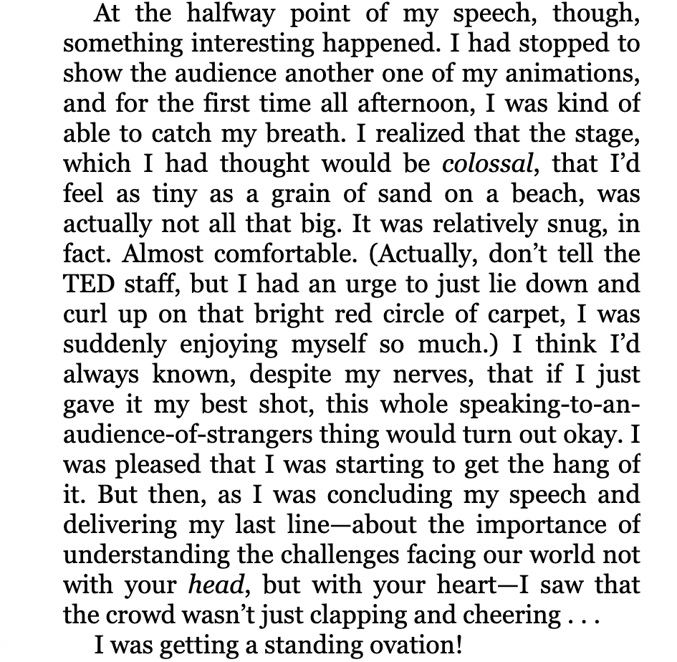

Slide 5
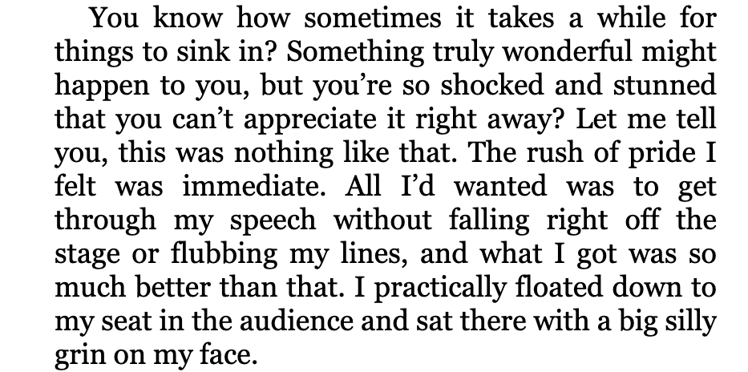
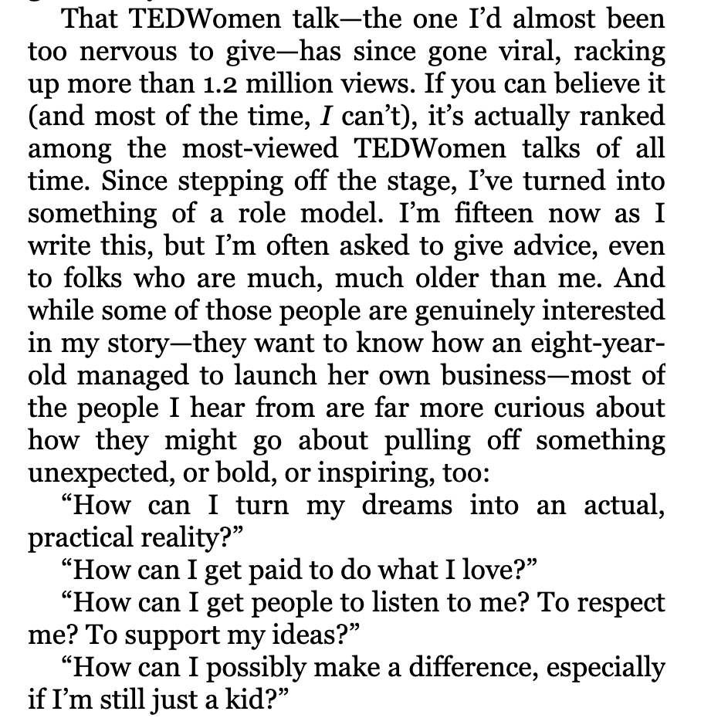
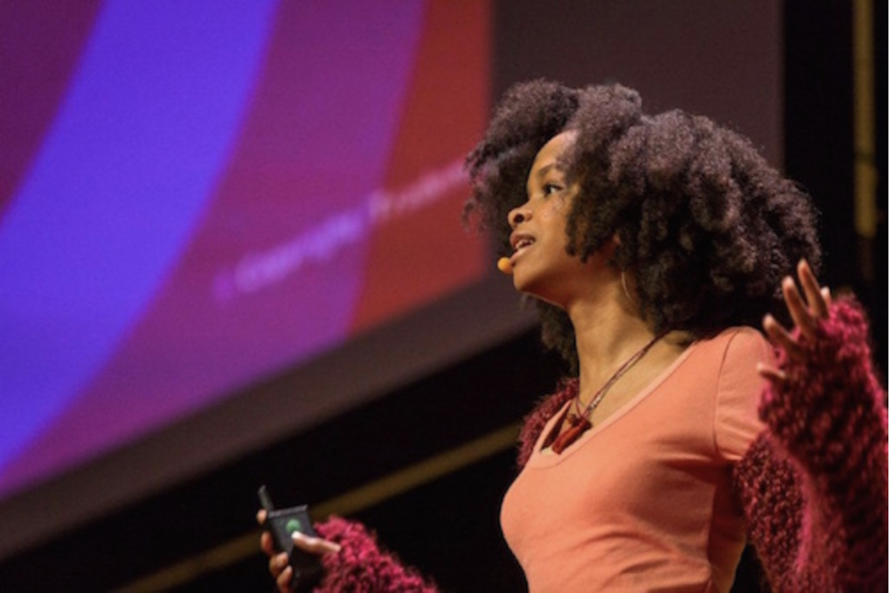

Slide 6
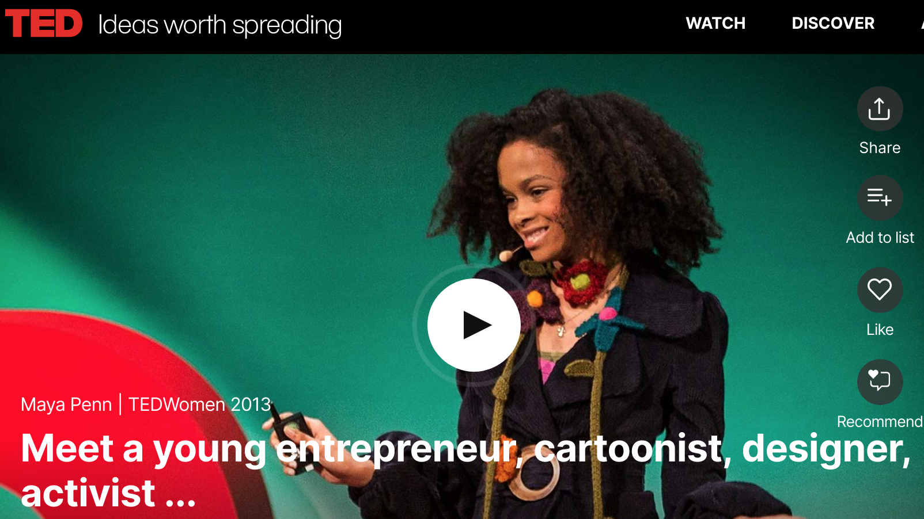
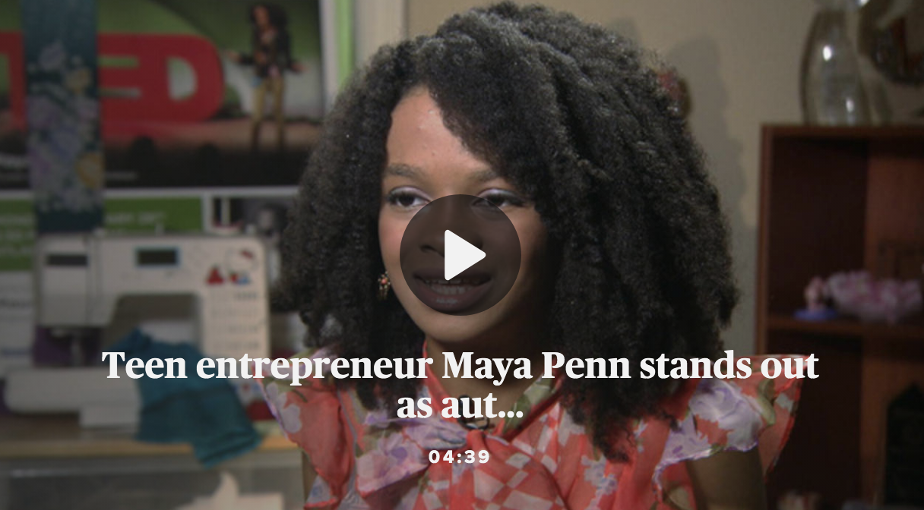
Why Was Maya So Nervous?
https://www.cbsnews.com/news/maya-penn-teen-entrepreneur-ted-speaker-environmental-activist-author-of-you-got-this/
https://www.ted.com/talks/maya_penn_meet_a_young_entrepreneur_cartoonist_designer_activist

Slide 7
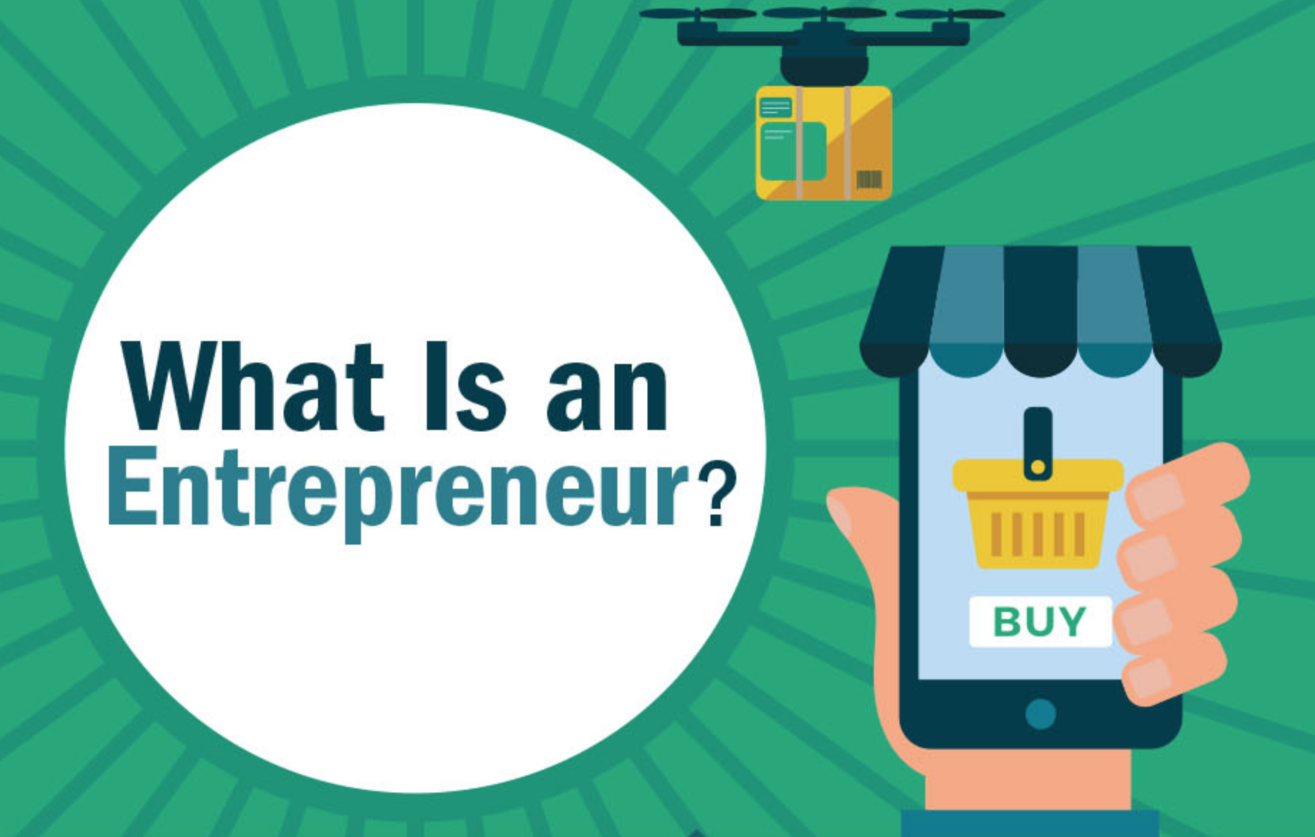
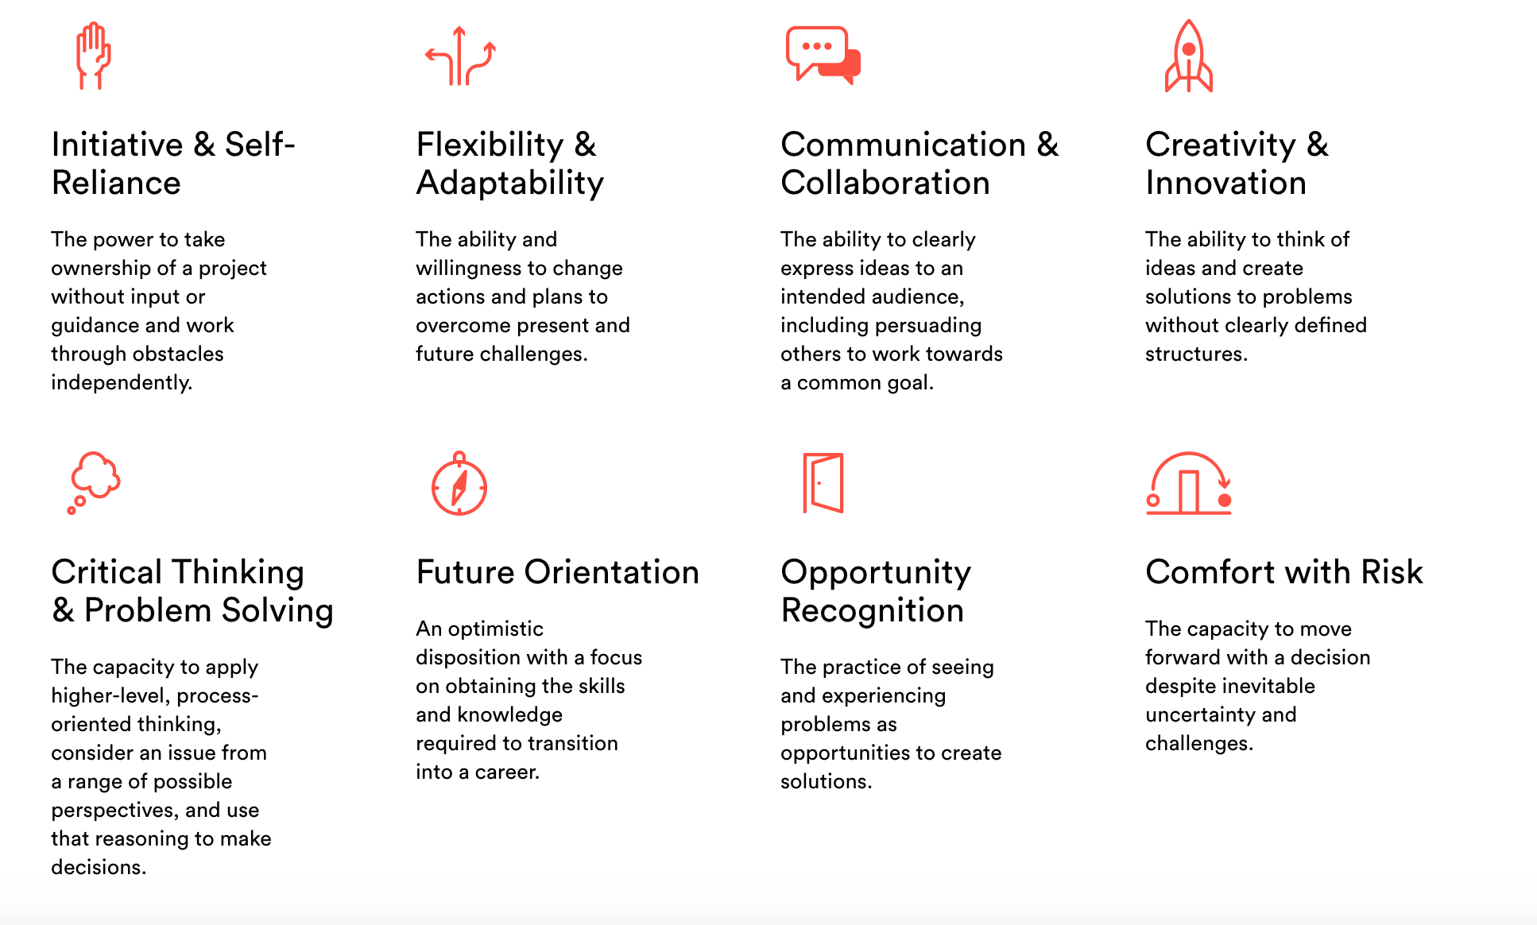
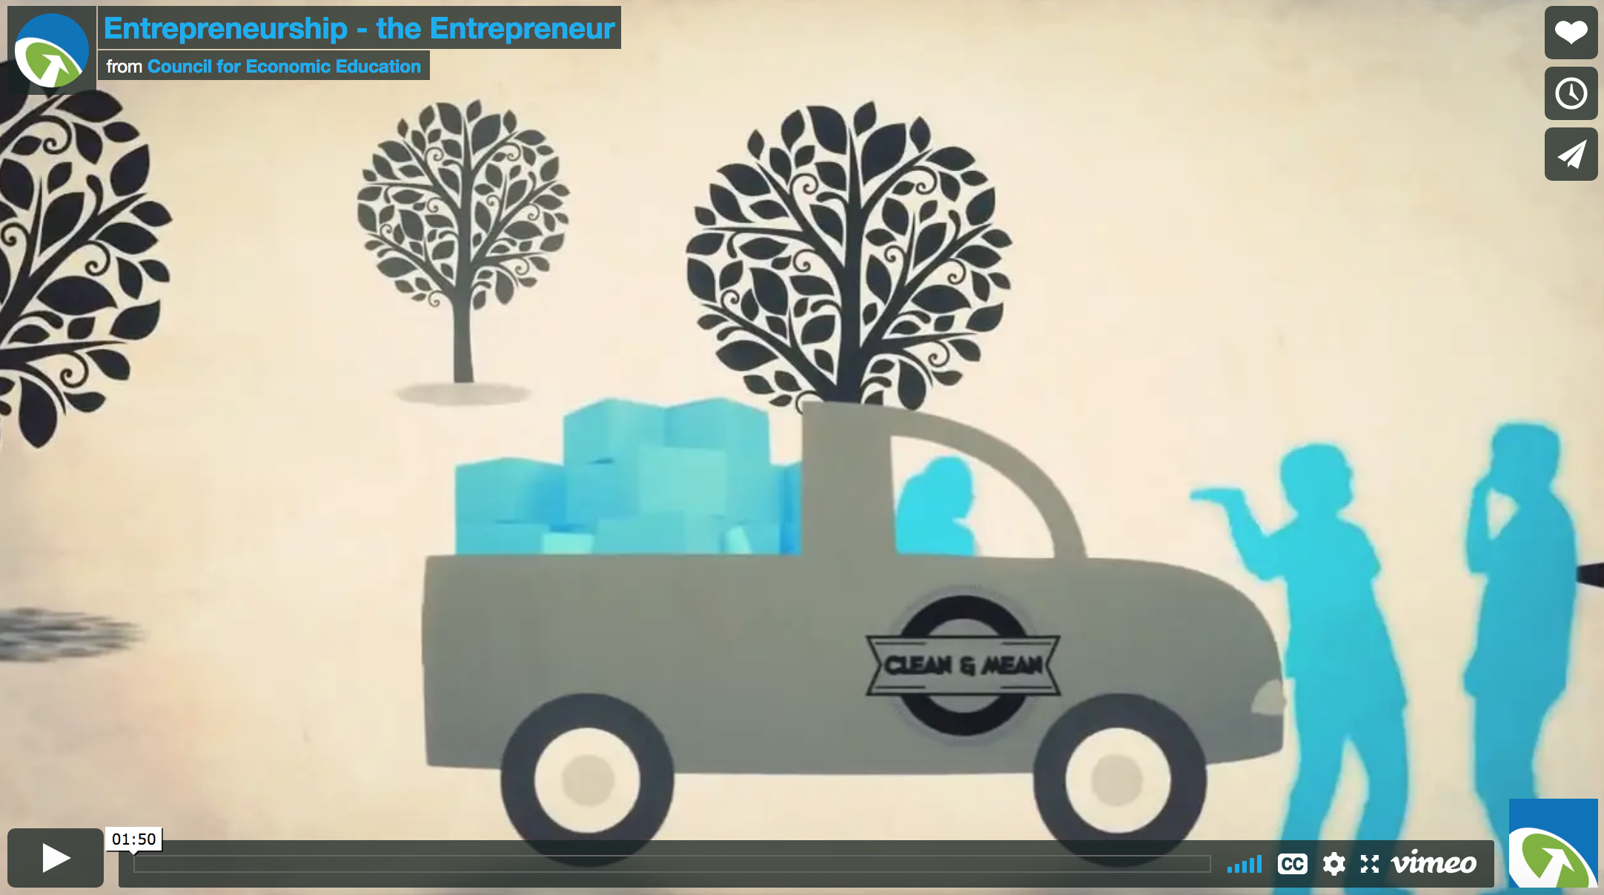
What is an Entrepreneur?
Infographic
Website: What is an entrepreneurial mindset?
How does Maya have an entrepreneurial mindset?
Video
Notes:
Discussion:
What are entrepreneurs?
What does is mean that entrepreneurs take a risk?
Where do entrepreneurs get their ideas?
Review the advantages and disadvantages of different types of businesses? What is your familiarity with these different types of business?
Look at the section on finances. How does think link to risk-taking?
Why are small businesses important to the country’s economy?
Think about Maya Penn. Where do you see connections between her experiences and the text?

Slide 8
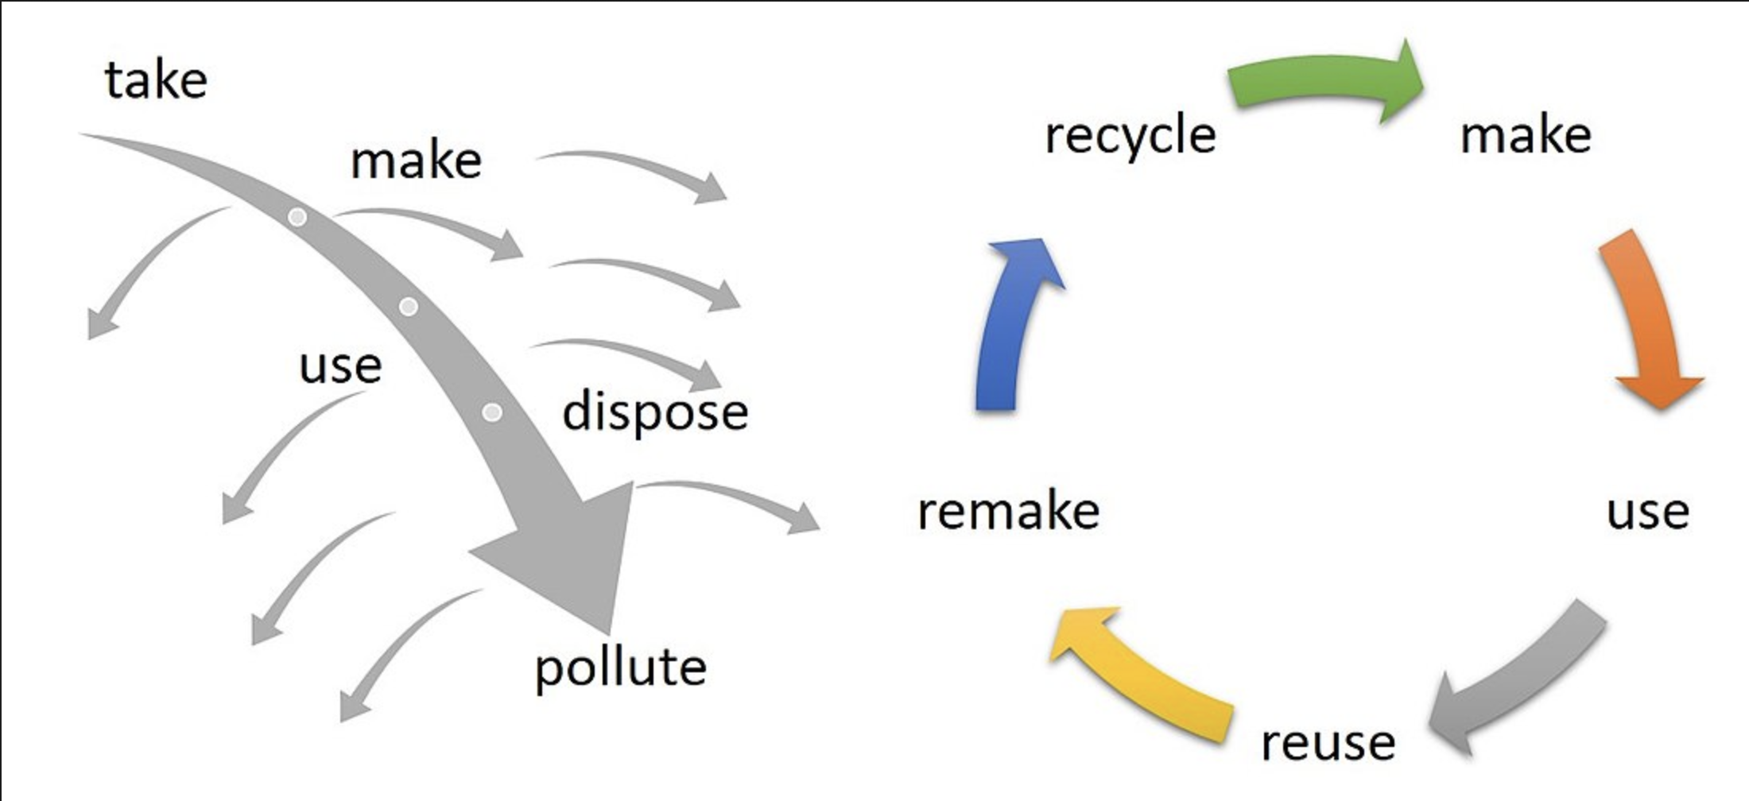
Entrepreneurship for the Environment: How did Maya’s idea help reduce waste?
To a Circular Economy:
Rethink resources so we have less waste . . .
From a Linear Economy:
Take Resources-Make Stuff-Dispose of Garbage

Slide 9
Entrepreneurship with Design Thinking

Slide 10
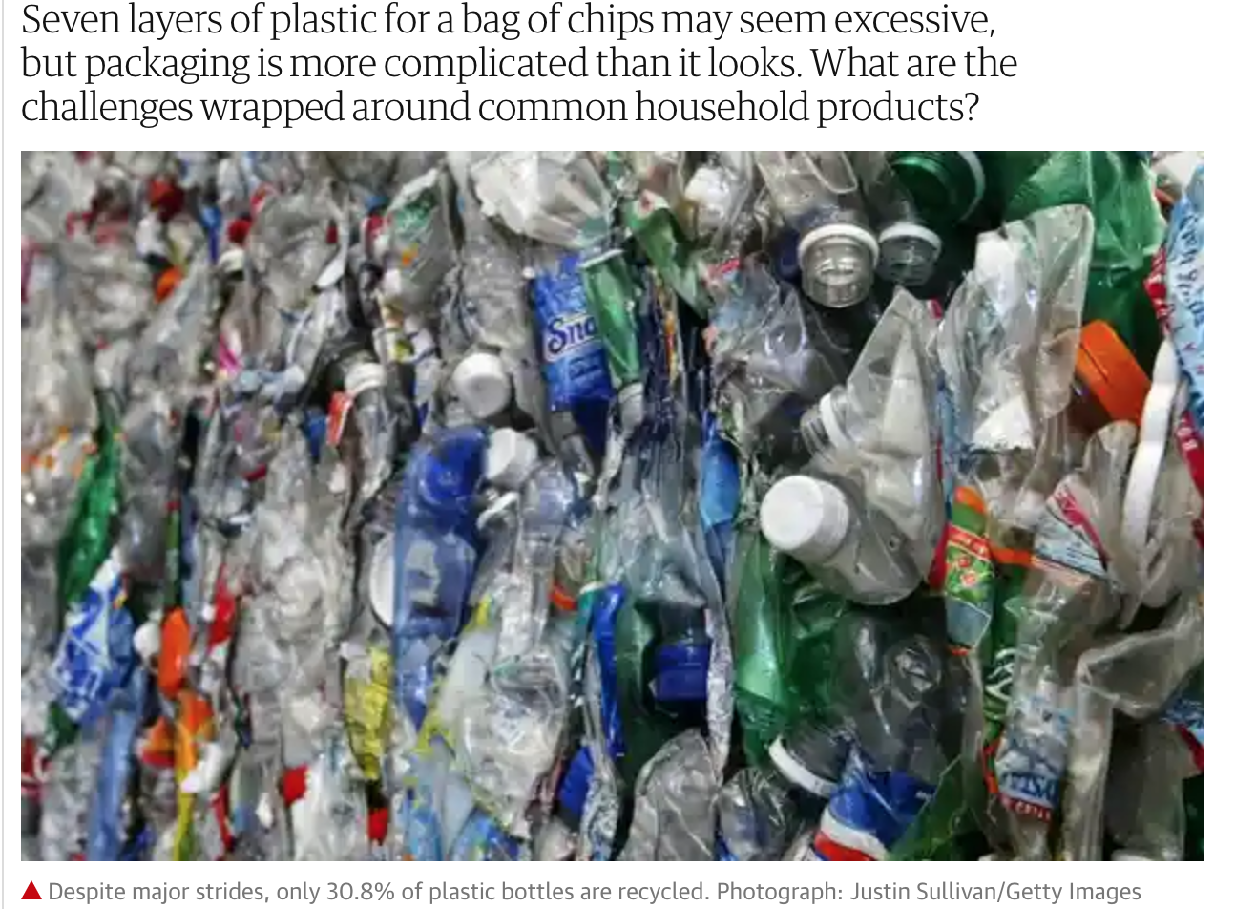
Let’s solve a problem with Design Thinking
Read the passages on the next few pages (that come from this article)
Choose one of the packages that you would like to redesign
Follow the design process to rethink the packaging
https://www.theguardian.com/sustainable-business/2014/jul/18/good-product-bad-package-plastic-recycle-mistakes

Slide 11
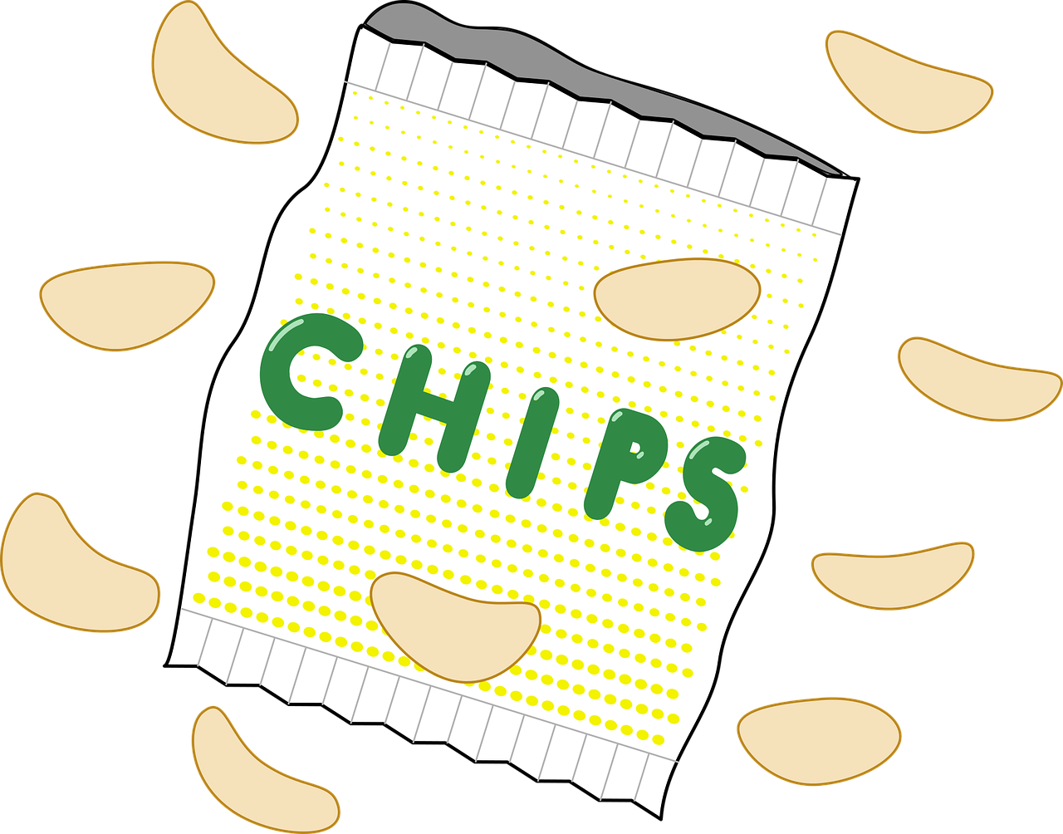
Problem 1: Snack Chip Bags

Slide 12
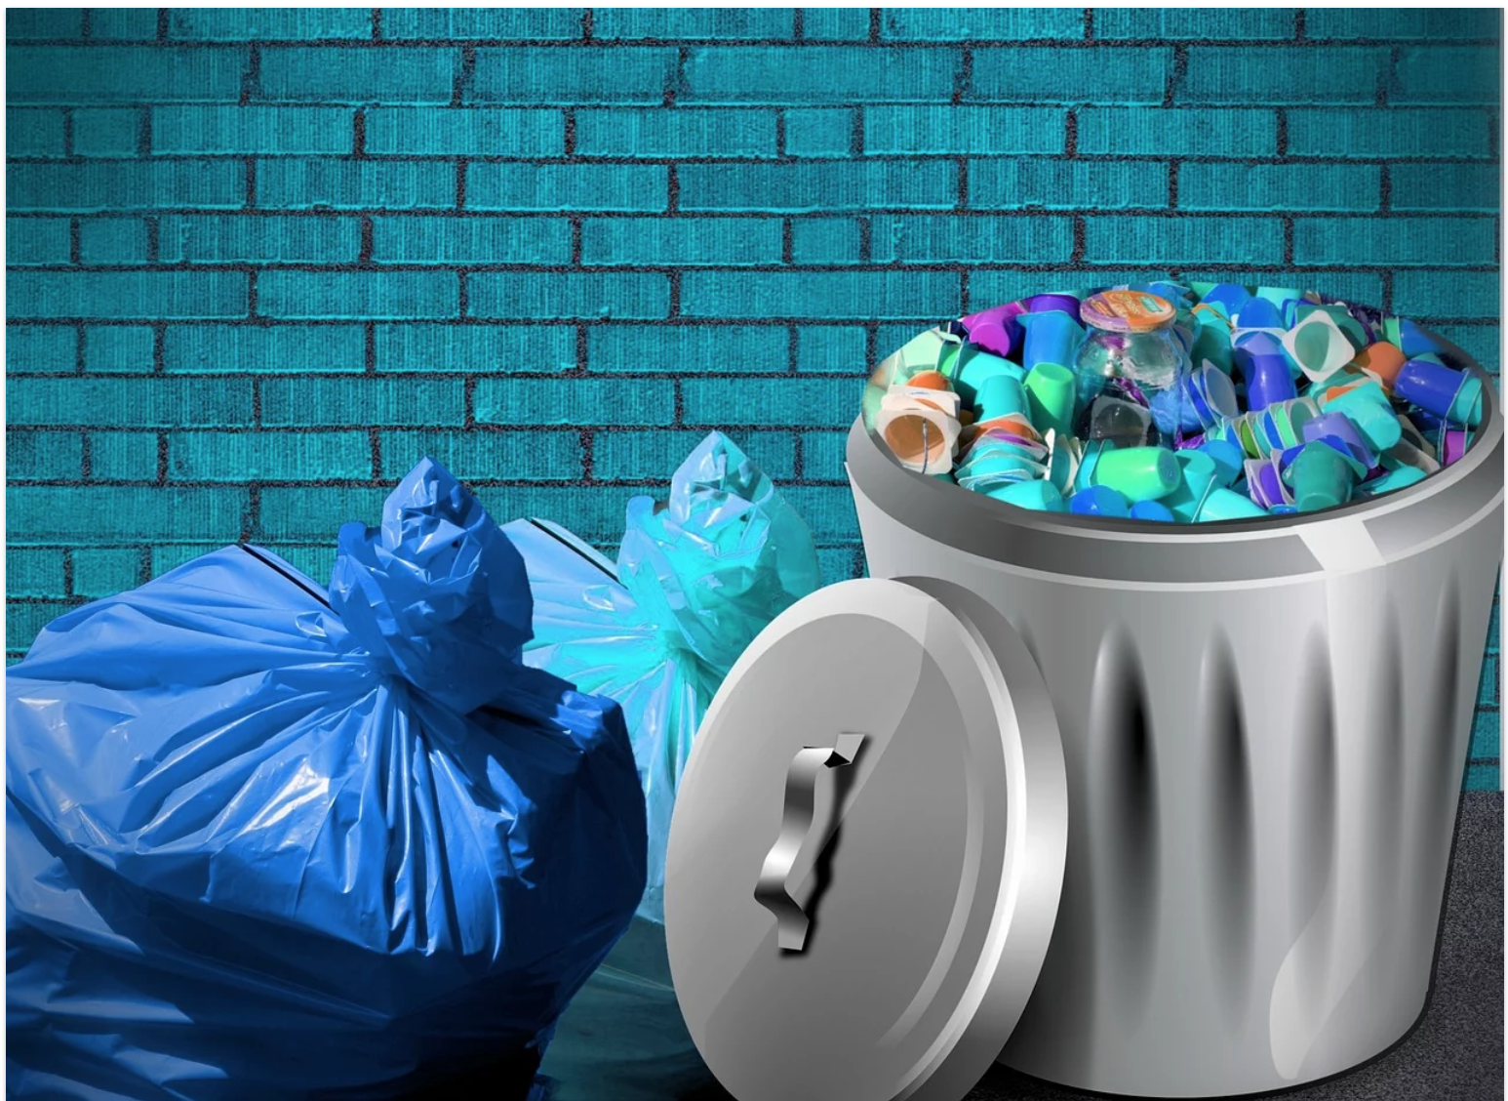
Problem 2: Single Serving Foods

Slide 13
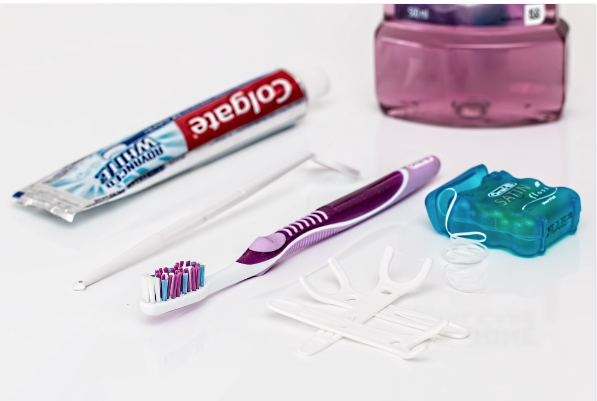
Problem 3: Toothbrush, Toothpaste Tube, and Plastic Single Use Flossers

Slide 14
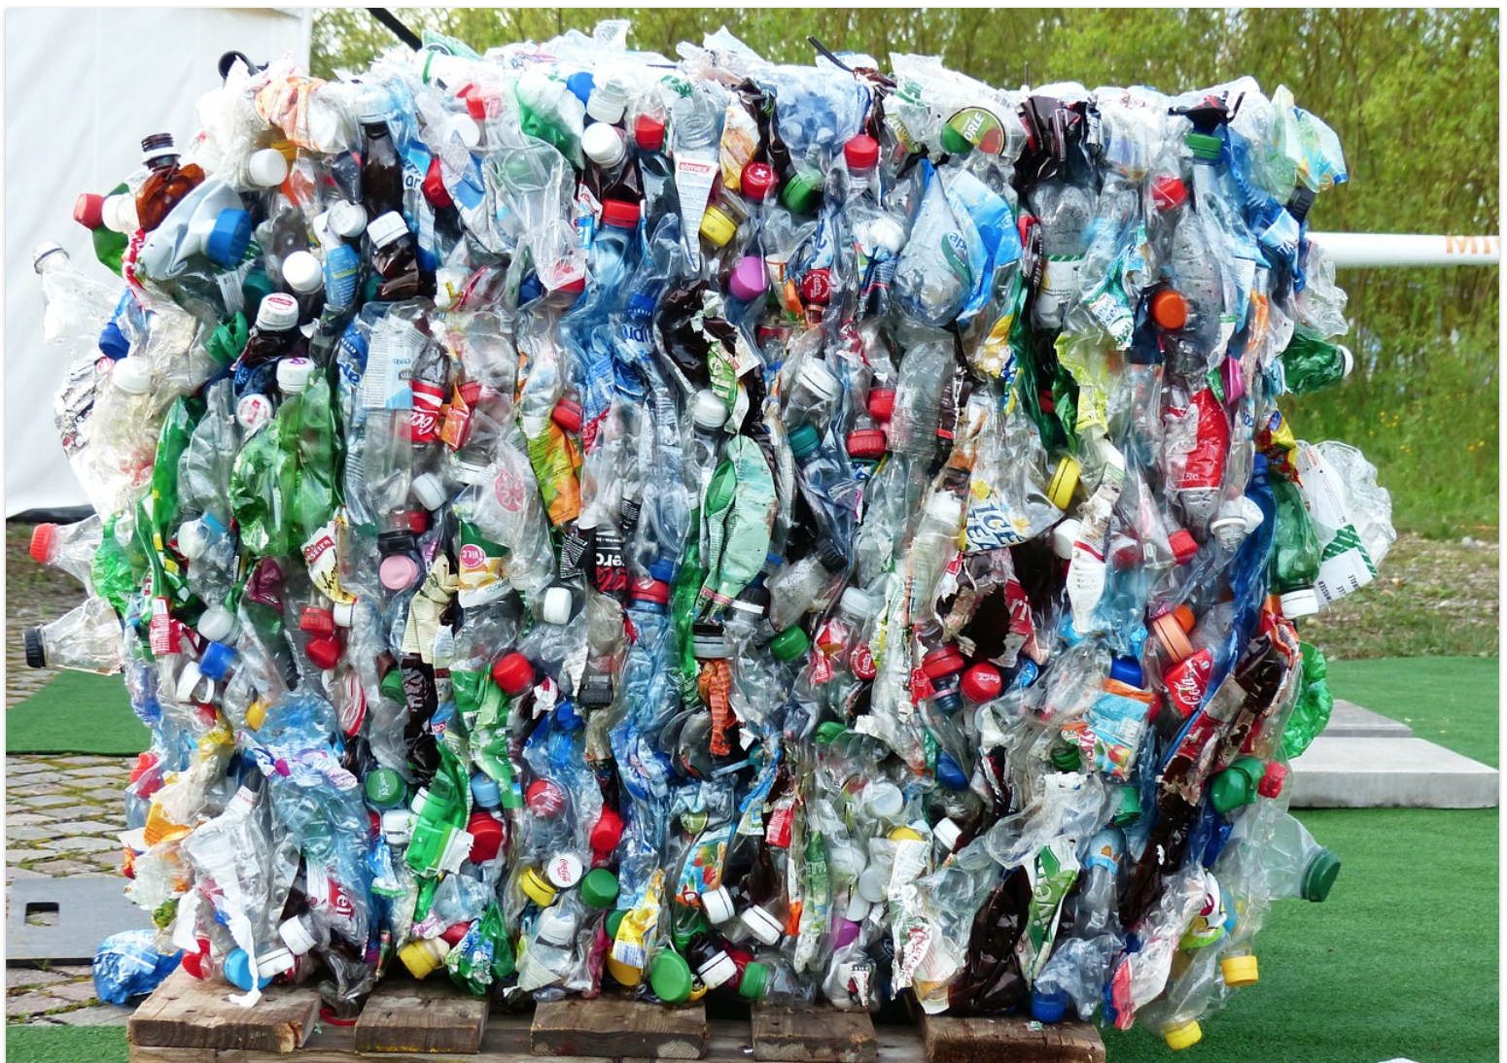
Problem 4: Single Use Plastic Bottles

Slide 15
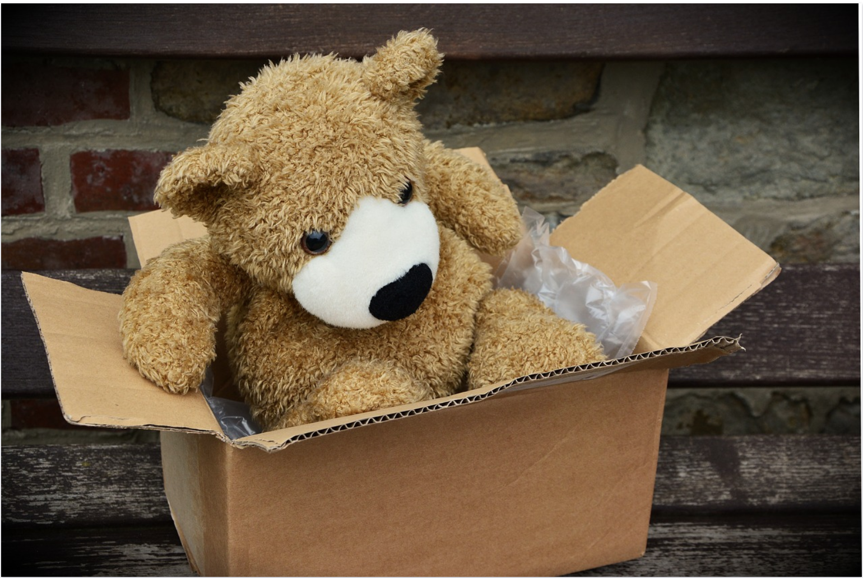
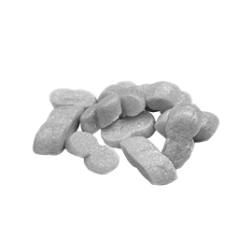
Problem 5: Excess Packaging in Delivered Goods

Slide 16
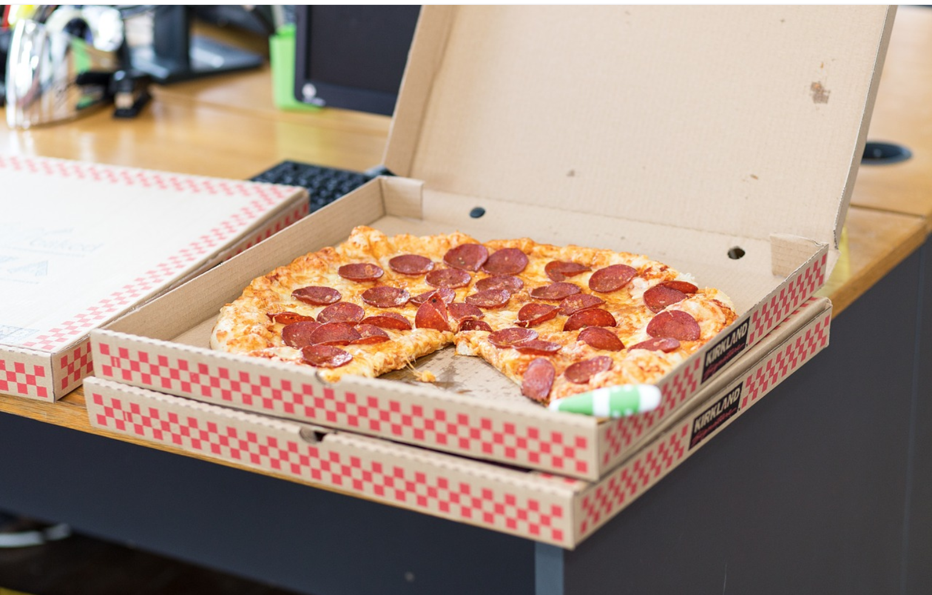
Problem 6: Pizza Boxes and Other Take Out Food Containers

Slide 17
Entrepreneurship with Design Thinking

Slide 18
Rethink Tank Step 1: What is?
What do you notice?
How is your product used?
What are some things your packaging needs to do?
What do you like about the product?
What could be better?

Slide 19
Rethink Tank: What if?
Reduce: What can you reduce?
Reuse: How can we reuse?
Recycle: What can we recycle?
Repurpose: How else can we use this?
Redesign: What can we change?

Slide 20
What Wows? Make a Pitch (Mini TED Talk) that Wows!
Show them what you do with question or personal story. Did you ever (problem)___________________________________________________
Who are you? We are (name of company)_________________________.
What are you creating? We are here to tell you about________________
Who do you help? What is the solution? This (name of good or service) __________________helps (customer)_______________________ by (solution)___________________________________________________.
What is your” secret sauce” or how is your product better? Our product is better because ______________________________________________.
Create a persuasive slogan. This is a short phrase that tells what you do. ___________________________________________________________.

Slide 21
What Works? Students evaluate pitches with SWOT

Slide 22
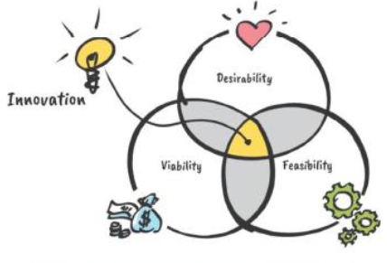
What Works?
” Design thinking is a human-centered approach to innovation that draws from the designer’s toolkit to integrate the needs of people, the possibilities of technology, and the requirements for business success”
–Tim Brown, president and CEO of IDEO
Is your idea desirable? Does it fit customer needs?
Is your idea feasible? Can it be accomplished with available technology?
Is your idea viable? Is it a good economic choice?

Slide 23
And More Websites on Entrepreneurship
https://blog.cheapism.com/futuristic-inventions/
Notes:
What ideas do your have about future goods or services? Can you think of something that you wish existed that would make your life easier?

Slide 24
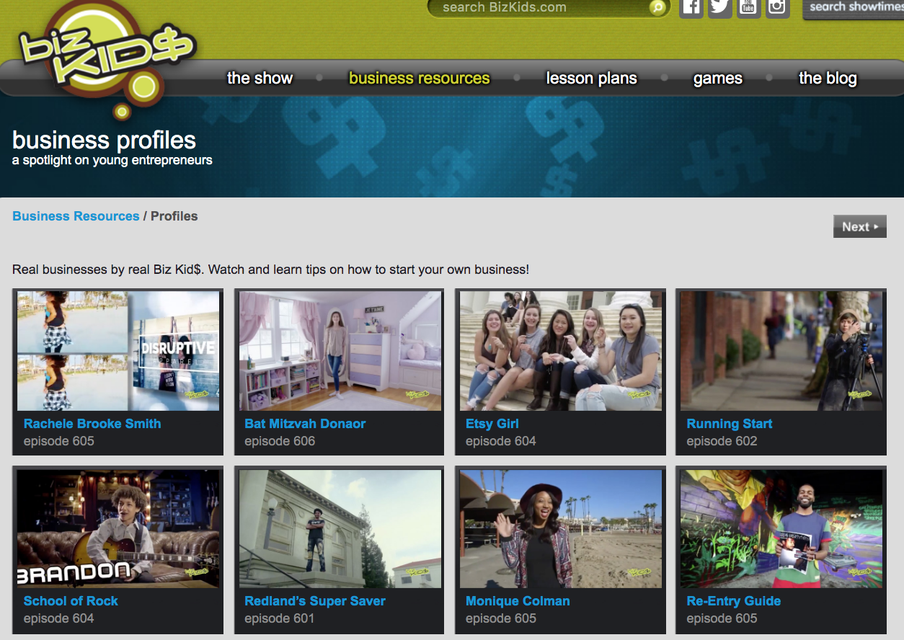
http://bizkids.com/groups/profiles
Notes:
Etsy Girl
Running Start
Re-Entry Guide

