Slide 1
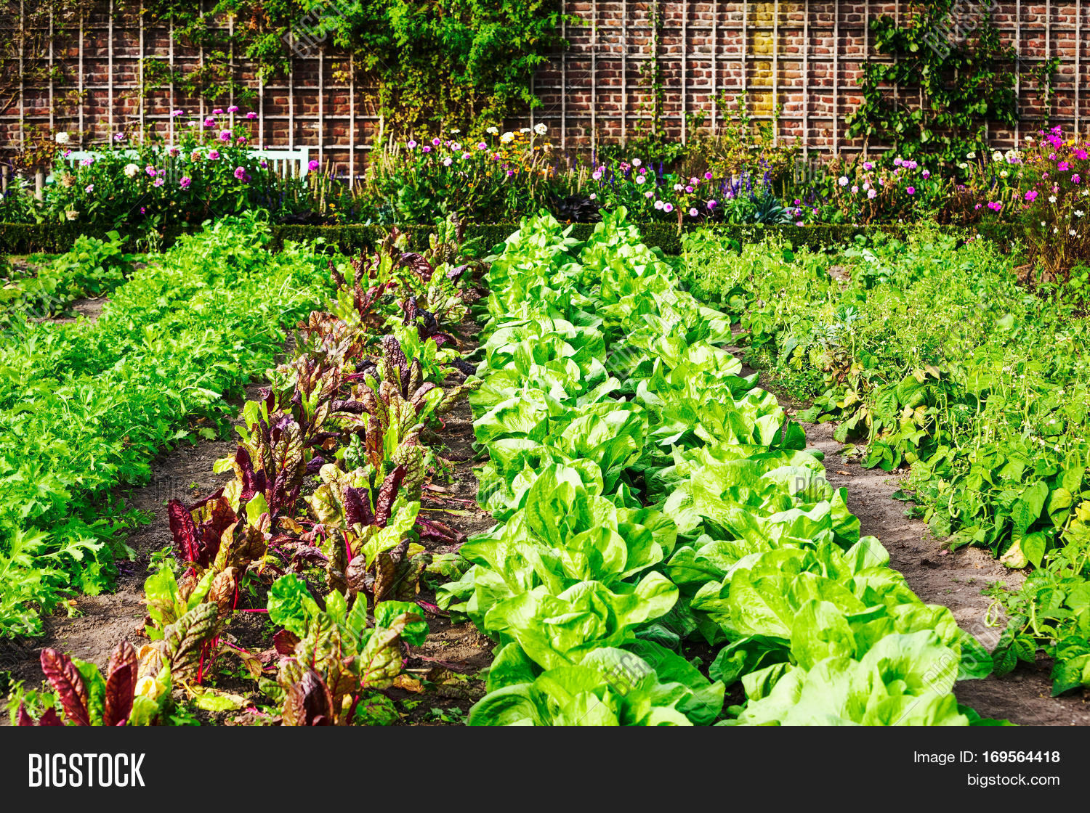
SustainabilitySuperheroes.org
In the Garden
@usfstavros
#CokeGivesBack
Deborah Kozdras, Angel Danger, and Sherry Moser

Slide 2
Image Analysis & Questioning
What do you observe? (evidence)
What do you think? (inferences)
What do you wonder?

Slide 3
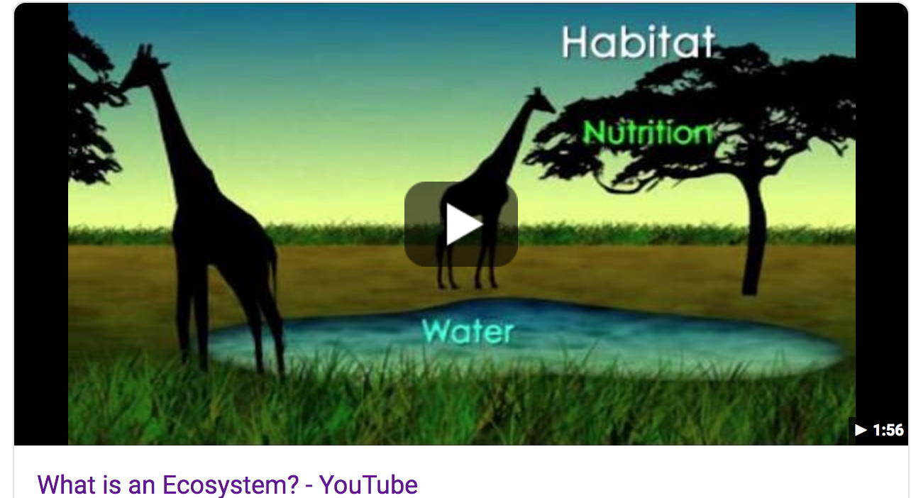
Watch the video: What is an ecosystem:.
What is an ecosystem?
What is an environment?
What are examples of living and nonliving things in an ecosystem?
What are different types of ecosystems?
What are producers?
What are consumers?
How does energy move through an ecosystem?
https://www.youtube.com/watch?v=JPHqUxxyLsY

Slide 4
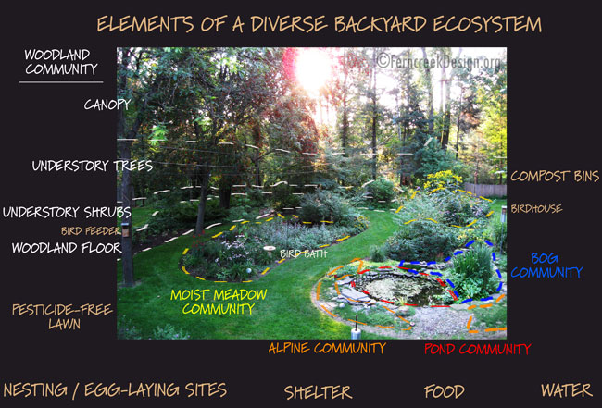

Slide 5
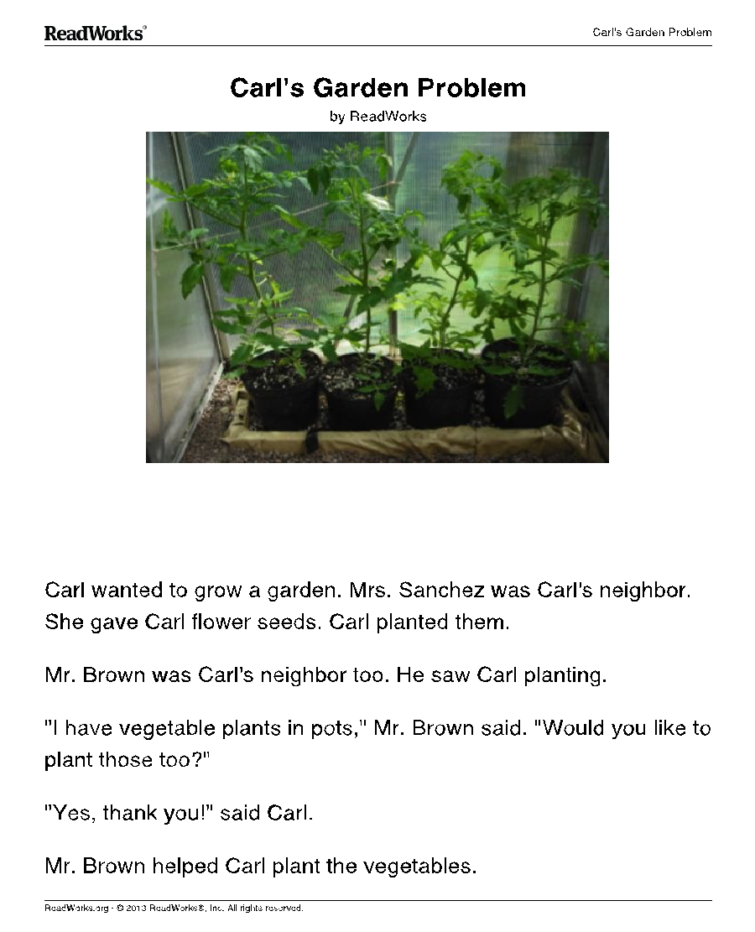
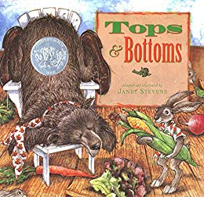
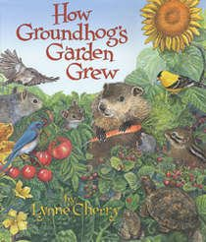
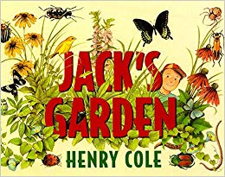
Narrative Texts

Slide 6
What resources does Bear have?
What resources does Hare have?
We can call Hare an entrepreneur? What does that mean?
Does Hare’s original deal with Bear sound like a good deal for both parties? Why or why not?
What resources do Hare and his family need to grow the garden?
How does Hare continue to outwit Bear?
What are the different parts of Hare’s garden ecosystem?
What lessons did both Bear and Hare learn?

Slide 7
What are the tools Jack needed to plant his garden?
What are different parts of the ecosystem of Jack’s garden?
What do seeds need in order to grow a plant, or germinate?
Which way to leaves grow? Why do they do this?
Why types of plants grew in Jack’s garden? How could we categorize these plants?
How does this garden ecosystem work?

Slide 8
Why did Groundhog to into his neighbor’s garden? Was this a good decision? Why or why not?
What does Squirrel offer to do?
What is the first thing they need to plant the garden?
How do they get the seeds?
Why did Squirrel save a few potatoes?
What does it mean that the potatoes were sprouting? How did Squirrel prepare the potatoes for planting?
What steps did Squirrel and Groundhog take in planting the garden?
Describe the ecosystem of the garden. What roles do the living and nonliving parts of the ecosystem play in the growth of the garden?
What resources did Squirrel and Groundhog use in planting and harvesting the garden?
What lessons did Groundhog learn?

Slide 9
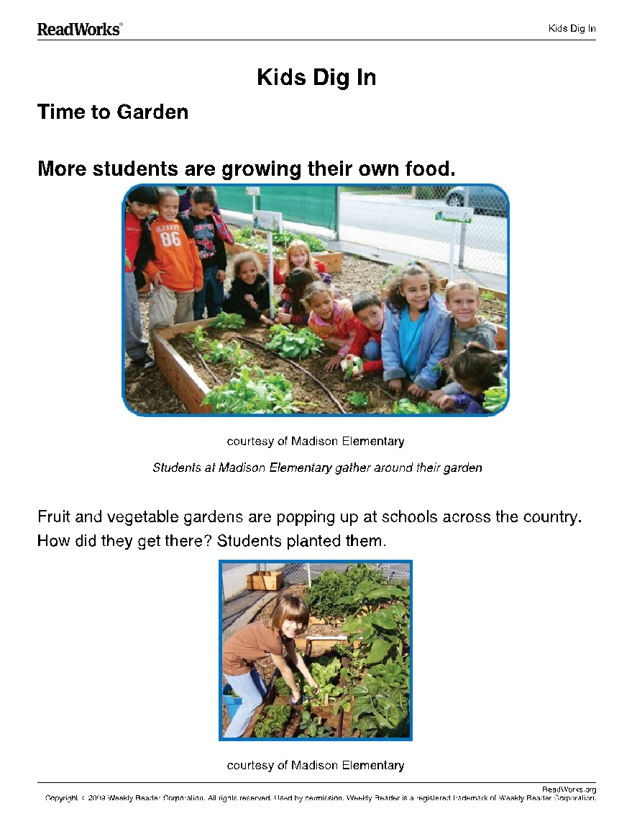
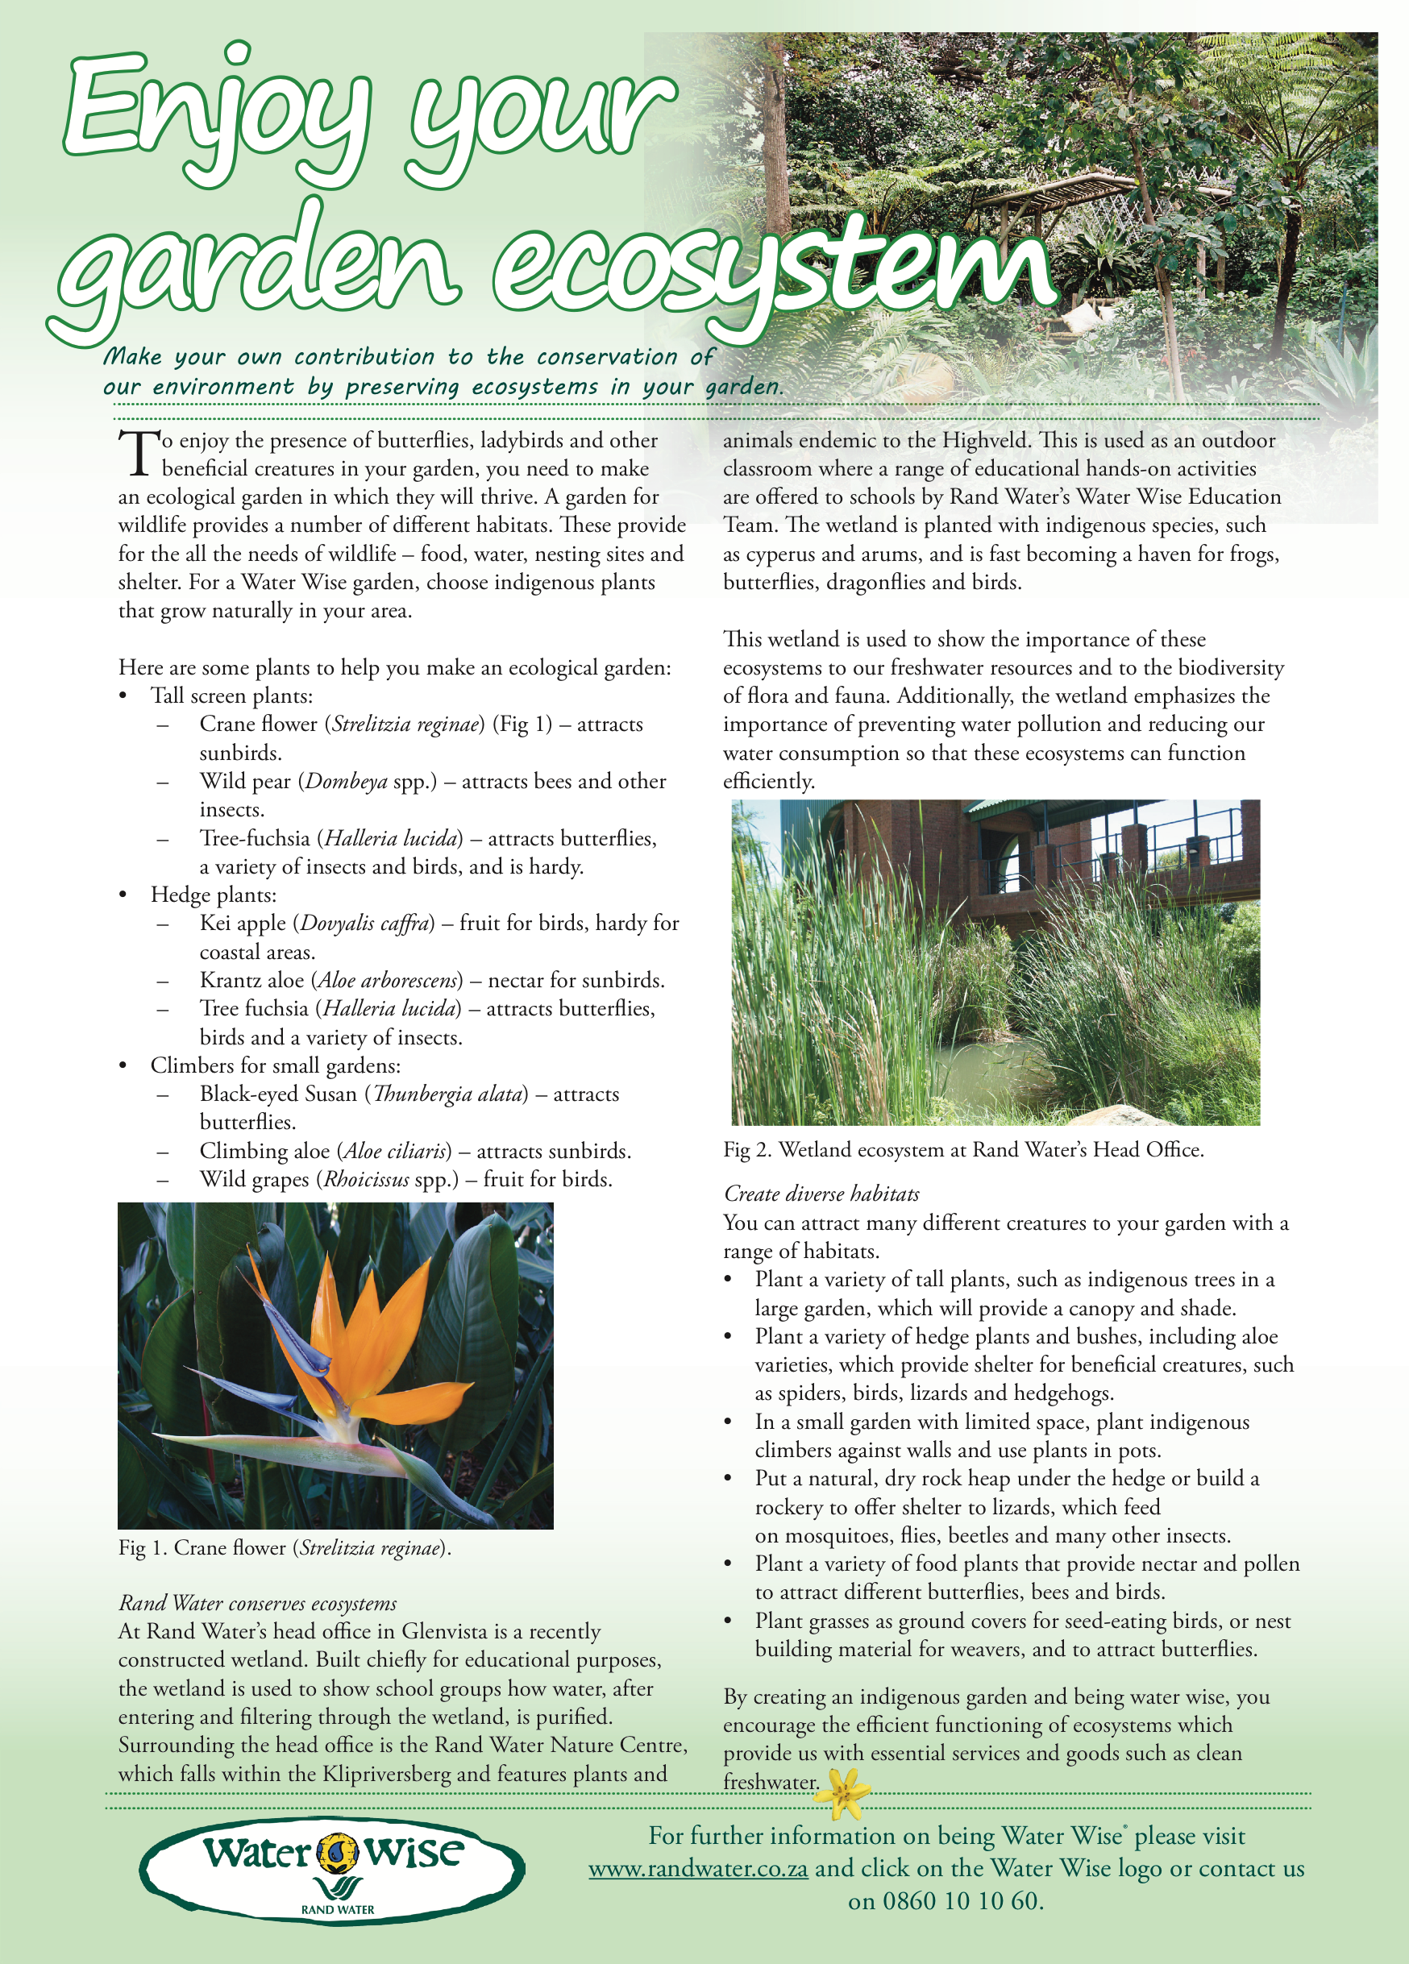
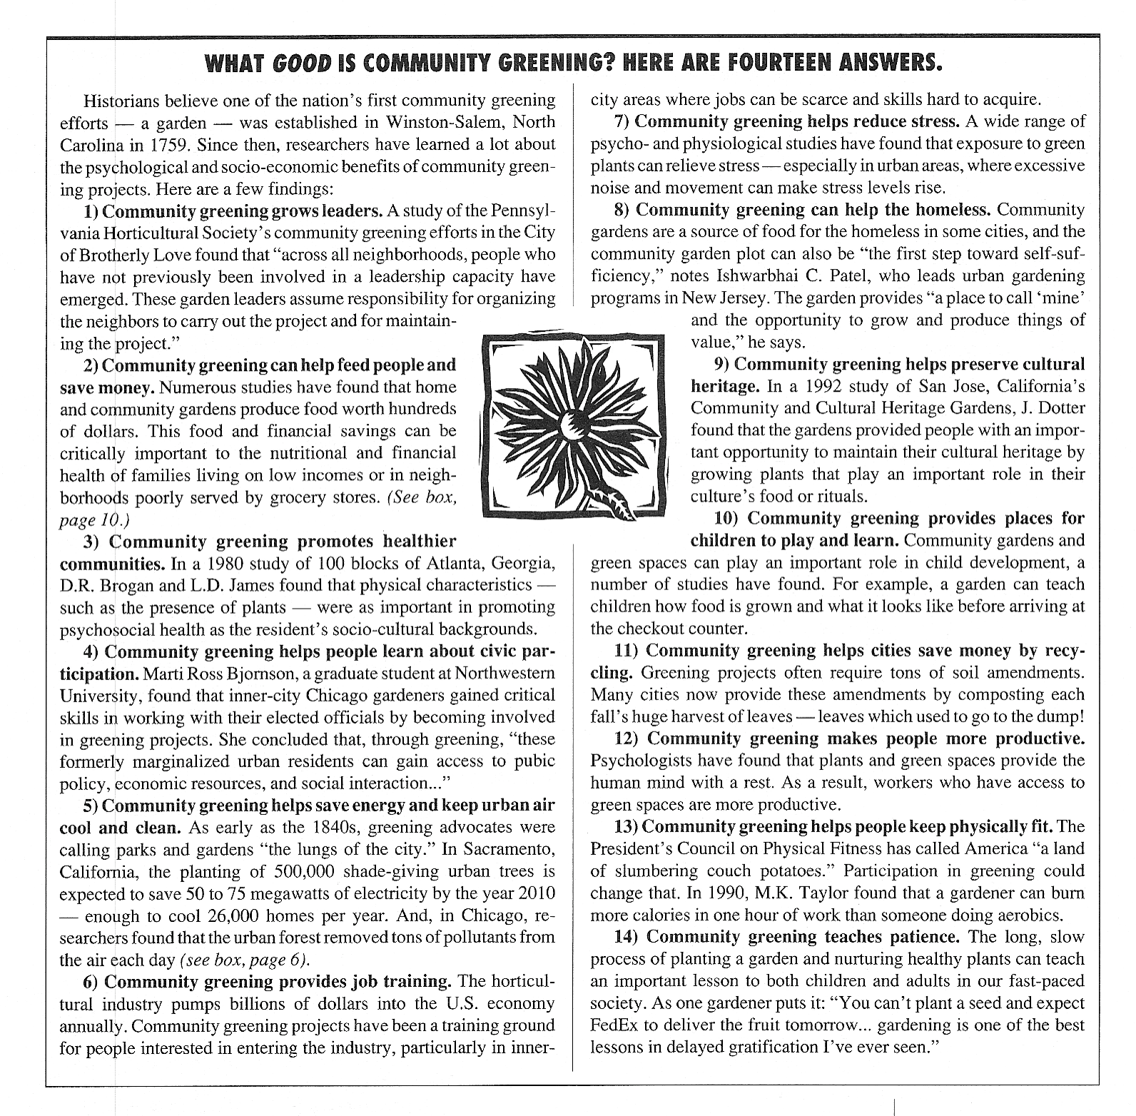
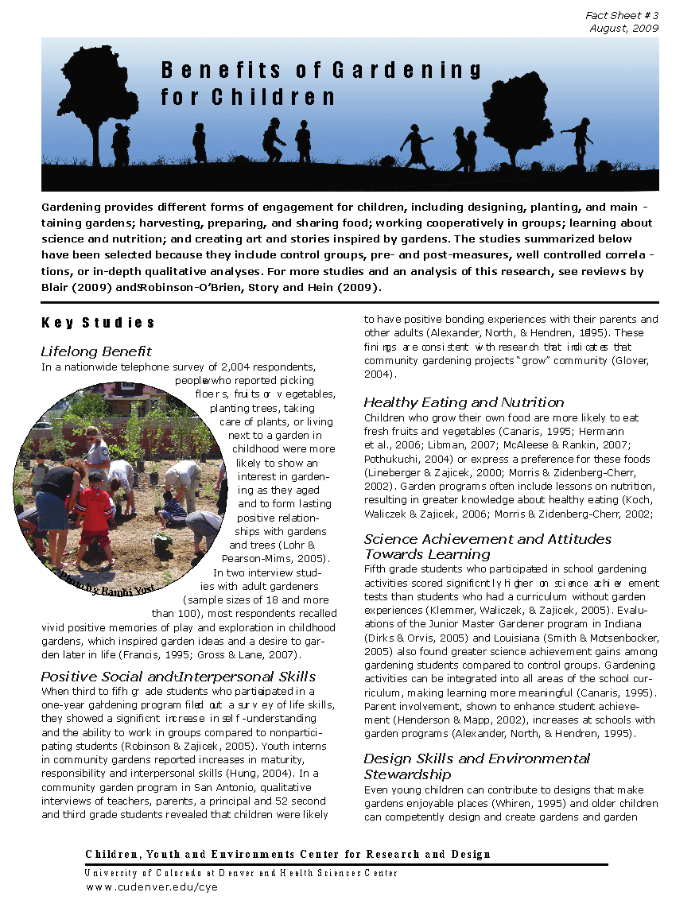
Informational Texts

Slide 10
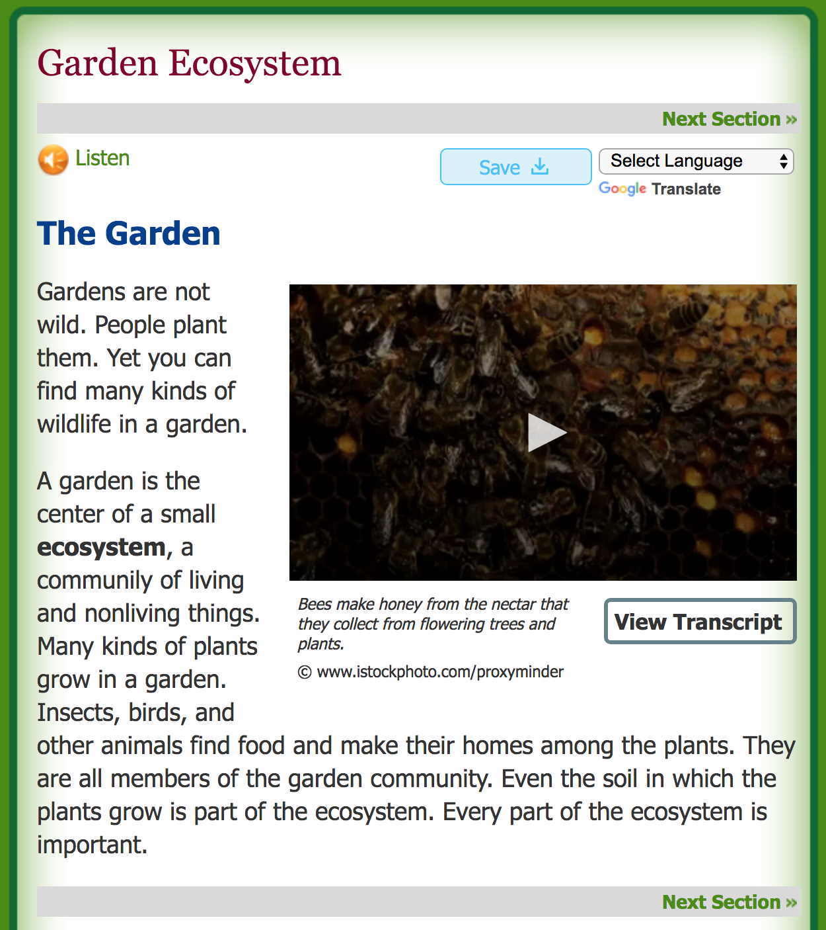
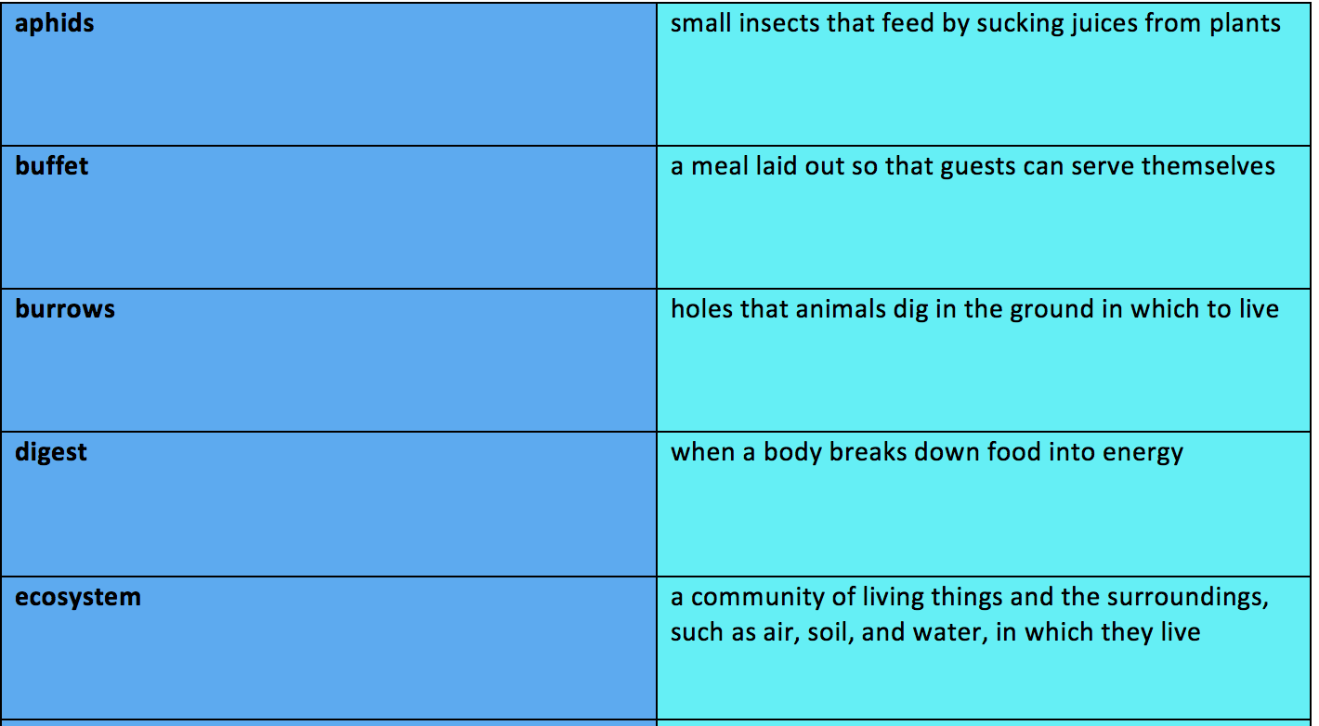
https://pklifescience.com/article/404/garden-ecosystemlogin?username=thealberta&password=library

Slide 11
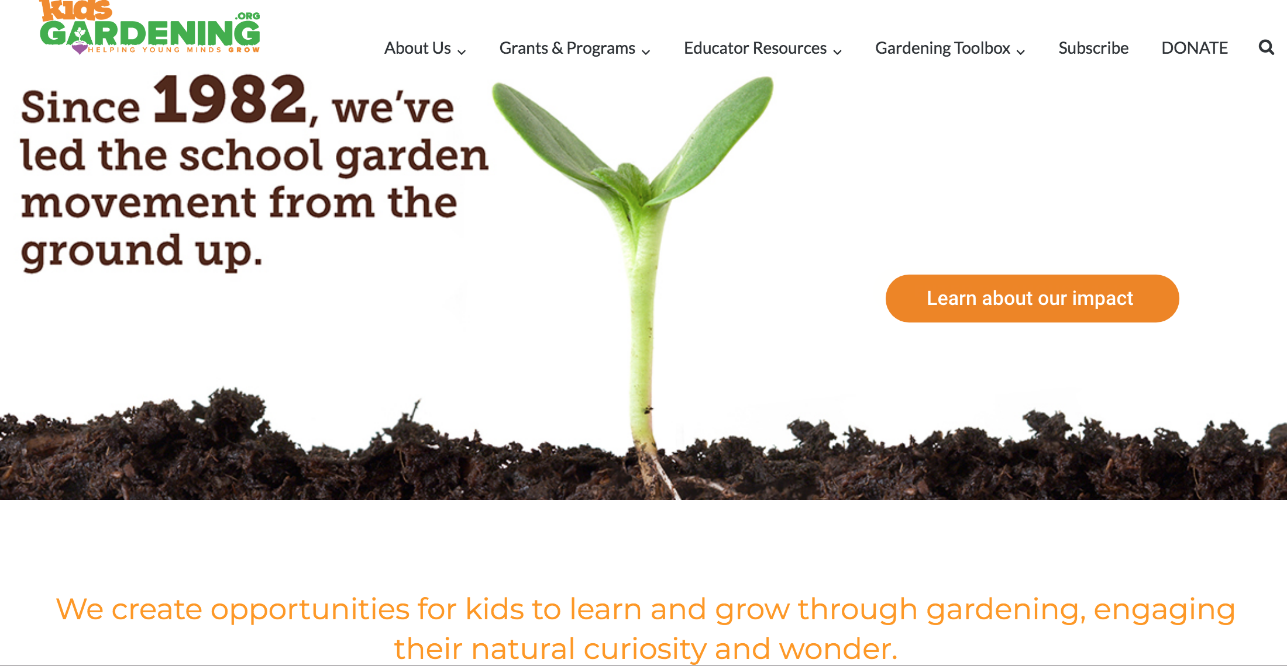
https://kidsgardening.org/

Slide 12
http://www.scholastic.com.au/files/schools/bookclub/aust/brochures/current/KAB_classroom_tips_creating_sustainable_garden_.pdf

Slide 13
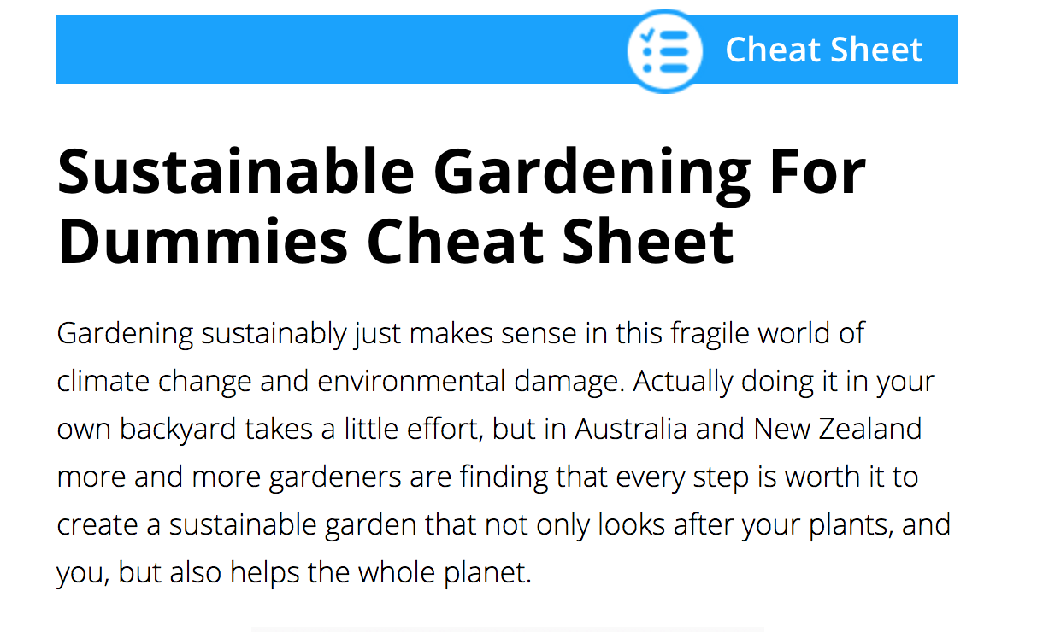
https://www.dummies.com/home-garden/gardening/sustainable-gardening-for-dummies-cheat-sheet/

Slide 14
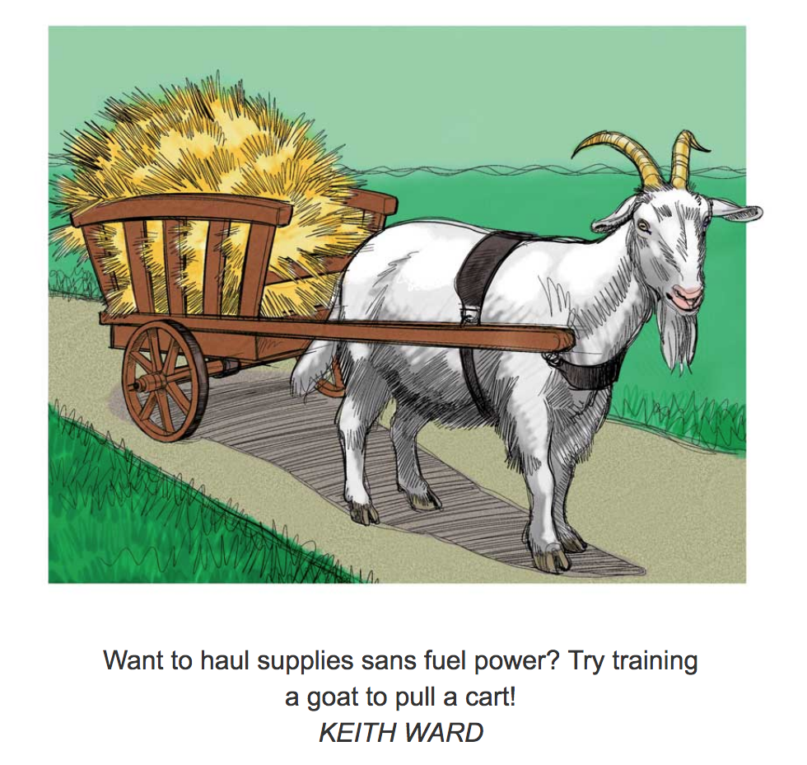
https://www.motherearthnews.com/organic-gardening/gardening-techniques/sustainable-gardening-zm0z11zsto

Slide 15
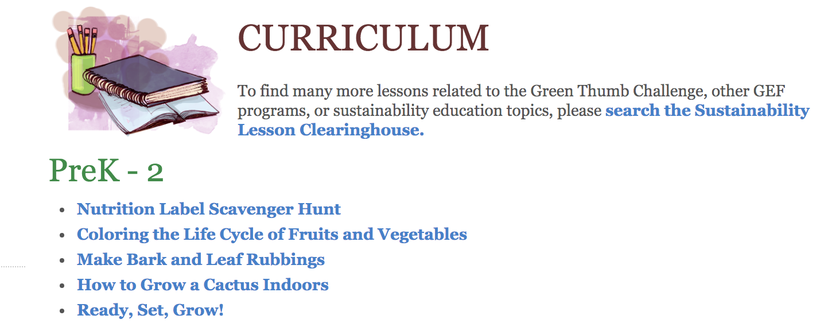
http://www.greeneducationfoundation.org/greenthumbchallengesub/curriculum-and-activities/curriculum.html

Slide 16
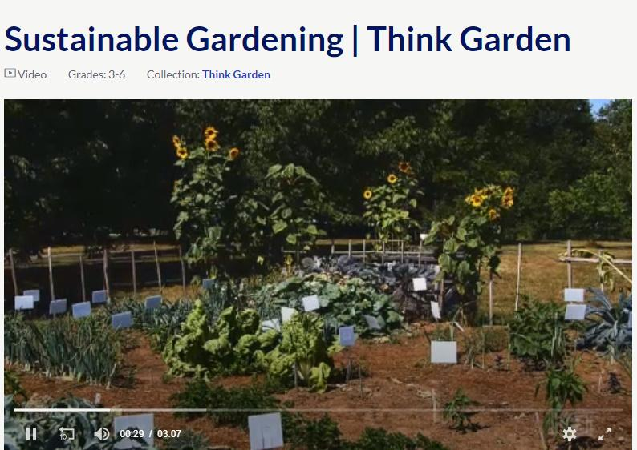
https://www.pbslearningmedia.org/resource/da823ff0-c229-4a3d-926e-278a4f366347/think-garden-sustainable-gardening/#.XXEkaSjYqM8

Slide 17
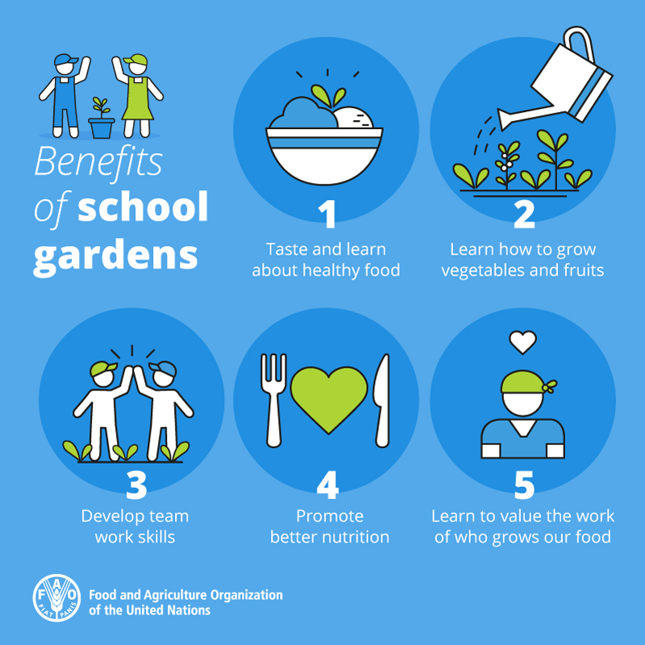
School gardens are a great way to get children to learn about nutrition. FAO encourages and supports countries to promote school gardens with educational goals to help students, school staff and families make the connection between growing food and good diets, develop life skills and increase environmental awareness.
Notes:
The why

Slide 18
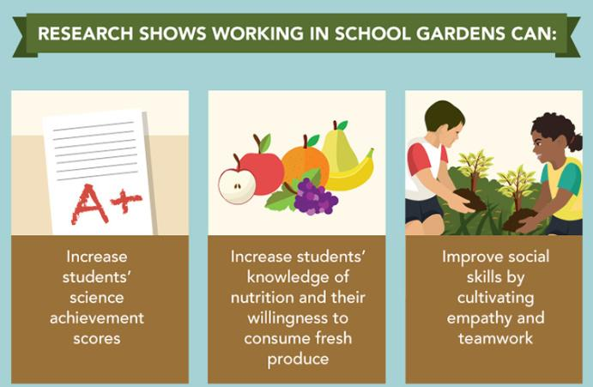
Getting Started
Step 1 - Find Your Compelling WHY.

Slide 19
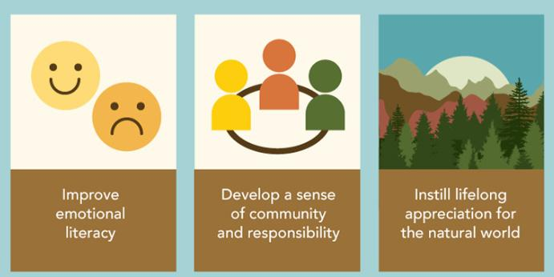
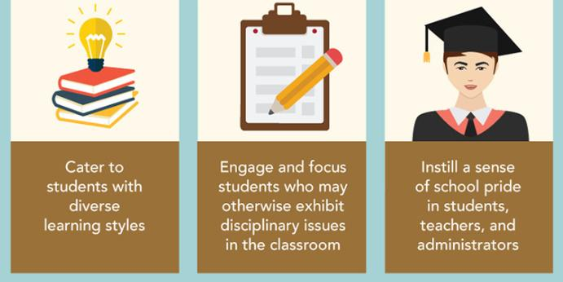

Slide 20
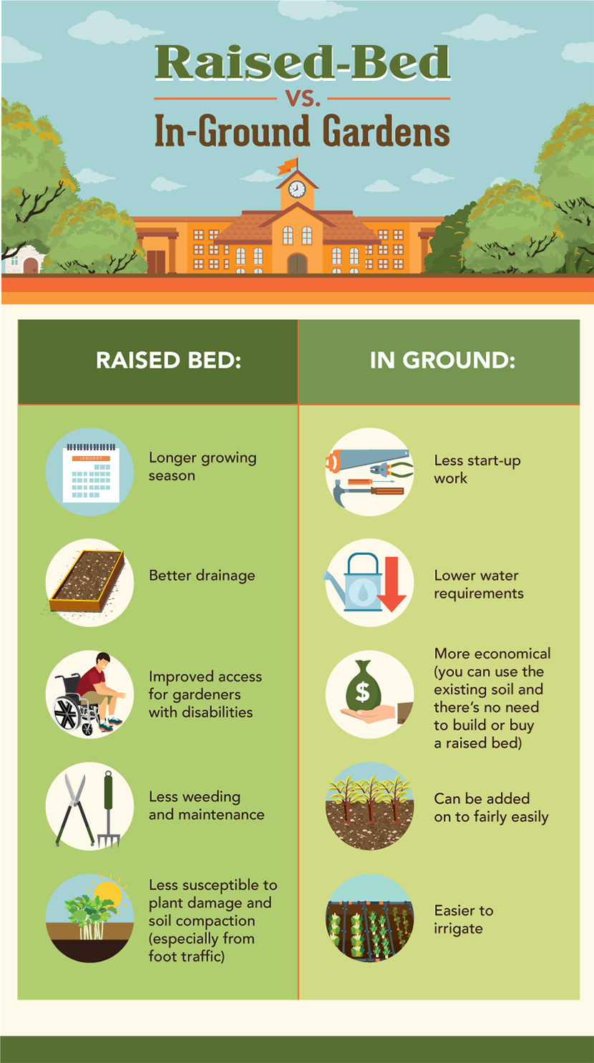
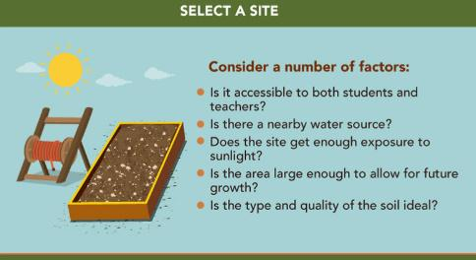
2. Make a Plan

Slide 21
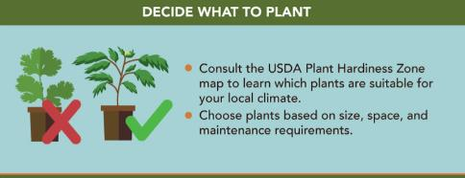
3

Slide 22
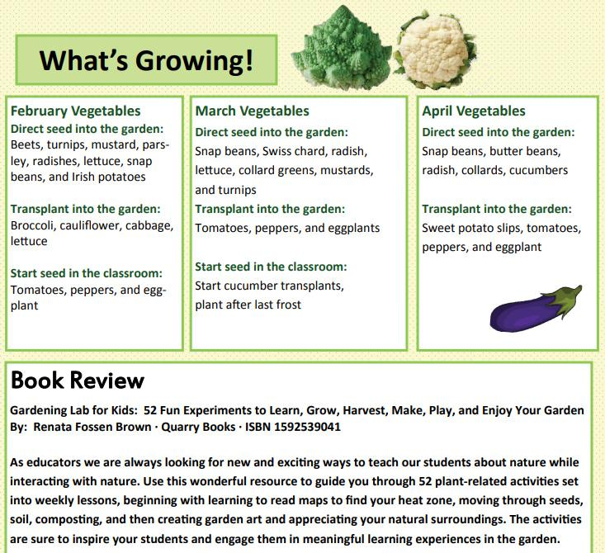
Example of school newsletter for writing https://www.lsuagcenter.com/MCMS/RelatedFiles/%7B6FADB974-A465-4BF0-B95E-11FFB1A7B1BF%7D/Veggie-bytes-6.1.pdf

Slide 23
Formative Assessment Probes:
Uncovering Students' Ideas in Science
Page Keeley, Francis Eberle, and Lynn Farrin
https://www.nsta.org/publications/news/story.aspx?id=50062
...most classroom assessments are focused on measuring and documenting student learning. ..how to score student work to determine the extent to which students meet standards.
Formative assessment probes shift the focus to include examining student thinking for the purpose of informing teaching and learning.

Slide 24
Formative assessment probes are designed to address difficulties identified in the research on student learning. For example, several studies on students’ ideas related to plants indicate that many students are likely to believe that plants get their food from the soil. A two-tiered assessment probe is a type of enhanced multiple-choice item that includes two parts—
Part 1: Selected response distracters that include research-identified ideas held by students.
Part 2: An open-ended response that asks students to explain their thinking.

Slide 25
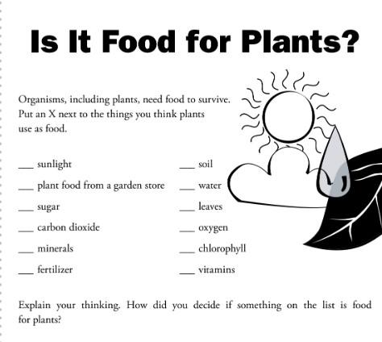

Slide 26
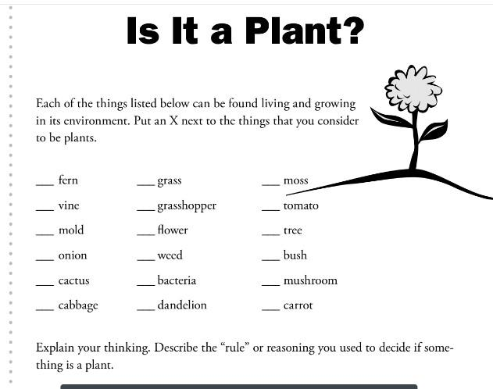

Slide 27
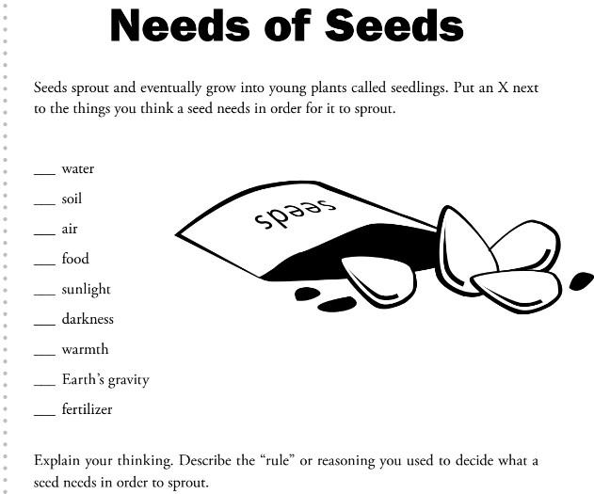

Slide 28
Garden Grant Resources
Florida Agriculture in the Classroom https://faitc.org/teacher-grants/
Florida Wildflower Foundation https://flawildflowers.org/
Lorrie Otto Seeds for Education Grants http://wildones.org/wp-content/images/SFE-Grant-Application.pdf
Kids Gardening Grant Opportunities https://kidsgardening.org/grant-opportunities/

