Slide 1
Energy

Slide 2
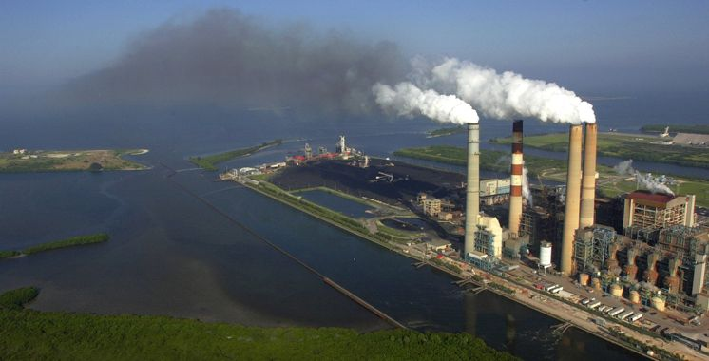
Coal Fired Plant

Slide 3
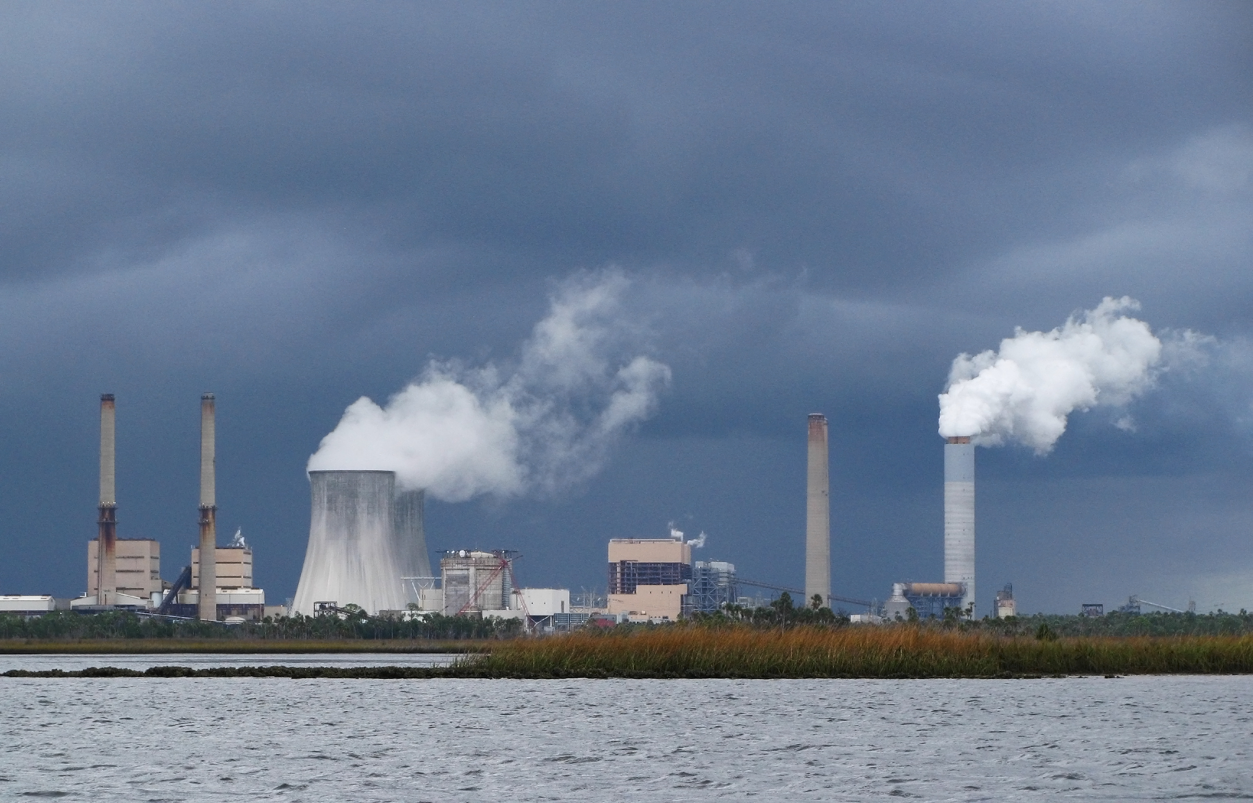
Nuclear Plant

Slide 4
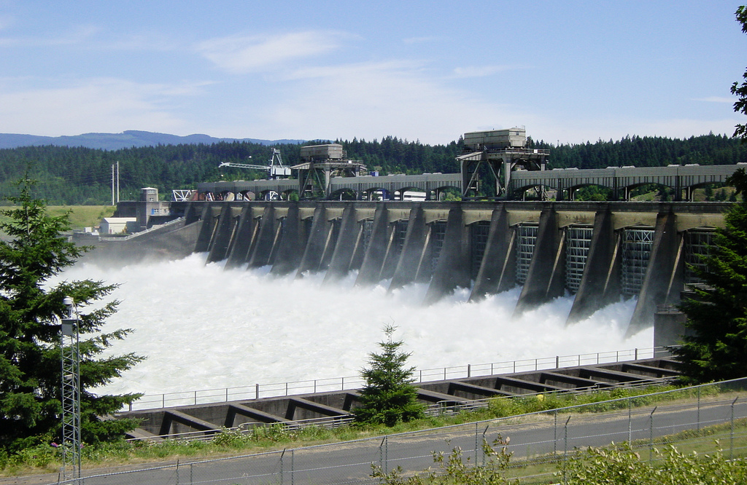
Hydroelectric Power Plant

Slide 5
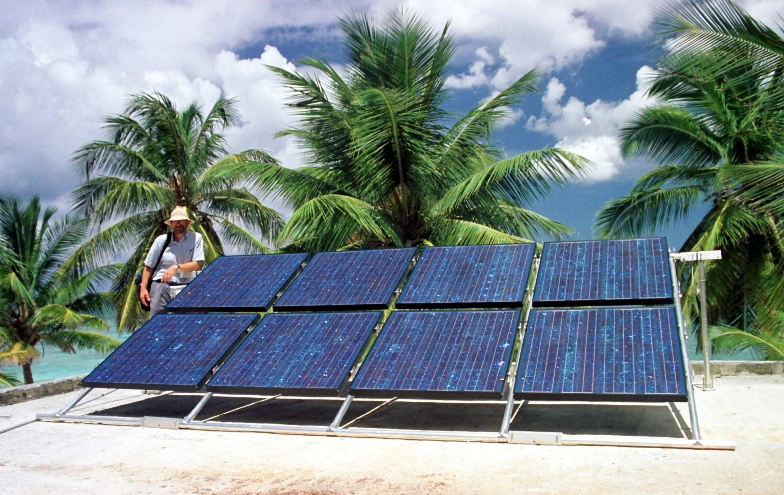
Solar

Slide 6
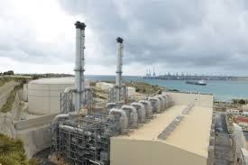
Diesel Generation Plant

Slide 7
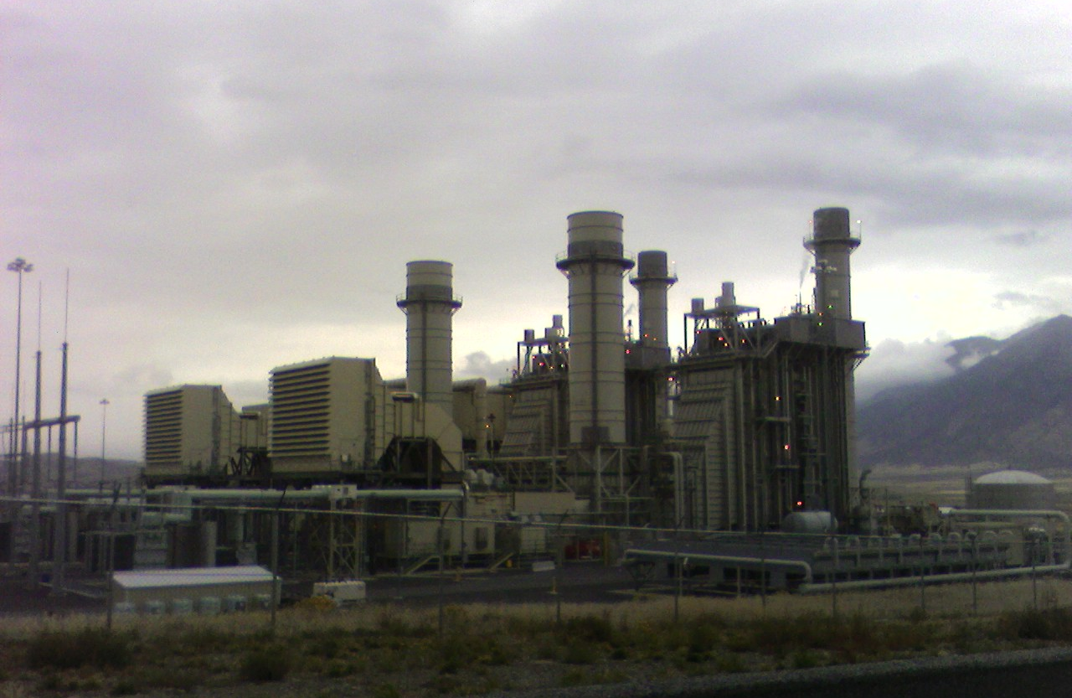
Gas Turbine Plant

Slide 8
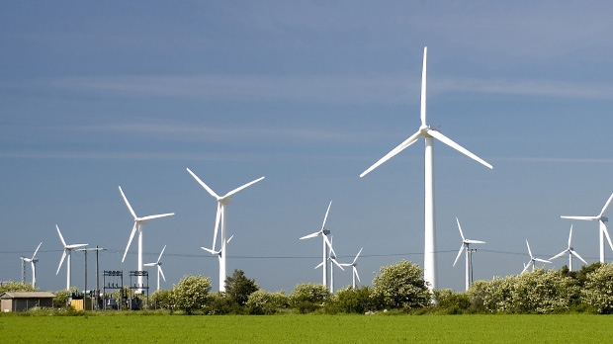
Wind Farm Turbine

Slide 9
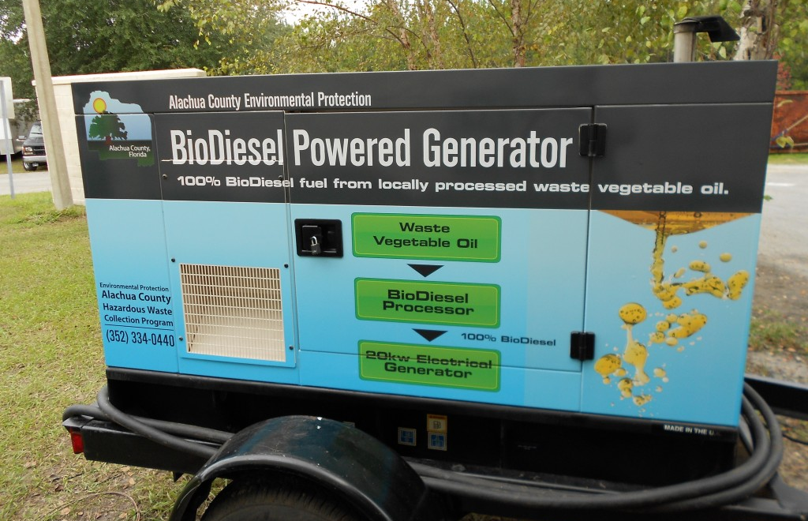
Biofuel Generator

Slide 10
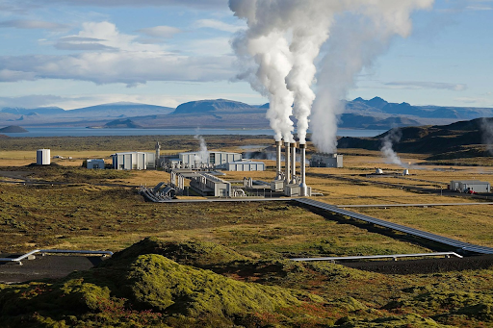
Geothermal

