Slide 1
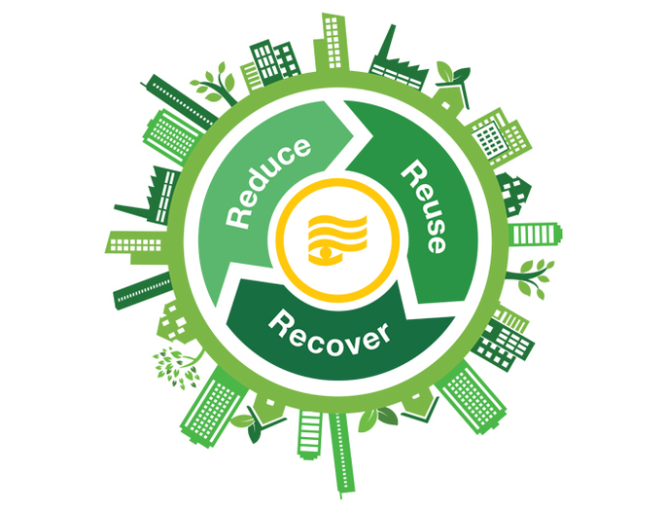
SUSTAINABILITY SUPERHEROES IMAGINE THE POSSIBILITIES OF A WORLD WITHOUT WASTE THROUGH THE CIRCULAR ECONOMY
Presented by: Dr. Heather Rothrock
July 25, 2019

Slide 2
Story of “Stuff”
https://www.youtube.com/watch?v=9GorqroigqM

Slide 3
Circular economy history
1970s: Reduce Waste (e.g. EU Waste Management Framework Directive 1975)
1980s: Waste Management Hierarchy (Reduce, Re-use, Recycle, Recover)
1990s: Circular Economy Directive (‘Kreislaufwirtschaftsgesetz 1996’) and DSD in Germany
2000s: Life Cycle Thinking
NOW: The Circular Economy

Slide 4
Take-make-dispose economy
New products = new raw materials
Recycling at “end-of-pipe”
Waste is chronically high

Slide 5
A further 3 billion middle-class consumers will enter the market by 2030 fueling demand ...

Slide 7
What is a circular economy?
“Closing the loop”
alternative, more sustainable model to the traditional linear economy.
resources kept in use for as long as possible
extracting the maximum value from them while in use
then recover and regenerate products and materials at the end of their service life.
Try to mimic nature

Slide 8
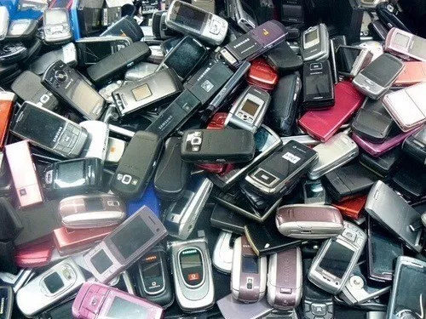
Natural vs. Unnatural systems
https://www.tutorialspoint.com/environmental_studies/environmental_studies_energy_flow_in_ecosystem
https://www.ecomena.org/ewaste-management-egypt/
In the living world there is no landfill, instead, materials FLOW!

Slide 9
Circular economy
But mobile phones, fridges, washing machines don’t biodegrade…
So we must rethink, reuse, remanufacture, and recycle materials

Slide 10
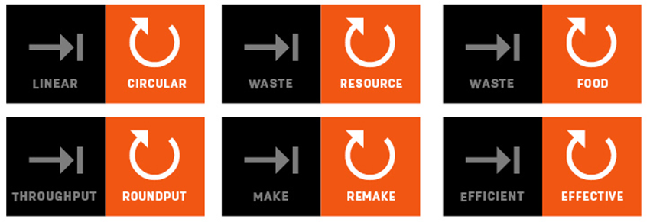
Systems thinking approach
Biological cycle
How can our waste build capital rather than reduce it?
By rethinking and redesigning products and components and the packaging they come in= compostable materials that help grow more stuff.
Technical/Material cycle
products and components are designed to be disassembled and regenerated.
One solution may be to rethink the way we view ownership.
What if we never actually owned our technologies, we simply licensed them from their manufacturers?
Eventually returned to manufacturer for recycling/reuse

Slide 11
Circular economy
Technical materials being reused, biological parts increasing agricultural value.
Renewable energy
Long-term resiliency
Big picture: interconnecting companies that form our infrastructure and economy coming together.
https://iecetech.org/Technical-Committees/2019-03/How-can-IEC-shape-the-circular-economy

Slide 12
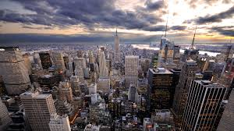
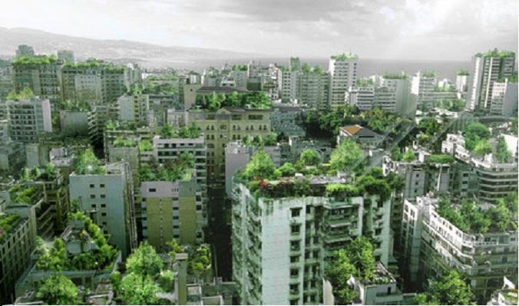
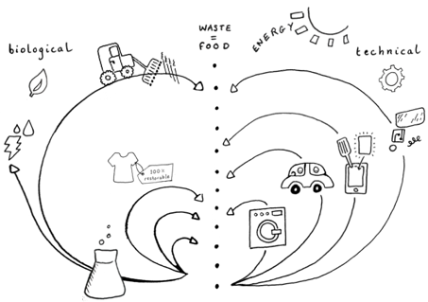
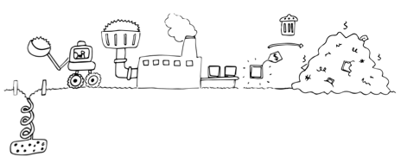
THE USA OPPORTUNITY AND CHALLENGE
Notes:
circular economy opportunity for the U.S. market, and key barriers and opportunities to mainstreaming the circular economy in the U.S

Slide 13
Principles of a circular economy: 1. Waste = Food
A material or product that is no longer used shouldn't become 'waste', but instead should be part of a new cycle of use. Natural system, example: Birds eat berries. Bird droppings contain berry seeds. Man-made system, example: I drink wine from a glass bottle. Glass gets recycled
https://circulareconomy.fooddrinkeurope.eu/

Slide 14
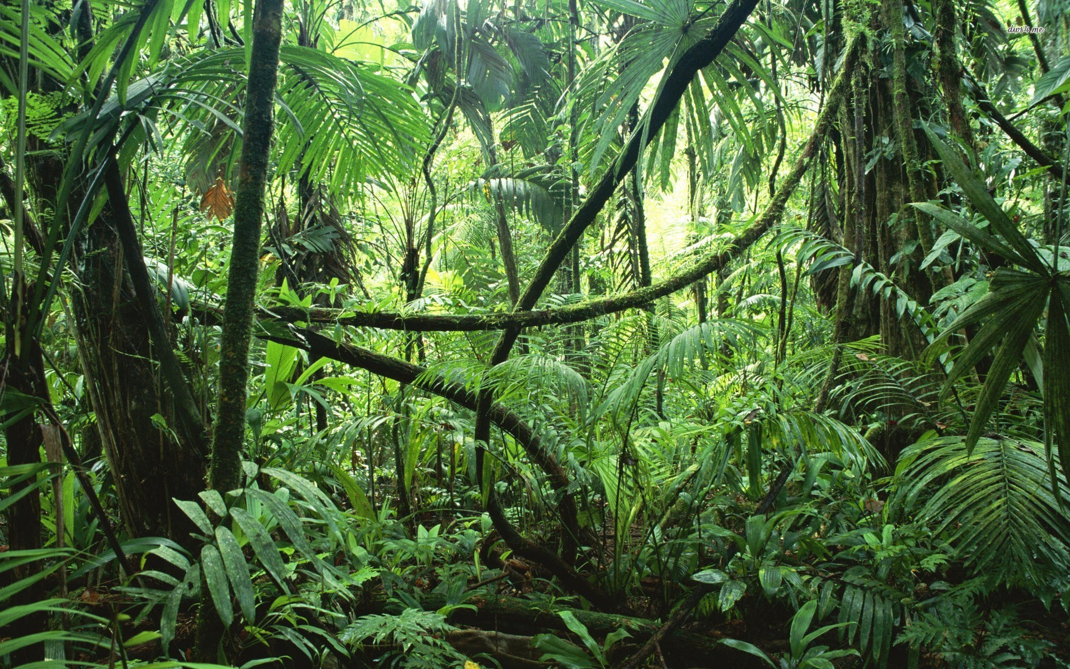
Principles of a circular economy: 2. More diversity=more resilient
Diverse systems i.e. systems with many different components, are more resilient.
Resilient is defined as being capable of dealing with change while continuing to develop.
This is particularly true if the components of a system respond differently to change and disruption.
Natural system, example: A jungle.
Man-made system, example: An organic farm with mixed crops (not one crop, but a variety of different foods).

Slide 15
Principles of a circular economy 3. Energy from Renewable Resources
Natural system, example: A green plant (sunlight converts CO2 and water into sugars: photosynthesis).
Man-made system, example: A solar cell (sunlight is converted into electricity).
https://ensia.com/voices/hurting-renewable-energy/

Slide 16
4. Externalities and loss of ecosystem services have a price
In most cases, resources are becoming more expensive to extract
Problematical to deliver cheap materials, cheap energy and cheap credit actually.
If you don't have all those three running it is very hard to run a linear economy
As resources become scarcer externalities will be internalized
Higher price on ecosystem services
http://www.napavalley.edu/Library/Pages/HSI-STEM-2015-Summer-Institute---Fracking-Resources.aspx

Slide 17
Circular Economy
1. Circular economy design
the way products are designed should change considerably to fit into a CE
2. New business models
3. Reverse cycles
cost-efficient, better-quality collection and treatment systems, and effective segmentation of end-of-life products, the leakage of materials out of the system will decrease, supporting the economics of circular design.
4. Enablers and favorable system conditions
Education
Finance
Collaborative platforms

Slide 18
Circular Business Models

Slide 19
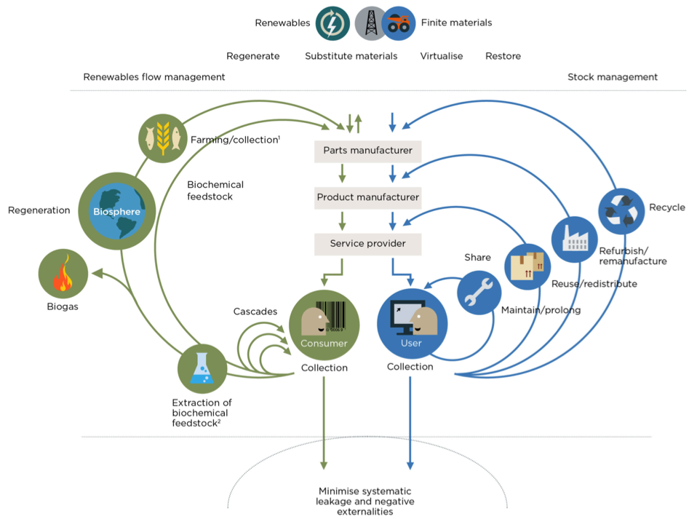
A NEW SYSTEM APPROACH
Source:

Slide 21
Does the circular economy cost more?
https://greenallianceblog.org.uk/2012/05/24/making-the-circular-economy-a-reality/

Slide 22
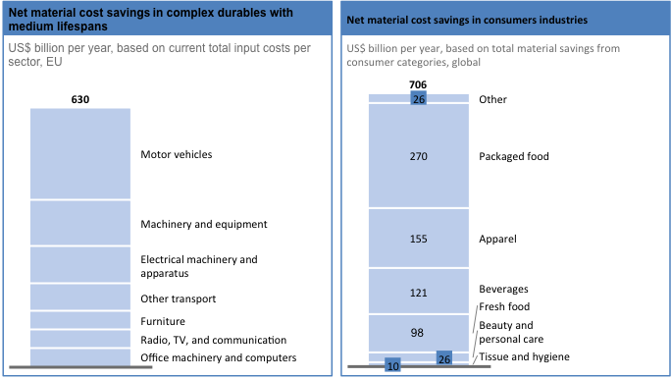
CIRCULAR ECONOMY - MATERIAL COST SAVINGS VALUE

Slide 23
Zero waste economies
https://chicagotoollibrary.org/

Slide 24
Circular economy-Finland

Slide 25
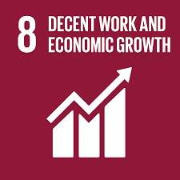
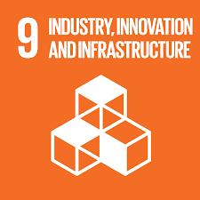
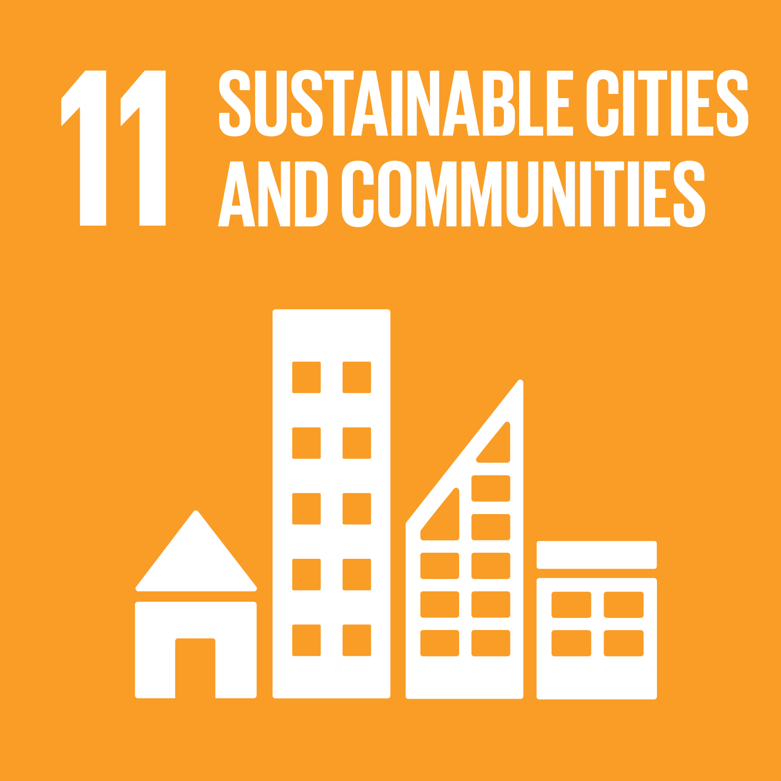
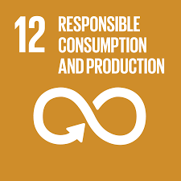
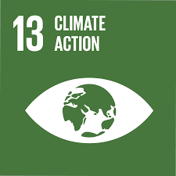
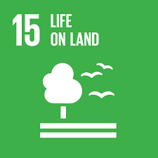
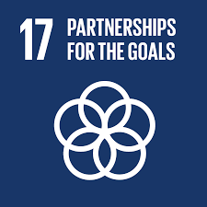
Circular economy and SDGs

Slide 26
Platform for Accelerating the Circular Economy (PACE)
Launched in 2017 as a public-private collaboration, co-chaired by the CEO of Philips, the heads of the Global Environment Facility and UN Environment, with the Ellen MacArthur Foundation, the International Resource Panel, Circle Economy and Accenture Strategy as knowledge partners.
The World Economic Forum hosts and facilitates the Platform.
PACE aims to create systems change at speed and scale by enabling partners to:
Develop blended financing models for circular economy projects, in particular in developing and emerging economies
Help create and adjust enabling policy frameworks to address specific barriers to advancing the circular economy
Bring the private and public sector into public-private collaborations to scale impact around circular economy initiatives

Slide 27
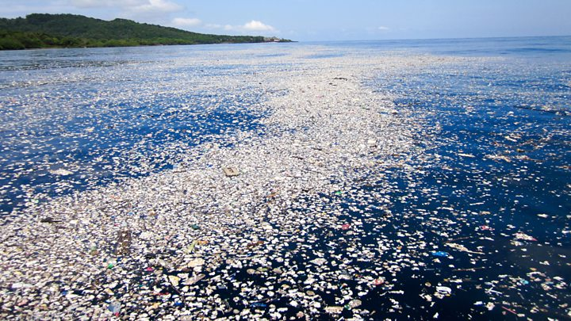
‘Linear economy: ‘take, make, use, and dispose’,
Primary driver of natural resource depletion, waste, environmental degradation, climate change, and has adverse human health effects.

Slide 28
Plastics problem
About 4900 Mt of the estimated 6300 Mt total of plastics ever produced have been discarded either in landfills or elsewhere in the environment.
By 2050, there will be more plastics, by weight, in the oceans than fish, if the current trends continue
Plastics stay in the environment for a long time; some take up to 500 years to break down

Slide 29
Plastics problem- Fossil fuels and CO2
Conventional plastic production is highly dependent on virgin fossil feedstocks (mainly natural gas and oil)
Plastic production uses up to 6% of global oil production, and this is expected to increase to 20% by 2050,
when plastic-related greenhouse gas emissions may represent 15% of the global annual carbon budget.

Slide 30
Plastics problem-water and soil contaminant
plastics are broken down into tiny pieces (microplastics) which threaten marine biodiversity: plastics pollution is the second most significant threat to the future of coral reefs, after climate change.
Furthermore, microplastics can end up in the food chain, with potentially damaging effects, because they
may accumulate high concentrations of POPs and other toxic chemicals.
Microplastics are an emerging source of soil and freshwater pollution
Some plastics contain toxic chemical additives, including persistent organic pollutants (POPs), which have been linked to health issues such as cancer, mental, reproductive, and developmental diseases.

Slide 33
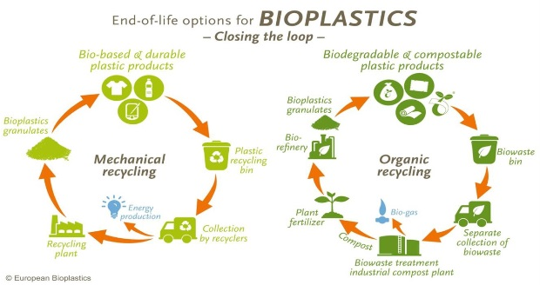
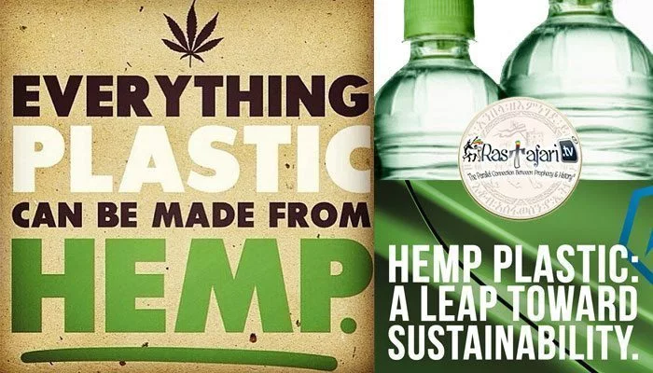
https://hempplastic.com/
https://www.polyestertime.com/andy-sweetman-bioplastics-next-generation-plastics/

Slide 34
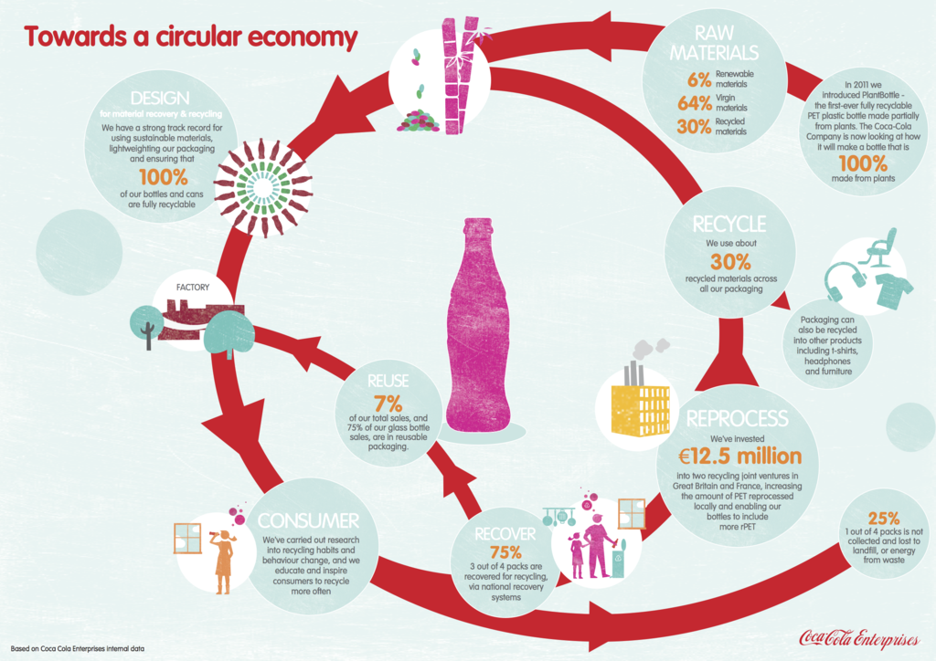
https://www.ellenmacarthurfoundation.org/case-studies/increasing-post-consumer-plastic-content-in-packaging

Slide 35
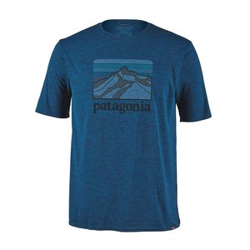
Example of a companies using recycled plastics
RAW FOR THE OCEANS: UPCYCLING OCEAN TRASH INTO CLOTHING
https://futur404.com/raw-for-the-oceans/
Adidas
Patagonia

Slide 36
Circular economy-toys
Ninety percent of toys manufactured today are made from plastics or plastic components that make them virtually impossible to recycle.
Globally, it is estimated that 10 million usable toys end up in landfills every year.
Companies with plastic-intensive toys like Lego are highly dependent on fossil fuels.
Lego uses almost 85,000 tons of raw materials, including petroleum, to produce 60 billion plastic Lego blocks each year.
Lego has committed to stop producing oil-based bricks by 2030 and spent $150 million on researching alternative plant-based materials
http://www.swedbrand-group.com/blog/lego-goes-bio-eco-friendly-makeover-toy-company

Slide 37
Circular economy-toys
circular economy calls for a new way of interaction between businesses, communities, and customers based on extracting the maximum value from products while they are in use.
Toy-Cycle is an example of the circular economy in action.
Online resource that connects families in local groups so they can save money and reduce waste by swapping free used toys and games with one another.
By maximizing the number of consecutive use cycles, each toy exchange avoids the material, energy, and labor involved in creating a new product.
decrease the plastics from toys and toy packaging that end up in landfills and in the broader environment.
Illustration by Angelica Jenett

Slide 38
Transitioning to a circular economy
The circular economy attempts to “close the loop”
The transition from a linear to a circular economy requires a joint effort by stakeholders from all sectors.
Companies can contribute to the transition by developing competencies in circular design to implement product reuse, and recycling, and serving as trend-setters of innovative circular economy business models.
Policy makers can support the transition by promoting the reuse of materials and higher resource productivity by rethinking incentives and providing the right set of policies and access to financing.
Major Groups e.g. lobbyists, non-profits consumers, and other Stakeholders also play an important role in promoting the transition to a circular economy by mobilizing broad forces to carry out practical actions and putting pressure on businesses and governments to accelerate implementation.

Slide 39
Circular Economy – piece of the sustainability puzzle
Systemic thinking
Technical systems
Ecological systems
Holistic approach
Can be applied at various levels- product/corporate/countries
Great opportunity for innovation
Macro economic impacts
https://www.luke.fi/en/blog/sustainable-development-goals-sdg-are-more-than-just-nicely-coloured-icons-a-puzzle/

Slide 40
Global Sustainability Conference on the Circular Economy
USF Patel College of Global Sustainability
Thursday, October 17, 2019 at 9:00 AM - Friday, October 18, 2019 at 3:00 PM (EDT)
Tampa, FL
https://www.eventbrite.com/e/global-sustainability-conference-on-the-circular-economy-tickets-60079687964

Slide 41
Additional Resources
http://www.nea.org/tools/lessons/73399.htm
https://www.ellenmacarthurfoundation.org/our-work/activities/schools-colleges
http://www.stapgef.org/sites/default/files/documents/PLASTICS%20formatted%20for%20posting.pdf
https://www.cultureofrepair.org/educator-resources
https://www.greenbiz.com/article/5-business-models-put-circular-economy-work
https://www.nature.com/articles/s41557-019-0226-9

