Slide 1
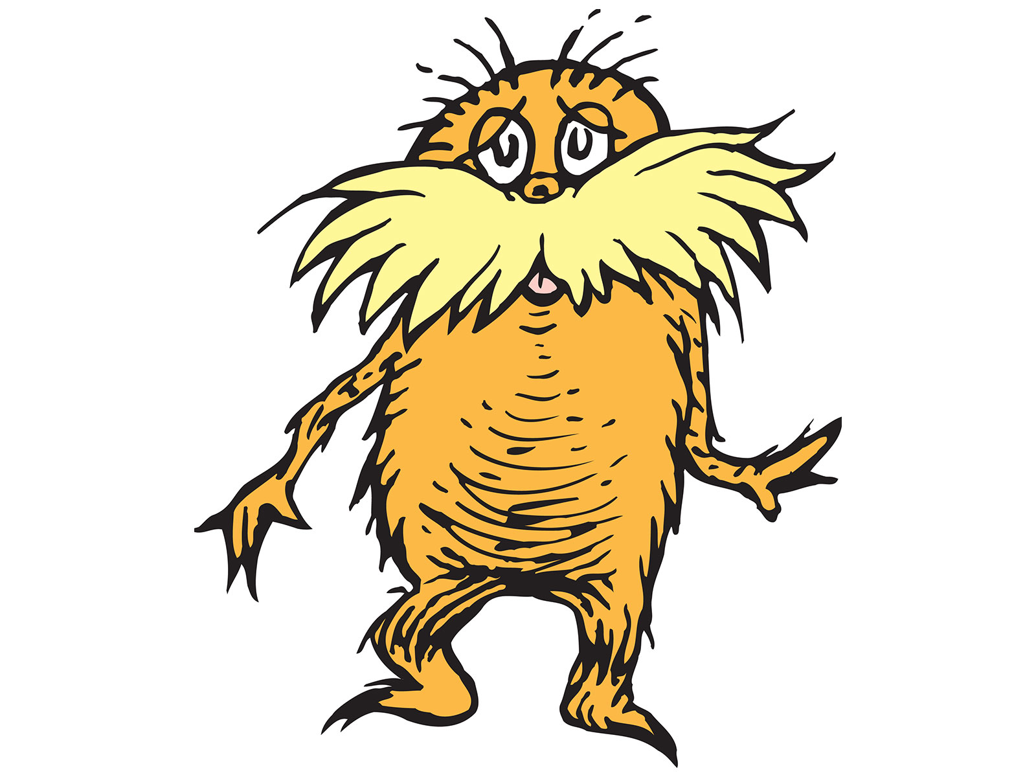
3rd Grade– At-risk Turtles
Problem
Which sea turtle is in the greatest need of protection?
Alternatives
Green Sea Turtle, Leatherback Sea Turtle, Loggerhead Sea Turtle, Hawksbill Sea Turtle
Criteria
To what extent are they endangered, who are their predators, how long do they live, why are they in trouble?
Decision
Which sea turtle presents the greatest need? How did you make that decision?

Slide 2
Social Studies Benchmarks:
SS.1.E.1.3 Distinguish between examples of goods and services.
SS.1.E.1.4 Distinguish people as buyers, sellers, and producers of goods and services.
SS.1.C.2.3 Identify ways students can participate in the betterment of their school and community.
Financial Literacy Benchmark:
SS.4.FL.1.1 People have many different types of jobs from which to choose. Identify different jobs requiring people to have different skills.

Slide 3
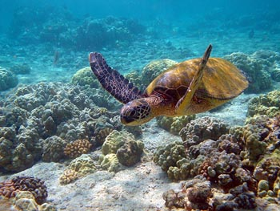
Image Analysis
What do I see? | What do I think? | What do I wonder?
What do you see in the picture? | Which things in the picture are living things? Which are nonliving things? | What other living or nonliving things might be behind the plants? Under the water?
Notes:
After analysis, explain to students that this image is of a lake’s ecosystem. Ecosystems are areas where living and nonliving things live together in balance.

Slide 4
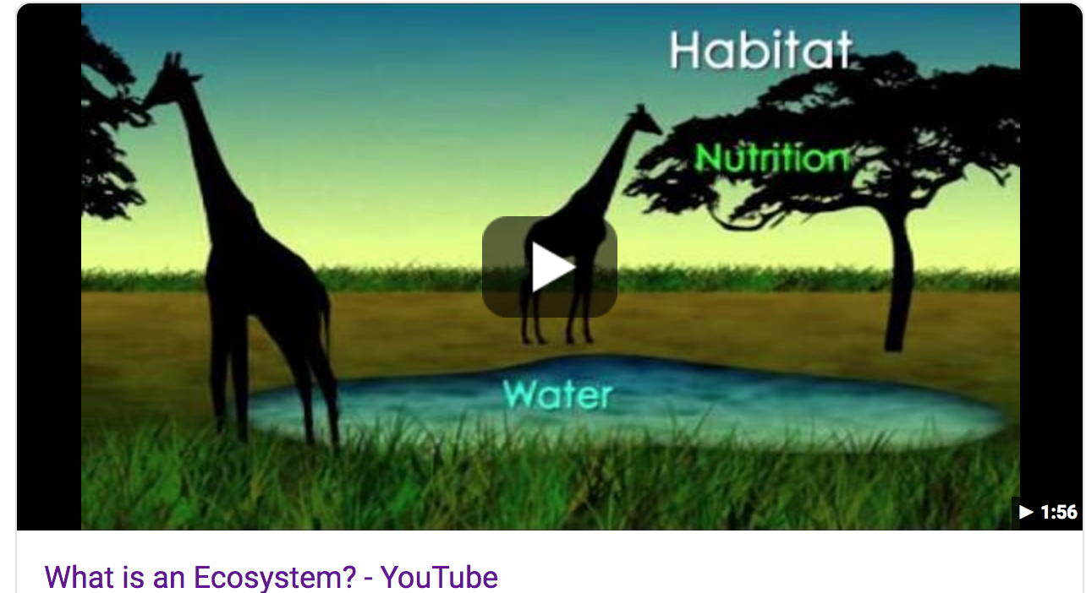
Watch the video: What is an ecosystem:.
What is an ecosystem?
What is an environment?
What are examples of living and nonliving things in an ecosystem?
What are different types of ecosystems?
What are producers?
What are consumers?
How does energy move through an ecosystem?
https://www.youtube.com/watch?v=JPHqUxxyLsY

Slide 5
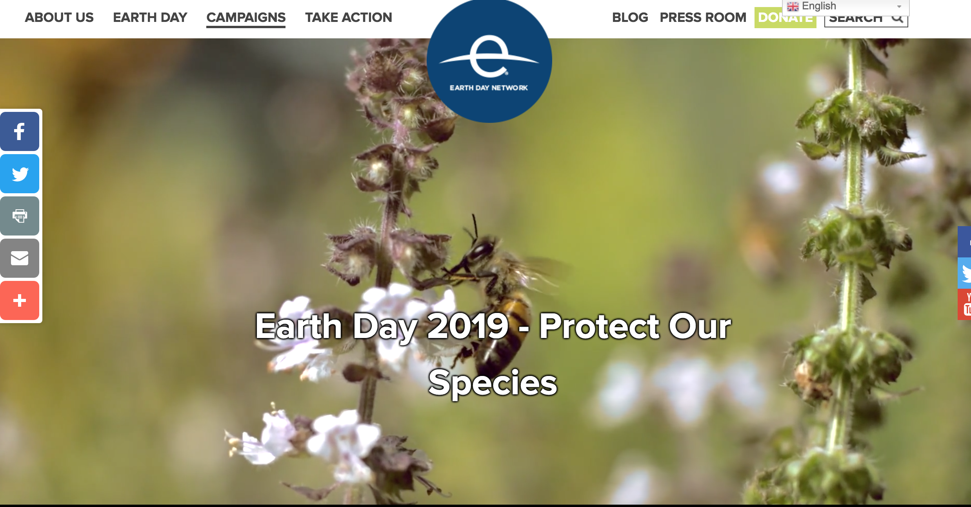
Read the informational text.
https://www.earthday.org/campaigns/endangered-species/earthday2019/

Slide 6
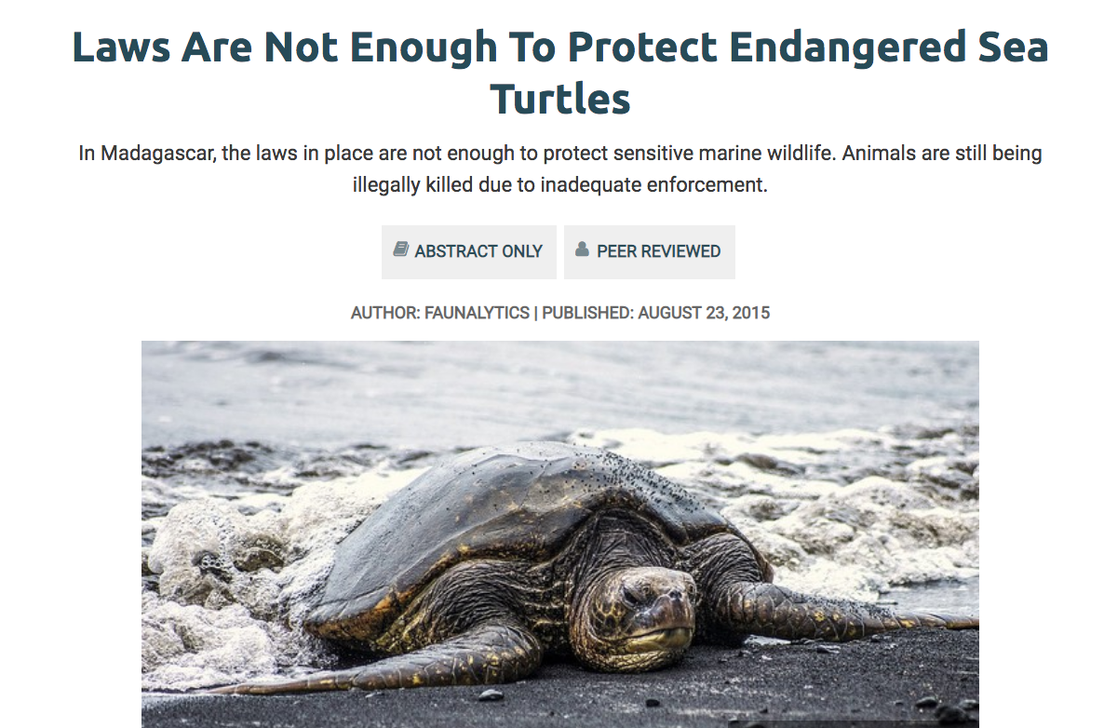
Read the Informational Text
https://faunalytics.org/laws-are-not-enough-to-protect-endangered-sea-turtles/
Why are turtles at risk even though there are laws to protect them?

Slide 7
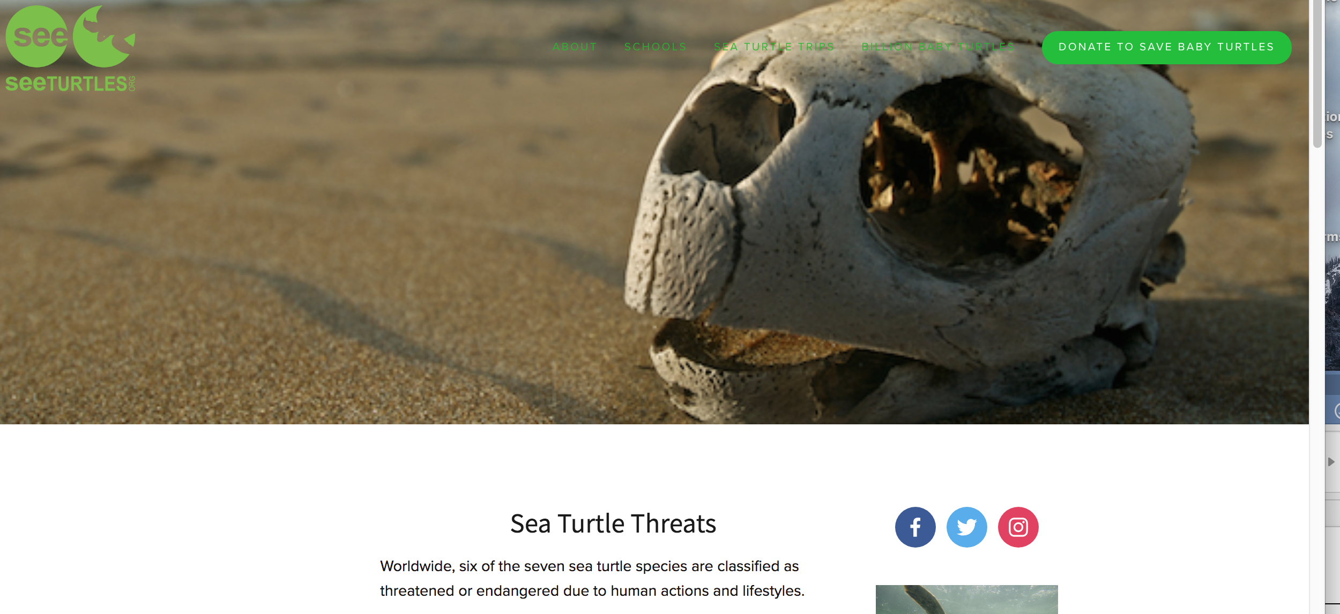
Learn More About Threats to Sea Turtles
https://www.seeturtles.org/sea-turtles-threats
Discuss how each of these threats are man-made.
Scroll down to find out the extent to which seven sea turtles are at-risk (The explanation of the scale is below the list of turtles. In a later link a chart that is kid-friendly will supply this information for each sea turtle).

Slide 8
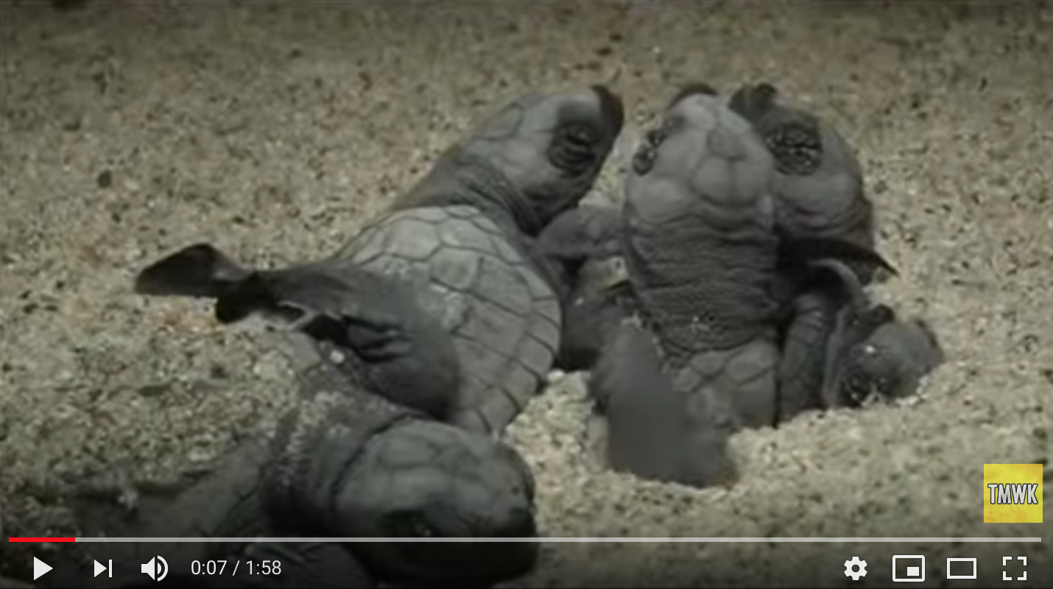
Watch the video
https://www.youtube.com/watch?v=w82xpBR_Z4A
What could happen to keep these babies from making it to the water? What dangers are in the environment (predators, people, trash on the beach, light that confuses the turtles, etc.)?

Slide 9
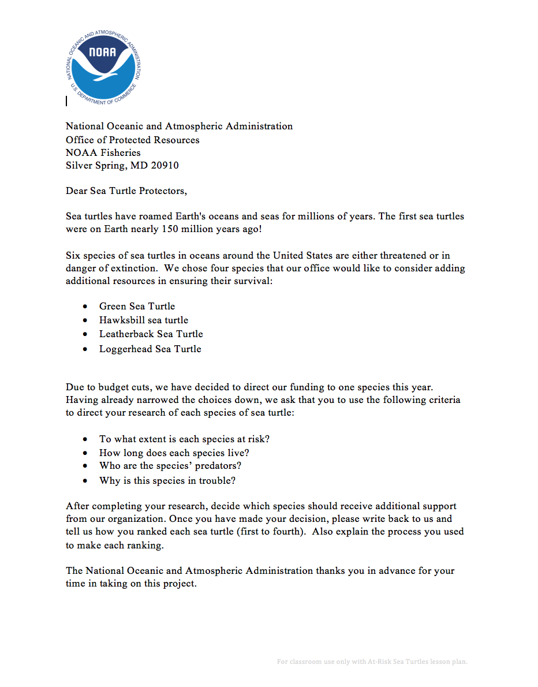
Introduce the problem.
What is the problem?
What is NOAA asking you to do?

Slide 10
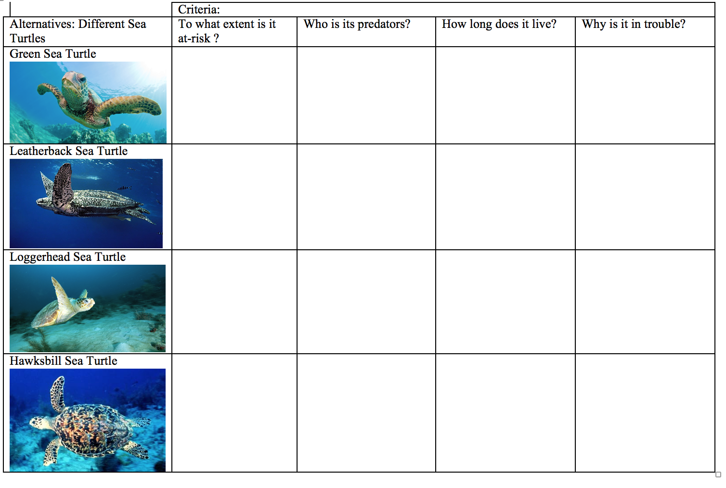
Research the alternatives.

Slide 11
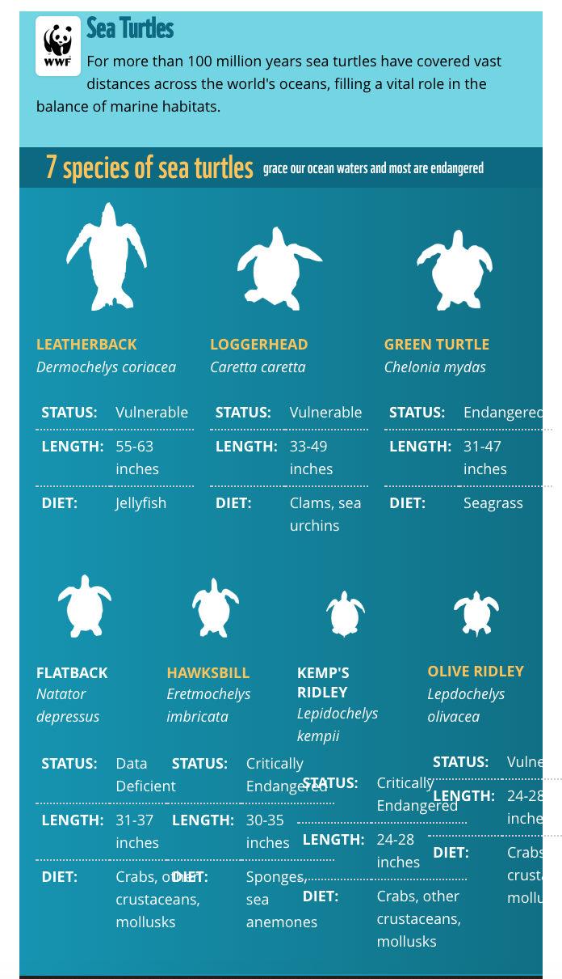
Research Each Turtle
https://www.worldwildlife.org/pages/infographic-sea-turtl
View the chart with students. Discuss the categories of being at-risk from least to most (vulnerable, endangered, critically endangered). Refer back to the website that explained what the category ‘data deficient’ means.
Model reading the chart on Green Sea Turtles. To what extent are these turtles at-risk (endangered)? Model entering this information into the matrix.
Continue reading the chart and discussing each of the other three types of turtles.

Slide 12
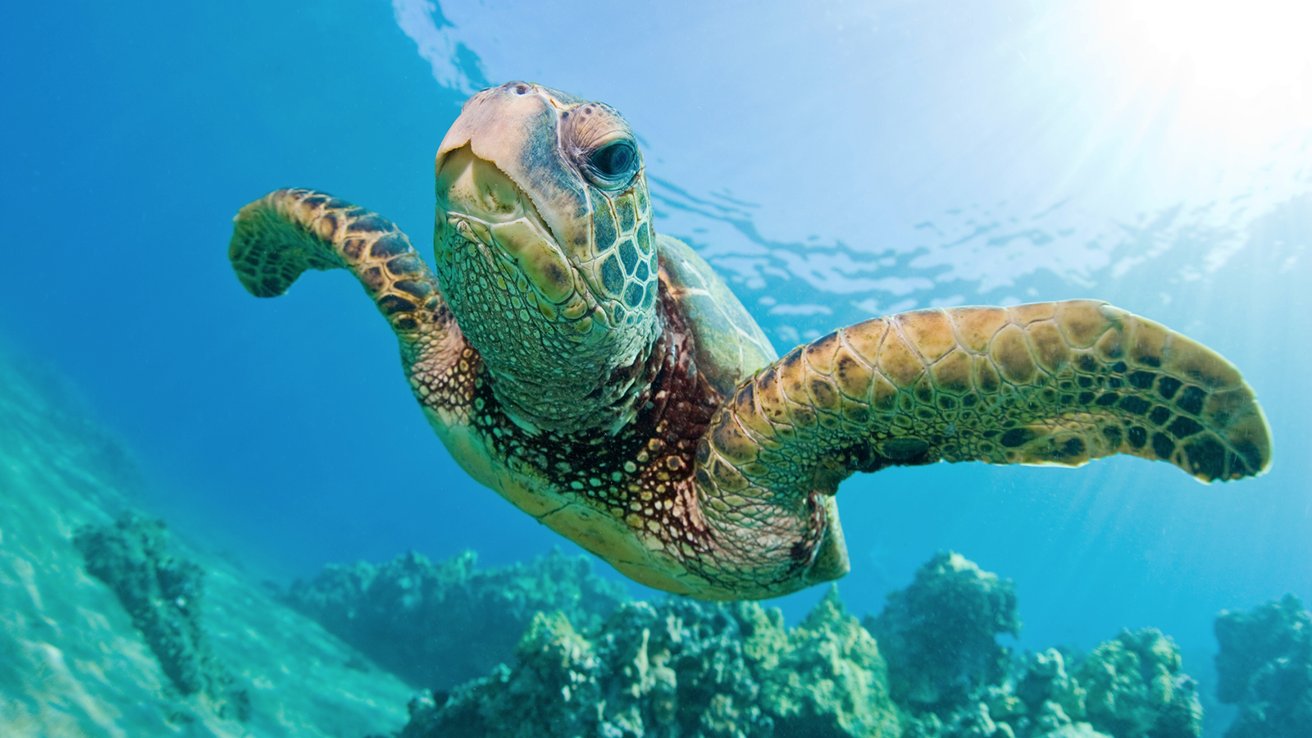
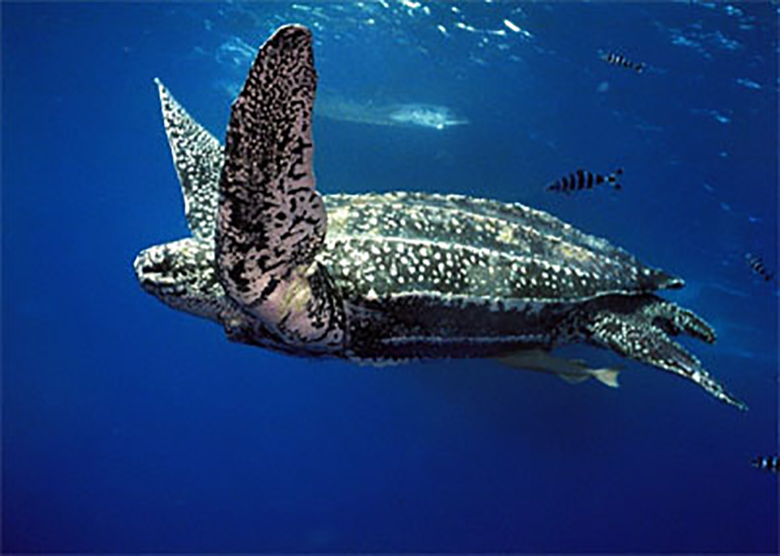
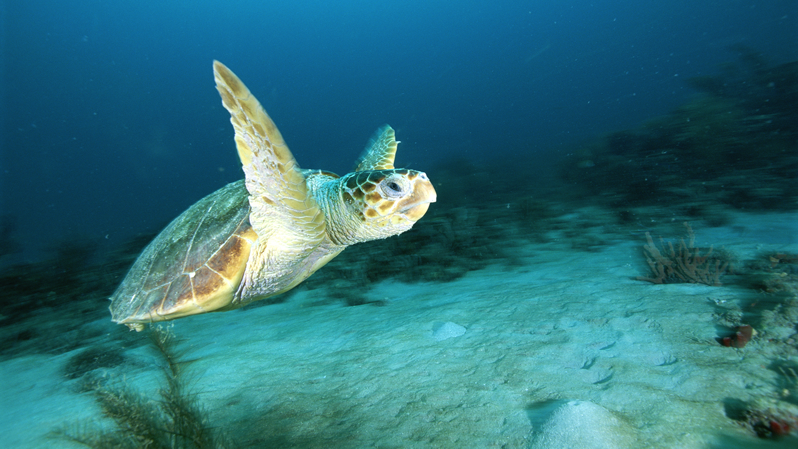
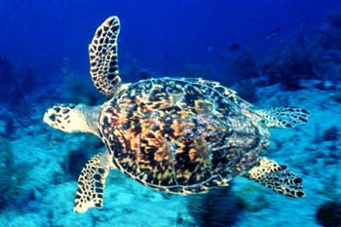
Research Using the NOAA site
Use the following link to go to the NOAA website: https://www.fisheries.noaa.gov/sea-turtles
Click on the links for each of the four sea turtles. Each article provides information related predators, life span, and why are they at-risk. Gather relevant information and write it on the matrix. (These articles can be downloaded as PDFs to allow students to annotate the texts)

Slide 13
Rank the alternatives.
Guiding/reflective Questions
Which turtle would be the best choice for support?
Why do you think that?
What of the criteria is the most important to you?
Which animal would be your next choice? And after that?
Do you agree with your group's ideas? Why or why not?

Slide 14
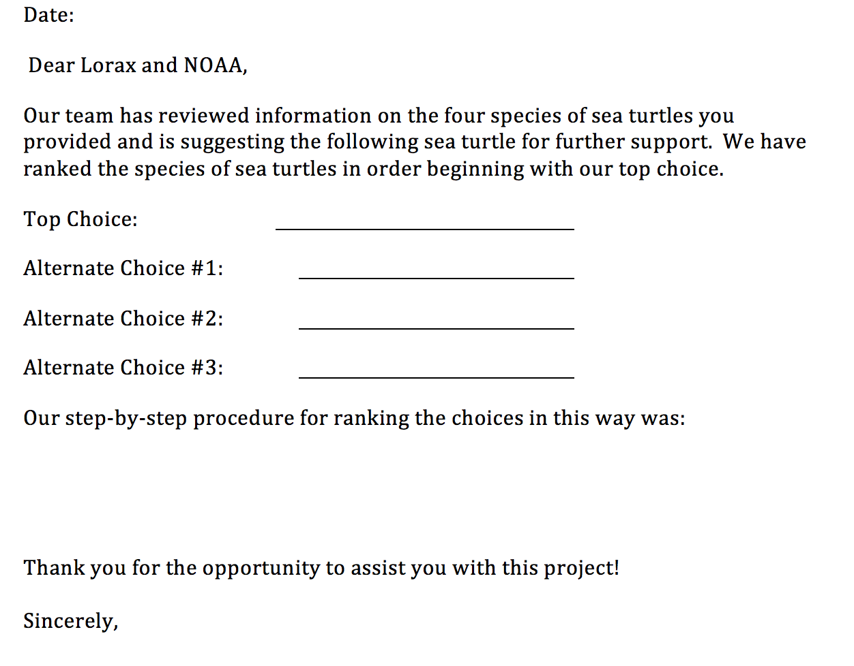
Write back to The Lorax and NOAA

Slide 15
Extend the learning.
Create a presentation for NOAA that outlines why a particular sea turtle should be further supported.
Read more about endangered species at ReadWorks:
Endangered Species (text set) https://www.readworks.org/article/Endangered-Species/3077e686-4015-43f3-80c2-ed39ae8b0dce#!articleTab:content/contentSection:d8ae9323-b2ff-4b73-bbbb-10b9a3af572d/
They’re Back! https://www.readworks.org/article/Theyre-Back!/4570c345-4dd0-4b2d-b687-bf9fb6ee1aed#!articleTab:content/

