Slide 1
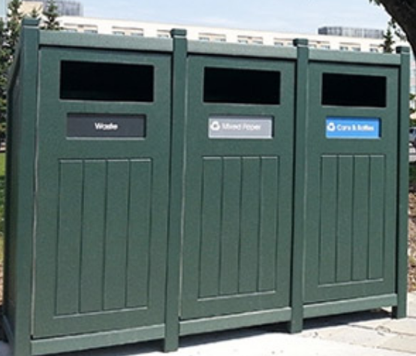

First Grade – Recycling
Problem
Where should the new recycling bin be placed?
Alternatives
Near vending machines, in the employee parking lot, at the outdoor break area, outside the back door, by the street entrance.
Criteria
Easy to get to, near where employees might have food or drinks, opportunity for other community members to use the bin, many people pass by it.
Decision
Should the new recycling bin go by vending machines, the employee parking lot, the outdoor break area, outside the back door, or near the street entrance?

Slide 2
Social Studies Benchmarks:
SS.1.E.1.3 Distinguish between examples of goods and services.
SS.1.E.1.4 Distinguish people as buyers, sellers, and producers of goods and services.
SS.1.C.2.3 Identify ways students can participate in the betterment of their school and community.
Financial Literacy Benchmark:
SS.4.FL.1.1 People have many different types of jobs from which to choose. Identify different jobs requiring people to have different skills.

Slide 3
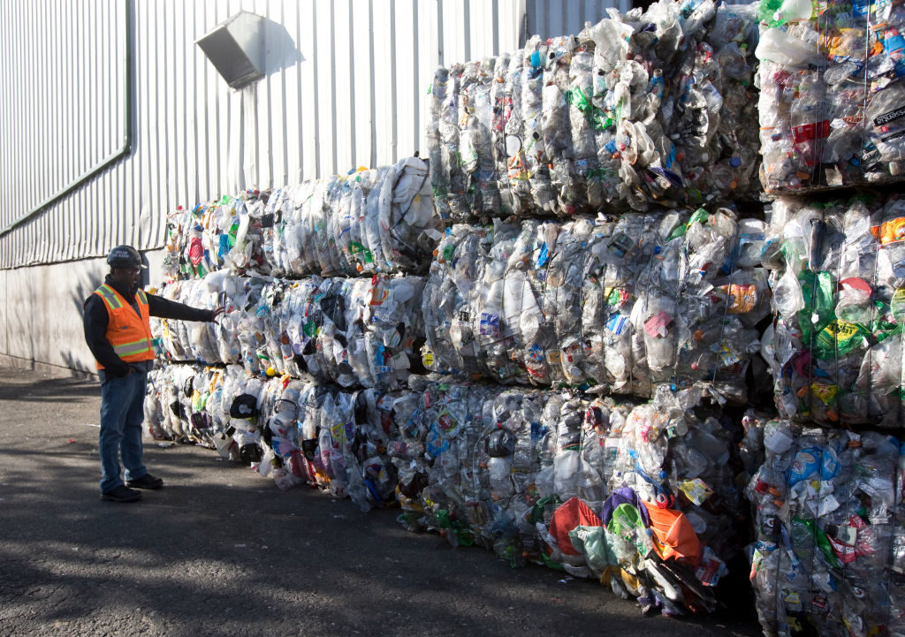
Image Analysis
What do I see? | What do I think? | What do I wonder?

Slide 4
Read the informational text.
Why is trash a problem?
Where does trash go when it is picked up from homes or businesses.
What are the three Rs?
What does it mean to reduce? To recycle? To reuse?
If you bring cloth grocery bags to the store, which of the Rs are you doing?

Slide 5
Read the informational text.
Where do workers take the plastic from a recycling bin?
What happens next? After that?
What do companies do with recycled plastic?

Slide 6
Read the informational text.
What does most garbage come from?
How does garbage get into the ocean?
What is a gyre?
What happens when birds and fish eat the garbage?

Slide 7
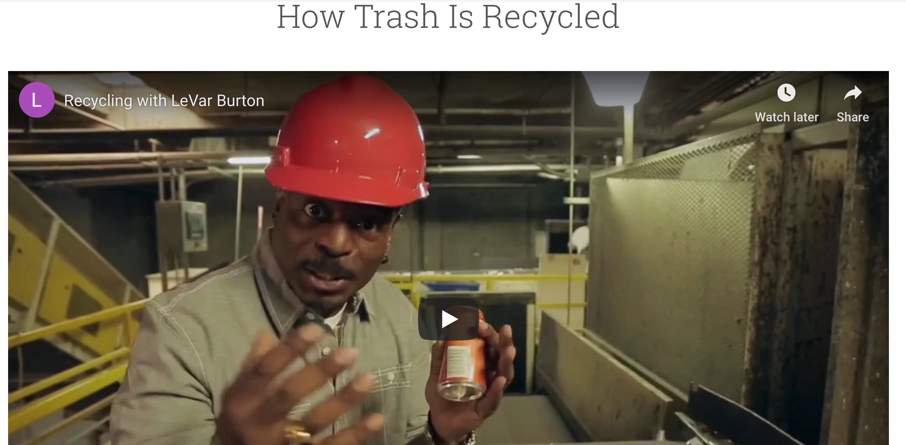
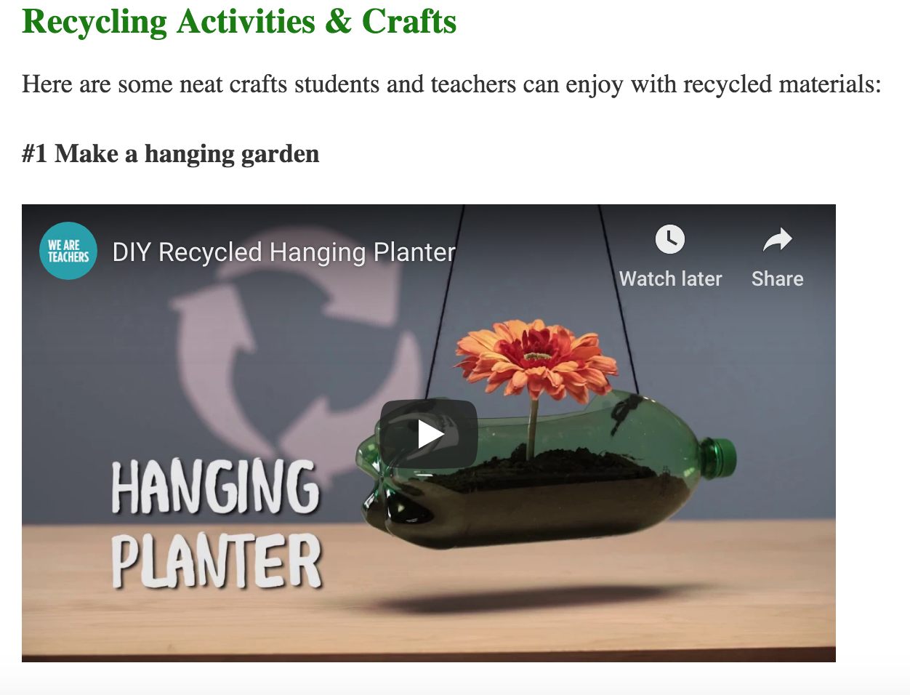
View the websites.
https://www.reusethisbag.com/articles/kids-guide-to-recycling/
https://thekidshouldseethis.com/post/84528738617

Slide 8
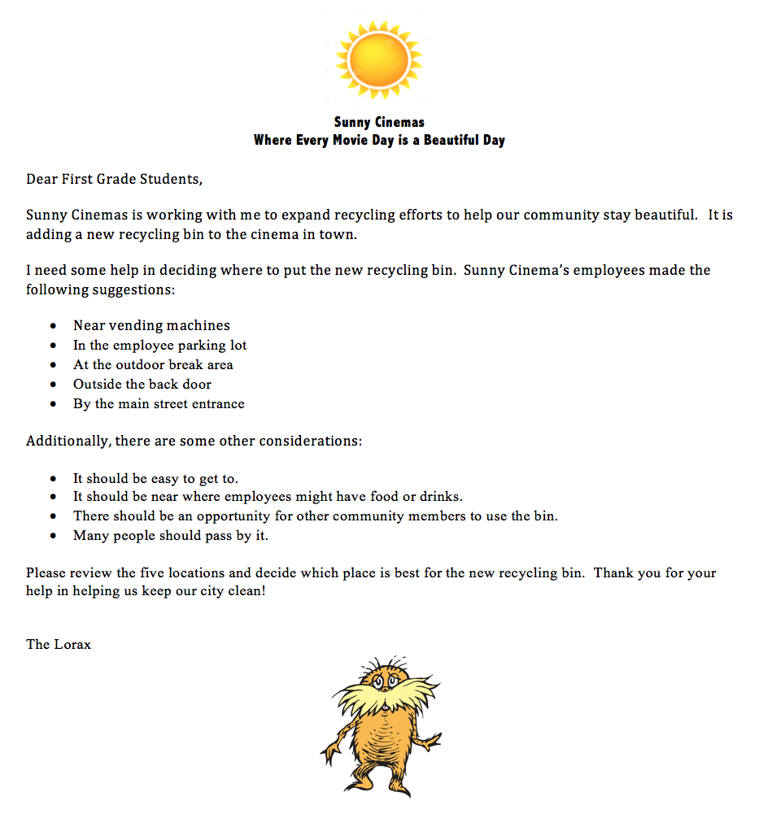
Introduce the problem.
What is Sunny Cinema’s problem?
Where might they place the recycling bin?
What should students consider when choosing the location?

Slide 9
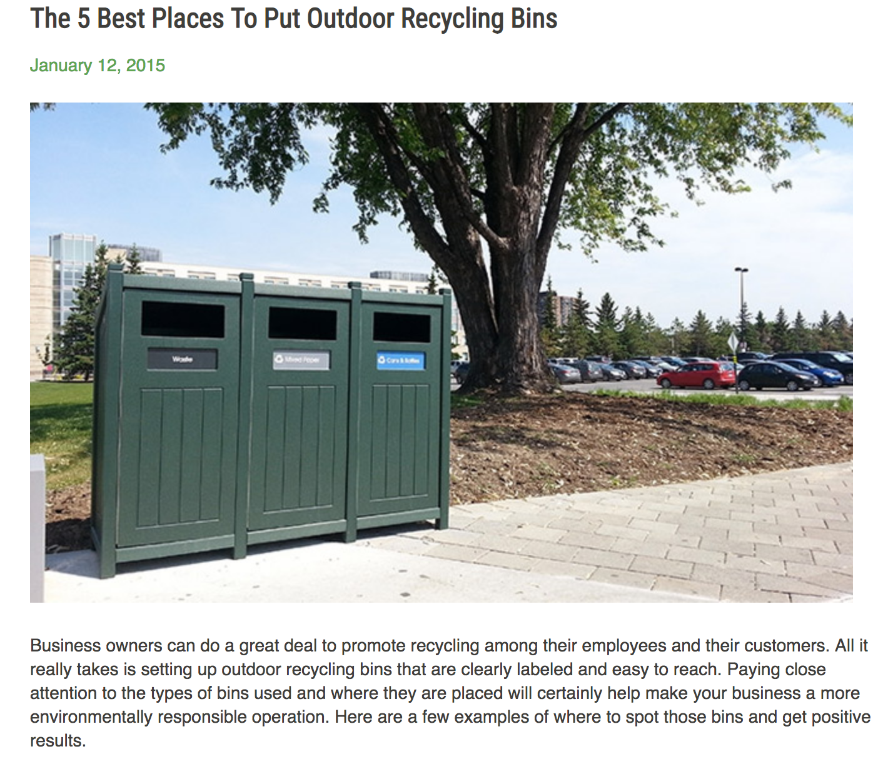
Read the informational text.
  https://www.wastewiseproductsinc.com/blog/workplace/the-5-best-places-to-put-outdoor-recycling-bins/

Slide 10
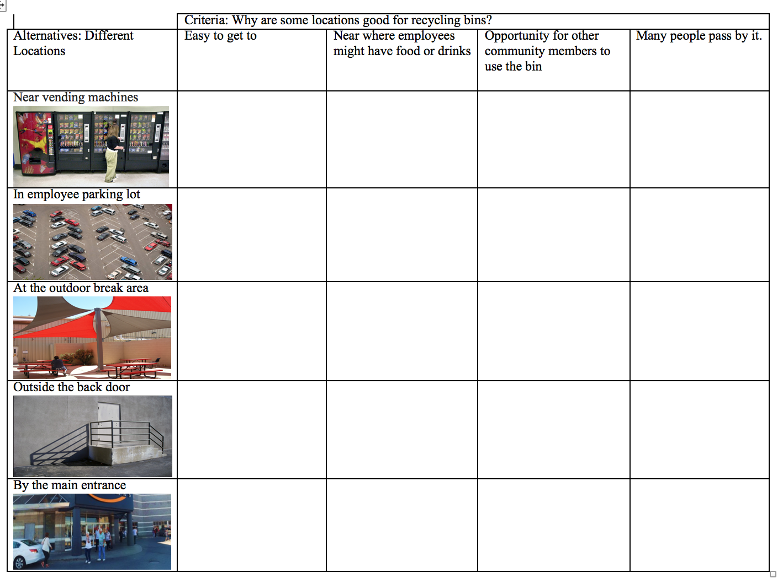
Research the alternatives.

Slide 11
Rank the alternatives.
Guiding/reflective Questions
Which location would be best for the recycling container?
Why do you think that?
What of the criteria is the most important to you?
Which location would be your next choice? And after that?
Do you agree with your group's ideas? Why or why not?

Slide 12
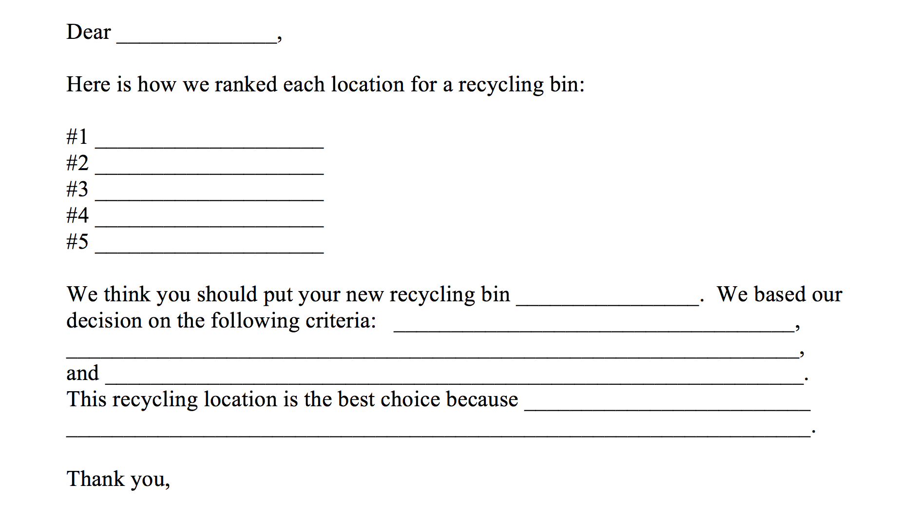
Write back to Landmark Cinema

Slide 13
Extend the learning.
Have student groups present their decisions to the class and discuss how they decided which road to adopt. Create a poster that highlights the best place to put the recycling container.
After groups rank their choices, suggest other criteria that could change their decisions:
Have students research recycling in their school and home communities.
Explore these NASA resources
  https://climatekids.nasa.gov/recycle-this/

Slide 14
Questions?
Thank you so much for attending!
Send us your ideas for future Decisionomics lessons linked to Reading Wonders ☺
Sherry Moser smoser@usf.edu

